Slide 1
Stem cells and Cancer
Cancer stem cell is not a novel concept
Cancer
Characteristics of Stem Cells and Cancer Cells
Definition of Cancer Stem cells (CSC).
Examples for the existence of CSC
Experimental systems to study CSC(examples)
Possible mechanisms for drug resistance of CSC
CSC debated

Slide 2
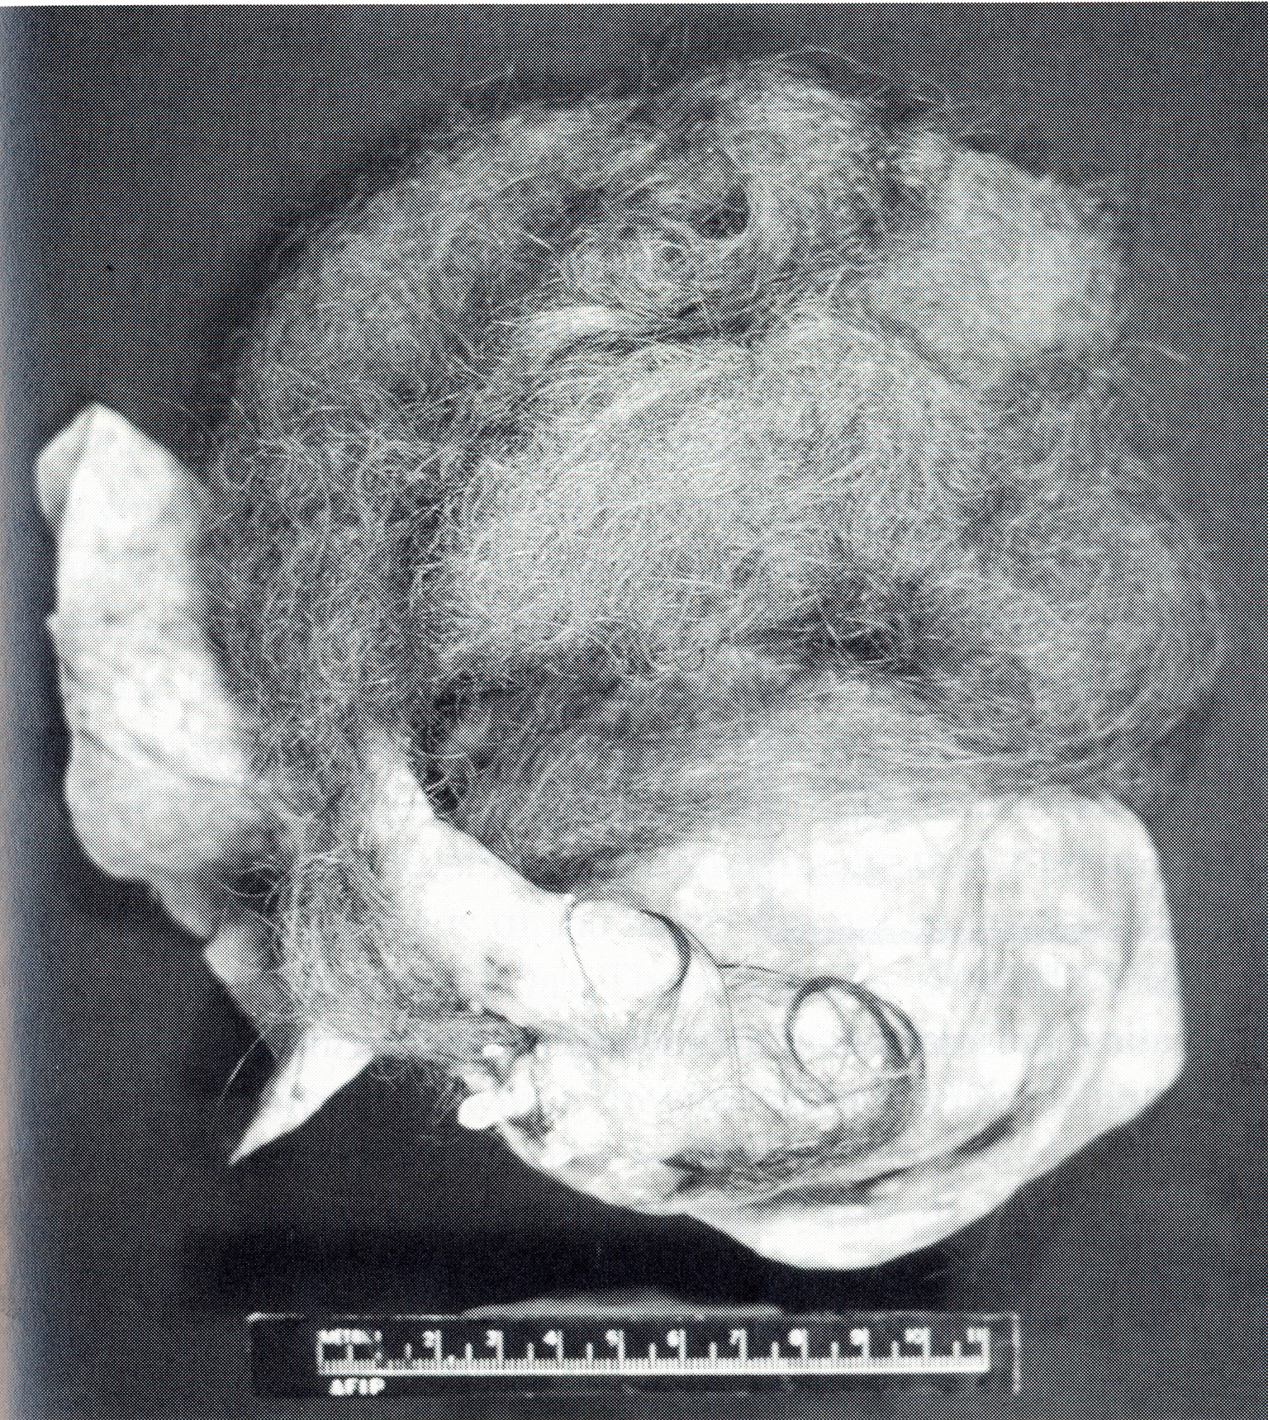
Hair
Teeth
12 cm
Human Teratoma
1907: Askanazy M. suggested that the well differentiated cystic structures from benign cystic ovarian teratomas develop from either a single multipotent type of cell or from a group of cells composed of representatives of each of the embryonic germinal layers

Slide 3
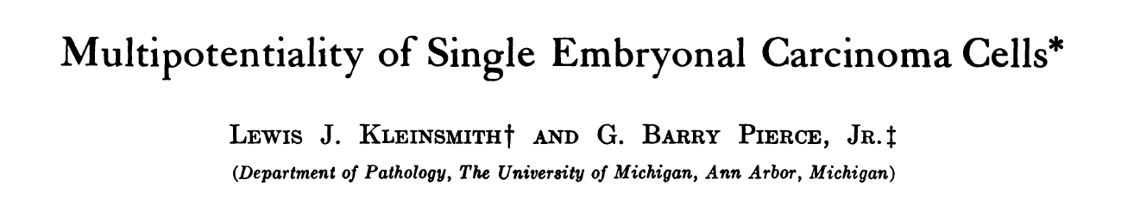
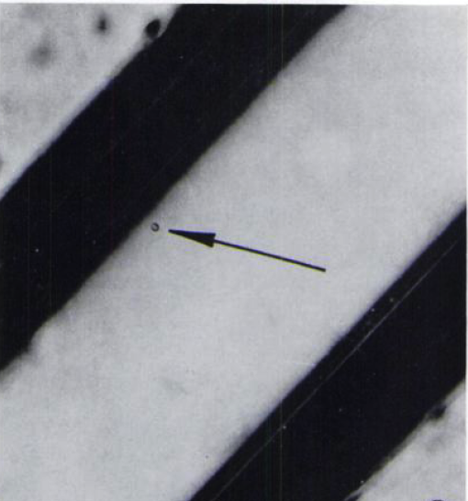
Cancer Research 1964
From 1700 single cell grafts, 43 multilineage, transplantable, teratocarcinomas were obtained

Slide 4
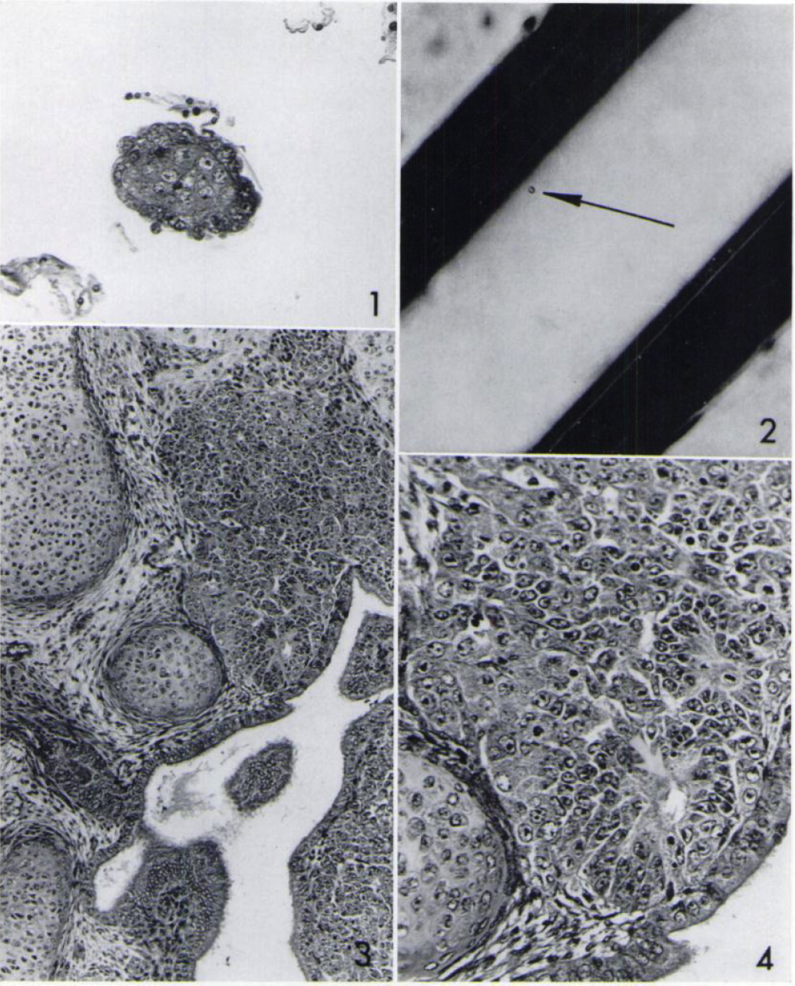
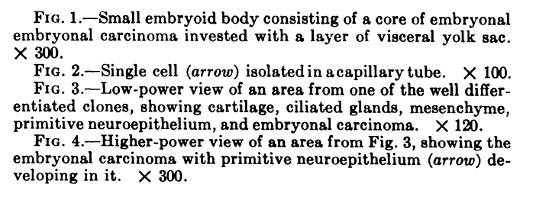

Slide 5
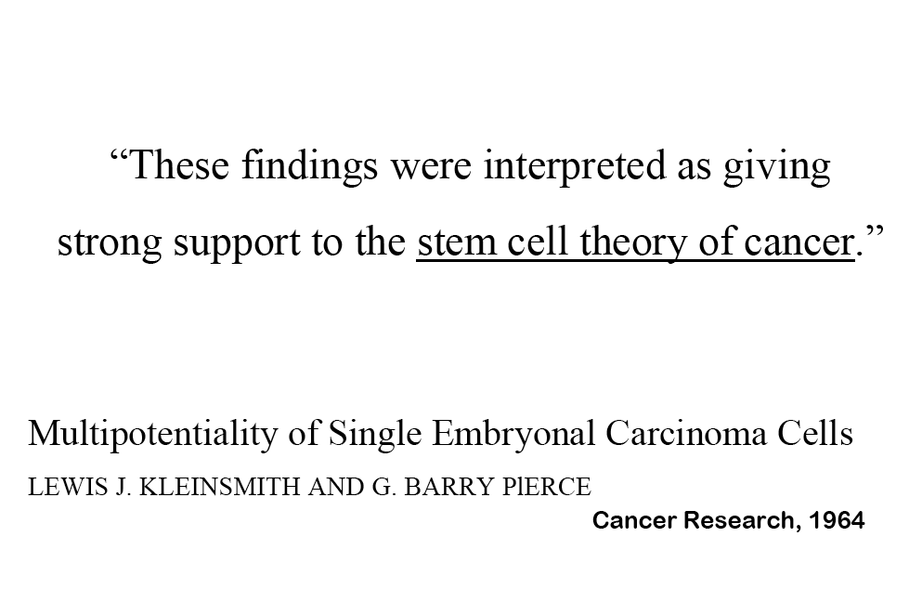

Slide 6
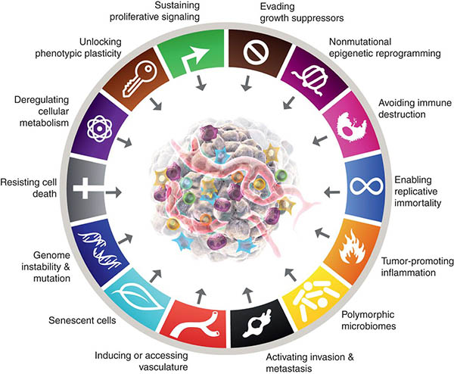
Breast
Colon
Lung
Prostate Ovary
Constitute approx. 80% of all cancers
(Hanahan D. and Weinberg RA,
(2000), Cell 100:57-70)

Slide 7
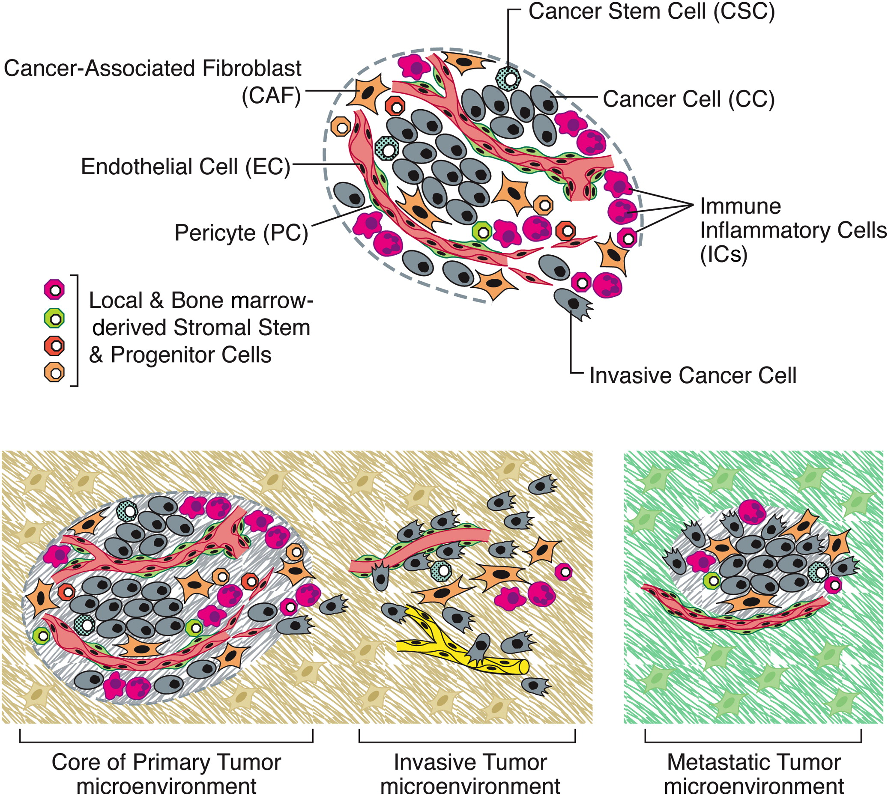
A tumor is a pathological mini organ

Slide 8
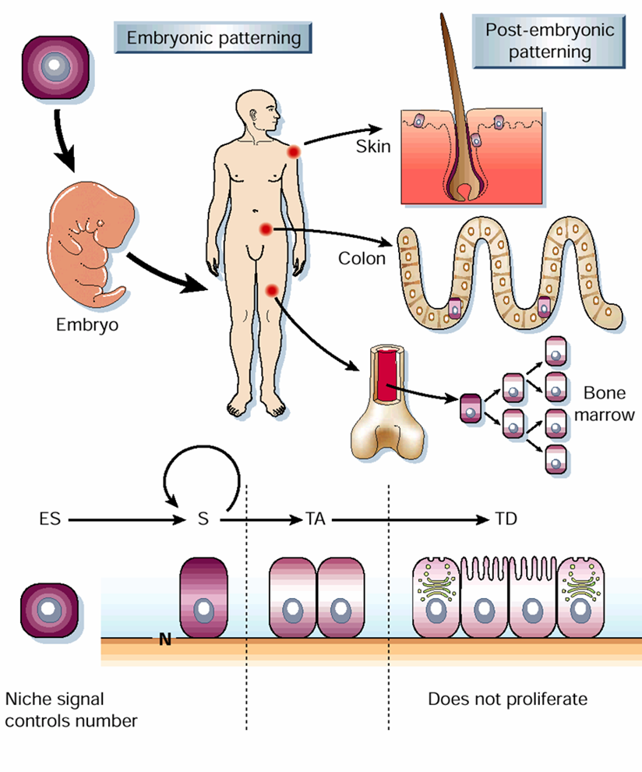
Adult tissue stem cells are essential for maintenance and repair of self-renewing tissues
Undergo replenishment or
repair from SC throughout life

Slide 9
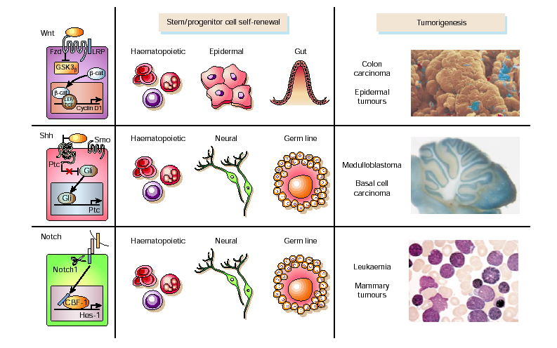
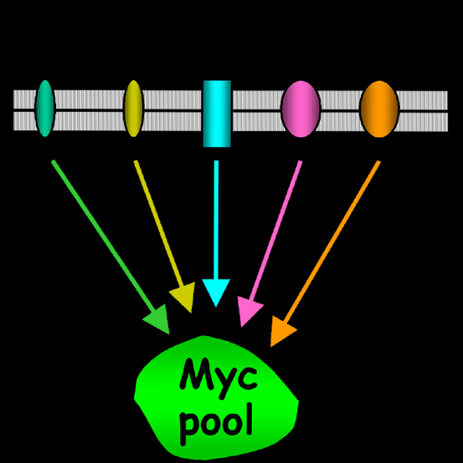
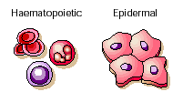
Leukemia
Lymphoma
Breast cancer
Prostate cancer
Colon cancer

Slide 10
Definition: Stem cell
Definition: Cancer Stem cell
A stem cell is a cell that has self-renewal capacity and that can give rise to all cell types of a given tissue.
A Cancer Stem Cell is a cell within the tumor that posseses the capacity to self-renew and to cause the heterogeneous lineages of cancer cells that comprise the tumor.
Thus these cells (stem cells) can only be defined experimentally by their ability to self-renew and to recapitulate the generation of all lineages of a given tissue or by the generation of a continuously growing tumor (CSC).

Slide 11
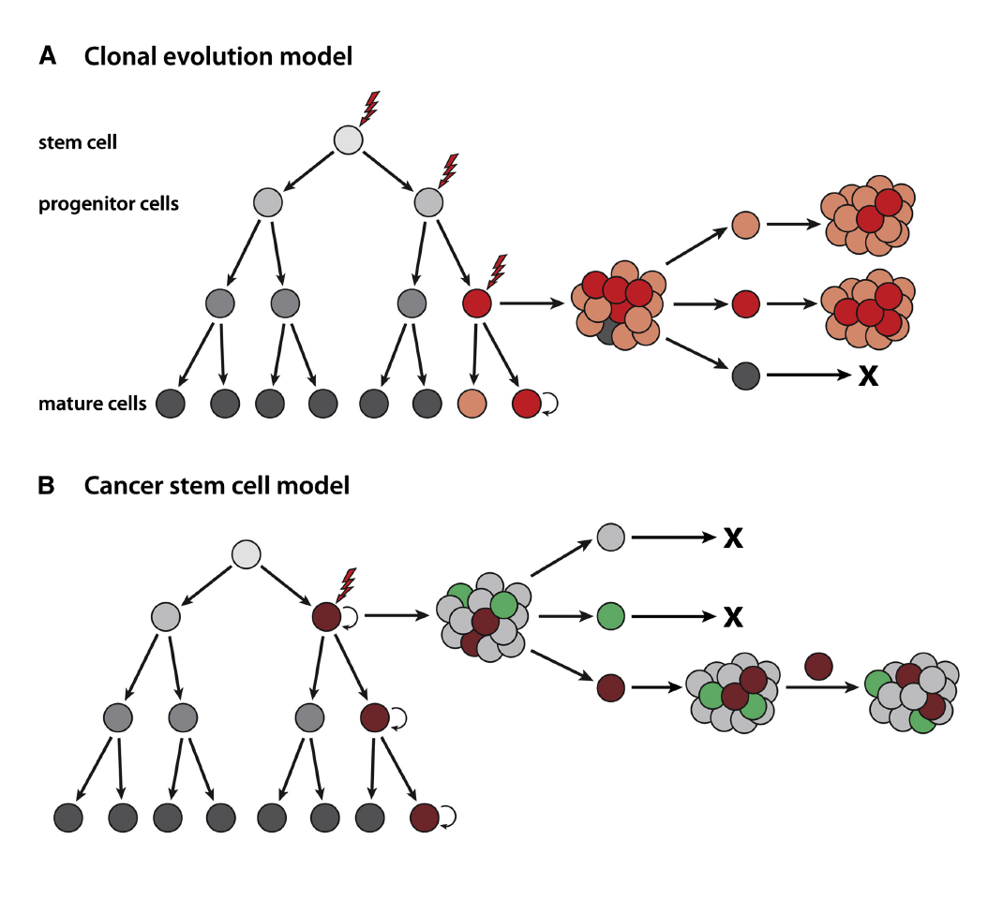
Two Main Cancer Models
Genetic changes leading to
development and progression
of the malignancy are operative
in all cells of the tumor!
Only a small subset of cancer cells have
the ability to initiate new cancer growth!

Slide 12
Current therapies succeed at eliminating bulky disease and rapidly proliferating cells but often miss a tumor reservoir (CSCs) that is the source of disease recurrence and metastasis.
Conventional chemotherapy:
Kills tumor cells but may spare
cancer stem cells
CSC
CSC
Cancer Stem Cell
(CSC)
Tumor initially shrinks
by 99% but relapses
TA cells
CSC
Novel drugs that eliminate
cancer stem cells
Tumor loses its ability to constantly produce
new cells and eventually degenerates
(Modified from Reya et al., 2001)
Park CH, Bergsagel DE, McCulloch EA, (1971)

Slide 13
What is the evidence for the existence of cancer stem cells?
Clinical observations
Experimentation mostly involving mice

Slide 14
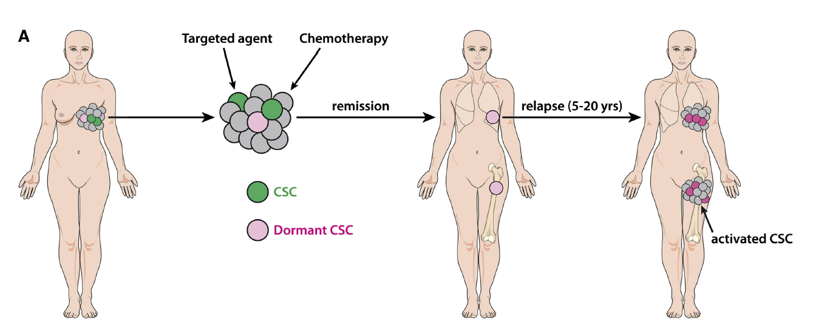
Examples for the existence of Cancer stem cells
Possible mechanisms of metastatic relapse after anticancer therapy

Slide 15
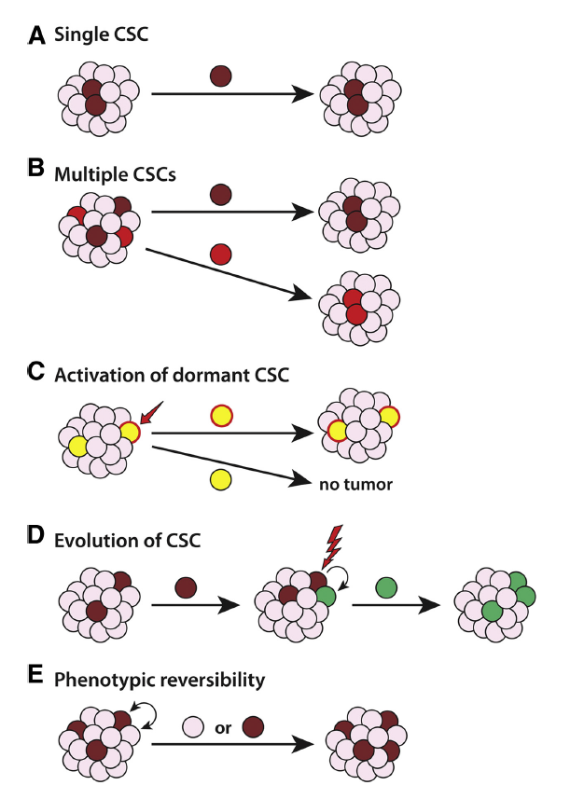
Schematic models of tumor propagation by Cancer stem cells

Slide 16
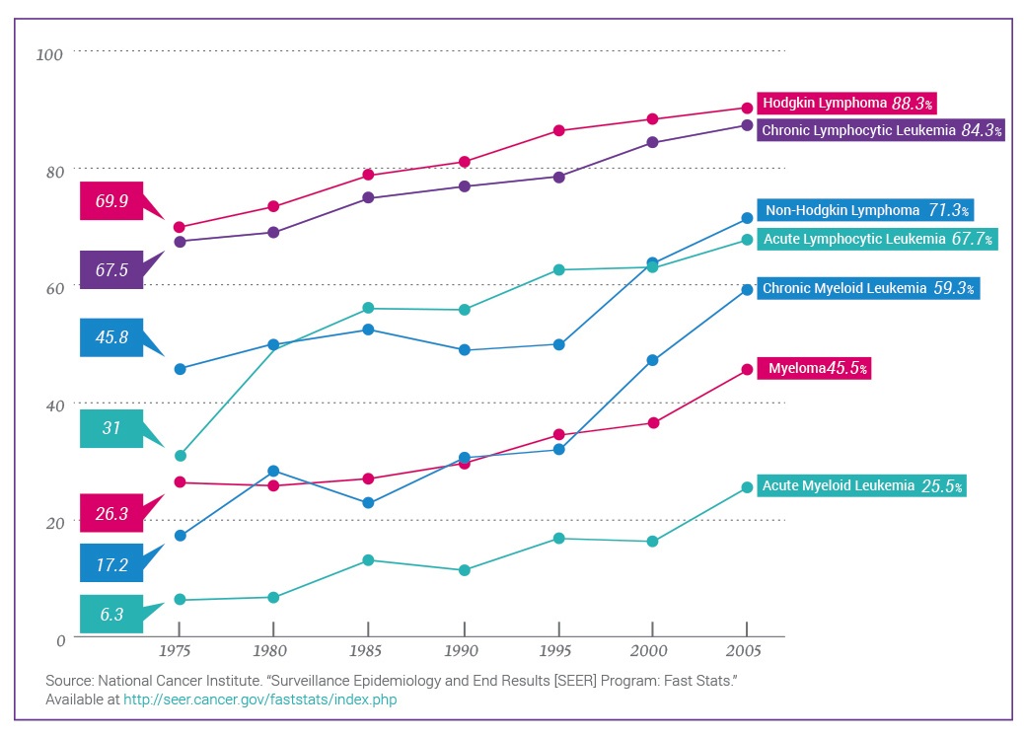
Blood Cancer Survival is on the Rise
Retuximab (anti-CD20)
Gleevec

Slide 17
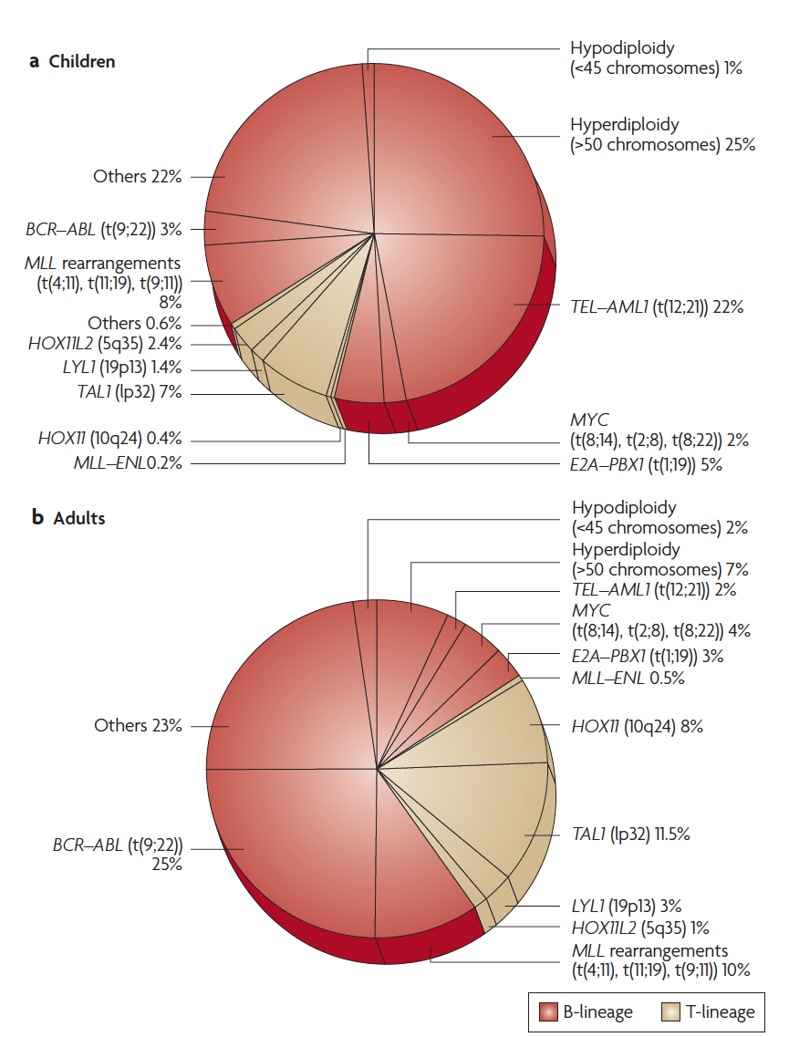
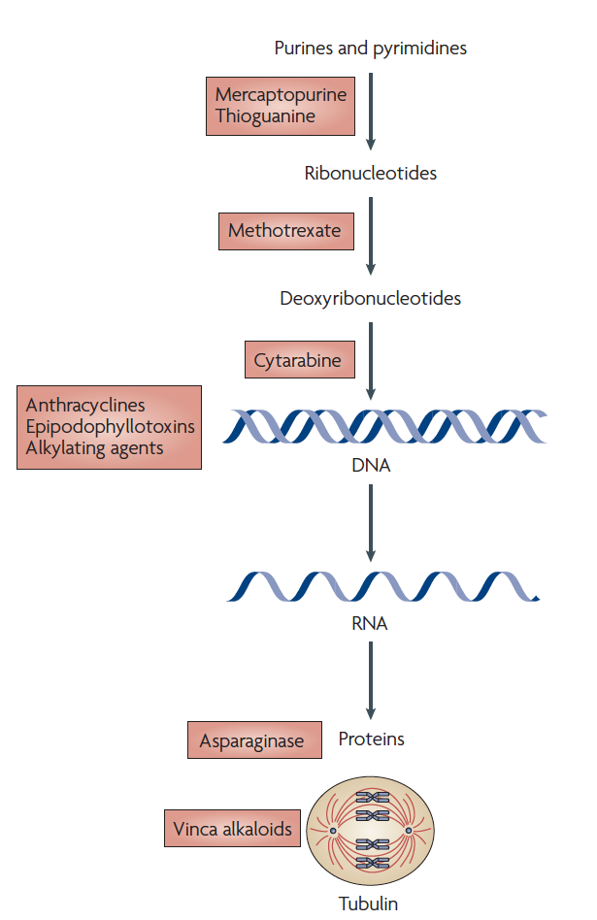
Cytogenetic and molecular genetic abnormalities of childhood and adult ALL
Agents that are conventionally used to treat ALL patients
Year approved
1953
1953
1969
1979-2002
1978
1963
Pui and Jeha Nature Reviews Drug Discovery 6, 149–165 (February 2007) | doi:10.1038/nrd2240

Slide 18
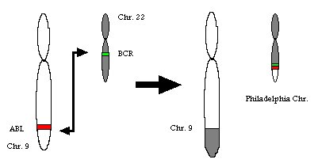
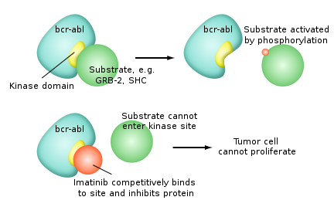
CML – Chromosomal Translocation – Philadelphia Chromosome
Chr.22
Bcr
Philadelphia Chromosome
ABL
Chr.9
Chr.9
t(9;22)(q34;q11)
Some CML Facts:
C-ABL: Abelson Murine Leukemia Viral Oncogene Homolog 1 (Tyrosinekinase/G_protein-Ras).
BCR: break cluster region
CML occurs in all age groups, but most commonly in middle-aged to elderly (mean age at onset 53 yrs)
Incidence of 1-2 cases per 100.000 per year & slightly more men than women are affected
CML presents ≈ 15-20% of all cases of adult leukemia
CML is treated with Bcr-Abl tyrosine kinase inhibitors (imatinib=Gleevec; desatinib; nilotinib)
Patients treated with imatinib show 89% survival rate after 5 yrs follow-up

Slide 19
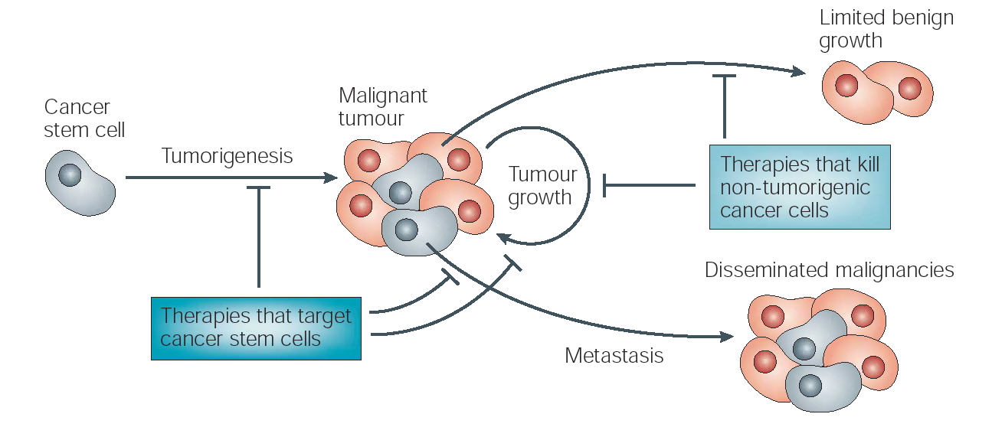
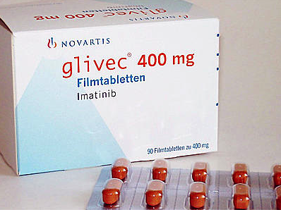
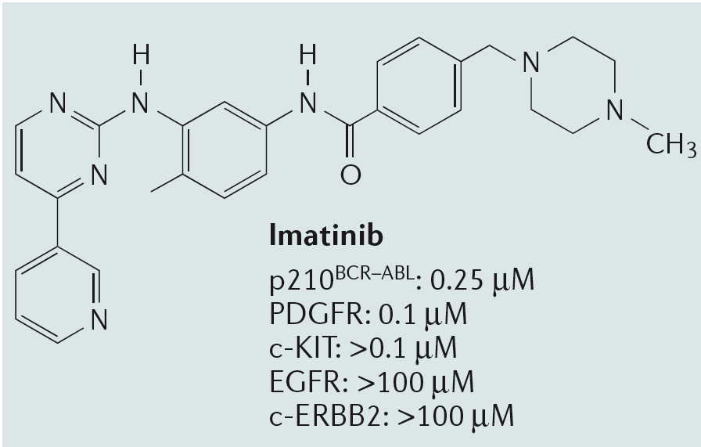
Imatinib targets (BCR-Abl carrying) leukemic progenitors but not the leukemic stem cell!
Quiescent?
Express ABC-T
Cycling
(Imatinib?)
(modified from Pardal et al., 2003)

Slide 20
How are cancer stem cells studied?

Slide 21
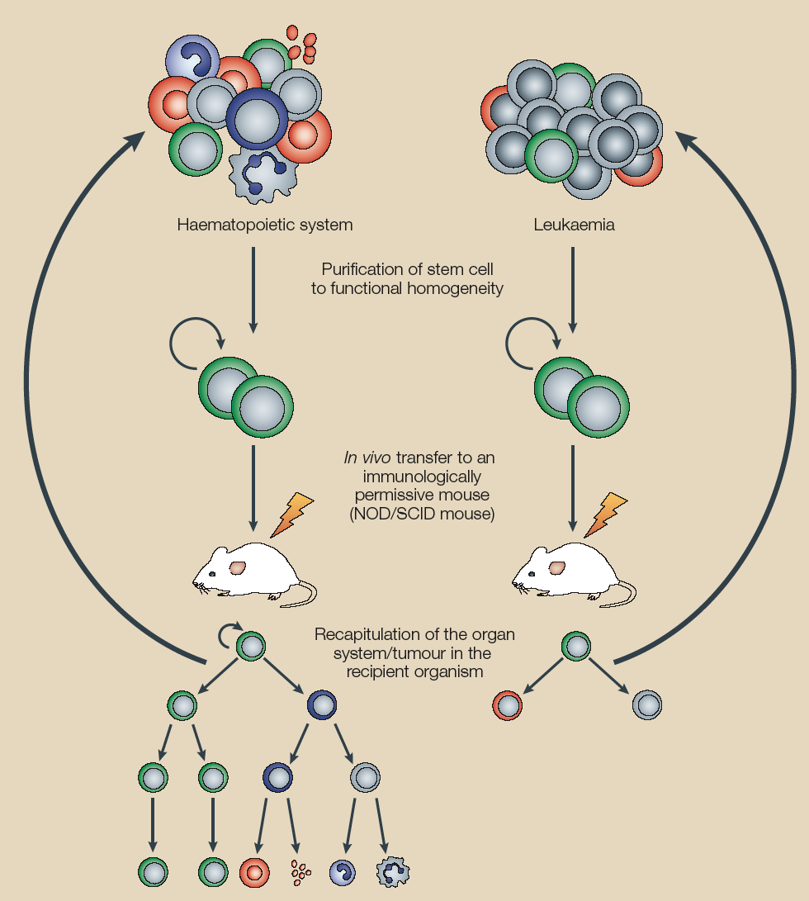
Tumor

Slide 22
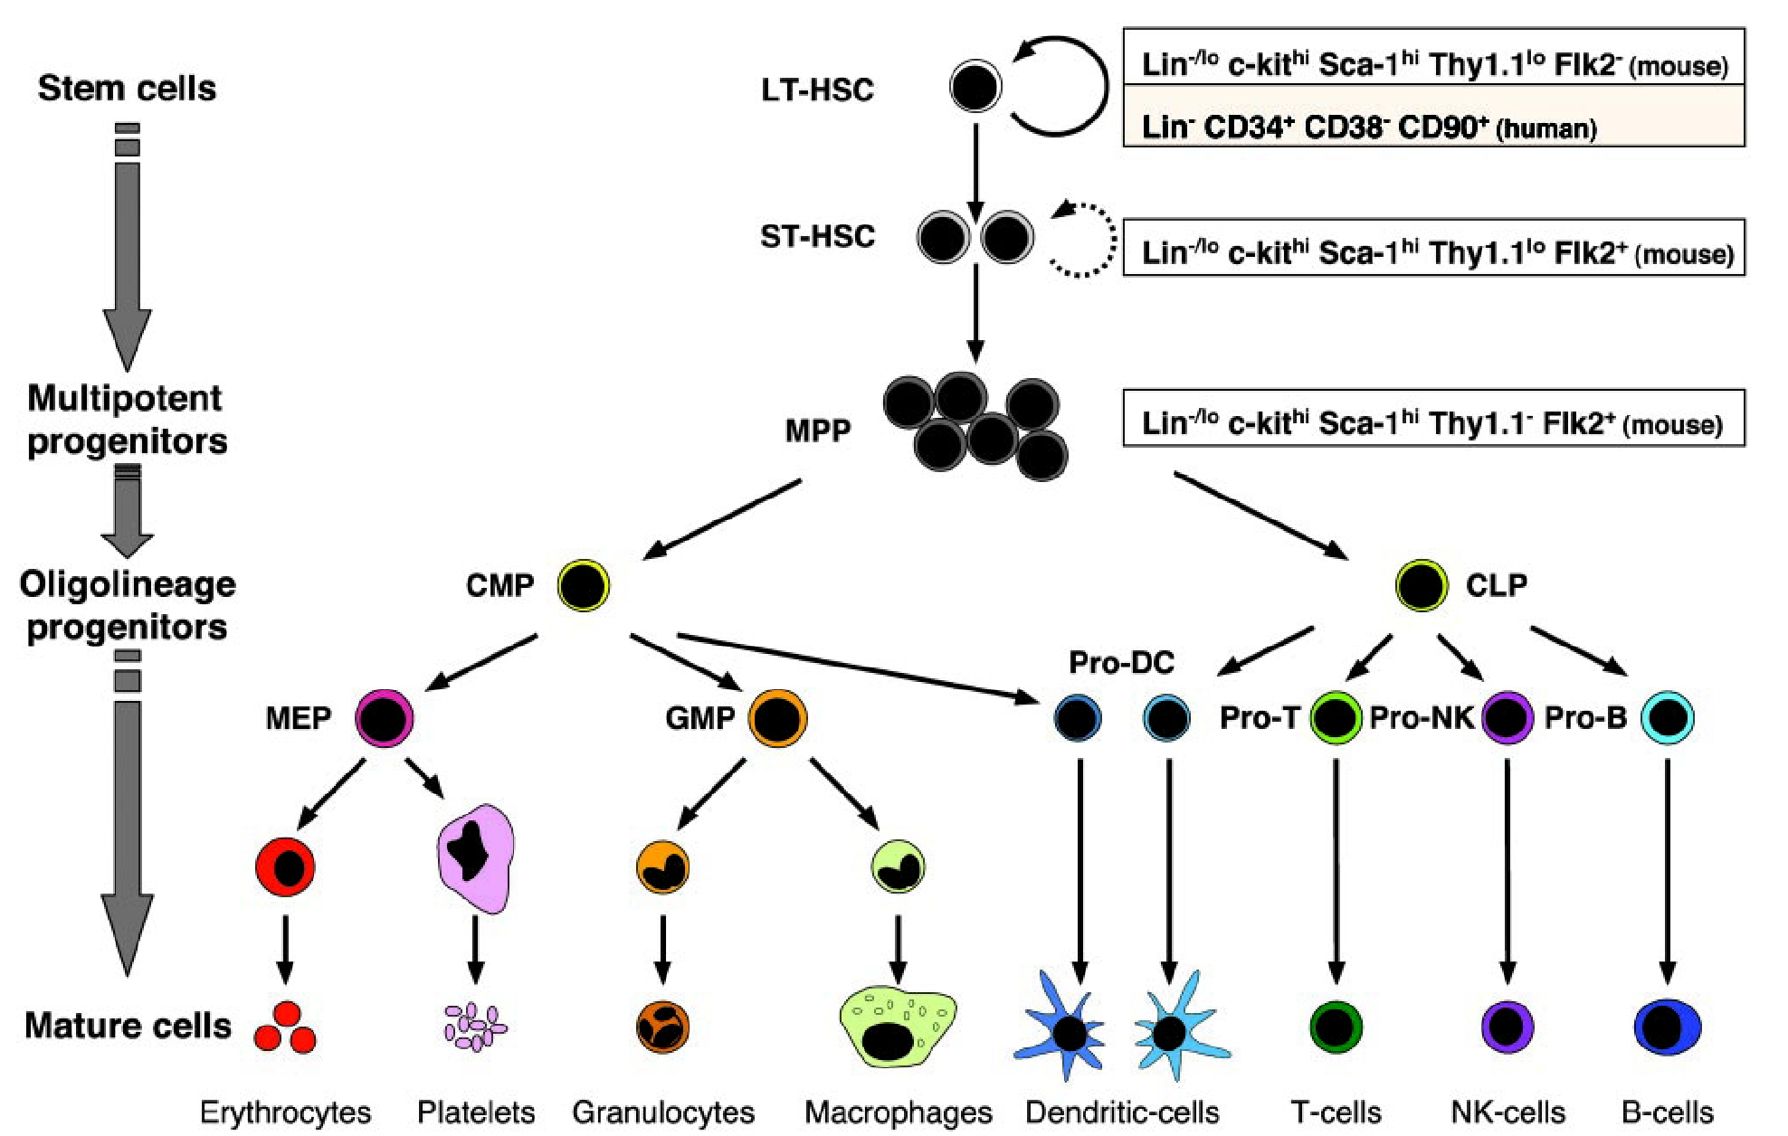
The adult murine hematopoietic system
cKit^{hi} Lin⁻ Sca-1⁺ CD34⁻ Flk2⁻CD150⁺CD48⁻
KLS
Lin⁻ c-Kit^{hi} Sca-1^{hi} CD34⁺ Flk2⁻
KLS
Lin⁻ c-Kit^{hi} Sca-1^{hi} Thy1.1⁻ Flk2⁺
KLS
(?)
Modified from Passegué E. et al., 2003, Yang et al., 2005, Kiel et al., 2005

Slide 23


The gold standard for identifying hematopoietic stem cells is Serial Bone Marrow Reconstitution
BM
13 weeks
BM
13 weeks
BM
1º
1º
2º
3º
2º
3º

Slide 24
The SCID-hu Mouse
J. McCune and I.Weissman (1988)
Severe combined immunodeficiency (SCID).
The mice are defective in rearranging their antigen receptors in differentiating T and B cells.
By engrafting human fetal liver, lymph node or thymus
onto the SCID mouse, human stem cell differentiation
can be observed in a mouse model
Possible to construct SCID-hu mice with a variety of human
lymphoid organs of defined genetic origin.

Slide 25
Tumor
Purification of cells able
to transplant the tumor
Often only a very small
sub-fraction of the tumor has
this activity!
cancer stem cell
or cancer initiating cell

Slide 26
Leukemias
- In an AML patient only one small population 0.2% (CD34+CD38-)
had transplantable activity (NOD/SCID)! Other AML cells were
unable to induce leukemia
(Lapidot et al., 1994; Bonnet and Dick, 1997; Hope et al., 2004)
Similar studies:
ALL: (George et al., 2001)
MDS: (Nilsson et al., 2002)
Muliple Myeloma: (Matsui et al., 2004)

Slide 27
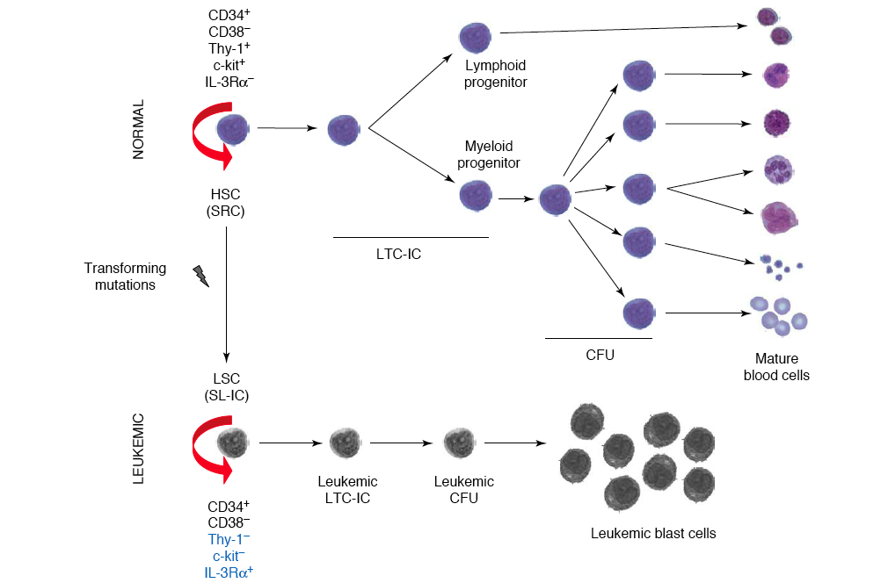

Slide 28
Leukemias
- In an AML patient only one small population 0.2% (CD34+CD38-)
had transplantable activity (NOD/SCID)! Other AML cells were
unable to induce leukemia
(Lapidot et al., 1994; Bonnet and Dick, 1997; Hope et al., 2004)
Similar studies:
ALL: (George et al., 2001)
MDS: (Nilsson et al., 2002)
Muliple Myeloma: (Matsui et al., 2004)
Solid tumors
Breast cancer: 200 CD44⁺ CD24^{neg} ESA⁺ cells transferred the tumor
(Al-Haij et al., and Clarke, PNAS 2003)
Glioblastoma: 100 CD133⁺ tumor cells (Singh et al. and Dirks, Nature 2004)

Slide 29
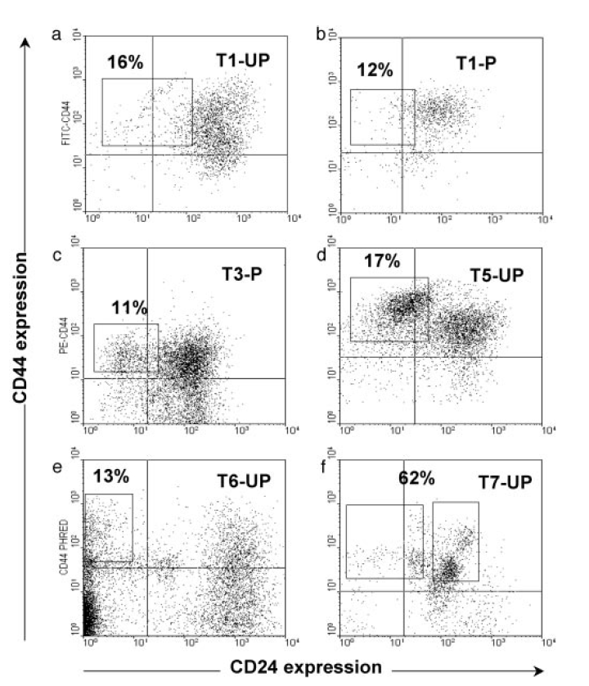
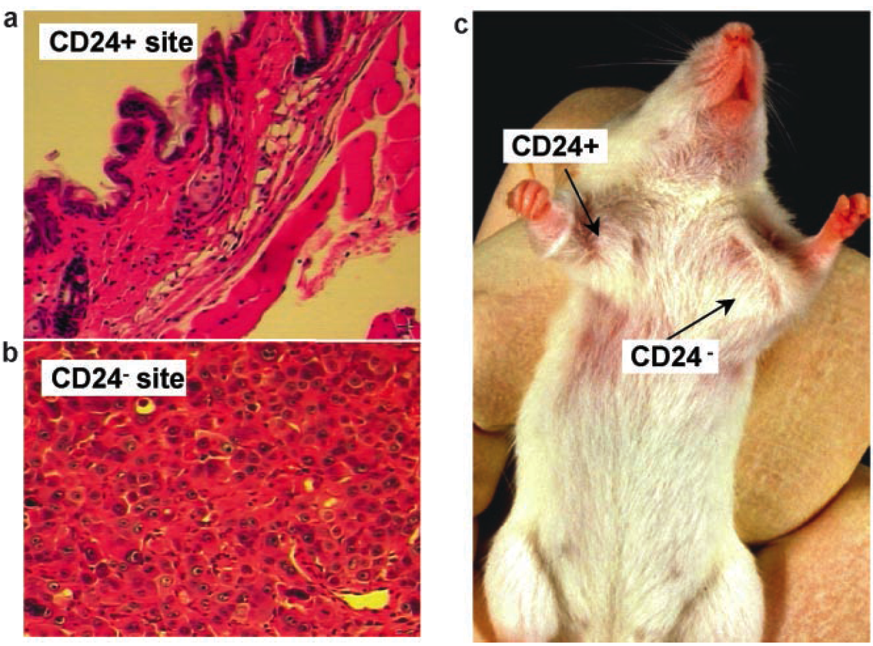
Solid Tumors 1
- Breast cancer: as few as 200 CD44⁺ CD24^{neg} ESA⁺ tumor cells
re-initiated (a phenotypic similar) tumor in NOD/SCID mice
(orthotopic graft into fat pads).
However, injecton of thousands of tumor cells with a different
phenotype did not. (Al-Haij et al., and Clarke, PNAS 2003)

Slide 30
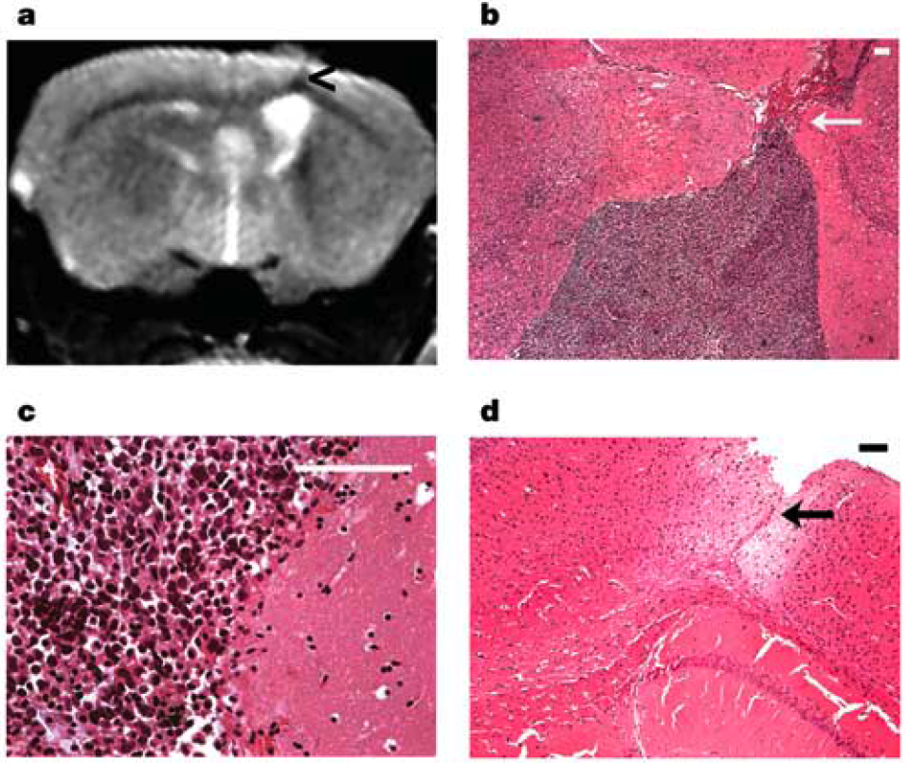
Solid Tumors 2
Brain tumors: as few as 100 CD133⁺ tumor cells re-initiated
(a phenotypic similar) tumor in NOD/SCID mice (orthotopic-frontal lobe).
However, injecton of thousands of CD133- tumor cells did not.
(Singh et al. and Dirks, Nature 2004)
MRI
Magnetic resonance imaging
100 CD133+ tumor cells
100.000 CD133- tumor cells

Slide 31
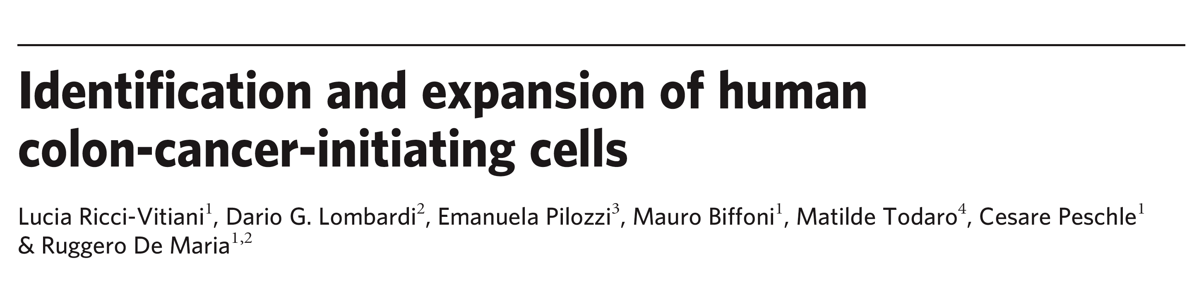
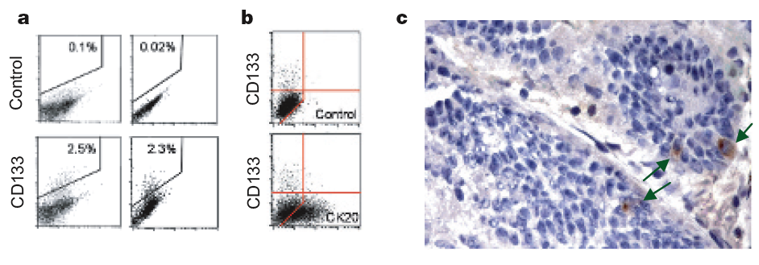
CD133 antigen also known as prominin-1 is a glycoprotein
CD133 is expressed in hematopoietic stem cells,[4] endothelial progenitor cells,[5] glioblastoma, neuronal and glial stem cells,[6] various pediatric brain tumors,[7] as well as adult kidney, mammary glands, trachea, salivary glands, placenta, digestive tract, testes, and some other cell types.
A rare CD133+ population of tumorigenic cells is present in colon cancer

Slide 32
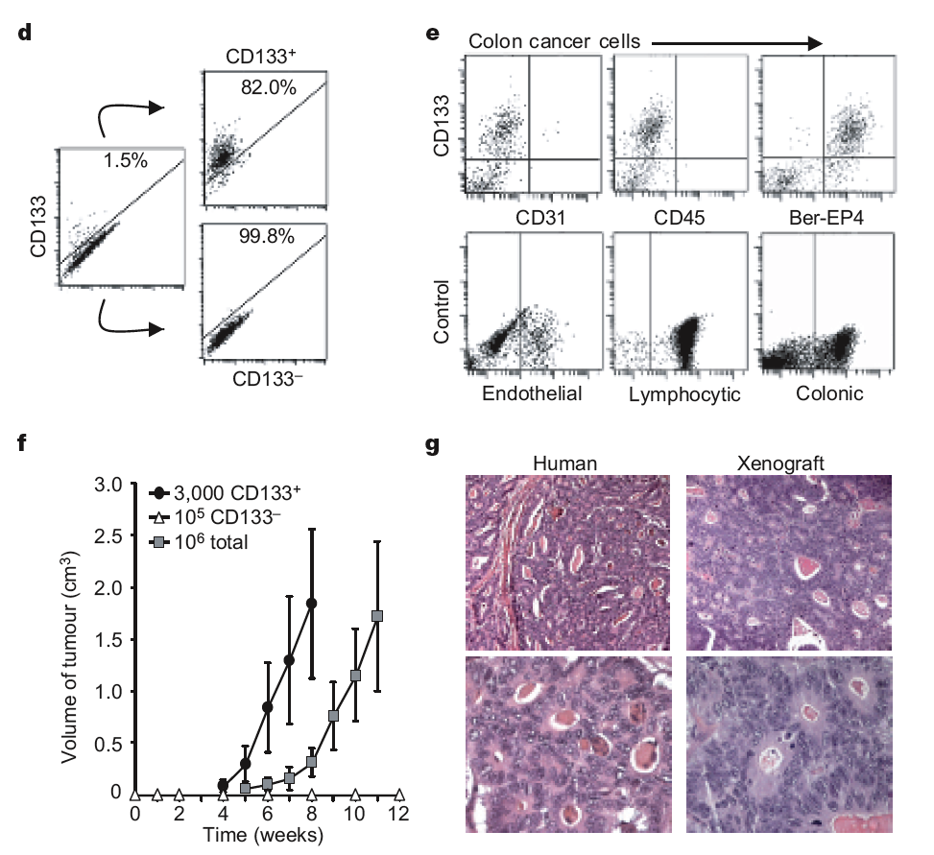

Slide 33
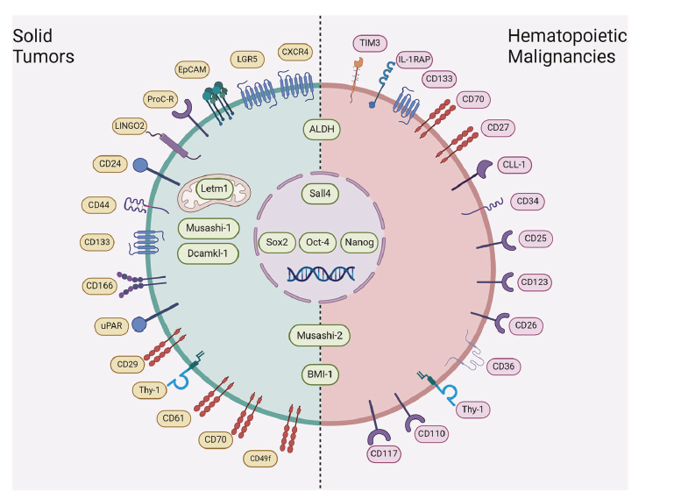
Cancer stem cells can be identified by cell surface markers
and isolated by fluorescence activated cell sorting (FACS)

Slide 34
Current therapies succeed at eliminating bulky disease and rapidly proliferating cells but often miss a tumor reservoir (CSCs) that is the source of disease recurrence and metastasis. What are these resistance mechanisms?
Conventional chemotherapy:
Kills tumor cells but may spare
cancer stem cells
CSC
CSC
Cancer Stem Cell
(CSC)
Tumor initially shrinks
by 99% but relapses
TA cells
CSC
Novel drugs that eliminate
cancer stem cells
Tumor loses its ability to constantly produce
new cells and eventually degenerates
(Modified from Reya et al., 2001)
Park CH, Bergsagel DE, McCulloch EA, (1971)

Slide 35
Possible mechanisms for drug resistance of
Cancer Stem Cells
Stem Cells and probably also Cancer Stem cells:
….. are dividing rarely and are mainly quiescent
(refractory to drugs that target dividing cells…)
….. express ABC transporters, which could mediate resistance to chemotherapy!
(built-in drug resistance!)
….. Activate the repaire machinerie more efficiently
(escape from irradiation induced apoptosis…)
! Even normal stem cells are resistant to chemotherapy
(recovery of blood and hair growth in patients after treatment)

Slide 36
Possible mechanisms of metastatic relapse after anticancer therapy

Slide 37
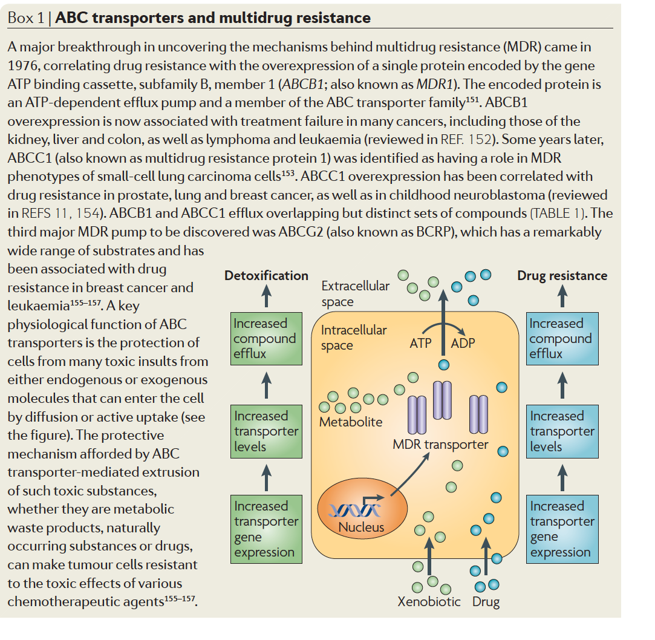
« Cancer Stem Cells » but not their
progeny may be resistant to chemotherapy

Slide 38
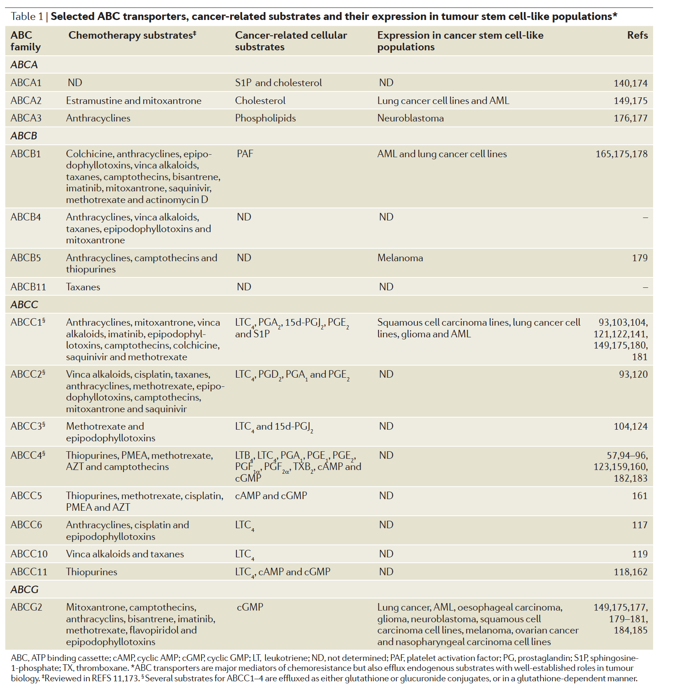

Slide 39
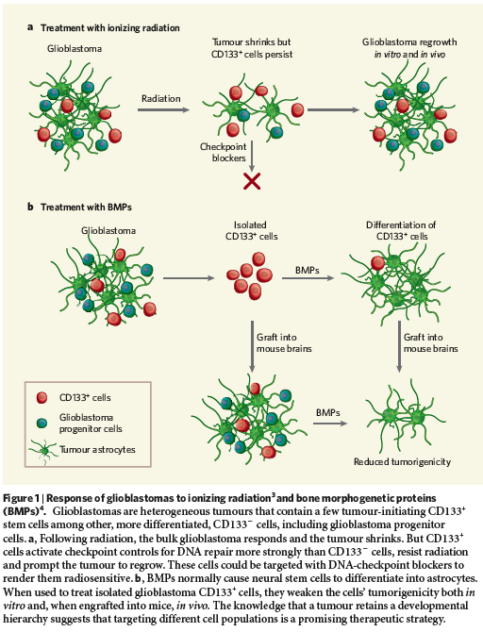
NCSC can repair their DNA more
efficient than other tumor cells.
Chk1/2 inhibitors
?
BMP induces differentiation of NSCs
towards mature astrocytes!
(P. Dirks, Nature 2006)

Slide 40
The choice of your experimental model system will influence the outcome and also the interpretation of your data
Melanoma
Cancer stem cells
Yes or No?

Slide 41
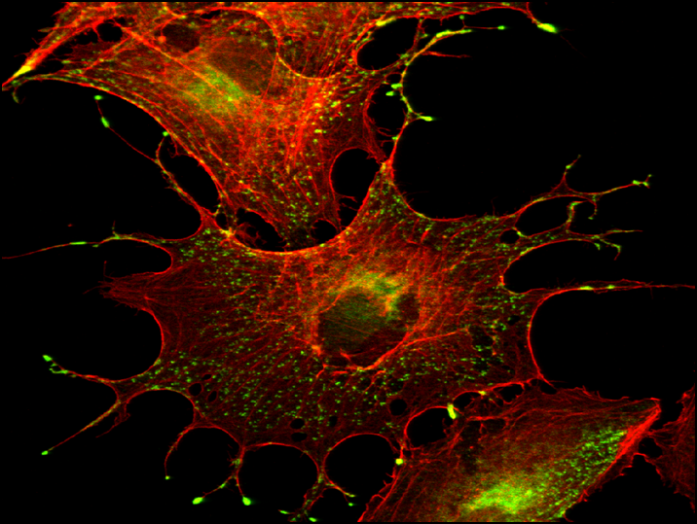

Melanocyte biology
Melanocytes in skin are low in number, but lead to prominent phenotype
Melanin - Pigment
  Eumelanin & Pheomelanin
Melanosome - A lysosome-related intracellular membrane-coated organelle that originates from endosomes
Notes:
So what are the melanocytes ?in order to understand it , I will take u through melanocyte biology briefly .. Melanocytes are neural crest–derived pigment cells that migrate into skin and hair follicles during embryogenesis.Under normal conditions it is not the numbers of melanocytes in the skin that determine the degree of pigmentation but their levels of activity. RPE -pigment cells originates from the optic cup and forms the retinal pigment epithelium (RPE), a cell monolayer lying at the interface between the photoreceptive retina and the choroid (Martinez-Morales et al., 2004).
AS I AM WORKING ON MOUSE MELANOCYTES ………………LETSS SEE THE

Slide 42
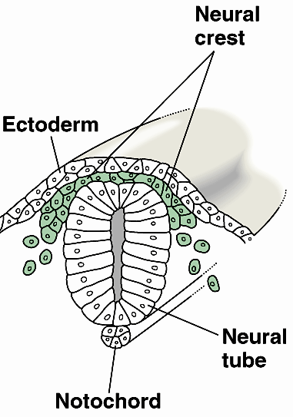
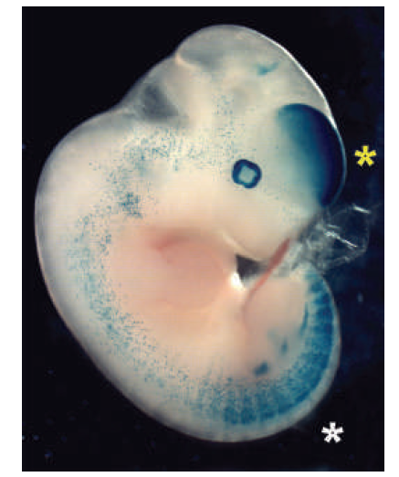
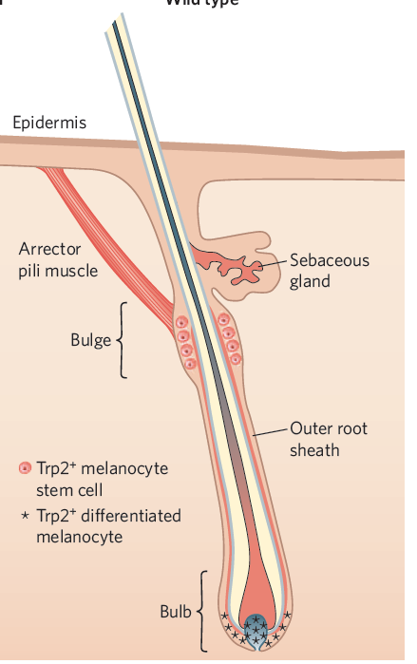
Skin and melanocytes
Mackenzie , 1997

Slide 43
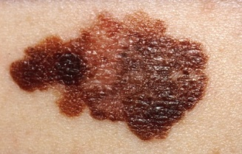
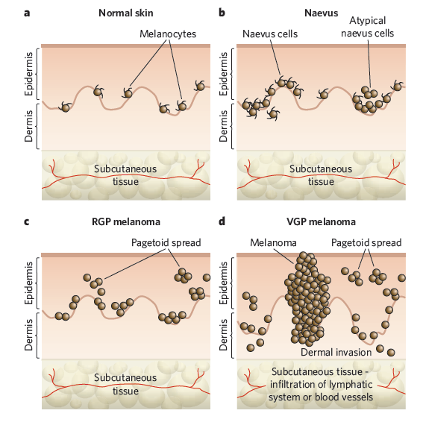
Melanoma formation
Malignant melanoma is one of the most aggressive types of human cancers
normal skin
naevi
Normal proliferation
Melanocyte
proliferation
RGP melanoma
VGP melanoma
Metastasis
(invasion
of dermis)
Local microinvasion
(intra-epidermal)
(Chin et al,2006)

Slide 44
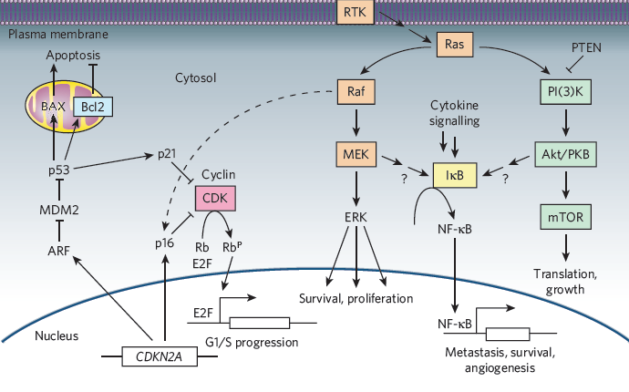
Genetics of melanoma
Adapted from Gray-Schopfer et al., Nature, 2008

Slide 45
Genetic alterations
Genotype | Gene | Alteration frequency/type(s) in melanoma (%)
Oncogenes | BRAF | 50-70% mutated
 | NRAS | 15-30% mutated
Tumour suppressors | CDKN2A | 30-70% deleted, mutated or silenced
 | p53 | 10% lost or mutated
Adapted from Gray-Schopfer et al, Nature, 2008

Slide 46
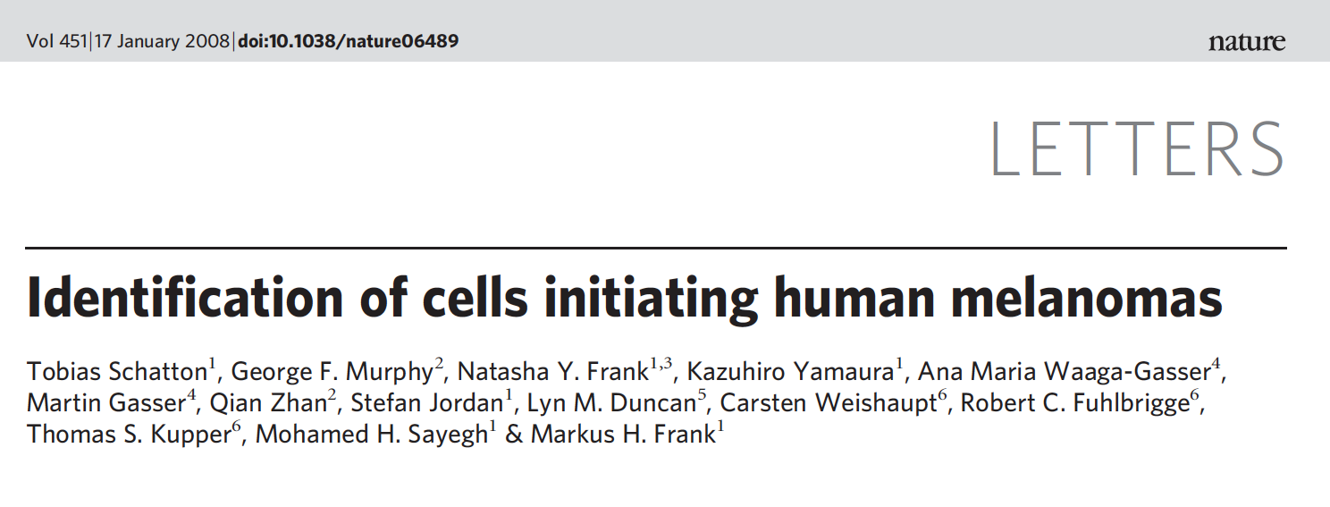
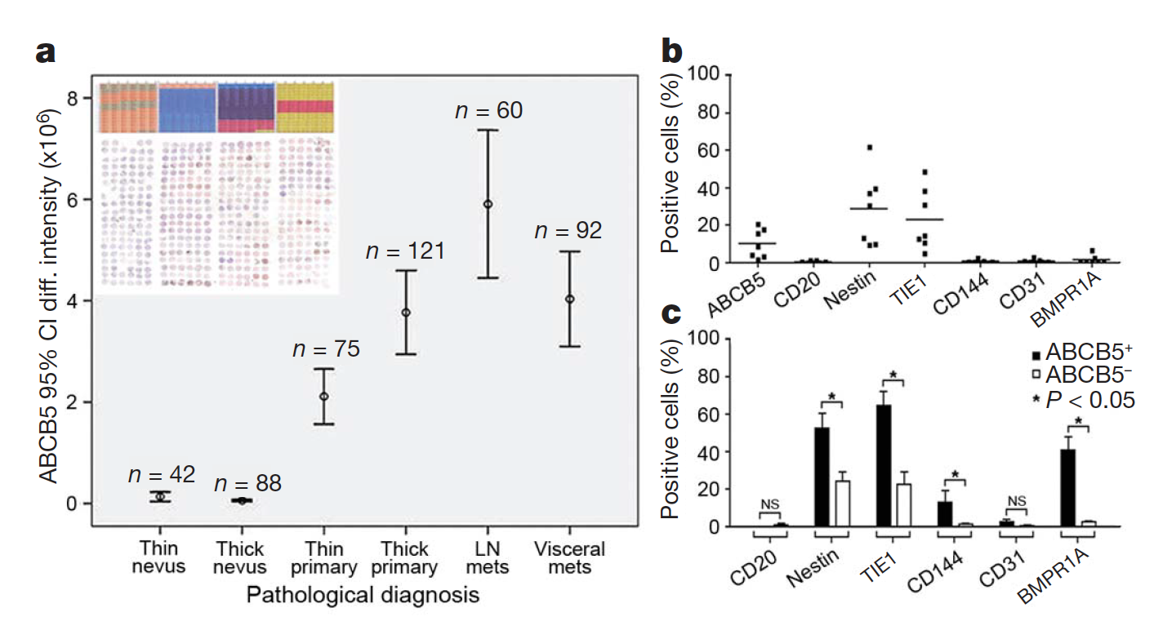
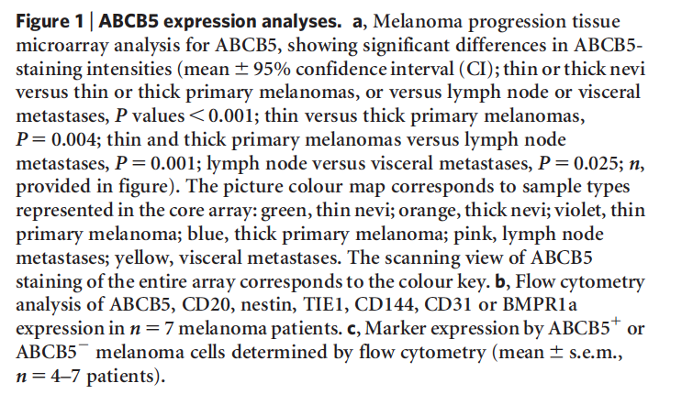

Slide 47
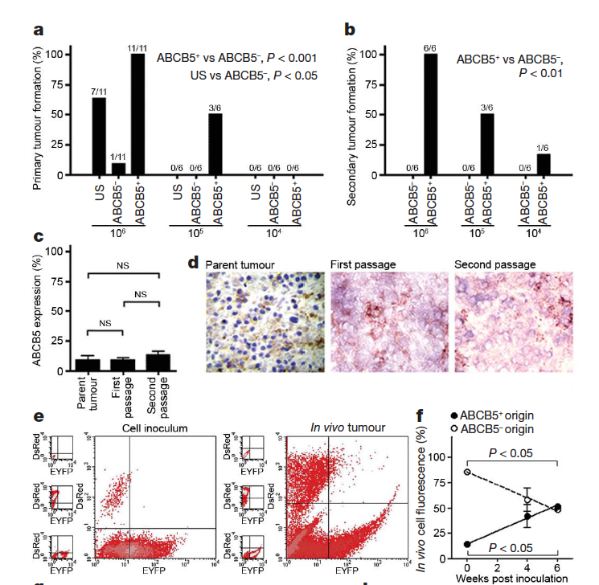
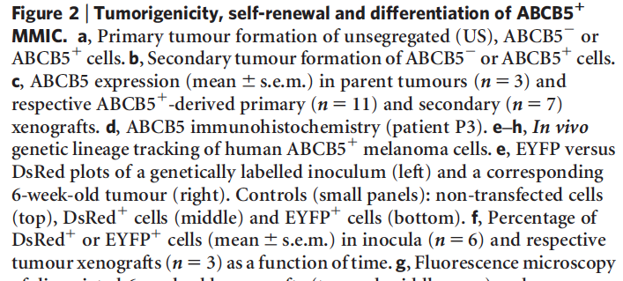

Slide 48
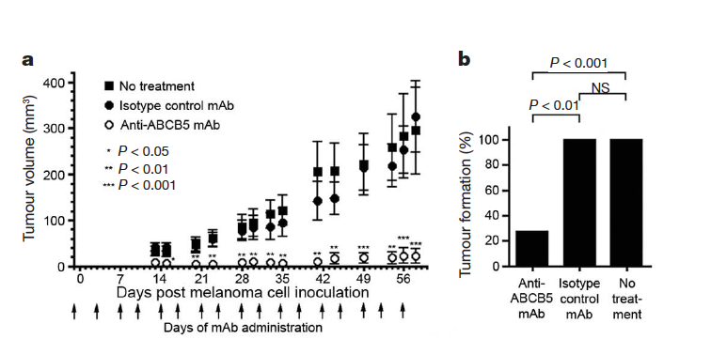
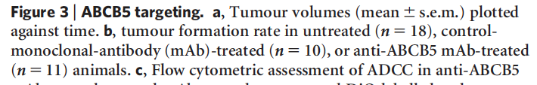

Slide 49



Slide 50



Slide 51




Slide 52



Slide 53
Xeno-transplantation assays of human tumor derived cells into NOD/SCID mice for the identification and determination CSC and their frequencies was recently heavily criticized.
Growth of tumor cells is not independent from its microenvironment.
Tumor needs soluble and membrane bound factors (tumor cell niche?)
Many of the soluble factors secreted by murine cells cannot bind the cognate human receptors and vise versa.
Thus the low frequency of human cancer derived cells might reflect (at least in part) cells that more easily adapt to growth in a foreign (mouse) environment.

Slide 54



Cancer stem cell hypothesis can best be tested by transfer of titrated numbers of mouse tumor cells into non-irradiated histocompatible recipient mice.

Slide 55


Leukemia stem cell signature and HSC stem cell signature in patient AML samples correlate with clinical outcome

Slide 56


Experimental strategy of transcriptional profiling of stem cell fractions identified by function

Slide 57



Slide 58




LSCs express HSC gene expression profile
CD34+
CD38-
CD34+
CD38lo
CD34+
CD38+
unsorted

Slide 59



LSCs and HSC gene signatures predict patient survival
(d) Correlation of an AML signature based on phenotypic markers (CD34+CD38-, stem cells versus CD34+CD38+, progenitor; 23 AML samples) and overall survival. Red line, subjects whose AML expressed the CD34+CD38- gene list greater than the median; black line, those who expressed the CD34+CD38- gene list less then median

Slide 60
Lines of evidence of whether human tumors contain CSCs
Fractionating primary tumors into populations that can generate xenografts and those that cannot.
Transplanting tumors into secondary recipient mice to demonstrate self-renewal capacity.
Biological properties specific to CSC (e.g. stem cell gene signature, tumor initiation potential in xenografts), but not to non-CSCs predict clinical important parameters such as patient survival.

Slide 61
Exam
Thursday 22. January 2026
09h15 to 12h15
CM1120

