Slide 1
Environmental factors and the increase risk in cancer development
Elisa Oricchio, PhD
Planetary Health

Slide 2
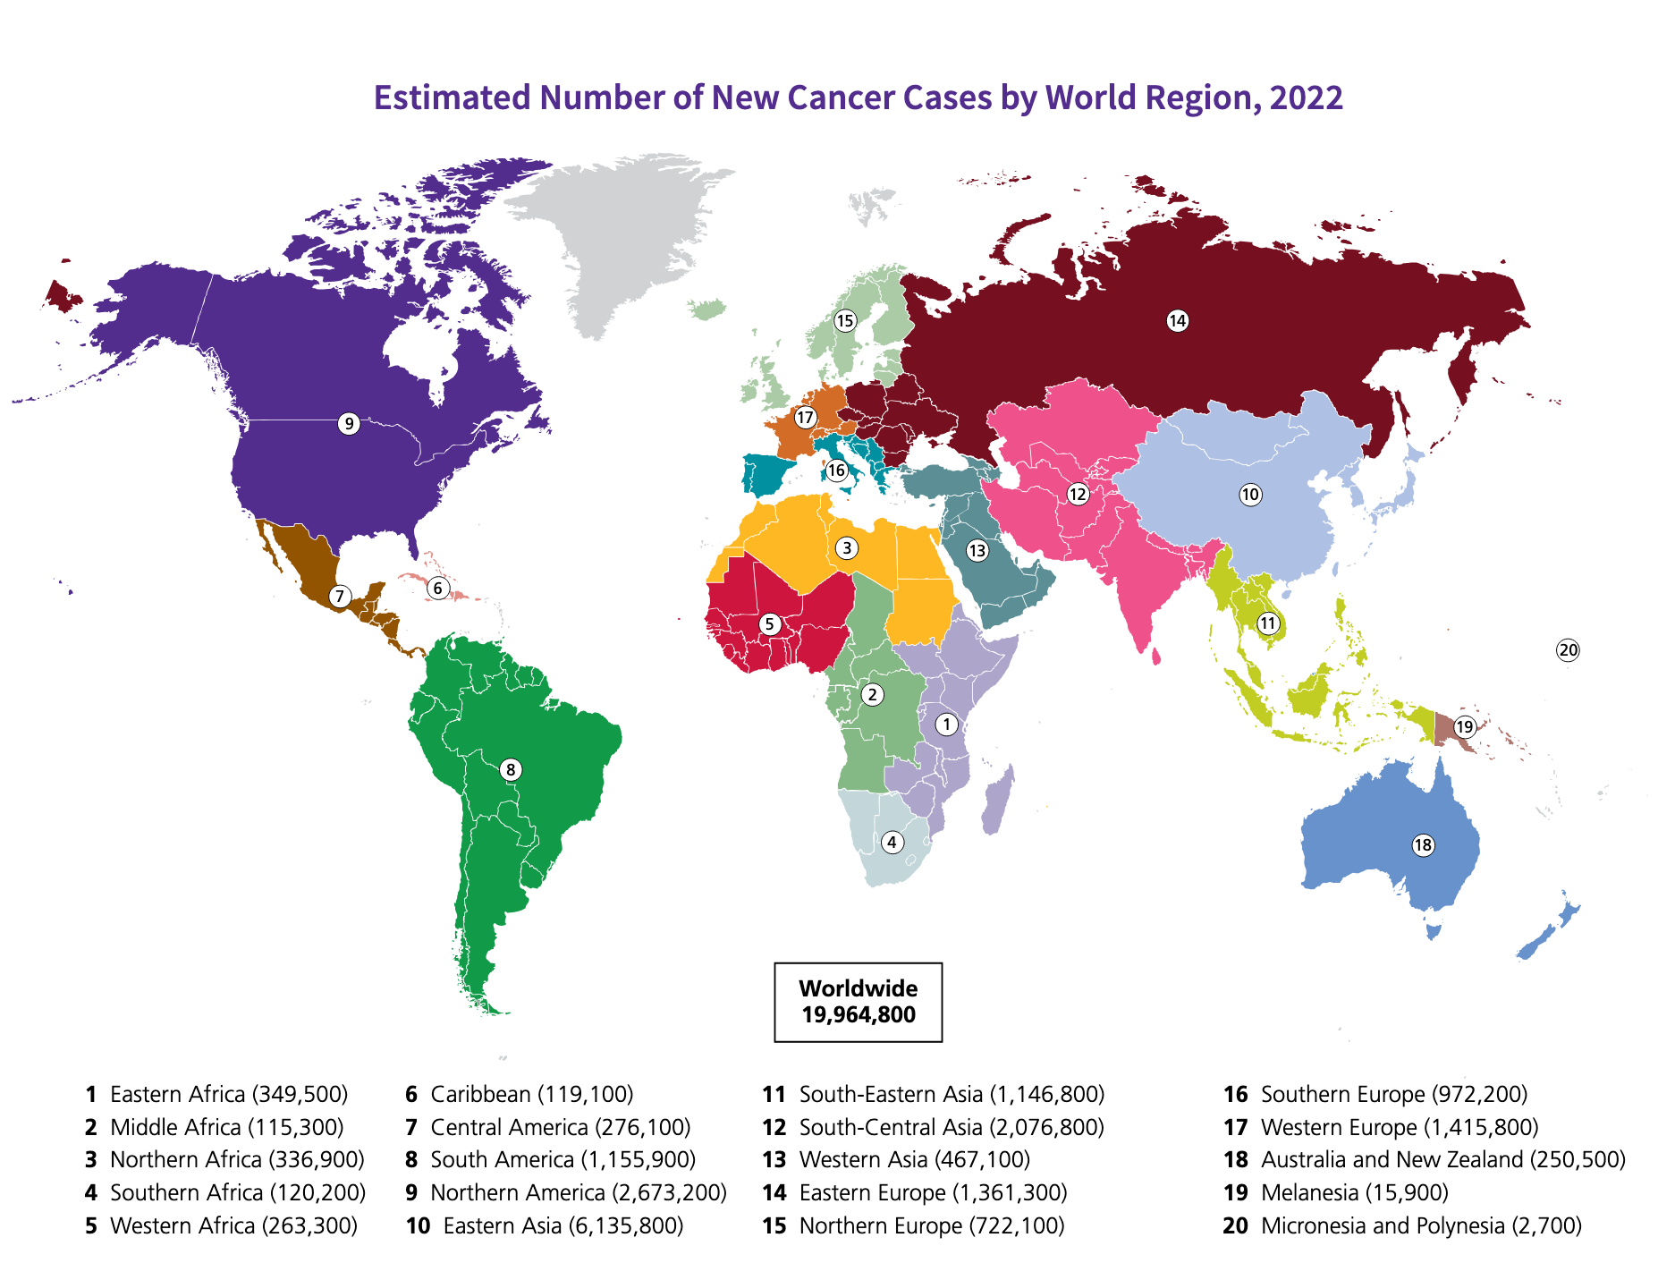
Global cancer Facts & figures
19,964,800 people were newly diagnosed with cancer in 2022
By 2025, an estimated 35 million people
will be diagnosed with cancer
Lung cancer is the most commonly diagnosed
Men: lung, prostate, colon and stomach
Female: breast, lung, colon and cervical
https://www.cancer.org/content/dam/cancer-org/research/cancer-facts-and-statistics/global-cancer-facts-and-figures/global-cancer-facts-and-figures-2024.pdf

Slide 3
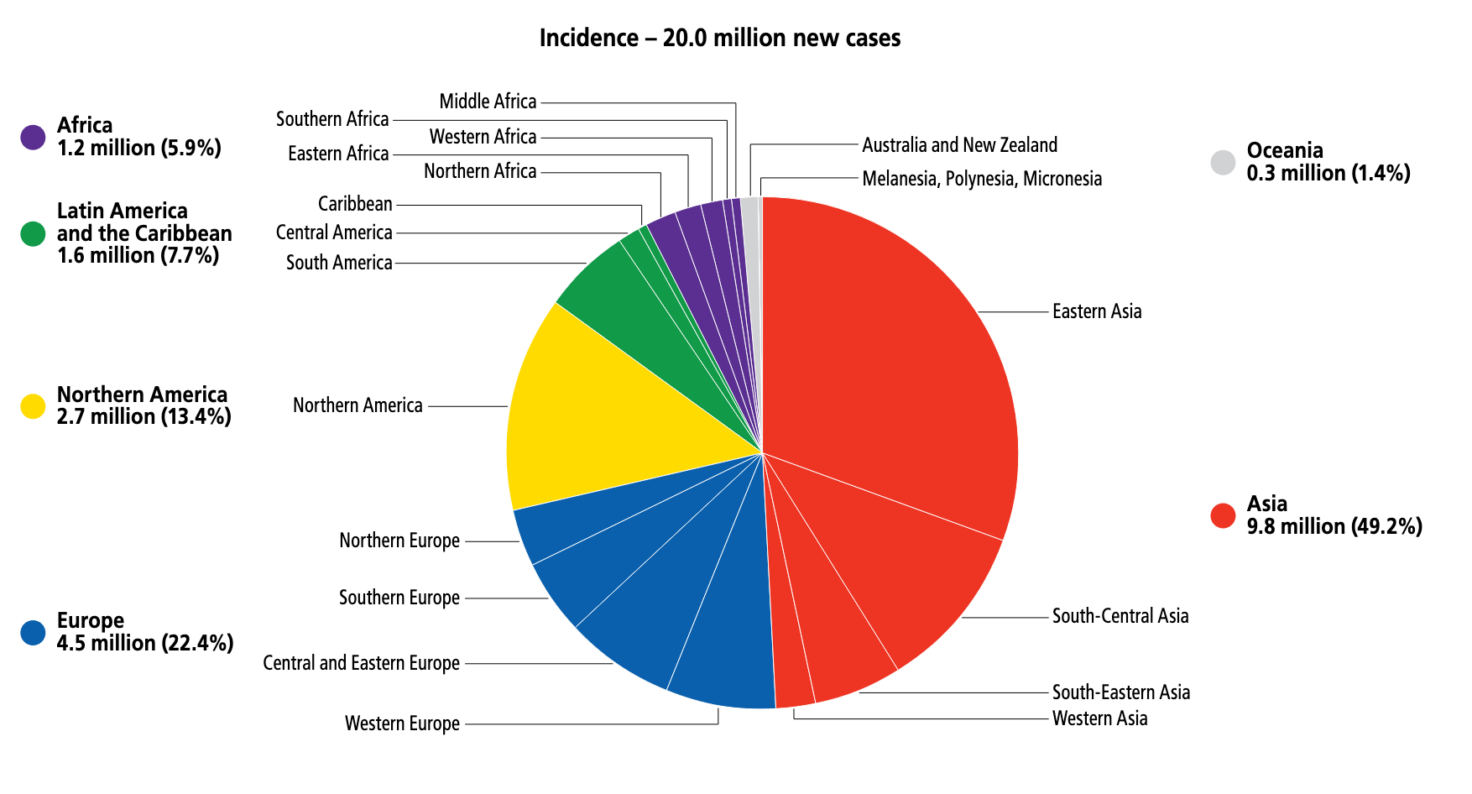
Global cancer Facts & figures

Slide 4
Global cancer Facts & figures
Higher life expectancy
Obesity
Smoking
Early diagnosis
Cancer incidence is highest in high-income countries
Why?

Slide 5
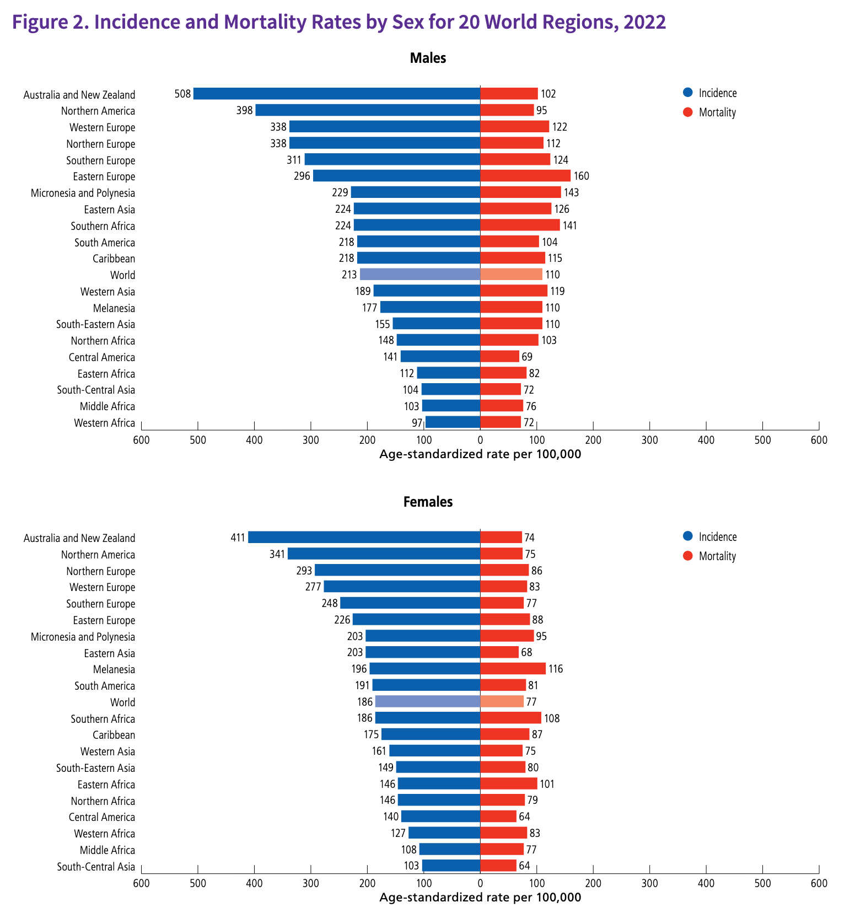
Mortality rate is high in low income countries
Increasing prevalence of risk factors
associated with economic development (e.g.,
smoking, unhealthy diet, alcohol use, obesity and
physical inactivity, and lower fertility), although
infection-related cancers (e.g., cervical cancer)
still prevail.
Cervical cancer is considered almost completely
preventable, yet it continues to be the leading
cause of cancer death in women in 37 countries,
predominantly in sub-Saharan Africa
The prevalence of lifetime cervical cancer screening
is nearly 100% in Sweden and the Netherlands
versus 4% in Ethiopia (Figure 24).
• With more than half of cancer deaths worldwide
being potentially preventable, prevention offers the
most cost-effective and sustainable strategy for
cancer control.

Slide 6
Prevention offers the most cost-effective
and a sustainable strategy for cancer control.
infection
from pathogens
Environment
Food

Slide 7
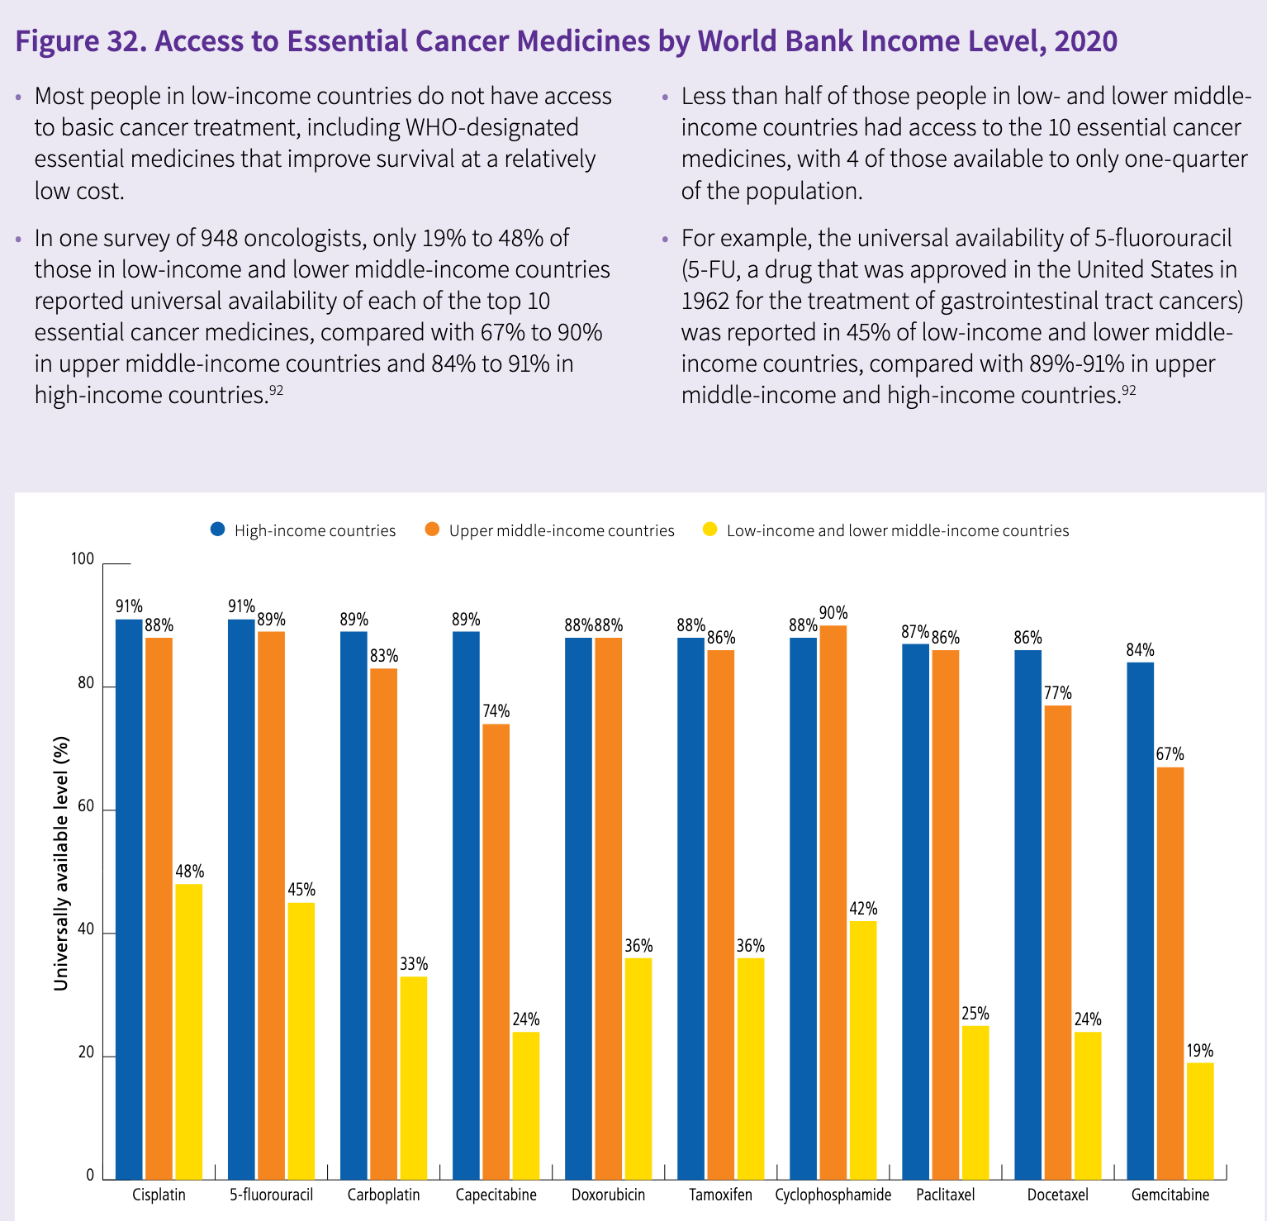

Slide 8
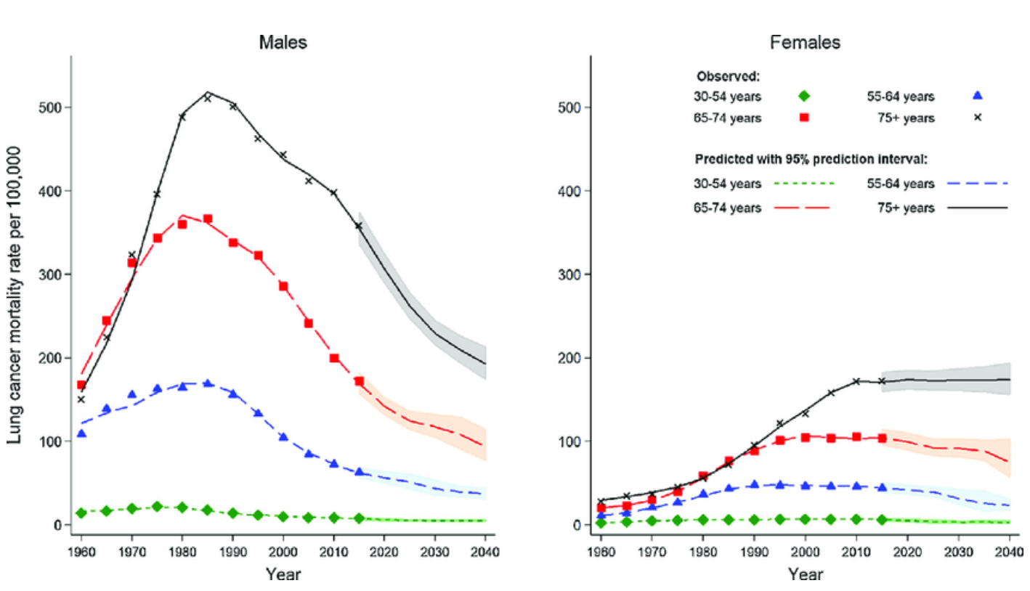
Trends for lung cancer mortality rate

Slide 9
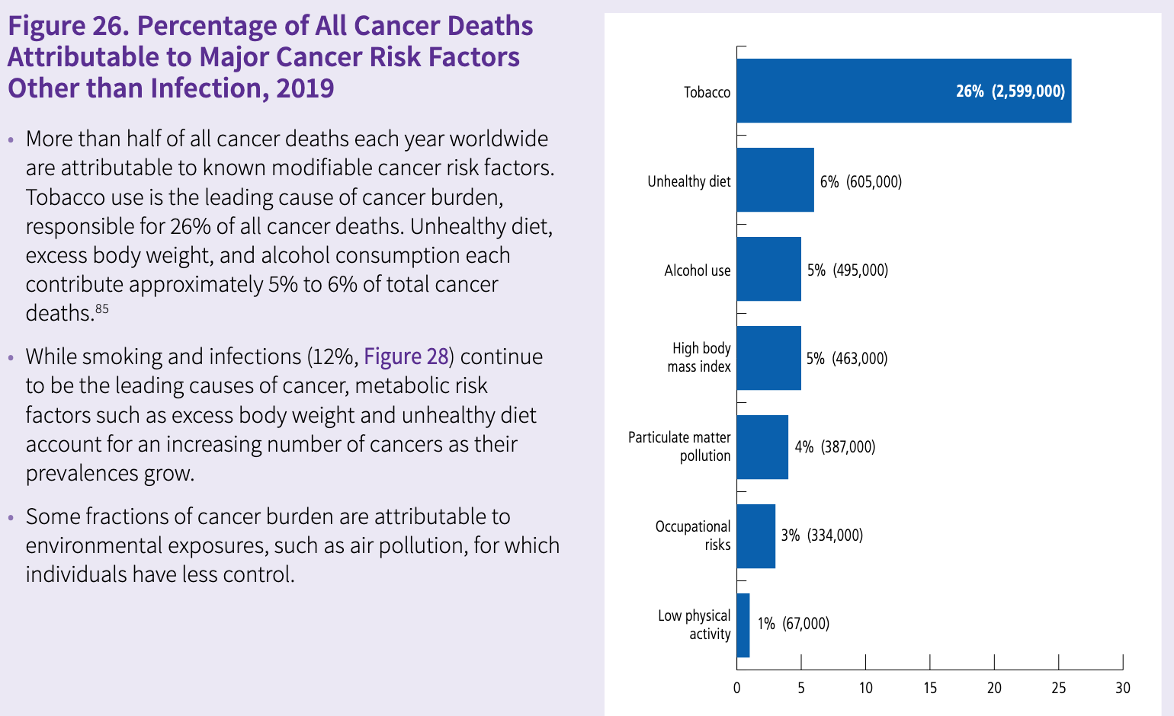
The elimination of Smoking could prevent about 1 in 4 deaths from cancer and approximately 2.6 million cancer deaths
annually

Slide 10
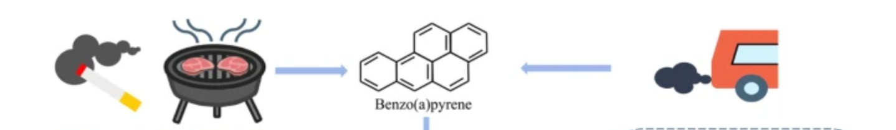
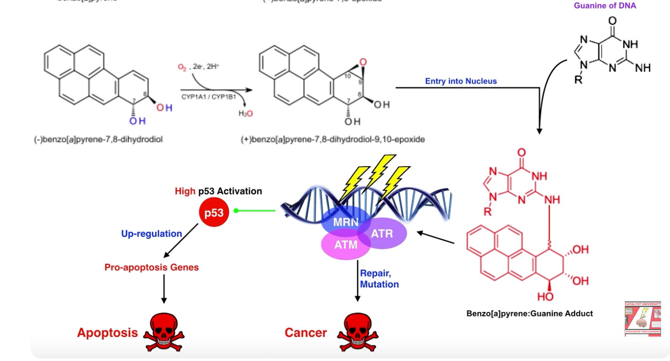
Smoking and pollution
vehicle exhaust
smocking
wood burning
Bushes fire
Active form of benzo(a) pyrene

Slide 11
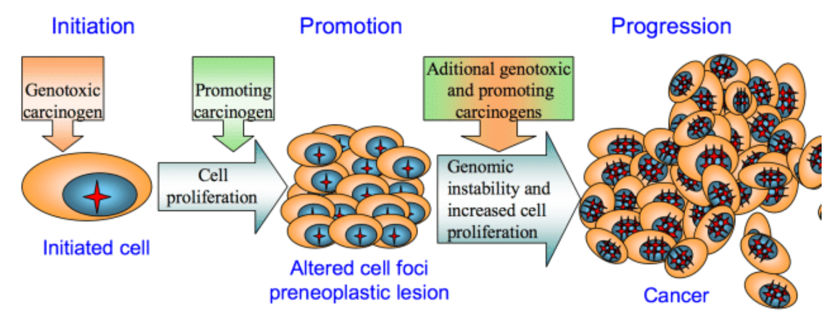
A complete understanding of how exposure to environmental substances promotes cancer is lacking
Tumorigenesis was proposed to occur in a two-step process: an initiating step that induces mutations in healthy cells,
followed by a promoter step that triggers cancer development
https://www.nature.com/articles/s41586-023-05874-3

Slide 12
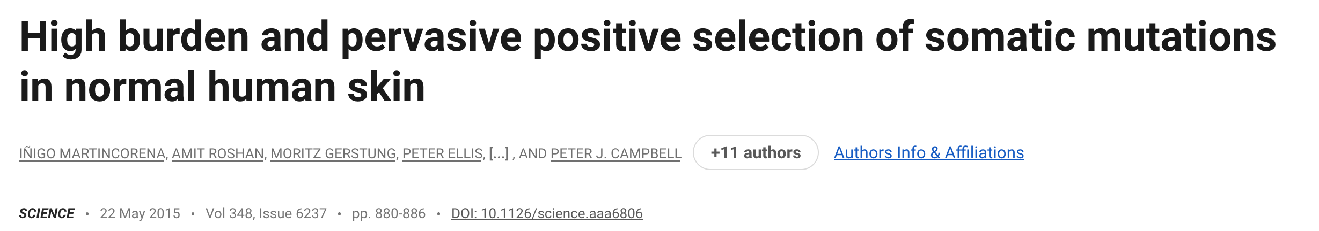
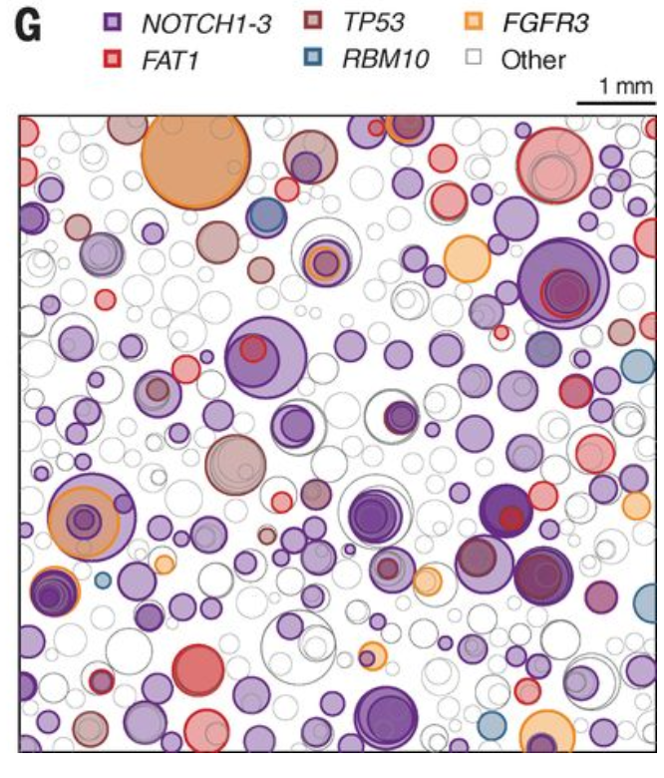
Oncogenic mutation in normal cells
Schematic representation of the mutant clones in an average 1 cm²
of normal eyelid skin.
To generate the figure, several biopsies were randomly selected
to amount to 1 cm² of sequenced skin, and all clones observed
these biopsies were represented as circles randomly distributed in space.
The density, size, and simulated nesting of clones are all based
on the sequencing data obtained in this study

Slide 13
Pollution and cancer
A pair of researchers, one in Hong Kong and one in Birmingham, United Kingdom,
studied long-term exposure to ambient fine particulate matter, a mixture of environmental pollutants that come from
transportation and power generation, among other sources.
Ambient fine particulate matter has an aerodynamic diameter of less than 2.5 micrometers and is known as PM_{2.5}.
PM_{2.5} was associated with increased risk of mortality for all causes of cancer [HR, 1.22 (95% CI, 1.11–1.34)]
and for specific cause of cancer in upper digestive tract [1.42 (1.06–1.89)],
digestive accessory organs [1.35 (1.06–1.71)] in all subjects; breast [1.80 (1.26–2.55)] in females;
and lung [1.36 (1.05–1.77)] in males
https://aacrjournals.org/cebp/article/25/5/839/71066/Cancer-Mortality-Risks-from-Long-term-Exposure-to

Slide 14
The study enrolled 66,280 residents of Hong Kong, all of whom were age 65 or older when initially recruited between 1998 and 2001.
The researchers followed the study subjects until 2011, ascertaining causes of death from Hong Kong registrations.
Annual concentrations of PM_{2.5} at their homes were estimated using data from satellites and fixed-site monitors.
After adjusting for smoking status and excluding deaths that had occurred within three years of the baseline to control for competing diseases, the study showed that for every 10 microgram per cubic meter (µg/m3) of increased exposure to PM_{2.5}, risk of dying from any cancer rose by 22 percent.
For cancers of the upper digestive tract, the mortality risk was 42 percent higher.
For cancers of the accessory digestive organs, which include the liver, bile ducts, gall bladder, and pancreas, the mortality risk was 35 percent higher.
For breast cancer, the mortality risk was 80 percent higher.
And for lung cancer, the mortality risk was 36 percent higher. All figures are per 10 µg/m3 increased exposure to PM_{2.5}.
Pollution might spark defects in DNA repair function, alterations in the body’s immune response, or inflammation that triggers angiogenesis, the growth of new blood vessels that allows tumors to spread.
In the case of the digestive organs, pollution could affect gut microbiota and influence the development of cancer, they said.
“The implications for other similar cities around the world are that PM_{2.5} must be reduced as much and as fast as possible,” he said. “Air pollution remains a clear, modifiable public health concern.”
Dr. Thach cautioned that pollution is just one risk factor for cancer, and others, such as diet and exercise, may be more significant and more modifiable risk factors.

Slide 15
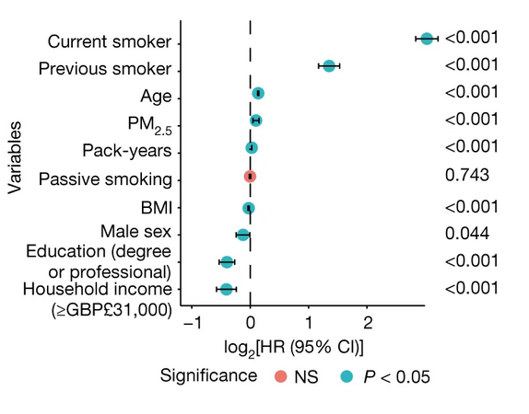
Environmental particles and lung cancer
environmental particulate matter measuring ≤2.5 μm (PM_{2.5}), known to be associated with lung cancer risk,
promotes lung cancer by acting on cells that harbour
pre-existing oncogenic mutations in healthy lung tissue.
Focusing on EGFR-driven lung cancer, which is more common in never-smokers or light smokers,
we found a significant association between PM_{2.5} levels and the incidence of lung cancer
for 32,957 EGFR-driven lung cancer cases in four within-country cohorts.

Slide 16
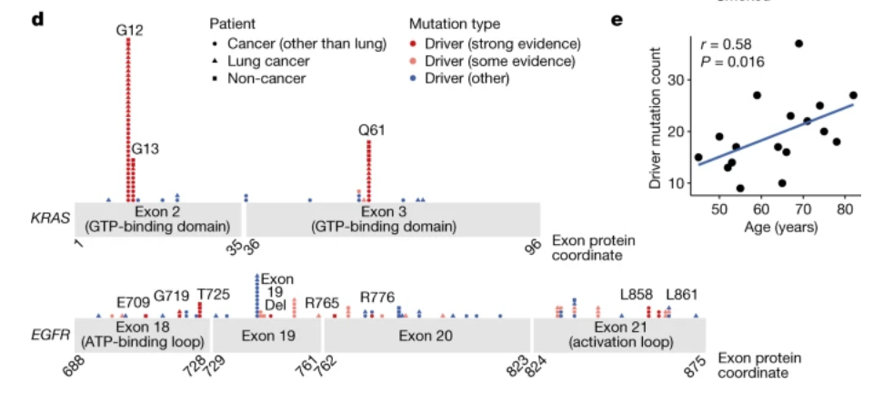
Ultradeep mutational profiling of histologically normal lung tissue from 295 individuals across 3 clinical cohorts revealed
oncogenic EGFR and KRAS driver mutations in 18% and 53% of healthy tissue samples, respectively.
These findings collectively support a tumour-promoting role for PM_{2.5} air pollutants
and provide impetus for public health policy initiatives to address air pollution to reduce disease burden.

Slide 17
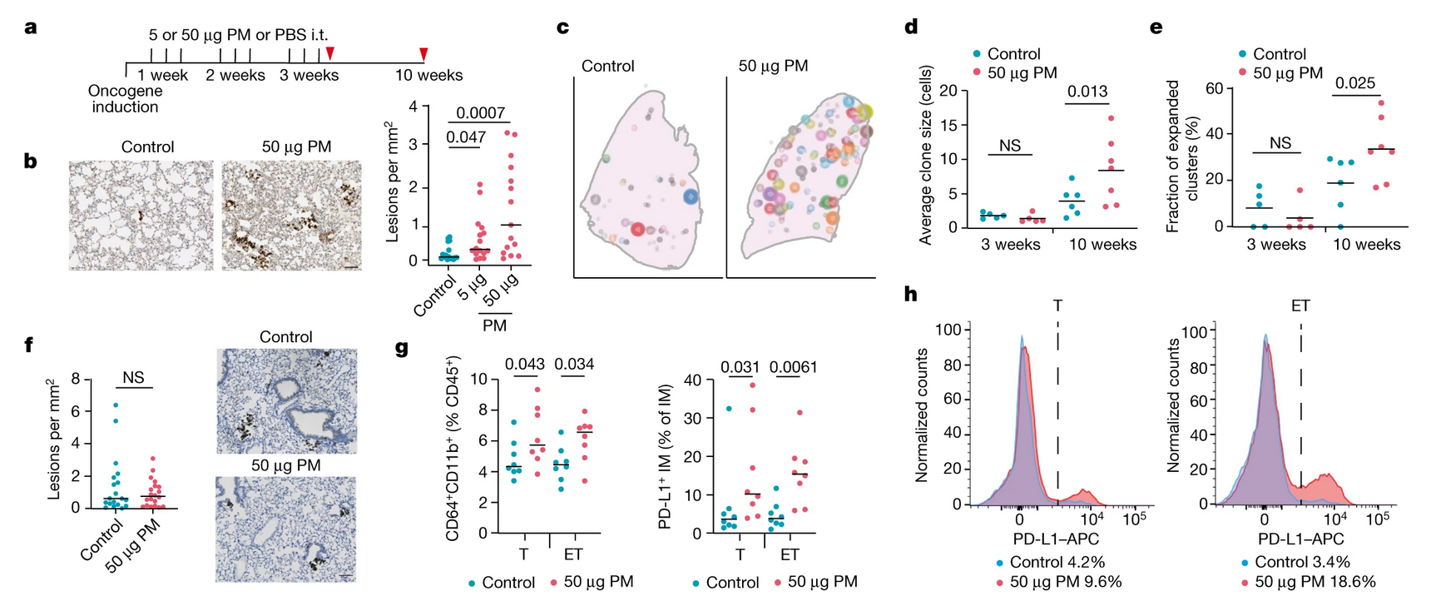
Functional mouse models revealed that air pollutants cause an influx of macrophages into the lung and the release
of interleukin-1β. This process results in a progenitor-like cell state within EGFR mutant lung alveolar type II epithelial cells
that fuels tumorigenesis.

Slide 18
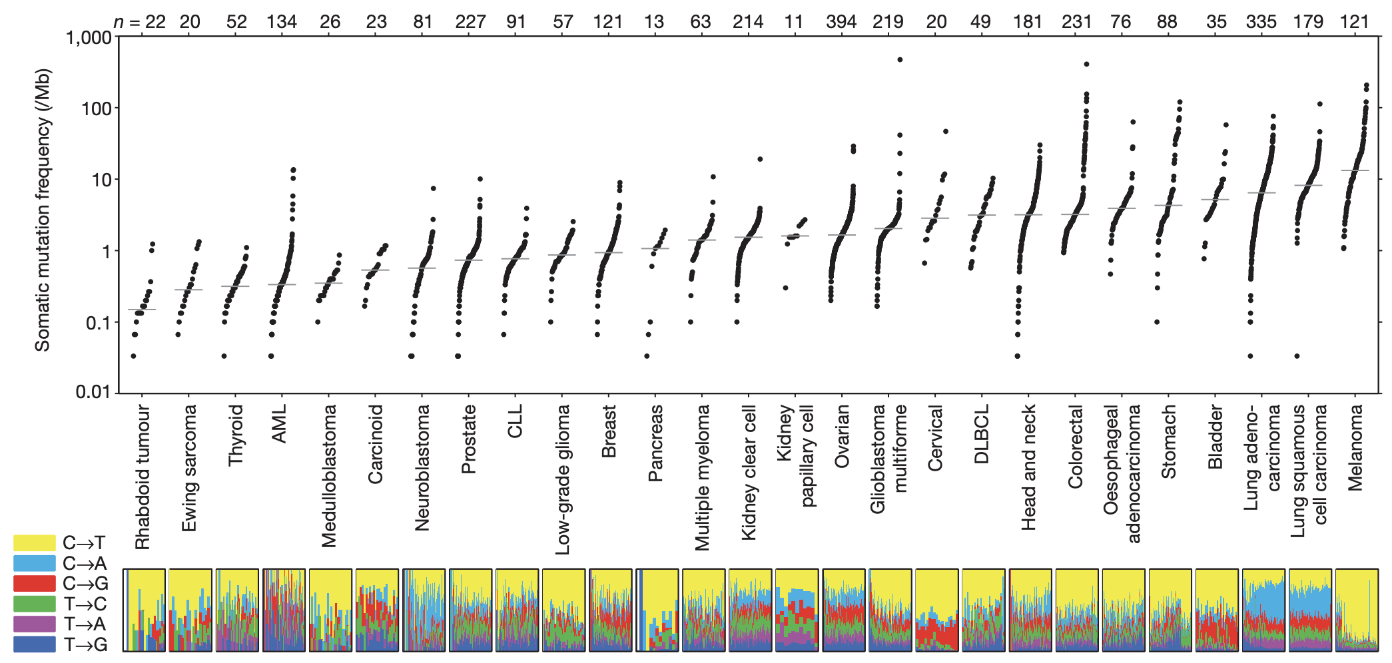
Cancer cells are full of mutations
(Whole
exome seq.)
# of mutations per Mb
(Lawrence et al, Nature 2013)

Slide 19
Cancer cells are full of mutations
(WES)
# of mutations per Mb
1
1 → 1/Mb * 3000Mb ~ 3000 mutations
2% are coding sequences → ~60 mutations in gene sequences
(Lawrence et al, Nature 2013)

Slide 20
Cancer cells are full of mutations
Young patients / pediatric diseases
(WES)
# of mutations per Mb
1
Low mutation rate
1 → 1/Mb * 3000Mb ~ 3000 mutations
2% are coding sequences → ~60 mutations in gene sequences
(Lawrence et al, Nature 2013)

Slide 21
Cancer cells are full of mutations
Young patients / pediatric diseases
(WES)
# of mutations per Mb
1
Low mutation rate
High Mutation Rate
Why a difference between tumor that develops in children vs the one that develop in adults?
(Lawrence et al, Nature 2013)

Slide 22
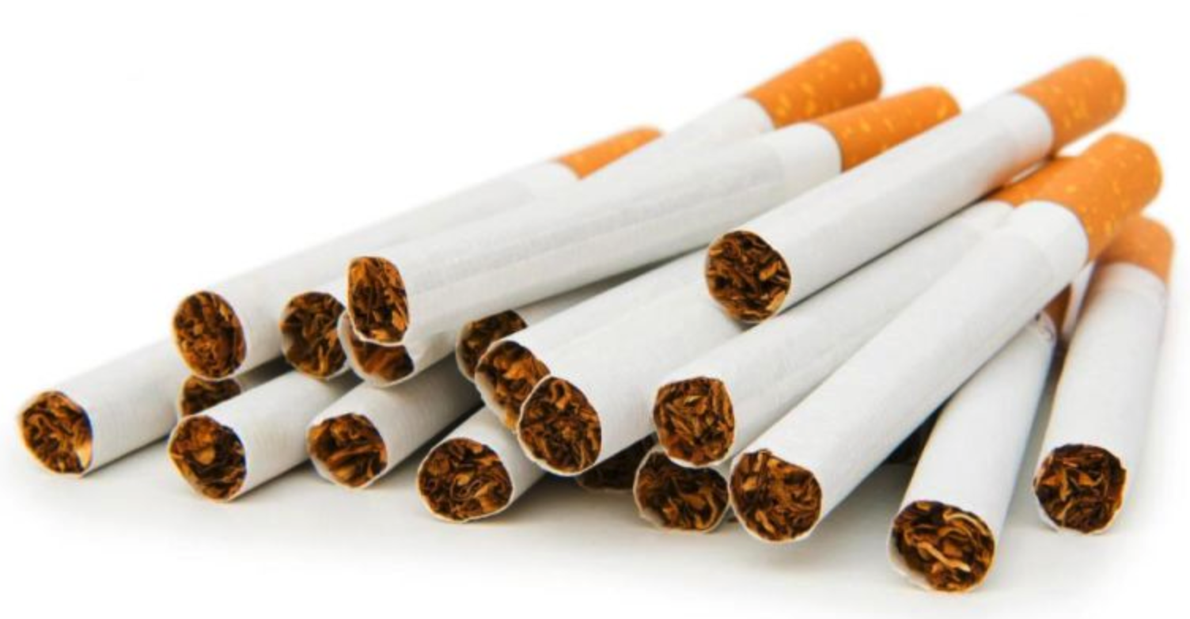

Cancer cells are full of mutations
Exogenous
Mutagens
(WES)
# of mutations per Mb
1
High Mutation Rate
(Lawrence et al, Nature 2013)

Slide 23
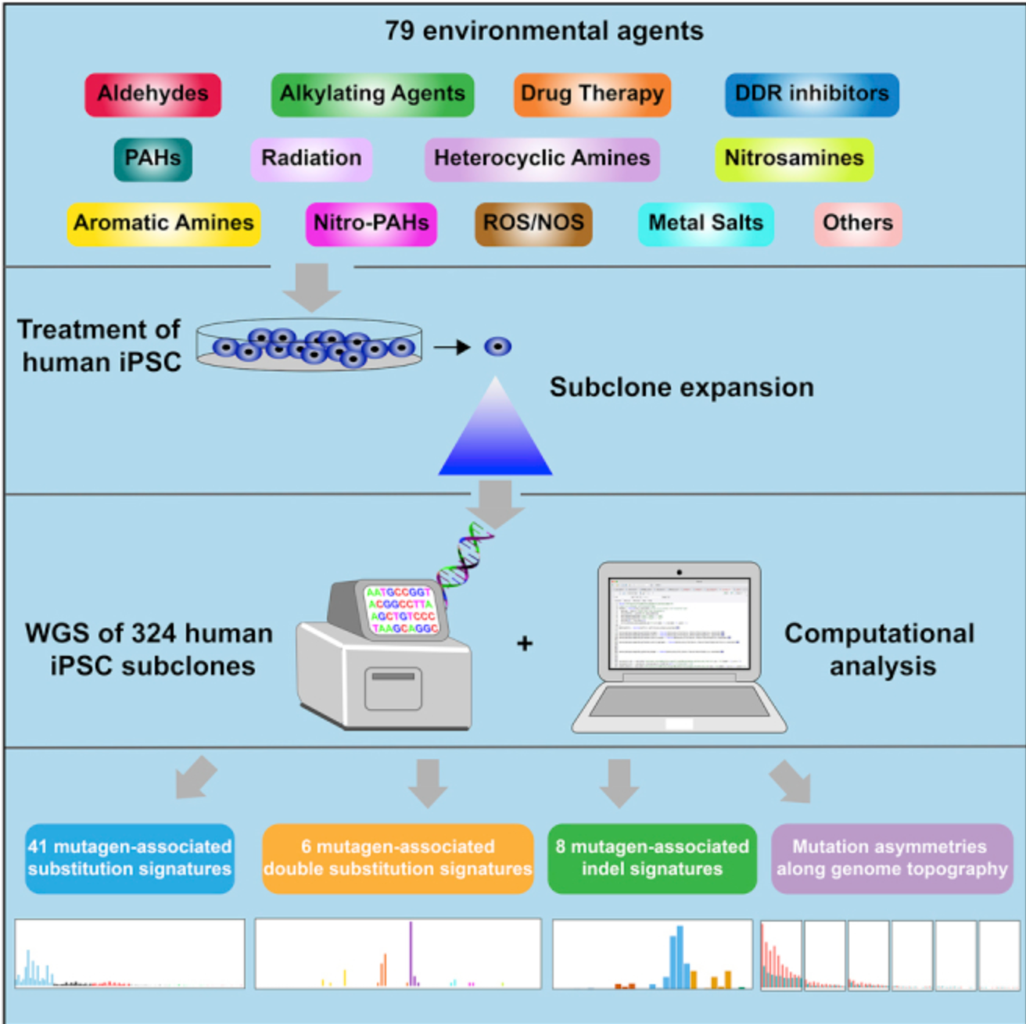
Mutational signatures of environmental agents
Test 79 chemical compounds to understand their
Effect on the DNA
https://pmc.ncbi.nlm.nih.gov/articles/PMC6506336/

Slide 24
Aldehydes
Alkylating Agent
Air pollution:
Aldehydes are significant air pollutants emitted from sources such as vehicle exhaust, industrial activities, and the combustion of fuels.
Tobacco smoke:
Both traditional and e-cigarettes expose people to aldehydes.
Household and consumer products:
Aldehydes are used as preservatives and can be found in cosmetics, hand sanitizers, and many building materials, furniture, and textiles.
Industrial processes:
They are released during various industrial activities, including the production of chemicals and plastics.
Anti-neoplastic drug, chemotherapies
These pharmaceuticals, known as antineoplastic agents, enter the aquatic environment via human excretion and wastewater
The antineoplastics most frequently detected in the environment included cyclophosphamide, ifosfamide, tamoxifen, methotrexate, and 5-fluorouracil; all were detectable in multiple water sources, including effluent and surface waters

Slide 25
Cancer: Mutational Signatures
Whole genome sequencing of 1000 different tumor
(WES)
# of mutations per Mb
What type
of mutations?
(Lawrence et al, Nature 2013)

Slide 26
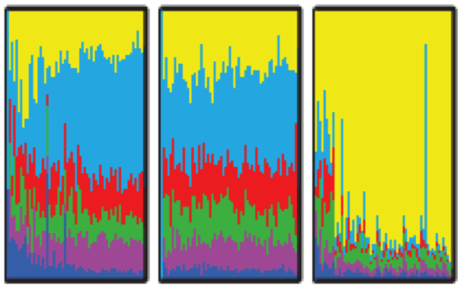
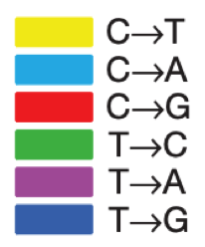
Mutational Signatures
Lung
Adenocarcinoma
Lung squamous
cell carcinoma
Skin melanoma
(Lawrence et al, Nature 2013)

Slide 27
Mutational Signatures
C → A
C → T
Lung
Adenocarcinoma
Lung squamous
cell carcinoma
Skin melanoma
(Lawrence et al, Nature 2013)

Slide 28
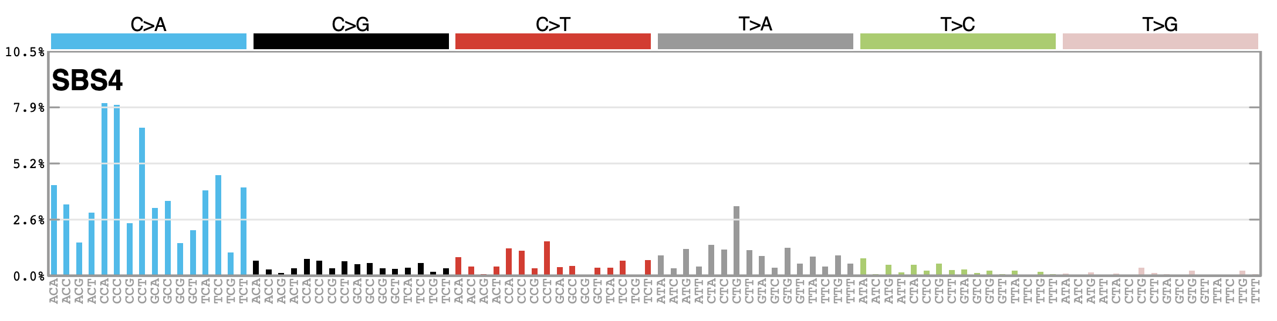
Mutational Signatures
C > A
Which nucleotide is before the mutated one
? C ?
Which nucleotide is after the mutated one
>
? A ?

Slide 29
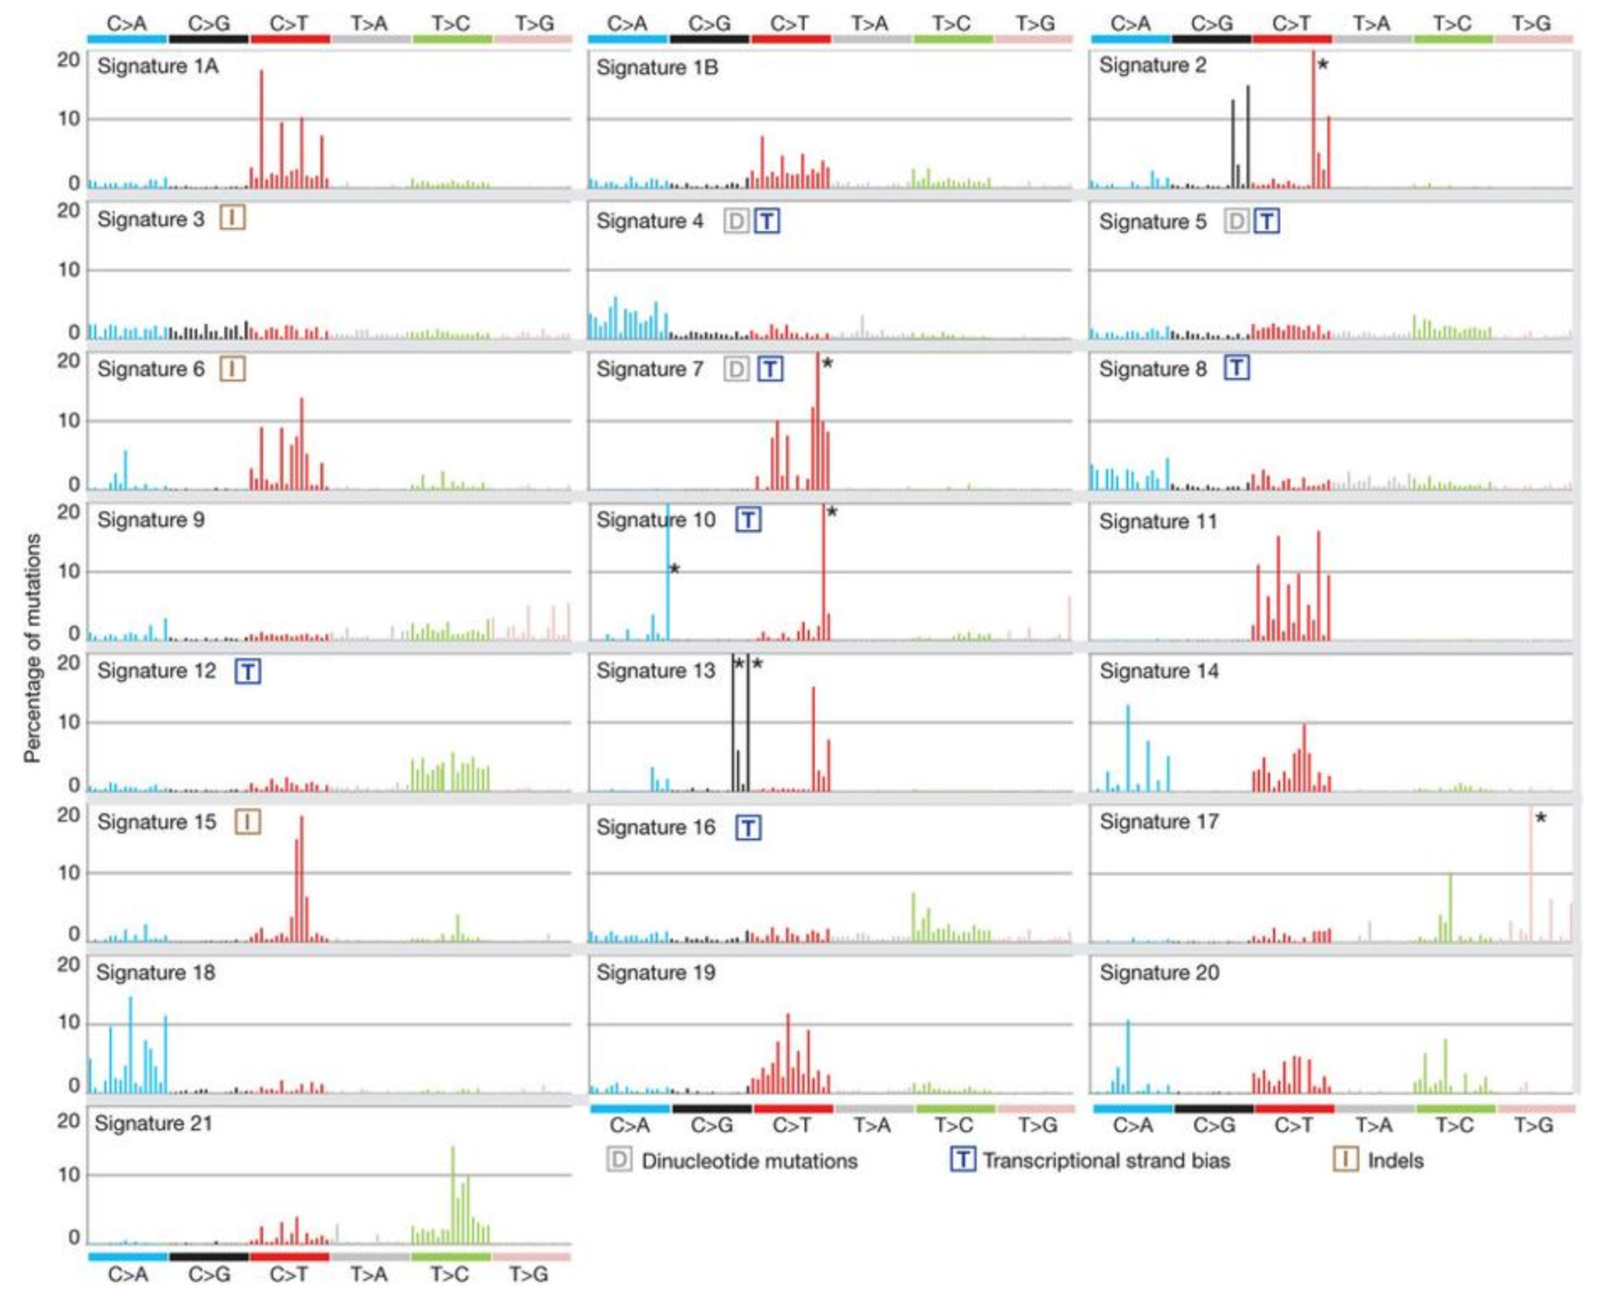
Mutational Signatures
Spontaneous
De-amination
(defective base
excision repair)
Tobacco
smoking
(Alexandrov et al., Nature 2013)

Slide 30
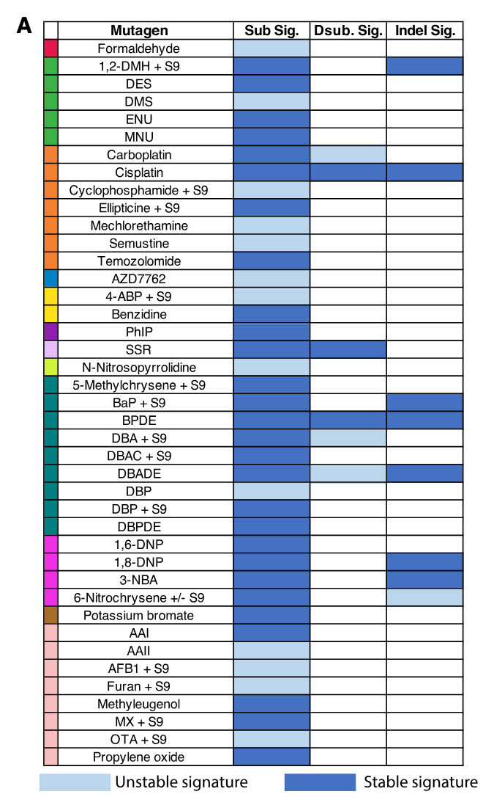
41 out of 79 compounds tested induce a mutational signature similar to what has been observed in tumors

Slide 31
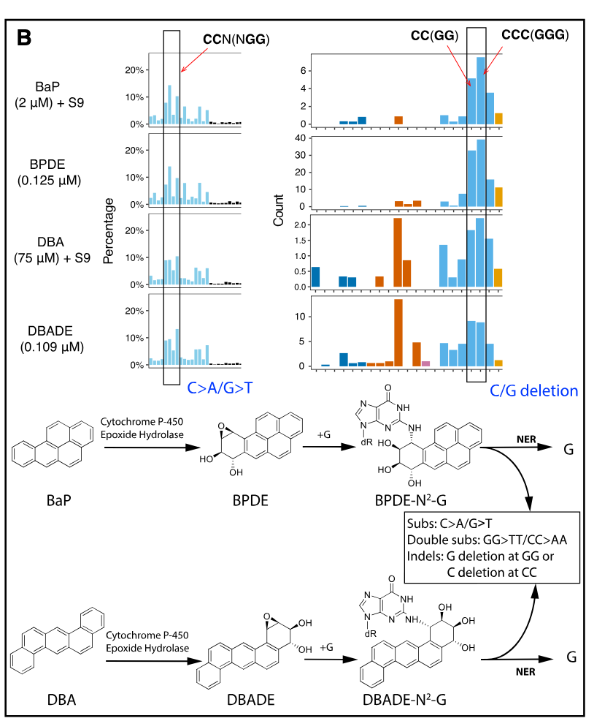
Mutational signatures with BaP
(benzopyrene)
PAHs are considered to be among the most significant
mutagenic components of tobacco smoke
Polycyclic Aromatic Hydrocarbons, a group of
chemicals formed by the incomplete combustion of organic material,
including tobacco leaves

Slide 32
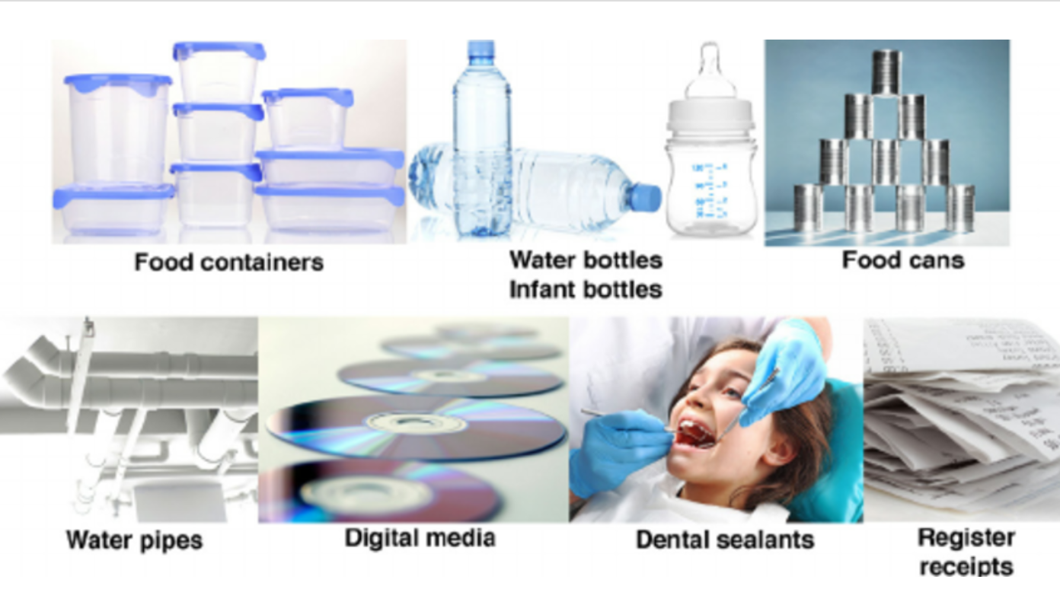
Hormone dependent cancer and bisphenols
Bisphenol A (BPA) is linked to cancer because it is an endocrine disruptor that can mimic estrogen,
potentially increasing the risk of hormone-sensitive cancers like breast, ovarian, and prostate cancer.

Slide 33
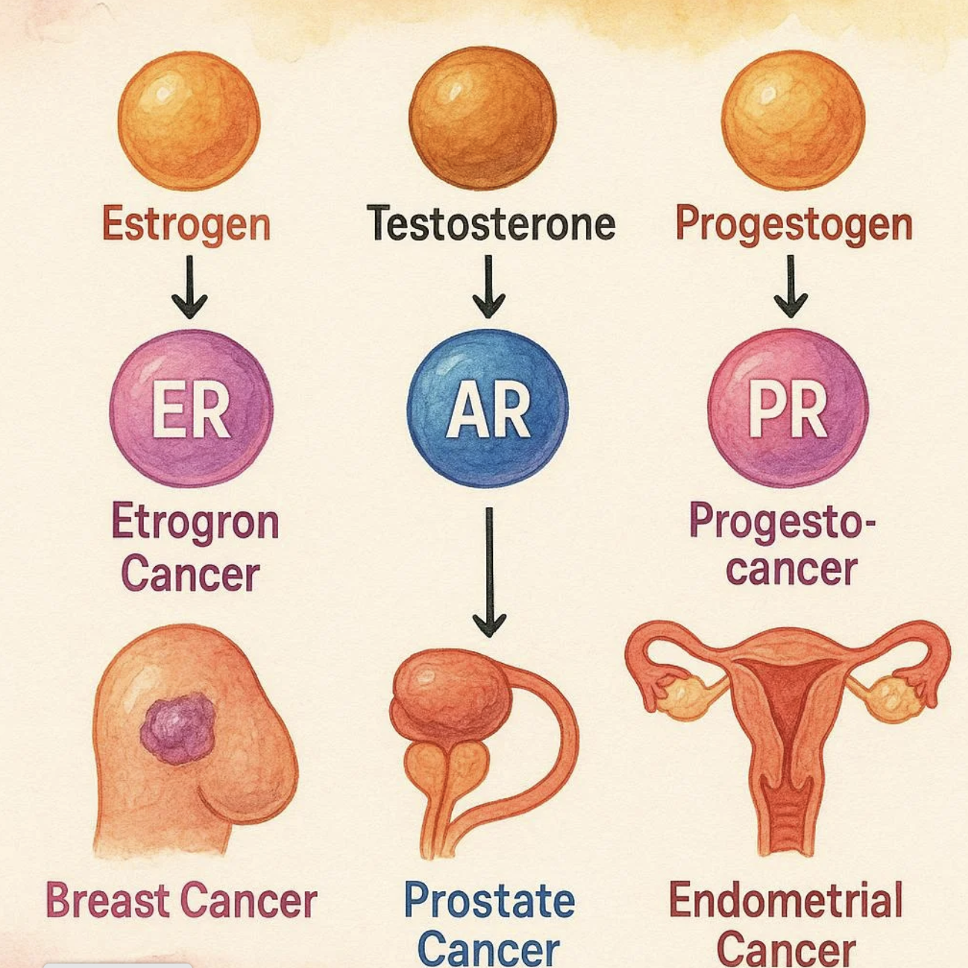
Hormone dependent cancer

Slide 34
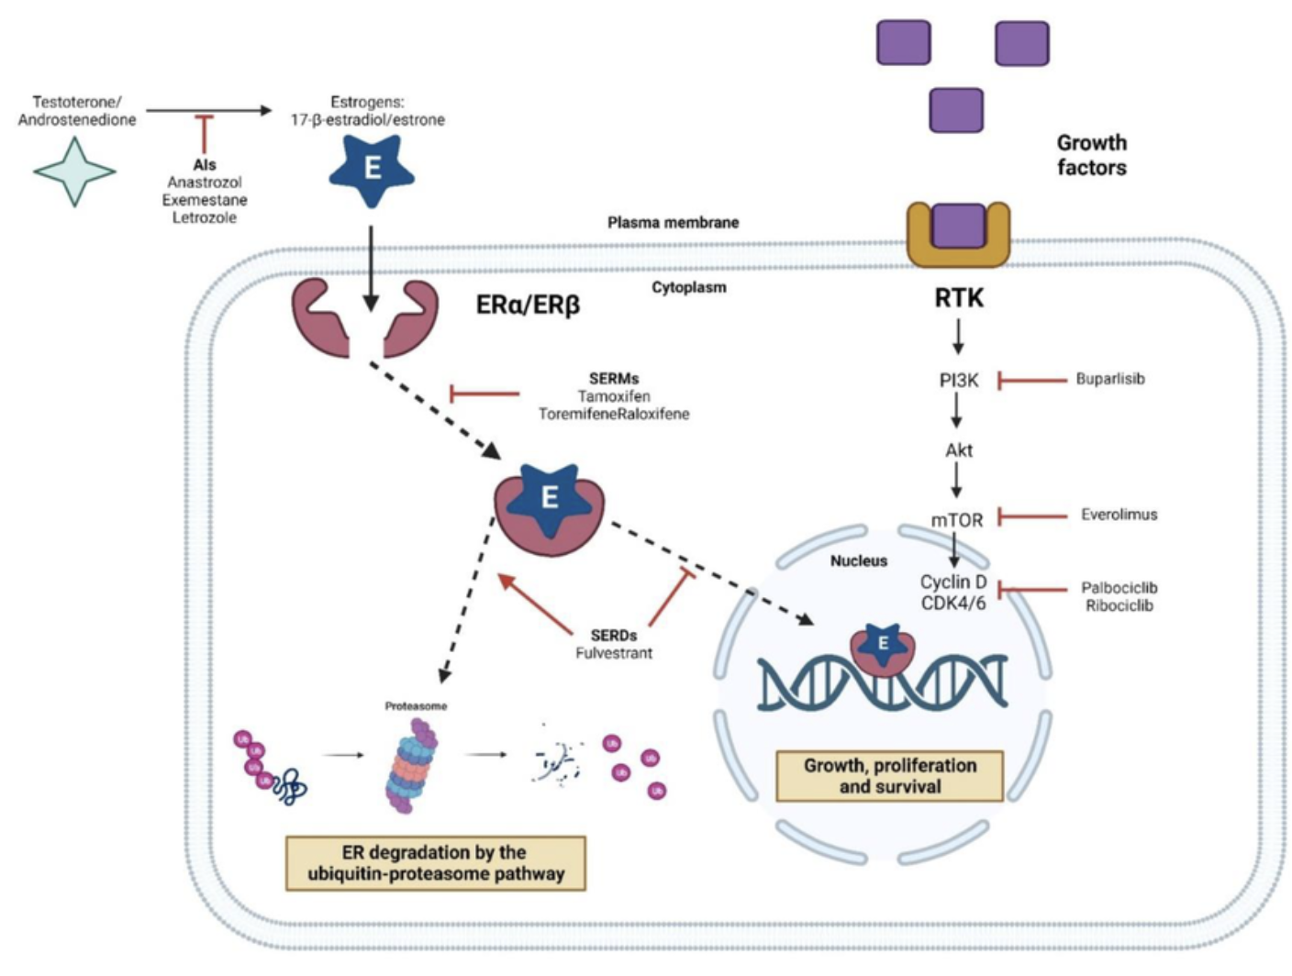
Hormone activity cancer

Slide 35
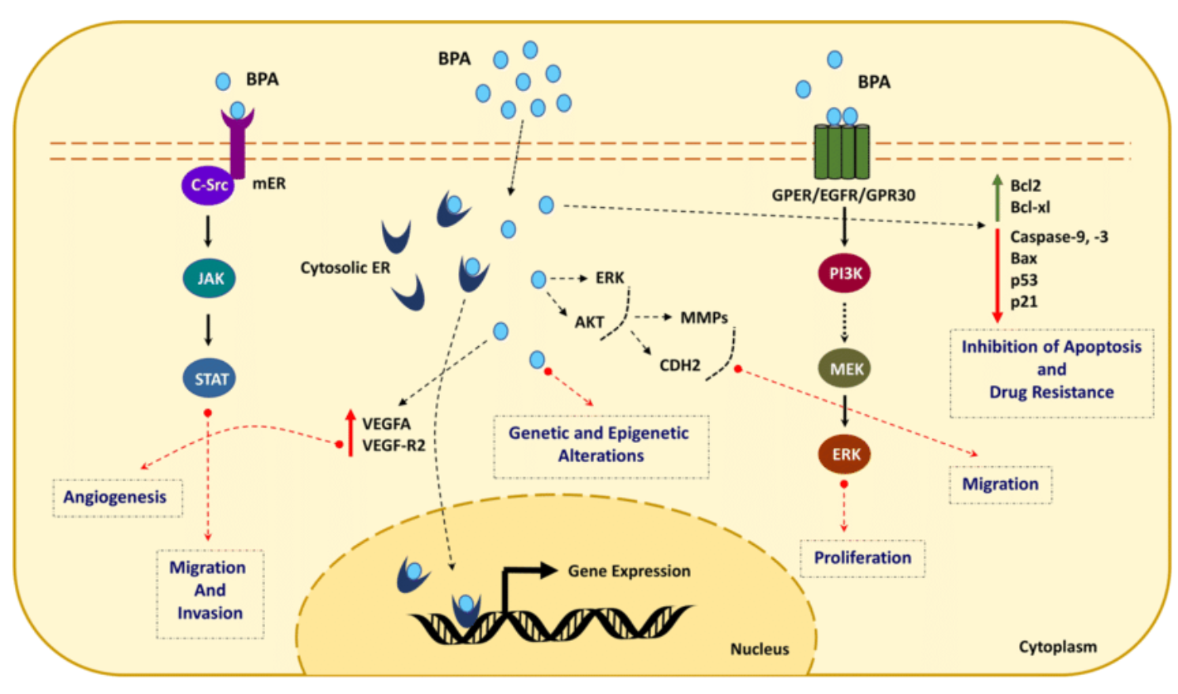
Hormone dependent cancer and bisphenols
Bisphenol A (BPA) is linked to cancer because it is an endocrine disruptor that can mimic estrogen,
potentially increasing the risk of hormone-sensitive cancers like breast, ovarian, and prostate cancer.

Slide 36
Prevention offers the most cost-effective
and a sustainable strategy for cancer control.
infection
from pathogens
Environment
Food

Slide 37
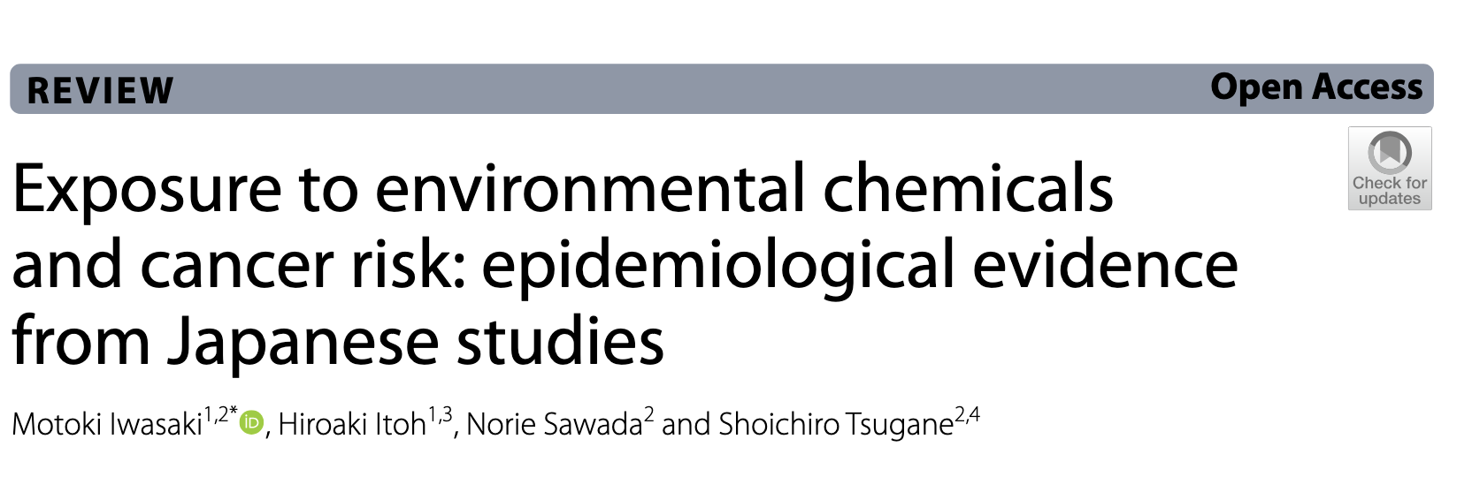
we reviewed epidemiological evidence on cancer risk and exposure to dichlorodiphenyltrichloroethane (DDT),
hexachlorocyclohexane (HCH), polychlorinated biphenyls (PCBs),
per- and polyfluoroalkyl substances (PFASs), cadmium, arsenic, and acrylamide.
Japanese are widely exposed to these chemicals, mainly through the diet and an association with increased cancer risk
is suspected
https://pmc.ncbi.nlm.nih.gov/articles/PMC10031963/

Slide 38
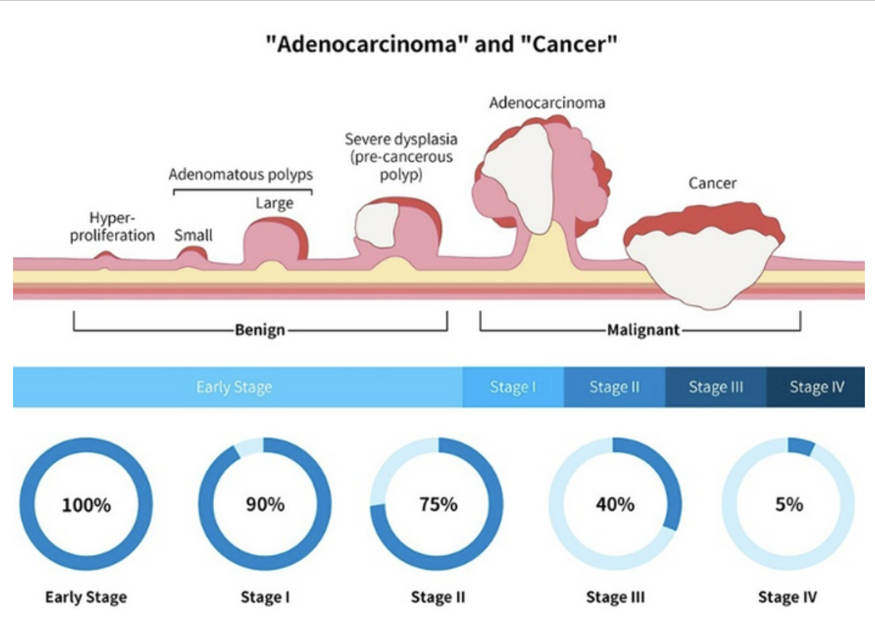
Colon cancer evolution

Slide 39
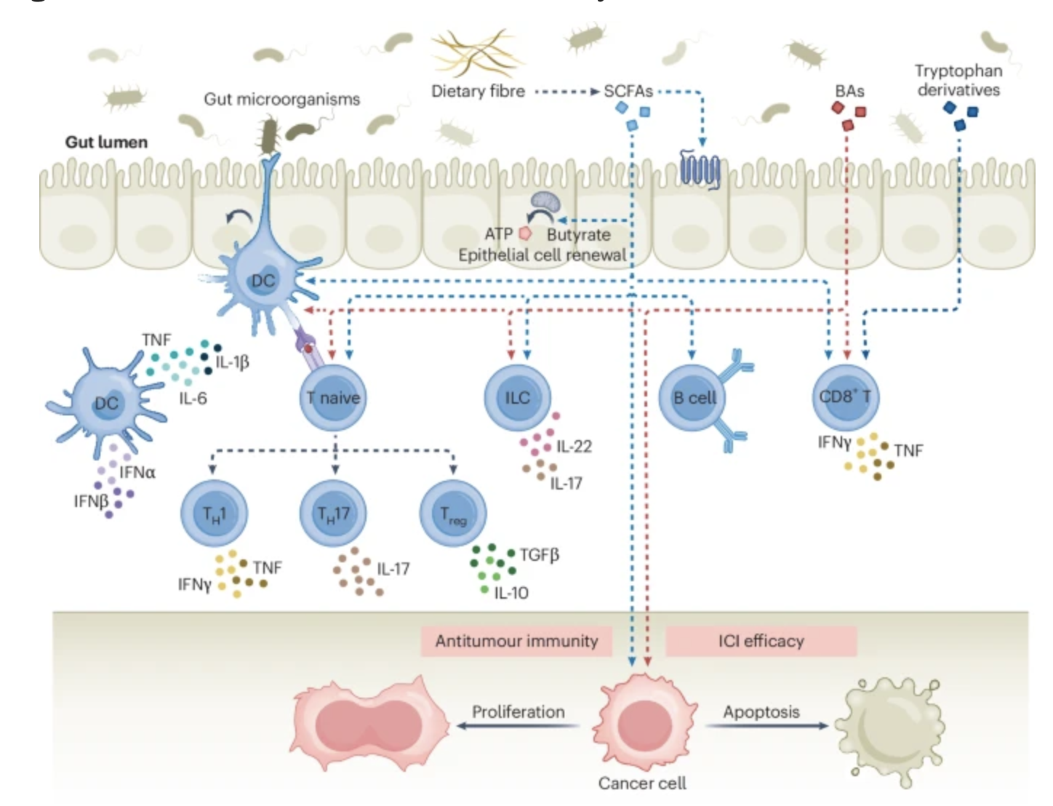
Colon cancer and microbiota

Slide 40
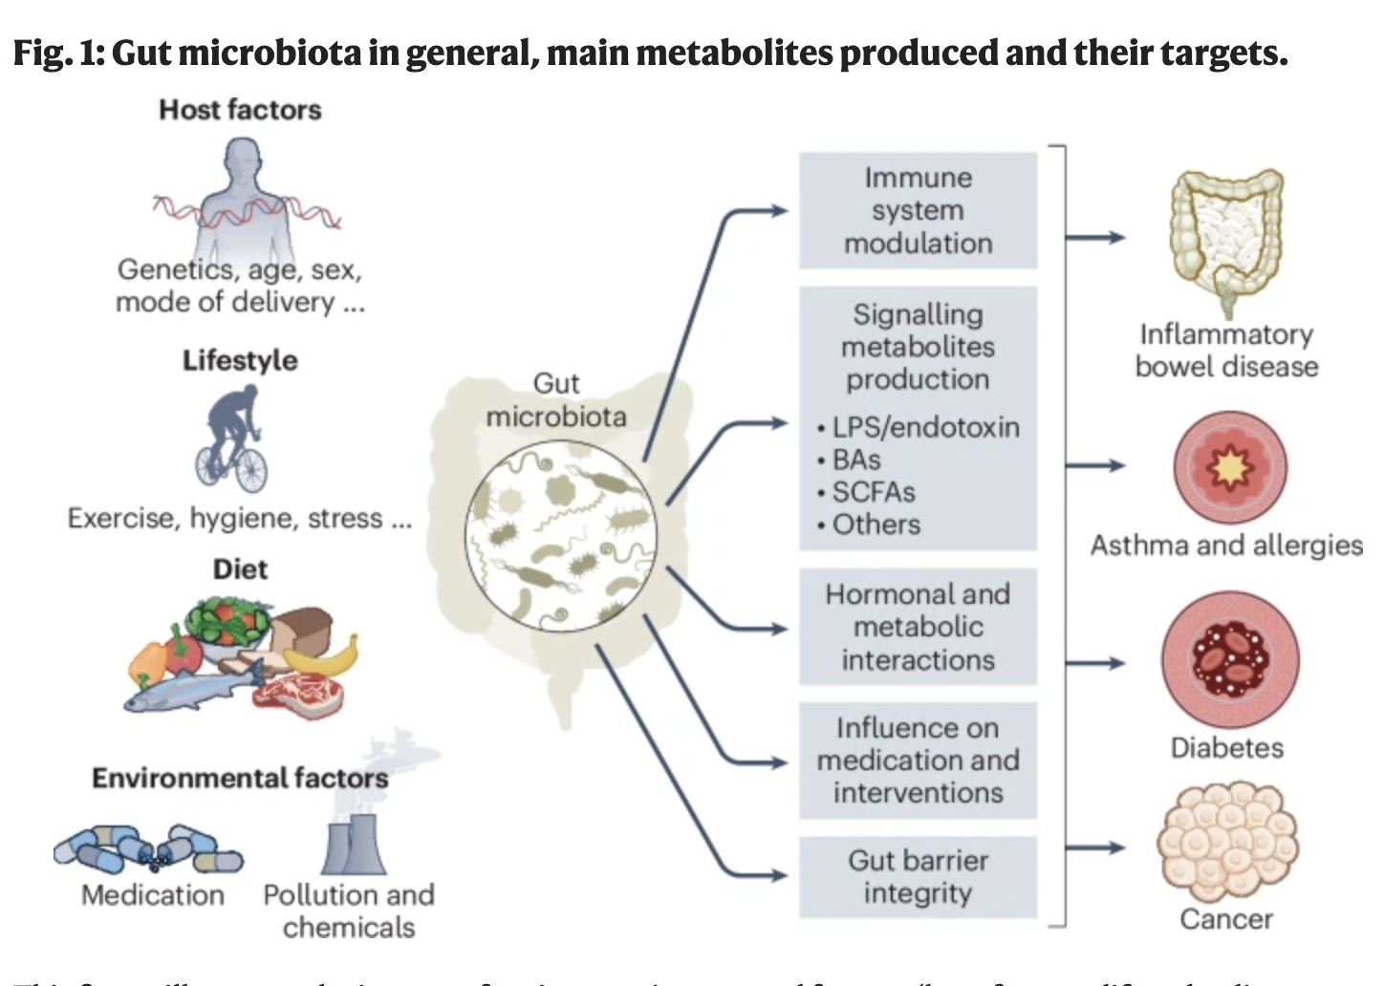
Colon cancer and microbiota

Slide 41
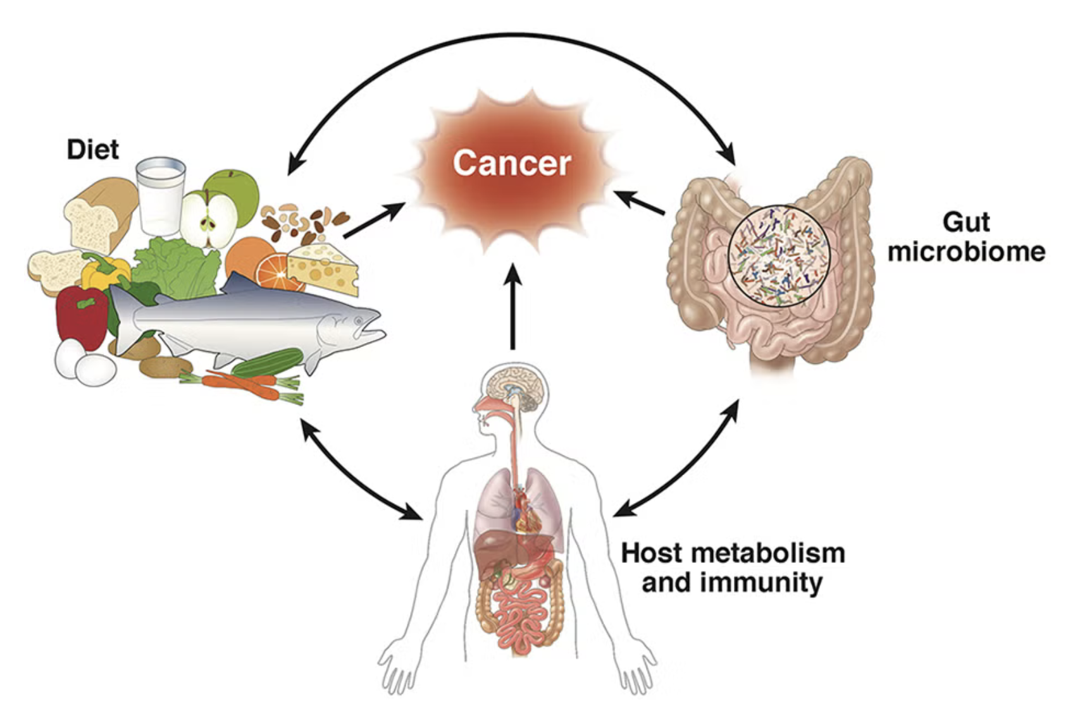
Colon cancer and microbiota

Slide 42


Cancer metabolism
Cancer cells have a different diet compare to the normal cells

Slide 43
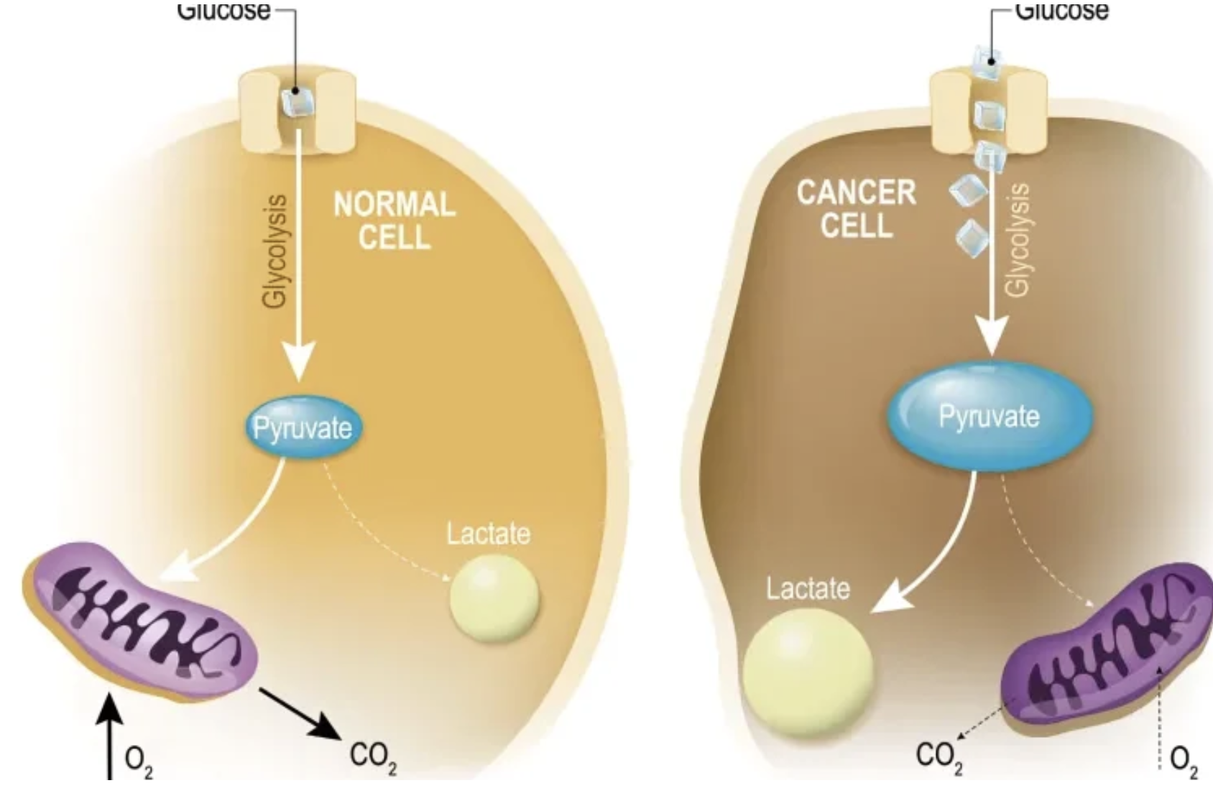
Cancer metabolism
High glucose
assumption
Normal glucose
metabolism

Slide 44

What type of diet?

Slide 45
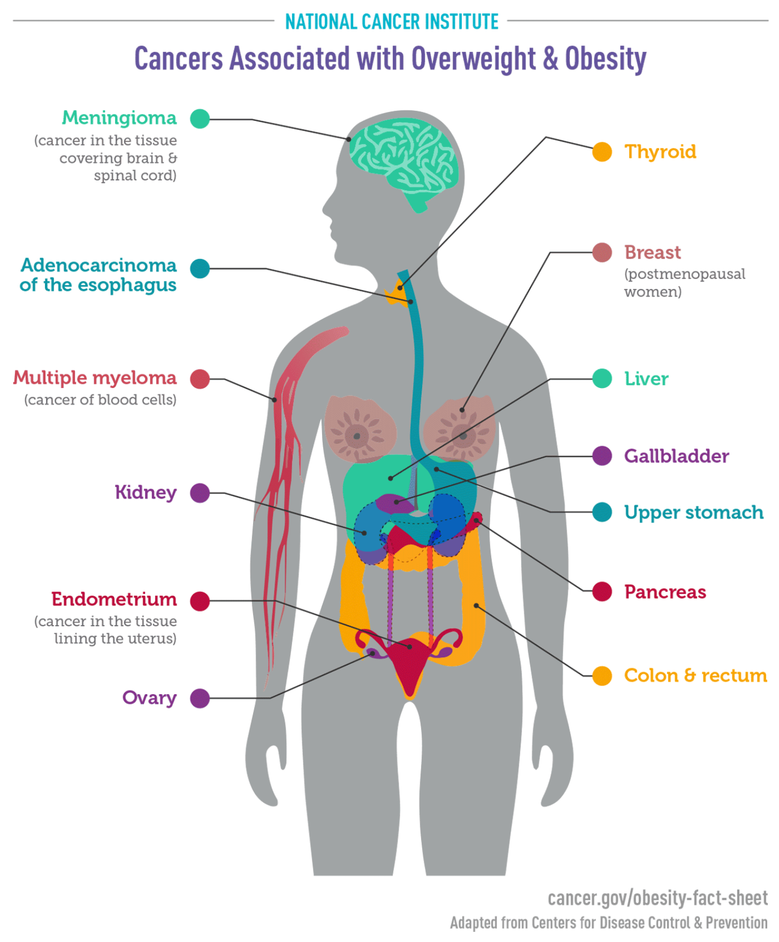
Cancer and obesity
Fat cells produce hormones which can stimulate cell growth
People with obesity often have increased blood levels of
insulin and insulin-like growth factor-1 (IGF-1).
High levels of insulin, a condition known as hyperinsulinemia, is due
to insulin resistance and precede the development of type 2 diabetes,
another known cancer risk factor.
High levels of insulin and IGF-1 are associated with increased risks of
colorectal, thyroid, breast, prostate, ovarian, and endometrial cancers
Weight loss through medications approved to treat obesity
(including the GLP-1 receptor agonists)
has also been found to be associated
with reduced risks of some obesity-related cancers.

Slide 46

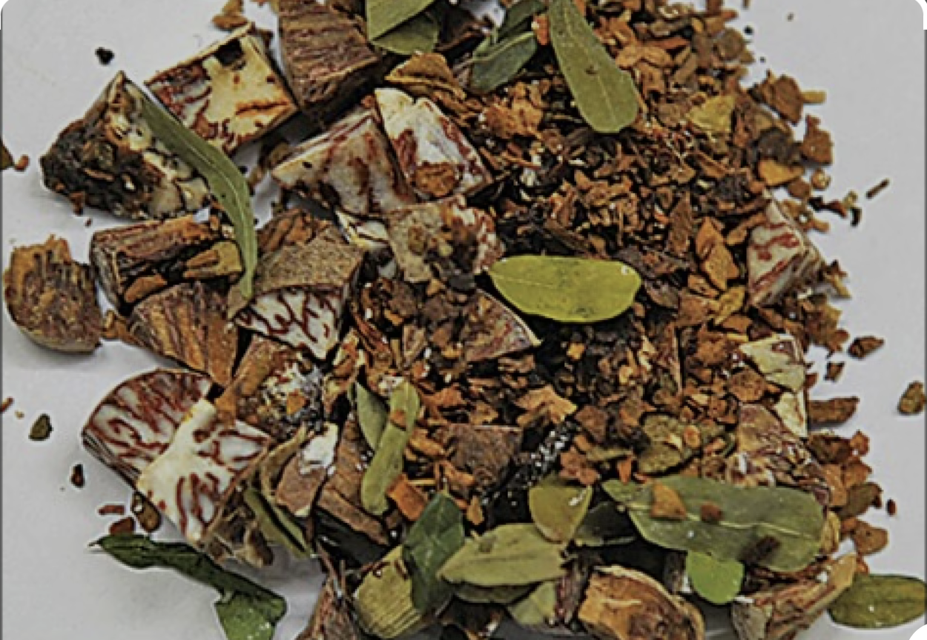
Increase risk of cancer for chewing
Smokeless tobacco consumption, such as paan and gutkha, which is widespread throughout the world,
leads to oral submucous fibrosis (OSMF),
which is a long-lasting and devastating condition of the oral cavity with the potential for malignancy.
People mostly use paan and gutkha due to a lack of awareness and education.
They are not aware of the harmful effects associated with the use of these substances,
and it has been reported that these products are consumed for perceived beneficial effects,
such as mouth freshening, aid in digestion, germ-killing, astringency, mood enhancement, tension relief, and oral cleaning
Notes:
Gutkha is sweet in taste, and children consider it to be a form of candy. Many people believe that gutkha is a mouth freshener,
but its pleasant taste and sweetness aggregate microbes, causing damage to teeth.
The use of paan and gutkha is difficult to control in most countries where it is widespread, and their extensive use leads to oral cancer [2]. The consumption of smokeless tobacco and areca nut is high in South Asian countries in the form of paan. In various South Asian languages, paan simply means “leaf.” Various ingredients are wrapped in the betel leaf. The common components of paan are tobacco, seeds, quenched lime, spices, and areca nut enfolded in betel quid [2]. In many developed and developing countries, tobacco is widely used with other constituents, as shown in Table 1. Over three decades ago, a tobacco industry
emerged in India producing gutkha, which consists of slaked lime, areca nut, chewing tobacco, spices, and catechu packed in tins or pouches [2].

Slide 47
How They Cause Cancer: Gutkha’s tobacco-specific nitrosamines (TSNAs) like NNN and NNK trigger DNA damage,
causing cells to multiply uncontrollably.
Areca nut and lime irritate tissues, speeding up precancerous changes like submucous fibrosis.
Smoking adds 60+ carcinogens, hitting the tongue and throat.
Gutkha and tobacco are driving India’s oral cancer epidemic,
with smokeless tobacco like gutkha (a mix of tobacco, areca nut, and lime) and smoking leading to 90% of cases.
In rural India, gutkha’s cheap sachets (5-10 rupees) and cultural acceptance make it a daily habit for 21.4% of adults.

Slide 48
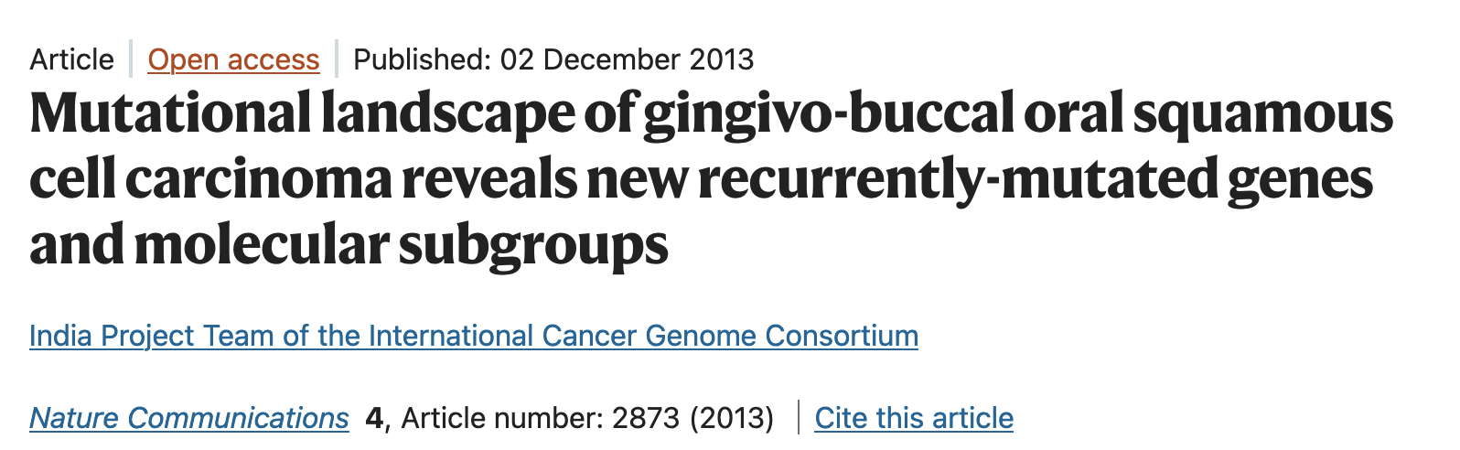
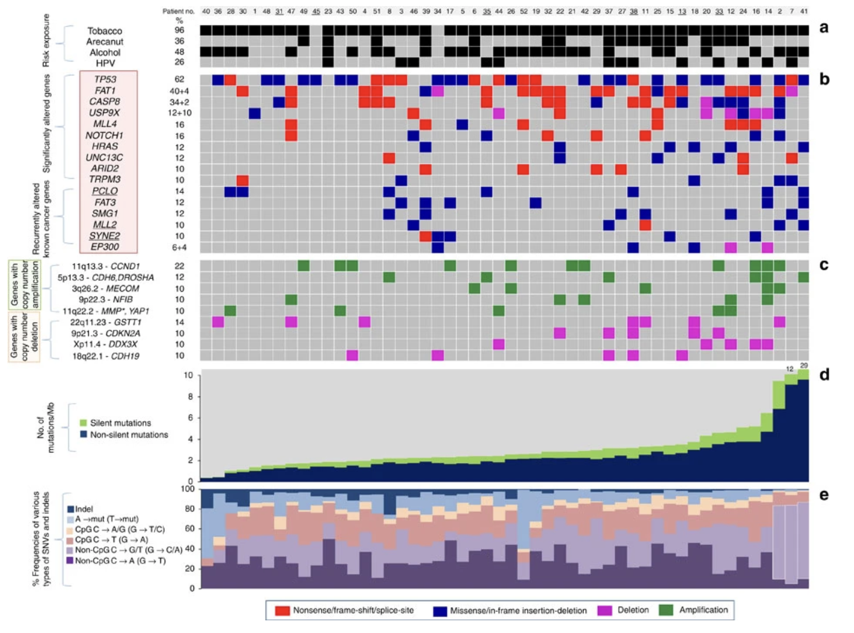

Slide 49
Prevention offers the most cost-effective
and a sustainable strategy for cancer control.
infection
from pathogens
Environment
Food

Slide 50
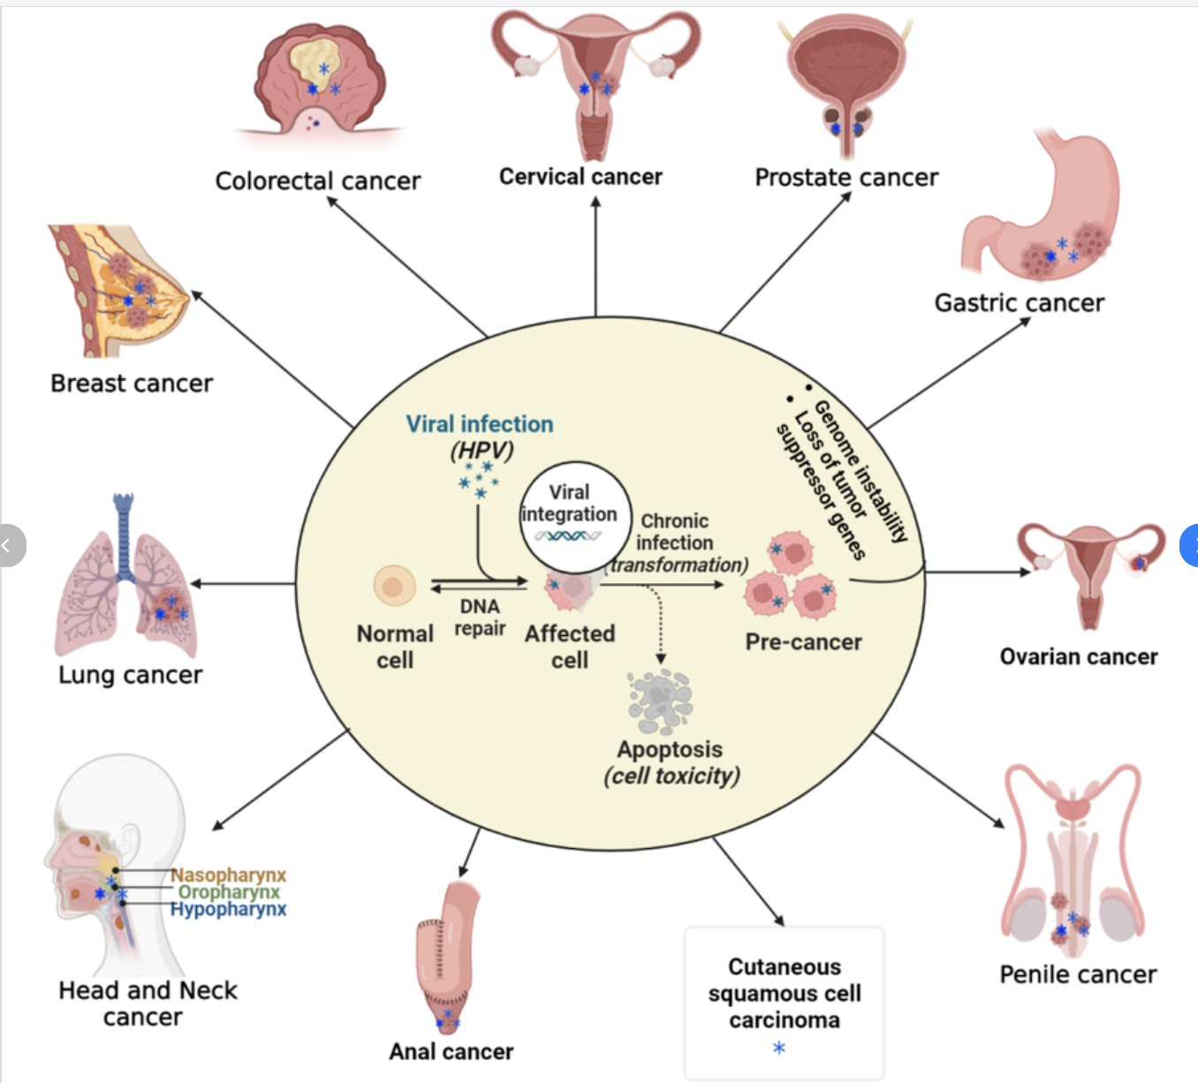
Cancer and infection: HPV
Sexually transmitted cancer
Can be prevented by vaccination at young age
12-15 years old

Slide 51
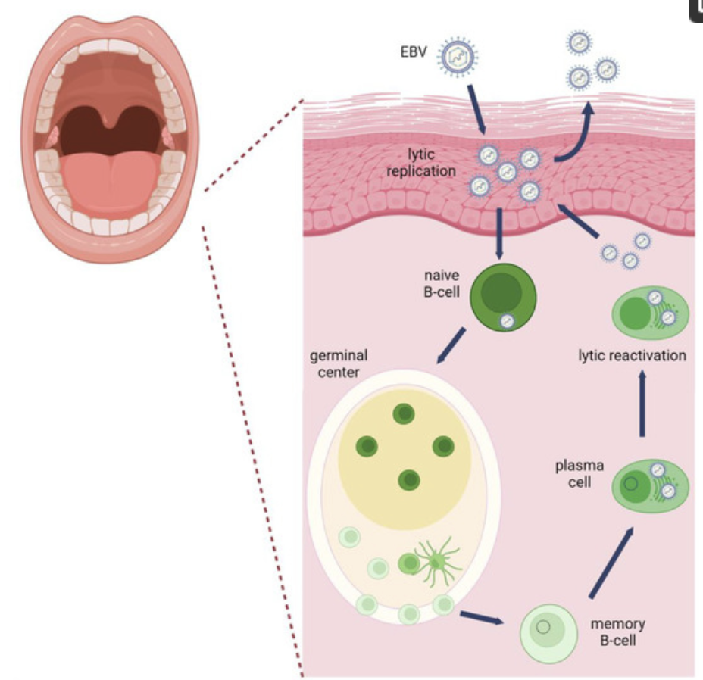
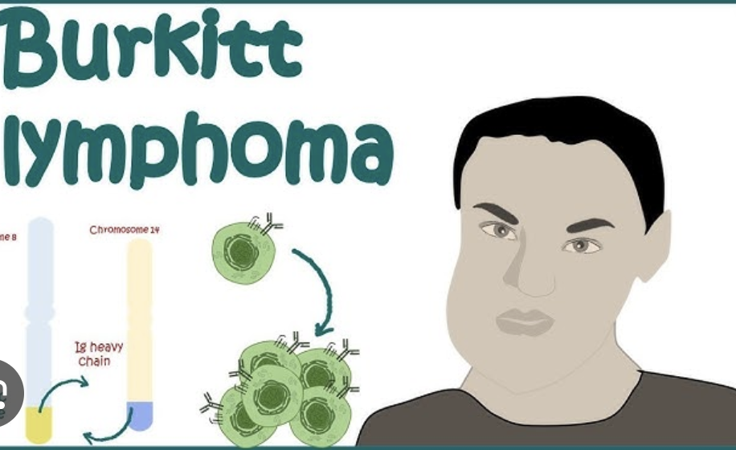
Cancer and infection: EBV
In Sub-Saharan Africa, Epstein-Barr virus (EBV) is strongly linked to certain cancers,
particularly Burkitt lymphoma, and to a lesser extent, Hodgkin lymphoma and nasopharyngeal carcinoma
The simultaneous infection with EBV and Plasmodium falciparum malaria is believed to disrupt the immune system,
leading to a higher risk of developing endemic Burkitt's lymphoma, a pediatric cancer more common in equatorial Africa

Slide 52
Prevention offers the most cost-effective
and a sustainable strategy for cancer control.
infection
from pathogens
Environment
Food

Slide 53
Exercise
https://www.nature.com/articles/s41586-023-05874-3
Read the paper during the first 45’
45’ each group presents one figure
The exam will be after Prof McKinney's exam
It will be 5 open questions (1 questions will be on the paper of the exercise)

