Slide 1
Hydra experiment
26/11/2025-01/12/2025

Slide 2
Experimental details and results
26/11/2025, Wednesday – cuts performed
Hydra left at 16°C
28/11/2025, Friday – initial scoring, observations
01/12/2025, Monday – final scoring and results
 | Head | Foot | Middle | Vertical cuts | Other cuts | Total
Before | 17 | 17 | 5 | 8 | 15 | 62
After | 5 | 4 | 0 | 2 | 7 | 18
Survival |  |  |  |  |  | 30%

Slide 3
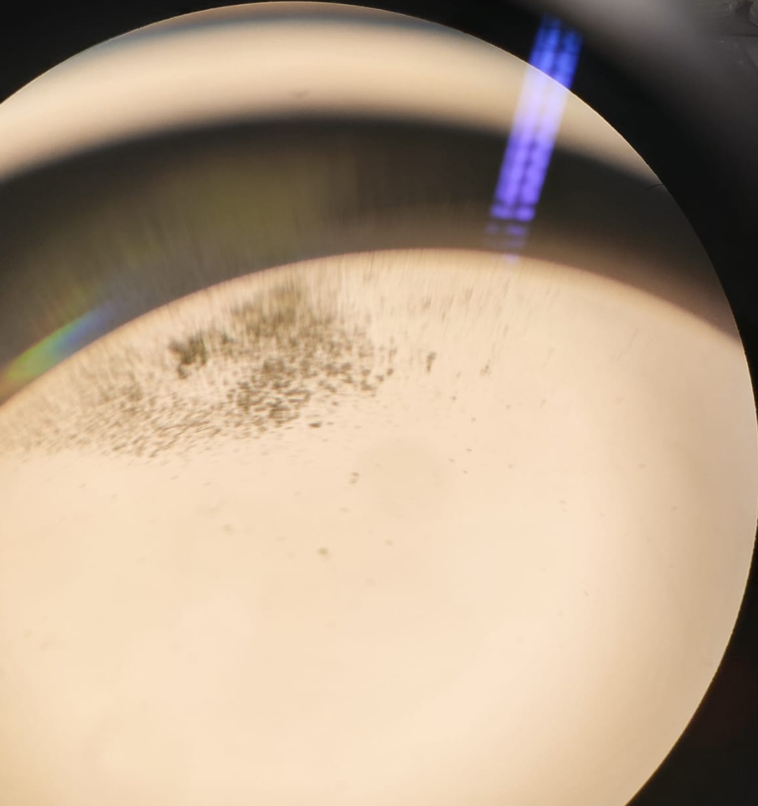
Disintegrated*
*also present in uncut control

Slide 4
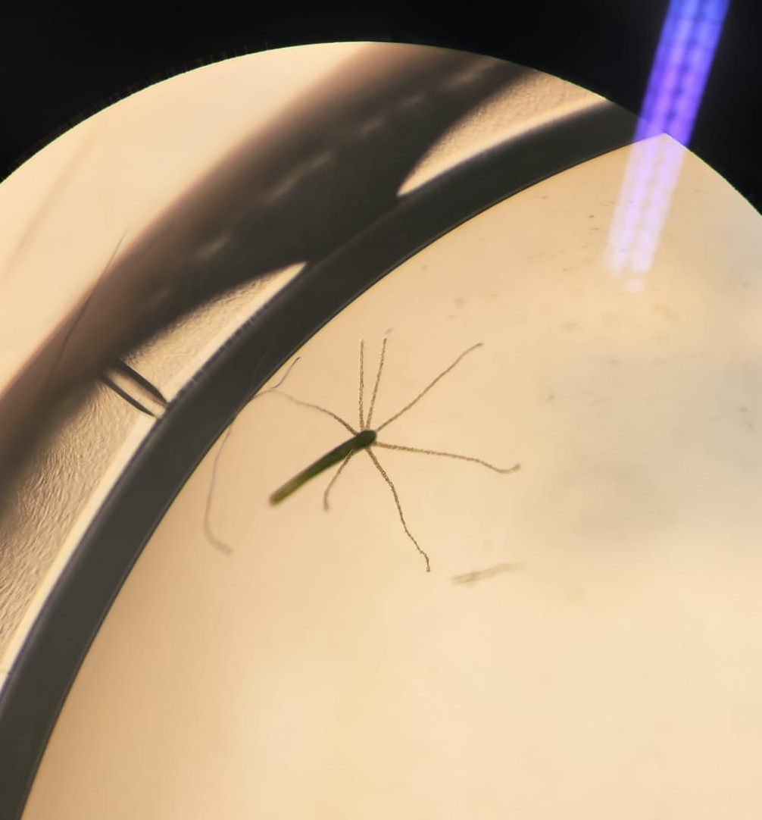
Head – regenerated a tail (5 of 17)

Slide 5
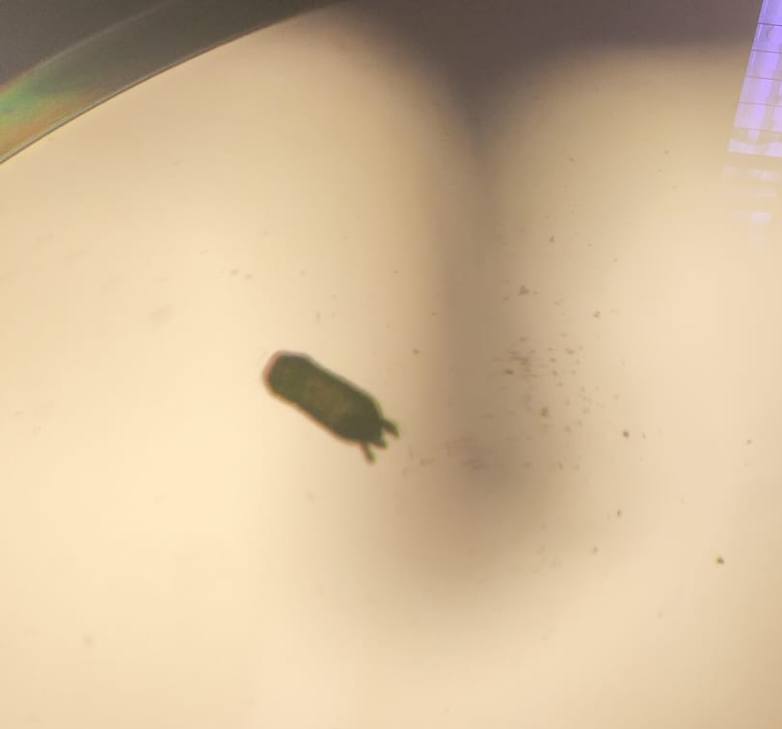
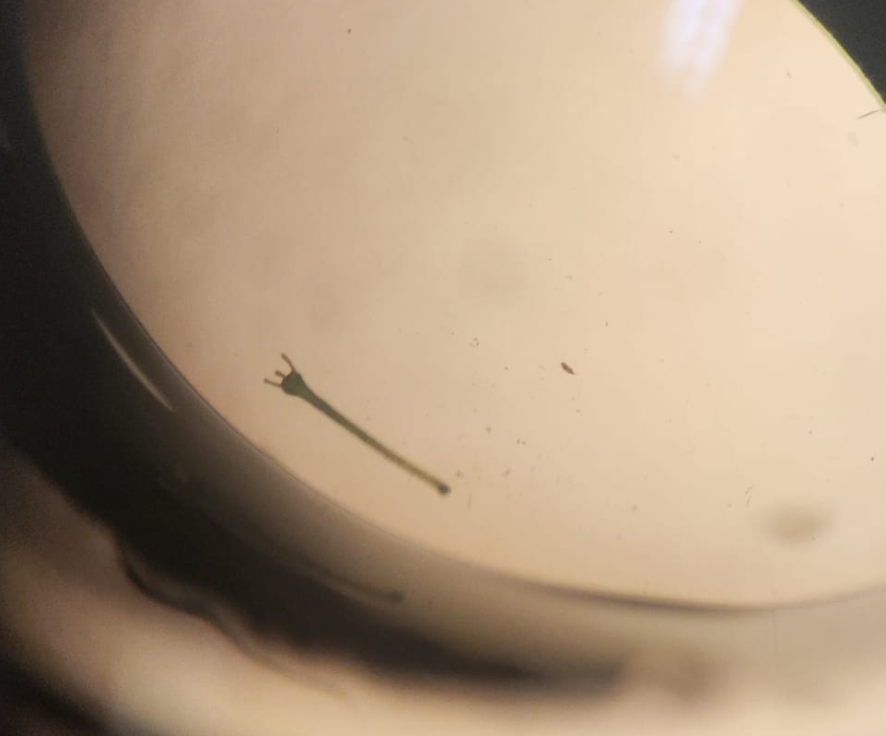
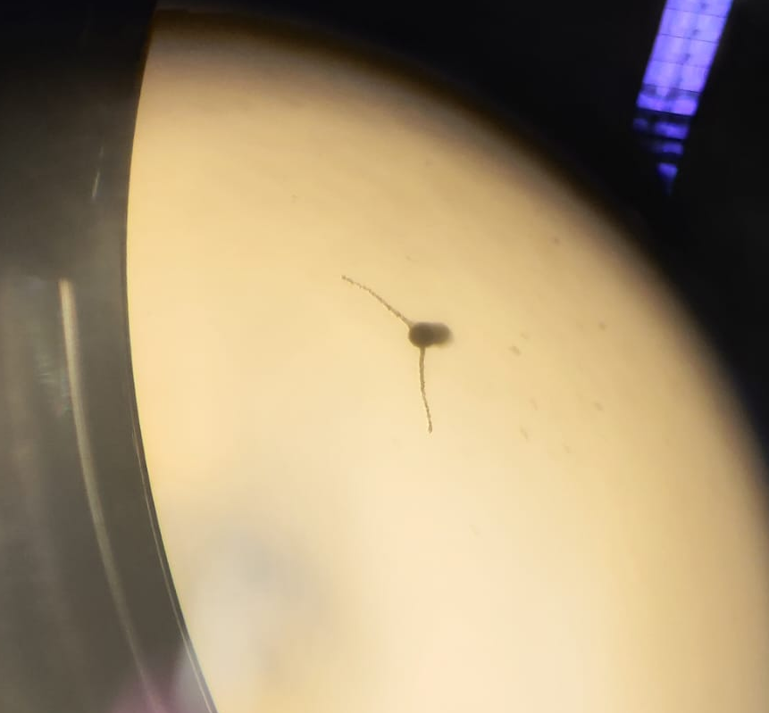
Foot – regenerated a head (4 of 17)

Slide 6
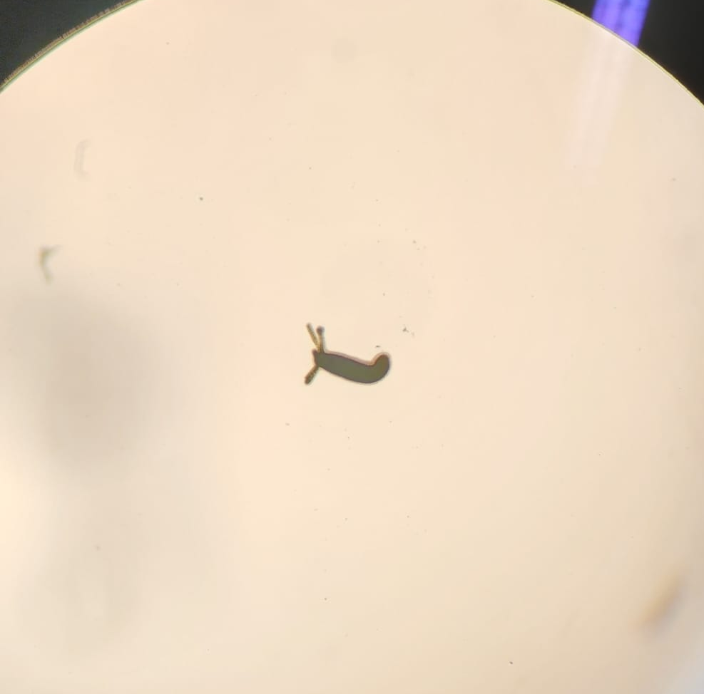
Vertical cut (2 of 8)

Slide 7
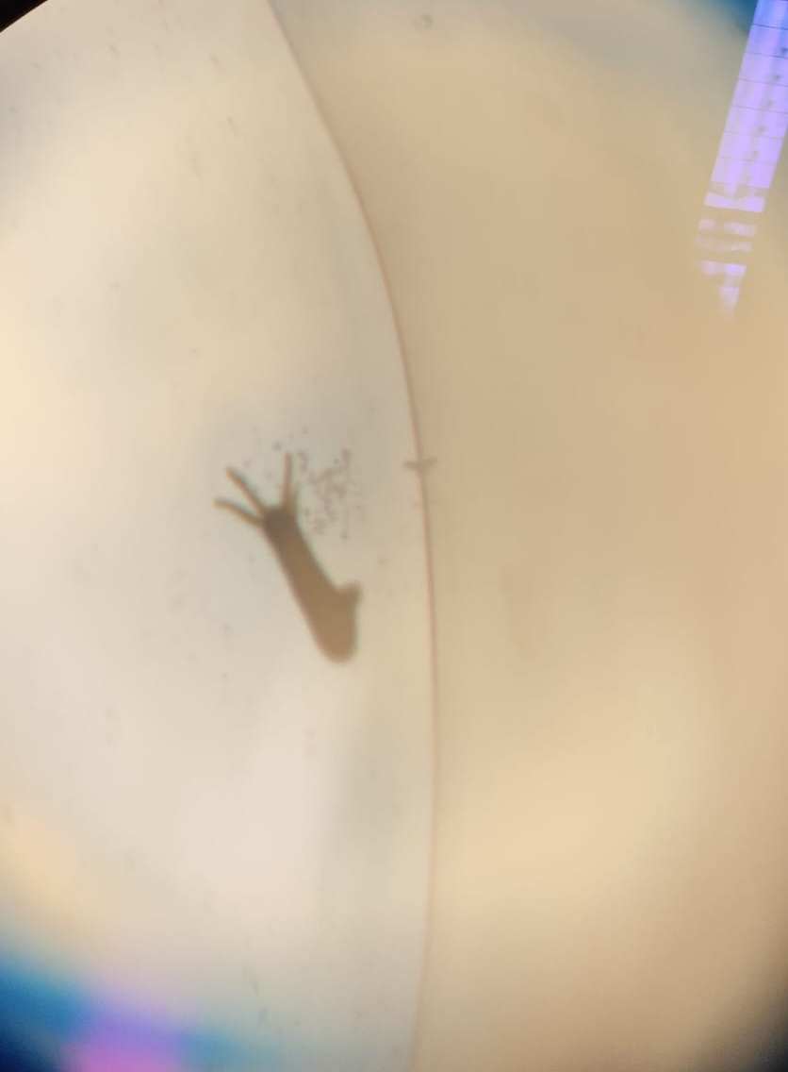
Cut a little, not entirely (other cuts), 7 of 15

