Slide 1
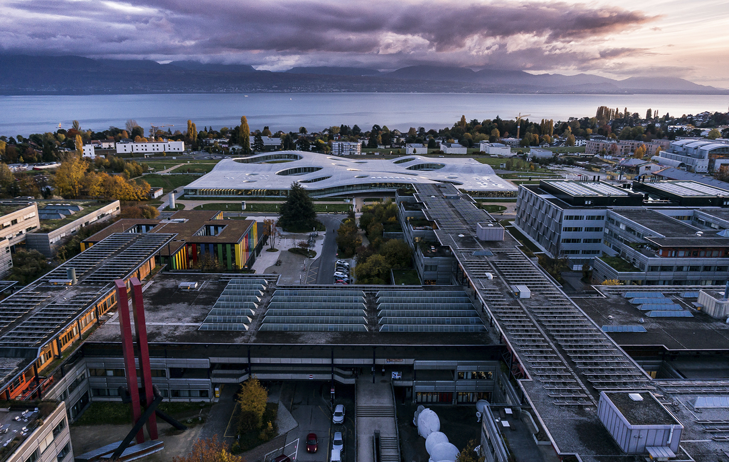
Hands-on with Research Data Management in Chemistry
Alain Borel
Francesco Varrato
Research Data Team, EPFL Library
EDCH-RDM, Feb. 2024

Slide 2

Program
2
 | 2024 – 02 – 21 | 2024 – 02 – 22 | 2024 – 02 – 29
Morning 9:00-12:30 | 1. [1h] Theory 1 | 5. [1h] Tools 2 | 9. [3h] Theory 3
 | 2. [3h] Patiny | 6. [3h] Dürr | 6. [3h] Dürr
 |  |  | 10. [1h] Theory 4
LUNCH BREAK
Afternoon 13:15-17:00 | 3. [1h] Tools 1 | 7. [3h] Hands-on: Data workflow | 11. [3h] Hands-on: Project / Report
 | 4. [3h] Theory 2
 | 4. [3h] Theory 2 | 8. [1h] Feedback 1 | 12. [1h] Feedback 2
Alain Borel, Francesco Varrato
EDCH 2024 / Hands-on with Research Data Management in Chemistry
+ short breaks every 1-2 hours
Notes:
2

Slide 3

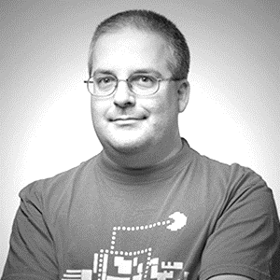

Us
3
Alain Borel, Francesco Varrato
Research Data Management Specialist
RDM Library Team
PhD in Chemistry
https://orcid.org/0000-0003-3268-3195
Research Data Management Specialist
RDM Library Team
PhD in Physics https://orcid.org/0000-0002-0983-0831
EDCH 2023 / Hands-on with Research Data Management in Chemistry
+ External interventions

Slide 4
You?
4
Name
When did you start your PhD?
What do you expect from this course?
Alain Borel, Francesco Varrato
EDCH 2023 / Hands-on with Research Data Management in Chemistry
1 minute live self-introduction

Slide 5
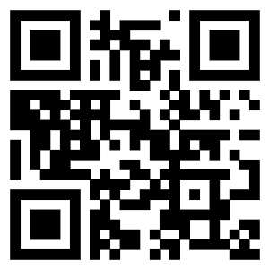
Main goals and topics
To provide you with useful information, tools and other resources for your RDM
To understand the costs and benefits of planning your RDM
Hands-on a.k.a. exercises on planning, management, processing and publication
Examples to follow or errors to avoid
Open Science, especially FAIR principles
Data Management Plan (DMP)
Digital formats for collaborations and reproducibility
Organize and document datasets
Naming conventions and metadata standards
Storage solutions and back-ups
Data publication
Legal and ethical issues
Licensing and reuse of datasets
Alain Borel, Francesco Varrato
Moodle
EDCH 2023 / Hands-on with Research Data Management in Chemistry
go.epfl.ch/ChE-601

Slide 6
Final evaluation
6
Report (max 3 pages)
Analyze the existing data workflow of your research project Describe your current practice (data collection, processing, analysis, storage, sharing, publication, archiving, ...)
Propose improvements using principles & tools presented during the course Identify improvements areas and pain points, list and prioritize actions, ...
Workflow diagram (1 page)
Create a diagram for your improved data workflow Integrate the proposed changes
Evaluation criteria
Consistency of the RDM approach
Completeness of the report
Completeness of the data workflow diagram
Coherence of data workflow representation with the report
Compliance with instructions (deadline, length, diagram attached)
Alain Borel, Francesco Varrato
EDCH 2023 / Hands-on with Research Data Management in Chemistry
Notes:
6

Slide 7

About this training material
7
This work is licensed under a Creative Commons Attribution-NonCommercial 4.0 International License
CC-BY-NC
Alain Borel, Francesco Varrato
EDCH 2023 / Hands-on with Research Data Management in Chemistry
Acknowledgements
This course includes content adapted from previous EPFL continuing education workshops, with contributions by Eliane Blumer, Alain Borel, Simon Leonard Dürr, Kevin Jablonka, Antoine Masson, Luc Patiny, Jessica Pidoux, Mathilde Panes, Sitthida Samath and Francesco Varrato.
Course material
Available on Moodle : go.epfl.ch/ChE-601

Slide 8
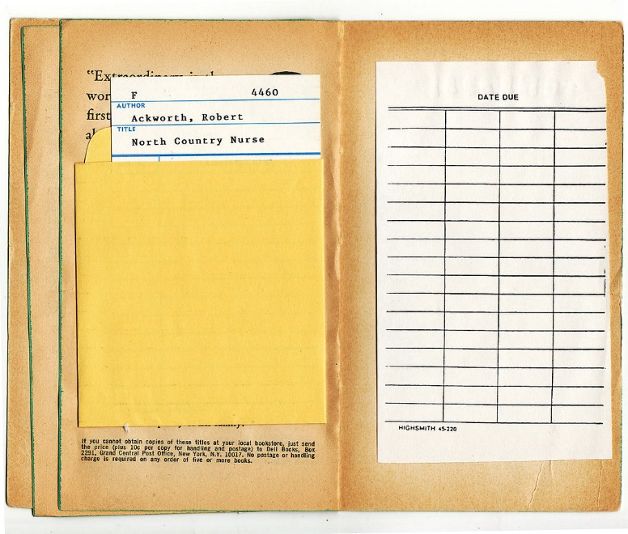
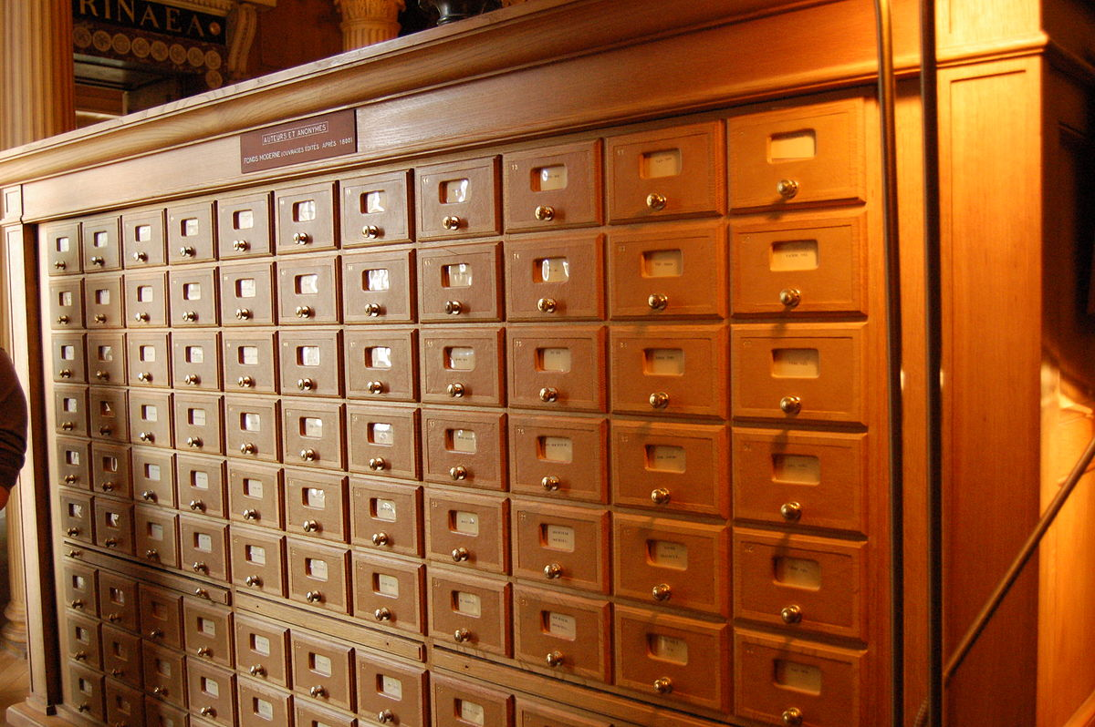
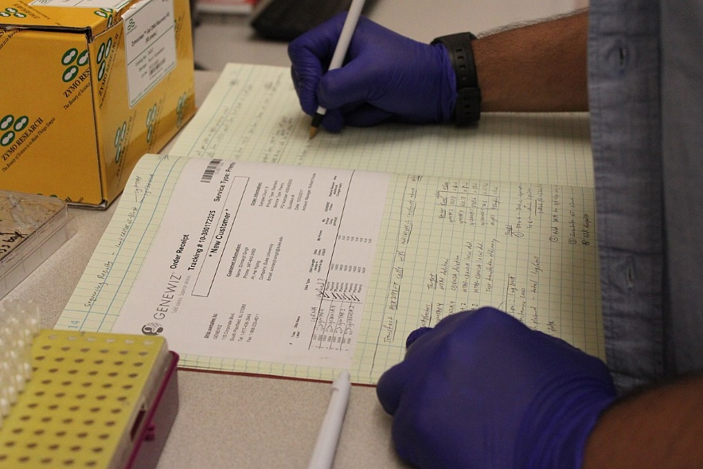
RDM is the new normal: don’t get left behind
8
DIGITAL LIBRARY
Alain Borel, Francesco Varrato
RECORD MANAGEMENT
EDCH 2024 / Hands-on with Research Data Management in Chemistry
ELN
Images: - commons.wikimedia.org/wiki/File:Lab_Notebook.jpg
- commons.wikimedia.org/wiki/File:Library_Book_Texture.jpg
- commons.wikimedia.org/wiki/File:Meubles_fiches_Institut_de_France.JPG
Notes:
Lab Notebook image: https://commons.wikimedia.org/wiki/File:Lab_Notebook.jpg
Library Book Texture image: https://commons.wikimedia.org/wiki/File:Library_Book_Texture.jpg
Meubles fiches Institut de France: https://commons.wikimedia.org/wiki/File:Meubles_fiches_Institut_de_France.JPG
8

Slide 9
Acronyms and where to find them
9
A | ACS | American Chemical Society
 | API | Application Programming Interface
C | CC | Creative Commons
 | CYD | Cyber Defence
D | DCC | Digital Curation Centre
 | DDI | Data Documentation Initiative
 | DLCM | Digital Lifecycle Management
 | DMP | Data Management Plan
 | DOI | Digital Object Identifier
 | DP | Data Protection
E | ELN | Electronic Lab Notebook
 | EOSC | European Open Science Cloud
 | ERC | European Research Council (Funding agency)
F | FADP | Federal Act on Data Protection
 | FAIR | Findable, Accessible, Interoperable, and Reusable
G | GDPR | General Data Protection Regulation
 | GIT | Global Information Tracker (when it works properly); or Goddamn Idiotic Truckload of sh*t (when it doesn't work properly)
H | HRA | Human Research Act
I | IPR | Intellectual Property Rights
 | ISO | International Standard Organization
 | IT | Information Technologies
L | LIMS | Laboratory Information Management System
N | NAS | Network Attached Storage
 | NCCR | National Centres of Competence in Research
O | OA | Open Access
 | OECD | Organization for Economic Co-operation and Development
 | ORCID | Open Researcher and Contributor ID
 | ORD | Open Research Data
P | PID | Persistent Identifier
 | PPDP | Privacy Preserving Data Publishing
R | RDA | Research Data Alliance
 | RDM | Research Data Management
S | SDMS | Scientific Data Management System
 | SNSF | Swiss National Science Foundation (Funding agency)
U | URL | Uniform Resource Locator
 | URN | Universal Resource Name
A | AREC | Animal Research Ethics Committee
D | DPO | Data Protection Officer
 | DSI | (former VPSI) Information Systems Management Department (Domaine des Systèmes d’Information)
H | HREC | Human Research Ethics Committee
O | OSSC | Open Science Strategic Committee
R | REO | Research Office
S | SDSC | Swiss Data Science Center
 | SCITAS | Scientific IT and Application Support
 | SISB | (i.e. Library) Scientific information and libraries (Information scientifique et bibliothèques)
T | TTO | Technology Transfer Office
Alain Borel, Francesco Varrato
EDCH 2024 / Hands-on with Research Data Management in Chemistry
on Moodle go.epfl.ch/ChE-601
Notes:
Lab Notebook image: https://commons.wikimedia.org/wiki/File:Lab_Notebook.jpg
Library Book Texture image: https://commons.wikimedia.org/wiki/File:Library_Book_Texture.jpg
Meubles fiches Institut de France: https://commons.wikimedia.org/wiki/File:Meubles_fiches_Institut_de_France.JPG
9

Slide 10

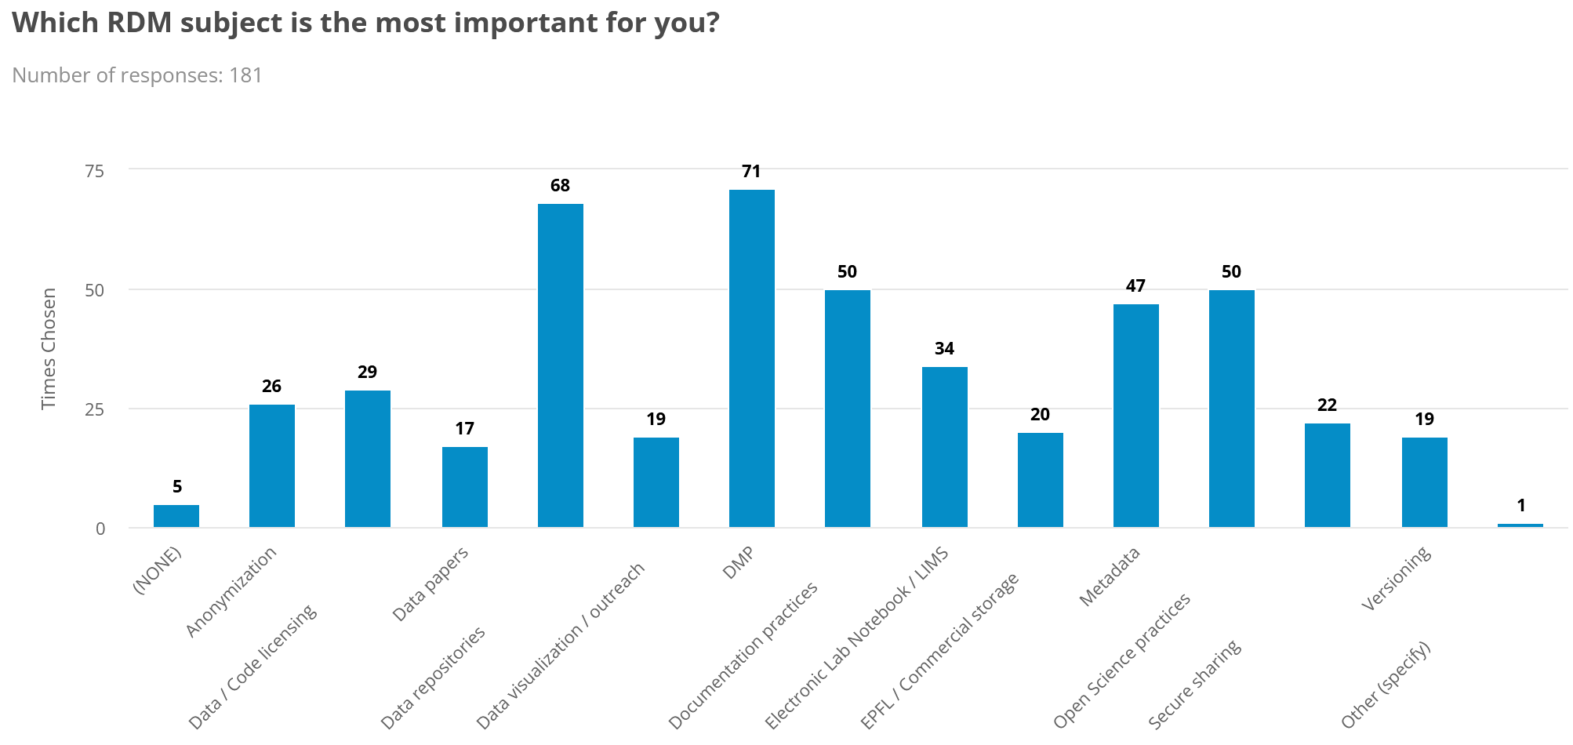
Participants Objectives (?)
10
From feedbacks
Alain Borel, Francesco Varrato
EDCH 2024 / Hands-on with Research Data Management in Chemistry
Notes:
10

Slide 11
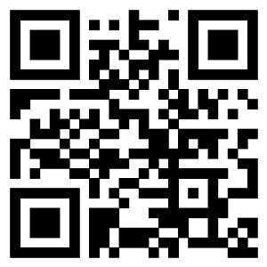
Discussion: RDM self-evaluation
11
go.epfl.ch/rdm-self
Alain Borel, Francesco Varrato
EDCH 20234/ Hands-on with Research Data Management in Chemistry
Notes:
https://library-survey.epfl.ch/c/RDM-self

Slide 12
Discussion: RDM self-evaluation
12
go.epfl.ch/rdm-self
Alain Borel, Francesco Varrato
EDCH 20234/ Hands-on with Research Data Management in Chemistry
Your results
Notes:
https://library-survey.epfl.ch/results/192389/f148e40a494ab83683b096cb2eb155cc

Slide 13
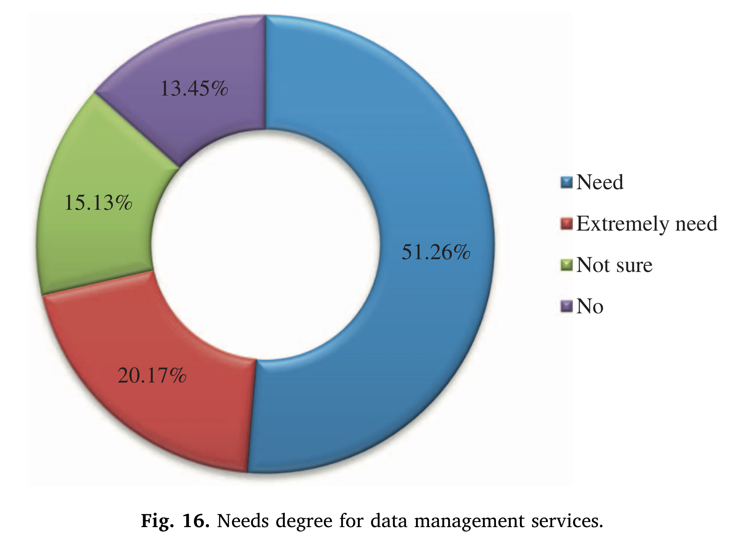
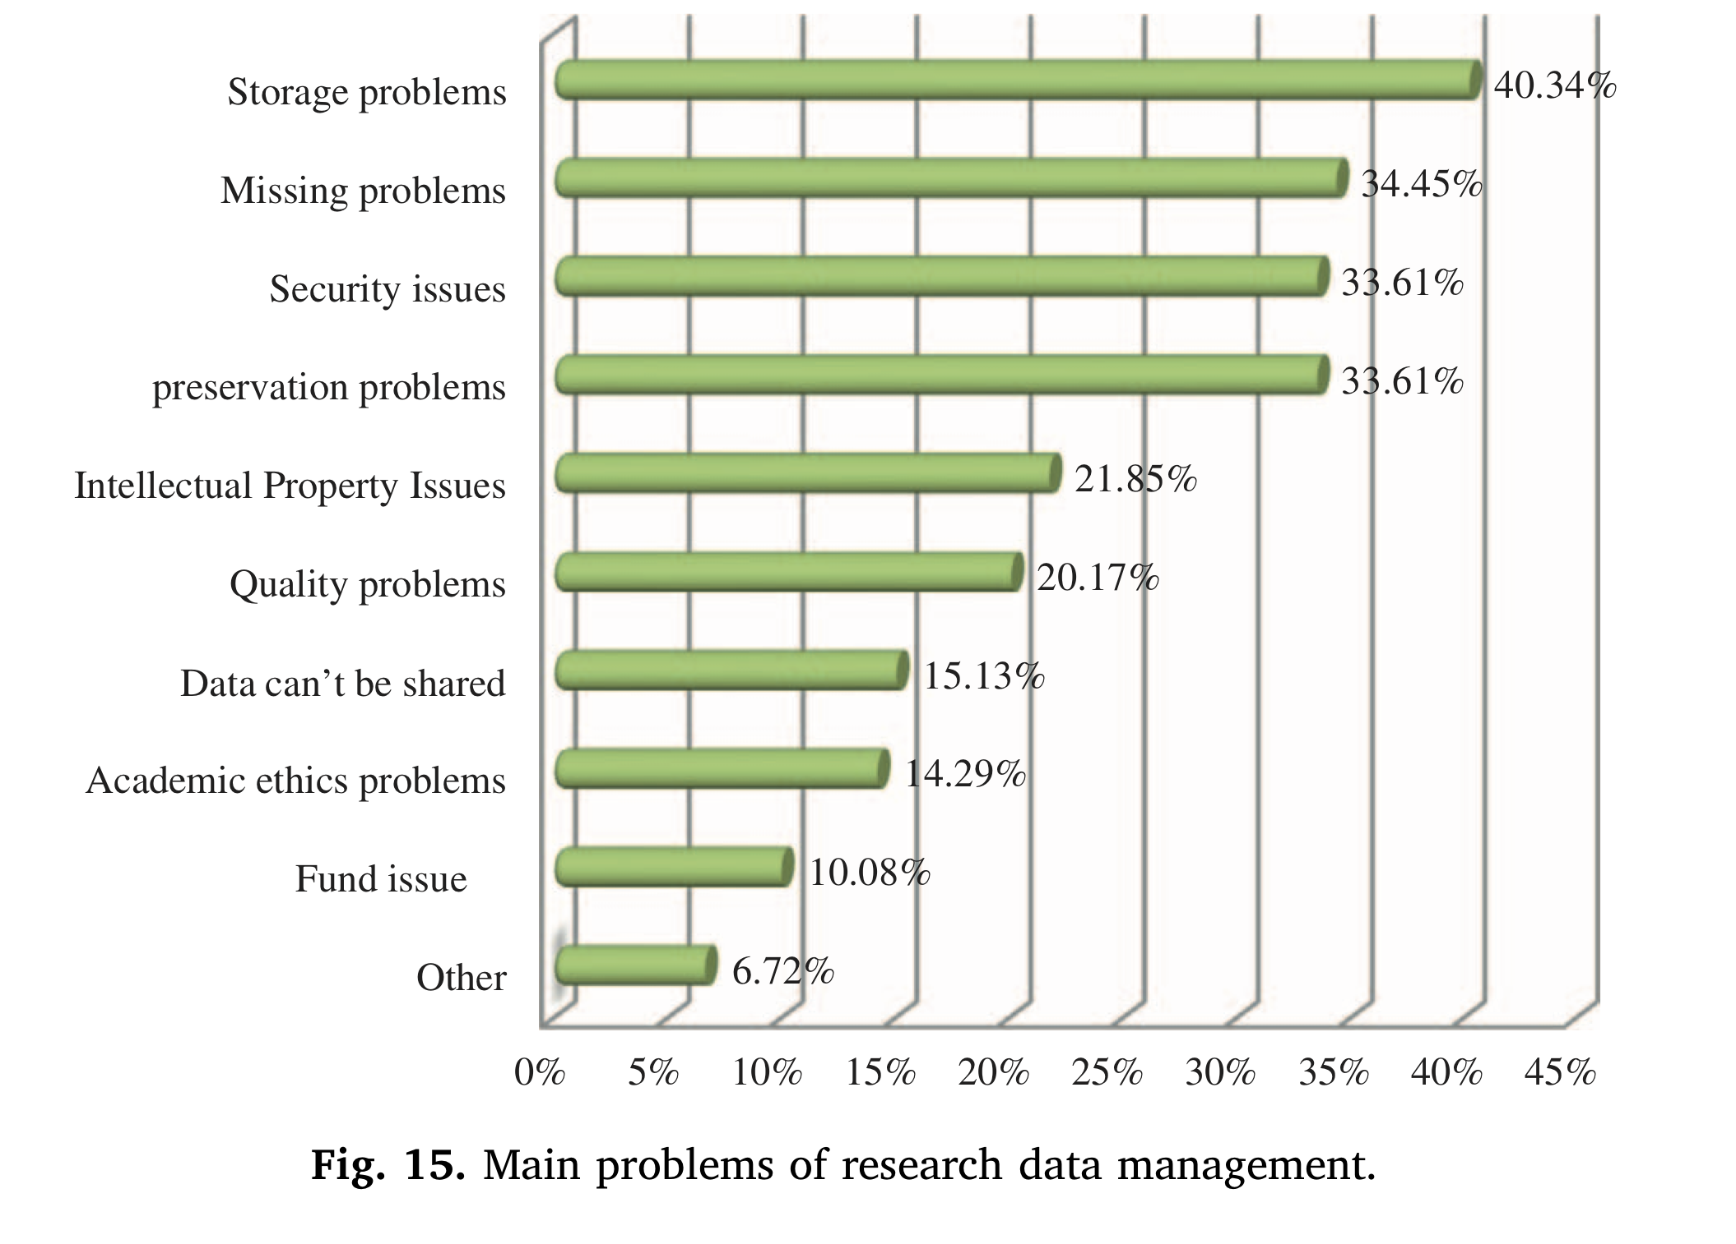
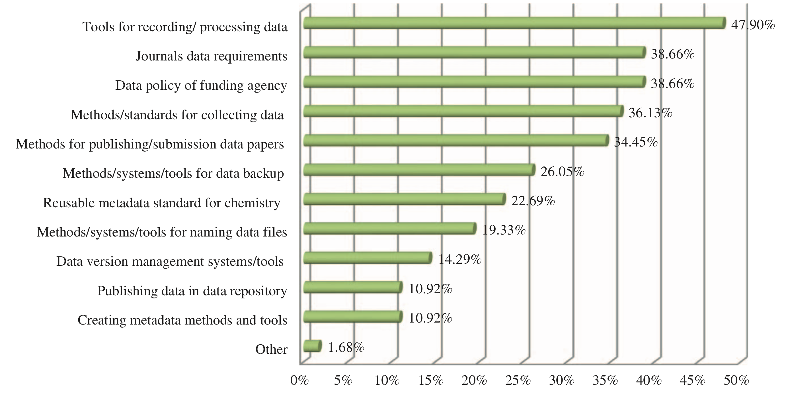
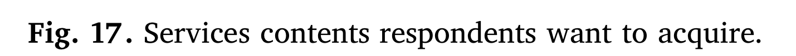
Chemists needs in RDM
13
Can’t say for sure what each EPFL researcher needs…
According to a survey among chemists at the Chinese Academy of Science:
Alain Borel, Francesco Varrato
EDCH 2024 / Hands-on with Research Data Management in Chemistry
[Chen & Wu, Journal of Academic Librarianship, 2017, DOI 10.1016/j.acalib.2017.06.006]

Slide 14
Chemists are a mixed crowd
14
Data-intensive chemist (usually theoreticians) or “classical” chemist (eg. experimentalists)?
Frequently processing data (experimental or not) or mostly working at the bench?
In charge of infrastructure (IT, instruments, …) or beginner with limited experience?
Etc. …
⇒ Whatever your profile is, talking to you is an exciting challenge for us!
Alain Borel, Francesco Varrato
EDCH 2024 / Hands-on with Research Data Management in Chemistry

Slide 15

Research Data Lifecycle (experimentalists)
15
Creating / Re-using
Data production
Data collection
Data sources
...
Processing / Analyzing
Validate data
Cleaning data
Transform data
Analyze data
Interpret data
...
Alain Borel, Francesco Varrato
EDCH 2024 / Hands-on with Research Data Management in Chemistry
Preserving / Publishing
Review data
Convert formats
Decide IP license
Depositing data
Promote data re-use
…
Planning all along
Documenting all along

Slide 16
Research Data Lifecycle (theoreticians)
16
Creating / Re-using
Data production
Data collection
Data sources
...
Processing / Analyzing
Validate data
Cleaning data
Transform data
Analyze data
Interpret data
...
Alain Borel, Francesco Varrato
EDCH 2024 / Hands-on with Research Data Management in Chemistry
Preserving / Publishing
Review data
Convert formats
Decide IP license
Depositing data
Promote data re-use
…
Planning all along
Documenting all along

Slide 17
What is RDM?
17
DATA Factual records: numerical scores, textual records, images, sounds, protocols, source code, ...
RESEARCH DATA Data used as primary sources for scientific research, and commonly accepted in the scientific community to validate research findings (OECD)
Alain Borel, Francesco Varrato
technical, legal & ethical aspects
EDCH 2024 / Hands-on with Research Data Management in Chemistry
RESEARCH DATA MANAGEMENT (RDM) The care and maintenance of research data during the research cycle (UC Berkeley Library) OPEN RESEARCH DATA (ORD) Research data that managed during its lifecycle to comply with the FAIR principles
Notes:
“Law Number XVII: Software is like entropy. It is difficult to grasp, weighs nothing, and obeys the Second Law of Thermodynamics; i.e., it always increases.” https://en.wikipedia.org/wiki/Augustine%27s_laws

Slide 18

RDM: addressing risks
18
Wasted time
Legal consequences
Alain Borel, Francesco Varrato
Endless updates
Ethics’ committee resubmission
EDCH 2024 / Hands-on with Research Data Management in Chemistry
Financial costs
Towards sustainability and accountability
Learning and sharing
Notes:
JP: Pitfalls: time consuming, financial costs, resubmitting to the ethics’ committee, correcting
what for? making research sustainable, towards reproducibility and transparency, learning and sharing
be aware of these problems and tackle them, consider them as part of the ethics of your research
define the limits, and avoid consequences for later

Slide 19
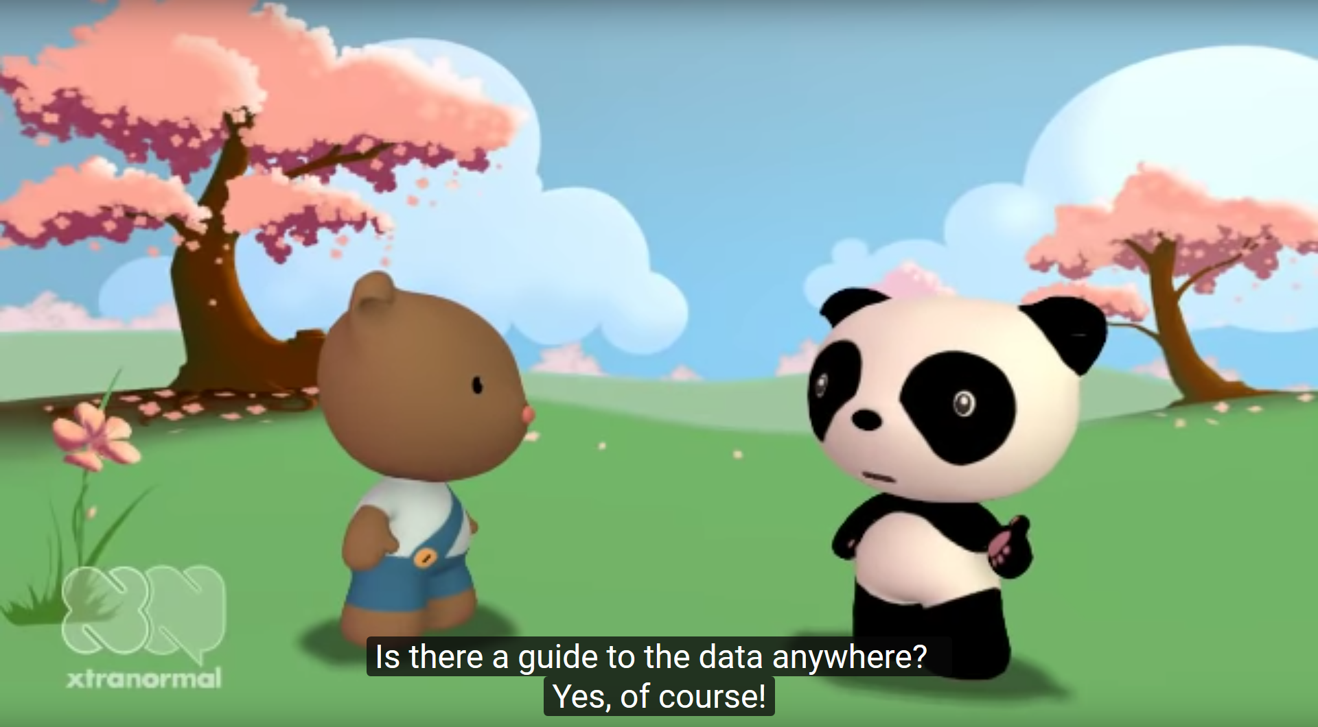

RDM: why bother? (9h40)
19
Alain Borel, Francesco Varrato
EDCH 2024 / Hands-on with Research Data Management in Chemistry
NYU Health Sciences Library, youtu.be/66oNv_DJuPc

Slide 20
FAIR Principles
20
[…] the annual cost of not having FAIR research data costs the European economy at least €10.2bn every year. In addition, we also listed a number of consequences from not having FAIR which could not be reliably estimated, […], we concluded that these unquantified elements could account for another €16bn annually on top of what we estimated.
Intro (pg.4)
[…] at €10.2bn per year in Europe, the measurable cost of not having FAIR research data makes an overwhelming case in favour of the implementation of the FAIR principles. […] To top this, figures for the open data economy suggest that the impact on innovation of FAIR could add another €16bn to the minimum cost we estimated.
Conclusions (pg.31)
Source: European Commission, Directorate-General for Research and Innovation, Cost-benefit analysis for FAIR research data – Cost of not having FAIR research data, Publications Office, 2018, https://data.europa.eu/doi/10.2777/02999
Alain Borel, Francesco Varrato
EDCH 2024 / Hands-on with Research Data Management in Chemistry
Notes:
Ajouter https://nccr-marvel.ch/highlights/2020-04AutoWannier comme exemple? ("a fully #FAIR and reproducible paper, with all data shared on the #MaterialsCloud Archive, including also #QuantumMobile virtual machine with #AiiDA to reproduce any calculation" (Giovanni Pizzi on Linkedin: https://www.linkedin.com/posts/giovanni-pizzi_automated-wannierisation-for-high-throughput-activity-6673242612645814272-9jv9))
20

Slide 21
FAIR Principles
21
F indable Data and metadata are easy to find by both humans & computers.
A ccessible Machines & humans can readily access or download (meta)data.
I nteroperable Data from different datasets are ready to be exchanged or combined.
R eusable (Meta)data are easily replicated / combined in future research.
Use metadata
Deposit (meta)data in repository/registry
Assign a persistent identifier (eg. DOI, HANDL, URN)
Alain Borel, Francesco Varrato
As-open-as-possible access to your data (licensing, …)
Services with user-friendly interfaces
Leave the metadata available after data deletion
EDCH 2024 / Hands-on with Research Data Management in Chemistry
Use open file format(s), whenever possible
Use standardized vocabularies/tags
Use cross-linking as much as possible
Attach standardized license to your data (CC, GPL, …)
Capture provenance information as precisely as possible
Download our Fast Guide on FAIR principles
More from the GO FAIR Initiative
Notes:
Ajouter https://nccr-marvel.ch/highlights/2020-04AutoWannier comme exemple? ("a fully #FAIR and reproducible paper, with all data shared on the #MaterialsCloud Archive, including also #QuantumMobile virtual machine with #AiiDA to reproduce any calculation" (Giovanni Pizzi on Linkedin: https://www.linkedin.com/posts/giovanni-pizzi_automated-wannierisation-for-high-throughput-activity-6673242612645814272-9jv9))
21

Slide 22
F – Examples
22
Provide rich, structured metadata (title, contributors, description, creation year...)
Get specific DOIs for published datasets
Cite these DOI in articles that use the data
Not necessarily the same as for the associated article(s)!
F indable Data and metadata are easy to find by both humans & computers.
Alain Borel, Francesco Varrato
EDCH 2024 / Hands-on with Research Data Management in Chemistry
Download our Fast Guide on FAIR principles
More from the GO FAIR Initiative
Notes:
Ajouter https://nccr-marvel.ch/highlights/2020-04AutoWannier comme exemple? ("a fully #FAIR and reproducible paper, with all data shared on the #MaterialsCloud Archive, including also #QuantumMobile virtual machine with #AiiDA to reproduce any calculation" (Giovanni Pizzi on Linkedin: https://www.linkedin.com/posts/giovanni-pizzi_automated-wannierisation-for-high-throughput-activity-6673242612645814272-9jv9))
22

Slide 23
A – Examples
23
A ccessible Machines & humans can readily access or download (meta)data.
As-open-as-possible access to your data (licensing, …)
Use services with user-friendly interfaces
Leave the metadata available after data deletion
Alain Borel, Francesco Varrato
EDCH 2024 / Hands-on with Research Data Management in Chemistry
Download our Fast Guide on FAIR principles
More from the GO FAIR Initiative
Notes:
Ajouter https://nccr-marvel.ch/highlights/2020-04AutoWannier comme exemple? ("a fully #FAIR and reproducible paper, with all data shared on the #MaterialsCloud Archive, including also #QuantumMobile virtual machine with #AiiDA to reproduce any calculation" (Giovanni Pizzi on Linkedin: https://www.linkedin.com/posts/giovanni-pizzi_automated-wannierisation-for-high-throughput-activity-6673242612645814272-9jv9))
23

Slide 24
I – Examples
24
I nteroperable Data from different datasets are ready to be exchanged or combined.
Use open file format(s), whenever possible
Contrary to common wisdom, text is better than images!
Vocabularies: remember the IUPAC Gold Book?
Use standard identifiers whenever possible: ORCID for contributors, InChi for chemical compounds...
Alain Borel, Francesco Varrato
EDCH 2024 / Hands-on with Research Data Management in Chemistry
Suggested links:
Your ORCID iD - your digital name identifier (ORCID)
InChI and InChIKeys for chemical structures (InChI Trust)
Compendium of Chemical Terminology (IUPAC Gold Book)
Download our Fast Guide on FAIR principles
More from the GO FAIR Initiative
Notes:
Ajouter https://nccr-marvel.ch/highlights/2020-04AutoWannier comme exemple? ("a fully #FAIR and reproducible paper, with all data shared on the #MaterialsCloud Archive, including also #QuantumMobile virtual machine with #AiiDA to reproduce any calculation" (Giovanni Pizzi on Linkedin: https://www.linkedin.com/posts/giovanni-pizzi_automated-wannierisation-for-high-throughput-activity-6673242612645814272-9jv9))
24

Slide 25
R – Examples
25
R eusable (Meta)data are easily replicated / combined in future research.
Standardized license means people will know what they may or may not do with your data
Data with better provenance information (how/where/when/by whom was it generated?) is easier to verify (perhaps to reproduce), and thus more trustworthy
Alain Borel, Francesco Varrato
EDCH 2024 / Hands-on with Research Data Management in Chemistry
Download our Fast Guide on FAIR principles
More from the GO FAIR Initiative
Notes:
Ajouter https://nccr-marvel.ch/highlights/2020-04AutoWannier comme exemple? ("a fully #FAIR and reproducible paper, with all data shared on the #MaterialsCloud Archive, including also #QuantumMobile virtual machine with #AiiDA to reproduce any calculation" (Giovanni Pizzi on Linkedin: https://www.linkedin.com/posts/giovanni-pizzi_automated-wannierisation-for-high-throughput-activity-6673242612645814272-9jv9))
25

Slide 26
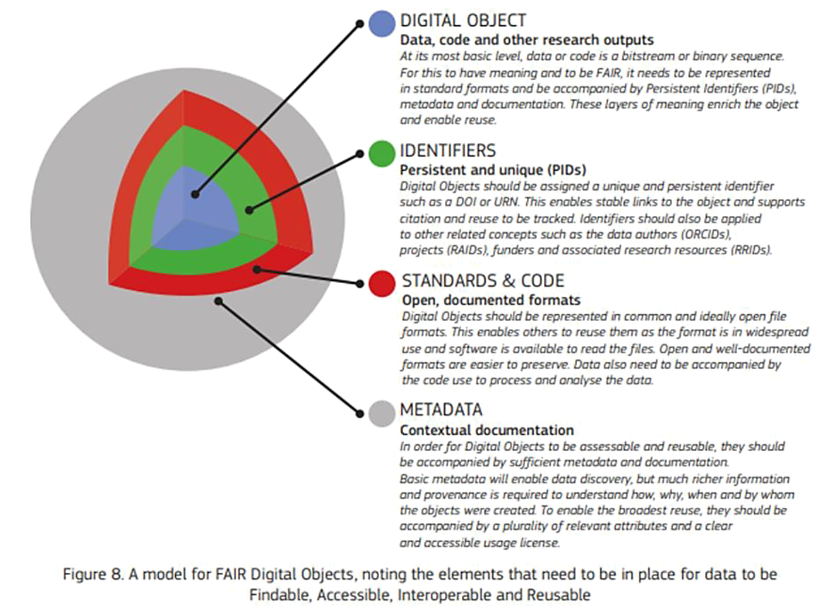
FAIR Principles
26
Boils down to …
Alain Borel, Francesco Varrato
EDCH 2024 / Hands-on with Research Data Management in Chemistry
Scholarly publications and the FAIR Principles Source: www.kb.se/openaccess
Notes:
Ajouter https://nccr-marvel.ch/highlights/2020-04AutoWannier comme exemple? ("a fully #FAIR and reproducible paper, with all data shared on the #MaterialsCloud Archive, including also #QuantumMobile virtual machine with #AiiDA to reproduce any calculation" (Giovanni Pizzi on Linkedin: https://www.linkedin.com/posts/giovanni-pizzi_automated-wannierisation-for-high-throughput-activity-6673242612645814272-9jv9))
26

Slide 27
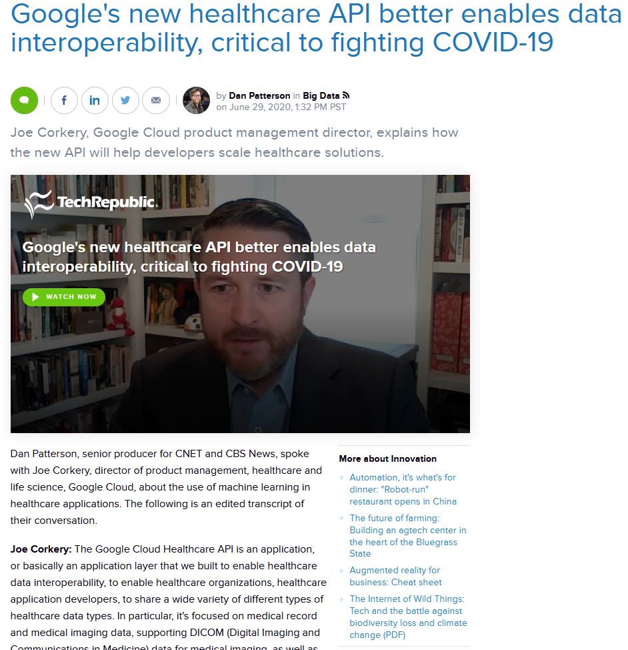
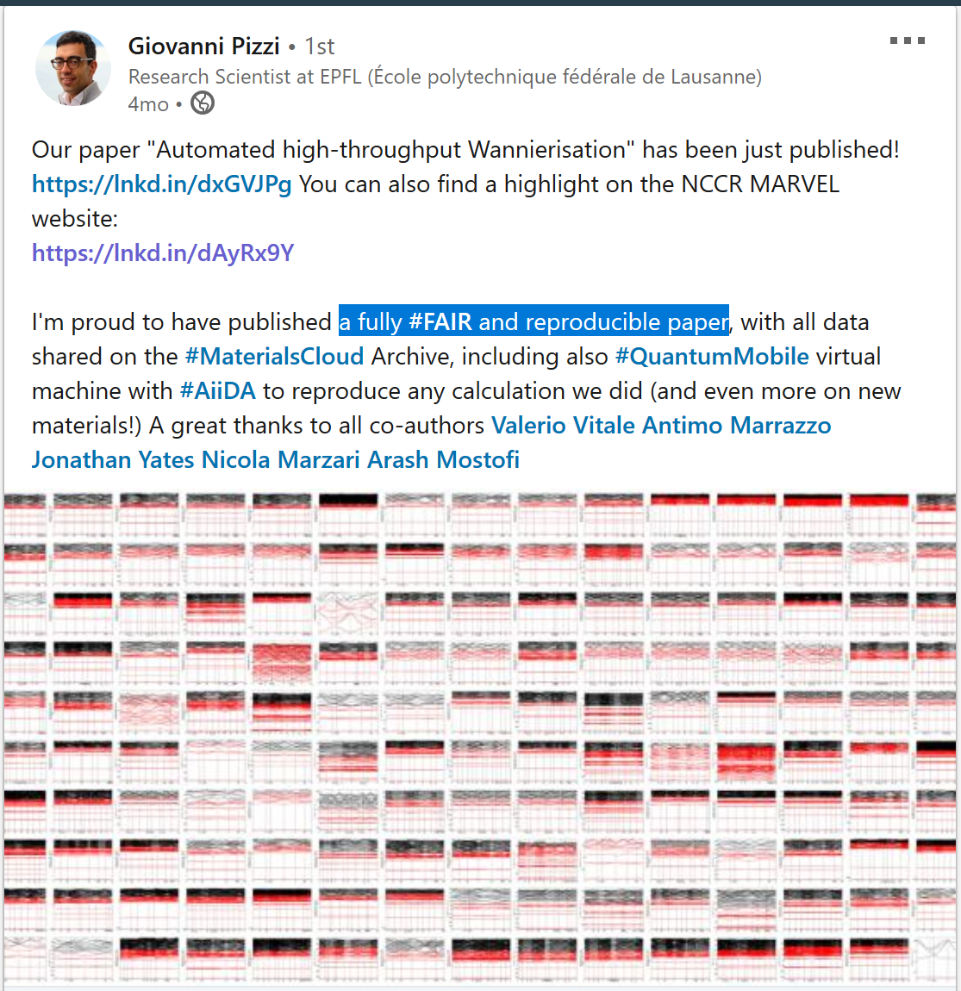
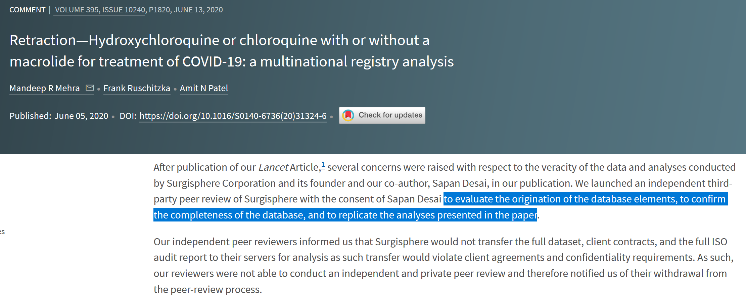
Importance of FAIR principles
27
www.techrepublic.com/article/googles-new-healthcare-api-better-enables-data-interoperability-critical-to-fighting-covid-19
Alain Borel, Francesco Varrato
doi.org/10.1016/S0140-6736(20)31324-6
màj : FV
Notes:
Ajouter :
https://nccr-marvel.ch/highlights/2020-04AutoWannier comme exemple? ("a fully #FAIR and reproducible paper, with all data shared on the #MaterialsCloud Archive, including also #QuantumMobile virtual machine with #AiiDA to reproduce any calculation" (Giovanni Pizzi on Linkedin: https://www.linkedin.com/posts/giovanni-pizzi_automated-wannierisation-for-high-throughput-activity-6673242612645814272-9jv9))
https://www.thelancet.com/lancet/article/s0140673620313246?utm_campaign=tlcoronavirus20&utm_source=twitter&utm_medium=social (DOI: https://doi.org/10.1016/S0140-6736(20)31324-6)
https://www.techrepublic.com/article/googles-new-healthcare-api-better-enables-data-interoperability-critical-to-fighting-covid-19/
27

Slide 28


Discussion: Issues & Services [10’]
ISSUE WHO
Set-up storage & backup ☐
Publishing data / code ☐
Ethical Requirements ☐
Budgeting for data storage ☐
Licensing of data / code ☐
Interpretation of data analysis ☐
Leak of sensitive data ☐
Sharing TB of images ☐
☐ Data Protection Officer (DPO)
☐ Technology Transfer Office (TTO)
☐ Research Office (ReO)
☐ My own research group
☐ EPFL Ethics Committee
☐ EPFL Data Champions
☐ RDM Library team
☐ Faculty / Central IT
Alain Borel, Francesco Varrato
?
[10’]
Notes:
We use EPFL as example and then ask participants to tell us which contact persons and resources they know from their institutions
Categories support: 1. Storage 2. Backup 3. Budget 4. Ethical clearance 5. Licensing 6. Industrial partners 7. Code sharing 8. Help on specific
9. Organization
Categories services:
1. DPO (Data Protection Officer) 2. TTO (Technology Transfer Office)
3. Research Data Library’s Team 4. HREC (Human Research Ethics Committee) 5. EPFL Data Champions community

Slide 29
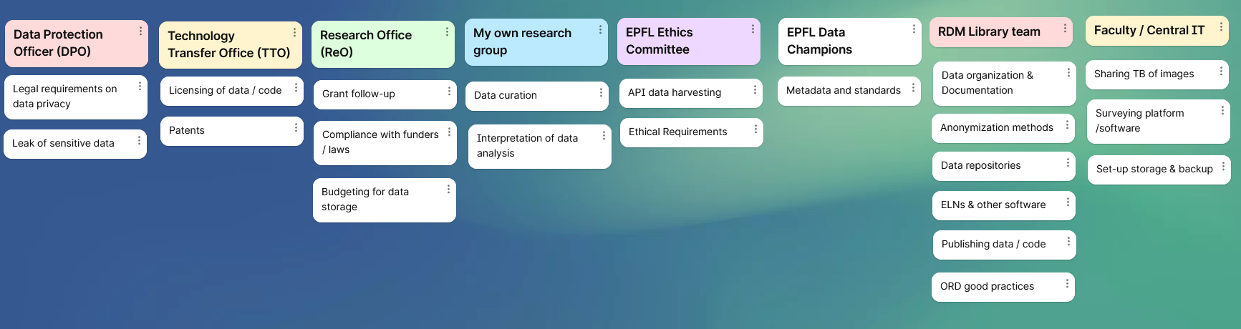

Slide 30
Intro à Luc Patiny
30
XXX
Alain Borel, Francesco Varrato
EDCH 2024 / Hands-on with Research Data Management in Chemistry
Notes:
30

