Slide 1

Data actions in your project … to fill in!
1
ACTIVITIES | COLLEAGUE / PARTNER | TOOLS | TO-DO
FUNDING PLANNING
CREATION
ETHICAL CLEARANCE
ACQUISITION
STORING
ANALYSIS
LEGAL CLEARANCE
SHARING
PUBLISHING
ARCHIVING
Alain Borel, Francesco Varrato
Documentation all along
EDCH 2024 / Hands-on with Research Data Management in Chemistry
See paper copy + on Moodle go.epfl.ch/ChE-601
Notes:
Présenter le doc
Leur dire de réfléchir à ce qu’ils savent déjà
Dire la documentation se fait à toutes les étapes (donc elle devrait être partout dans la to-do)

Slide 2
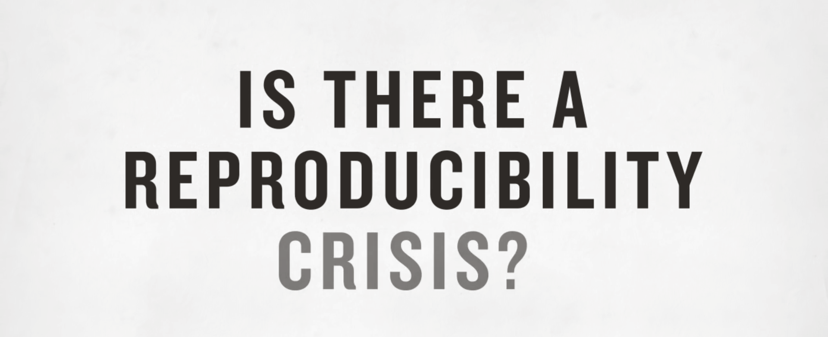

Research reproducibility (issue)
2
“There are two possible outcomes: if the result confirms the hypothesis, then you've made a measurement. If the result is contrary to the hypothesis, then you've made a discovery.”
Enrico Fermi
But you can have results that were unexpected, or that had barely achieved statistical significance.
Alain Borel, Francesco Varrato
EDCH 2024 / Hands-on with Research Data Management in Chemistry
Source: Nature 2016
Notes:
According to a Nature study in 2012, 47 out of 53 medical research papers are irreproducible (1).
A previous study showed in 2009 that 16 out of 18 bioinformatics papers could not be reproduced entirely (2).
In 2004, it was found that less than 9% of papers share their code (3).
Begley, C. G.; Ellis, L. M. (2012). "Drug development: Raise standards for preclinical cancer research". Nature 483 (7391): 531–533.
Ioannidis JPA, Allison DB, Ball CA, et al. Repeatability of published microarray gene expression analyses. Nat Genet 2009;41(2):149–55.
Vandewalle, Patrick, Jelena Kovacevic, and Martin Vetterli. "Reproducible research in signal processing." Signal Processing Magazine, IEEE 26.3 (2009): 37-47
https://www.nature.com/news/1-500-scientists-lift-the-lid-on-reproducibility-1.19970
[Slide inspired by https://github.com/saloot/IPythonClass , Amir Hessam Salavati & ,Robin Schiebler 2015 ]
2

Slide 3
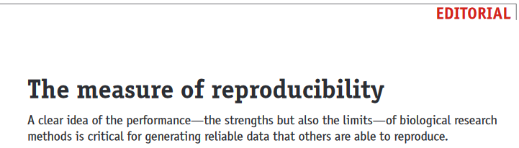

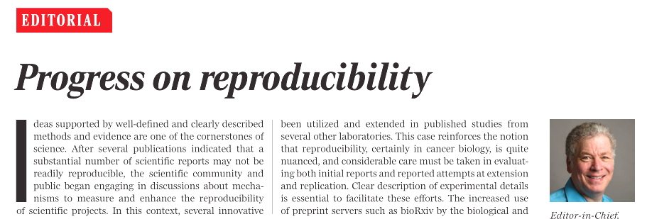
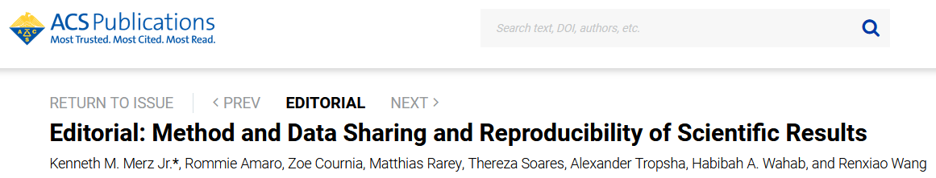
Research reproducibility
3
Improvement on the horizon ?
Nature Methods (2014)
Alain Borel, Francesco Varrato
Science & Society (2017)
EDCH 2024 / Hands-on with Research Data Management in Chemistry
Science (2018)
J. Chem. Inf. Model. 2020
Notes:
According to a Nature study in 2012, 47 out of 53 medical research papers are irreproducible (1).
A previous study showed in 2009 that 16 out of 18 bioinformatics papers could not be reproduced entirely (2).
In 2004, it was found that less than 9% of papers share their code (3).
Begley, C. G.; Ellis, L. M. (2012). "Drug development: Raise standards for preclinical cancer research". Nature 483 (7391): 531–533.
Ioannidis JPA, Allison DB, Ball CA, et al. Repeatability of published microarray gene expression analyses. Nat Genet 2009;41(2):149–55.
Vandewalle, Patrick, Jelena Kovacevic, and Martin Vetterli. "Reproducible research in signal processing." Signal Processing Magazine, IEEE 26.3 (2009): 37-47
https://www.nature.com/news/1-500-scientists-lift-the-lid-on-reproducibility-1.19970
[Slide inspired by https://github.com/saloot/IPythonClass , Amir Hessam Salavati & ,Robin Schiebler 2015 ]
3

Slide 4
Research reproducibility
4
Improvement on the horizon ?
Two projects of the Open Science Framework:
Reproducibility Project: Cancer Biology
Reproducibility Project: Psychology
Some readings:
Implementing Reproducible Research
Reproducible research with R and Rstudio
Nature Methods (2014)
Alain Borel, Francesco Varrato
Science & Society (2017)
EDCH 2024 / Hands-on with Research Data Management in Chemistry
Science (2018)
J. Chem. Inf. Model. 2020
Notes:
According to a Nature study in 2012, 47 out of 53 medical research papers are irreproducible (1).
A previous study showed in 2009 that 16 out of 18 bioinformatics papers could not be reproduced entirely (2).
In 2004, it was found that less than 9% of papers share their code (3).
Begley, C. G.; Ellis, L. M. (2012). "Drug development: Raise standards for preclinical cancer research". Nature 483 (7391): 531–533.
Ioannidis JPA, Allison DB, Ball CA, et al. Repeatability of published microarray gene expression analyses. Nat Genet 2009;41(2):149–55.
Vandewalle, Patrick, Jelena Kovacevic, and Martin Vetterli. "Reproducible research in signal processing." Signal Processing Magazine, IEEE 26.3 (2009): 37-47
https://www.nature.com/news/1-500-scientists-lift-the-lid-on-reproducibility-1.19970
[Slide inspired by https://github.com/saloot/IPythonClass , Amir Hessam Salavati & ,Robin Schiebler 2015 ]
4

Slide 5
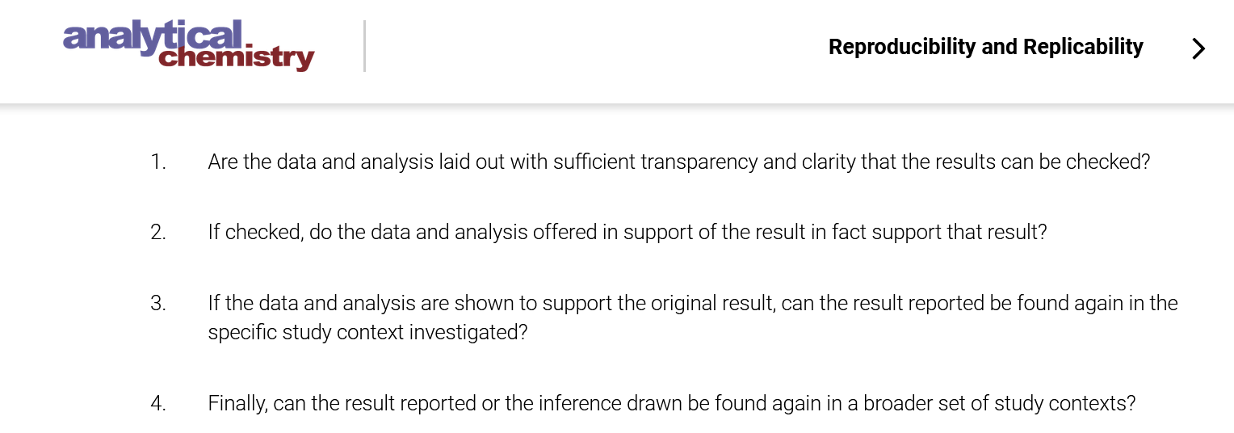
Research reproducibility (issue)
5
Alain Borel, Francesco Varrato
EDCH 2024 / Hands-on with Research Data Management in Chemistry
Source: https://doi.org/10.1021/acs.analchem.9b02719
Notes:
According to a Nature study in 2012, 47 out of 53 medical research papers are irreproducible (1).
A previous study showed in 2009 that 16 out of 18 bioinformatics papers could not be reproduced entirely (2).
In 2004, it was found that less than 9% of papers share their code (3).
Begley, C. G.; Ellis, L. M. (2012). "Drug development: Raise standards for preclinical cancer research". Nature 483 (7391): 531–533.
Ioannidis JPA, Allison DB, Ball CA, et al. Repeatability of published microarray gene expression analyses. Nat Genet 2009;41(2):149–55.
Vandewalle, Patrick, Jelena Kovacevic, and Martin Vetterli. "Reproducible research in signal processing." Signal Processing Magazine, IEEE 26.3 (2009): 37-47
https://www.nature.com/news/1-500-scientists-lift-the-lid-on-reproducibility-1.19970
[Slide inspired by https://github.com/saloot/IPythonClass , Amir Hessam Salavati & ,Robin Schiebler 2015 ]
5

Slide 6
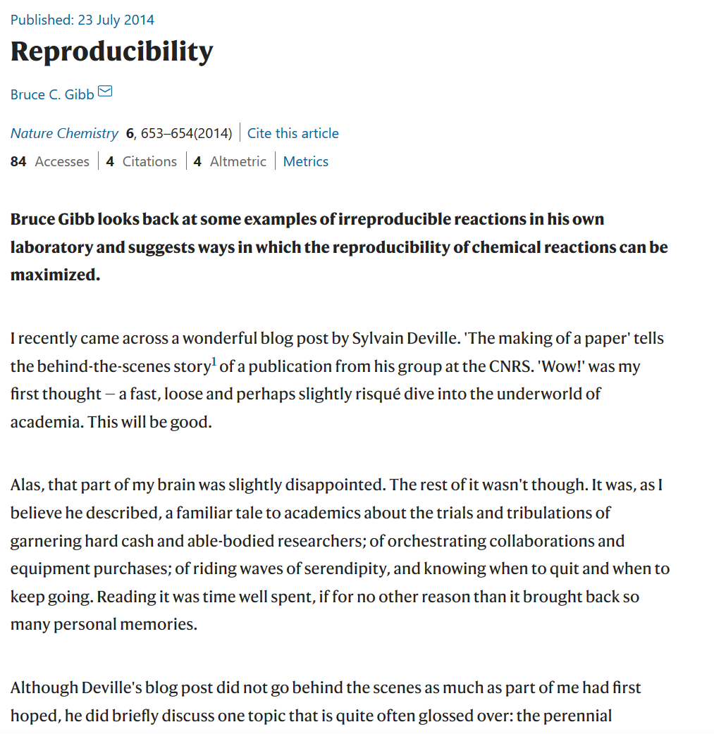
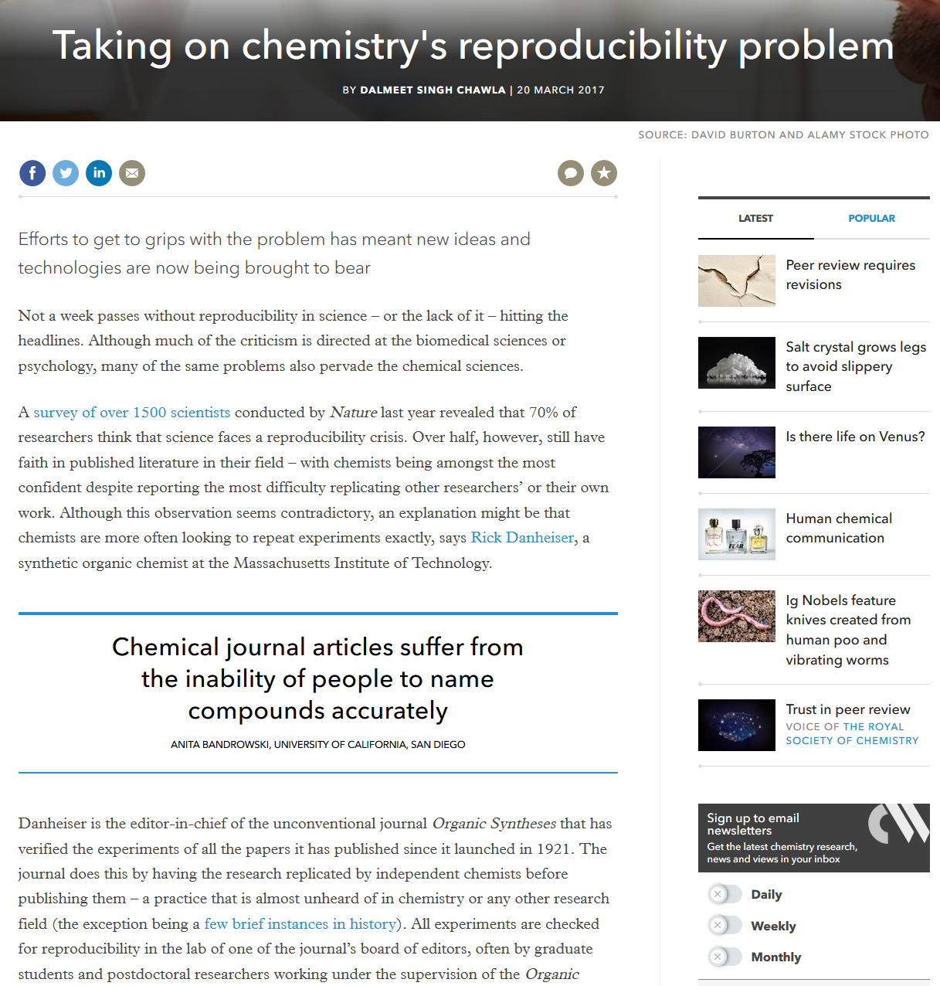
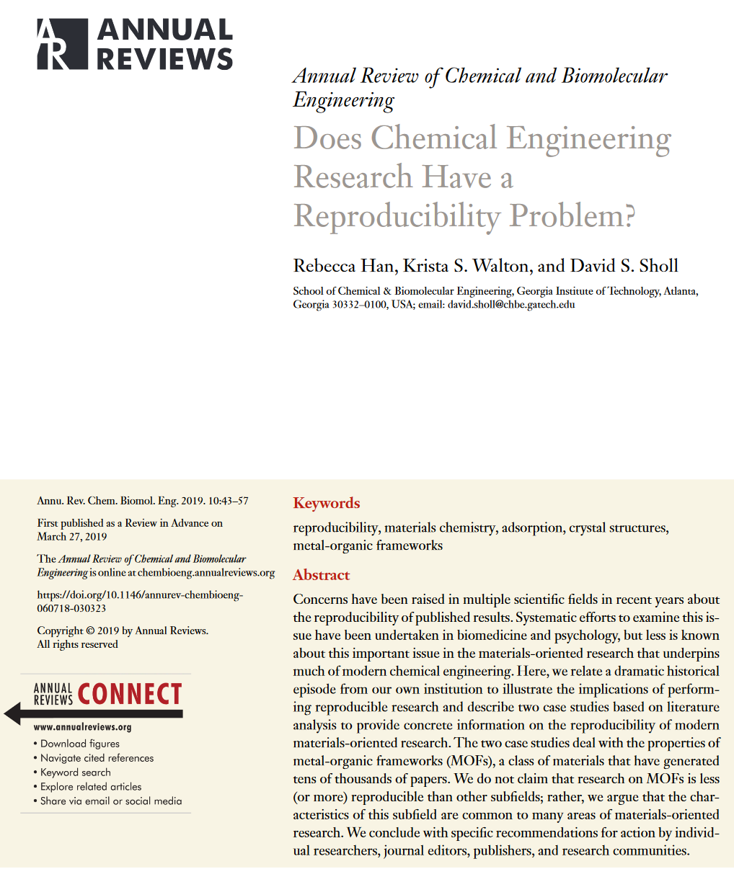
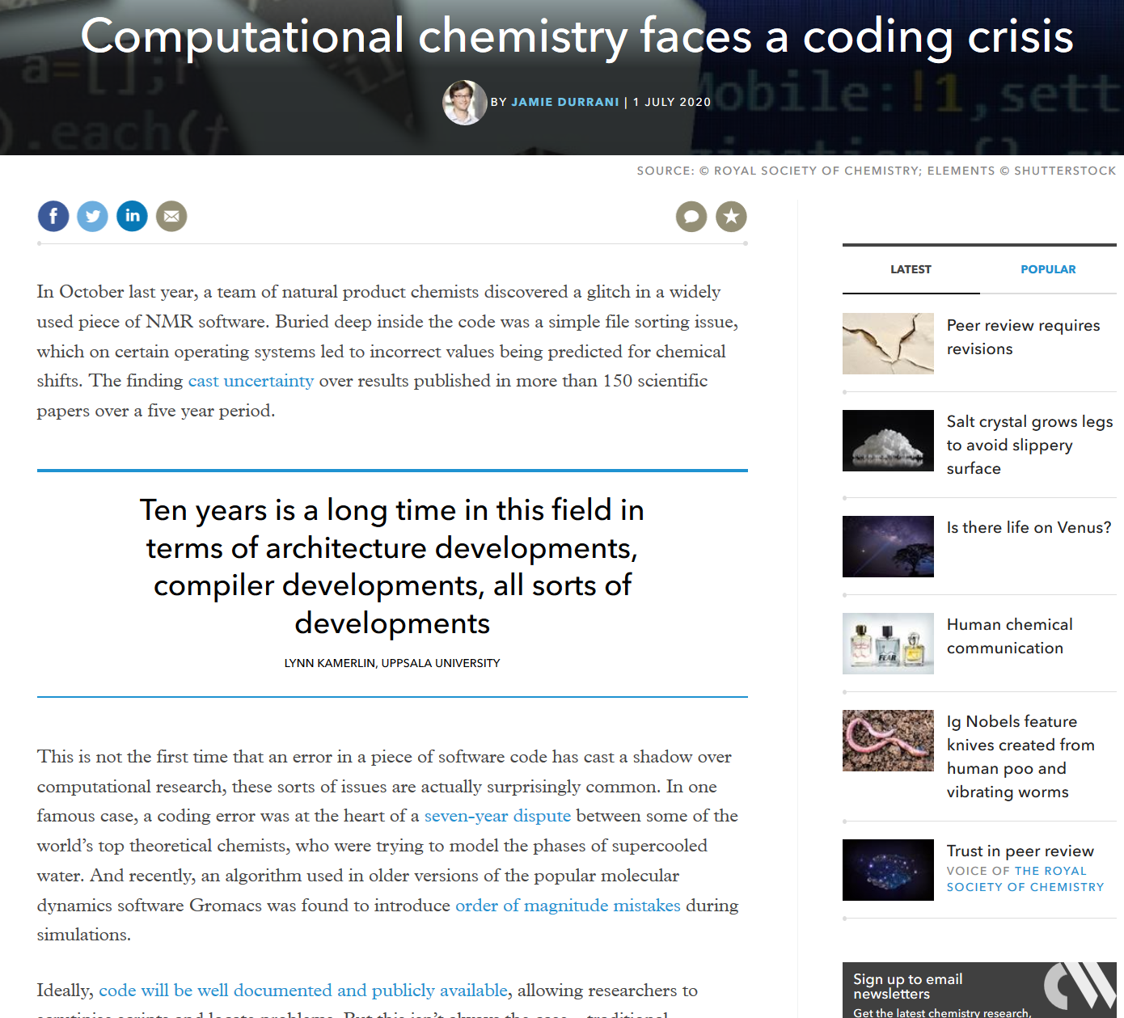
Research reproducibility (Horror stories)
6
doi.org/10.1038/nchem.2017
www.chemistryworld.com/news/chemistrys-reproducibility-crisis-that-youve-probably-never-heard-of/4011693.article
doi.org/10.1146/annurev-chembioeng-060718-030323
www.chemistryworld.com/news/taking-on-chemistrys-reproducibility-problem/3006991.article
Alain Borel, Francesco Varrato
Notes:
Problem not seen as severe in chemistry compared to other fields.
According to a Nature study in 2012, 47 out of 53 medical research papers are irreproducible (1).
A previous study showed in 2009 that 16 out of 18 bioinformatics papers could not be reproduced entirely (2).
In 2004, it was found that less than 9% of papers share their code (3).
Begley, C. G.; Ellis, L. M. (2012). "Drug development: Raise standards for preclinical cancer research". Nature 483 (7391): 531–533.
Ioannidis JPA, Allison DB, Ball CA, et al. Repeatability of published microarray gene expression analyses. Nat Genet 2009;41(2):149–55.
Vandewalle, Patrick, Jelena Kovacevic, and Martin Vetterli. "Reproducible research in signal processing." Signal Processing Magazine, IEEE 26.3 (2009): 37-47
https://www.nature.com/news/1-500-scientists-lift-the-lid-on-reproducibility-1.19970
[Slide inspired by https://github.com/saloot/IPythonClass , Amir Hessam Salavati & ,Robin Schiebler 2015 ]
6

Slide 7
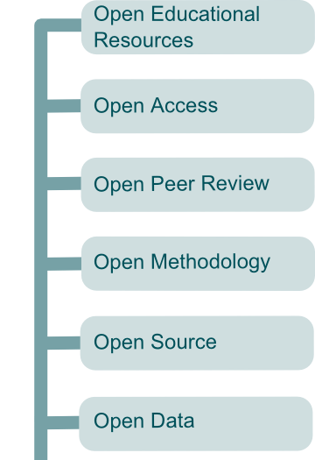

RDM ⇔ Open Science?
The elephant in the room
7
RDM
Alain Borel, Francesco Varrato
EDCH 2024 / Hands-on with Research Data Management in Chemistry
IDEAL
OPEN
SCIENCE
Good data management practices apply also to not Open Data and not Open-Source research

Slide 8

Openness
8
“As open as necessary, as restricted as possible”
Alain Borel, Francesco Varrato
EDCH 2024 / Hands-on with Research Data Management in Chemistry
True or False?
Notes:
8

Slide 9




RDM policies, guidelines ...
9
Institutional policies
ETHZ Guidelines for RDM
Humboldt-Universität zu Berlin
MIT
TU Delft
UNIGE
University of Cambridge
University of Edinburgh
University of Oxford
Alain Borel, Francesco Varrato
EDCH 2024 / Hands-on with Research Data Management in Chemistry
General guidelines
SNSF Open Research Data policy
EC Data Management manual for Horizon 2020 …
Digital Lifecycle Management (DLCM) Swiss National Project
EPFL compliance guide 2019 (p.36)
... and a forthcoming (?) Data Policy
Images: https://pixabay.com/fr/users/kmicican-2305081/

Slide 10




Funders’ requirement
10
SNSF (Ambizione, NCCR, …)
  Mandatory DMP to obtain funding
  Researchers must share (at least) the data underlying their publications
ERC (H2020, MSCA, Horizon Europe 2021-2027 ...)
  Mandatory DMP to obtain funding
  The research data is open by default
+
EPFL (internal projects) + U.S. Federal Grants + Wellcome Trust + Defitech + AXA Research Fund + Chinese government + Ligue contre le cancer + …
Alain Borel, Francesco Varrato
EDCH 2024 / Hands-on with Research Data Management in Chemistry
Notes:
this has changed

Slide 11
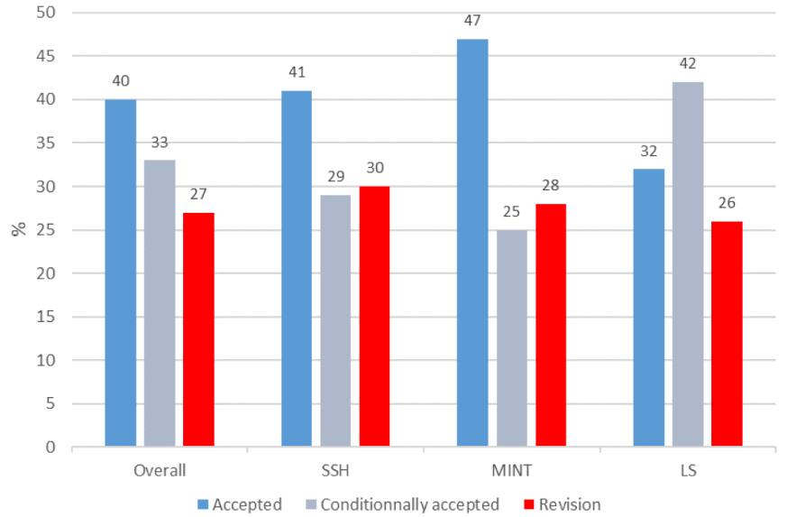
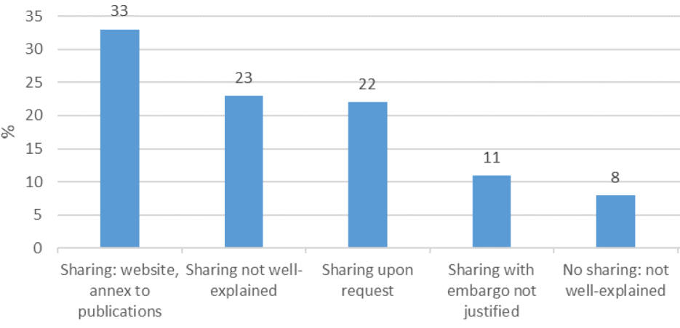
Open Research Data
11
Assessment of DMP
Main reasons for DMPs sent for revision
SNSF report 2017-2018
16% applicants requested ORD funds
0.2% annual costs budgeted for ORD
21% applications budgeted > 10k CHF
45% did not mention
a data repository
Alain Borel, Francesco Varrato
EDCH 2024 / Hands-on with Research Data Management in Chemistry
Main reasons for DMP conditional acceptance
10.5281/zenodo.3618209
Notes:
11

Slide 12


Publishers’ requirement
Many journals require authors to
publish the data underlying the published results
Examples of journals policies on data / code publication
A list of journal open-data policies
A list of Publisher Data Availability Policies (See: ACS, RSC)
More than supplementary material:
valid academic output
Alain Borel, Francesco Varrato
EDCH 2024 / Hands-on with Research Data Management in Chemistry
~
OPEN
DATA
Open Data logo by the EPFL Research Data Library Team:
https://pixabay.com/fr/donn%C3%A9es-ouvertes-base-de-donn%C3%A9es-1518223/
Open Sans: https://fonts.google.com/specimen/Open+Sans?selection.family=Open+Sans
Notes:
Maybe add some info from https://swafs.se/in-english/open-access/?

Slide 13
Publishers’ requirement: Examples
Science
All data used in the analysis must be available to any researcher for purposes of reproducing or extending the analysis. Data must be available in the paper or deposited in a community special-purpose repository or a general-purpose repository [source]
SpringerNature
[…] authors are required to make materials, data, code, and associated protocols promptly available to readers without undue qualifications. Any restrictions on the availability of materials or information must be disclosed to the editors at the time of submission [source]
ACS
Where ethically and legally feasible, all ACS journals strongly encourage authors to make the research data underlying their articles publicly available at the time of publication […] To ensure data accessibility, we encourage the use of open licenses for reuse of data, such as Creative Commons CC BY [source]
… etc.
Alain Borel, Francesco Varrato
EDCH 2024 / Hands-on with Research Data Management in Chemistry
Notes:
Maybe add some info from https://swafs.se/in-english/open-access/?

Slide 14
FAIR data vs. Supplementary Information
Alain Borel, Francesco Varrato
EDCH 2024 / Hands-on with Research Data Management in Chemistry
Notes:
Maybe add some info from https://swafs.se/in-english/open-access/?

Slide 15
Data actions in your project … to fill in!
15
ACTIVITIES | COLLEAGUE / PARTNER | TOOLS | TO-DO
FUNDING PLANNING
CREATION
ETHICAL CLEARANCE
ACQUISITION
STORING
ANALYSIS
LEGAL CLEARANCE
SHARING
PUBLISHING
ARCHIVING
Alain Borel, Francesco Varrato
To-Dos?
Choose a data repository
Assess the cost of your RDM
EDCH 2024 / Hands-on with Research Data Management in Chemistry
See paper copy + on Moodle go.epfl.ch/ChE-601
Notes:
Présenter le doc
Leur dire de réfléchir à ce qu’ils savent déjà
Dire la documentation se fait à toutes les étapes (donc elle devrait être partout dans la to-do)

Slide 16

Documentation
horror stories [5’]
16
Think about your project…
… does your ELN decide the file naming for you?
… how do you currently document your data / code?
… which naming standard do you use for the labels in your tables?
… what will happen to
your data / code if not
properly documented?
Alain Borel, Francesco Varrato
EDCH 2024 / Hands-on with Research Data Management in Chemistry
Notes:
Francesco a un truc à raconter

Slide 17
Documentation
17
WHAT? | Description of your data / code
 | Planned before starting the data collection
HOW? | Project-dependent
 | Consistent documentation methodology
WHY? | Data more understandable for yourself
 | Data more understandable for others
 | Saves time upon publication
Alain Borel, Francesco Varrato
EDCH 2024 / Hands-on with Research Data Management in Chemistry

Slide 18
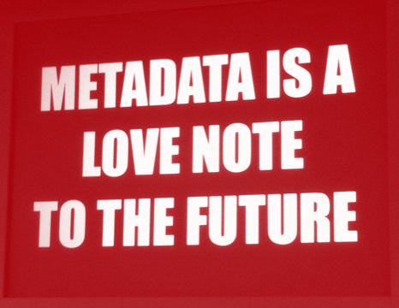
Ways to document data
18
Metadata
In-file metadata (ex. .docx author, creation date, file tagging,…)
Naming convention (for files & folders & database objects)
Folders structure
Database schema
Version
Data dictionaries
Codebooks
Metadata standards
Metadata vocabularies
Discovery metadata (ex. publication keywords)
Documentation
README files
Laboratory notebooks
Experimental protocols
Software parameters
Output / Log files
DMP
RDM Strategy
Alain Borel, Francesco Varrato
EDCH 2024 / Hands-on with Research Data Management in Chemistry
Notes:
This slide at least should be CC-BY-SA because using info from V:\J_Formations\J2_Formations_courantes\J2.03_Chercheurs\2020\2020-06-23_The_power_of_metadata
18

Slide 19
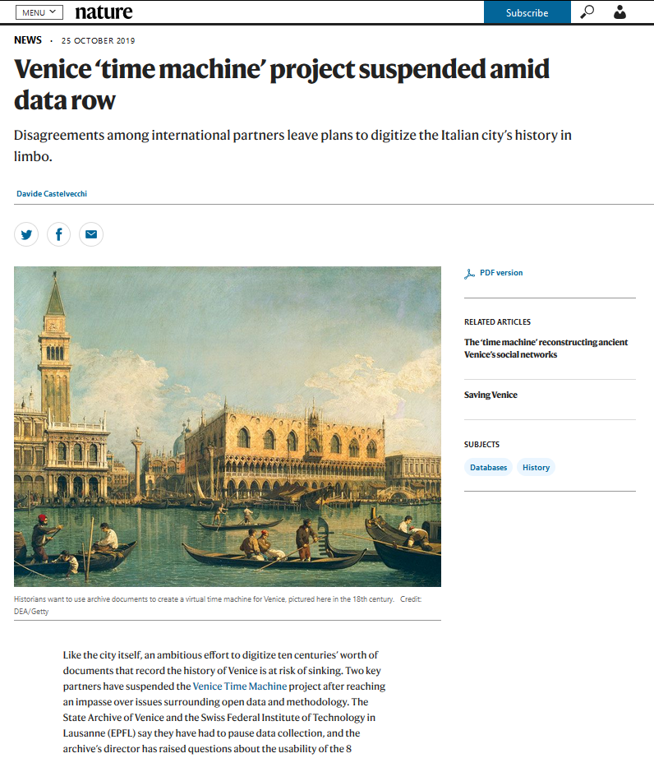
Importance of metadata (!)
19
2012 – Project of officially launched:
Venice’s State Archive + Ca’ Foscari Univ. + EPFL (DHLAB)
2014 – Non-binding agreement signed. But … didn't specify the licensing that would regulate researchers’ use of the digitized data
2017 – At stake: 1,000 years of records in dynamic digital form: special high-speed scanners, thousands HD images per hour
2019 – Allegedly, the digitization of ~190,000 documents (8 TB) didn’t follow a common metadata policy: archival-science guidelines (require records of provenance for each document)
2019 – ... data collection has been paused, amid doubts on the usability of the data already collected!
EDCH 2024 / Hands-on with Research Data Management in Chemistry
DOI: 10.1038/d41586-019-03240-w
Notes:
Metadata war: InterPARES recommendations vs ISADg norm (International Council on Archives)
19

Slide 20
DMP as documentation: What is it?
20
Data Management Plan
Living document & Research roadmap
Alain Borel, Francesco Varrato
Describes
strategy to manage data
actions to take
needed resources
(time, money, people, tools)
(Minimum) Content of a DMP
Institution and contacts
Data collection and documentation
Ethics, legal and security issues
Resources and responsibilities
Data storage and preservation
Data sharing and reuse
EDCH 2024 / Hands-on with Research Data Management in Chemistry

Slide 21
What is a DMP?
21
Data Management Plan
Living document & Research roadmap
Alain Borel, Francesco Varrato
EDCH 2024 / Hands-on with Research Data Management in Chemistry
Do you/your thesis supervisor(s)
have a DMP for your project?

Slide 22
Why a DMP?
Plan: future needs (material, software, HR ...)
Science: impact, better reproducibility, posterity
Data reuse: better use of public funds
Openness: impact, transparency, accountability
Visibility: citations, collaborations, career
Compliancy: law (ex. GDPR), funders (ex. SNSF)
Efficiency: faster research for your lab and beyond
Risk reduction: data loss, privacy, patents, …
Modernity: world-scale digital research, big data
…
Alain Borel, Francesco Varrato
EDCH 2024 / Hands-on with Research Data Management in Chemistry
Notes:
JP: I added “ethics” as this term is missing to conscientize researchers on the way of conducting research, the term is now used as “legal compliance” only

Slide 23
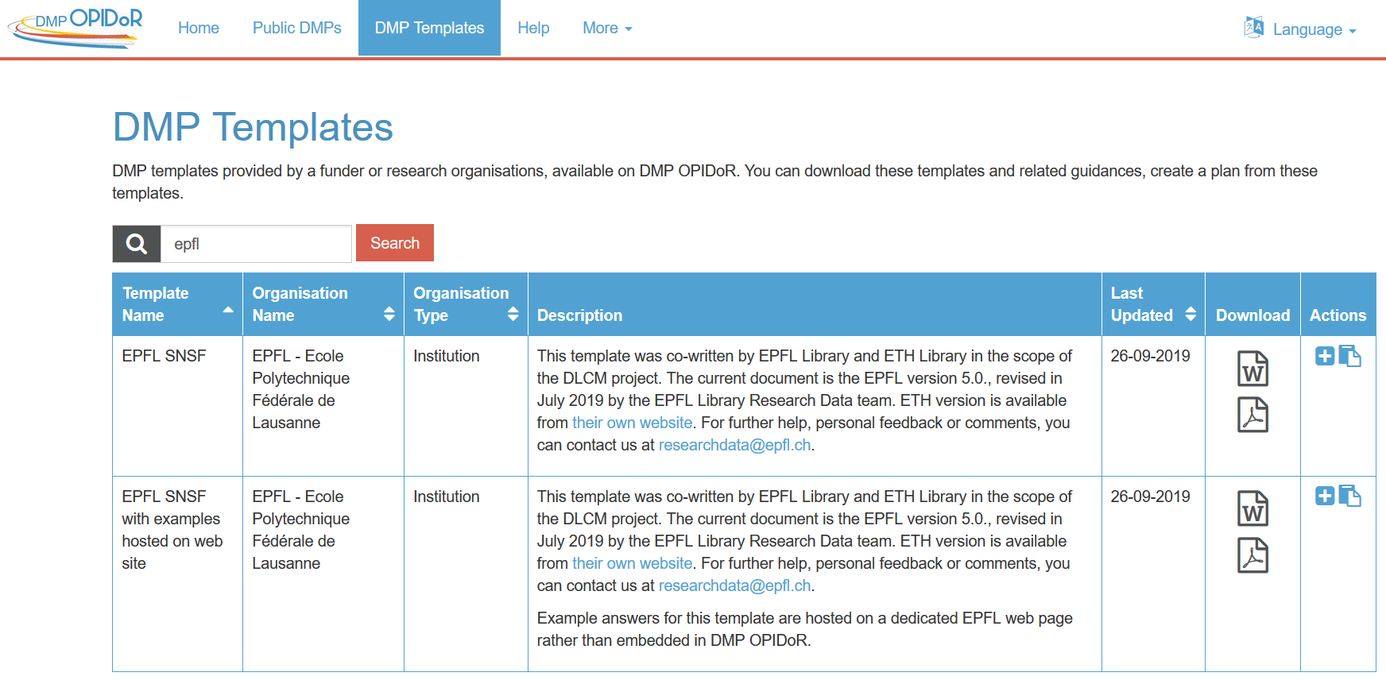
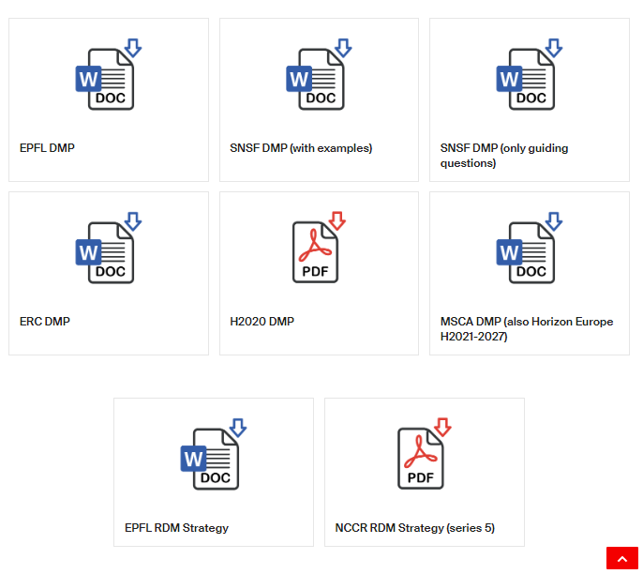

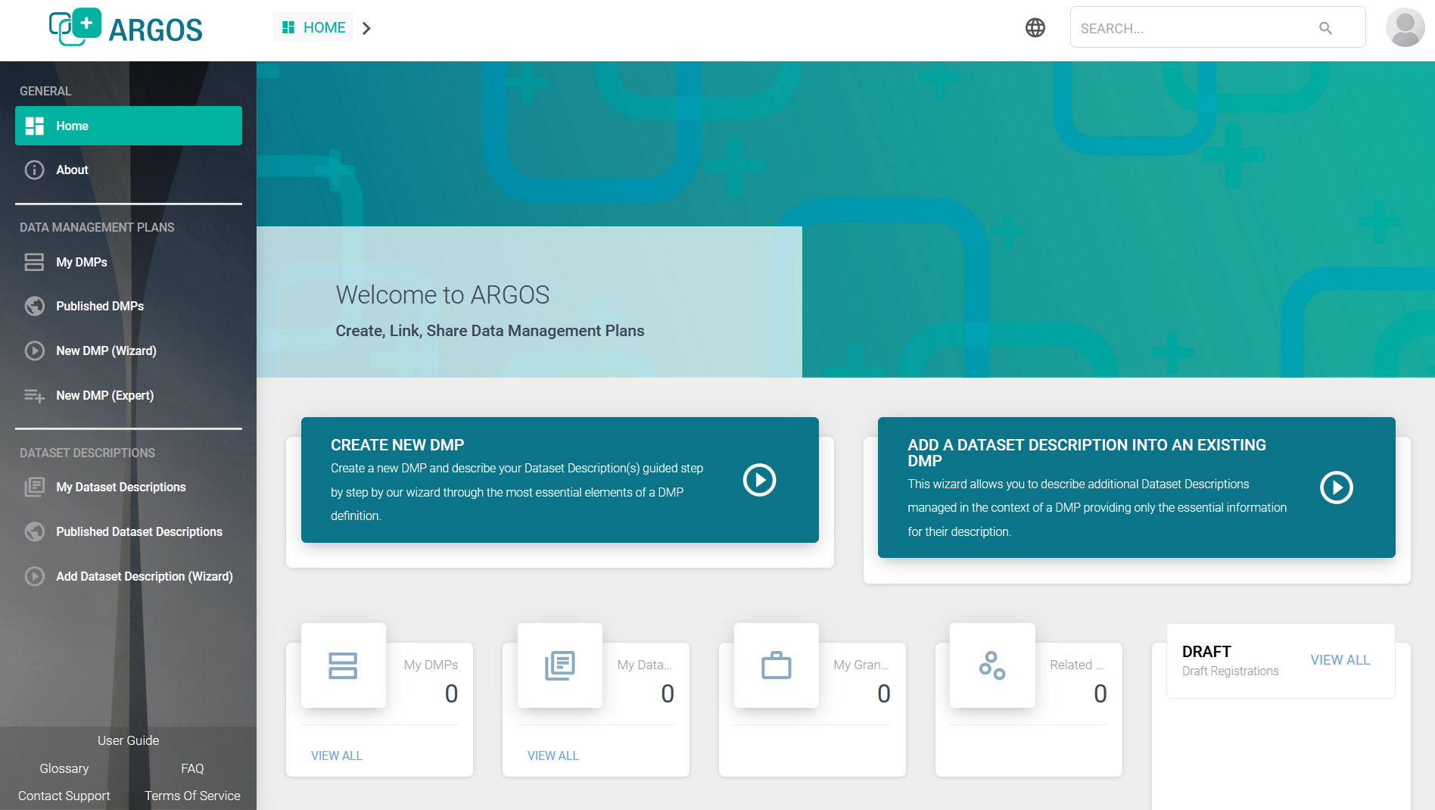
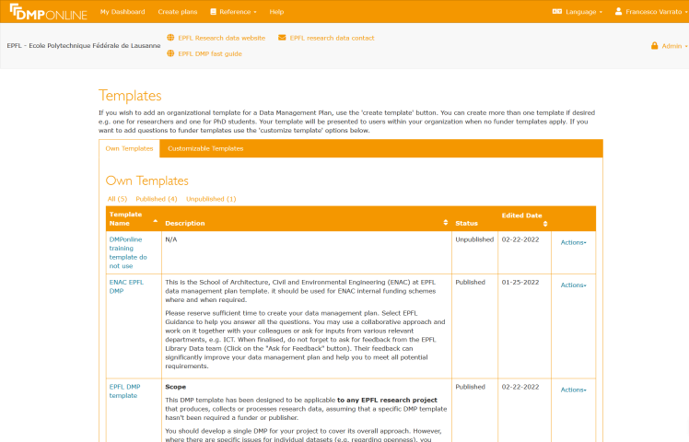
Some resources
Other resources
go.epfl.ch/rdm-guide
dmp.opidor.fr/public_templates
Alain Borel, Francesco Varrato
EDCH 2024 / Hands-on with Research Data Management in Chemistry
argos.openaire.eu
dmponline.dcc.ac.uk
Notes:
JP: I added “ethics” as this term is missing to conscientize researchers on the way of conducting research, the term is now used as “legal compliance” only

Slide 24
Example: Check out a DMP
24
ERC Template
0. SUMMARY
(dataset reference and name; origin and expected size of the data generated/collected; data types and formats)
Alain Borel, Francesco Varrato
EDCH 2024 / Hands-on with Research Data Management in Chemistry
1. MAKING DATA FINDABLE
(dataset description: metadata, persistent and unique identifers e.g., DOI)

Slide 25
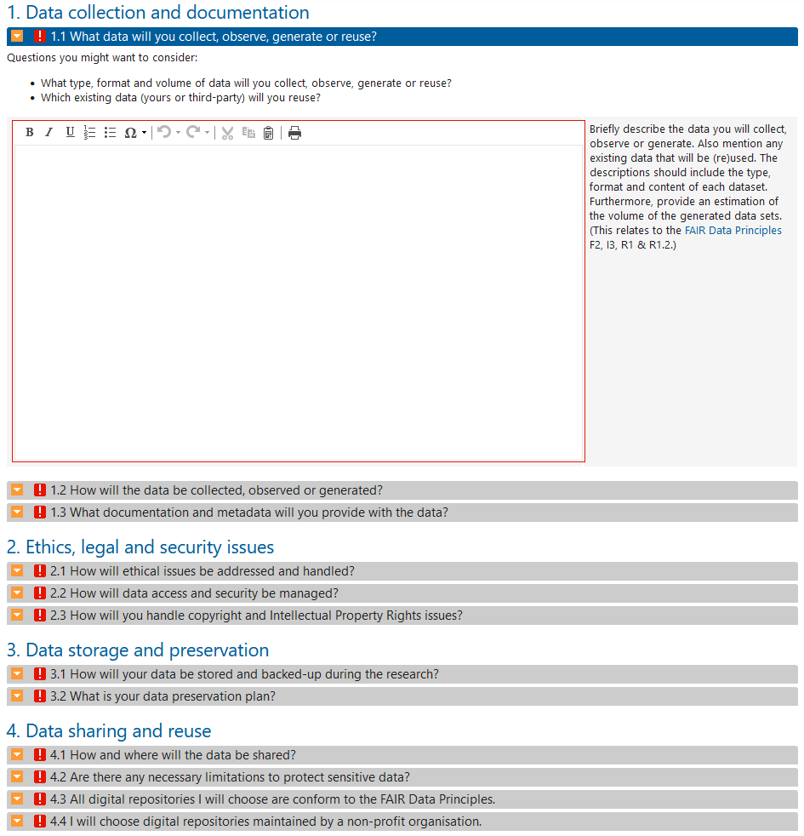

DMP example: SNSF
Online form
Accessible from PI (Principal Investigator)
Can be modified at each moment
Should be updated when funding ends
go.epfl.ch/dmp-snsf
EDCH 2024 / Hands-on with Research Data Management in Chemistry

Slide 26
Exercise [~15’]: SNSF DMP
[5’] Write section 1.1 of DMP (about your actual project)
[5’] Live peer-review (by couples)
[5’] Common feedback
Alain Borel, Francesco Varrato
go.epfl.ch/dmp-snsf
EDCH 2024 / Hands-on with Research Data Management in Chemistry
1.1 What data will you collect, observe, generate or re-use?
What type, format and volume of data will you collect, observe, generate or reuse?
Which existing data (yours or third-party) will you reuse?

Slide 27
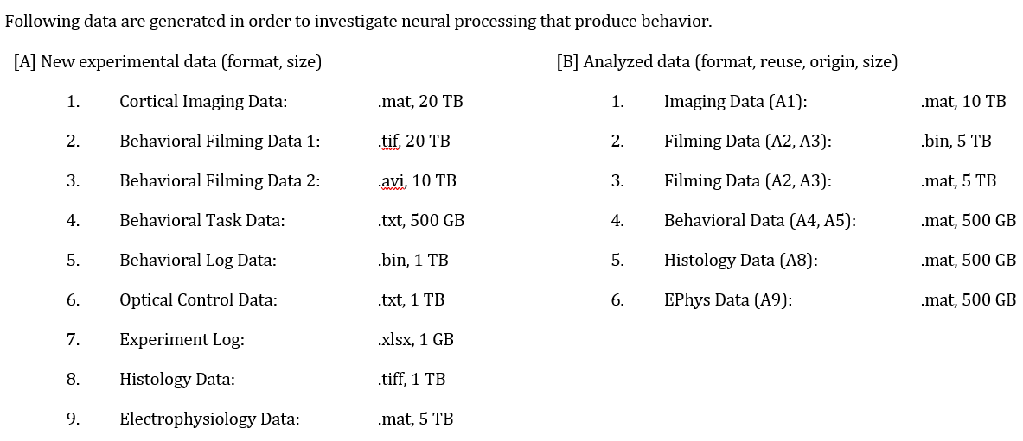
Data categorization: Example
27
Alain Borel, Francesco Varrato
EDCH 2024 / Hands-on with Research Data Management in Chemistry
Source: DMP draft by Keita Tamura, Marie Curie fellowship application
Notes:
Source http://help.osf.io/m/bestpractices/l/618767-how-to-make-a-data-dictionary#!prettyPhoto
27

Slide 28


RDM strategy
28
DMP is for 1 project
RDM Strategy is for > 1 projects Personal RDM strategy Research group strategy Research collaboration strategy
Alain Borel, Francesco Varrato
EDCH 2024 / Hands-on with Research Data Management in Chemistry
DMP templates:
go.epfl.ch/rdm-guide
argos.openaire.eu
RDM Strategy templates:
NCCR RDM Strategy (SNSF)
RDM Strategy (EPFL)
Notes:
a major DMP for sub projects, partnerships between labs

Slide 29
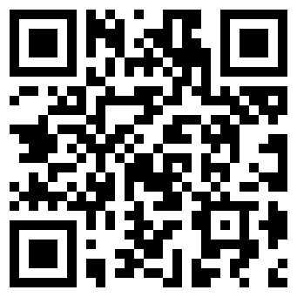
README as documentation
29
A README provides info about data file(s) and enables reusability
README content:
General information
Data and file overview
Sharing and access information
Methodological information
README vademecum and template
go.epfl.ch/rdm-readme
Alain Borel, Francesco Varrato
EDCH 2024 / Hands-on with Research Data Management in Chemistry
Best practices
Write the README as a plain text file (open format)
Follow existing conventions…. Smartly ☺
1 README per data folder (whenever possible)
Name the README in accordance with described files
Use the same template for multiple READMEs
Use standardized date formats [W3C/ISO 8601 date standard]:
YYYY-MM-DD or YYYY-MM-DD-hh:mm:ss
Write for human readers (does not replace metadata)

Slide 30
README example/template ^{(* recommended)}
30
Dataset title
General information or Introduction section
author(s) info (name, affiliation, persistent id) *
date of collection *
geolocation data
funding or sponsorship info *
Sharing / Access information / License
licenses *
terms of use *
citation instructions *
links to related publication(s)
links to related datasets or code
url in repository
persistent identifiers
Data and file(s) overview
files and folders structure description *
file formats *
additional related data
data dictionary or data codebook *
original source if any
dataset version, update description/changelog
Methodological info / Preparation
link to publications used as base for methods
methods for processing data *
technical requirements: instruments, software, parameters, calibration data *
people involved in experiments, surveys, analysis
quality assurance process applied
standards applied
Alain Borel, Francesco Varrato
EDCH 2024 / Hands-on with Research Data Management in Chemistry
More details: https://go.epfl.ch/rdm-readme-template

Slide 31
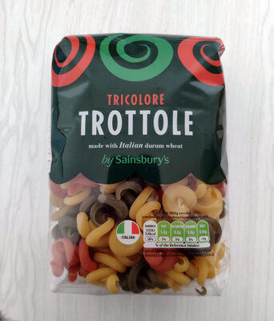
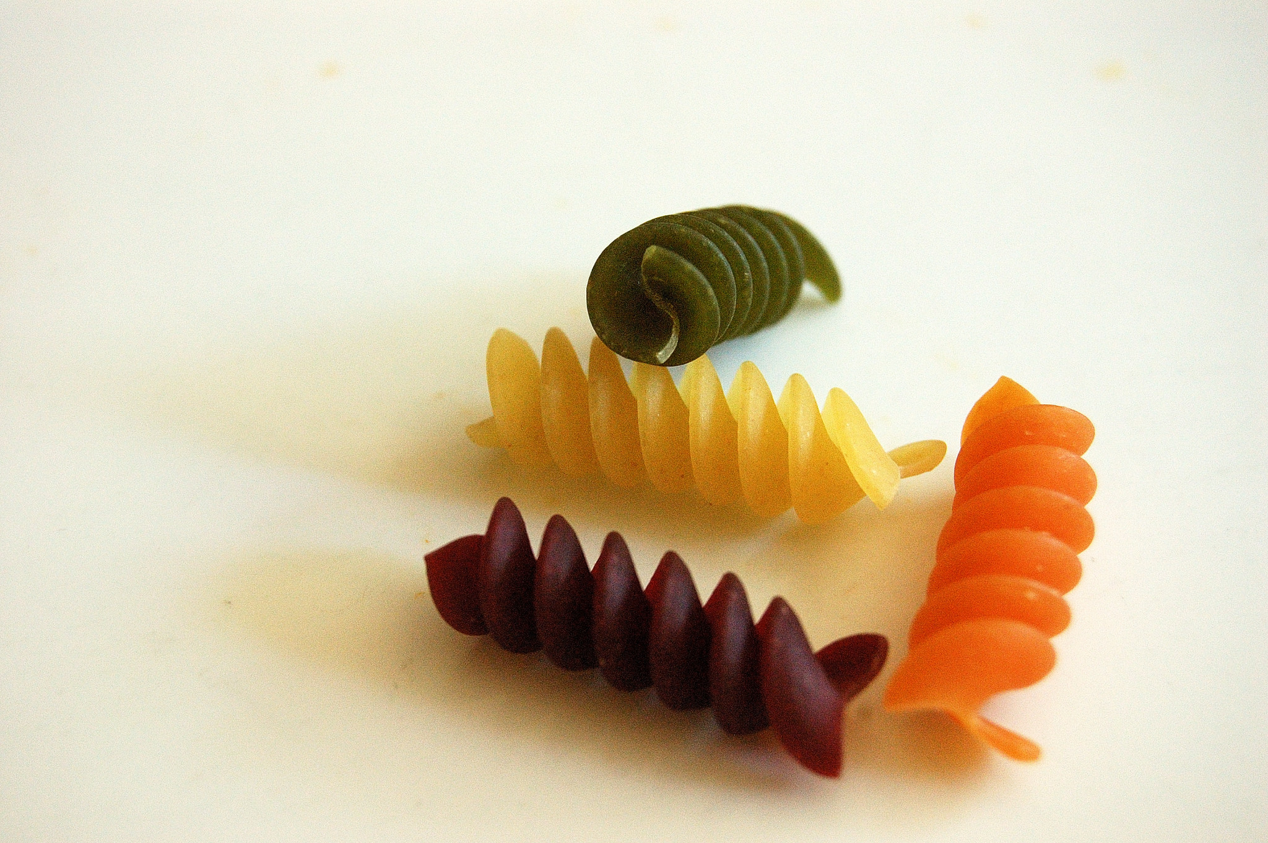
Data or Metadata?
31
Alain Borel, Francesco Varrato
EDCH 2024 / Hands-on with Research Data Management in Chemistry
DATA = Input Values
METADATA = Info about data
CC BY SA 3.0 by Chiefio per Wikimedia Commons
CC BY SA 3.0 by alia per Open Food Facts

Slide 32
Metadata
32
Is both machine-readable AND human-readable
Is not free text/char strings, is typed and formatted
Metadata is structured information associated with an object for purposes of discovery, description, use, management, and preservation.
NISO (2008) framework.niso.org/24.html
Alain Borel, Francesco Varrato
EDCH 2024 / Hands-on with Research Data Management in Chemistry
Ex. associated to research data and code
Supporting the research data lifecycle
(*) Taken from Taylor, C. F., Paton, N. W., Lilley, K. S., Binz, P.-A., Julian, R. K., Jones, A. R., Zhu, W., Apweiler, R., Aebersold, R., Deutsch, E. W., Dunn, M. J., Heck, A. J. R., Leitner, A., Macht, M., Mann, M., Martens, L., Neubert, T. A., Patterson, S. D., Ping, P., … Hermjakob, H. (2007). The minimum information about a proteomics experiment (MIAPE). Nature Biotechnology, 25(8), 887‑893. https://doi.org/10.1038/nbt1329
Notes:
Click on MIAPE figure excerpt to see full cited figure

Slide 33
Data or Metadata?
33
Metadata: Data
Brand: Sainsbury’s
Fabrication Country: Italy
Fat in grammes: 1.1
Pasta Type: Fusilli
Cooking Time in minutes: 12
In a client database, client, brand and fabrication country are your metadata.
The data is not in bold
Alain Borel, Francesco Varrato
EDCH 2024 / Hands-on with Research Data Management in Chemistry
Client | Brand | Fabrication Country
Sainsbury’s | Sainsbury’s | Italy
Coop | Barilla | Italy

Slide 34
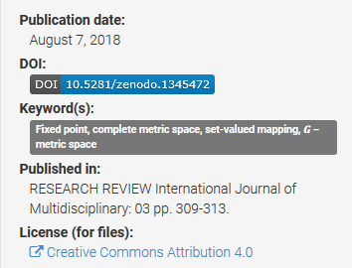
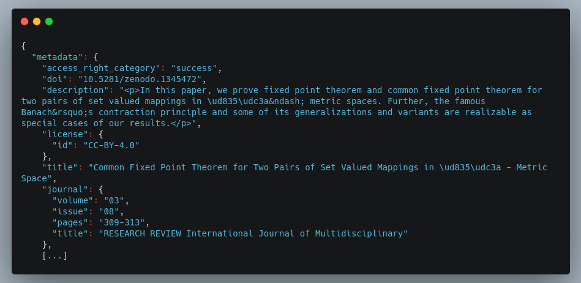
Metadata Example
34
Title, author, date, DOI, format, version, …
Info stored in repository’s internal database
Alain Borel, Francesco Varrato
EDCH 2024 / Hands-on with Research Data Management in Chemistry
Human readable
Machine readable
Notes:
Click on MIAPE figure excerpt to see full cited figure

Slide 35
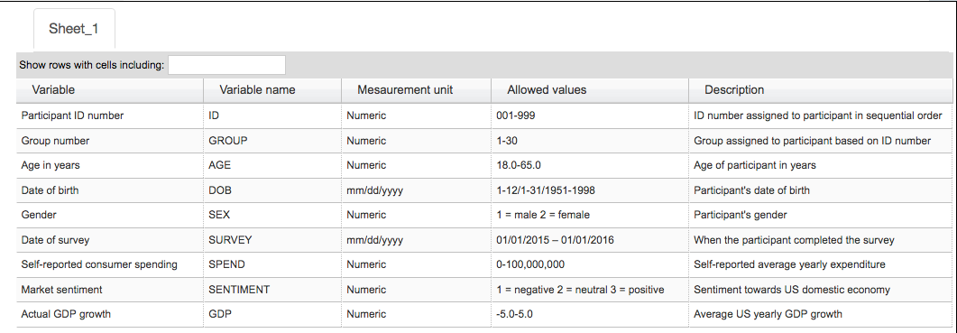
Data dictionaries / Codebooks
35
Explain variables used in a dataset, within a table
Source: https://help.osf.io/hc/en-us/articles/360019739054-How-to-Make-a-Data-Dictionary
Alain Borel, Francesco Varrato
EDCH 2024 / Hands-on with Research Data Management in Chemistry
Example of content:
variable name, variable label, variable definition, units of measure, allowed ranges, value code, missing data, etc.
Discover more on how to Create a Codebook on the Data Documentation Initiative (DDI) Alliance website.
Notes:
À modif. avec types qui concernent plus la chimie … pas clair si quelqu’un utilise les codebooks en chimie, et si oui pourquoi…
35

Slide 36
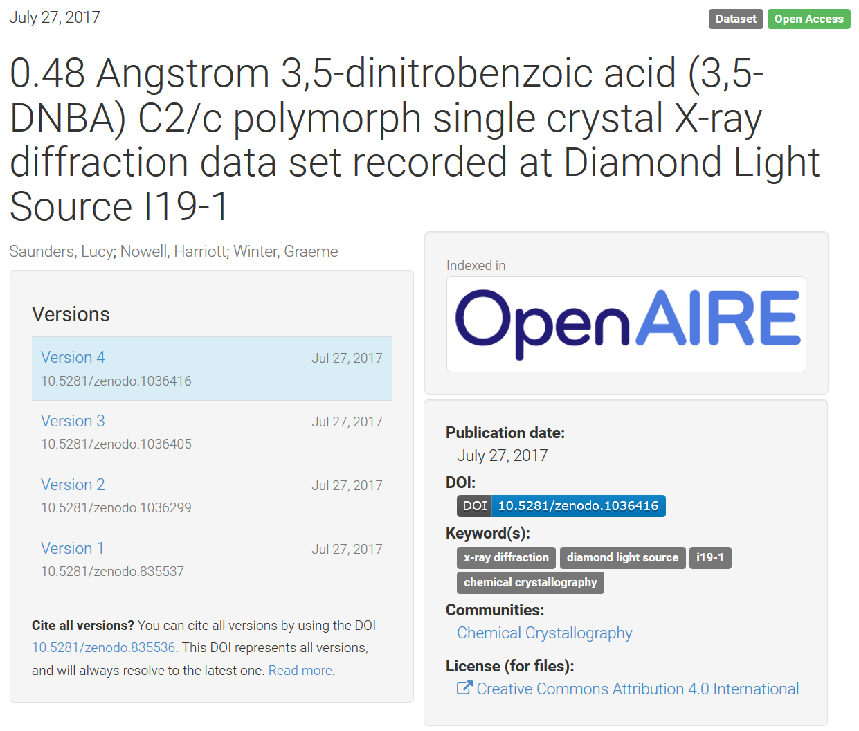
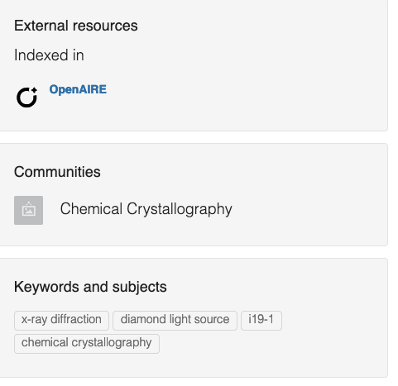
Metadata standards
36
Dataset description (metadata)
Data Repository integration (example)
Identifier Title Creator Subject Description | Publisher Date Formats Rights ...
Alain Borel, Francesco Varrato
Basic & General schemas
Dublin Core
DataCite
…
Disciplinary schemas
Digital Curation Centre
Linked Open Vocabularies (LOV)
Fairsharing
…
EDCH 2024 / Hands-on with Research Data Management in Chemistry
Source: https://doi.org/10.5281/zenodo.835536
Notes:
Bad example: https://ord.fkp.jku.at/dataset/151027b
36

Slide 37
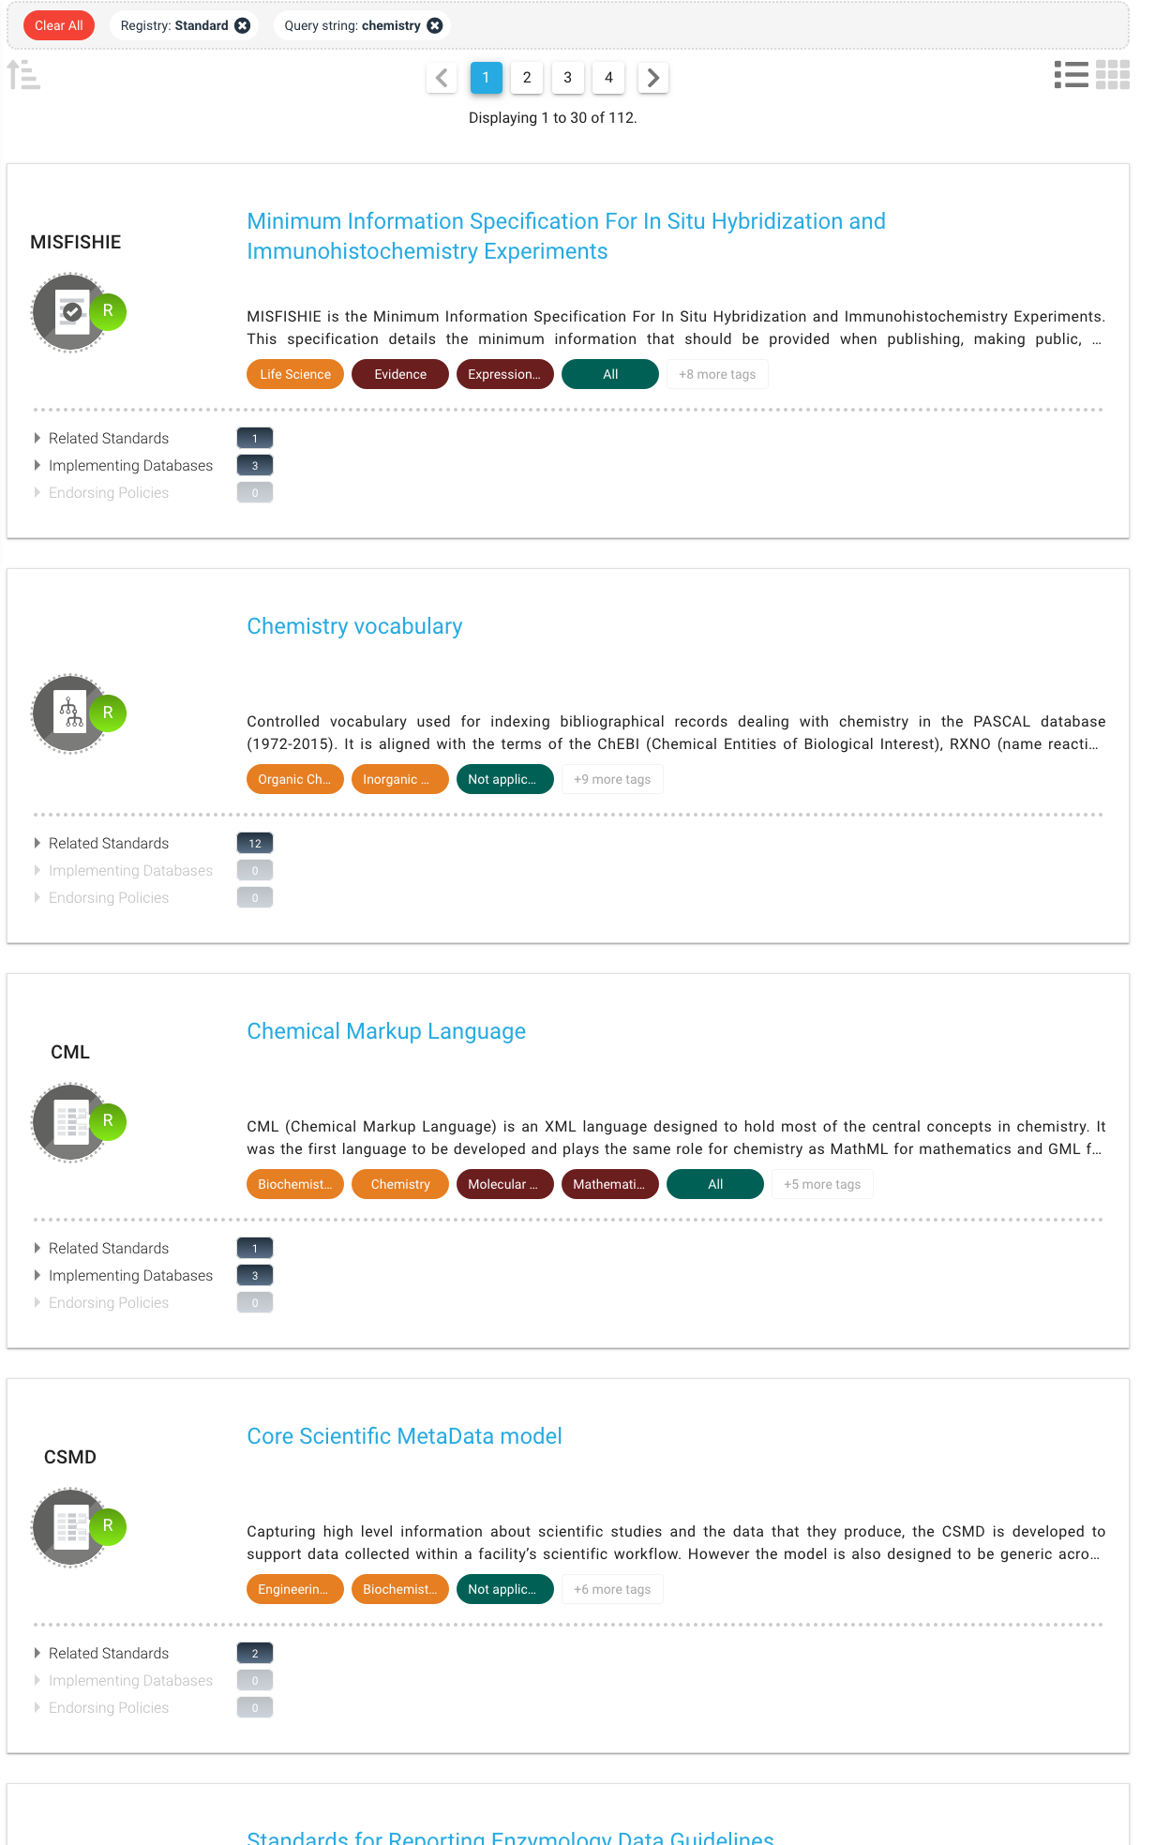

Metadata standards
37
Notes:
Bad example: https://ord.fkp.jku.at/dataset/151027b
37

Slide 38
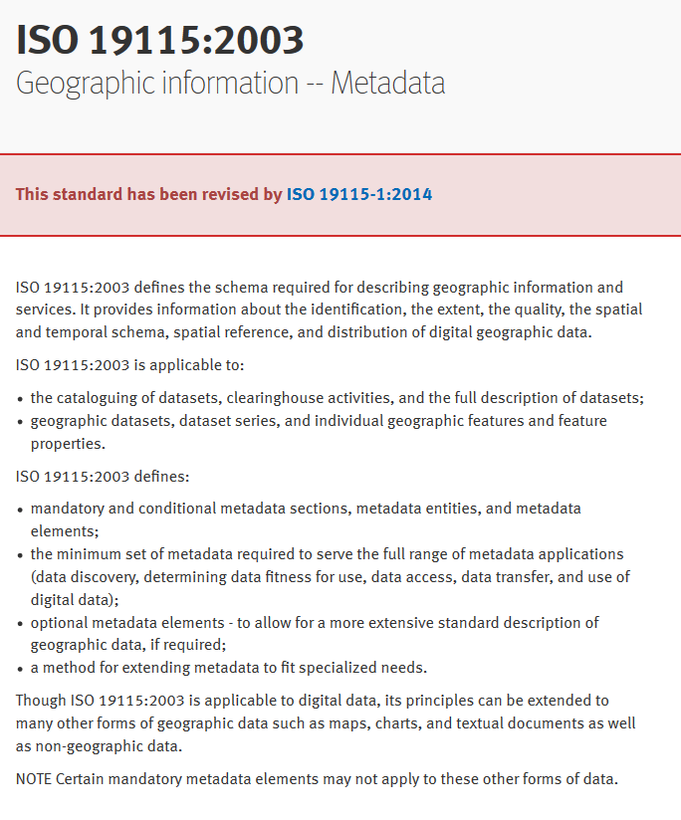
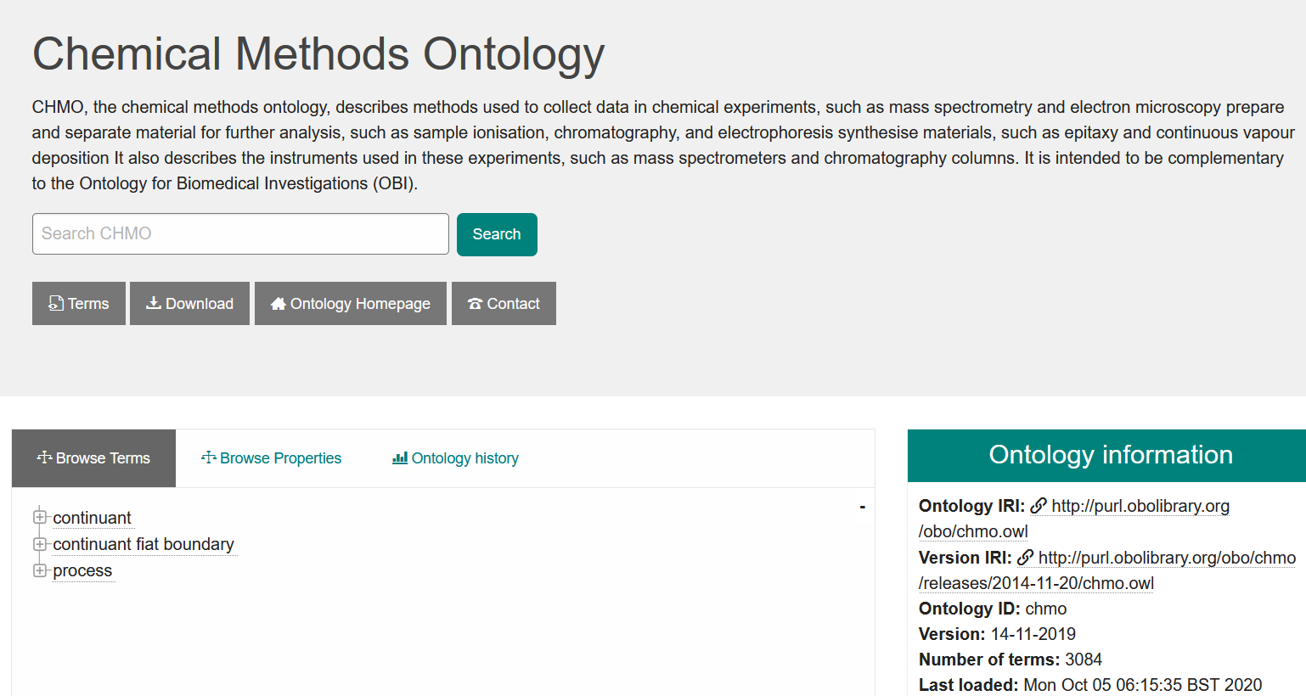
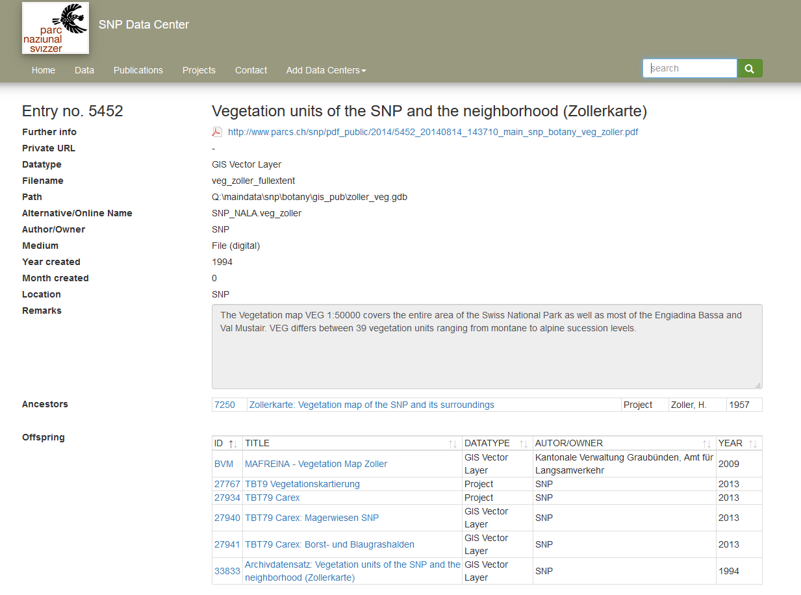
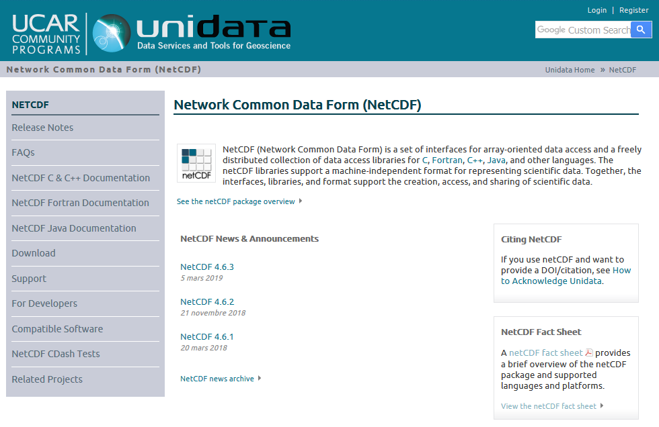
Metadata standards usage (examples)
38
Alain Borel, Francesco Varrato
EDCH 2024 / Hands-on with Research Data Management in Chemistry
Notes:
38

Slide 39
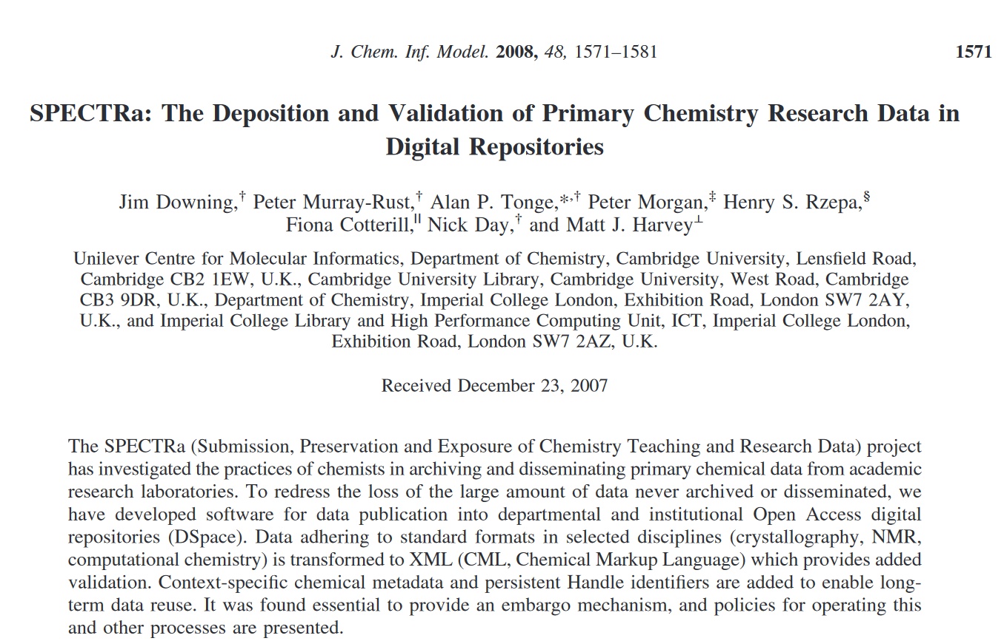
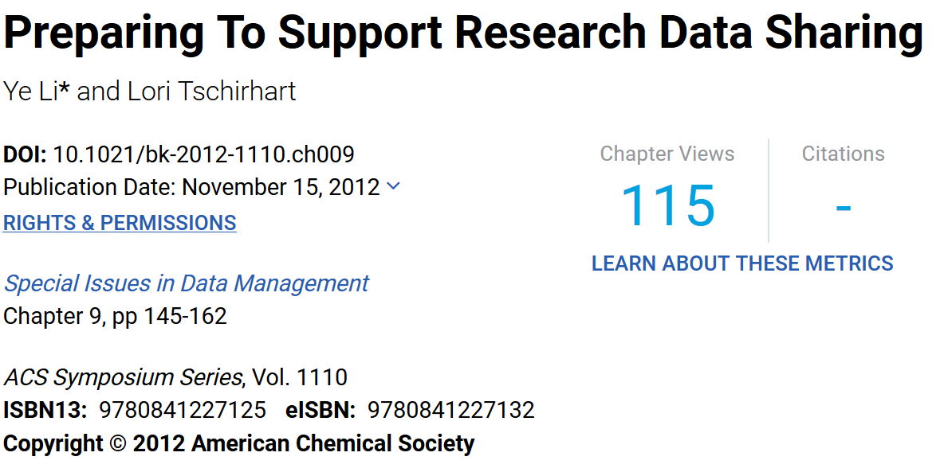
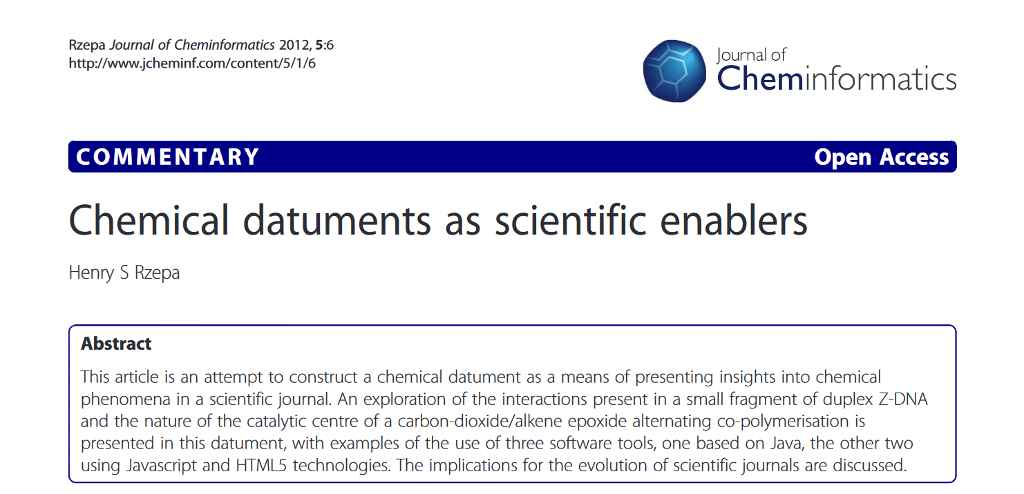
Standards: From awareness to practice
39
Alain Borel, Francesco Varrato
EDCH 2024 / Hands-on with Research Data Management in Chemistry
doi.org/10.1021/ci7004737
doi.org/10.1021/bk-2012-1110.ch009
doi.org/10.1186/1758-2946-5-6
Ex.: “Datument […] refers to a data-rich document […] that describes a story of chemical research in a manner which allows the data underpinning the discourse to be provided as an integral part of that story.”
Notes:
Source http://help.osf.io/m/bestpractices/l/618767-how-to-make-a-data-dictionary#!prettyPhoto
39

Slide 40
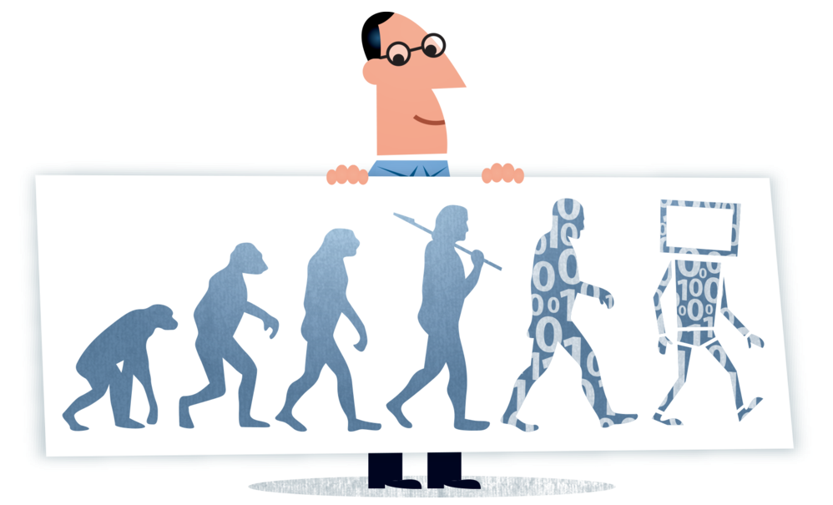
Files or Database?
40
File management
Database management
File / folder organization
File / folder naming
File / folder versioning system
File / folder access rights management
Data model / Data dictionary
Metadata design / standards
Administrative data / logs
User rights management
Database administrator
Alain Borel, Francesco Varrato
EDCH 2024 / Hands-on with Research Data Management in Chemistry
Image source: Digitalbevaring.dk (CC BY 2.5 DK)

Slide 41
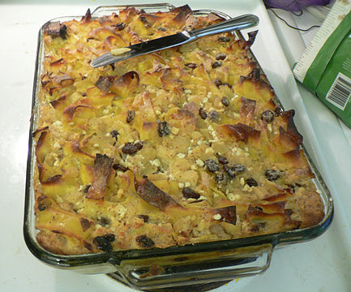
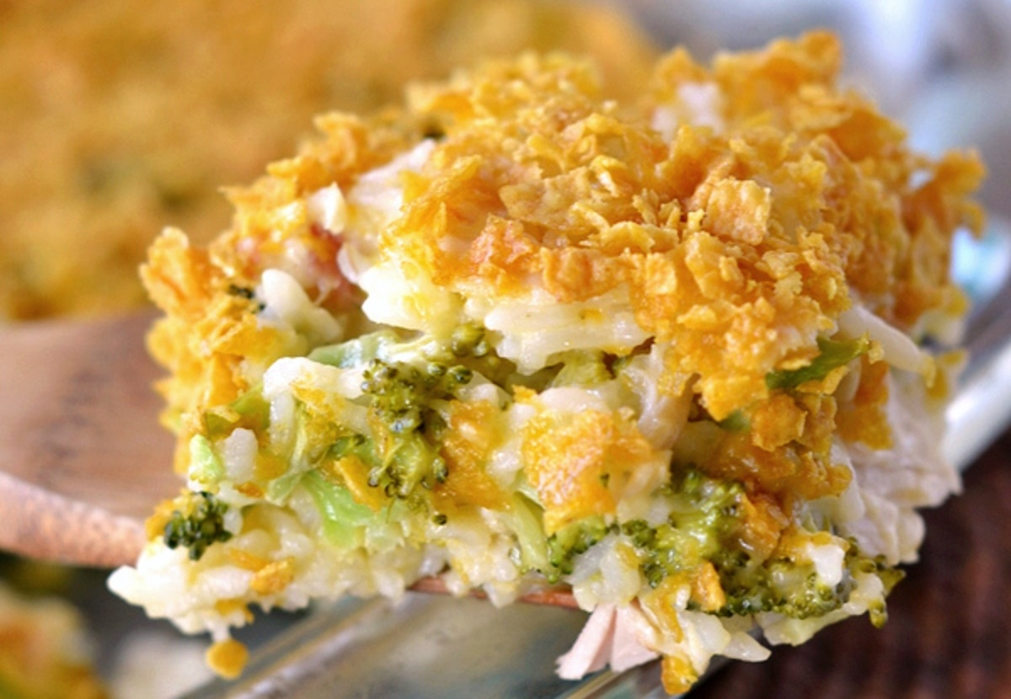
Dataset or Database?
Alain Borel, Francesco Varrato
EDCH 2024 / Hands-on with Research Data Management in Chemistry
Database:
Organized collection of data stored as multiple datasets
Dataset:
Data+Code+Metadata associated with a unique body of work
Definition source: U.S.G.S.

Slide 42
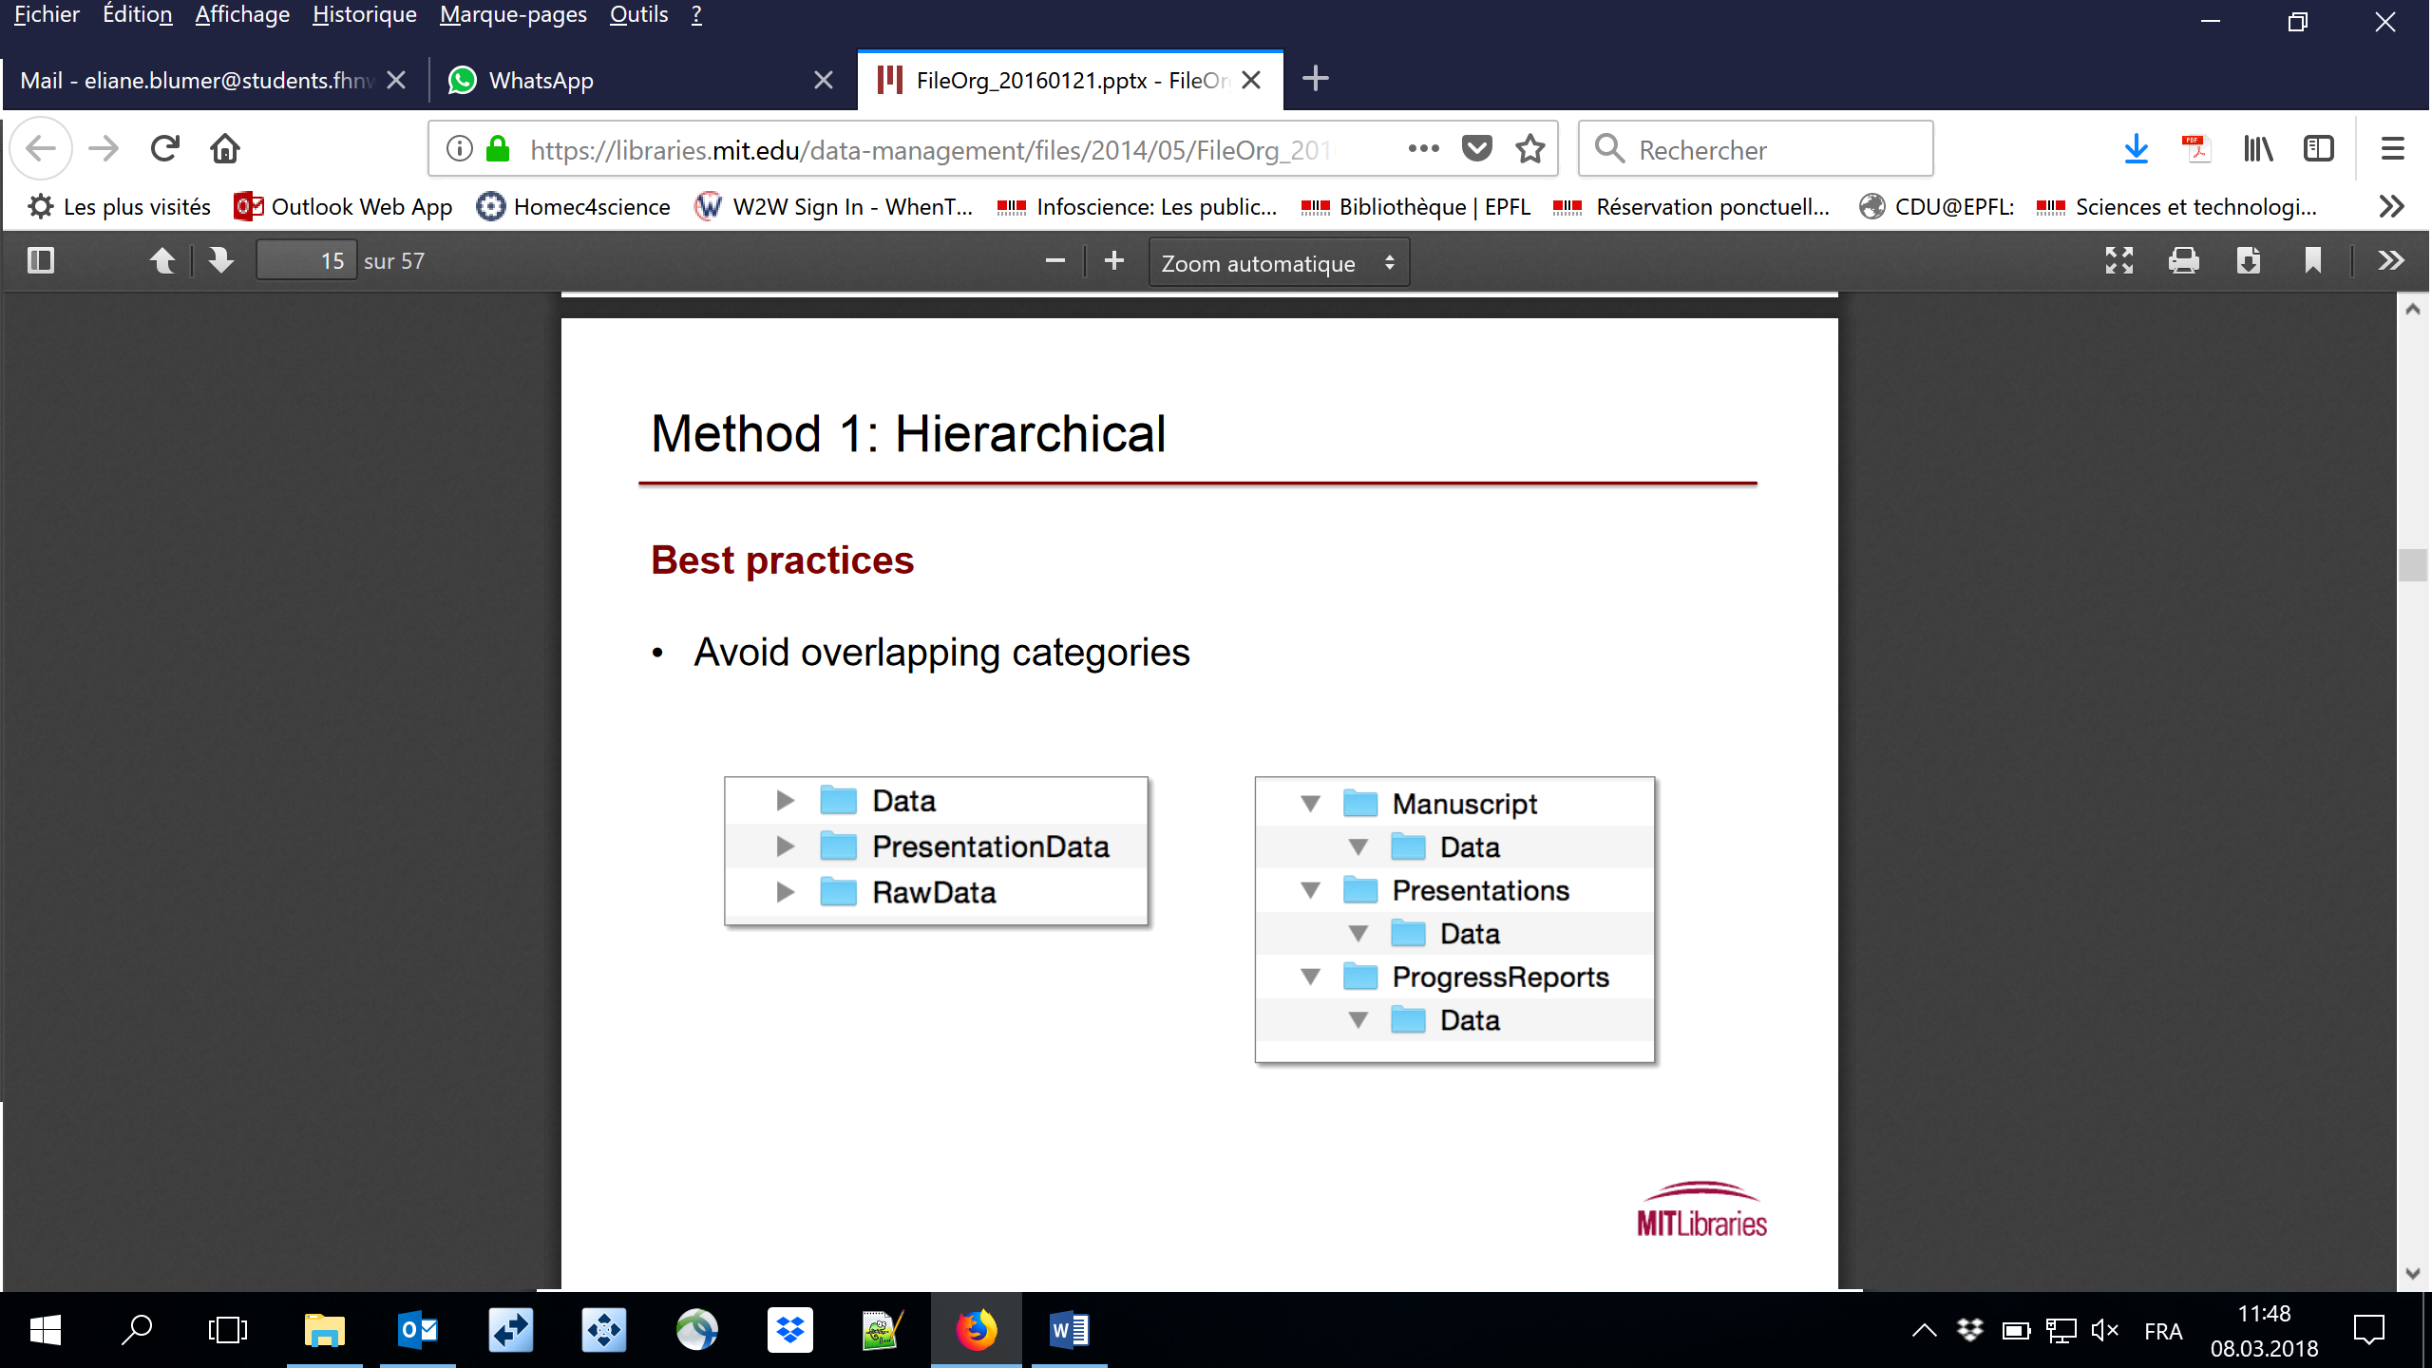
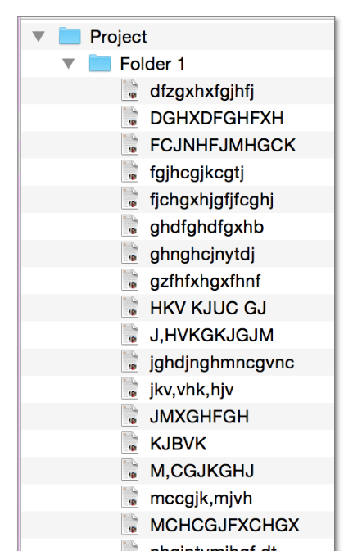
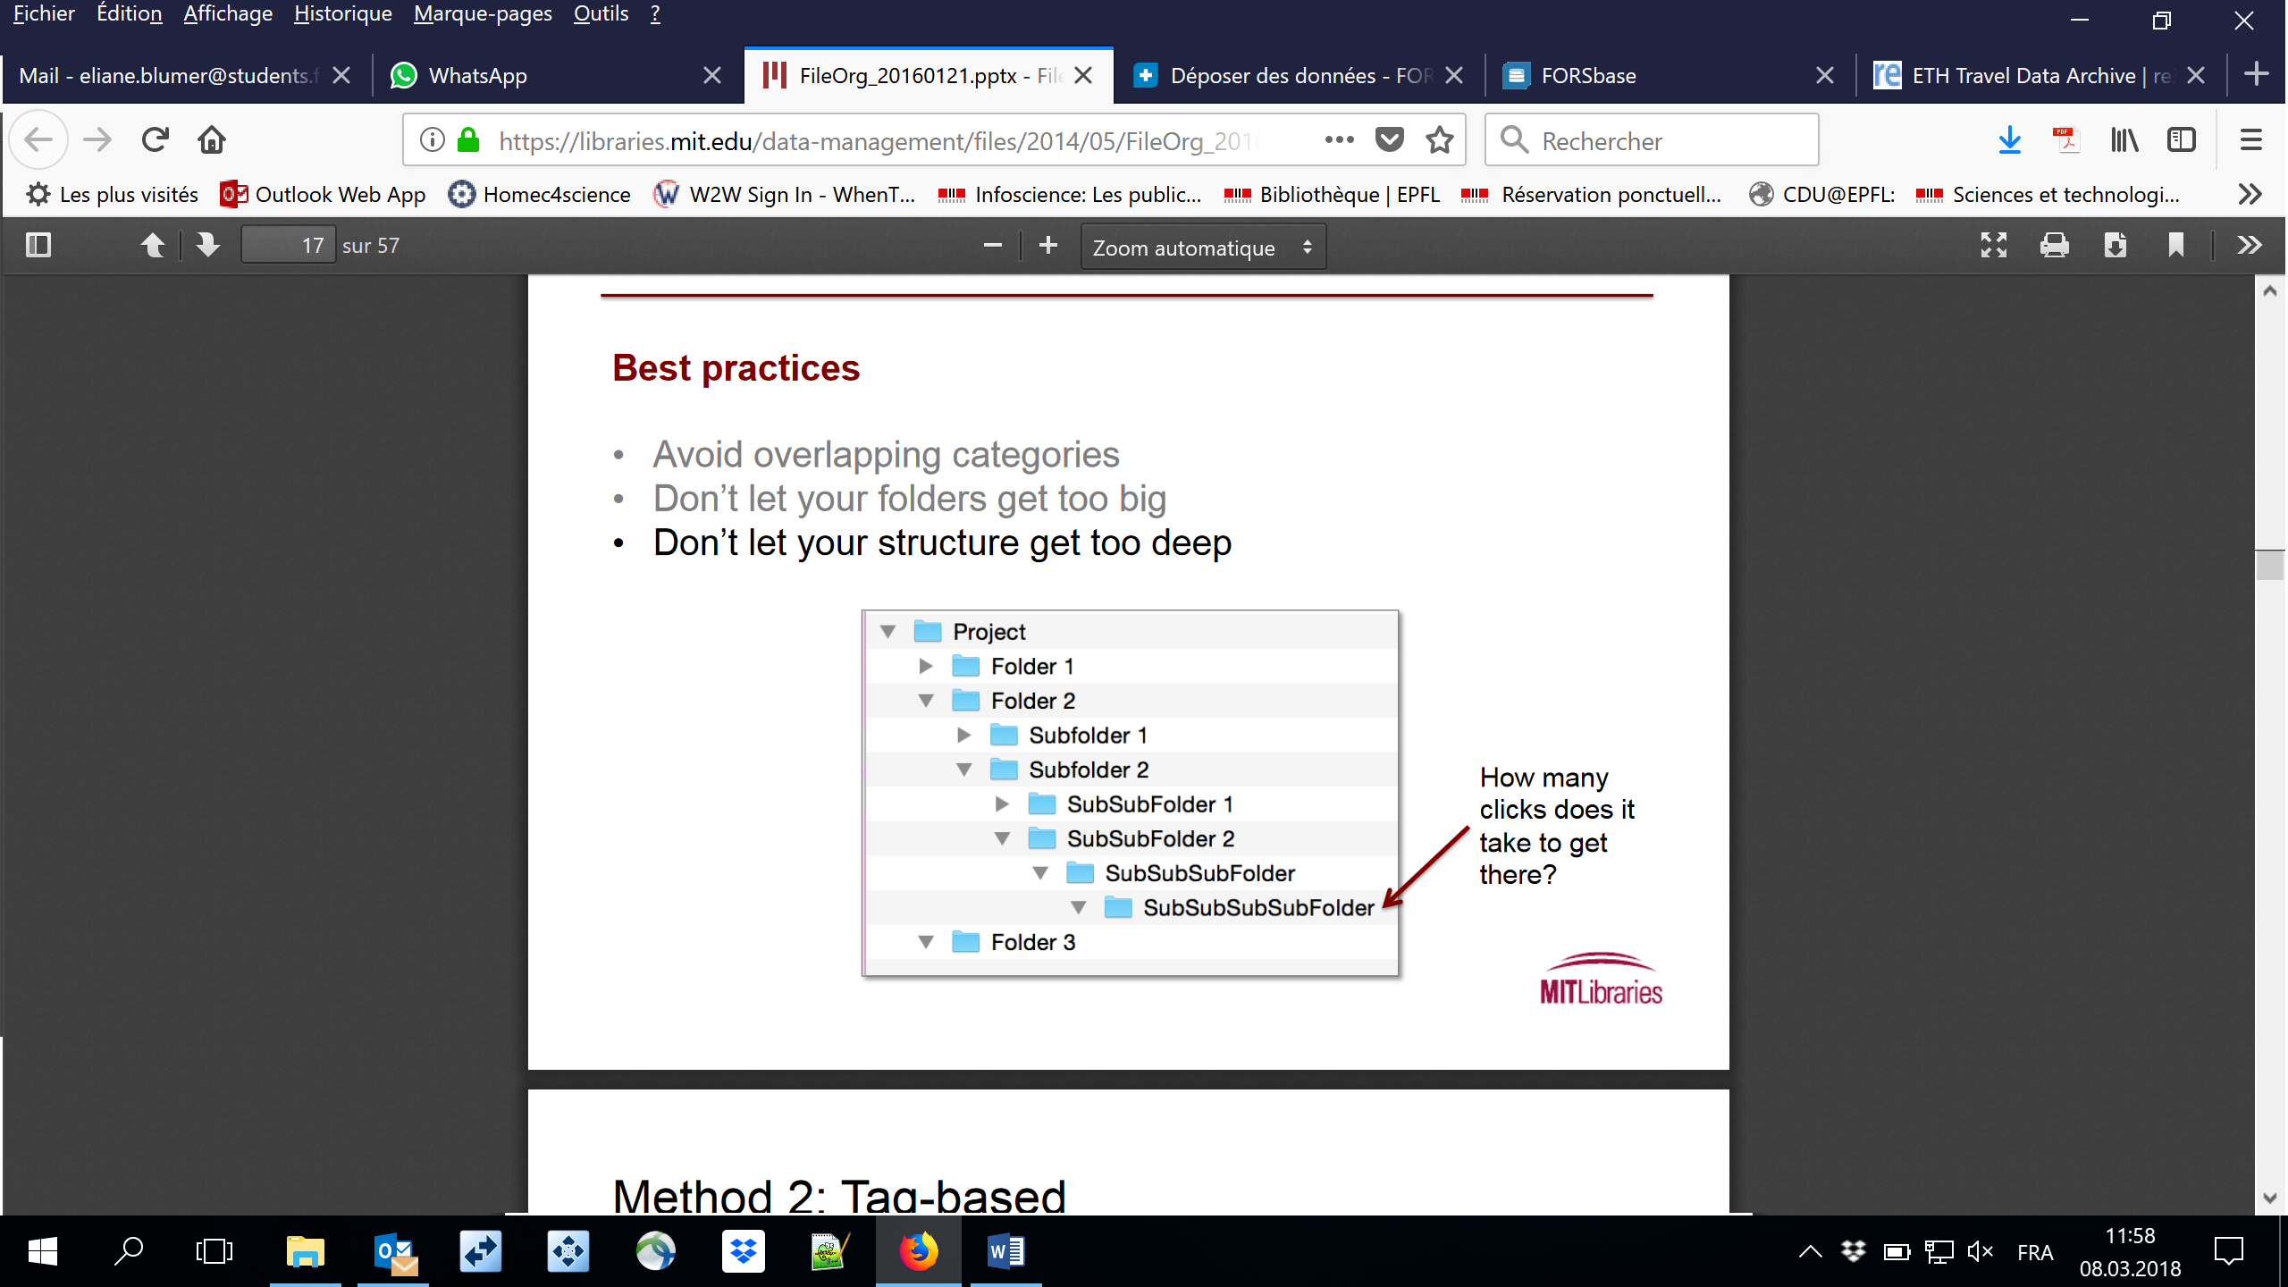
Dataset organization
42
Try to avoid …
overlapping categories too deep structures too crowded folders
Alain Borel, Francesco Varrato
EDCH 2024 / Hands-on with Research Data Management in Chemistry
Rule of thumb:
“sure of the right subdirectory”
Rule of thumb:
“no more than 3 clicks”
Rule of thumb:
“fit in one screen”
Check out:
https://library.stanford.edu/research/data-management-services/data-best-practices/best-practices-file-naming
https://libraries.mit.edu/data-management/files/2014/05/file-organization-july2014.pdf

Slide 43
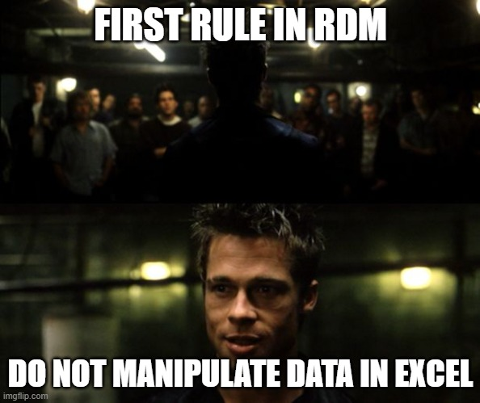
Data in spreadsheets?
43
Alain Borel, Francesco Varrato
EDCH 2024 / Hands-on with Research Data Management in Chemistry

Slide 44
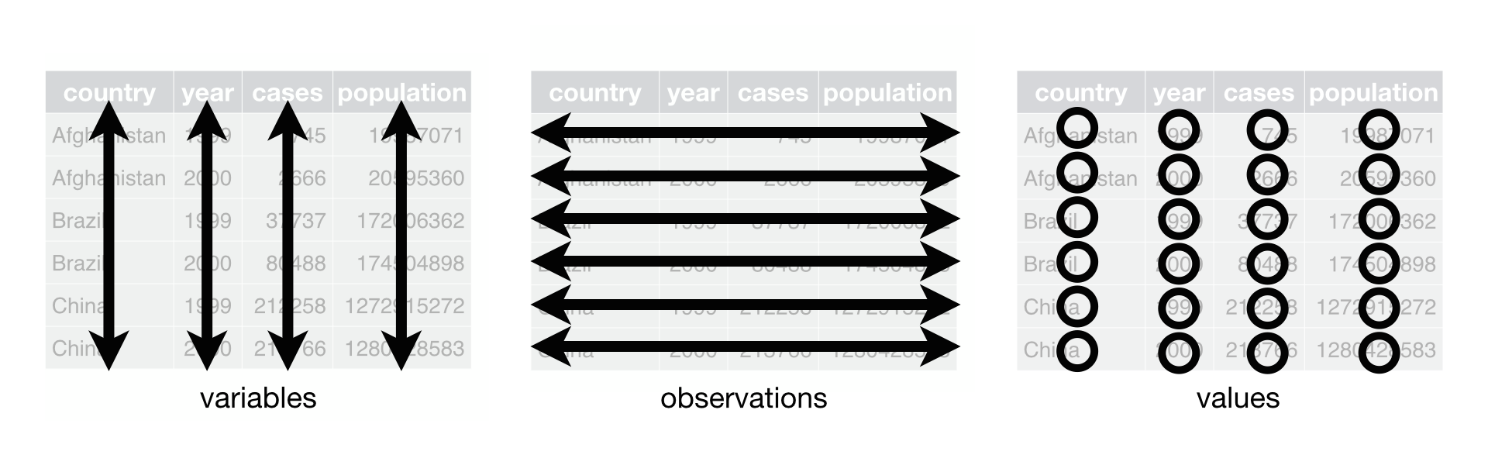
Tidy format
44
Always prefer plain-text formats
Don’t mix data and analysis
Don’t use color coding or other features that don’t translate to plain text
Alain Borel, Francesco Varrato
EDCH 2024 / Hands-on with Research Data Management in Chemistry
Data validation service goodtables.io
Notes:
https://the-turing-way.netlify.app/reproducible-research/rdm/rdm-spreadsheets.html
One column = one variable (no more, no less, this implies that two header names can not be identical)
One row = one sample
One cell = one information
The first row is the header
Header names must not include a special character (including space) or start with a number

Slide 45
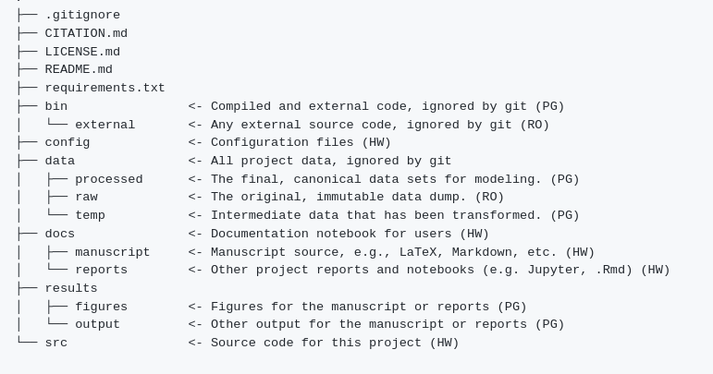
Example : Organization starter template
45
RO = Read-only, never changes
HW = Human writable, you make changes here
PG = Project generated, your analysis script that update code here
Alain Borel, Francesco Varrato
EDCH 2024 / Hands-on with Research Data Management in Chemistry
Check out Starter template 1 or Starter template 2

Slide 46
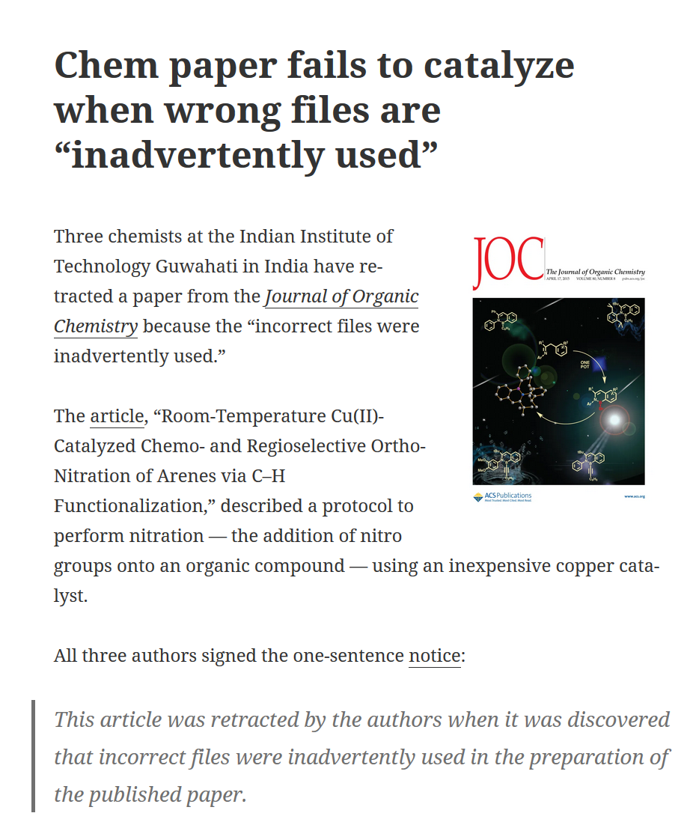
Importance of naming (!)
46
2014 – “Room-Temperature Cu(II)-Catalyzed Chemo- and Regioselective Ortho-Nitration of Arenes via C–H Functionalization” gets published, co-signed by three chemists
2015 – Article retracted (and resubmitted!) by its authors
  incorrect files used in preparing the published paper
  the student kept similar files names for both the updated and un-updated files
  by mistake, the student provided the un-updated file (incorrect file) that led to error in the yield
Moral (?) – It’s the student’s fault … or is it?
EDCH 2024 / Hands-on with Research Data Management in Chemistry
retractionwatch.com/2015/04/29/chem-paper-fails-to-catalyze-when-wrong-files-are-inadvertently-used/
Notes:
Metadata war: InterPARES recommendations vs ISADg norm (International Council on Archives)
46

Slide 47
Discussion: File naming
47
6 months from now, will you recognize what your files contain?
What information needs to be contained in your file names?
What would you change in the following names?
Alain Borel, Francesco Varrato
EDCH 2024 / Hands-on with Research Data Management in Chemistry
My passwords.doc | My data.xls
IMPORTANT.doc | My study.doc
My Thesis final final.doc | Doc.1.doc
My Thesis version 12.doc | New doc.doc
Data 01/08/2016.xls | Int 1 (2).doc

Slide 48
Data & Dataset
Which one is the data?
Which one the dataset?
EDCH 2024 / Hands-on with Research Data Management in Chemistry
Notes:
So, what does a dataset include?
Raw data: from experiments, machines, simulations, interviews, external sources, …
Pre-processed data: tables, transcriptions, organized, anonymized, to be interpreted and cleaned, …
Processed data: cleaned, graphs, published or unpublished, reusable by the scientific community, …
Code / Software: scripts, executables, spreadsheets ☹, electronic notebooks [np, mat], …
Documentation: log files, README, input files, protocols, standards or vocabularies, …

Slide 49
Data & Dataset
Dataset
Data
EDCH 2024 / Hands-on with Research Data Management in Chemistry
Notes:
So, what does a dataset include?
Raw data: from experiments, machines, simulations, interviews, external sources, …
Pre-processed data: tables, transcriptions, organized, anonymized, to be interpreted and cleaned, …
Processed data: cleaned, graphs, published or unpublished, reusable by the scientific community, …
Code / Software: scripts, executables, spreadsheets ☹, electronic notebooks [np, mat], …
Documentation: log files, README, input files, protocols, standards or vocabularies, …

Slide 50
Data & Dataset w/ Metadata
Dataset
Data
Name: Tricolore Trottole
Brand: Sainsbury
Nutritionals (100g):
Fats 2g, Proteins 10g, …
Cooking time: 11 min
[…]
EDCH 2024 / Hands-on with Research Data Management in Chemistry
Input Values
Contain METADATA
= Info about data
Notes:
Metadata is structured information associated with an object for purposes of discovery, description, use, management, and preservation.
NISO (2008) framework.niso.org/24.html

Slide 51
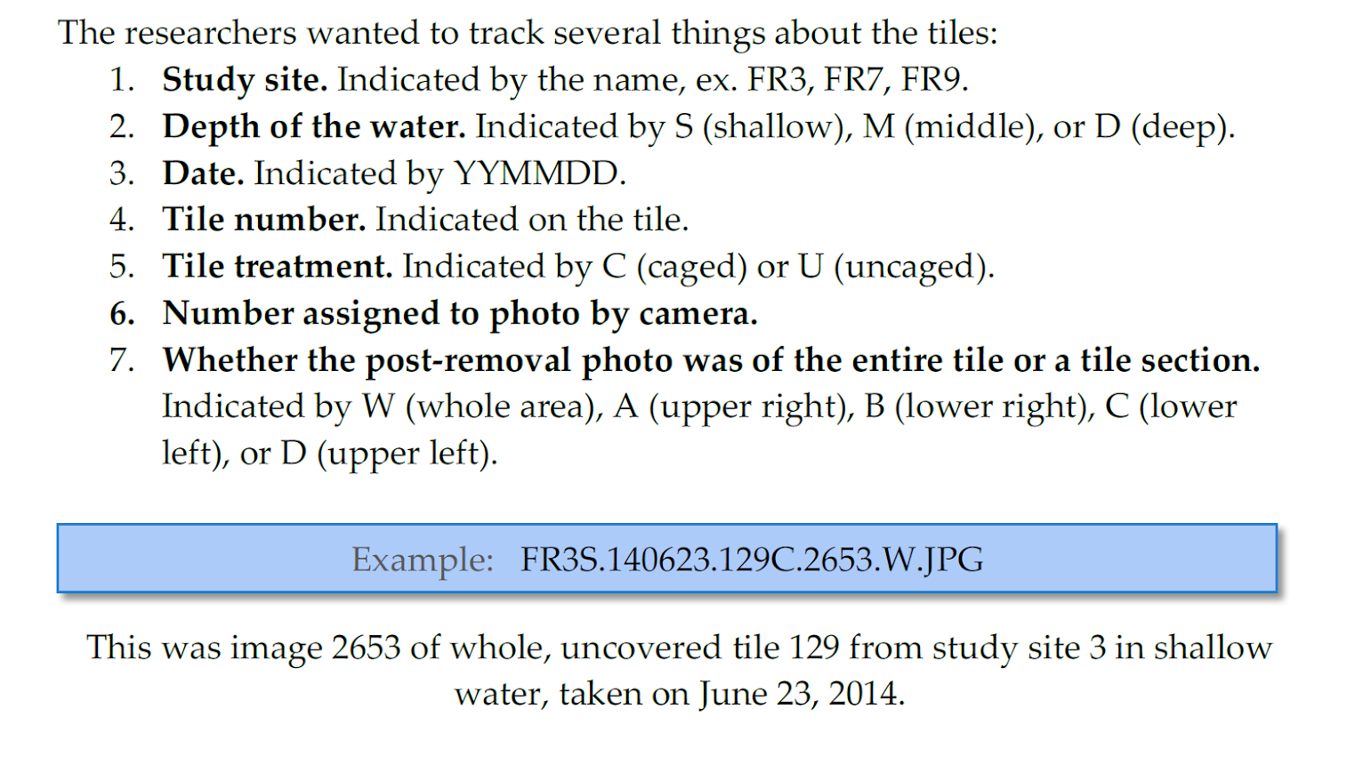
What is the content of the file?
EDCH 2024 / Hands-on with Research Data Management in Chemistry
FR3S_140623_129C_2653_W.jpg

Slide 52
What is the content of the file?
EDCH 2024 / Hands-on with Research Data Management in Chemistry
FR3S_140623_129C_2653_W.jpg

Slide 53
What is the content of the file?
EDCH 2024 / Hands-on with Research Data Management in Chemistry
FR3S_140623_129C_2653_W.jpg

Slide 54
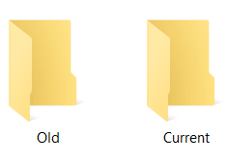
Use it for consistent file versioning
Sort Distinguish Separate
…
FR3S_140623_129C_2651_W.jpg
FR3S_140623_129C_2652_W.jpg
FR3S_140623_129C_2653_W.jpg
FR3S_140623_129C_2654_W.jpg
FR3S_140623_129C_2655_W.jpg
…
…
FR3S_140623_129C_2653_A.jpg
FR3S_140623_129C_2653_B.jpg
FR3S_140623_129C_2653_C.jpg
FR3S_140623_129C_2653_D.jpg
FR3S_140623_129C_2653_W.jpg
…
…\CURRENT
FR3S_140623_129C_2655_W.jpg
FR3S_140622_129C_2645_W.jpg
FR3S_140621_129C_2638_W.jpg
FR3S_140620_129C_2631_W.jpg
…\OLD
EDCH 2024 / Hands-on with Research Data Management in Chemistry
FR3S_140623_129C_2653_W.jpg

Slide 55
Align it with a data codebook
EDCH 2024 / Hands-on with Research Data Management in Chemistry
FR3S_140623_129C_2653_W.jpg
Explain variables within a table!

Slide 56
What is wrong with this file name?
EDCH 2024 / Hands-on with Research Data Management in Chemistry
FR3Shallow.230614 & 129C(2653) WholeArea.jpg

Slide 57
Standardize it for both files & folders
Limit name to 32 characters | 32CharactersLooksExactlyLikeThis.csv
Use leading zeros for multi-digit versions | NO ProjID_1.csv ProjID_12.csv YES ProjID_01.csv ProjID_12.csv
Use _ or - instead of spaces | NO Proj ID 1.csv YES Proj_ID_01.csv YES Proj-ID-01.csv
Avoid special characters: ~ ! @ # $ % ^ & * ( ) ` ; < > ? , [ ] { } ‘ “ | NO name&date@location.doc
Use standardized date formats: YYYYMMDD or YYMMDD. | ProjID_01_20180305.csv
Use only one period for the file extension | NO name.date.doc NO name_date..doc YES name_date.doc
Use specific file names to avoid conflicting naming | NO MyData.csv YES ProjID_data.csv
EDCH 2024 / Hands-on with Research Data Management in Chemistry

Slide 58
Document it in a README file
[…]
[…]
EDCH 2024 / Hands-on with Research Data Management in Chemistry
Info about data
+
Reusability instructions
=
Recipe!

Slide 59
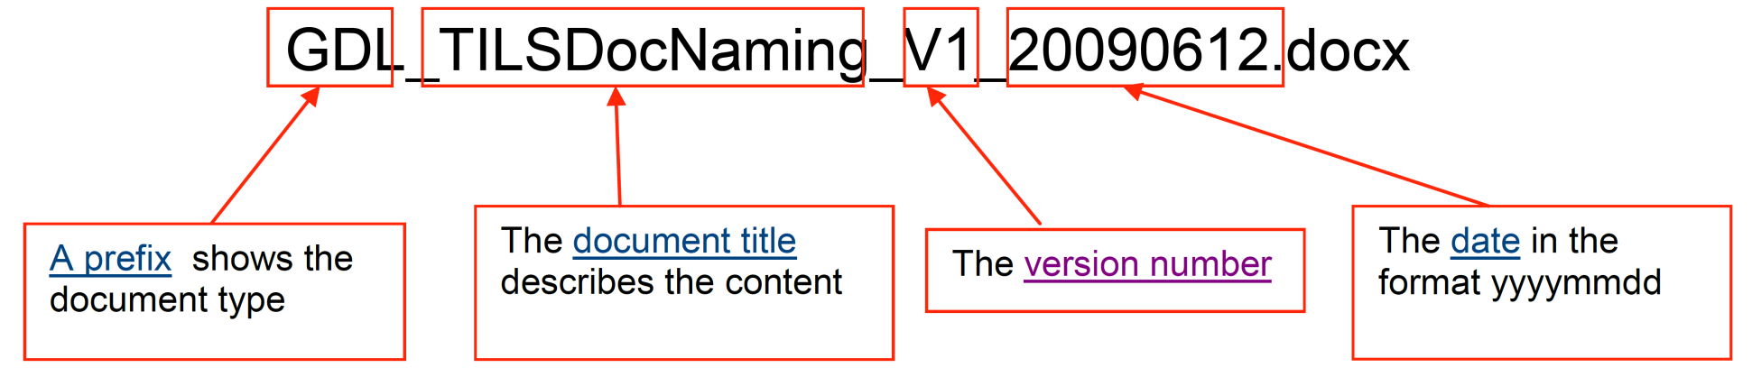
Naming convention(s)
59
TILS Document Naming Convention (just an example)
Alain Borel, Francesco Varrato
EDCH 2024 / Hands-on with Research Data Management in Chemistry
Some renaming tools
Bulk Rename Utility (Win; free)
PowerRename (part or PowerToys, Win)
Renamer 4 (Mac)
Ant Renamer (Win; open source)

Slide 60
Main takeaways
Organize your data with a naming convention to:
Know the content of files without opening them
Version your files
Harmonize practices in your lab
Make your research more easily
Understandable
      Reusable
      Cook pasta better ;-)
EDCH 2024 / Hands-on with Research Data Management in Chemistry

Slide 61
Naming good practices
61
For both folders and files
Limit file name to 32 characters (better less) | 32CharactersLooksExactlyLikeThis.csv
Use leading zeros for multi-digit versions. For a sequence of 1-10: 01-10 For a sequence of 1-100: 001-010-100 | NO ProjID_1.csv ProjID_12.csv YES ProjID_01.csv ProjID_12.csv
Don’t use spaces. Some software read file names with spaces enclosed in quotes when used in the command line. | NO Proj ID 1.csv YES Proj_ID_01.csv YES Proj-ID-01.csv
Don’t use special characters: ~ ! @ # $ % ^ & * ( ) ` ; < > ? , [ ] { } ' " | NO name&date@location.doc
Use a good format for date designations: YYYYMMDD or YYMMDD. | ProjID_01_20180305.csv
Use only one period (before the file extension) | NO name.date.doc NO name_date..doc YES name_date.doc
Use specific file names: generic ones may conflict when moved between locations. | NO MyData.csv YES ProjID_data.csv
Alain Borel, Francesco Varrato
EDCH 2024 / Hands-on with Research Data Management in Chemistry
Table based on: MIT Library’s file organization slides + Standford Univ. Library’s file naming guidelines
Want more? Check EPFL Library file organization and naming vademecum

Slide 62
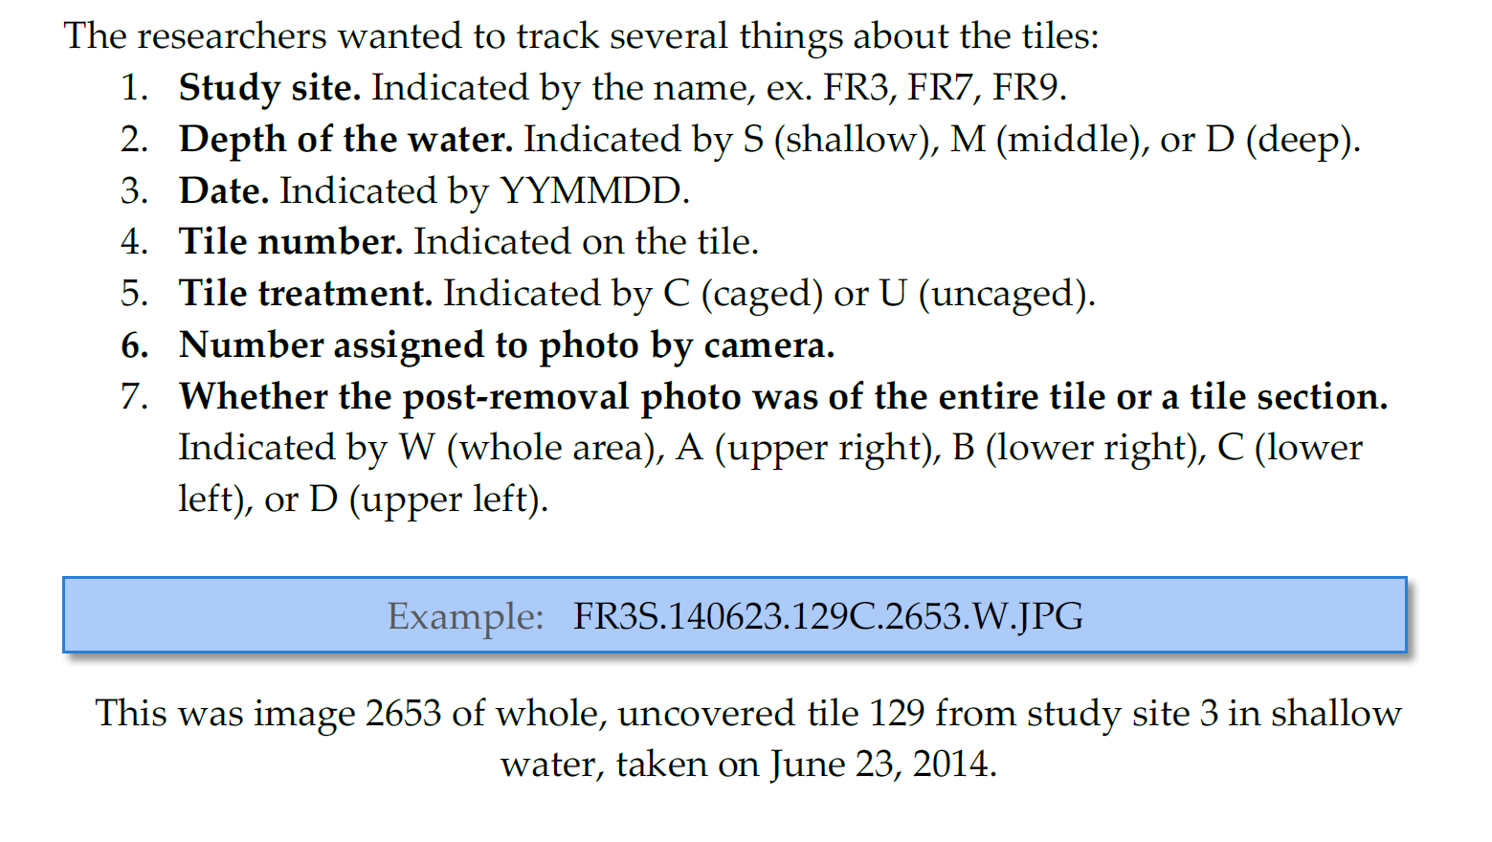
File naming example
62
E.g. in the README file:
Alain Borel, Francesco Varrato
EDCH 2023 / Hands-on with Research Data Management in Chemistry
Source: https://libraries.mit.edu/data-management/files/2014/05/file-organization-july2014.pdf
Notes:
À lier au README

Slide 63
Your own naming convention: Exercise
63
Limit file name to 32 characters (better less) | 32CharactersLooksExactlyLikeThis.csv
Use leading zeros for multi-digit versions. For a sequence of 1-10: 01-10 For a sequence of 1-100: 001-010-100 | NO ProjID_1.csv ProjID_12.csv YES ProjID_01.csv ProjID_12.csv
Don’t use spaces. Some software read file names with spaces enclosed in quotes when used in the command line. | NO Proj ID 1.csv YES Proj_ID_01.csv YES Proj-ID-01.csv
Don’t use special characters: ~ ! @ # $ % ^ & * ( ) ` ; < > ? , [ ] { } ' " | NO name&date@location.doc
Use a good format for date designations: YYYYMMDD or YYMMDD. | ProjID_01_20180305.csv
Use only one period (before the file extension) | NO name.date.doc NO name_date..doc YES name_date.doc
Use specific file names: generic ones may conflict when moved between locations. | NO MyData.csv YES ProjID_data.csv
Alain Borel, Francesco Varrato
EDCH 2023 / Hands-on with Research Data Management in Chemistry
[ 5’ ] Write your own example of naming convention
[10’] Let’s discuss some difficulties for everyone to listen

Slide 64










File versioning
64
Sort Distinguish Separate
Alain Borel, Francesco Varrato
Major changes: ordinal numbers Minor changes: decimal numbers
Dates distinguish between the different versions.
Archive older files in a separate folder.
EDCH 2024 / Hands-on with Research Data Management in Chemistry
Source: http://bit.ly/fileOrgSlides
Versioning solutions
EPFL
Git Project
Git LFS
GitHub
EPFL GitLab
C4Science
TortoiseGit
git-annex
Need mirroring? c4science.ch/w/c4science/tips
Notes:
pas de vraie pratique de Git à moins que ce soit chez Kevin.
Gitlab pas pour tout l’EPFL ?

Slide 65

Git
65
Alain Borel, Francesco Varrato
EDCH 2024 / Hands-on with Research Data Management in Chemistry
Image by Recoopre, CC-BY-SA-4.0

Slide 66


Discussion: what information is missing?
66
go.epfl.ch/btF
Alain Borel, Francesco Varrato
EDCH 2024 / Hands-on with Research Data Management in Chemistry
Source: QR Code generator library of the Project Nayuki.

Slide 67

Data cleaning: to be documented, too
67
GARBAGE IN ➔ GARBAGE OUT
Alain Borel, Francesco Varrato
EDCH 2024 / Hands-on with Research Data Management in Chemistry
“60% data scientists say they spend the most time cleaning and organizing data”
Crowdflower 2016 Datascience report
“in a data analysis project, data cleansing of poor quality data can take up to 80% of the total effort”
Cost-Benefit analysis for FAIR research data, EC report 2018
Image source:
thedailyomnivore.net/2015/12/02/garbage-in-garbage-out

Slide 68
Data cleaning: to be documented, too
68
WHEN
Preprocessing, as 1st step (if applicable)
Quality assurance processes
WHY
Data ready for analysis / sharing / publishing / preservation / …
Compliance
HOW
Transform / Reformat / Clean / Merge / Reconciliate data
Detect errors / aberrations
Define expected quality / criteria in a policy (completeness, consistency, accuracy, …)
Implement quality control with human / machine protocols / procedures
Alain Borel, Francesco Varrato
EDCH 2024 / Hands-on with Research Data Management in Chemistry
Ex. of tools: OpenRefine (free, open-source tool for working with messy data)

Slide 69
Data actions in your project … fill in!
69
ACTIVITIES | COLLEAGUE / PARTNER | TOOLS | TO-DO
FUNDING PLANNING
CREATION
ETHICAL CLEARANCE
ACQUISITION
STORING
ANALYSIS
LEGAL CLEARANCE
SHARING
PUBLISHING
ARCHIVING
Alain Borel, Francesco Varrato
Documentation all along
EDCH 2024 / Hands-on with Research Data Management in Chemistry
[5’] Fill your own table
[…] Continue updating it … the content is useful for your report
Notes:
Présenter le doc
Leur dire de réfléchir à ce qu’ils savent déjà
Dire la documentation se fait à toutes les étapes (donc elle devrait être partout dans la to-do)

Slide 70
Data cleaning: to be documented, too
70
When | Preprocessing (1st step, if applicable) | Quality assurance (Sub-process in the whole process)
Motivation | Data ready for analysis | Data ready for analysis / sharing / publishing / preservation / … Compliance
How | Transform / Reformat / Clean / Merge / Reconciliate data Detect errors / aberrations Try tools such as OpenRefine | Define expected quality / criteria in a policy (completeness, consistency, accuracy, integrity…) Implement quality control with human / machine protocols / procedures
Alain Borel, Francesco Varrato
EDCH 2023 / Hands-on with Research Data Management in Chemistry

