Slide 1
Localising proteins to and within membranes
• Membranes
• Lipidation
  - GPI anchors
  - Prenylation
- Myristoylation
- Palmitoylation
• Modulation of biological outcome..
6 - Lipidation p

Slide 2
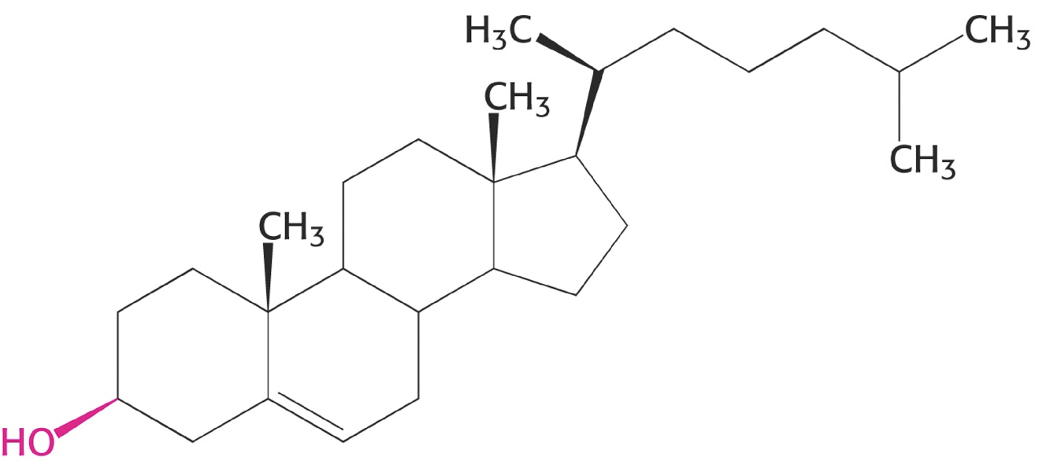
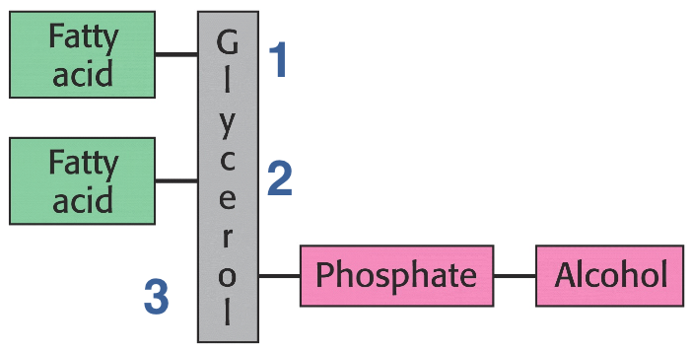
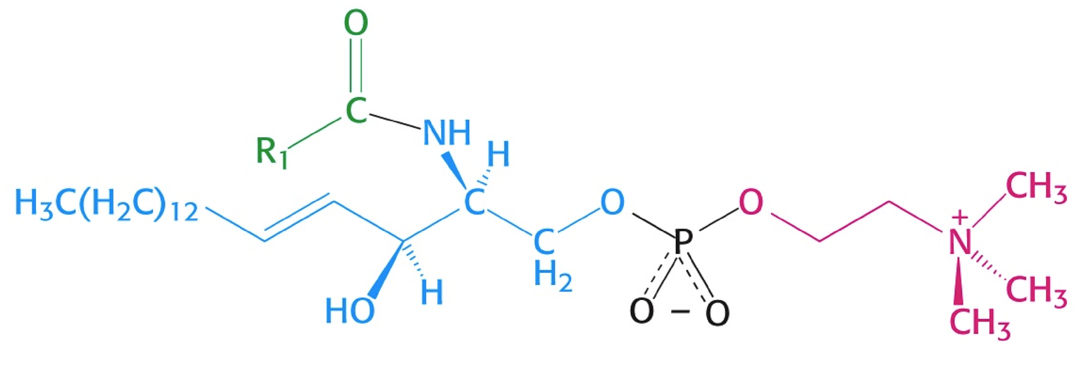
Membrane lipids : Major classes
Phospho-glycerides
Sterols, e.g. cholesterol (Chol)
Phospho -sphingolipids, e.g. sphingomyelin (SM)
6 - Lipidation • Membranes p

Slide 3
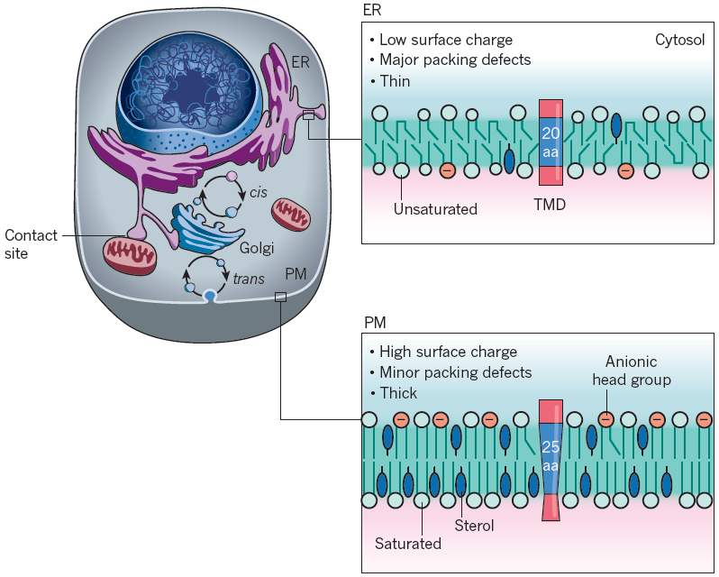
Transfersal lipid asymmetry in Eukaryotic membranes
Holthuis & Menon (2014) Nature
Lumen
Cytosol
Elbaz & Schuldiner (2011) TiBS 36, 616
Outside of cell
6 - Lipidation • Membranes p

Slide 4
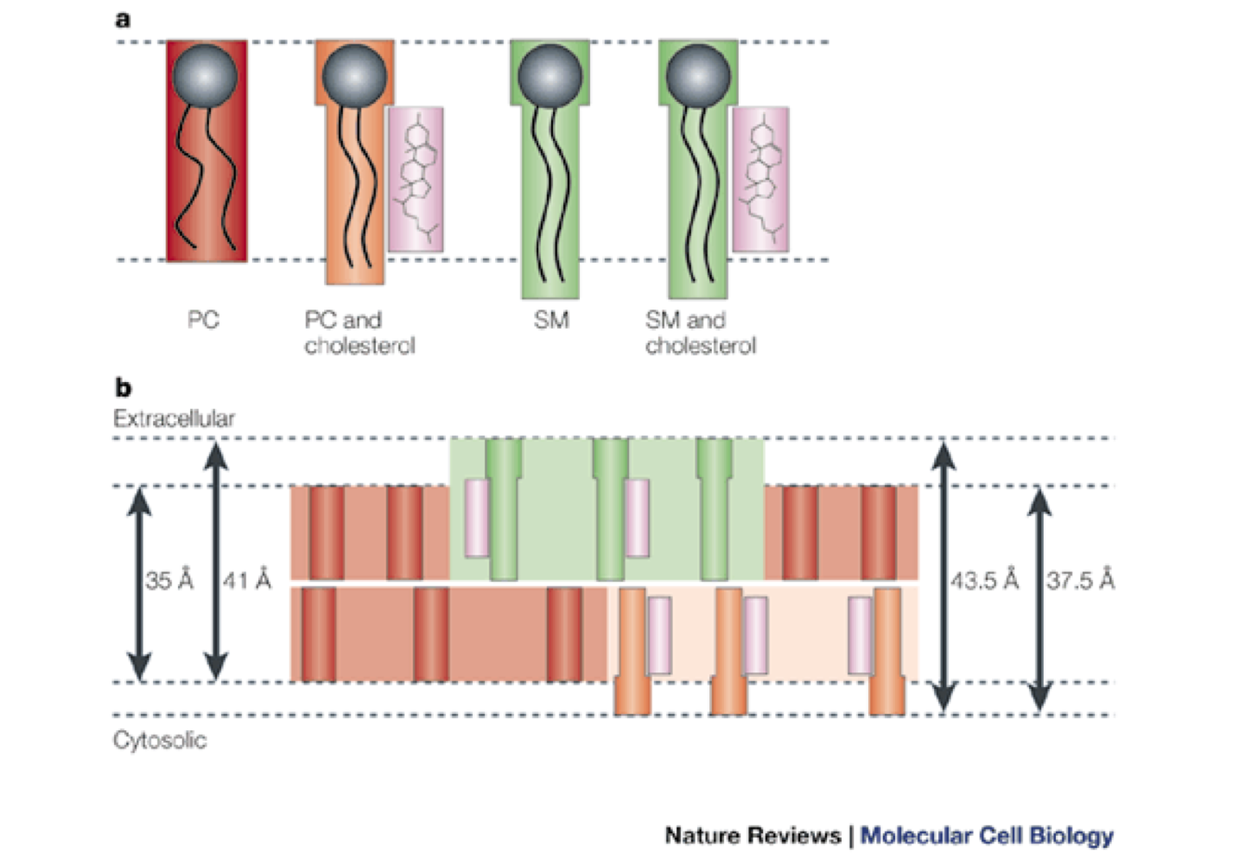
Lateral lipid asymmetry and phase-coexistence : Plasma membrane
• Cholesterol: Preference for sphingomyelin and not so “fluid” lipids
“Cholesterol domains”:
- membrane thickening
- fluidity decrease
PC PC SM SM
+Chol +Chol
6 - Lipidation • Membranes p

Slide 5
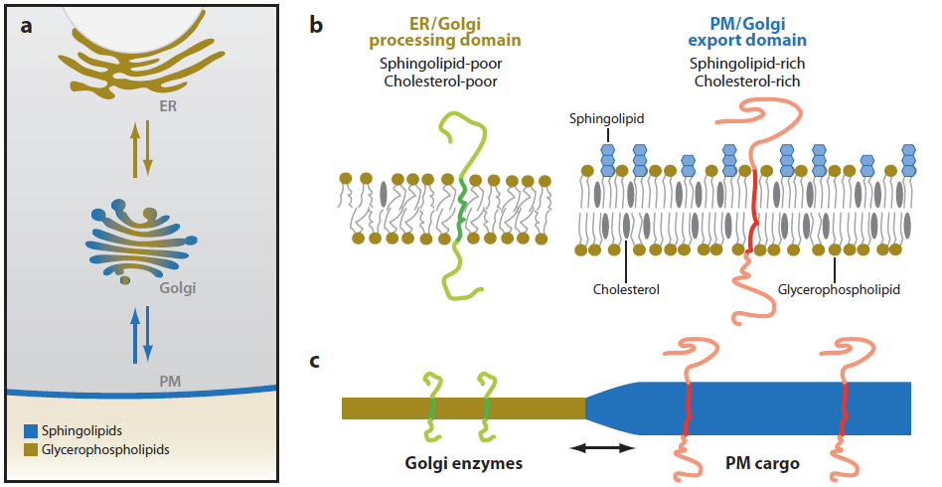
Phase separations facilitate sorting and transport
-Temperature
- Ions
- Cholesterol
Zoom of Golgi
Lippincott-Schwartz, Ann Rev Biophys 2010
6 - Lipidation • Membranes p

Slide 6
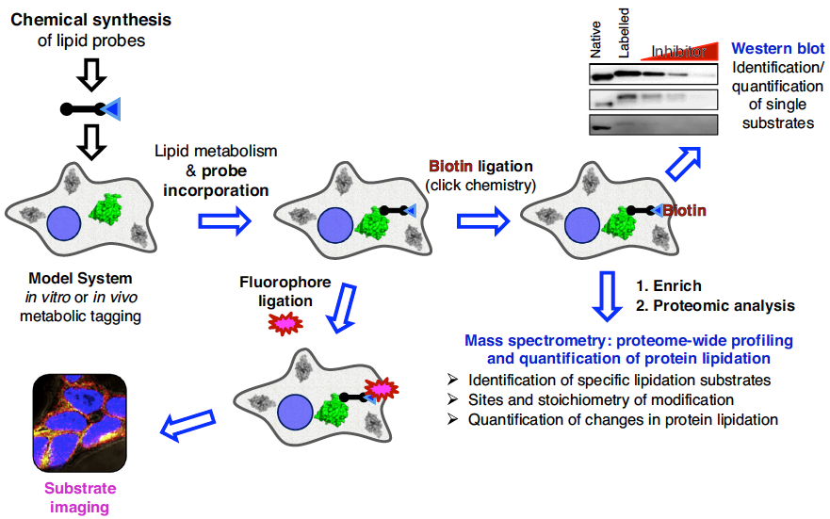
Identifying & localising lipidated proteins
Exploiting bio-orthogonal click-chemistry
6 - Lipidation p
Notes:
or the bio-orthogonal Staudiger ligations between e.g. strained cyclo-octene & tetrazzini

Slide 7
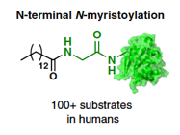
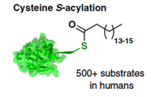
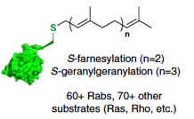
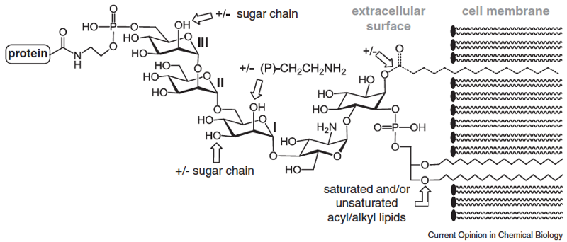
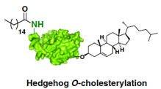
Lipidation of proteins
GPI anchors
l
6 - Lipidation p

Slide 8
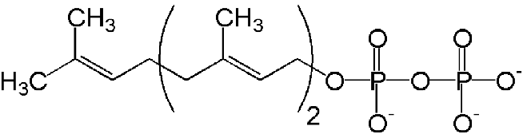
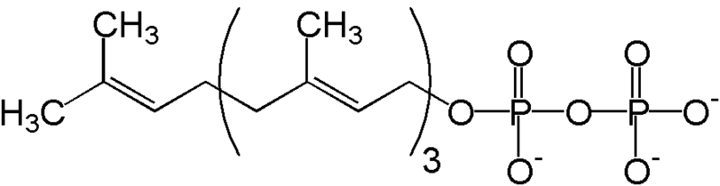
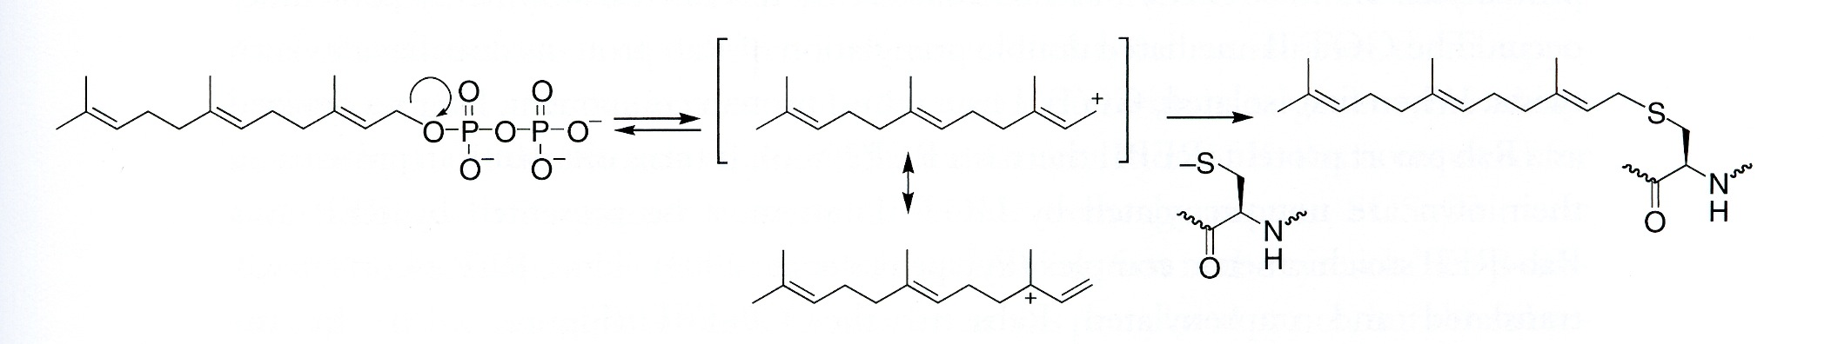
S-Prenylation
Conjugation of farnasyl-(F) or geranylgeranyl- (GG)pyrophosphate precursors
by the enzymes protein F-transferase or protein GG-transferase
        (F) (GG)
Allyl cation reacts with thiolate to form a stable thioether
÷ About 1% of the proteome is prenylated
÷ These proteins are involved in cell growth, differentiation,
transport and motion
6 - Lipidation • Prenylation p
Notes:
Prenyl C5 compounds
pKa of Cys ~8.1

Slide 9
S-Prenylation close to the C-terminus
Post-translational addition to Cys residues at the C-terminus:
÷ Motif 1: -C-a-a-X a = aliphatic
=> Geranylgeranylation if X = Leu
=> Farnesylation if X = Ala, Ser
NB: upon farnesylation a-a-X are proteolytically removed
÷ Motif 2: 2 Cys in a short amino acid motifs, e.g.
-C-•-C, -•-•-C-C, -•-C-•-C, -C-C-•-•
  => Geranylgeranylation of one or both Cys-residues
6 - Lipidation • Prenylation p

Slide 10
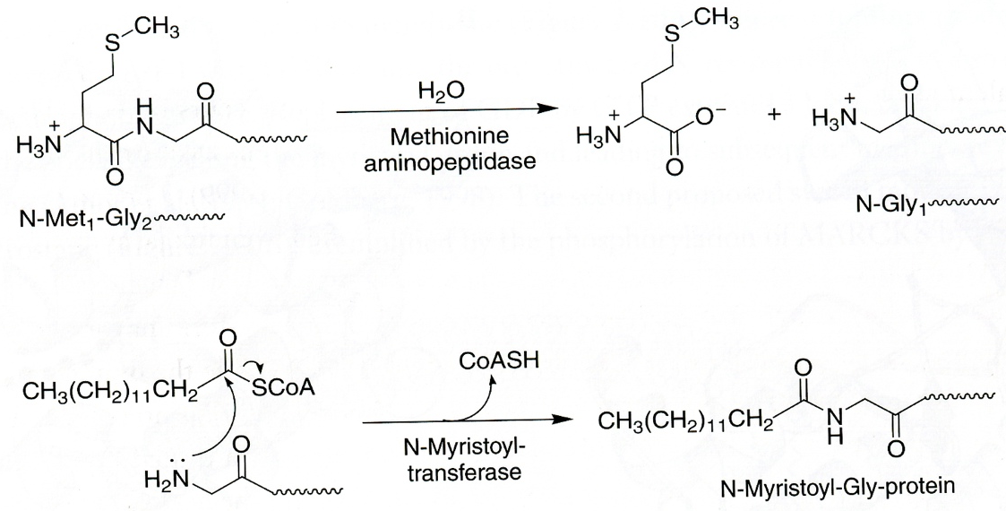
N-Myristoylation at the N-terminus
Co-translational addition of a myristate (C14:0) through formation of
a stable amide bond to amino group of N-terminal glycine
if N-terminus is : H2N-Met-Gly-x-x-x-[Ser/Thr]-y-y x: small & uncharged
y: basic
Enzyme: myristoyl-CoA:protein N-myristoyl transferase
Substrate: myristoyl-CoA
Step 1:
removal of Met
Step 2:
addition C14:0
6 - Lipidation • N-Myristoylation p

Slide 11
S-Palmitoylation
Addition of a palmitate (C16:0) via of a labile thioester bond
Post-translational attachment of a C16:0 to thiol group of a Cys
within the endoplasmic reticulum or Golgi system.
Targets: • Intrinsic membrane proteins
Cys a few (3-6) residues next to a TM domain on cytosolic side
• Soluble proteins
=> No clear consensus sequence,
but often close to myristoylation or prenylation site
6 - Lipidation • S-Palmitoylation p

Slide 12
S-Palmitoylation : To be or not anymore to be
Palmitoylation is dynamic and reversible
=> regulation of location, sorting and activity
• Acylation:
=> protein-S-acyltransferease (PAT) in ER and Golgi
• De-acylation:
=> S-acylprotein thioesterase (APT) in cytosol
=> Palmitoyl protein thioesterase (PPT) in lysosomes,
plasma membrane
6 - Lipidation • S-Palmitoylation p

Slide 13
Lipidation of proteins
Summary
GPI anchor C-term co-trans “perm” raft & cell surface
S-prenylation C-term post-trans perm non-raft
N-myristoylation N-term co-trans perm raft
S-palmitoylation post-trans reversible raft
7 - Lipidation • Prenylation p

Slide 14
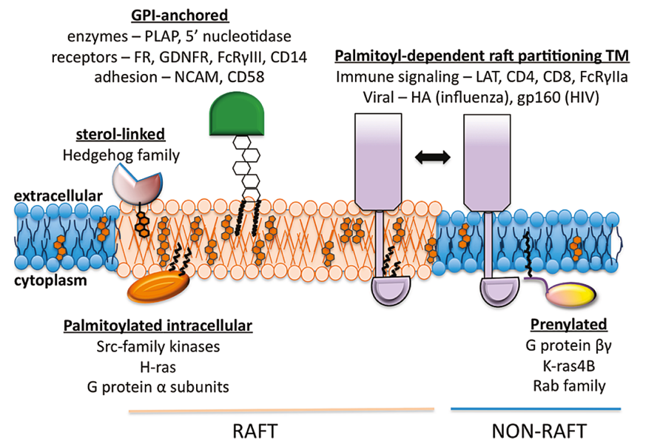
Lipidation rules location of proteins in membrane
Levental 2010
6 - Lipidation • Localisation p

Slide 15
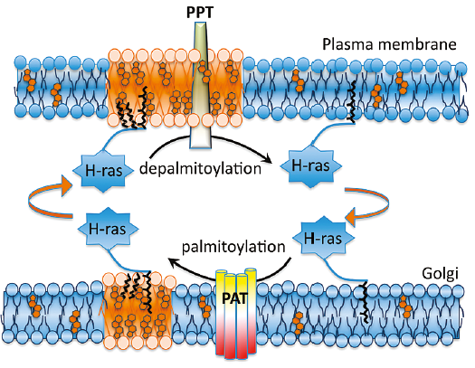
An example : H-ras
  H-ras:
  - farnesylated
  - 2 palmitoylation sites
  => H-ras activation enhances
  de-palmitoylation
  • T-lymphocytes reaction upon antigen presence:
  i - strong antigens => negative selection => DEATH :: ras in PM
    ii - weak antigens => positive selection => proliferation :: ras in ER
Levental 2010
6 - Lipidation • Localisation and signalling p
Levental 2010

Slide 16
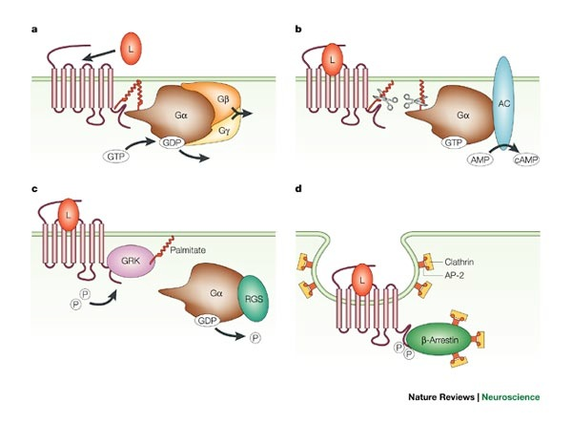
Dynamic palmitoylation : Modulating GPCR signalling
AC: Adenylate Cyclase
GRK: GPCR kinase
RGS: Regulator of G-protein signalling
El-Husseini, 2002
6 - Lipidation • Localisation and signalling p
Notes:
s

Slide 17
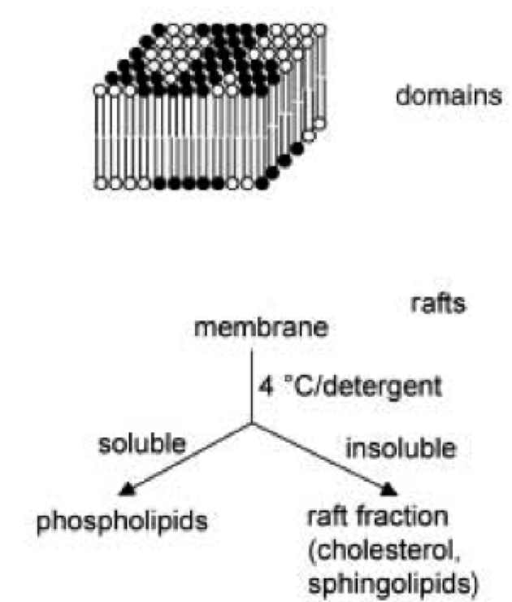
Biological lateral phase separations : Rafts
Historically, lipid rafts have been defined as :
• insoluble in cold 1%-solution of Triton X-100, a detergent.
=> thus named: Detergent-Resistant Membrane (DRM)
• low buoyant density
Properties of rafts:
- rich in cholesterol and various sphingolipids.
=> aggregates in cell membranes consist mainly of
non-covalent clustering.
- size varies between 1 nm - 1 μm
- life time ranging from 10⁻³ to 10³ seconds
Binder, Angew Chem Intl Ed 2003.
6 - Membrane domains and signalling p

Slide 18
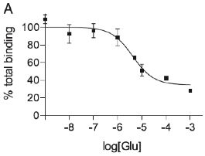
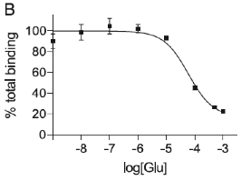
Case 1: Modulation of GPCR signalling by lipids domains
E.g., a metabotropic glutamate receptor (mGlu-R) expressed in
Sf9 insect cells or Drosophila eyes
Radioligand competition binding assays :
=> higher affinity in Sf9
Sf9 Drosophila
IC50: 4.17 μM
IC50: 54.5 μM
Eroglu PNAS 2003
6 - Lipid modulation of signalling p

Slide 19
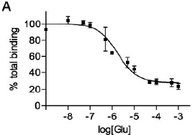
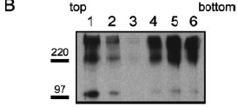
Modulation of mGlu-R “fitness” by lipid domains
• Observation: Drosophila membranes contain very little cholesterol
Q: Is cholesterol needed for high affinity?
Experiment 1:
◊ Cholesterol addition to Drosophila membranes
=> receptor gains affinity => receptor goes to rafts
IC50 54.5 => 1.2 μM “light” fractions gradient
IC50: 1.2 μM
Eroglu PNAS 2003
6 - Lipid modulation of signalling p

Slide 20
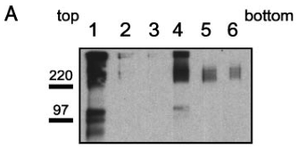
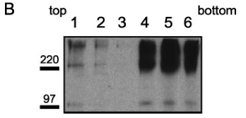
Modulation of mGlu-R signalling by lipid domains
Are rafts involved ?
Sf9 insect cells or Drosophila eyes
• Membrane density fractionation followed by SDS-PAGE analysis :
=> In Drosophila, the receptor is present only in the heavy fractions
=> In Sf9 the receptor is present mainly in the light raft fraction,
rich in cholesterol and sphingomyelin
Sf9 Drosophila
6- Lipid modulation of signalling p
Eroglu PNAS 2003

Slide 21
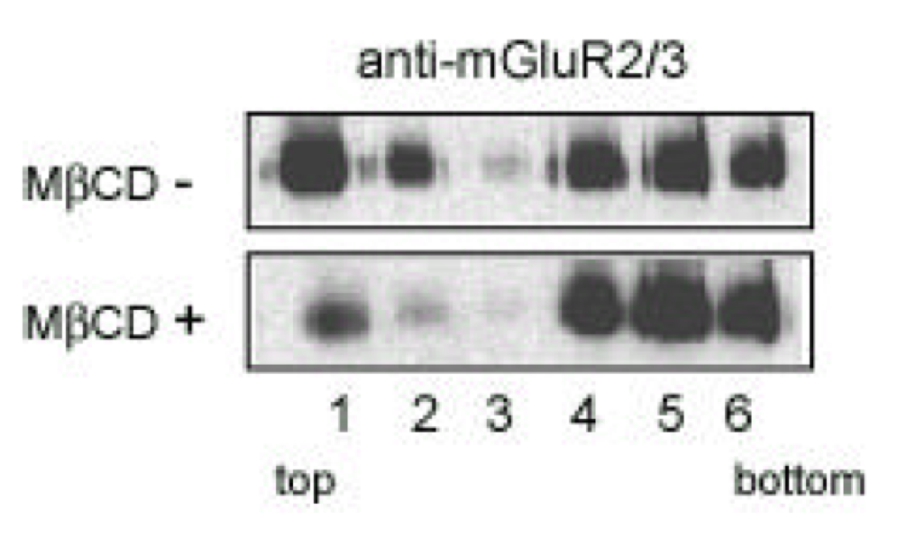
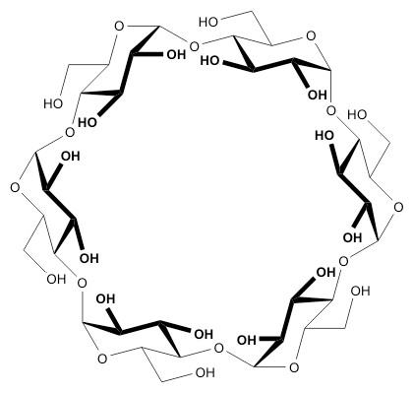
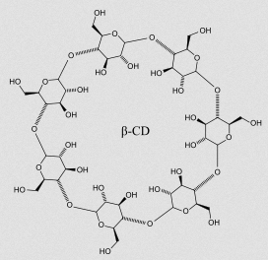
Modulation of mGlu-R “fitness” by lipid domains
Experiment 2:
◊ Cholesterol depletion in Sf9 by methyl-β-cyclodextrin (mβCD)
  => receptor goes to heavy membranes upon mβCD treatment
=> Yes, cholesterol is needed for both high affinity & raft localisation !
Eroglu PNAS 2003
6 - Lipid modulation of signalling p

Slide 22
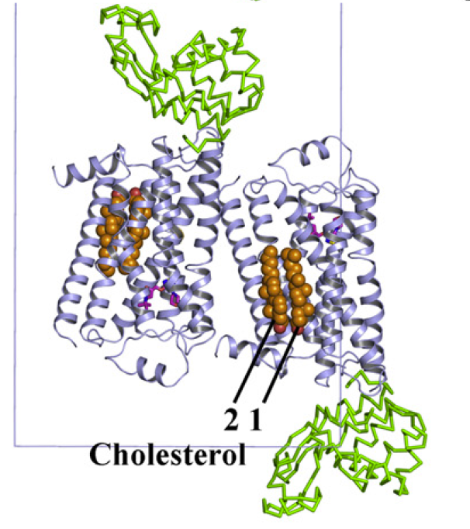
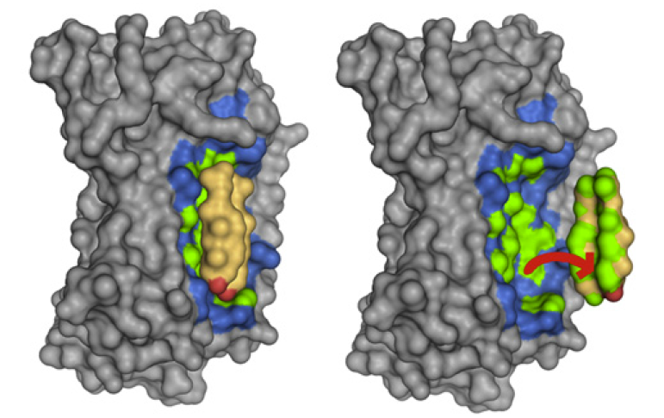
Cholesterol binding site on GPCRs
Crystal structure of the 2β-adrenergic receptor
=> 2 cholesterol molecules / receptor within the protein structure
Unit cell Cholesterol 1 docks on receptor
Brown Cholesterol 1
green d < 4Å
blue 4 Å < d < 5 Å
Green : T4 lysozyme
Hanson Nature 2008
6 - Lipid modulation of signalling p

Slide 23
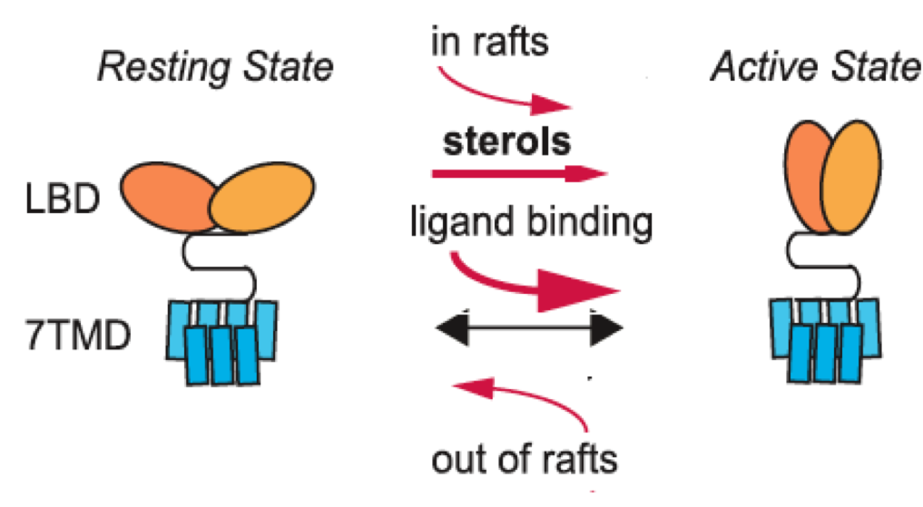
Modulation of mGlu-R “fitness” by lipid domains
Model to explain effect cholesterol:
Cholesterol rich domains act as positive allosteric modulator,
favouring active state that has a higher affinity.
less sterols
ligand dissociation
Eroglu PNAS 2003
6 - Lipid modulation of signalling p

Slide 24
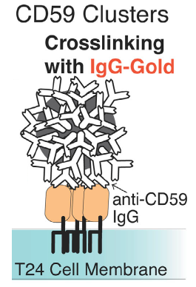
Case 2 : Signaling cascade of CD59
- CD59 is a GPI anchored receptor
- Ligand-binding induced clustering of CD59
-> Recruitment of G-protein Gαi2 and the kinase Lyn
-> Lyn phosphorylates some proteins (?)
-> Activation of phospholipase Cγ (PLase Cγ)
-> Production of IP3
-> Ca²⁺ release from ER
Additional info:
- Duration of Ca²⁺ signaling is ~15 min
- Cholesterol is essential
• Method of investigation: Single molecule imaging
- Gold labelling & clustering of CD59
- GFP labelled Gαi2, PLase Cγ, Lyn
6 - Membrane domains and signalling p
Suzuki, J Cell Biol May 21, 2007

Slide 25
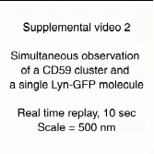
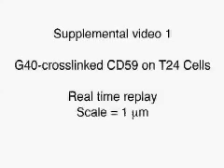
Single molecule observation of CD59 and Lyn
Observations of signalling pathway :
CD59 and Lyn
6 - Membrane domains and signalling p
Suzuki, J Cell Biol May 21, 2007

Slide 26
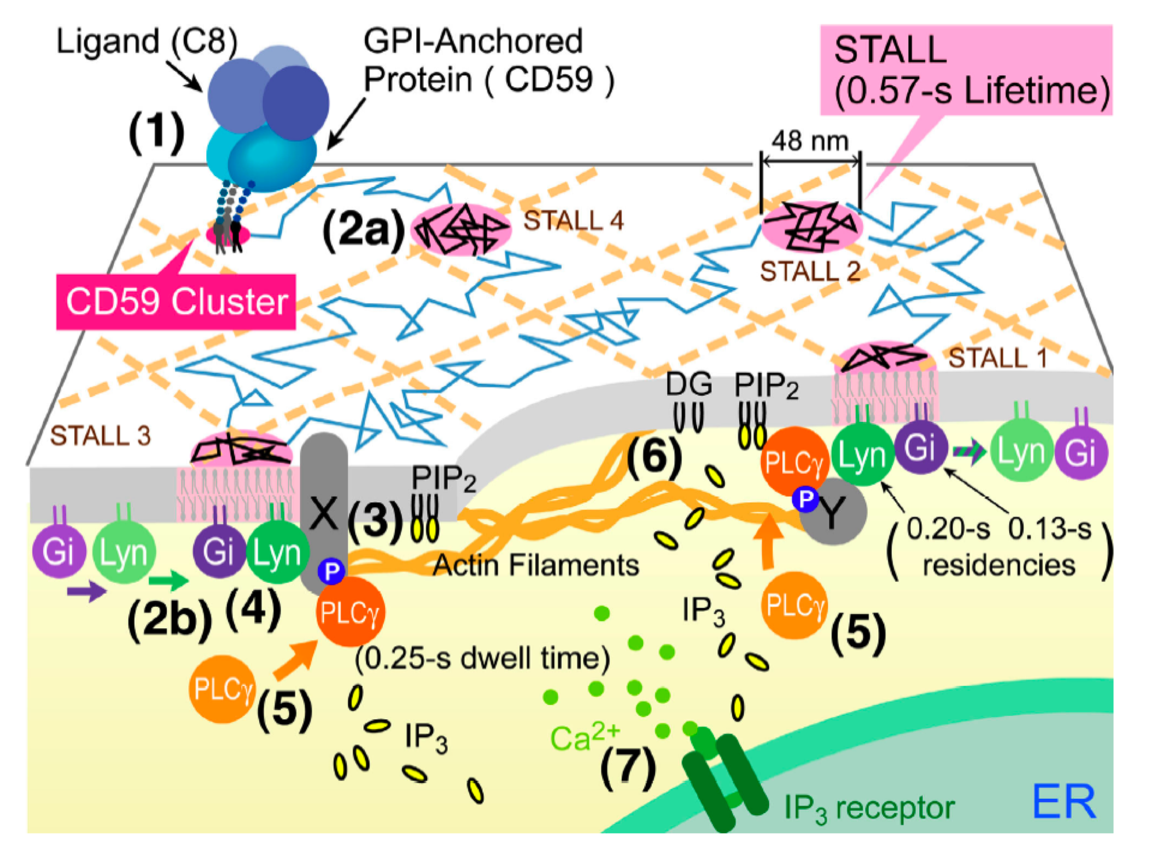
Single-molecule imaging reveals transient interactions
1) Clustering of the GPI-anchored receptor CD59
2a) Translocation into domains (0.57 sec)
2b-4) Recruitment of Gαi2 (0.1 sec) & Lyn (0.2 sec)
4) Recruitment of and
activation of Lyn by Gαi2
=> STALL
5) Recruitment & activation
of PLase Cγ (0.25 sec)
6) Production of IP3
(20- 50 molecules)
7) Ca²⁺ release from ER
STALL = Stimulation-activated
transient arrest of
lateral diffusion
6 - Membrane domains and signalling p
Suzuki, J Cell Biol May 21, 2007

Slide 27
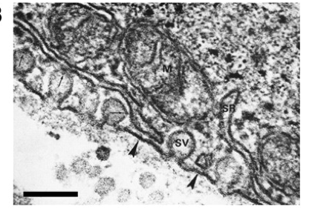
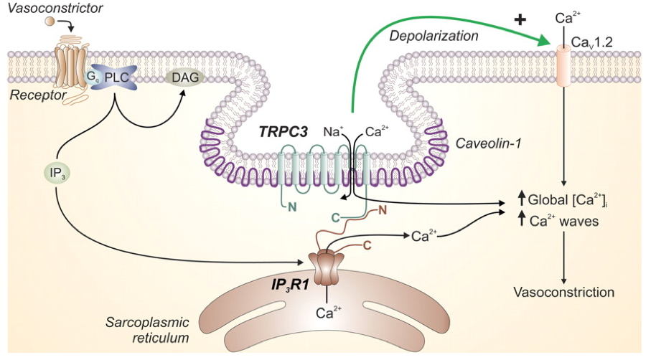
Close proximity between plasma membrane and ER
Electron microscopic image showing apposition of sarcolemma & plasma membrane (arrow head)
Schematic representation
Scale bar : 100 nm
6 - Membrane domains and signalling p
Narayanan et al. Heart & Circul Physiol 302(2012) H2190

Slide 28
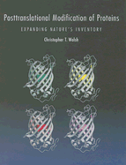
  Further reading:
  Walsh Post-translational modifications of proteins Chpt. 7
  Van Meer Membranes & lipids (2008)
  Yu GPI (2013)
  Levental Membrane association (2010)
  Tate Lipidation profiling (2014)
6 - Lipidation • Localisation and signalling p

Slide 29
Protein lipidation
• Attachment of one or several acyl chain or lipids
- reversible or irreversible modifications
=> translocation from cytosol to membrane
=> location to a specific membrane or membrane domain
=> change in protein structure/function
=> change in accessibility
◊ Manipulation of location in space & time
- In general, location rimes with activity.
6 - Lipidation p

Slide 30
Modulation of signalling
by
lipids and membrane domains
6 p

Slide 31
  Further reading:
  Walsh Post-translational modifications of proteins Chpt. 7
  Van Meer Membranes & lipids (2008)
  Yu GPI (2013)
  Levental Membrane association (2010)
  Tate Lipidation profiling (2014)
6 - Lipidation • Localisation and signalling p

