Slide 1
Véronique Vallet, PhD Institute of Radiation Physics
Beam charaterisation

Slide 2
Outline
Measurements means of dose in radiotherapy
Dosimetry parameters of photons beams
Use of the dosimetry parameters

Slide 3
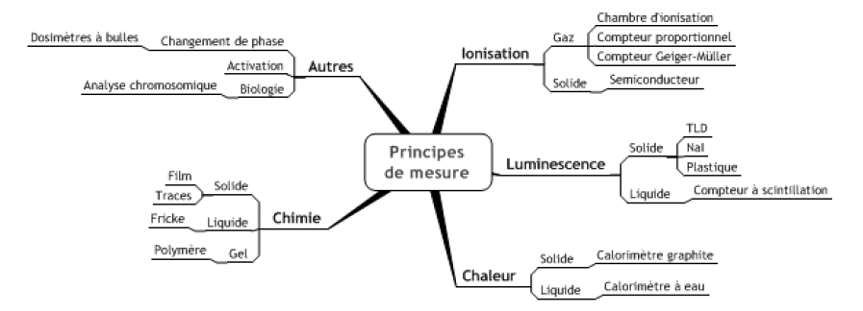

Measure of ionising beam
Indirect measurement (effects measurement)
Unit
$$1 Gy=1\frac{J}{kg}$$

Slide 4
Ionising radiation
Electrons - direct:
Continuously interacts with matter through Coulomb forces
Energy loss in form of ionizations and excitations along the path
Photons - Indirect:
“long” distance between successive interactions
Interaction → often release of an electron
Released electron loss its energy in form of ionizations and excitations

Slide 5
Ionisation based measurement devices
Ionization of material (production of + and - charges)
Migration of charges to electrodes
Measurement of current (or charge) by electrometer
Electrometer signal increases with voltage
Negative electrode
Secondary electron
+
+
+
+
-
+
-
+
-
+
-
+
-
+
+
-
-
-
-
-
+
+
+
+
+
+
+
+
+
-
-
-
-
-
Ionizing radiation
-
+
-
-
+
-
-
-
+
-
+
+
-
+
Positive ion
+
-
-
+
+
-
+
-
+
-
+
-
+
+
-
+
Negative ion
-
-
-
-
Positive electrode
A
+
HV
electrometer

Slide 6
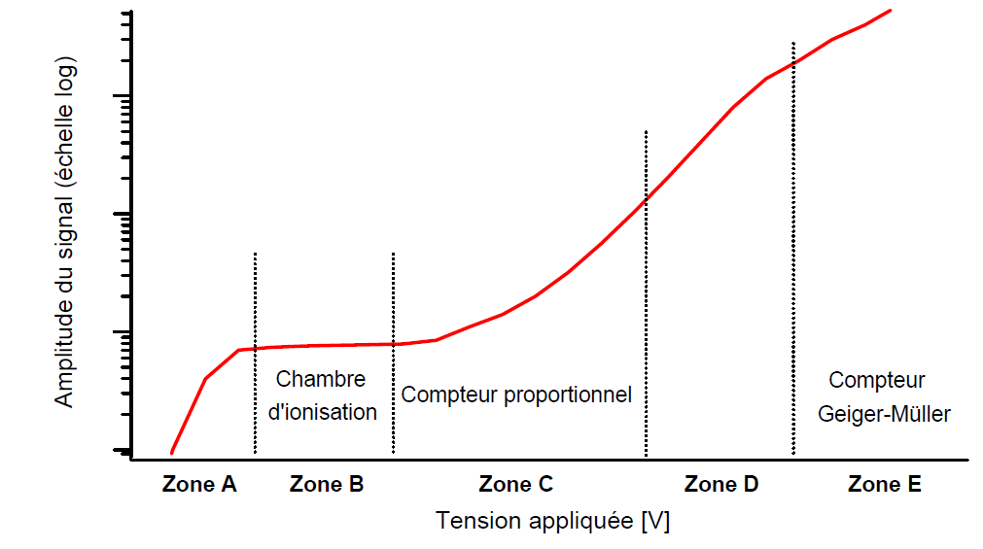
Ionisation based measurement devices
Produced ionized particles produces other ionisations
No recombination
Recombination before reaching the electrode

Slide 7
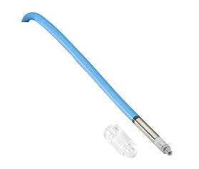
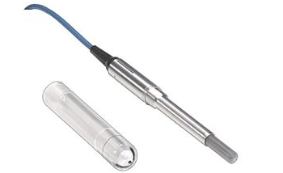
Chambre d’ionisation en radiothérapie
Sensitive volume
Voltage high enough to prevent recombination
Voltage low enough to prevent the created ions from ionizing
Cylindrical shape with central electrode
Sensitive volume size according to use
Sealed or ventilated
Scattered photon
e⁻
-
-
Incident photon
+
+
Central electrode

Slide 8
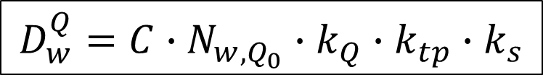
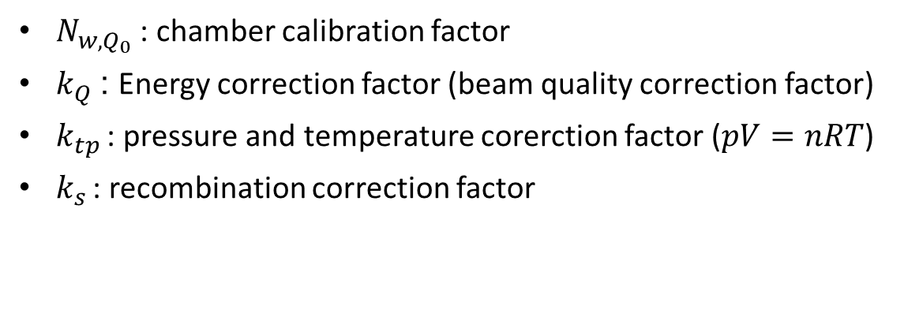
Charge - Dose
$$D_{w}^{Q}=C∙N_{w,Q_{0}}∙k_{Q}{∙k_{tp}∙k}_{s}$$
$N_{w,Q_{0}}$: chamber calibration factor
$k_{Q}$: Energy correction factor (beam quality correction factor)
$k_{tp}$ : pressure and temperature corerction factor ($pV=nRT$)
$k_{s}$ : recombination correction factor

Slide 9
Reference condition
Field size
Fixe distance
SAD = source – axe distance (isocentric)
SSD = source – surface distance
Depth
target
target
SAD
SSD
Measurement point =
isocentre
measurement point
Isocentric condition
fixed SSD condition

Slide 10
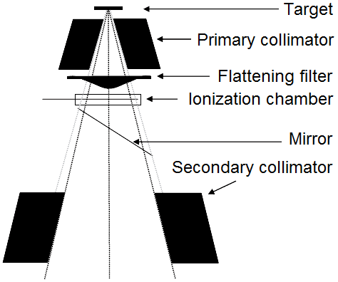
Machine calibration
In reference condition:
1 UM = 1 cGy
«counts» measurement by the monitor chamber
Monitor chamber calibration
# counts_{m}
# counts_{1UM}
=
D_{m}
0.01 Gy
Dose measurement by the reference ionisation chamber
# counts_{m}
# counts_{1UM}
=
0.01
D_{m}

Slide 11
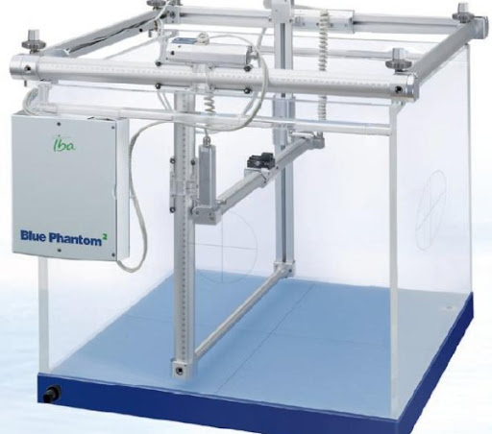
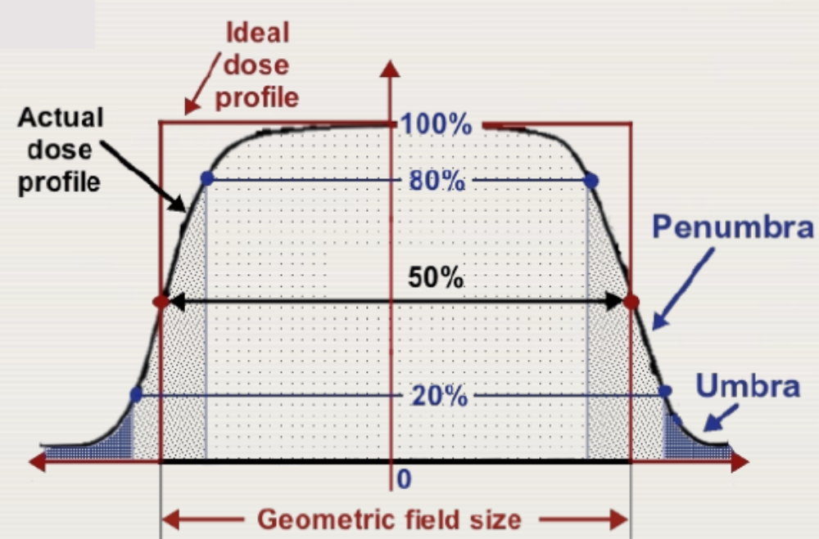
Field profil
Measured in a water tank with an ionization chamber

Slide 12
Field profil
Parameters determining the quality of the measurement:
Detector size
Measurement interval

Slide 13
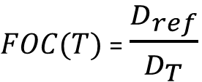
Output Factor (FOC)
Field size effect:
ratio of the dose measured under reference conditions and the dose measured for a field size T, other conditions being similar
$FOC(T)$ = $\frac{D_{ref}}{D_{T}}$
D_{ref}
D_{T}

Slide 14
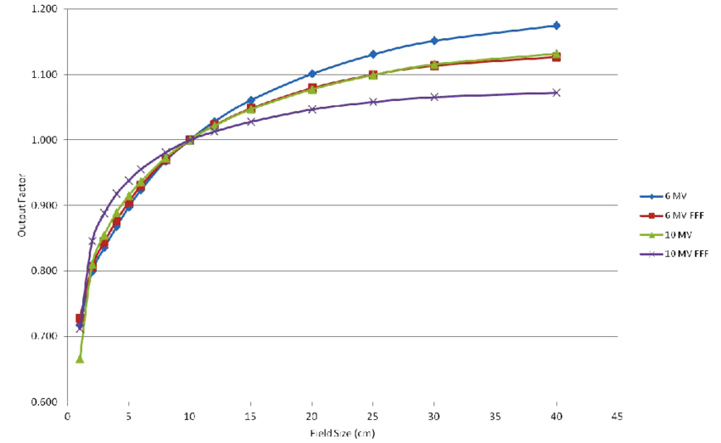
Output Factor
Head and phantom scatter
Detector size vs. field size → detector can disturb field
Use of diodes or diamond detector + Monte-Carlo calculated correction factors for output factor of small fields

Slide 15
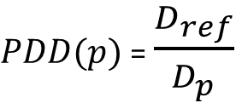
Percentage Depth Dose
Depth effect in fixed SSD condition:
Ratio of the dose measured under reference conditions and the dose measured for a depth p, other conditions being similar
$PDD(p)$ = $\frac{D_{ref}}{D_{p}}$
D_{ref}
D_{p}

Slide 16
Percentage Depth Dose
Three zones:
Build-up
Electronic equilibrium
Exponential decay

Slide 17
Photons → Indirectly ionising
Energy is not deposited where photons interacts with matter
Ahnesjö and Aspradakis, PMB 44 (1999), R99-155

Slide 18
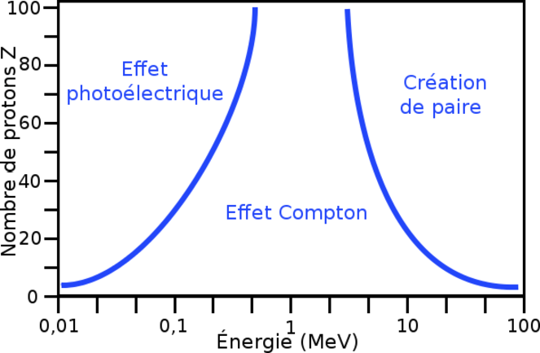
Interaction photon-matter
 |  | Quantité d’énergie cédée à la matière E
 |  | E = E₀ (absorption) | 0 < E < E₀ (inelastic diffusion) | E = 0 (elastic diffusion)
Type d’interaction | with electrons | Photoelectric | Compton | Thomson Rayleigh
 | with elm field | Pair creation
 | with nucleus | Photonuclear

Slide 19
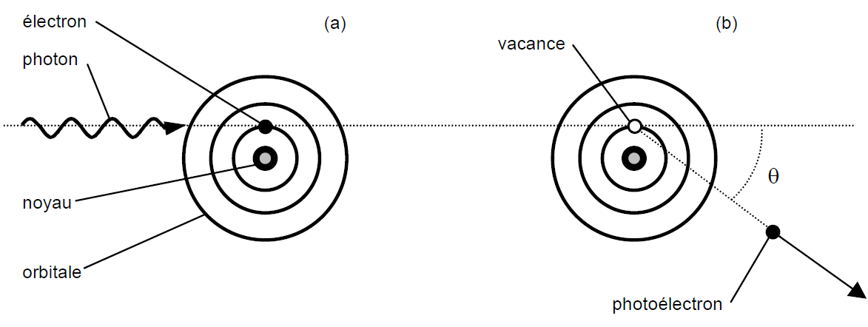
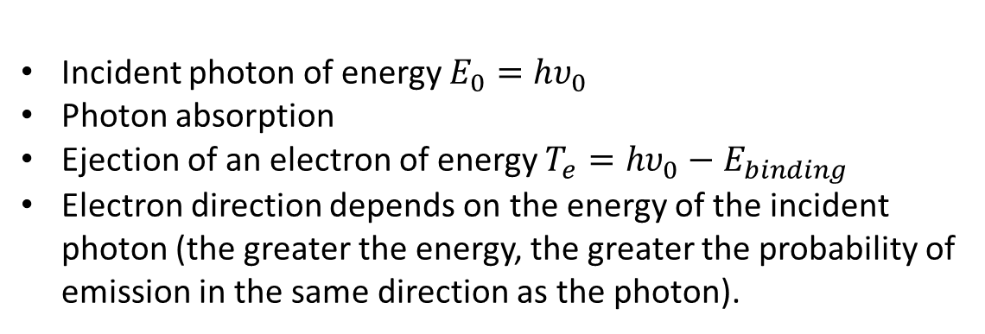
Photoelectric
Incident photon of energy $E_{0}=hυ_{0}$
Photon absorption
Ejection of an electron of energy $T_{e}=hυ_{0}−E_{binding}$
Electron direction depends on the energy of the incident photon (the greater the energy, the greater the probability of emission in the same direction as the photon).

Slide 20
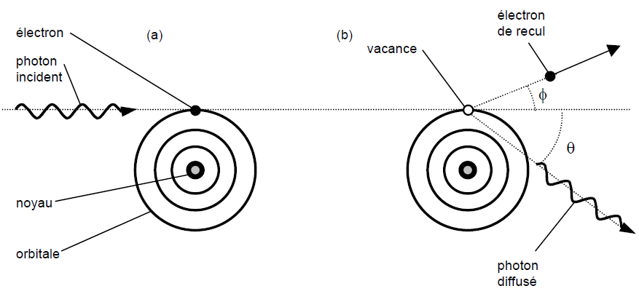
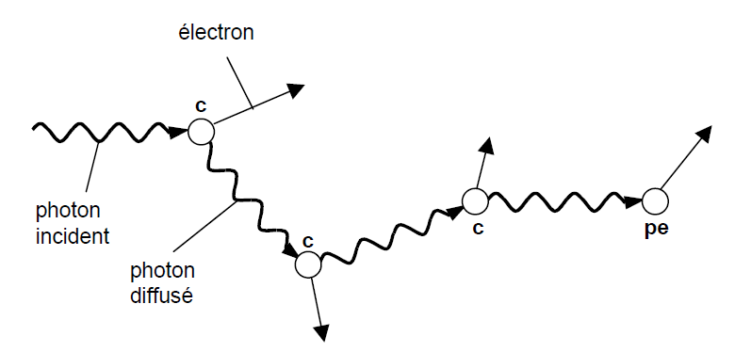
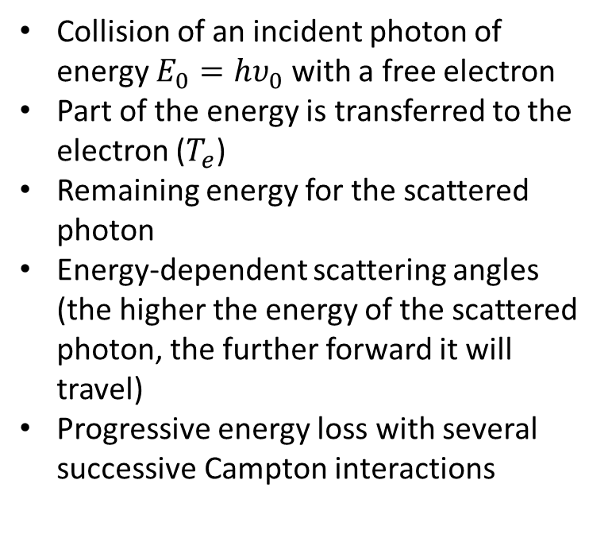
Campton
Collision of an incident photon of energy $E_{0}=hυ_{0}$ with a free electron
Part of the energy is transferred to the electron ($T_{e}$)
Remaining energy for the scattered photon
Energy-dependent scattering angles (the higher the energy of the scattered photon, the further forward it will travel)
Progressive energy loss with several successive Campton interactions

Slide 21

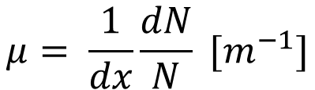
Attenuation
Linear attenuation coefficient
=
Probability of at least one interaction per unit length for a photon in a beam
$$μ= \frac{1}{dx}\frac{dN}{N} [m^{−1}]$$
$$N\left(x\right)= N_{0}e^{−μx}$$
Exponential decrease of number of photon that did not interacted yet

Slide 22
Percentage depth dose
Three zones:
Build-up:
Electrons deposit energy
Electrons move predominantly forward
Lack of electrons on the surface due to absence of material before the surface
Electronic equilibrium
As many electrons in as out
Exponential decay
Less photons available to interact → less electrons produced

Slide 23
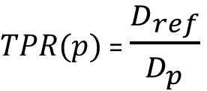
Tissu phantom ratio (TPR)
Depth effect in isocentric condition Ratio of the dose measured under reference conditions andof the dose measured for a depth p, other conditions being similar
$TPR(p)$ = $\frac{D_{ref}}{D_{p}}$
D_{ref}
D_{p}

Slide 24

Manual UM calculation
Retrieve reference conditions by applying correction factors
Fixed DSP conditions
Field size
OF
Depth
PDD
C
C_{ref}
C_{ref}
z_{ref}
z
z
$$UM=D\left(z,C\right)\frac{1}{OF(C)∙PDD(z)}\frac{100 UM}{1Gy}$$

Slide 25

Manual UM calculation
Retrieve reference conditions by applying correction factors
Isocentric Conditions
Field size
OF
Depth
TPR
z
z
z_{ref}
C
C_{ref}
C_{ref}
$$UM=D\left(z,C\right)\frac{1}{OF(C)∙RTP(z,C)}\frac{100 UM}{1Gy}$$

Slide 26
Manual UM calculation
Additional correction factors can be used to take account for exemple of:
Field shape (equivalent square)
Heterogeneity (equivalent depth)

Slide 27
Beam modeling in treatment planning system
Reference conditions used directly
Profiles and PDD (or TPR) used to validate the model

