Slide 1
Introduction to Particle Accelerators 2024-2025
Tutorial 5 - 10.10.2024, BSP 626
Prof. Mike Seidel
Teaching Assistants:
Werner Herr, Tatiana Pieloni, Léon Van Riesen-Haupt, Christophe Lannoy, Raziyeh Dadashi, Yi Wu

Slide 2
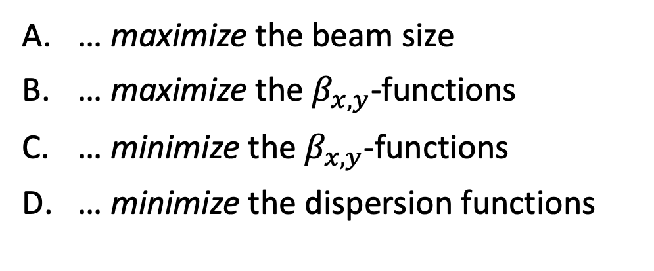
Interaction point
At the interaction point, we typically aim to …
… maximize the beam size
… maximize the $β_{x,y}$-functions
… minimize the $β_{x,y}$-functions
… minimize the dispersion functions

Slide 3
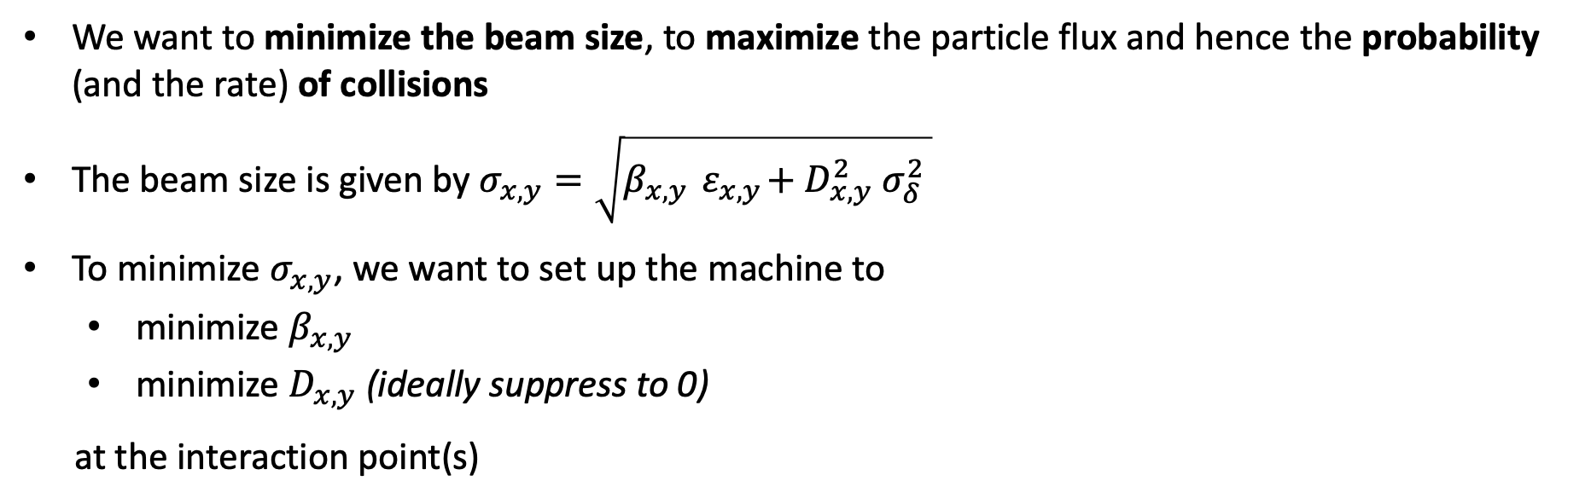
Interaction point
Answers C & D are correct
We want to minimize the beam size, to maximize the particle flux and hence the probability (and the rate) of collisions
The beam size is given by $σ_{x,y}=\sqrt{β_{x,y}{ ε}_{x,y}+D_{x,y}^{2} σ_{δ}^{2} }$
To minimize $σ_{x,y}$, we want to set up the machine to
minimize $β_{x,y}$
minimize $D_{x,y}$ (ideally suppress to 0)
at the interaction point(s)

Slide 4
Evolution of the β-functions
What is the typical dependence of the β-function on the s parameter around the interaction point (where 𝛽_{x,y} is minimal)?
(Hint: Region around interaction point is a drift space)
We can’t say generally
Linear
Quadratic
Exponential

Slide 5
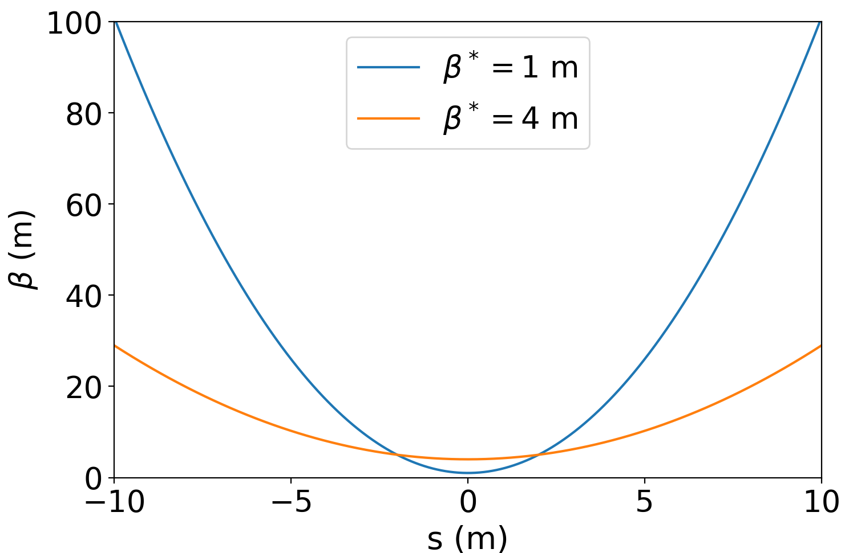
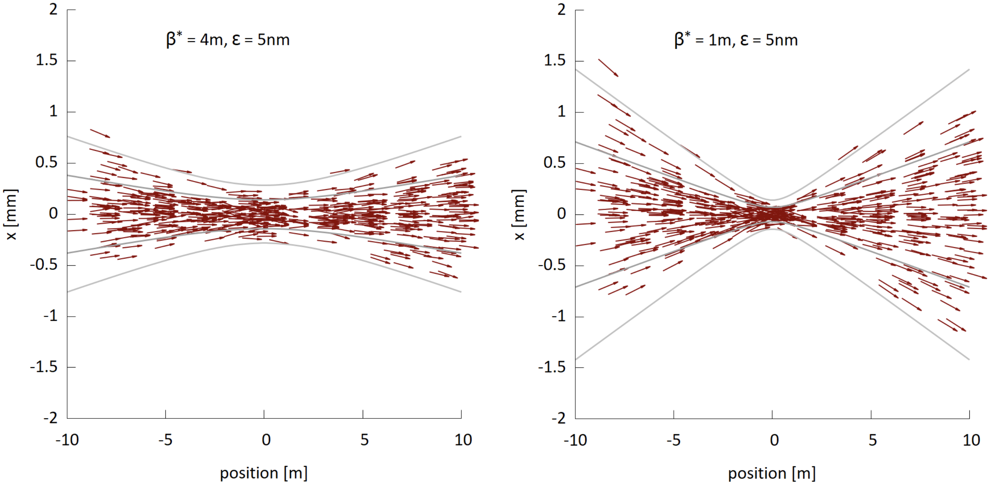
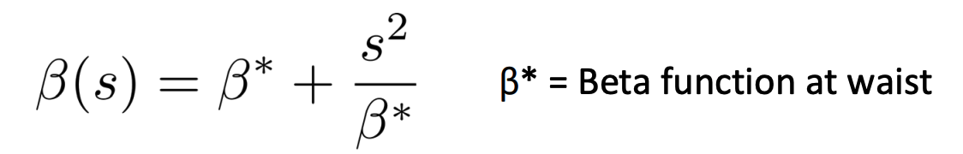
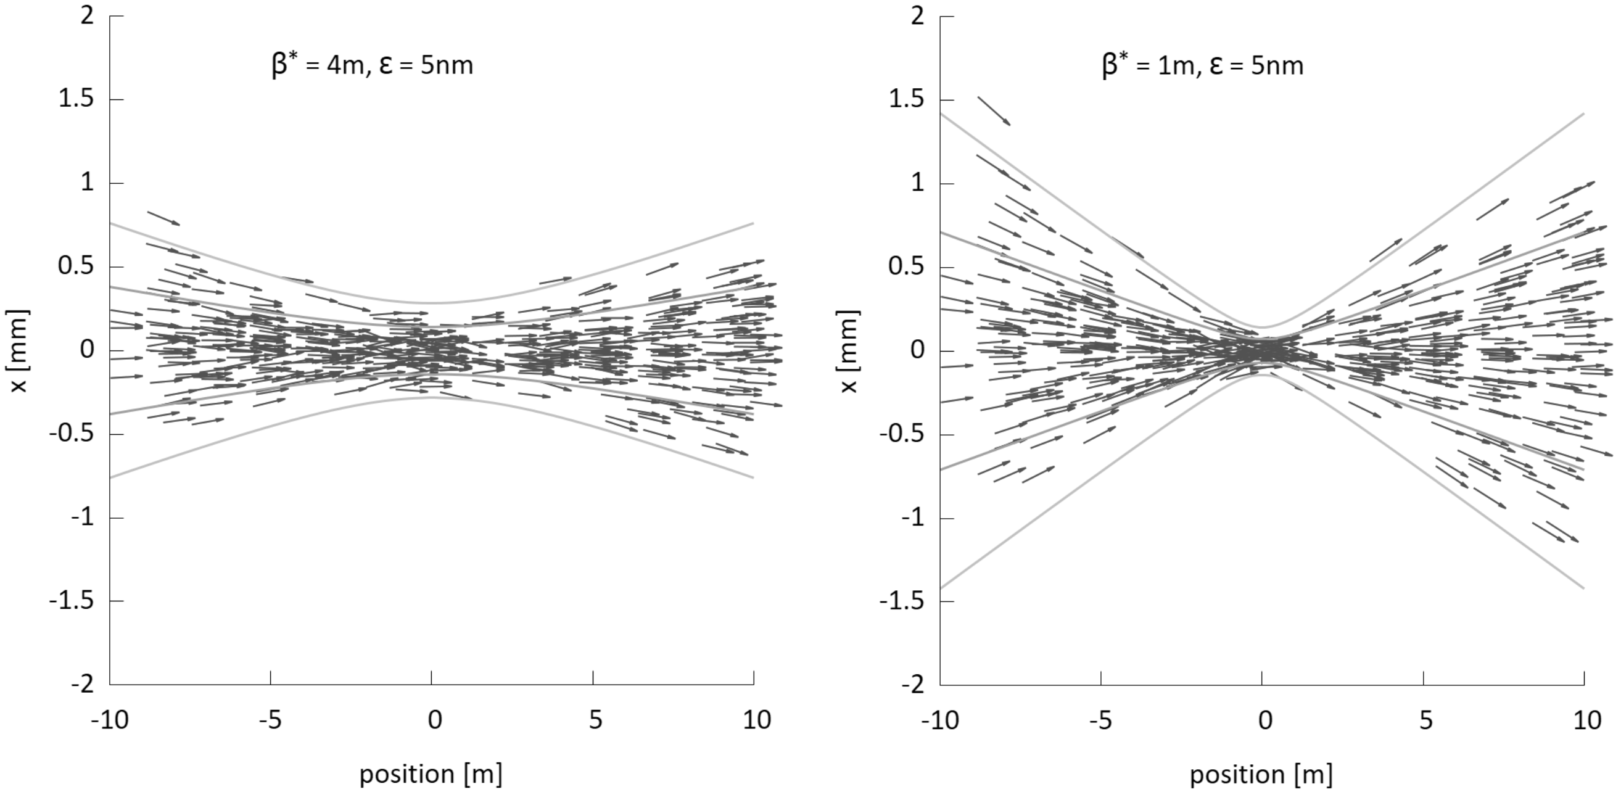






Evolution of the β-functions
Answer C is correct
Region around interaction point is a drift space, since we cannot place any accelerator elements there (particle physics detector … lack of space)
$$x′$$
$$x′$$
$$x′$$
You will derive it in Ex. 1 today.
$$x$$
$$x$$
$$x$$

Slide 6
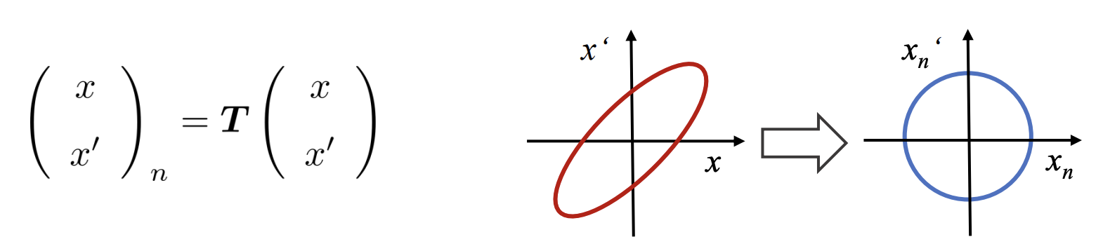
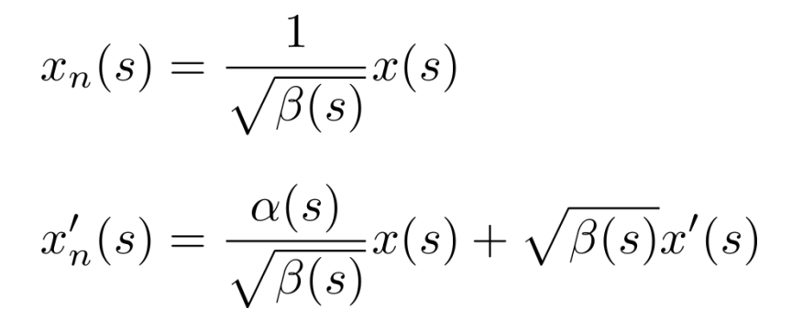
Normalized coordinates
What happens to the phase space ellipse of a particle when transformed to normalized coordinates?
The ellipse is transformed into a circle of …
smaller area
same area
larger area

Slide 7
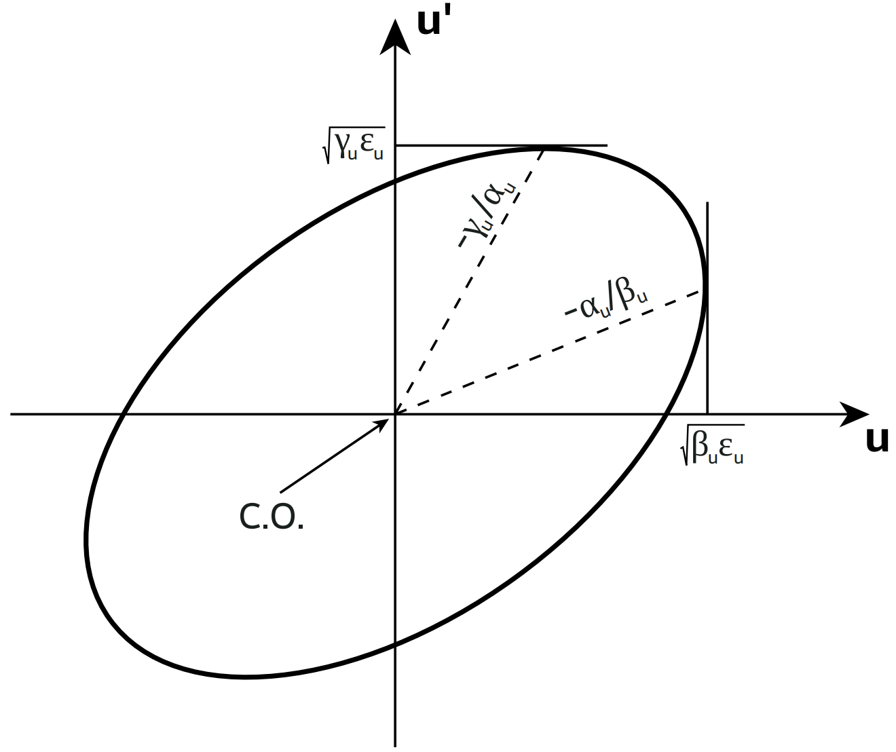
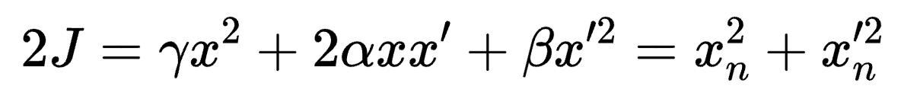








Normalized coordinates
Answer B is correct
Normalized coordinates
$$x′$$
$$x_{N}^{′}$$
The area is a conserved quantity, also known as the Courant-Snyder invariant.
It corresponds to 2J𝜋, where J is the particle action.
$$\sqrt{2J_{x}γ_{x}}$$
$$−γ_{x}/α_{x}$$
T
$$−α_{x}/β_{x}$$
$$\sqrt{2J_{x}}$$
$$\sqrt{2J_{x}β_{x}}$$
$$x$$
$$x_{N}$$
You will prove that in Ex. 2 today
See also lecture 3, Transverse Dynamics, (slide 56)

Slide 8
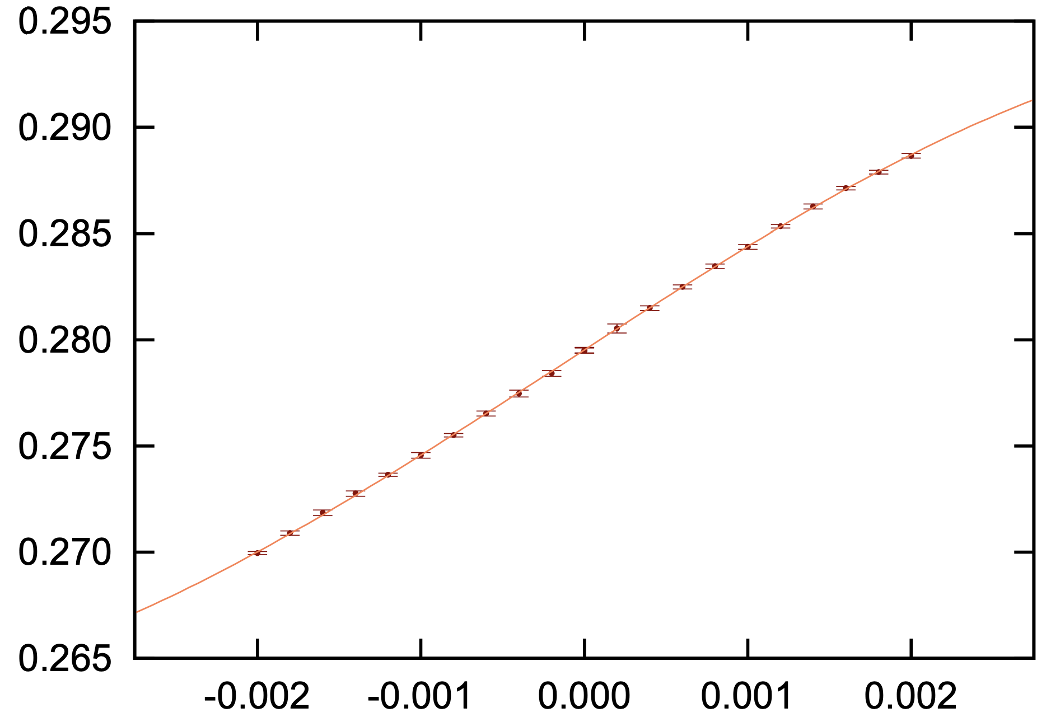
What are we measuring here?
LHC Beam 2
Q_{x}
Dispersion
β-functions
Chromaticity
Beam energy
𝛿

Slide 9
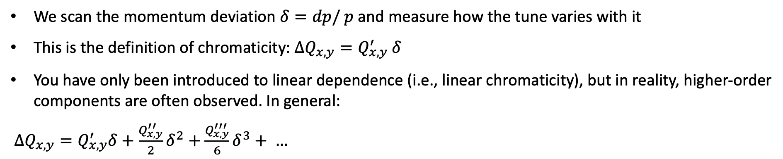
What are we measuring here?
Answer C is correct
We scan the momentum deviation $δ=dp/ p$ and measure how the tune varies with it
This is the definition of chromaticity: ${ΔQ}_{x,y}=Q_{x,y}^{′} δ$
You have only been introduced to linear dependence (i.e., linear chromaticity), but in reality, higher-order components are often observed. In general:
$ΔQ_{x,y}=Q_{x,y}^{′}δ+\frac{Q_{x,y}^{′′}}{2}δ^{2}+\frac{Q_{x,y}^{′′′}}{6}δ^{3}+ …$

