Slide 1


PHYS-448 Introduction to particle accelerators
Tutorial 4
Werner Herr, Tatiana Pieloni, Léon Van Riesen-Haupt, Christophe Lannoy, Yi Wu, Raziyeh Dadashi
3rd October 2024

Slide 2


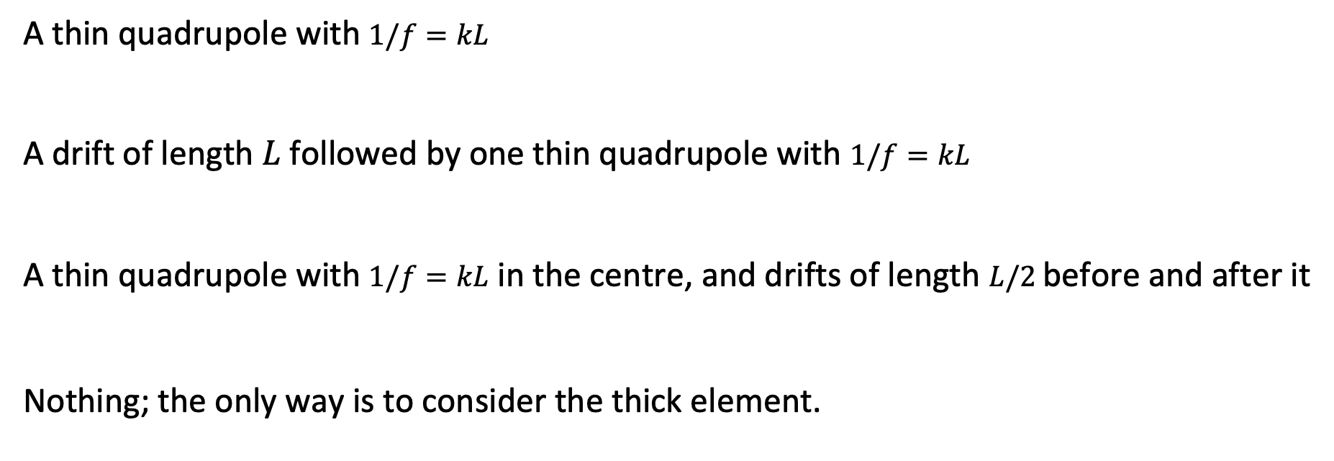










Thick and thin lenses
The best way to approximate a thick quadrupole of length L by using the thin-lens approximation is to replace it with …
$$k$$
A thin quadrupole with $1/f=kL$
A drift of length $L$ followed by one thin quadrupole with $1/f=kL$
A thin quadrupole with $1/f=kL$ in the centre, and drifts of length $L/2$before and after it
Nothing; the only way is to consider the thick element.
$$k$$
$$L$$
$$k$$
$$k$$
$$L$$
$$L$$
$$k$$
$$k$$
$$L/2$$
$$L/2$$
$$L$$

Slide 3







Thick and thin lenses
is the correct answer.
$$k$$
Thick quadrupole
$$L$$
$$k$$
$$L$$
$$k$$
Better approximation!
$$L/2$$
$$L/2$$
Calculations in exercise 3 of this tutorial!

Slide 4
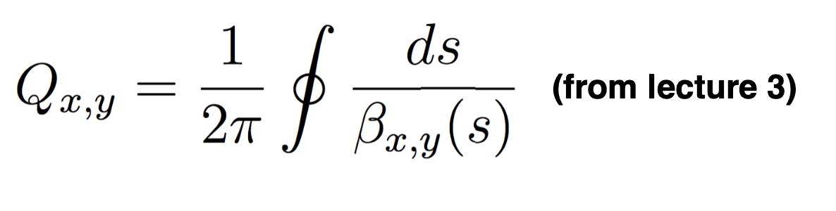
Betatron Tunes
Which of the following is false?
If you increase the strength of the horizontally focusing quadrupoles...
The horizontal tune increases
Both the vertical and horizontal tunes change
The horizontal tune decreases
The maximum of the horizontal beta function will be smaller
Hint:

Slide 5
Betatron Tunes
The horizontal tune does not decrease!
Horizontal plane: Increasing the strength of the focusing magnets → Smaller beta function → The tune increases.
Vertical plane: Less focusing → The vertical tune decreases.

Slide 6
Beta-functions
Where are the maxima of the horizontal β-function located in a circular collider?
At the interaction points
At the horizontally defocusing quadrupoles
The β-function is constant everywhere
At the horizontally focusing quadrupoles

Slide 7
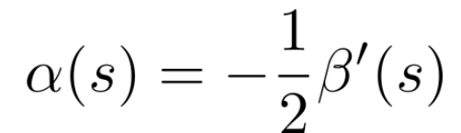
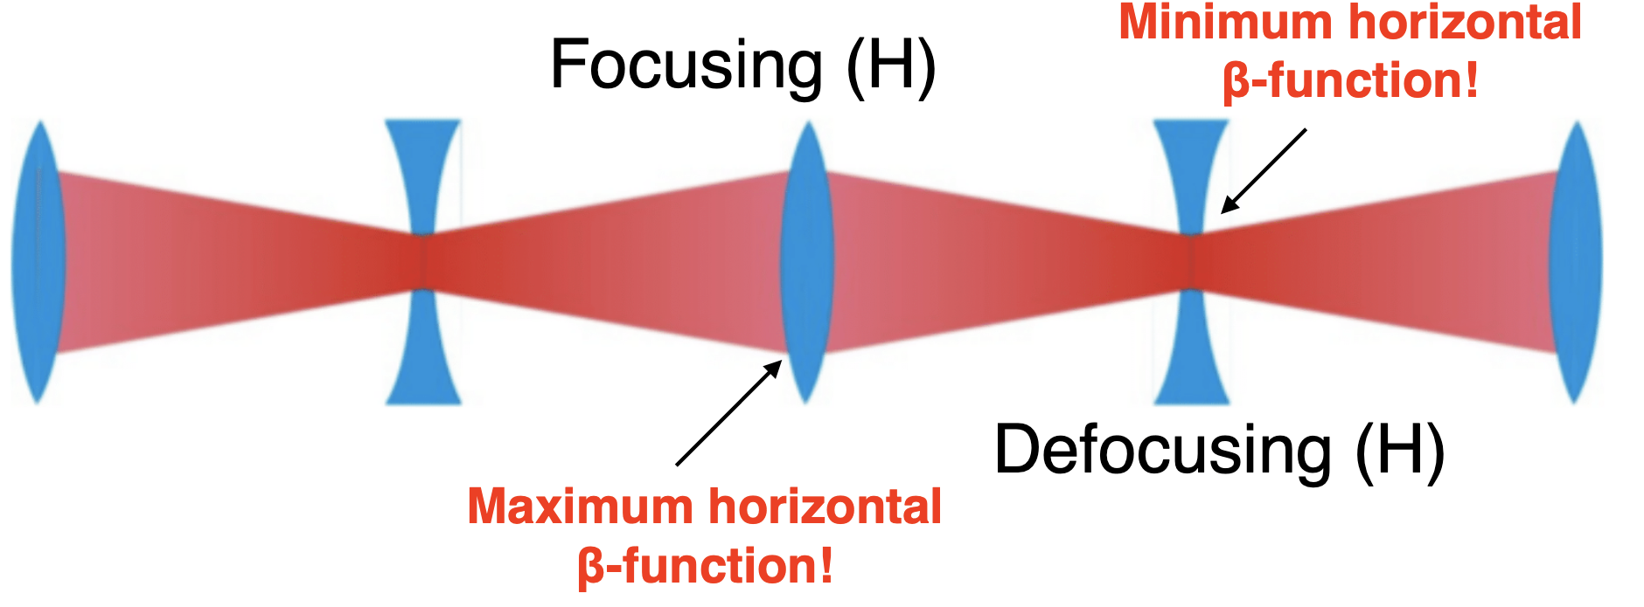
Beta-functions
At the focusing quadrupoles
In the middle of quadrupole magnets, where α=0, the β-function has an extreme value.

Slide 8
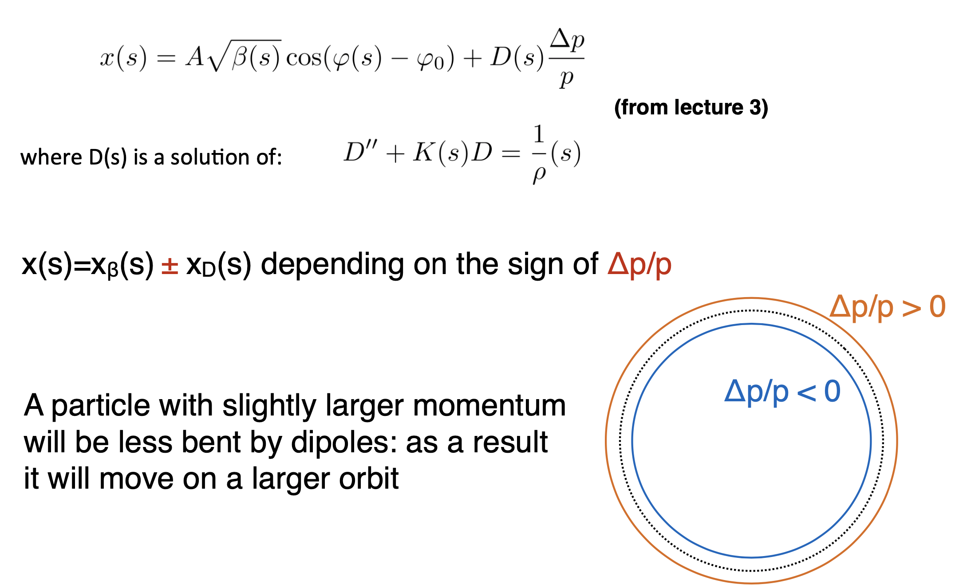
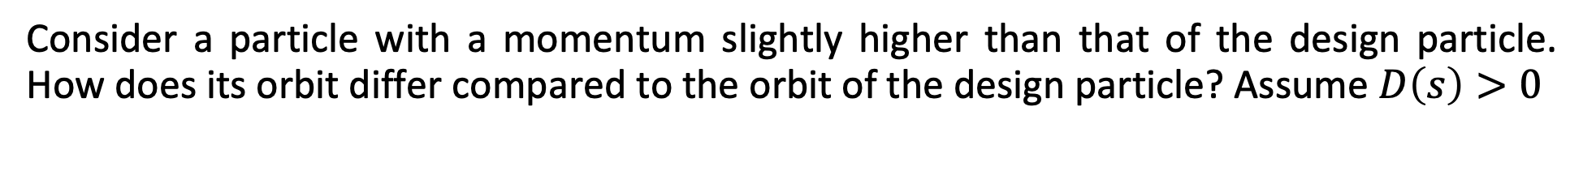
Dispersion (single particle dynamics)
Consider a particle with a momentum slightly higher than that of the design particle. How does its orbit differ compared to the orbit of the design particle? Assume $D\left(s\right)>0$
It will move on a smaller orbit
It will move on a larger orbit
Its orbit stays the same
It cannot be determined based on this information
Hint:

Slide 9
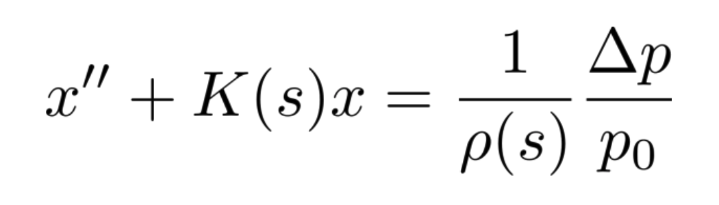
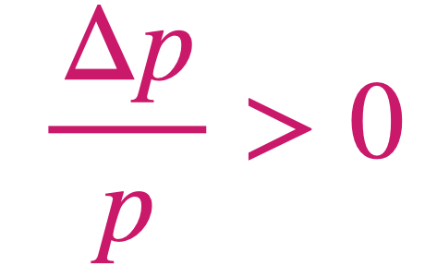
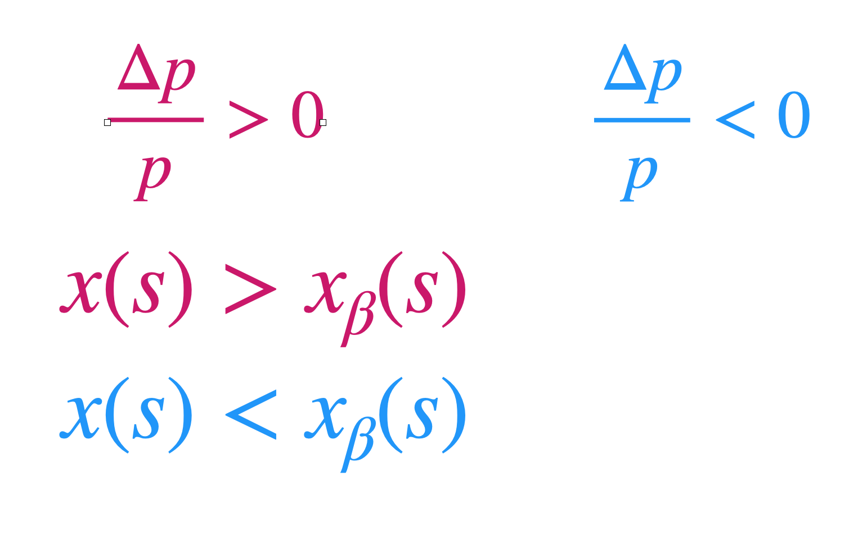
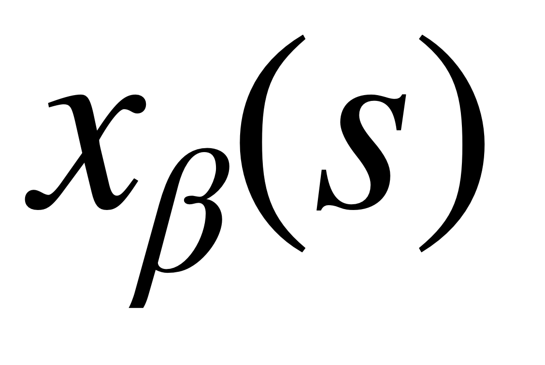
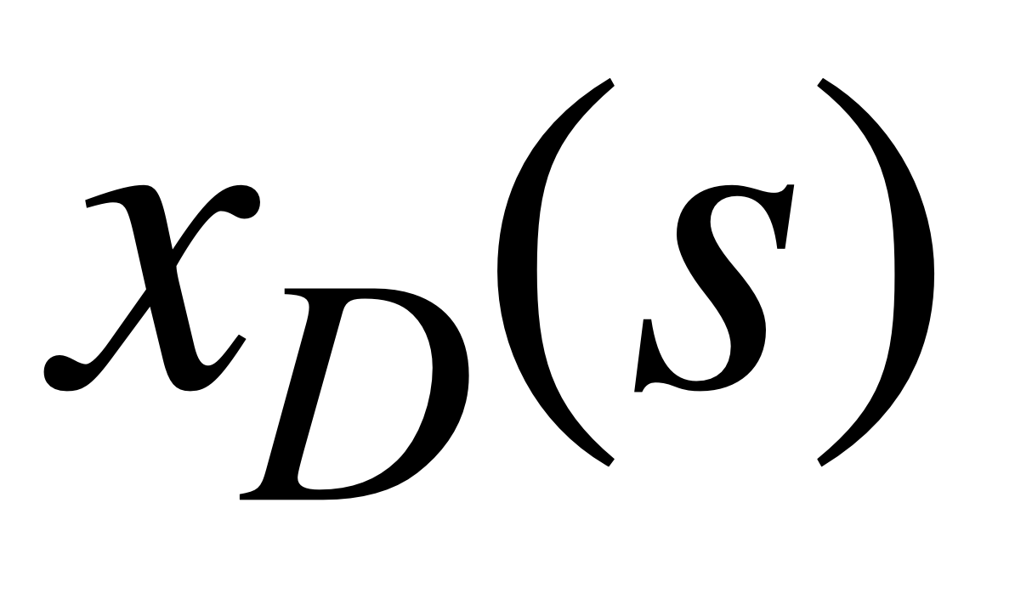
Dispersion (single particle dynamics)
It will move on a larger orbit
4.32
4.32
4.32
Homogeneous solution
(betatron oscillation)
Particular solution
Larger momentum →Less bent by dipoles →Larger orbit

Slide 10
Dispersion (beam dynamics)
Assuming that the horizontal and the vertical motions are uncoupled, at a location with non-zero dispersion:
There is no effect on the beam size
The horizontal beam size will be larger
The horizontal beam size will be smaller
Both the horizontal and the vertical beam sizes will be larger

Slide 11
Dispersion (beam dynamics)
The horizontal beam size will be larger
Horizontal plane: Dispersion is not zero → Particles with different momentum will have different bending radius → There will be a spread in the displacement → Beam size increases
Vertical plane: No dipoles → No dispersion → No effect on the vertical beam size

