Slide 1
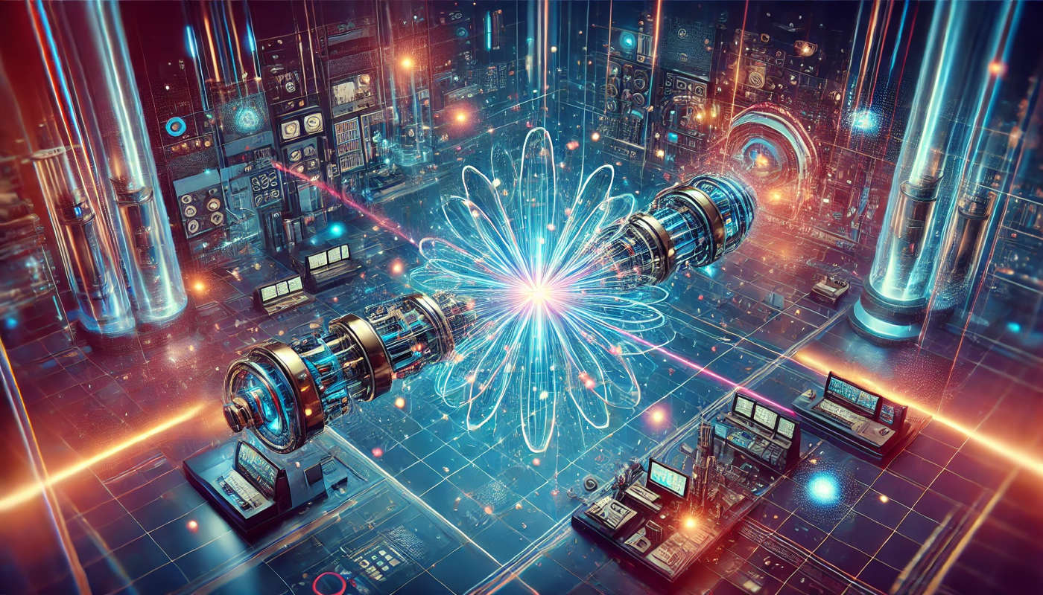

PHYS-448 Introduction to particle accelerators
Tutorial 10
Werner Herr, Tatiana Pieloni, Léon Van Riesen-Haupt, Christophe Lannoy, Yi Wu, Raziyeh Dadashi
21st November 2024

Slide 2

Luminosity
What is the SI unit of luminosity 𝐿?
$${kg}^{−2} m^{2}$$
$$m^{2}$$
$m^{−2}$ $s$
$m^{−2}$ $s^{−1}$

Slide 3

Luminosity
What is the SI unit of luminosity 𝐿?
$${kg}^{−2} m^{2}$$
$$m^{2}$$
$m^{−2}$ $s$
$m^{−2}$ $s^{−1}$
Reaction rate depends on $L$ and cross section:
$$dN/dt =L σ$$

Slide 4
Linear Lepton Colliders
What are the main challenges of linear lepton colliders?
Synchrotron radiation
Accelerating gradient
Beam-beam effects
Beam degradation when the beam is being re-used

Slide 5
Linear Lepton Colliders
What are the main challenges of linear lepton colliders?
Synchrotron radiation
Accelerating gradient
Beam-beam effects
Beam degradation when the beam is being re-used
One pass to accelerate particles – ultra-high accelerating gradient needed. At these electric field, vacuum should be high.
Small beam sizes at collisions – beam-beam effects can distort beams.

Slide 6
Circular Lepton Colliders
In many cases, the ultimate limiting factor for circular lepton colliders is...
Beam-beam forces
Superconducting dipole magnet fields
Synchrotron radiation losses
RF power limitations

Slide 7

Circular Lepton Colliders
In many cases, the ultimate limiting factor for circular lepton colliders is...
Beam-beam forces
Superconducting dipole magnet fields
Synchrotron radiation losses
RF power limitations
Synchrotron radiation losses scale with ${(E/m)}^{4}$, so light particles at high energies lose a lot of energy per turn.

Slide 8
Linear vs Circular Accelerator
Linear accelerators are more cost efficient than circular accelerators for..
Protons for lower energies
Protons for higher energies
Electrons for lower energies
Electrons for intermediate energies

Slide 9
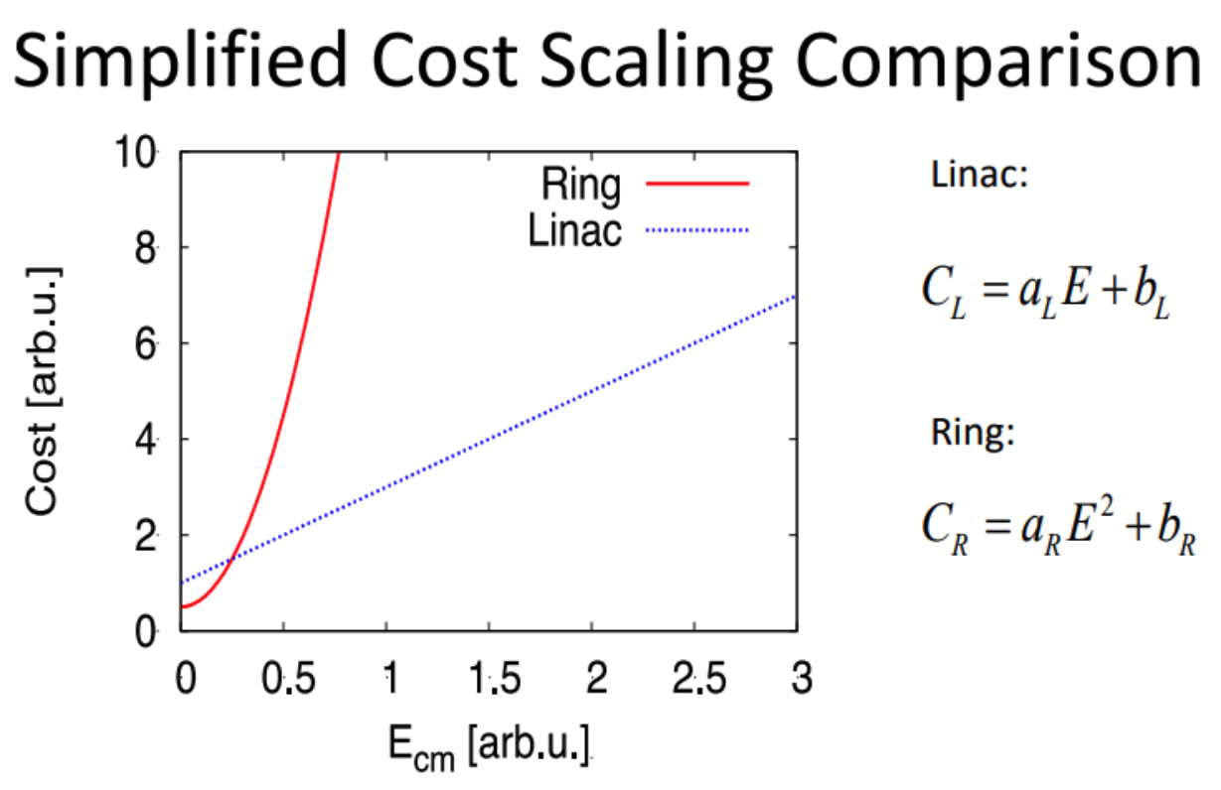
Linear vs Circular Accelerator
Linear accelerators are more cost efficient than circular accelerators for..
Protons for lower energies
Protons for higher energies
Electrons for lower energies
Electrons for intermediate energies

Slide 10
Luminosity and Beam Quality
Luminosity...
Increases with larger beam size and increases with lower intensity
Increases with higher energy
Decreases with higher revolution frequency
Increases with higher intensity and smaller beam size

Slide 11
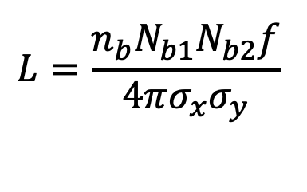
Luminosity and Beam Quality
Luminosity...
Increases with larger beam size and increases with lower intensity
Increases with higher energy
Decreases with higher revolution frequency
Increases with higher intensity and smaller beam size
$${L=\frac{n_{b}N_{b1}N_{b2}f}{4πσ_{x}σ_{y}}}^{ }$$

