Slide 1

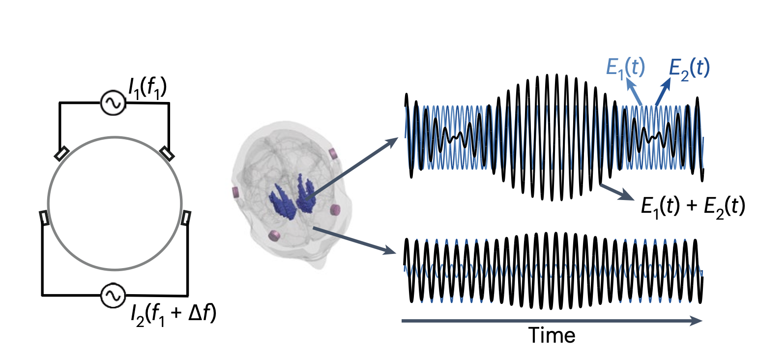
Noninvasive Theta-Burst Stimulation of the Human Striatum Enhances Striatal Activity and Motor Skill Learning
(Wessel, Beanato et al., 2023, Nature Neuroscience)
Presented by Lio Grienenberger, Laura Ducret and Toscane Revillard

Slide 2
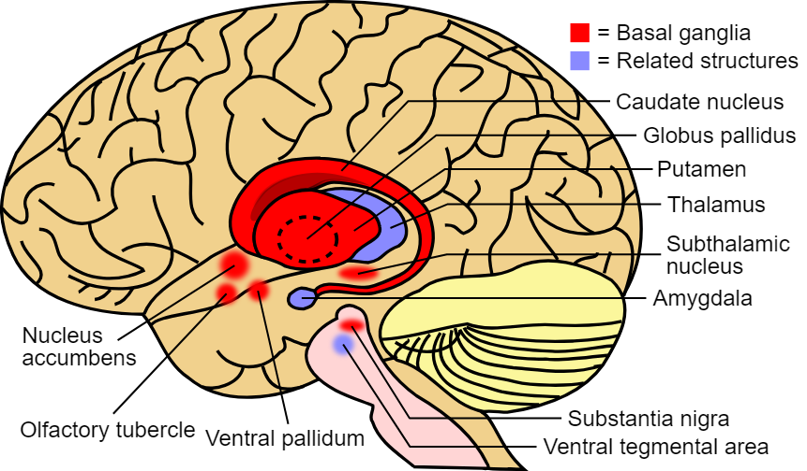
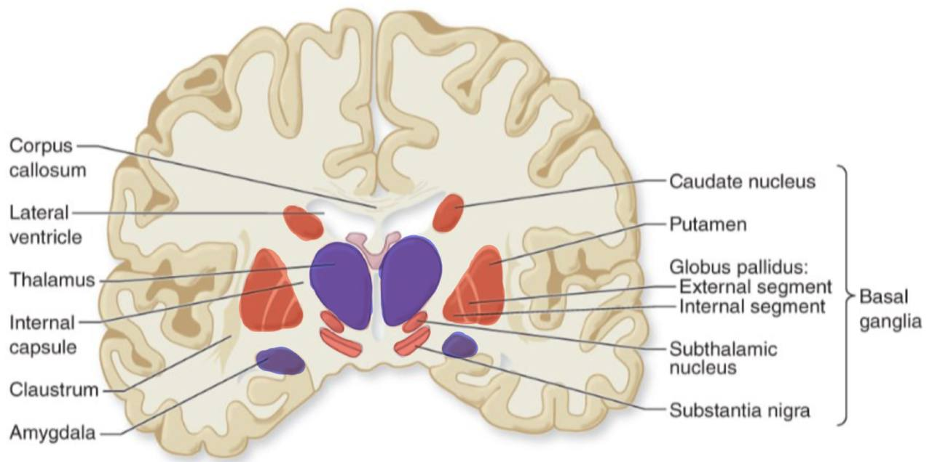
Research Context
Striatum:
Two main parts (putamen and caudate nucleus)
Involved in both motor learning and cognitive functions.
Two learning phases :
Initial fast phase: Mainly linked to the caudate nucleus (associative striatum)
Later slower phase: Primarily involves the putamen (sensorimotor striatum)
marklucernas.dev

Slide 3
Research Context
Studying the Striatum: Current Limitations
Invasive techniques:
DBS : surgical risks
Non-invasive techniques:
TMS and tES : depth-focality tradeoff.
Neuroimaging (fMRI, EEG):
Associative evidence but no causal links in humans.
Causality only studied in animal models or non-healthy humans
tTIS Strategy:
More Selective Modulation
Overcome Depth-Focality Tradeoff
Motor Learning Enhancement

Slide 4
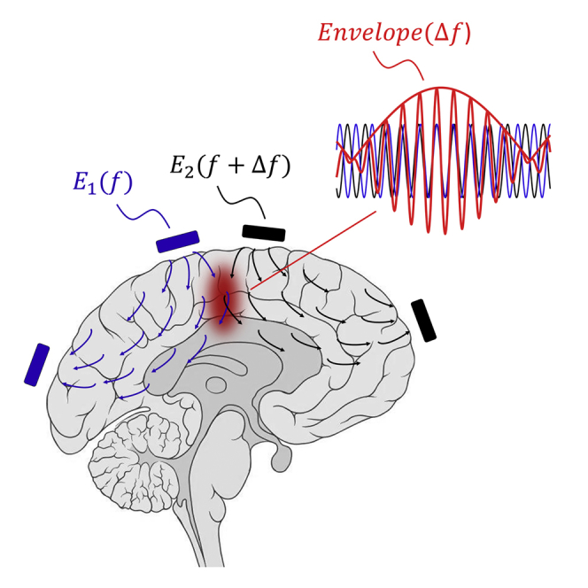
Research Context : Transcranial Temporal Interference Stimulation
Grossman et al. in rodents
Specifically targets regions in the brain non-invasively and without pain
Mechanism :
Two pairs of electrodes delivering high-frequency alternating current
Small frequency shift between currents
Superposition of the electrical fields creates an enveloppe, where the maximal amplitude can be steered

Slide 5
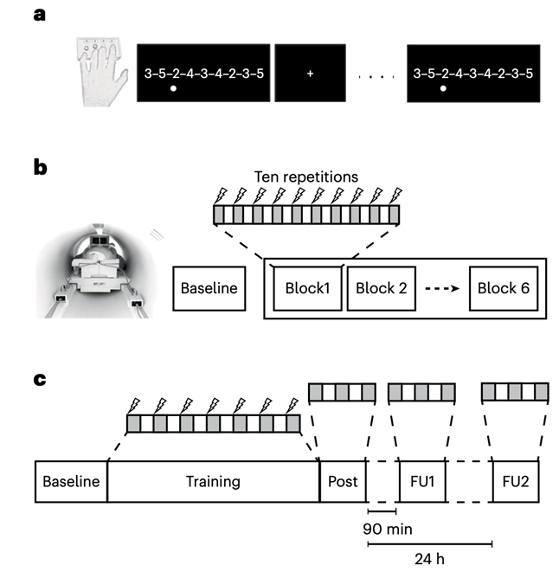
Methodology
45 healthy participants (15 young in Experiment 1, 15 young and 15 older in Experiment 2)
8 patients in the control experiment
Sequential finger tapping task (SFTT)
Theta-burst (5Hz) patterned tTIS: Delivered subthreshold currents using surface electrodes.
Train of 2-s theta-bursts delivered every 10 s
Structural and functional imaging via 3T MRI scanner.

Slide 6
Methodology
Experiment 1: tTIS effects on striatal activity
4 fMRI sessions (minimum 3-day wash-out period between sessions) :
Two were resting-state (rs) fMRI sessions.
Two were task-based fMRI sessions.
Each session alternated between tTIS and HF control stimulation.
rs-fMRI : Three 8-minute scans (pre, during, and post-stimulation) while participants fixated on a white cross.
task-based fMRI : six 9.5-minute blocks of the SFTT, with 10 repetitions of the task per block.
Experiment 2: tTIS improvement of motor learning
2 training sessions (minimum 3-day wash-out period between sessions)
During each session: tTIS or HF control stimulation was applied while participants performed seven 90-second repetitions of the SFTT, alternating with 90-second breaks.
Performance was evaluated:
Immediately after training (post).
90 minutes later (FU1).
24 hours later (FU2).

Slide 7
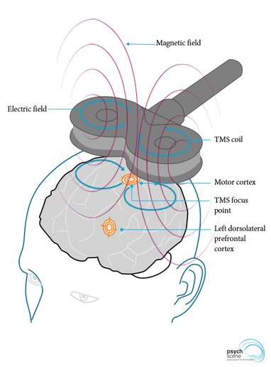
Methodology
TMS Control Experiment
Purpose: Assess corticospinal excitability in the motor cortex during and after tTIS.
Single-pulse TMS applied to the M1 at 130% of resting motor threshold.
Recorded motor-evoked potentials (MEPs) from hand muscles to evaluate changes.
psychscene.com

Slide 8
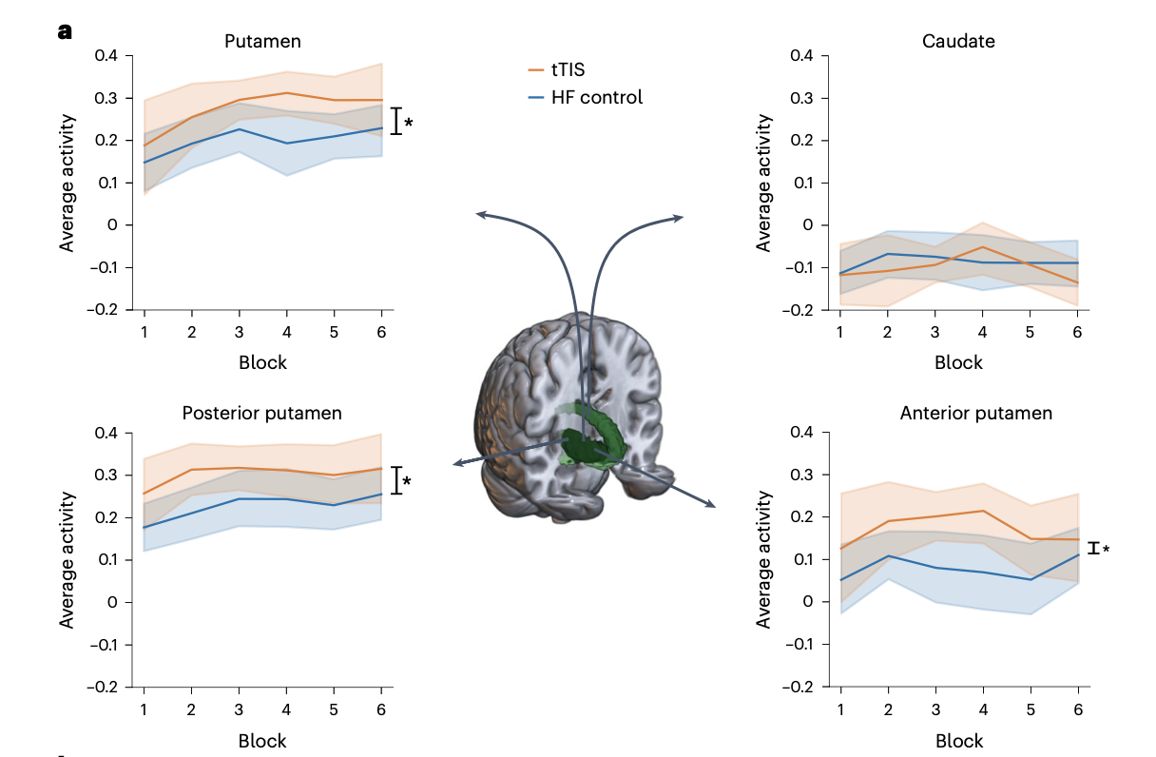
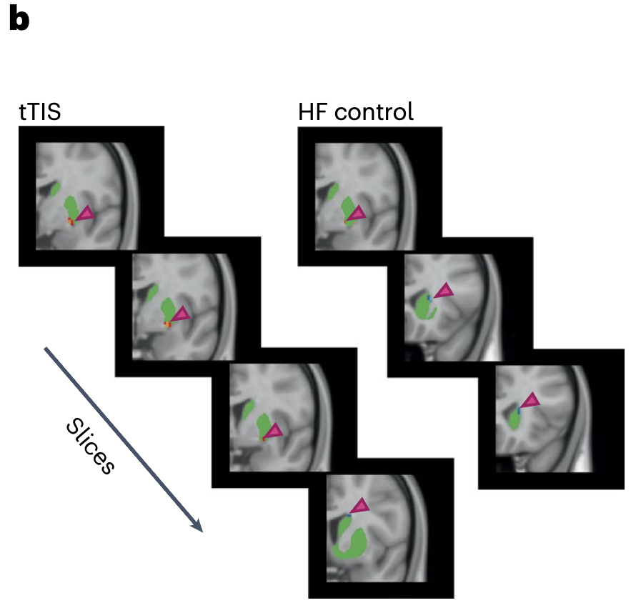
Paper Findings (1)
LTP-like plasticity effects due to tTIS show a more significant activity in striatal subregion (putamen)
Posterior part of the putamen showing more activity than the anterior

Slide 9
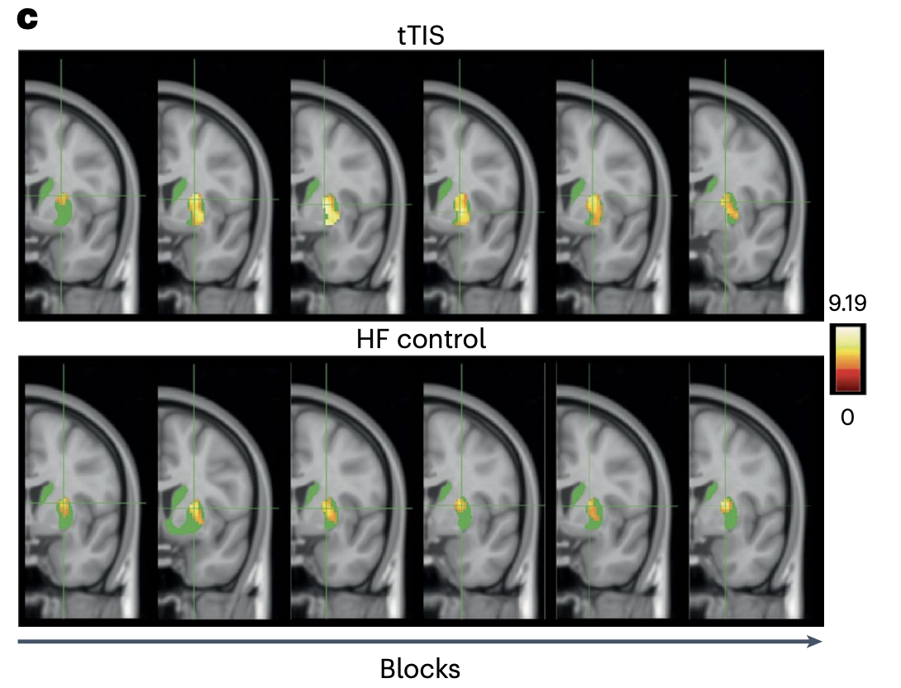
Paper Findings (2)
A greater part of the sensorimotor striatum is involved over time during tTIS
Thus, simultaneous theta-burst patterned tTIS application and motor training causes different regions of the striatum to respond
tTIS accelerates the shift of activation towards sensorimotor subregions: regulation of the learning-phase dependent recruitment patterns in targeted regions

Slide 10
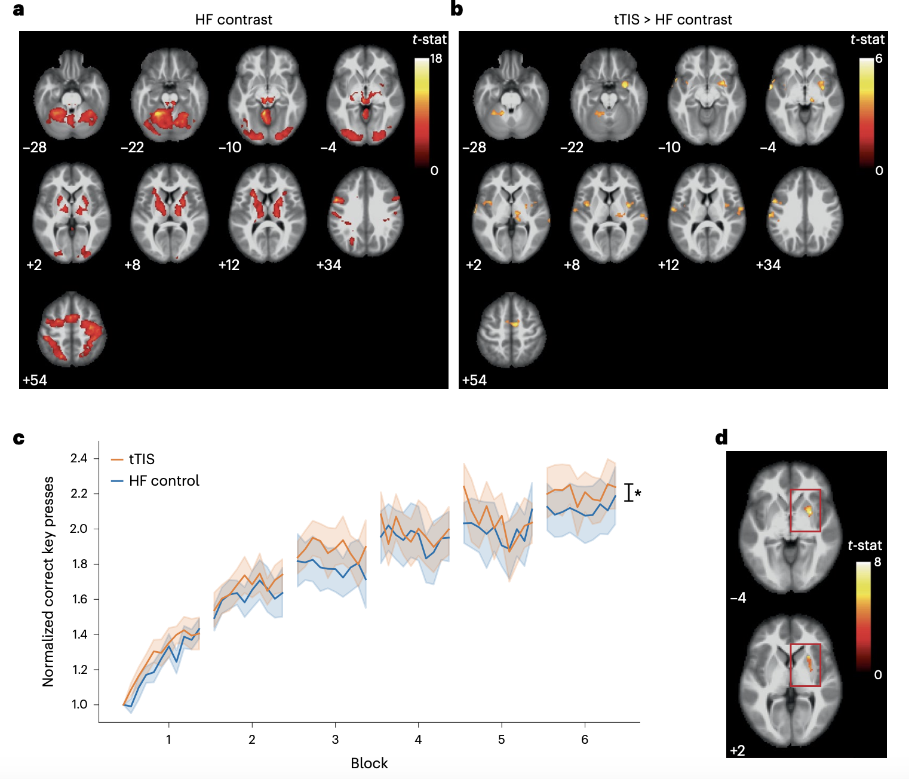
Paper Findings (3)
Striatal tTIS modulates activity in the motor network. Clusters show significantly more activity during tTIS than HF contrast (b)
Higher activity within regions associated with the left hand (striatum R, thalamus R, SMA and left cerebellum)

Slide 11
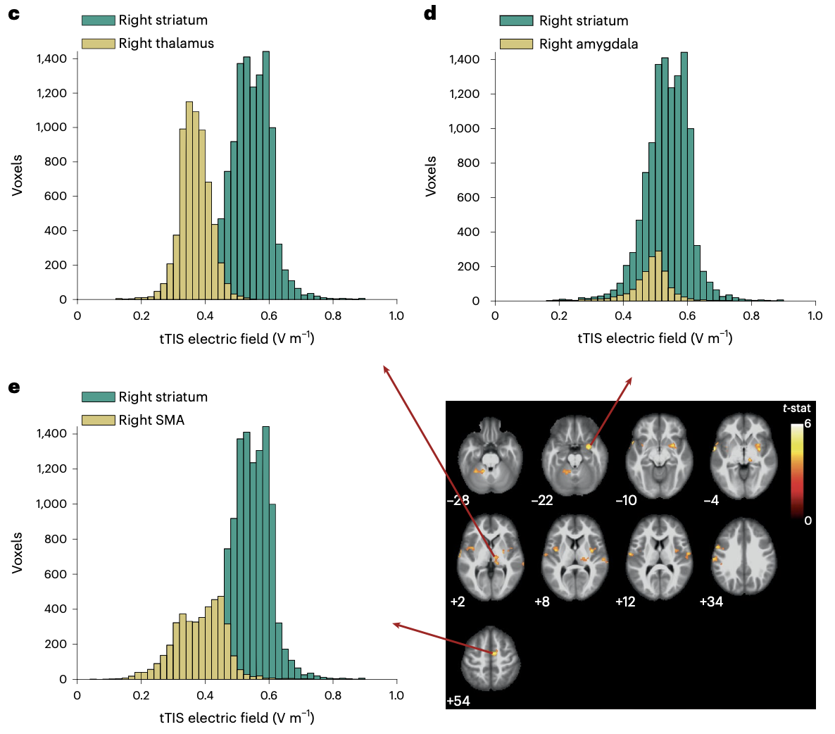
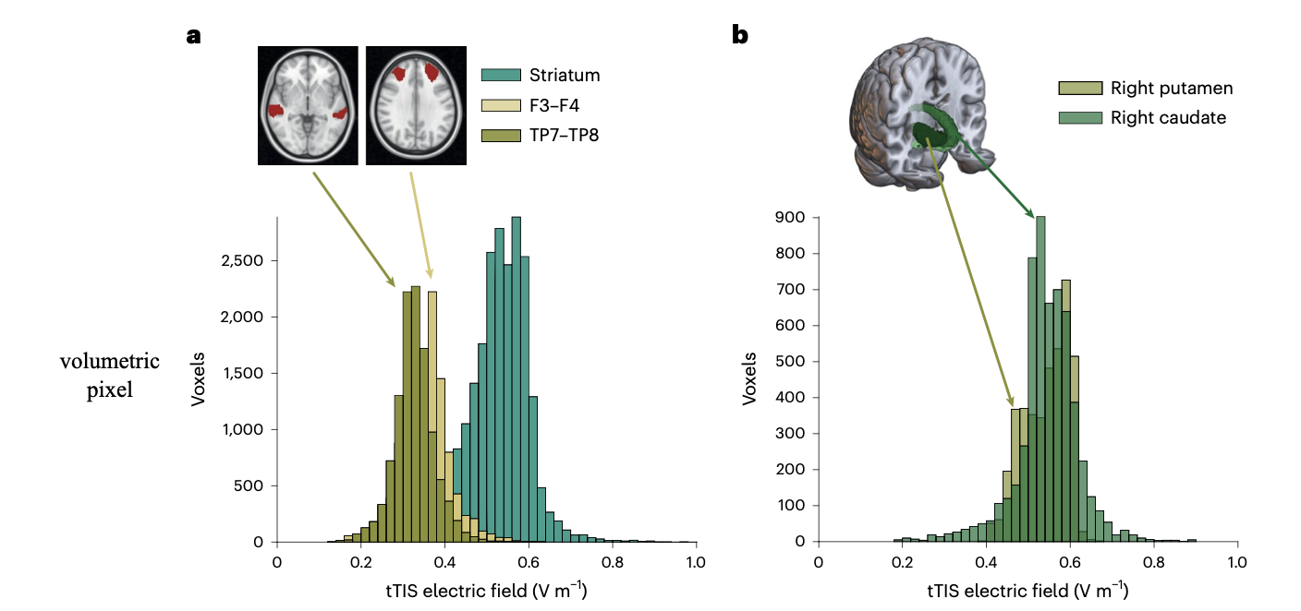
Paper Findings (4)
More activity shown on the right striatum
Distribution of the electrical field within different control areas compared to the striatum

Slide 12
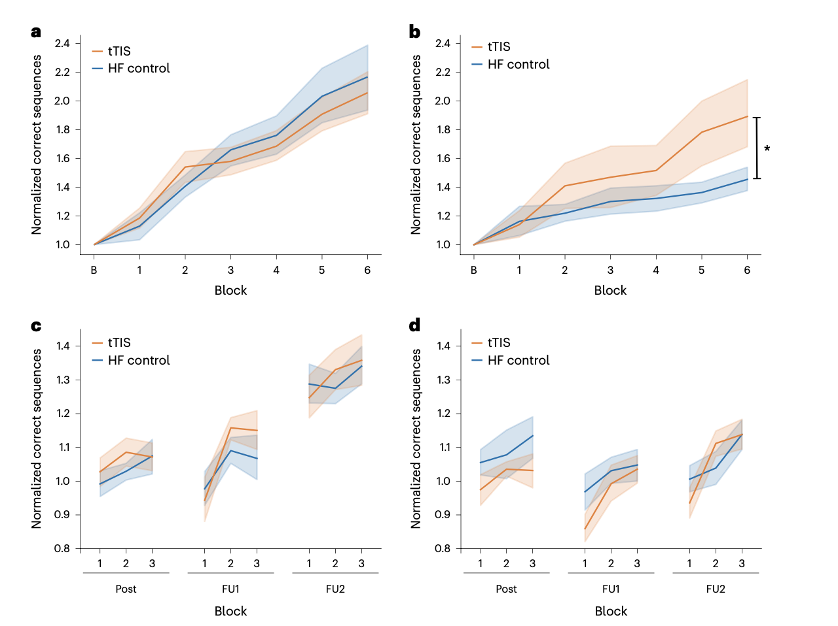
Paper Findings (5)
Younger Cohort
Older Cohort
Striatal tTIS effects are more significant in older adults. Cohort performing better during tTIS stimulation and had higher gain.
No significant performance difference in younger adults
No difference in sensory perceptions and stimulation did not affect attention or fatigue levels

Slide 13
Limitations
Small Sample Size:
Limits the generalizability of the findings.
Variability in Response:
Significant variability across individuals, not yet fully understood.
Single-session Intervention:
Longer-term or multi-session studies are necessary to evaluate the durability and scalability of the observed effects.
Potential Influence of High-Frequency Signals:
The possibility that unmodulated high-frequency signals contributed cannot be entirely ruled out.
Electrode Placement and Anatomy Variability:
Based on a generic reference model, but variability in individuals may affect stimulation effectiveness.
Generalizability Beyond Healthy Individuals:
The study focuses on healthy subjects, and the effects might differ in populations with neurological disorders

Slide 14
Future Directions
Mechanistic Exploration:
Investigate the underlying mechanisms of how tTIS modulates striatal and network activity.
Personalized Applications:
The authors suggest using imaging techniques such as diffusion tensor imaging (DTI) to improve personalization.
Clinical Translation:
Understanding how this technique could treat disorders linked to the striatum (e.g., Parkinson’s disease, Alzheimer’s, stroke, and anxiety disorders).
Optimization of Protocols:
Explore the effects of multi-session applications or variations in stimulation dose.
Addressing Variability:
Investigate inter-individual variability and identify factors influencing this variability, potentially using subject-specific models.

Slide 15
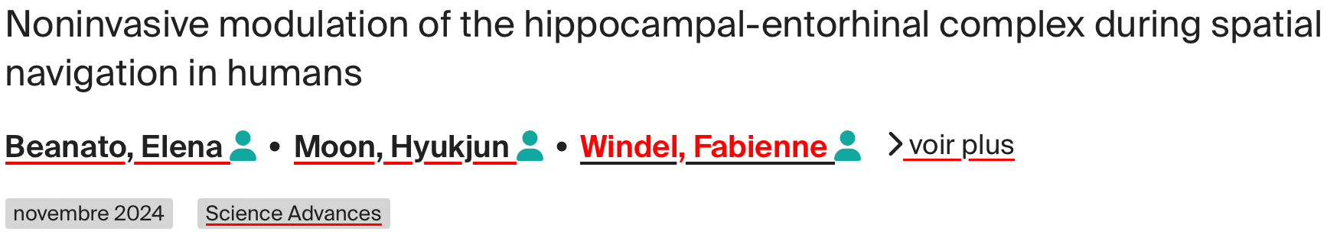
Open Questions
Cognitive Effects:
Given the striatum’s role in motor and cognitive functions, how might tTIS enhance cognitive domains like memory or decision-making?
Spatial navigation studies and hippocampal stimulation have shown potential effects on memory. Decision-making is currently being studied in the lab, with initial findings suggesting promise.
Personalized Approaches:
How can advances in neuroimaging or computational modeling contribute to the development of personalized tTIS protocols?
Neuroimaging techniques, such as diffusion tensor imaging (DTI), could help refine electrode placement and stimulation parameters for each individual.

Slide 16
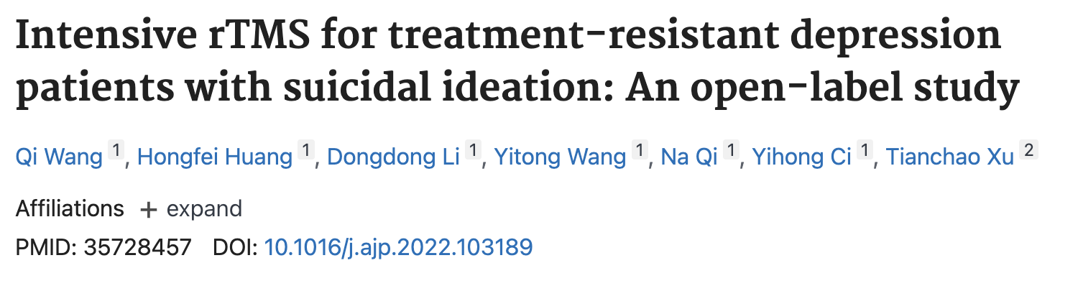
Open Questions
Long-Term Effects:
How can long-term studies assess the durability of tTIS effects? What role might repeated or intensive sessions play in maintaining or enhancing benefits?
Upcoming studies on stroke patients will test intensive stimulation paired with physiotherapy, with hopes for cumulative benefits. Evidence from long-term TMS studies (e.g., in depression) suggests cumulative effects might be achievable, and tTIS research is moving in this direction.
Mechanisms of Action
What are the underlying mechanisms through which tTIS influences motor learning?
The exact mechanisms are not yet known. Further research is needed to explore this area.

Slide 17
Thank you for your attention !
Presented by Lio Grienenberger, Toscane Revillard and Laura Ducret

