Slide 1
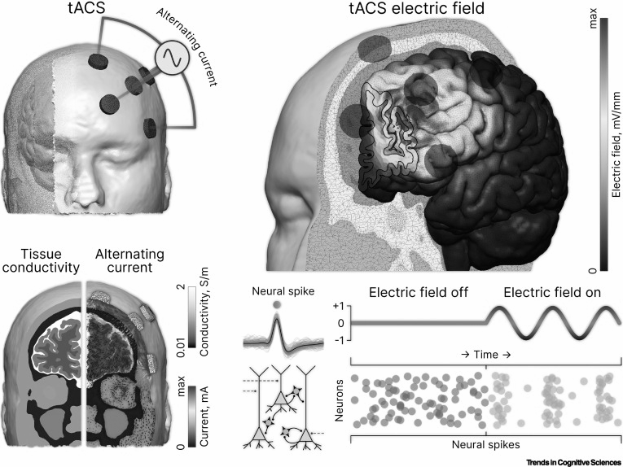
Long-lasting, dissociable improvements in working memory and long-term memory in older adults with repetitive neuromodulation
Shrey Grover et. al. 2022
Shiu-Cheng Wang
Nivedya Suresh
Figure from [2]
NX-436/Journal Club
Notes:
Hello everyone, we’re going to present the paper titled “long-lasting, dissociable improvements in working memory and long-term memory in older adults with repetitive neuromodulation”. The neuromodulation here is tACS, transcranial alternating current stimulation, which is the same technique as the one discussed in this week’s lecture.

Slide 2
Background
Challenges due to rapidly aging global population
Aging induced impairment in basic memory system is essential for activities of daily living
Studies have suggested that the rhythmic activity of cognitive circuitry may be important for the coordination of information processing
Notes:
To give a bit of the background, one of the challenges due to rapidly aging global population is the impairment in basic memory system, which will lead to the older adults making bad financial decisions, and have trouble comprehending language.
And previous studies have suggested that …. … processing, especially for the memory functions
such as making financial decisions or comprehending language
Studies regarding brain circuits and networks have suggested that the rhythmic activity of cognitive circuitry may be important for the coordination of information processing. [6]

Slide 3
General Objectives
Need non-invasive technologies to:
protect or enhance memory function for older adults
in a rapid and sustainable fashion
by isolate and augment the rhythmic activity of neural circuits
Notes:
To give you a very general direction of this study, they tried to use non-invasive technologies, to protect or …., in a rapid…., …
inspired by models of healthy aging!

Slide 4
Introduction: memory
Working memory (WM) has limited capacity (7 +- 2), duration: 10-15s without rehearsal.
Long-term memory (LTM) has unlimited capacity, store for sustained maintenance of information.
Operationalized WM and LTM: associated with recency and primacy effects in the immediate free recall paradigm.
Notes:
Now about memory. They focused on two kinds of memory: working memory and long-term memory.
WM is the temporary storage for the information that our executive function is actively manipulating. It has limited capacity, 7 plus or minus 2 chunks, with the duration of 10-15 seconds without rehearsal.
Long-term memory is more self-explanatory, the information can be sustained for a long time, and it has unlimited capacity.
But WM and LTM are still very complicated and abstract ideas, so to test these concepts, they had to operationalized them. WM was operationalized as the recency effect, and LTM was operationalized as primacy effect in the immediate free recall paradigm.
Difference between WM and STM: STM is about passively retaining information for a brief period, e.g. remembering phone number to dial; WM is about temporary storage and manipulation of the information. WM is an extension of STM. There is double dissociation.
Immediate free recall paradigm: Ask participants to recall the temporally presented items, without any specific order.
While LTM is operationalized as such, it does not really fit the definition that requires delayed recal

Slide 5
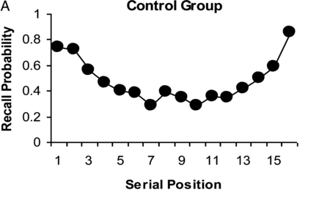
Introduction: memory
Primacy Effect: LTM
Recency Effect: WM
[3]
Notes:
In the immediate free recall paradigm, the stimuli were serially presented. The recall probability curves upwards in the two ends. The higher recall probabilities in the beginning of the trial is called the primacy effect, the operationalization of LTM. Primacy effect is like the thing that the first impression sticks. In the end of the series, there is the recency effect, which is the operationalization of WM. Because it just happened, so you have can recall them better.
https://pubmed.ncbi.nlm.nih.gov/22360707/

Slide 6
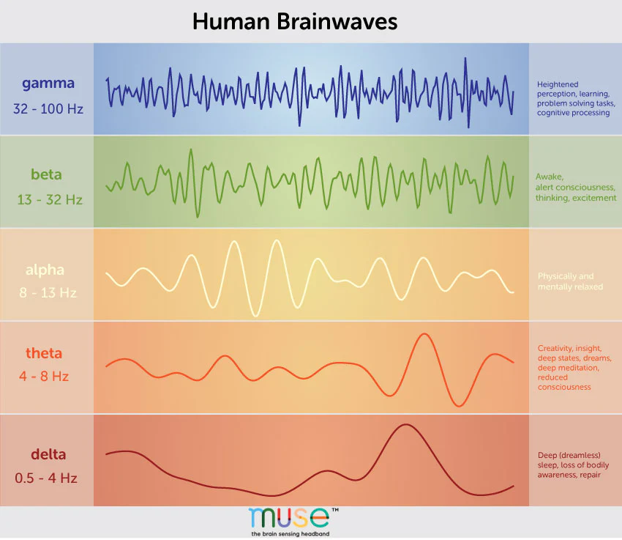
Introduction: brainwave frequency
[4]
Notes:
A little reminder of brainwave frequencies, theta is in the range of 4-8 Hz, in this paper they chose 4 Hz; and gamma is in the range of 32-100 Hz, and they chose 60 Hz, based on previous studies saying that these are the frequencies that produce optimal effects.
60 Hz/4Hz

Slide 7
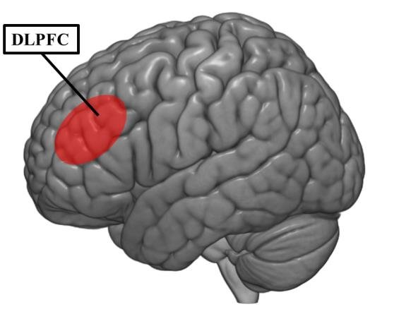
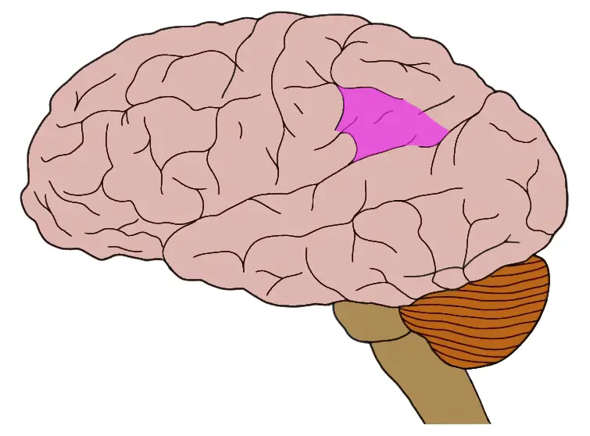
Introduction: brain regions and rhythmic activity
Dorsolateral prefrontal cortex (DLPFC) and inferior parietal lobule (IPL) have differential contributions
Theta and gamma frequencies are associated with WM and LTM functions
IPL
[5] [6]
Notes:
The two brain regions targeted are …. And …… . Specifically, they chose left-DLPFC and left-IPL, we think it’s because the task involved were auditory-verbal, which is related to the language function.
Previous studies have shown contradictory results in all four combinations of the two brain regions and the two frequencies, in both tACS and TMS. But just to be clear, the two combinations they tested, theta rhythm in DLPFC with improved working memory, and gamma rhythm in IPL with improved LTM function had both been shown, but never tested together, and shown the separation.
Positive: WM in parietal theta rhythms, LTM in frontal gamma rhythms
Contradictory: Theta in frontal, gamma in parietal and frontal
Theta in parietal
https://www.researchgate.net/figure/Left-DLPFC-location-on-the-Montreal-Neurological-Institute-MNI-brain-template-central_fig15_321848671
https://neuroscientificallychallenged.com/glossary/inferior-parietal-lobule

Slide 8
Introduction: significance
Whether distinct rhythmic mechanisms in these regions subserve distinct memory process during free recall remained unknown.
Causal evidence: combinations of location and frequency
Auditory-verbal
HD-tACS: higher resolution
In older adults
Notes:
Used to be visuospatial memory, traditional tACS, and in young adults

Slide 9
Objectives: Experiment 1
Exp 1 | IPL | DLPFC
Theta | V
Gamma |  | V
Test the following hypotheses:
Modulation of theta rhythms in the IPL would improve auditory-verbal WM function (recency effect) in older adults.
Modulation of gamma rhythms in the DLPFC would improve auditory-verbal LTM function (primacy-effect) in older adults.
Examined interindividual differences, tested whether people with lower general cognitive performance would benefit more from neuromodulation.
Notes:
One of the objectives of experiment 1 was to test these two hypotheses. The first one was:..... . The second one is similar, but instead of theta rhythms in IPL, its gamma rhythms in DLPFC for long-term memory. They also examined the individual differences, to see whether people with lower cognitive performance would benefit more from the tACS stimulation.

Slide 10
Objectives: Experiment 2 & 3
Exp 2 | IPL | DLPFC
Theta |  | V
Gamma | V
Exp 3 | IPL | DLPFC
Theta | V
Gamma |  | V
Experiment 2: to confirm the location specificity and frequency specificity:
switch the frequencies between the two regions
Experiment 3: an independent sample again with the same setup in experiment 1.

Slide 11
Methods: Participants
Inclusion Criteria
Above 65 years old
Native or fluent in English
No implants, neurological disorders
….
Control for Covariates
GDS (Geriatric Depression Scale): assessed depressive symptoms
MoCA (Montreal Cognitive Assessment): assessed general cognitive performance
Notes:
The participants were all above 65 years old, …, … . Also left-handed people were excluded, because there’s a higher chance that left-handed people’s language area is in the right hemisphere.
To control for covariates, they assessed their depression symptoms and also their general cognitive performance before the experiments Inclusion criteria:
>65
Native or fluent in English
(Corrected to) normal vision and hearing
Exclusion criteria:
Metal implants in the head
Implanted electronics
Seizure, stroke, neurological problems, head injury
Psychiatric, neurological disorders
Substance abuse
Skin sensitivity
Claustrophobia
Smoking
Psychotropic medication
Left-handedness
Severe tinnitus

Slide 12
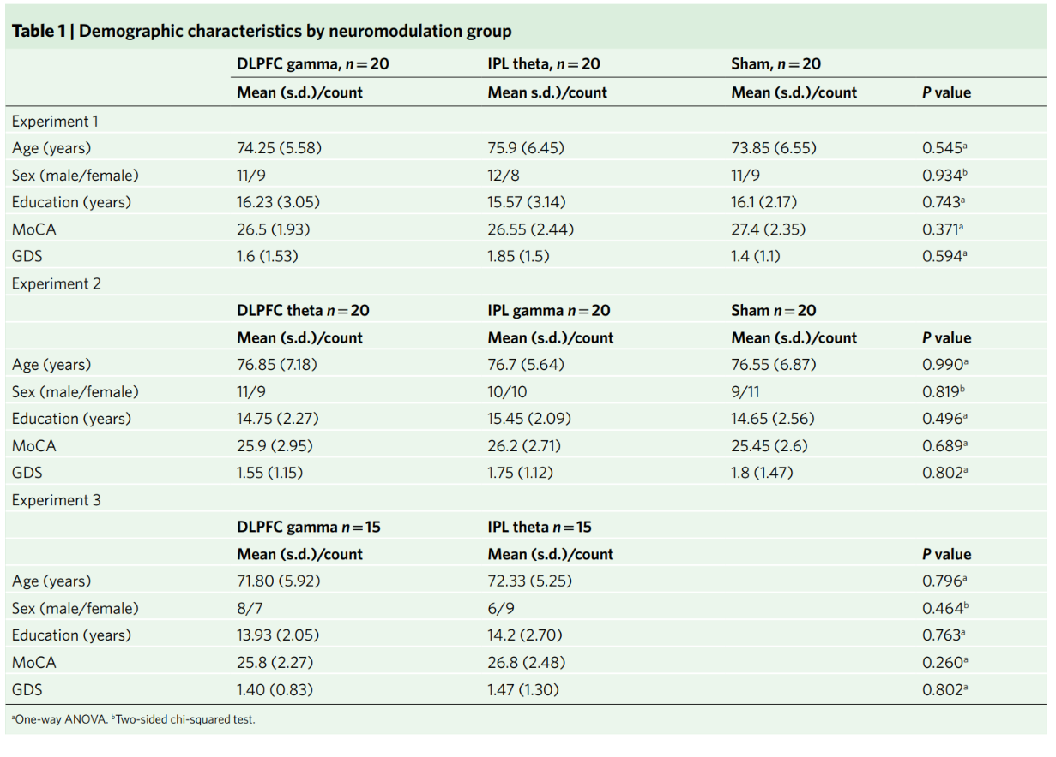
Methods: Participants
Notes:
This is the demographic of the participants. They tested whether theres a difference of the respective variables between the groups, and none of them were significant.
Inclusion criteria:
>65
Native or fluent in English
(Corrected to) normal vision and hearing
Exclusion criteria:
Metal implants in the head
Implanted electronics
Seizure, stroke, neurological problems, head injury
Psychiatric, neurological disorders
Substance abuse
Skin sensitivity
Claustrophobia
Smoking
Psychotropic medication
Left-handedness
Severe tinnitus

Slide 13
Methods: Stimuli and Procedures
Randomized, double-blind, sham-controlled
Stratified by age and baseline general cognitive performance
Exp1, Exp2: four consecutive days, sham-controlled
Exp3: three consecutive days
Notes:
WM and LTM functions were evaluated at baseline before interventions

Slide 14
Methods: Stimuli and Procedures
Immediate Free Recall Task
Each day, immediate free recall task, consisting of 5 lists of 20 unrelated English high-frequency words.
Words were read aloud to the participants at the rate of 1.5-2 seconds/word, with 2 seconds interval.
Two minutes to recall after the listening.
HD-tACS applied through the entire duration of encoding and recall of all five lists
Notes:
4-12 letters
Extreme values along frequency, concreteness, and emotional valence dimensions were removed

Slide 15
Methods: Stimuli and Procedures
Immediate Free Recall Task
During analysis, 20 words split into four word clusters
Serial positions 1-4: primacy effect (LTM)
Three middles 5-8, 9-12, 13-16
Serial positions 17-20: recency effect (WM)
Notes:
4-12 letters
Extreme values along frequency, concreteness, and emotional valence dimensions were removed

Slide 16
Experiment (total no. participants) | Neuromodulation groups (no. participants in randomized split) | Offline measurements (Metric) | Neuromodulation (entire duration of encoding+recall) | Free recall task
Experiment 1 (60) | DLPFC gamma (20) | Memory performance (Recall performance) baseline; 1 month after intervention General cognitive function (MoCA) Depression symptoms (GDS) | 20 mins/day for 4 consecutive days | Encode list of 20 words and recall at the end of presentation. Perform for a total of 5 runs corresponding to 5 lists. Compute recall performance for each run - primacy, middle 1, middle 2, middle 3 and recency
 | IPL theta (20)
 | Sham (20)
Experiment 2 (60) | DLPFC theta (20)
 | IPL gamma (20)
 | Sham (20)
Experiment 3 (30) | DLPFC gamma (15) |  | 20 mins/day for 3 consecutive days
 | IPL theta (15)

Slide 17
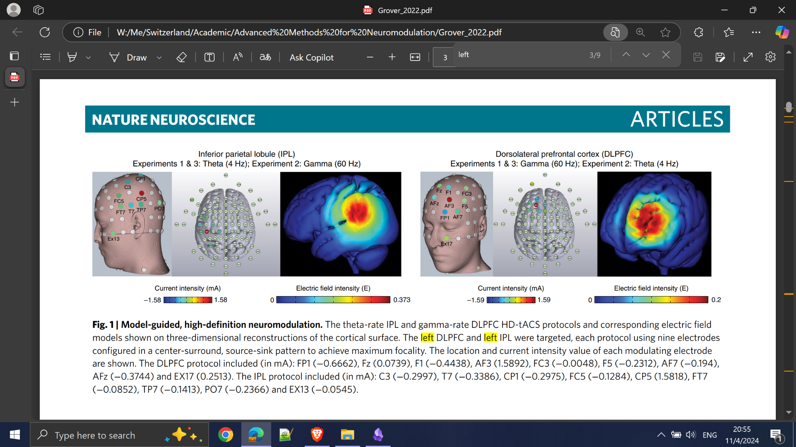
Methods: HD-tACS
8x1 source-sink configuration
Notes:
The high-definition transcranial alternating current stimulation is the same as discussed in the course, but in traditional tACS, current flows from one source to one sink. But the HD version, has many sources and one sink, for example in this experiment, there were 8 sources, as you can see by the green dots, and then the currents flowed to the central electrode, where the targeted brain region was.
Another thing is, tACS entrains the rhythm by subthreshold excitation, so there’s no action potential directly caused by tACS.
This is the figure for left IPL
While HD-tACS doesn’t induce action potentials directly, the oscillating electric field affects the membrane potentials of neurons. Neurons naturally oscillate between slightly depolarized (closer to firing) and hyperpolarized (further from firing) states.
Subthreshold Influence: The electrical currents in HD-tACS are low-intensity and designed to stay below the threshold required to cause neurons to fire (i.e., not strong enough to create action potentials).
"8x1" means there are 8 electrodes (the "8") acting as sources surrounding a single central electrode (the "1") acting as a sink.
The eight electrodes surrounding the target area deliver alternating current (AC), while the central electrode serves as the ground or "sink," collecting the current. This arrangement helps to create a focal stimulation zone directly beneath the central sink electrode, improving the spatial precision of tACS.
(Traditional tACS usually employs two large electrodes—one anode (positive) and one cathode (negative)—placed on the scalp over target areas. Electrode Size: These electrodes are typically larger (often 5 cm x 5 cm or larger), which leads to a more diffuse electric field that affects a broad cortical region.)

Slide 18
Methods: HD-tACS
8x1 source-sink configuration
Notes:
While HD-tACS doesn’t induce action potentials directly, the oscillating electric field affects the membrane potentials of neurons. Neurons naturally oscillate between slightly depolarized (closer to firing) and hyperpolarized (further from firing) states.
Subthreshold Influence: The electrical currents in HD-tACS are low-intensity and designed to stay below the threshold required to cause neurons to fire (i.e., not strong enough to create action potentials).
"8x1" means there are 8 electrodes (the "8") acting as sources surrounding a single central electrode (the "1") acting as a sink.
The eight electrodes surrounding the target area deliver alternating current (AC), while the central electrode serves as the ground or "sink," collecting the current. This arrangement helps to create a focal stimulation zone directly beneath the central sink electrode, improving the spatial precision of tACS.
(Traditional tACS usually employs two large electrodes—one anode (positive) and one cathode (negative)—placed on the scalp over target areas. Electrode Size: These electrodes are typically larger (often 5 cm x 5 cm or larger), which leads to a more diffuse electric field that affects a broad cortical region.)

Slide 19
Methods: HD-tACS
MxN nine-channel high-definition transcranial electrical current stimulator.
Nine 12-mm-diameter Ag/AgCl ring electrodes, with conductive gel around.
A bipolar sinusoidal alternating current was applied
Intensity: minimum of 0.2 V/m in target region, and above 1mA (1.58 mA) to have better effect
Notes:
While HD-tACS doesn’t induce action potentials directly, the oscillating electric field affects the membrane potentials of neurons. Neurons naturally oscillate between slightly depolarized (closer to firing) and hyperpolarized (further from firing) states.
Subthreshold Influence: The electrical currents in HD-tACS are low-intensity and designed to stay below the threshold required to cause neurons to fire (i.e., not strong enough to create action potentials).
"8x1" means there are 8 electrodes (the "8") acting as sources surrounding a single central electrode (the "1") acting as a sink.
The eight electrodes surrounding the target area deliver alternating current (AC), while the central electrode serves as the ground or "sink," collecting the current. This arrangement helps to create a focal stimulation zone directly beneath the central sink electrode, improving the spatial precision of tACS.
(Traditional tACS usually employs two large electrodes—one anode (positive) and one cathode (negative)—placed on the scalp over target areas. Electrode Size: These electrodes are typically larger (often 5 cm x 5 cm or larger), which leads to a more diffuse electric field that affects a broad cortical region.)

Slide 20
Methods: HD-tACS
Passive Sham
At the beginning and the end of the 20-minute period
30 seconds per time
producing the warming and poking sensations
Notes:
Chance level thing
While HD-tACS doesn’t induce action potentials directly, the oscillating electric field affects the membrane potentials of neurons. Neurons naturally oscillate between slightly depolarized (closer to firing) and hyperpolarized (further from firing) states.
Subthreshold Influence: The electrical currents in HD-tACS are low-intensity and designed to stay below the threshold required to cause neurons to fire (i.e., not strong enough to create action potentials).
"8x1" means there are 8 electrodes (the "8") acting as sources surrounding a single central electrode (the "1") acting as a sink.
The eight electrodes surrounding the target area deliver alternating current (AC), while the central electrode serves as the ground or "sink," collecting the current. This arrangement helps to create a focal stimulation zone directly beneath the central sink electrode, improving the spatial precision of tACS.
(Traditional tACS usually employs two large electrodes—one anode (positive) and one cathode (negative)—placed on the scalp over target areas. Electrode Size: These electrodes are typically larger (often 5 cm x 5 cm or larger), which leads to a more diffuse electric field that affects a broad cortical region.)
## Sham
Very interesting thing: They stimulated the same brain region in the sham group, but the timing of the stimulation is not the same. It is described as "the gold standard" in this field of research, but I fail to understand why.
Another thing: They said they use the same intensity, for example, in the two conditions in Exp1. But they probably did so by fixing the amplitude of the current. In this case, the overall energy delivered to the brain is not controlled. (But is somehow justified, as the peak stimulation effect is more important)
Participants were all asked to guess whether they are in an active or sham procedure, the results were at chance level.

Slide 21
Objectives
Sought evidence for a double dissociation in the two memory stores according to the distinct spatiospectral characteristics of their underlying anatomical and functional substrates
For selective and long-lasting improvements in memory function in older adults

Slide 22
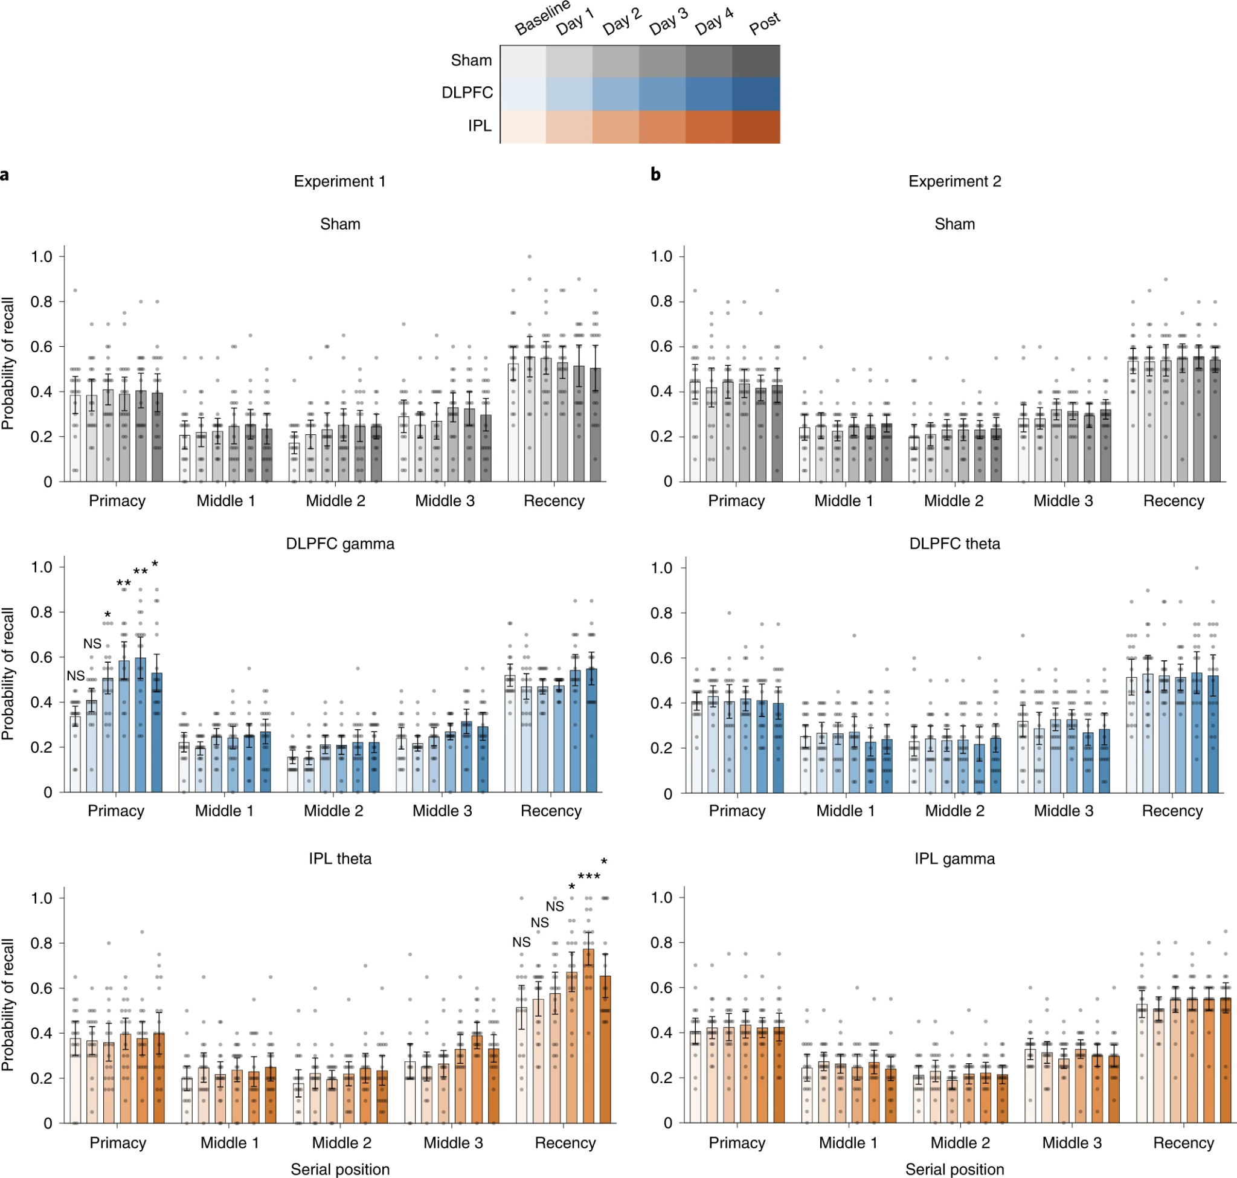
Results
Experiment 1
DLPFC gamma group have significantly higher recall probability in the primacy cluster relative to sham
Similarly, IPL theta group have significantly higher recall probability in the recency cluster relative to sham
DLPFC gamma modulation selectively improves LTM while IPL theta modulation selectively improves WM
Figure from [1]
Notes:
We first have here the results of experiment 1. In exp 1, we split the participants into dlpfc gamma neuromodulation, ipl theta neuromodulation, and sham. The dlpfc gamma group have higher performance in primacy relative to sham=>dlpfc gamma modulation selectively improves ltm; ipl theta have higher performance in recency relative to sham.=>ipl theta modulation selectively improves wm
Question - significance?

Slide 23
Results
Experiment 2
Results of experiment 1 are both location and frequency specific!
Results confirm that findings from experiment 1 are the result of frequency-specific entrainment of relevant brain circuits and not due to non-specific effects of tACS such as transretinal or transcutaneous modulation.
Figure from [1]
Notes:
Active control for exp1 - stimulating the same regions hence if there is a non-specific effect it would be observed in both experiments
Check transretinal neuromodulation - these non-specific side effects are caused by concomitant stimulation of afferent nerves and sensory organs; volume conduction in the head allows for direct retinal stimulation for a wide range of montages, even for those that are not targeting visual areas https://www.frontiersin.org/journals/psychology/articles/10.3389/fpsyg.2019.00213/full#h3

Slide 24
Results
Validation of sham and pre-intervention baseline controls
The three groups in each experiment did not differ in baseline performance for any serial position cluster
i.e., selective effects of neuromodulation on serial positions were not driven by inherent differences within the groups in either experiment

Slide 25
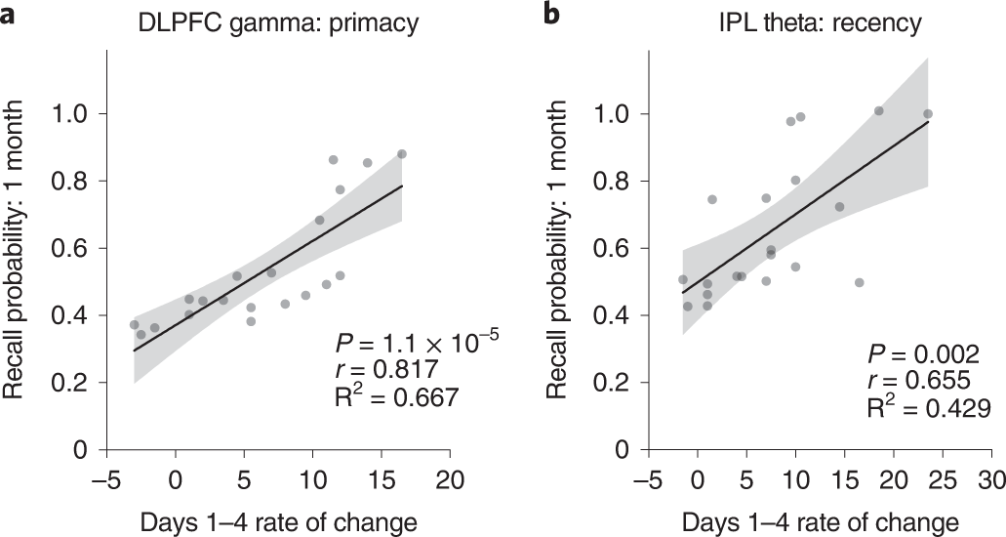
Results
Four-day improvement rate predicts benefits 1 month later
Significantly higher improvement rates were observed for primacy in the DLPFC gamma group relative to sham and for recency in the IPL theta group relative to sham
Participant with greater primacy improvement rates in DLPFC gamma group during the intervention showed largest primacy benefits at 1 month after intervention
A corresponding trend was also observed with the IPL theta group and recency improvement rates
Figure from [1]

Slide 26
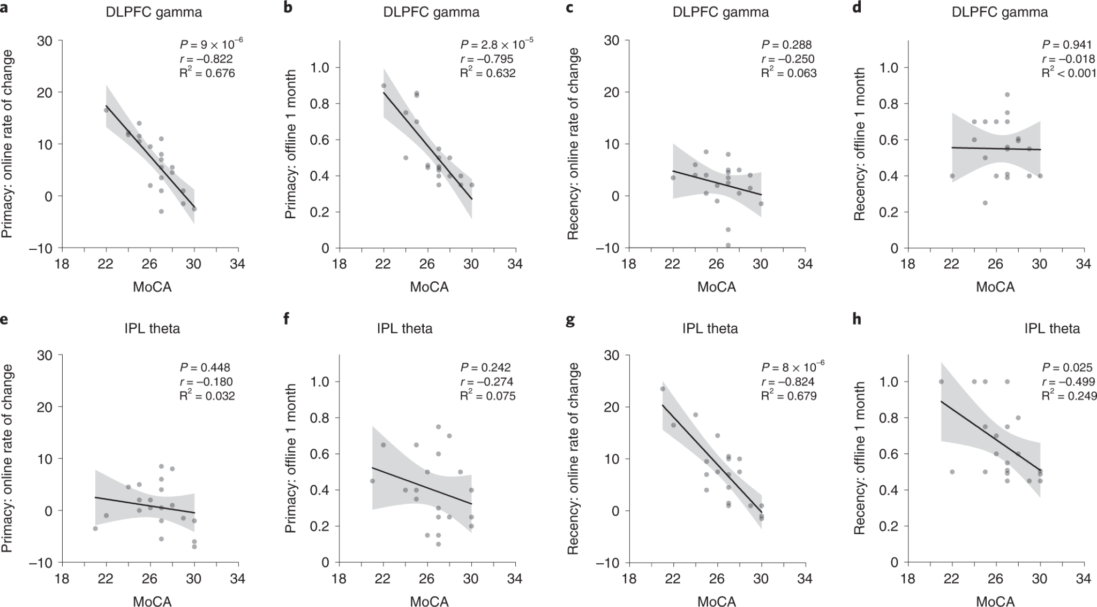
Results
General cognitive function moderates memory improvements
In the DLPFC gamma group and IPL theta group, participants with lower baseline cognitive performance showed greater improvement over the intervention period and after 1 month, in primacy and recency respectively

Slide 27
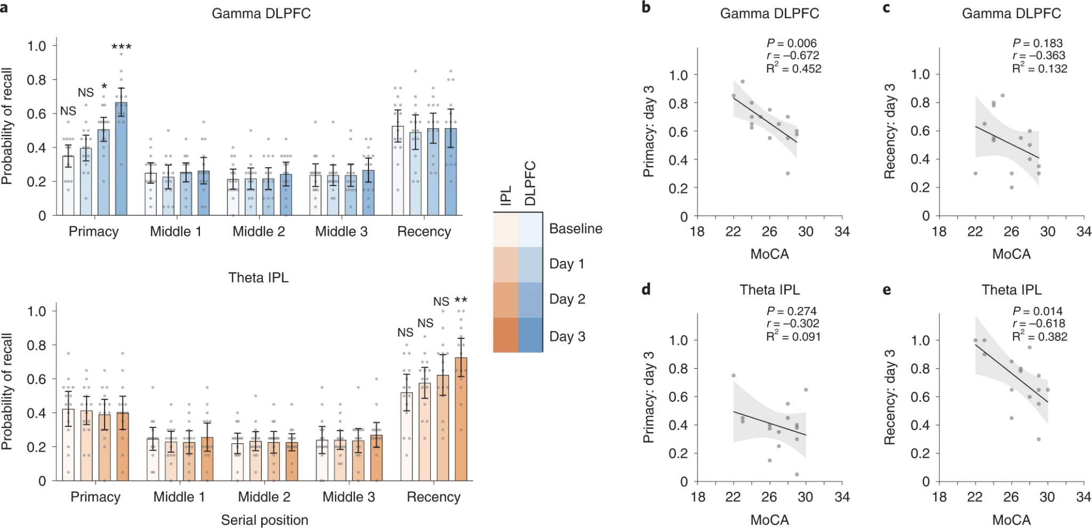
Results
Replication of primary findings in an independent sample
Observations in experiment 3 replicated findings from experiment 1, including the selective improvements of primacy and recency clusters by DLPFC gamma and IPL theta modulation respectively
Observed similar relation between baseline cognitive performance and improvements after neuromodulation

Slide 28
Discussion
The results suggest that the interventions manipulated two distinct cognitive operations - long-term memory and working memory
IPL theta modulation may facilitate temporal segregation between successive memory representations which improves WM operations.
This explains why there are exclusive recency improvements without improvements in middle clusters
Notes:
To conclude, we saw that the interventions manipulate 2 distinct cognitive operations - LTM and WM
The authors suggest a potential mechanism for wm improvement. Ipl theta modulation may be facilitating the temporal segregation between representations of different clusters ie recency, middle clusters, primacy; this can explain why we see improvement exclusively in recency
X - Herweg, N. A., Solomon, E. A. & Kahana, M. J. Theta oscillations in human memory. Trends Cogn. Sci. 24, 208–227 (2020).
To explain the selectivity of the results, the authors suggest that while IPL modulation could improve recall of later items, it could not improve transfer of previously presented information to LTM. This may be due to distinct encoding mechanisms for WM and LTM or the transfer involving separate executive control processes unaffected by this modulation design

Slide 29
Discussion
Both theta and gamma rhythms, and both DLPFC and IPL regions contribute to WM and LTM performance, but may relate to distinct cognitive processes selectively underlying dissociable improvements as observed here
Primacy improvements may have been caused because of improved encoding efficiency from downstream effects of DLPFC gamma activation
Findings suggest that functionally specific neuromodulation has the potential to mitigate functional dedifferentiation due to aging
Notes:
According to previous findings both .. but this study suggests that these frequency ranges and regions may relate to..
In dlpfc gamma activation improvement could be because of activation of downstream regions directly impacting attention and therefore encoding efficiency

Slide 30
Future work and limitations
Addressing exact mechanisms via which these improvements occur, for instance, whether said regions are directly responsible for improvements or through downstream effects
Both regions and both frequencies can contribute to the effect
Generalizing to different cognitive paradigms spanning memory function across sensory domains and in larger samples
Promoting sustainable effects going beyond the 1-month duration
Notes:
Other limitations
-Definition of sham
-look at healthy participants with general cognitive decline due to age - how useful are the results?

Slide 31
Future work and limitations
Determining optimal modulation design and personalization of protocols
Quantifying baseline cognitive function with more comprehensive neuropsychological assessments
Translational implications for people with neuropsychiatric and neurodegenerative disorders, particularly with selective memory deficits and at risk for dementia

Slide 32
Limitations
To examine whether the encoding or recall phase was affected for WM and LTM
The “optimal” frequencies were chosen from studies using young adults
Confounding regions could be a problem, for the precision might not be high enough
Theta-gamma coupling suggest internal coupling between the two frequencies

Slide 33
References
[1] Grover, S., Wen, W., Viswanathan, V. et al. Long-lasting, dissociable improvements in working memory and long-term memory in older adults with repetitive neuromodulation. Nat Neurosci 25, 1237–1246 (2022). https://doi.org/10.1038/s41593-022-01132-3
[2] Wischnewski, Miles et al. Neurocognitive, physiological, and biophysical effects of transcranial alternating current stimulation. Trends in Cognitive Sciences, Volume 27, Issue 2, 189 - 205 https://www.cell.com/trends/cognitive-sciences/fulltext/S1364-6613%2822%2900298-4
[3]S;, D. M. G. S. (n.d.). Restoring primacy in amnesic free recall: evidence for the recency theory of primacy. Retrieved from https://pubmed.ncbi.nlm.nih.gov/22360707/
[4]Muse. (2023). Understanding Brainwaves and Frequencies: A Comprehensive Guide: MuseTM EEG-Powered Meditation & Sleep Headband. Retrieved from https://choosemuse.com/blogs/news/a-deep-dive-into-brainwaves-brainwave-frequencies-explained-2
[5](N.d.). Retrieved from https://www.researchgate.net/figure/Left-DLPFC-location-on-the-Montreal-Neurological-Institute-MNI-brain-template-central_fig15_321848671
[6] Inferior parietal lobule - definition. (n.d.). Retrieved from https://neuroscientificallychallenged.com/glossary/inferior-parietal-lobule

Slide 34
Thank you for your attention!

