Slide 1
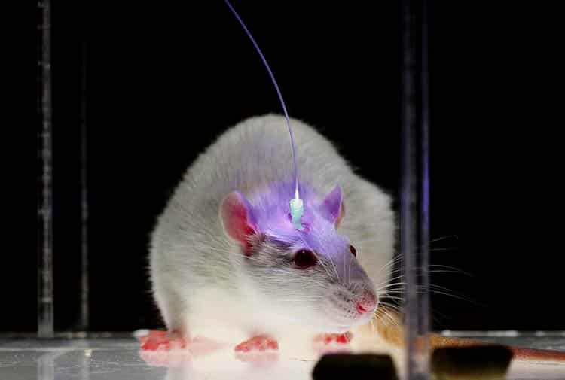
Optogenetic activation of striatal D1R and D2R cells differentially engages downstream connected areas beyond the basal ganglia (C. Grimm et al., 2021)
Rodrigo Anjos
Camille Bénard
15 November 2024

Slide 2
Background

Slide 3
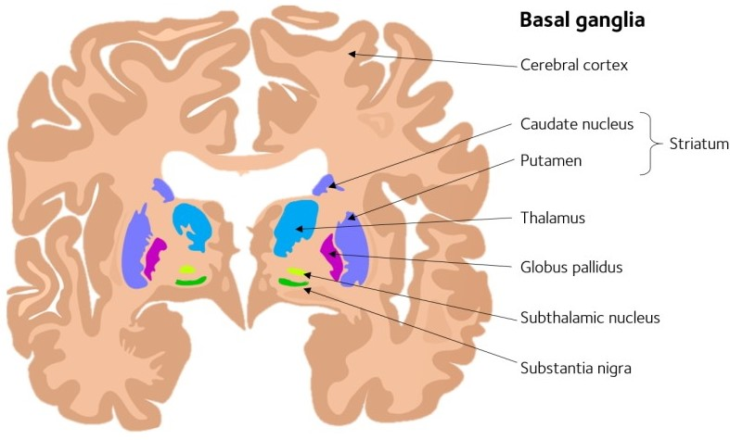
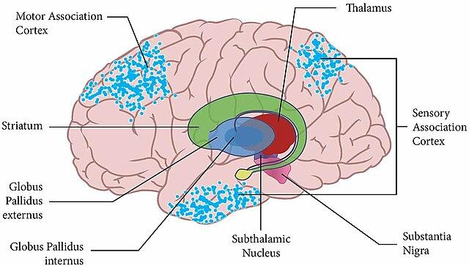
Basal Ganglia (BG)
Figure 1 - Basal ganglia coronal view [1]
Figure 2 - Basal ganglia sagittal view [2]
Notes:
Basal ganglia zones: deep structures, complex connections
Caudate (striatum)
Putamen (striatum)
(striatum receives projections from cortex)
Globus Pallidus, substantia nigra and subthalamic nucleus (process info and send to thalamus)
Thalamus (relay station / connects inputs from many zones and projects to the cortex)

Slide 4


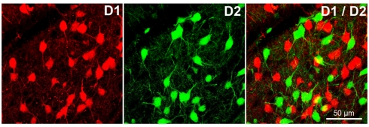

D1 and D2 receptors
Different dopamine receptors, expressed in different cells
D1 -> excite cell
D2 -> inhibit cell
Figure 3 - D1R and D2R cells in the basal ganglia [3]
Notes:
D1 and D2 receptors are the main types of dopamine receptors , G-coupled receptors, which react differently to dopamine and are expressed in different cells: D1R cells -> +cAMP -> excites cell
D2R cells -> -cAMP -> inhibits cell

Slide 5
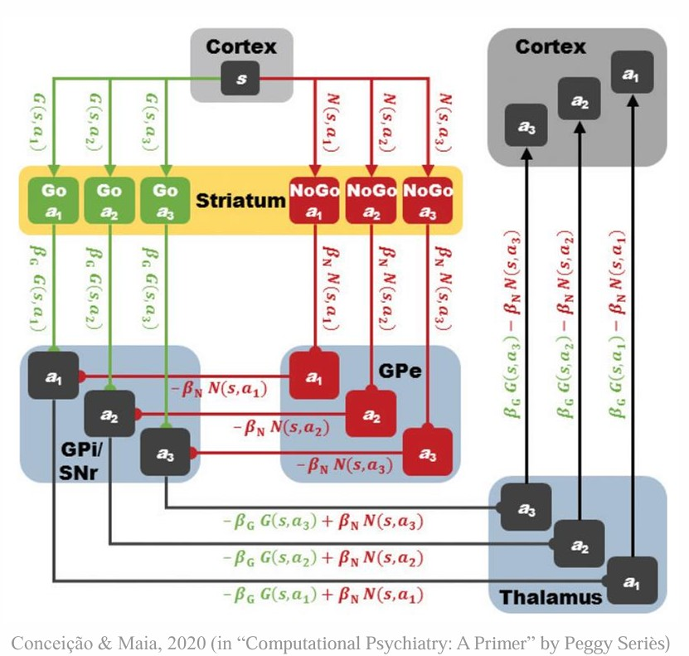
BG thalamocortical canonical model
D1 -> Go
D2 -> NoGo
Figure 4 - Canonical model scheme [4]
Notes:
from what we know, they seem to have opposite effects - D1R expressed in direct pathway (Go) and D2R expressed in indirect (NoGo)
arrows, dots . green, red . a1, a2, a3 .
essential:
for actions to be executed, cortex is excited by thalamus
thalamus sends an excitatory signal for each action more intense the more there is gain in the go network and less intense the more there is gain in the nogo network
which is achieved by single inhibition of GPi/SNr in the Go and double inhibition of GPi/SNr, so its excitation, in the NoGo network, through the GPe

Slide 6
Objectives and methods

Slide 7
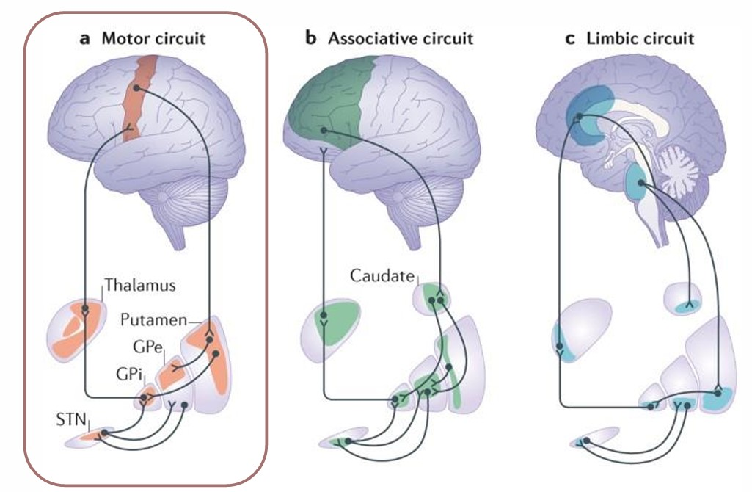
Research question
Test the canonical model
Explore other differential effects in the BG thalamocortical network
Find downstream effects outside this network
Figure 5 - Links of basal ganglia with different circuits [5]
Notes:
BG have been shown to be physically linked to associative and limbic circuits
explore effects in the whole brain

Slide 8
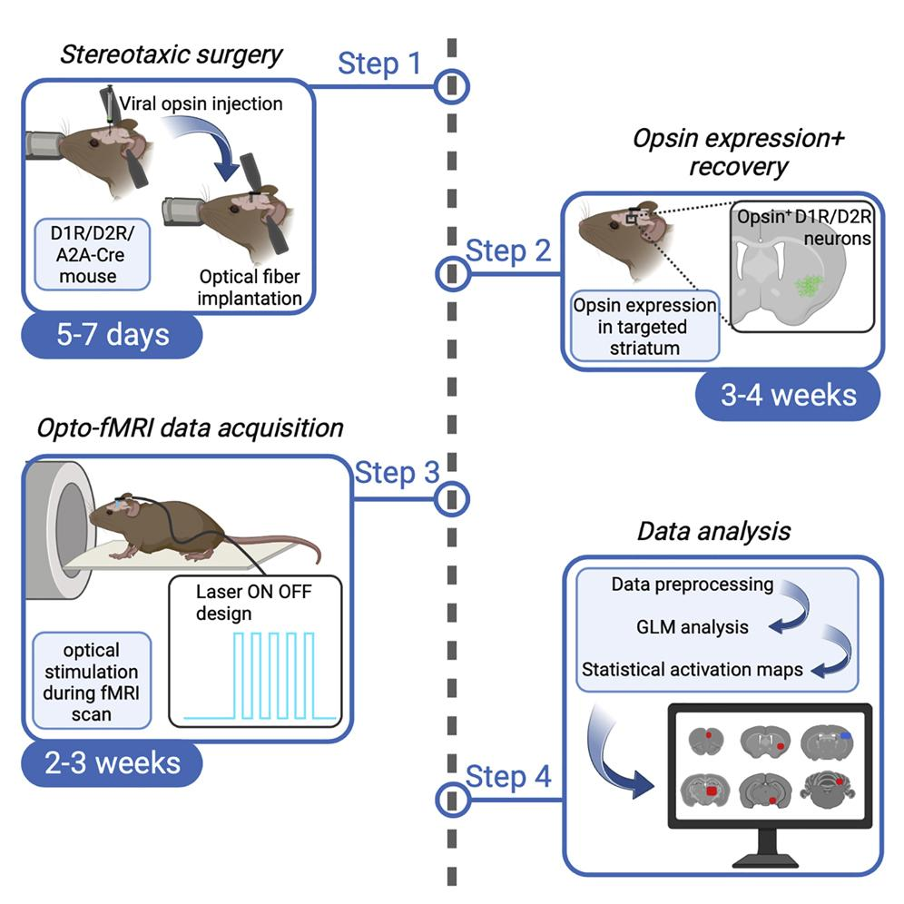
Methods - Opto-fMRI
Figure 6 - Opto-fMRI steps [6]

Slide 9
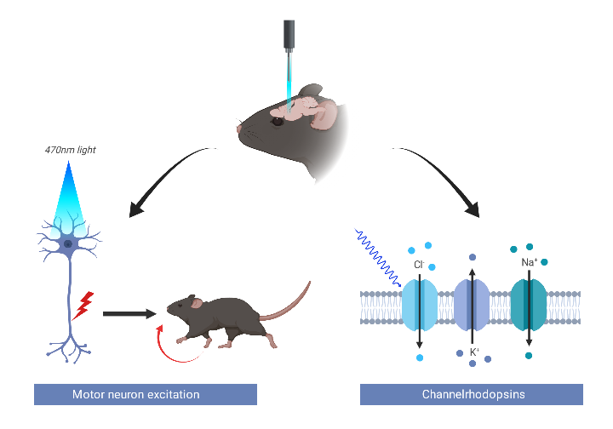
Optogenetics
Figure 7 - Optogenetics [7]
Notes:
Optogenetics is a technique where animals are genetically modified to produce light sensitive channels in neurons of interest so that when light is shown to those neurons through fiber it is stimulated or inhibited
In this case, the protein used is ChR2 (channel rhodopsin 2), which, when exposed to blue light, causes the cell to be excited (and causes Na+ and Ca2+ to enter the cell and sometimes K+ exit).
If someone asks: blue light makes a retinal molecule in the protein change conformation and that opens it (and its a non-specific channel)

Slide 10
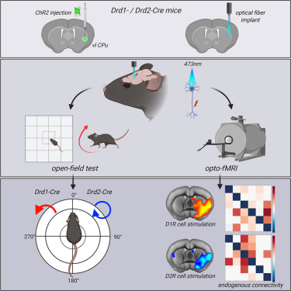
Optogenetics
4 groups:
Control (D1 Cre with no ChR2)
D1 Cre
D2 Cre
A2A Cre
Figure 8 - Opto-fMRI [6]
Notes:
virus with gene injected , groups
say what is control

Slide 11
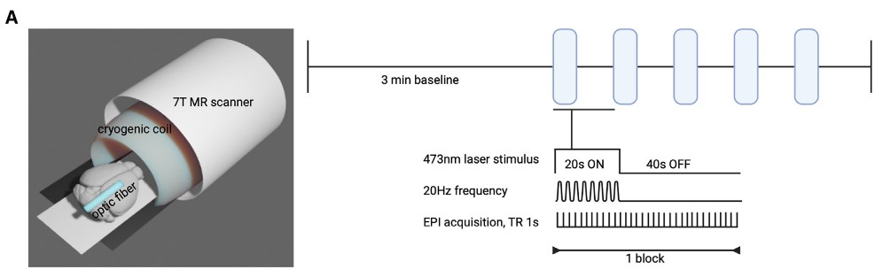
fMRI
5 cycles of 20 s, 20 Hz pulses at 5 mW (on) interleaved by 40-s periods (off)
3 modalities:
Gradient-echo
Spin-echo
Diffusion fMRI
Figure 9 - Stimulation parameters in fMRI [6]
Notes:
stimulation process
sedated and head fixed
modalities of fMRI
analyze z-stat maps consensus over groups and modalities

Slide 12
fMRI
Background
Objectives
Results
Challenges

Slide 13
Objectives
Head and neck movements during D1-Cre mice stimulation similar to cervical dystonia : possible modeling of these symptoms in mice
Test whether D2-Cre activation leads to the activation of cell types other than MSNs in the striatum (such as glutamatergic and dopamine afferents)
Since the D1R and D2R cell activation has impact on mPFC, possible applications in psychiatric diseases impacting this region (OCD, addiction, anxiety)
Development of a more detailed model than the canonical direct-indirect network, involving more brain regions than the BG alone
Study the long-term impact of repetitive D1R and D2R cells on brain activity

Slide 14
Results

Slide 15
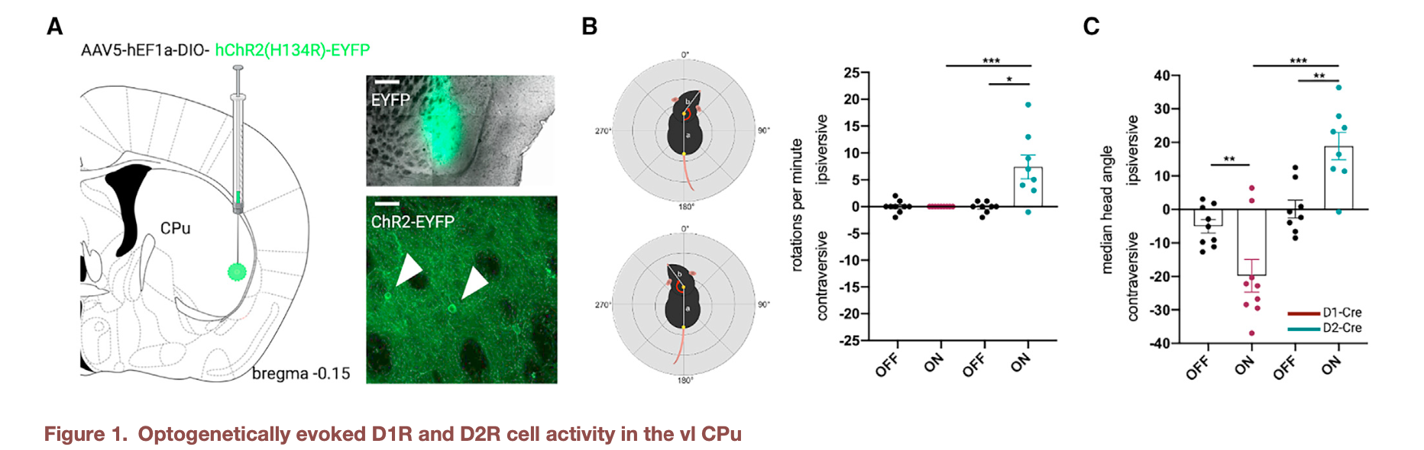
Results - motor activation
Figure 10 - Optogenetically evoked D1R and D2R cell activity in the vl CPu [6]
Notes:
Testing optogenetics in open field test showed different movements than from other articles stimulating other zone of striatum
(head movements instead of full body in D1)
different movements in D1 stimulation and D2 stimulation

Slide 16
Results - motor activation
Background
Objectives
Results
Challenges
Notes:
Optogenetics :
D1 and D2 Cre mice : expressing Cre in D1R -positive and D2R -positive cells respectively
ventrolateral
Movement :
5 cycles of 20s, 20Hz at 5 mW stimulation with light
in D1R : contraversive rotations (dystonia, not full body movements)
in D2R : ipsiversive rotations
verification of the action of stimulation of D1R and D2R cells, and different results of activation

Slide 17
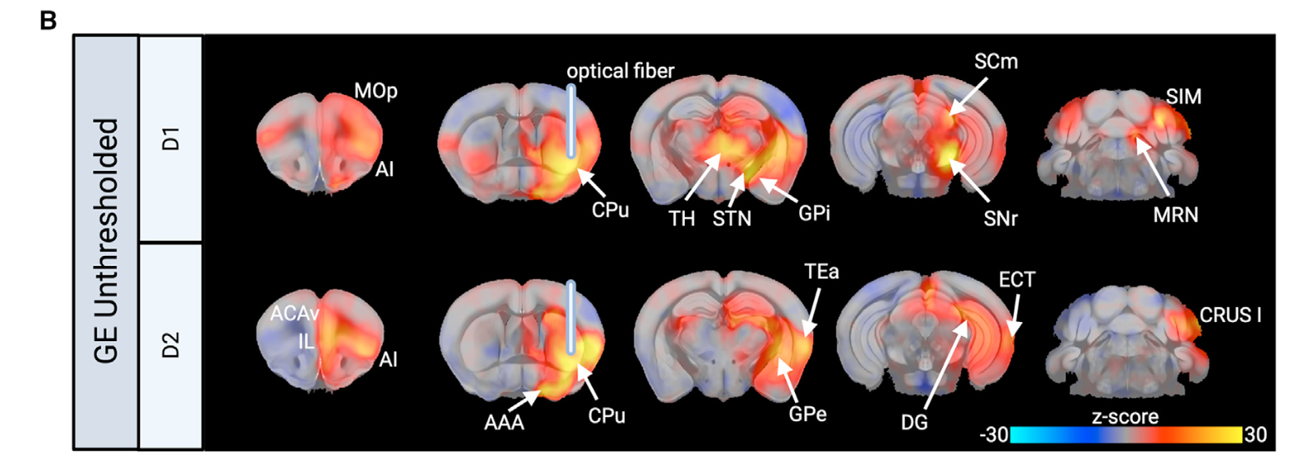
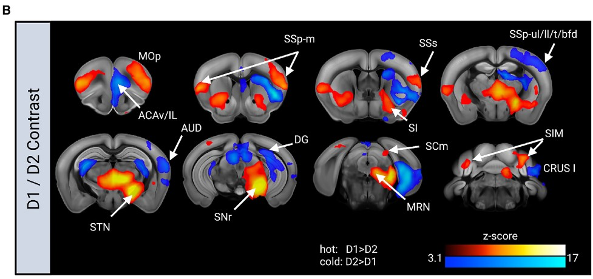
Results - fMRI
Objectives
Results
Challenges
Notes:
fMRI protocol :
anaesthetized mice during the fMRI
intubated for ventilation
stimulation with 5 cycles of 20s blue light laser at 20 Hz, then 40s rest period
GLM z-stat activation maps of D1 vs D2 cell activation
Accordance to canonical model : Primary motor cortex (MOp) activated in D1 but not D2
Contrary to canonical model : STN and GPi activation in D1
Activation of other regions :
cerebellum (SIM region in D1, CRUS 1 region in D2)
Cortex : Anterior cingulate Cortex (ACAv) in D2

Slide 18
Results - fMRI
Figure 11 - Opto-fMRI reveals causal brain-wide influences of D1R and D2R cell activity [6]
Notes:
fMRI protocol :
anaesthetized mice during the fMRI
intubated for ventilation
stimulation with 5 cycles of 20s blue light laser at 20 Hz, then 40s rest period
GLM z-stat activation maps of D1 vs D2 cell activation
Accordance to canonical model : Primary motor cortex (MOp) activated in D1 but not D2
Contrary to canonical model : STN and GPi activation in D1
Activation of other regions :
cerebellum (SIM region in D1, CRUS 1 region in D2)
Cortex : Anterior cingulate Cortex (ACAv) in D2

Slide 19
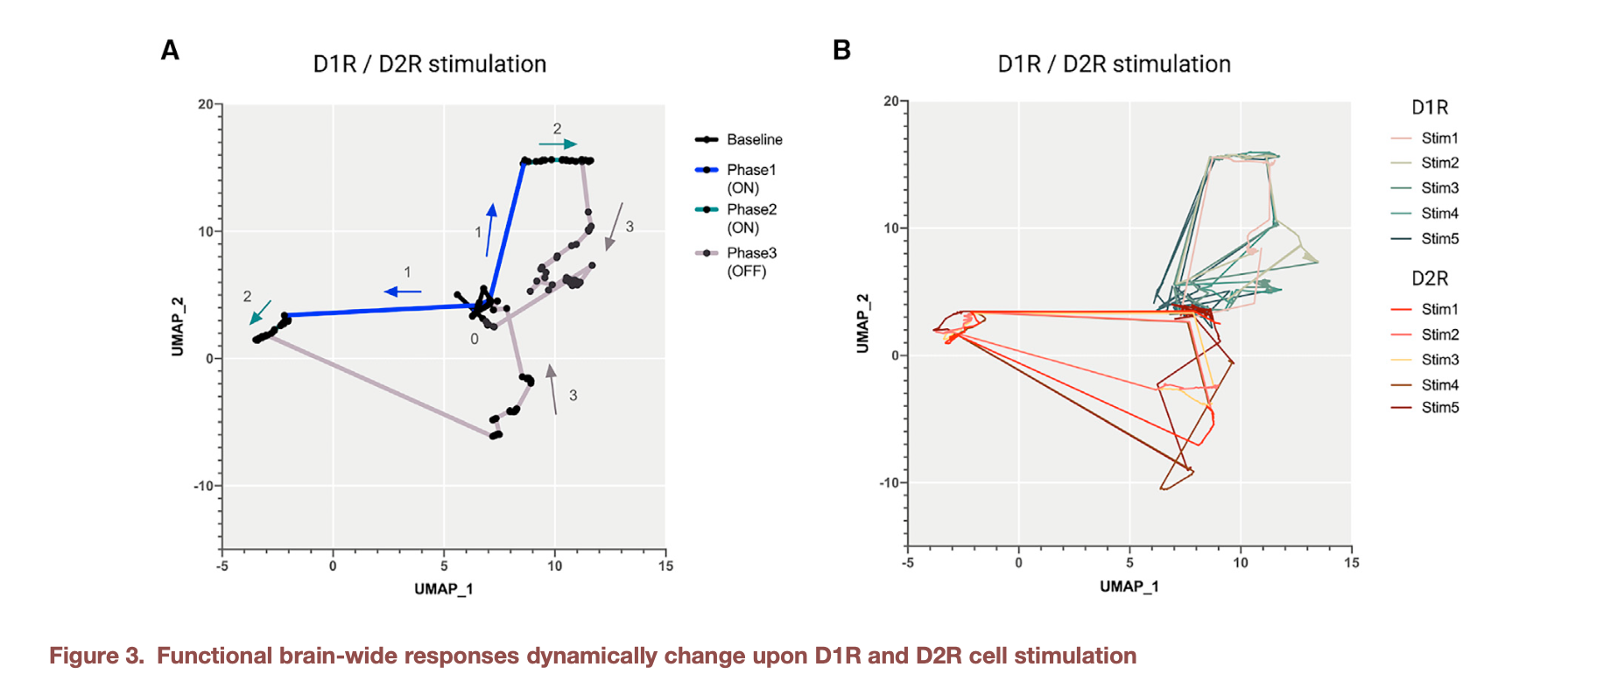
Results - Neuronal activation
Figure 12 - Functional brain-wide responses dynamically change upon D1R and D2R cell stimulation [6]
Notes:
UMAP : unsupervised non-linear dimensionality reduction technique that keeps the structure of the data
Here :
data divided into time steps fed into UMAP
low-dimension representation of the evolution of brain activity over time in D1R vs D2R stimulation
3 phases of response to optogenetic stimulation :
phase 1, phase 2 (ON) : initial and sustained response
phase 3 (OFF) : back to baseline
Different trajectories between D1 and D2 cell activation : different brain region activations

Slide 20
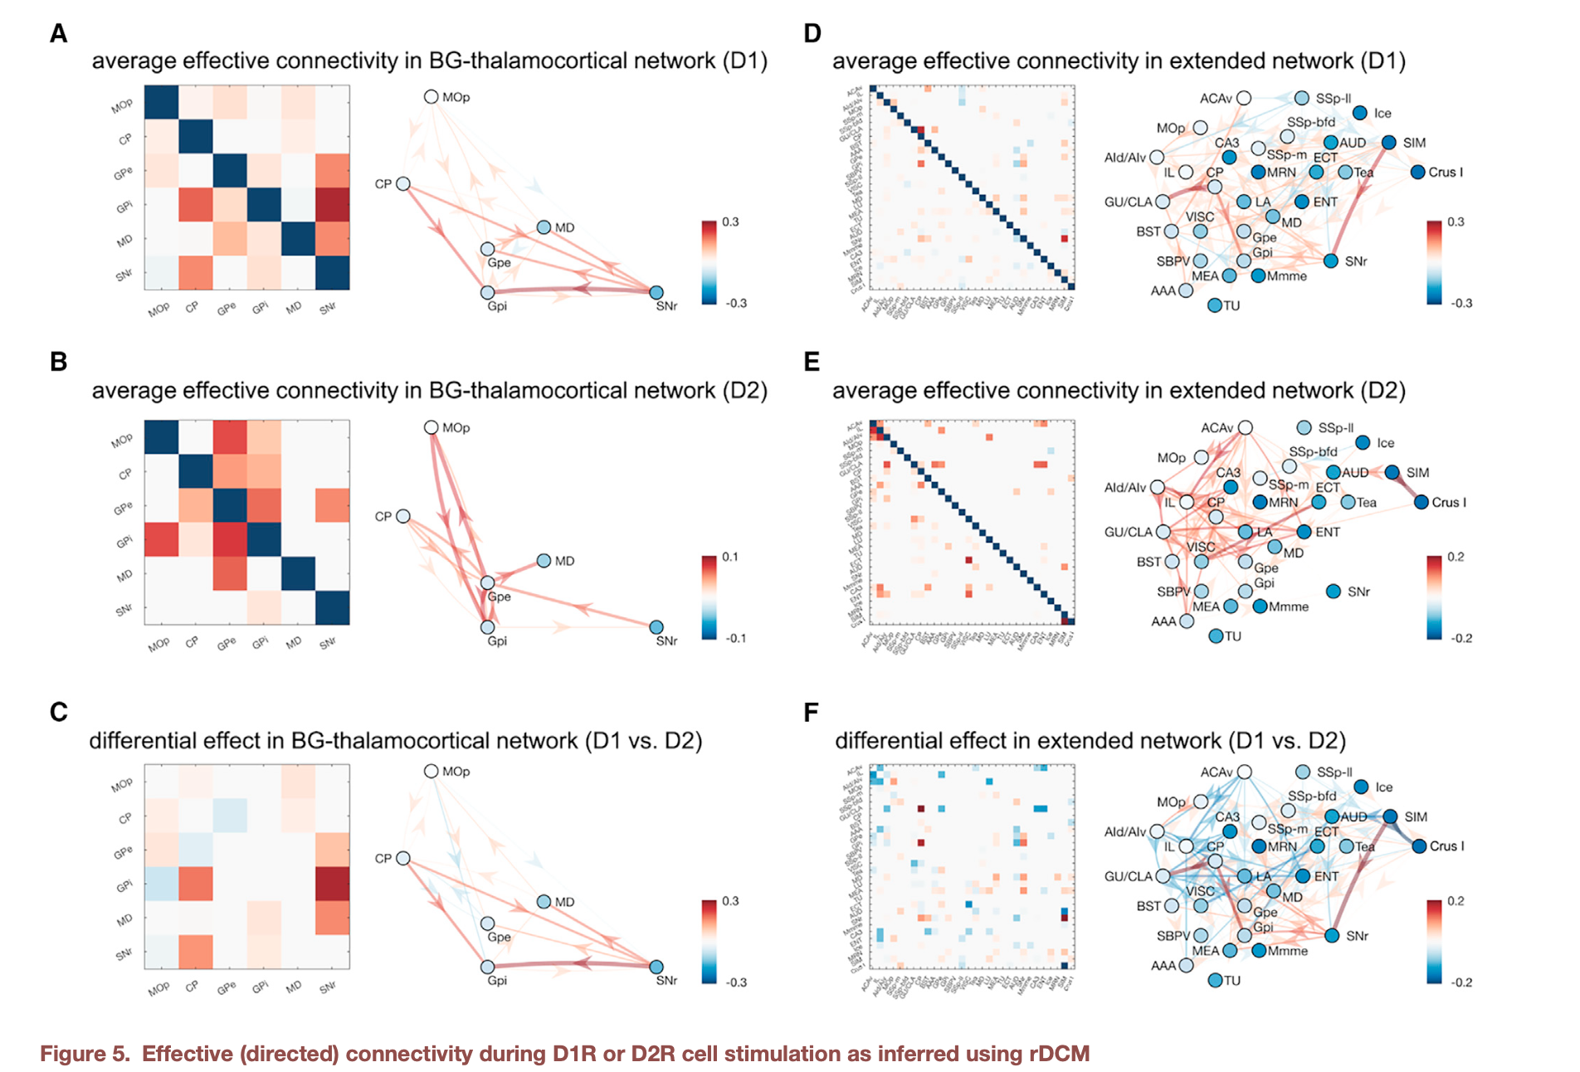
Results - Effective connectivity
Figure 13 - Effective (directed) connectivity during D1R or D2R cell stimulation as inferred using rDCM
Notes:
rDCM :
method to determine effective connectivity on the fMRI data : directed influence of a neural system on another
Two types of connectivity :
functional correlation between activities in different brain regions,
effective : directed influence of a neural system on another
Method :
Direct Causal Modeling (DCM) : model of neural dynamics fitting the observed BOLD responses to controlled perturbations
DCM model : models the evolution of the neural population state based on :
the current state
the external inputs
the functional interactions between brain regions
optimization of the parameters with regression, in order to predict as precisely as possible the observed BOLD response (Balloon model to go from neuronal dynamics to BOLD response)
rDCM : Bayesian linear regression, in the frequency domain => faster
better than usual techniques (anatomical and electrophysiological signals in isolation)
Results : connectivity in D1 vs D2 stimulation is different in BG:
D1 : connections of CPu to GPi and SNr increased (direct pathway)
D2 : connections for CPu to GPe increased (indirect pathway)
Results : connectivity in whole brain is different in D1 vs D2 :
D1 : connection from cerebellar region, SIM, to SNr
D2 :
connection with prefrontal regions (AId/AIv), cingulate regions (ACAv)
connection between cerebellar regions : SIM to Crus I

Slide 21
Results - rDCM
Background
Objectives
Results
Challenges
Key concepts and methods
tested new region of CPu
maybe rDCM ?
use functional recordings while stimulating (using opto-fMRI) along with computational modeling (the rDCM i guess) instead of traditional individual measurements and based on “fragmented” anatomical connections

Slide 22
General findings
Different effects of D1 and D2 cell stimulations in the Basal Ganglia
Different activations beyond the basal ganglia :
prefrontal regions
cerebellum
Motor activation from D1 depends on the location of cells in the CPu
dm CPu : full body contraversive rotations
vl Cpu : dystonia head and neck contraversive rotations
Notes:
Different effects of D1 and D2 cell stimulations in the Basal Ganglia
Different activations beyond the basal ganglia :
prefrontal regions
cerebellum
Motor activation from D1 depends on the location of cells in the CPu
dm CPu : full body contraversive rotations
vl Cpu : dystonia head and neck contraversive rotations

Slide 23
Limitations and challenges

Slide 24
Limitations
Sample size : 14 D1-Cre, 8 D2-Cre, 13 A2A-Cre
fMRI in anaesthetized animals
animal study : does not necessarily translate to human studies
Only short-term impact of D1R and D2R cell activation on brain activity
Notes:
Sample size : 14 D1-Cre, 8 D2-Cre, 13 A2A-Cre
fMRI in anaesthetized animals
animal study : does not necessarily translate to human studies
Only short-term impact of D1R and D2R cell activation on brain activity

Slide 25
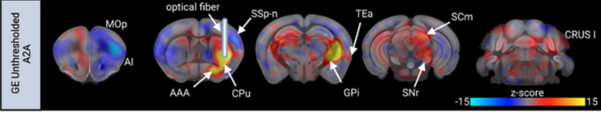
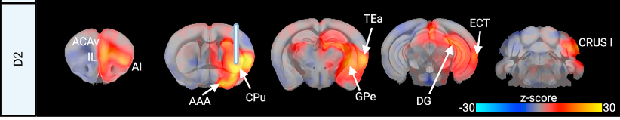
Challenges
Difficulty of isolating the activation of D2R striatal cells :
Striatal cholinergic neurons also express D2 receptors
Expression of acetylcholine => activation of D1R cells
Comparison with A2A-Cre mice activation : similar activation, except for MOp and GPe
Figure 14 - D2 and A2A show similar activation [6]
Notes:
Difficulty of isolating the activation of D2R striatal cells :
Striatal cholinergic neurons also express D2 receptors
Expression of acetylcholine => activation of D1R cells
Comparison with A2A-Cre mice activation : similar activation, except for MOp and GPe

Slide 26
Open questions
Activation of D1R in vl CPu involved in cervical dystonia ?
Study stimulation of D1 and D2 cells at different locations of the CPu
Study activation of other cell types (ex : glutamatergic and dopamine afferents) in response to D2 stimulation
Development of a more detailed model than the canonical direct-indirect network (involving other regions)
Notes:
Activation of D1R in vl CPu involved in cervical dystonia ?
Study stimulation of D1 and D2 cells at different locations of the CPu
Study activation of other cell types (ex : glutamatergic and dopamine afferents) in response to D2 stimulation
Development of a more detailed model than the canonical direct-indirect network (involving other regions)

Slide 27

Thank you

Slide 28
Questions

Slide 29
References
Image in first slide - Buchen, L. (2010). Neuroscience: Illuminating the brain. In Nature (Vol. 465, Issue 7294, pp. 26–28). Springer Science and Business Media LLC. https://doi.org/10.1038/465026a
[1] - Anatomy of basal ganglia and it’s disorders. medmaps.in - WELCOME TO MEDMAPS. (2024, April 17). https://medmaps.in/anatomy-of-basal-ganglia-and-its-disorders/
[2] - Colder, B. (2015). The basal ganglia select the expected sensory input used for predictive coding. In Frontiers in Computational Neuroscience (Vol. 9). Frontiers Media SA. https://doi.org/10.3389/fncom.2015.00119
[3] - Del’Guidice, T. (2011). Role of beta-arrestin 2 downstream of dopamine receptors in the basal ganglia. In Frontiers in Neuroanatomy (Vol. 5). Frontiers Media SA. https://doi.org/10.3389/fnana.2011.00058
[4] - Conceição, V. A., Dias, Â., Farinha, A. C., & Maia, T. V. (2017). Premonitory urges and tics in Tourette syndrome: computational mechanisms and neural correlates. In Current Opinion in Neurobiology (Vol. 46, pp. 187–199). Elsevier BV. https://doi.org/10.1016/j.conb.2017.08.009
[5] - Jahanshahi, M., Obeso, I., Rothwell, J. C., & Obeso, J. A. (2015). A fronto–striato–subthalamic–pallidal network for goal-directed and habitual inhibition. In Nature Reviews Neuroscience (Vol. 16, Issue 12, pp. 719–732). Springer Science and Business Media LLC. https://doi.org/10.1038/nrn4038
[6] - Grimm, C., Frässle, S., Steger, C., von Ziegler, L., Sturman, O., Shemesh, N., Peleg-Raibstein, D., Burdakov, D., Bohacek, J., Stephan, K. E., Razansky, D., Wenderoth, N., & Zerbi, V. (2021). Optogenetic activation of striatal D1R and D2R cells differentially engages downstream connected areas beyond the basal ganglia. In Cell Reports (Vol. 37, Issue 13, p. 110161). Elsevier BV. https://doi.org/10.1016/j.celrep.2021.110161

Slide 30
References

Slide 31
questions fmri modalities
Notes:
1. Gradient Echo (GRE)
Mechanism: An initial radiofrequency (RF) pulse flips the net magnetization, and gradients (varying magnetic fields) alter the phase of precessing spins. The signal forms when the gradient is reversed, causing spins to rephase and produce an echo.
Key Point: GRE is sensitive to differences in magnetic susceptibility, making it ideal for detecting BOLD signals related to brain activity.
2. Spin Echo (SE)
Mechanism: An initial 90° RF pulse flips the net magnetization, followed by a 180° refocusing pulse that re-aligns dephased spins. This refocusing reduces signal loss from inhomogeneities and results in a spin echo.
Key Point: SE is used to mitigate dephasing effects from inhomogeneities, leading to clearer images and more uniform signal across tissues.
3. Diffusion fMRI (dfMRI)
Mechanism: This method applies diffusion-weighted gradients before and after a 90° RF pulse to measure water molecule movement. Changes in diffusion can reflect cellular or microstructural activity related to brain function.
Key Point: dfMRI tracks water diffusion, offering potential insight into neuronal activation or microstructural changes during functional tasks, rather than just blood flow.

Slide 32
questions diffusion fmri
Notes:
How it Works:
Application of Gradients: During a diffusion MRI scan, a pair of magnetic field gradients are applied—one before and one after the main RF pulse. These gradients temporarily alter the local magnetic field and phase of the spins of water molecules.
Effect on Stationary vs. Moving Water Molecules:
Stationary Molecules: Spins of stationary water molecules are rephased by the second gradient, so their signal remains strong.
Moving (Diffusing) Molecules: If water molecules have moved between the application of the two gradients (due to diffusion), their spins will not fully rephase, causing a reduction in signal intensity.
Purpose:
These gradients are crucial for measuring how water molecules diffuse within the brain tissue, which can reveal microstructural properties of the tissue, such as the density and orientation of fibers. In diffusion fMRI, this sensitivity helps infer neuronal activity by detecting changes in water movement associated with cellular processes.
Key Point:
The strength and timing of these gradients can be adjusted to control the degree of diffusion weighting in the image. This weighting is what makes diffusion-sensitive sequences capable of highlighting differences in tissue structure and pathology.

Slide 33
questions parameters stimulation
Notes:
1. Frequency (20 Hz):
Physiological Relevance: A frequency of 20 Hz falls within the beta range of brain wave frequencies, which is associated with certain types of neuronal processing and can mimic the natural firing patterns of specific neuronal populations. This helps ensure that the optogenetic activation more closely resembles physiological conditions.
Effect on Neuronal Activity: 20 Hz is a relatively high stimulation rate that can lead to sustained depolarization and firing of the targeted neurons. It is fast enough to induce continuous activation without overstimulating to the point of causing potential damage or desensitization.
2. Duration (20 seconds on, 40 seconds off):
On Period (20 s): This duration provides a significant period for sustained stimulation, allowing researchers to observe robust changes in brain activity or behavior. Shorter stimulations might not produce strong enough effects, while much longer periods could lead to adaptation or changes that do not reflect natural activity.
Off Period (40 s): The 40-second rest period prevents overexposure and potential neural fatigue or damage, allowing the neurons to return to baseline activity levels. This interleaving helps maintain the responsiveness of the neurons and prevents issues such as phototoxicity or overstimulation, which could lead to altered cellular health or experimental artifacts.
3. Power (5 mW):
Optimal Activation: A power level of 5 mW is typically chosen to be sufficient to activate opsins (light-sensitive proteins used in optogenetics) effectively without being so intense that it causes heat damage or other adverse effects in the tissue.
Safety and Specificity: Using 5 mW allows targeted activation while minimizing the spread of light beyond the desired area. This level is generally safe for biological tissue under controlled durations.

Slide 34
Background
Key concepts and methods
basal ganglia (emphasis on D1R and D2R)
Objectives/research question
how D1R and D2R affect regions outside canonical BG function
importance - rethink BG model to understand their influence on whole brain
Methods
optogenetics
fMRI
opto-fMRI
rDCM
what happened and results
UMAP

