Slide 1

MSE-213
Probability and statistics for materials science
Thermodynamics, quantum, statistical mechanics
Your research
+ aaa
1
[15, 21, 45, 50, 52, 55, 55]
Lecture 6
The test IS good enough
The test is NOT good enough
I would need more data to decide

Slide 2
Recap: The mean and variance of means
1

Slide 3
We measured a sample, what now?
2

Slide 4
Estimating the true mean from a sample mean
3

Slide 5
Inspecting real data

Slide 6
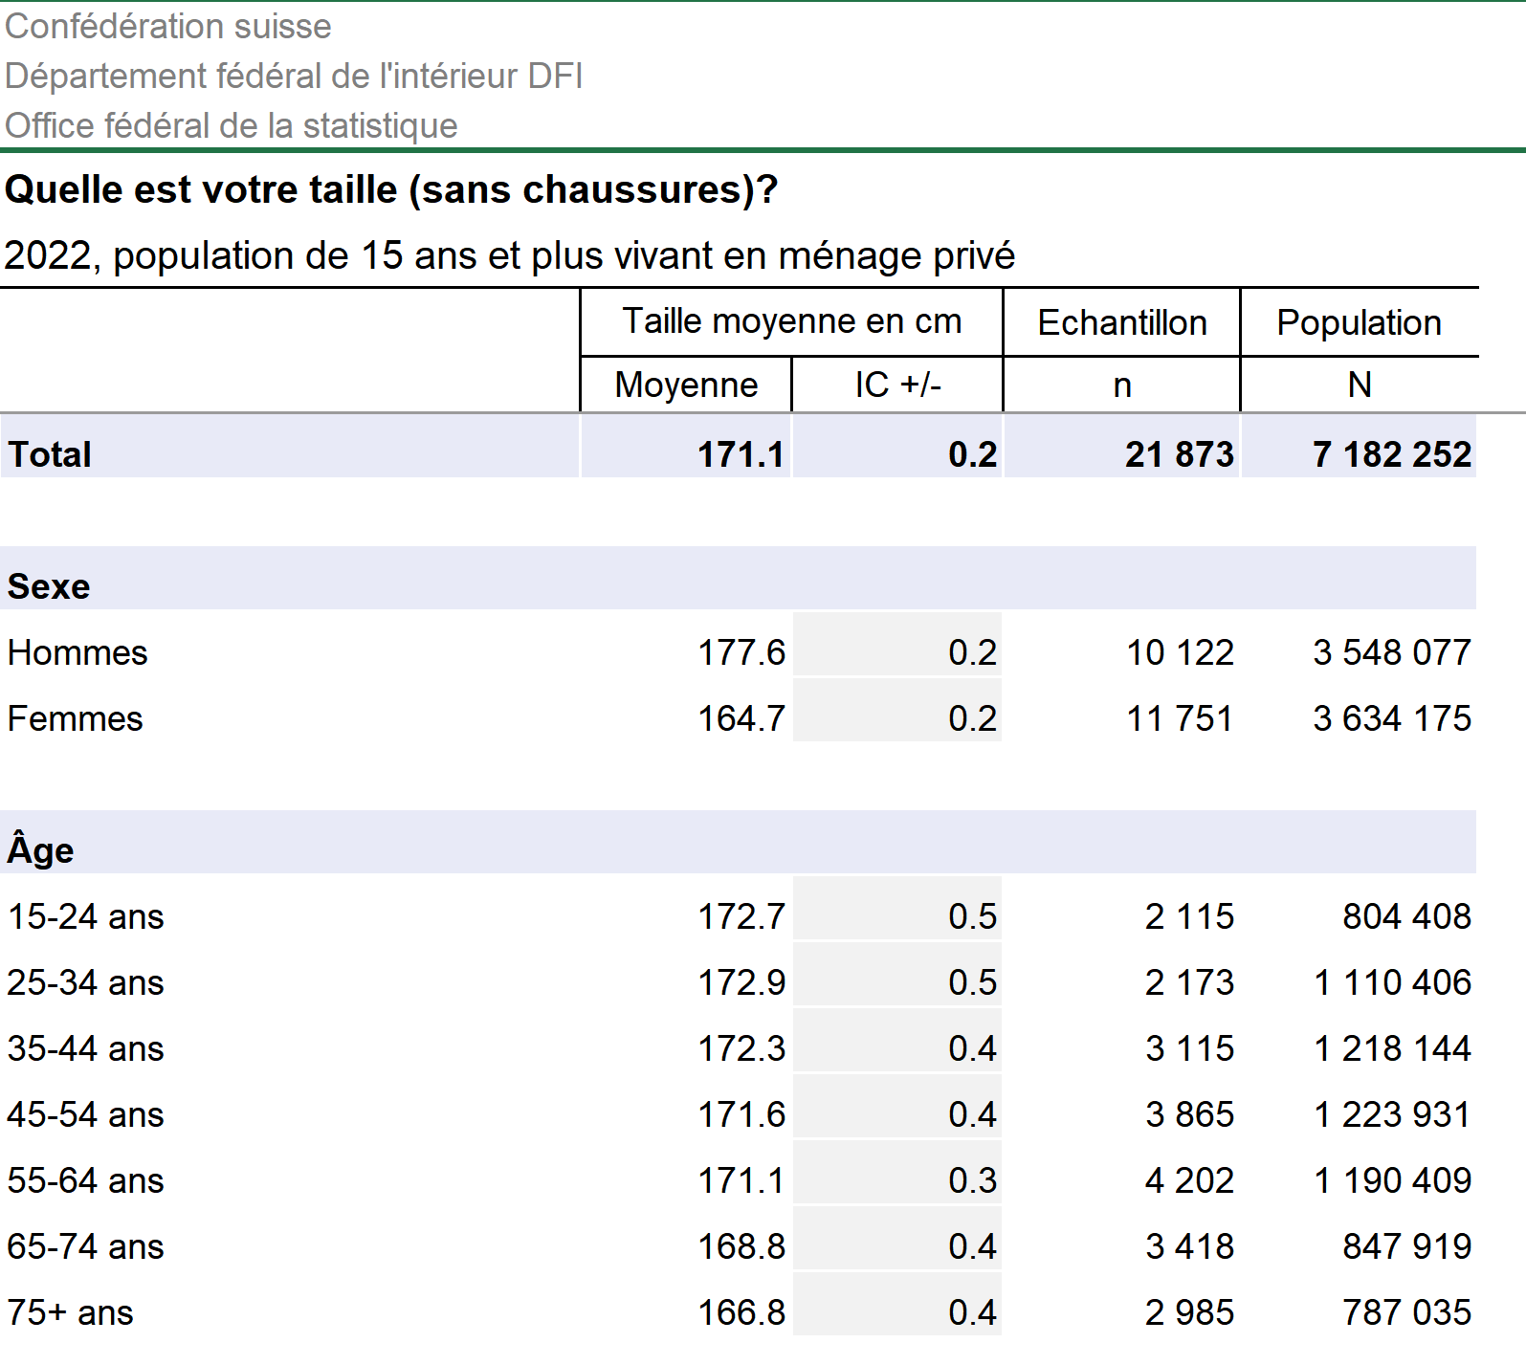

Slide 7
Inspecting real data

Slide 8
Hypothesis testing
4

Slide 9
Hypothesis testing – the procedure
5

Slide 10
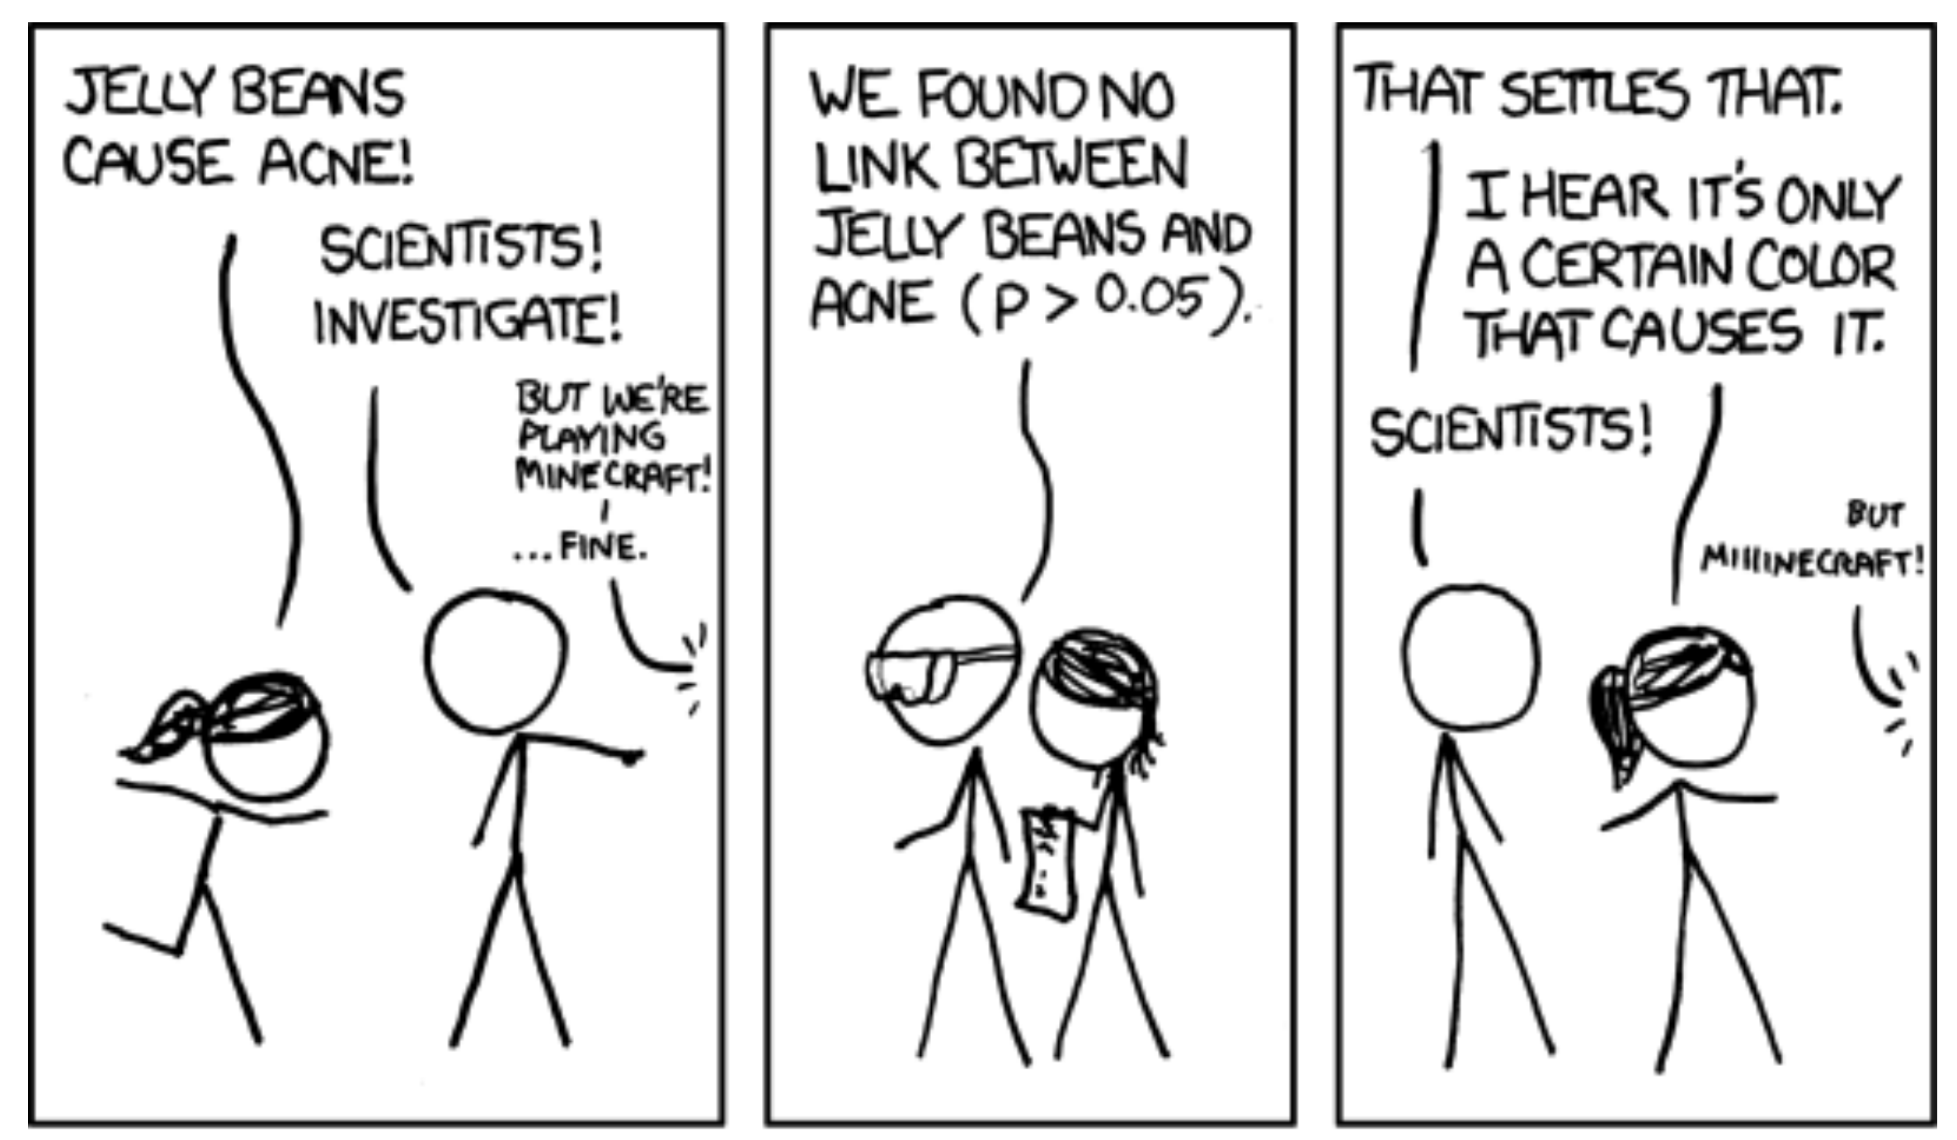

Slide 11
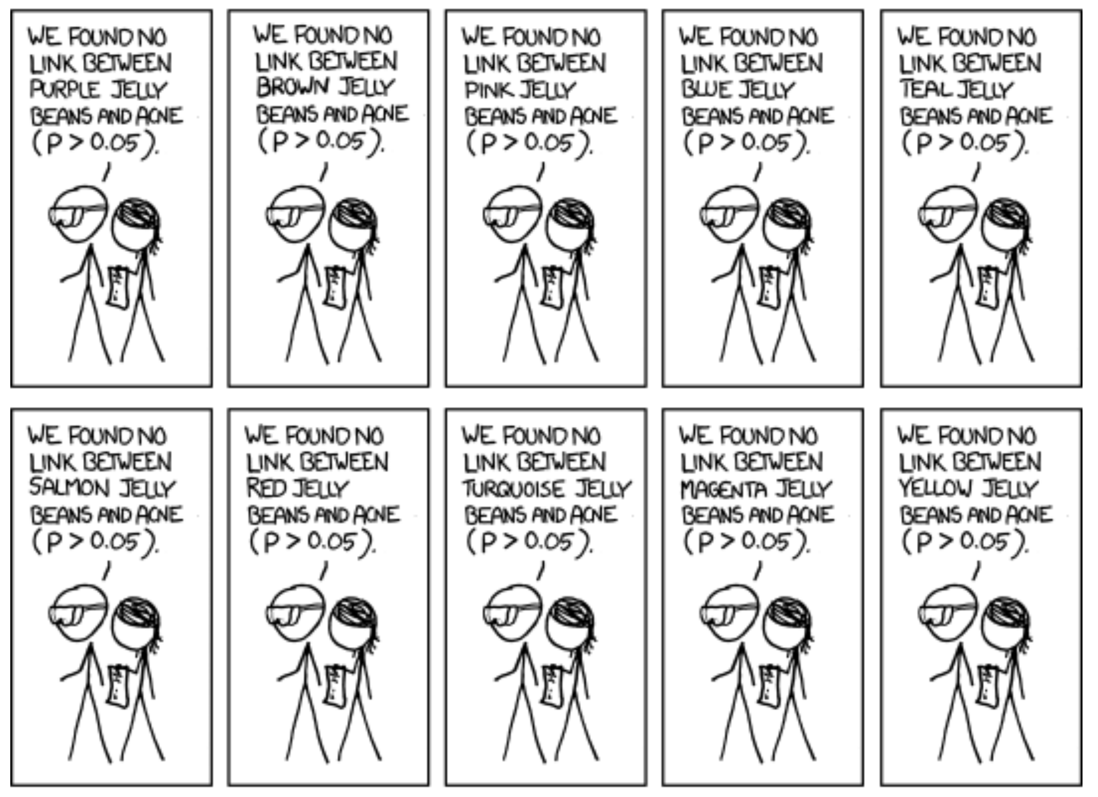

Slide 12
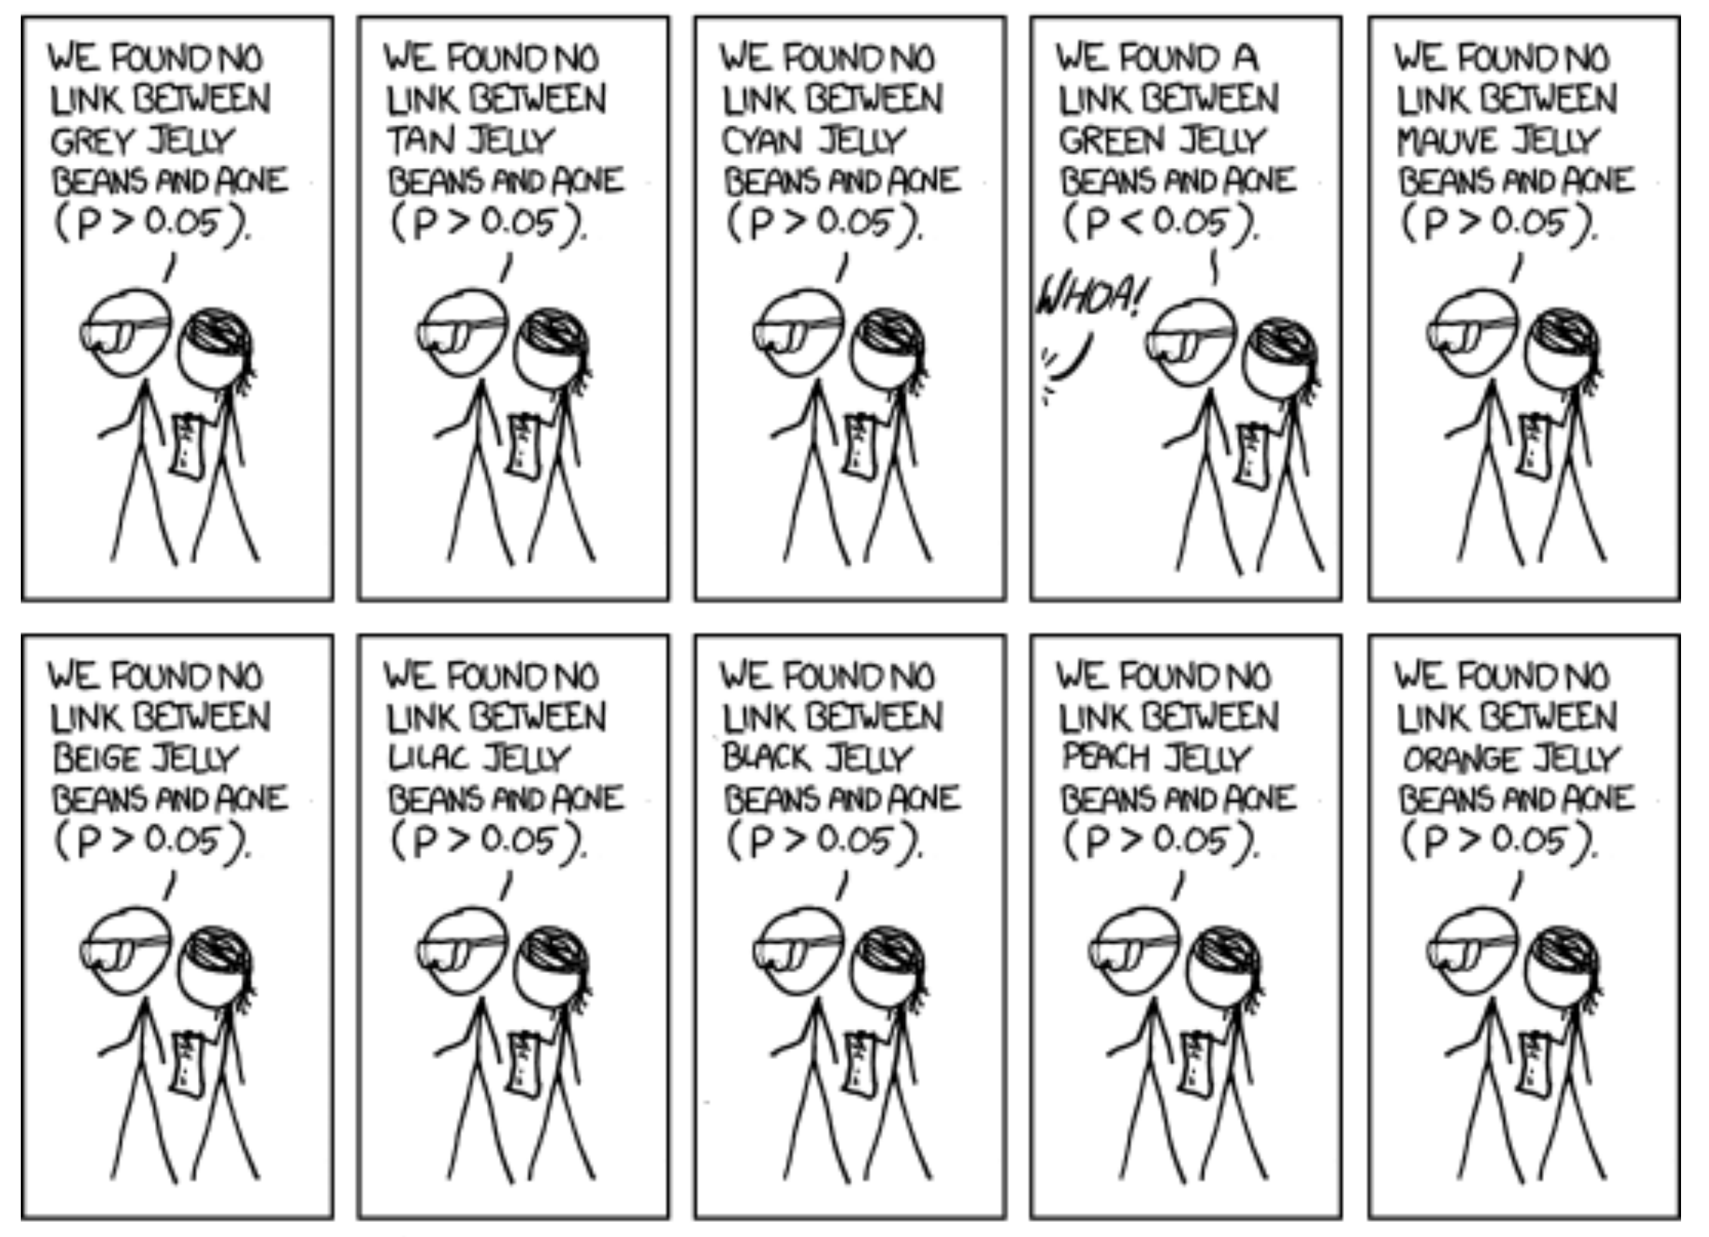

Slide 13
