Slide 1

MSE-213
Probability and statistics for materials science
Thermodynamics, quantum, statistical mechanics
Your research
+ aaa
1
[15, 21, 45, 50, 52, 55, 55]
Lecture 5
The test IS good enough
The test is NOT good enough
I would need more data to decide

Slide 2
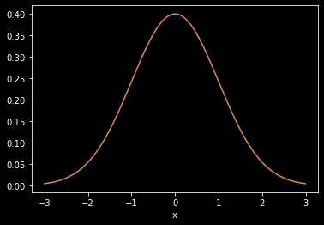
The Normal/Gaussian distribution
1

Slide 3
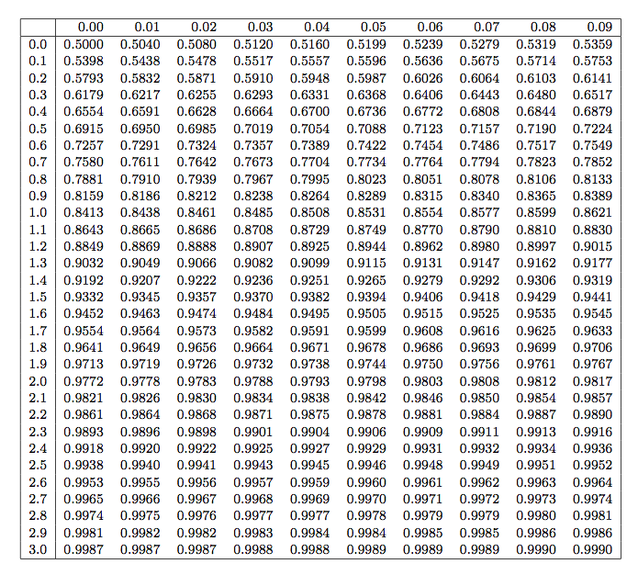
Standard normal table
(z table)

Slide 4
Probability density function of a mean
2

Slide 5
The Central Limit Theorem
3

Slide 6
From probability distributions to data... and back

Slide 7
From probability distributions to data... and back
Situation A: We want to know something about a large POPULATION
but only have the ressources to look at N SAMPLES
All Swiss citizens 1000 people chosen at “random”
All iPhones produced in 2023 8000 phones inspected for quality
Every Rb atoms in the universe 10^9 Rb atoms measured in my lab

Slide 8
From probability distributions to data... and back
Situation A: We want to know something about a large POPULATION
but only have the ressources to look at N SAMPLES
All Swiss citizens 1000 people chosen at “random”
All iPhones produced in 2023 8000 phones inspected for quality
Every Rb atoms in the universe 10^9 Rb atoms measured in my lab
Situation B: we want to know the “true” probability distribution of a RANDOM PROCESS but we can only SAMPLE THE PROCESS N TIMES
Flipping a coin 10 coin flips we record
Electrons scattering in a resistor voltage drop across this resistor
Quantum measurement of a laser number of photons recorded

Slide 9
From probability distributions to data... and back
Cleaning up the notation
4

Slide 10
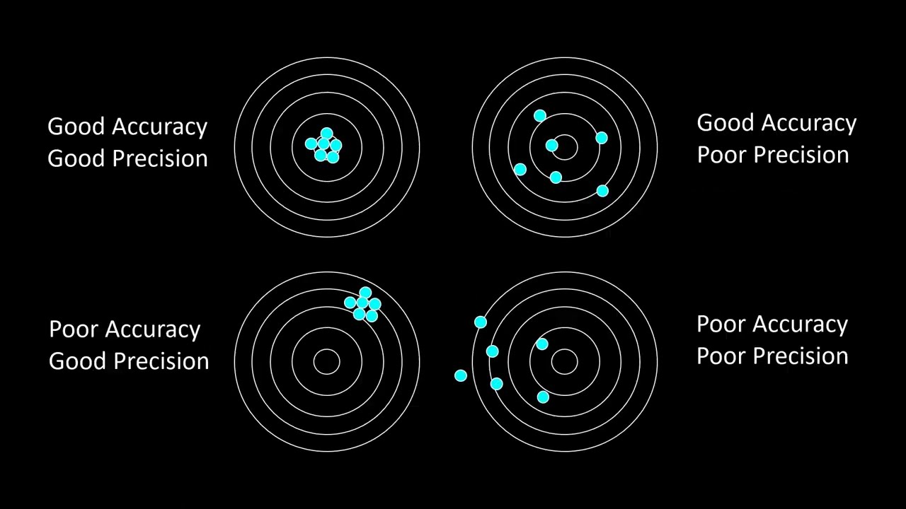

Slide 11
“Bias” /
systematic error

Slide 12
Large Variance

Slide 13
Sample mean vs population mean
5

Slide 14
The sample mean is an unbiased estimator of the mean of the population / of the probability distribution

Slide 15
The sample mean is an unbiased estimator of the mean of the population / of the probability distribution
The sample VARIANCE is....
Systematically too high (Bias > 0)
Unbiased
Systematically too low (Bias < 0)

Slide 16
Sample variance vs population variance
[11, 13, 12, 14]
6

Slide 17
Sample variance vs population variance
7

Slide 18
Sample std. dev. vs population std. dev.
7

Slide 19
The Mean Square Error (MSE)
8

