Slide 1
Lecture 5
Interference and Coherence

Slide 2
oultine
Phase measurement and Interference
Light intensity
Michelson interferometer
Temporal coherence
Young’s double slit interferometer
Spatial coherence
Fourier transform lenses and the 4F system
Imaging with incoherent light
Is it + or -?

Slide 3
Light Propagation:
Diffraction or Interference?
Optical
System
Output
Input

Slide 4
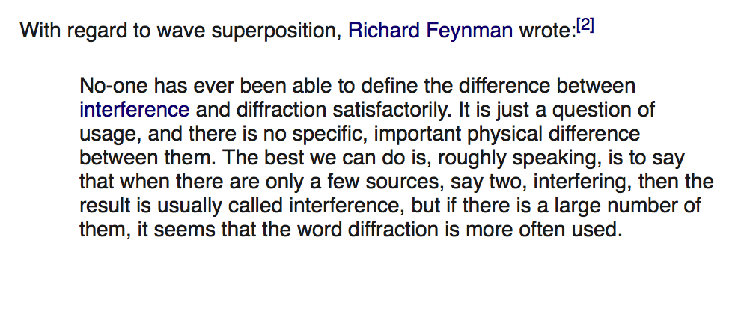

Slide 5
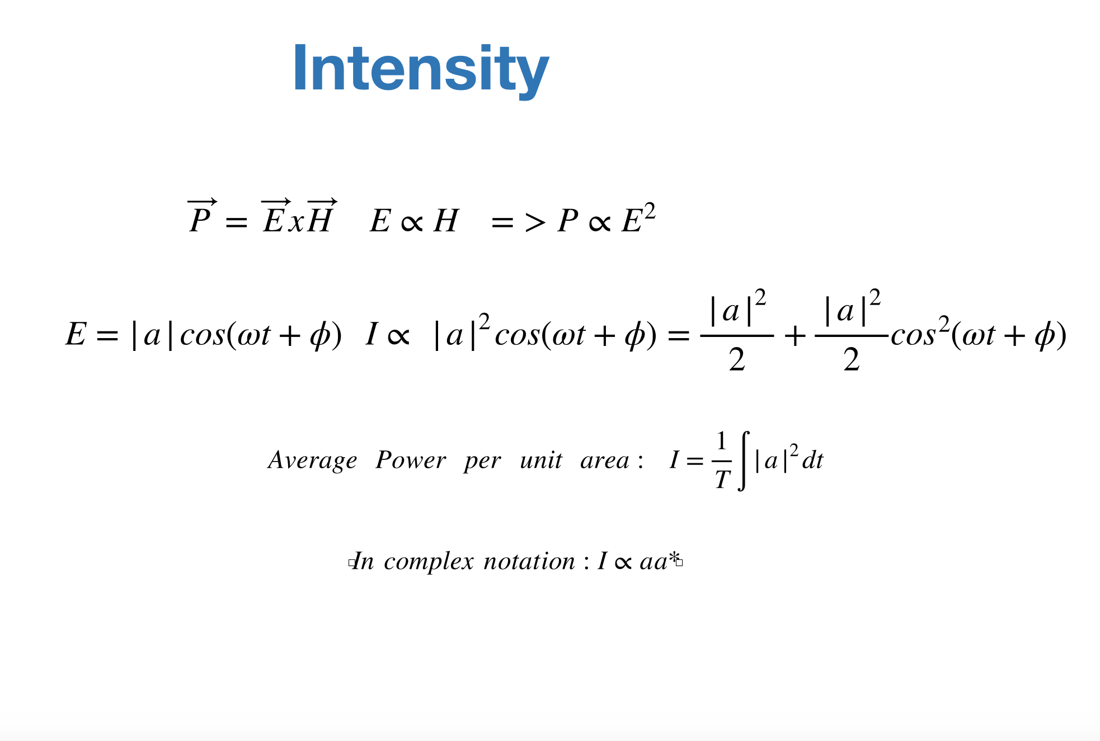

Slide 6
Interferometry
Interference fringes

Slide 7
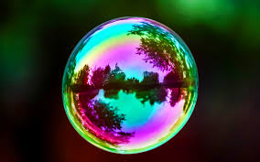
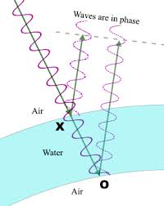
Soap Bubbles

Slide 8
Michelson Interferometer
Mirror
Illumination
Mirror
Beam splitter
Detector

Slide 9
Temporal (longitudinal) coherence
Δz= v τ
z
a(t)
a(t-τ)

Slide 10
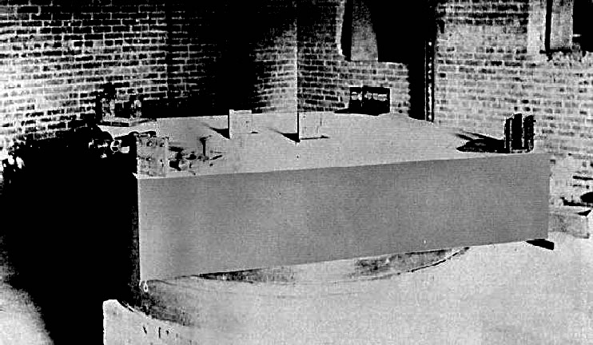
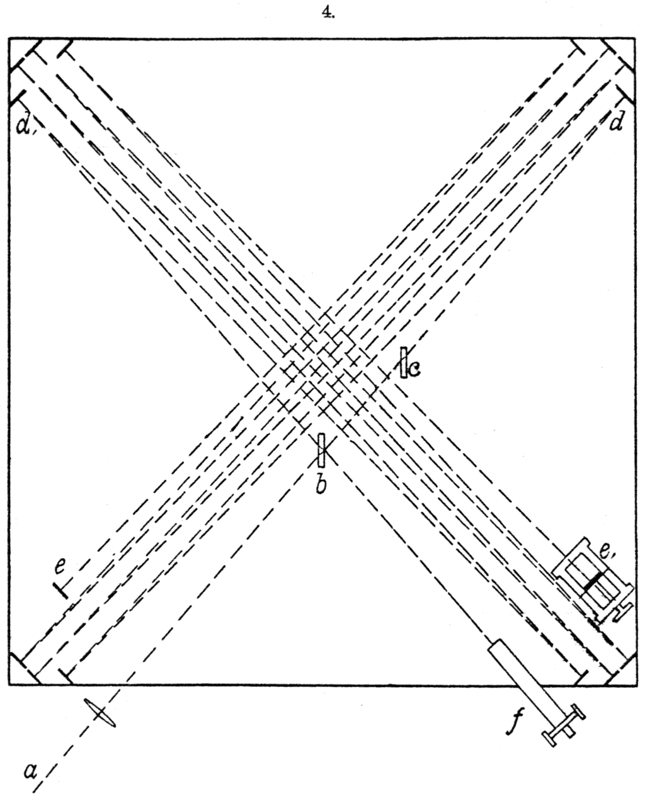
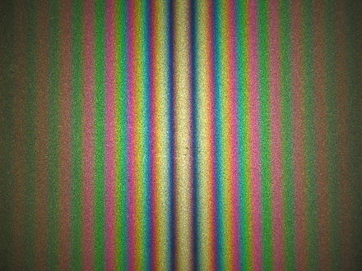
Michelson’s apparatus

Slide 11
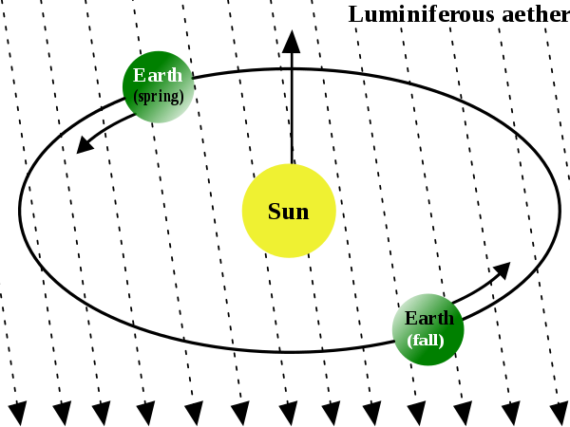
Michelson-Morley experiment

Slide 12
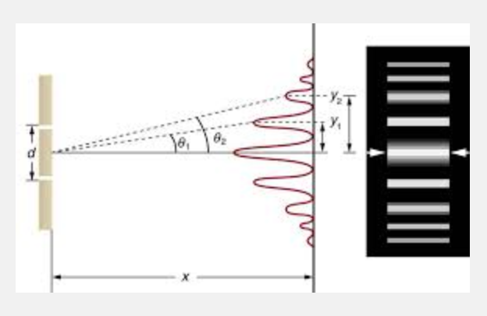
Young’s double slit interferometer

Slide 13
Spatial coherence
x₁
P
x₂
a(x,t)e^{jωt}

Slide 14
dt

Slide 15
Fourier transforming lens
F
F
Fourier
Transform

Slide 16
Far Field

Slide 17
4F Imaging System
F
F
F
F
Fourier
Transform
Fourier
Transform

Slide 18
4F Imaging System
F
F
F
F
Fourier
Transform
Fourier
Transform

Slide 19
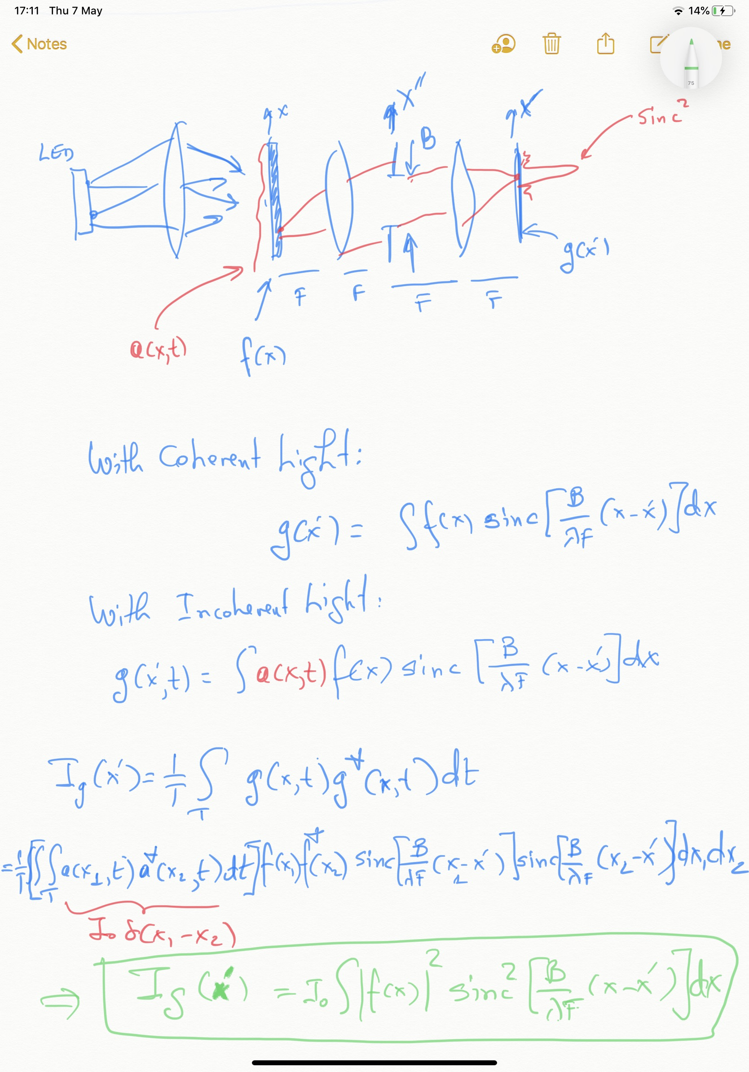

Slide 20
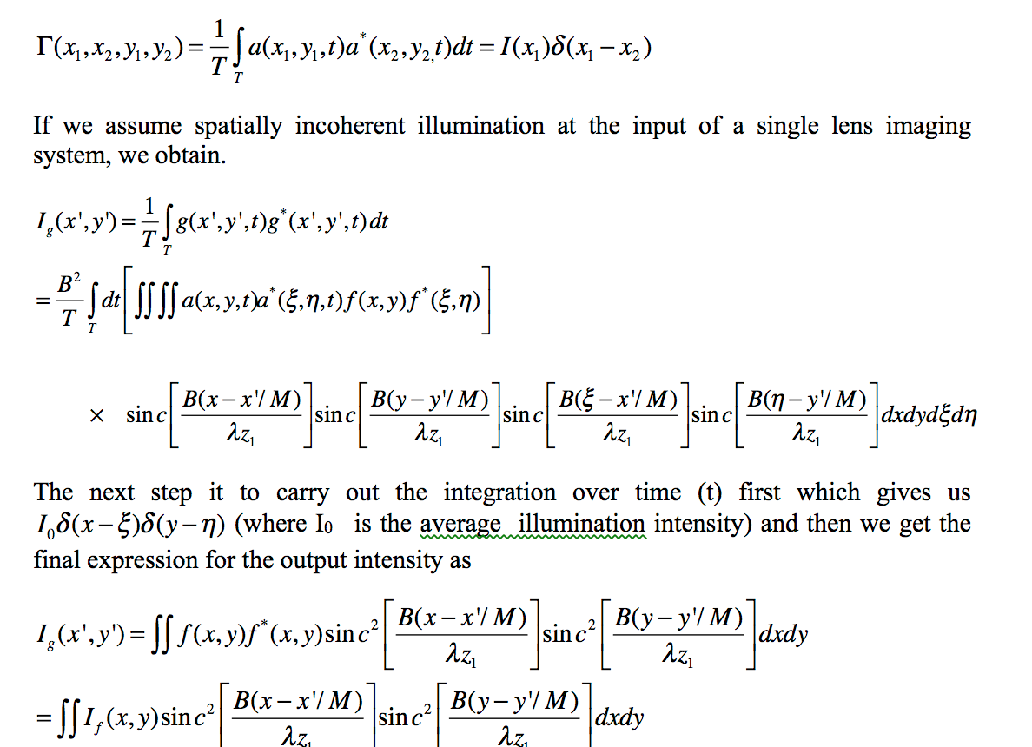

Slide 21
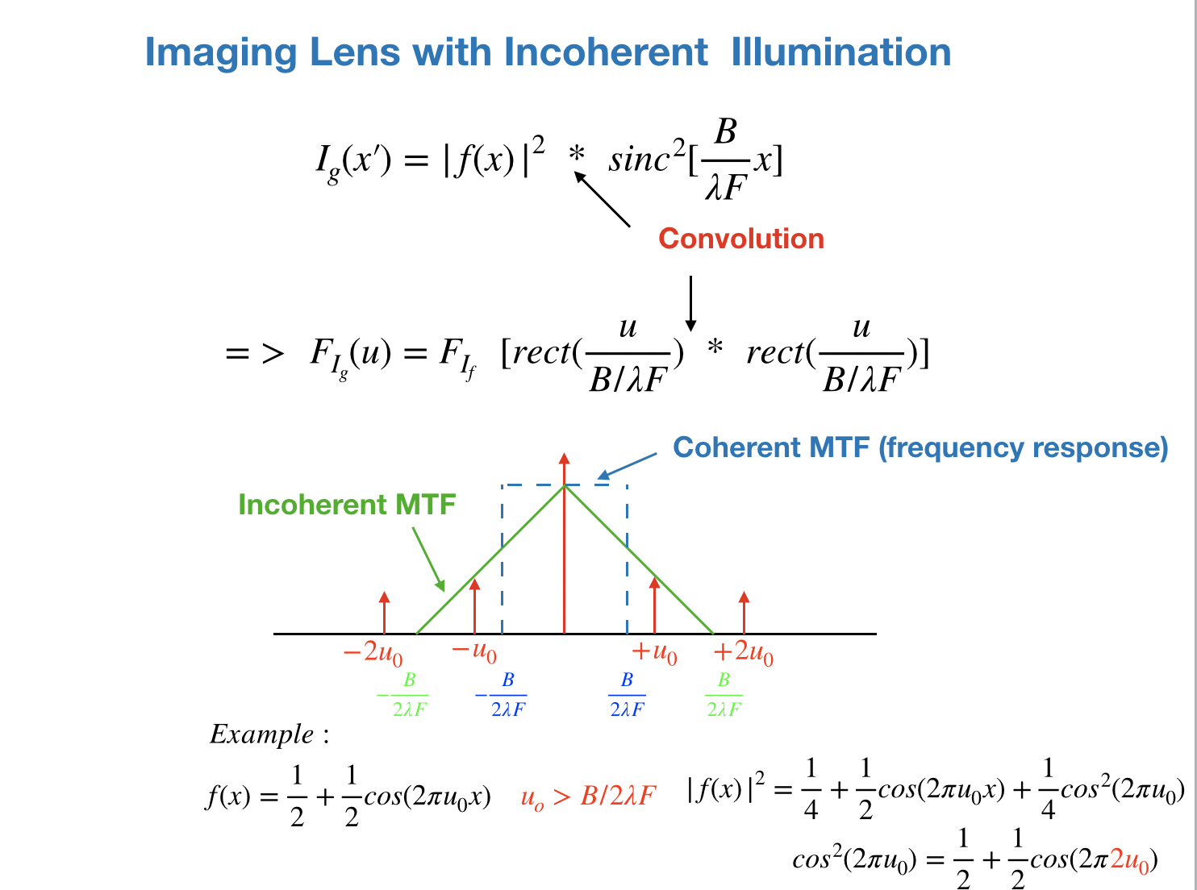

Slide 22
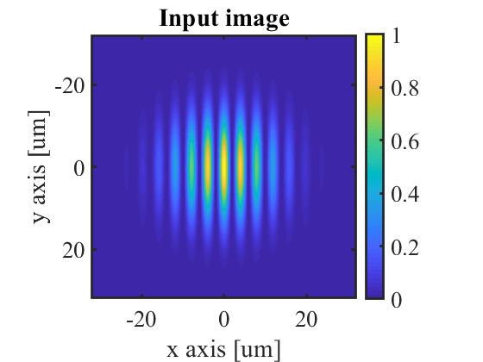
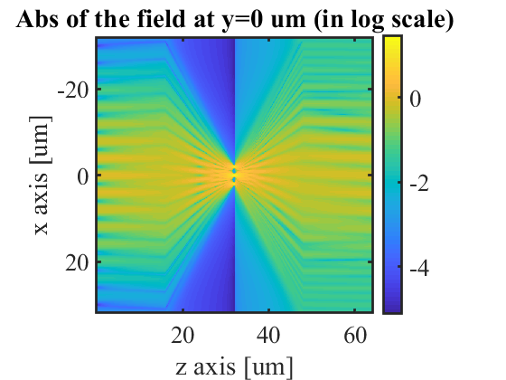
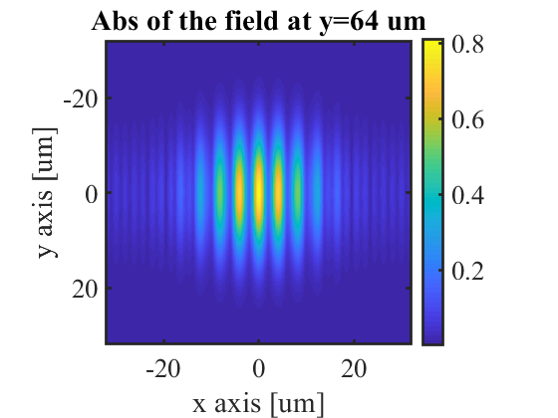
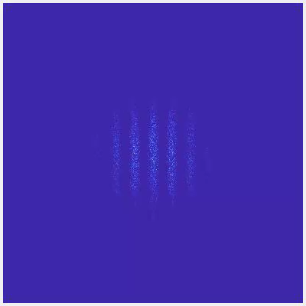
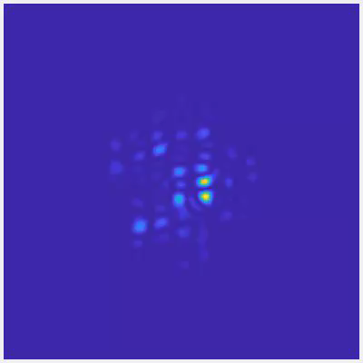
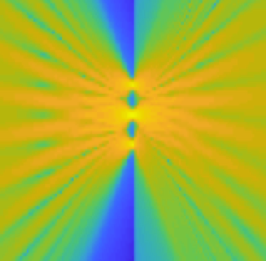

Intensity

Slide 23
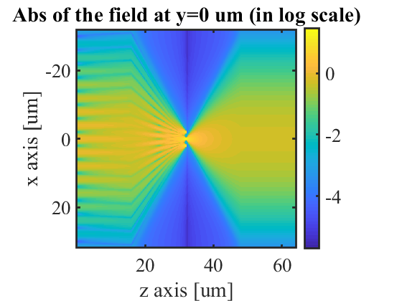
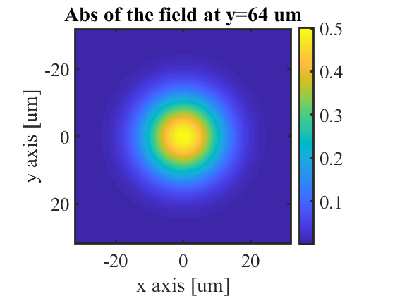
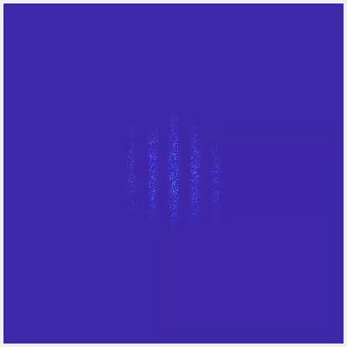
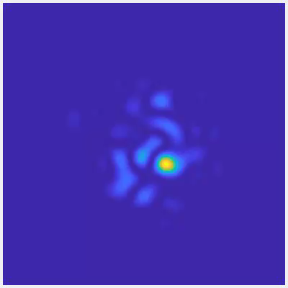
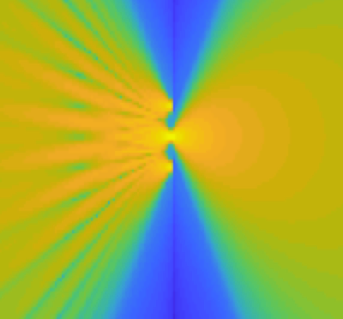
Intensity

Slide 24
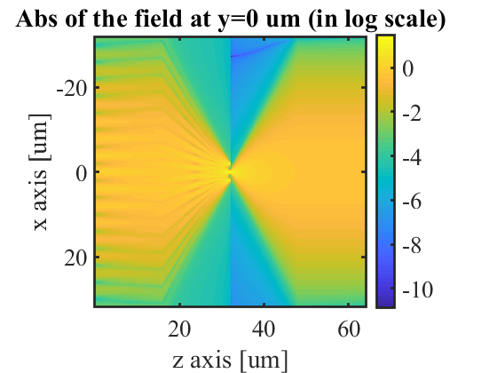
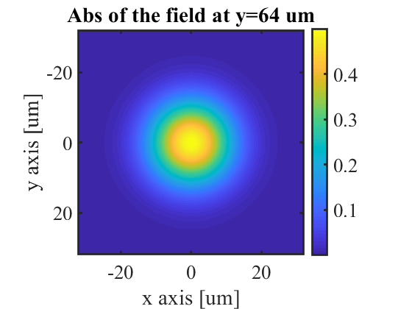
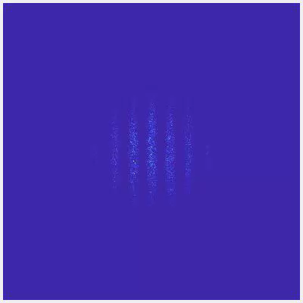
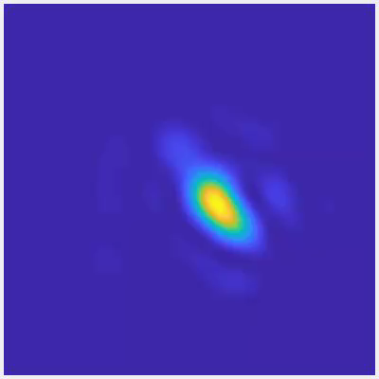
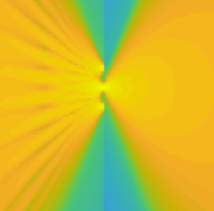
Intensity

Slide 25
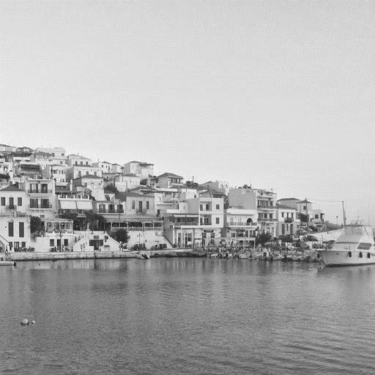

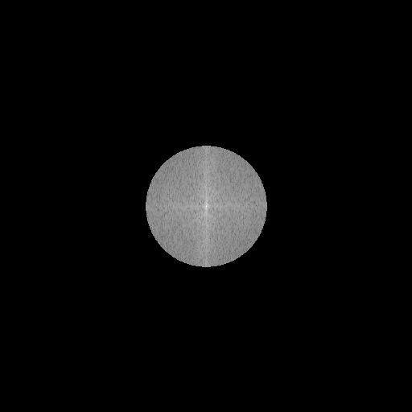
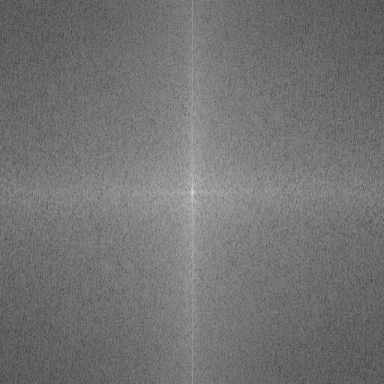
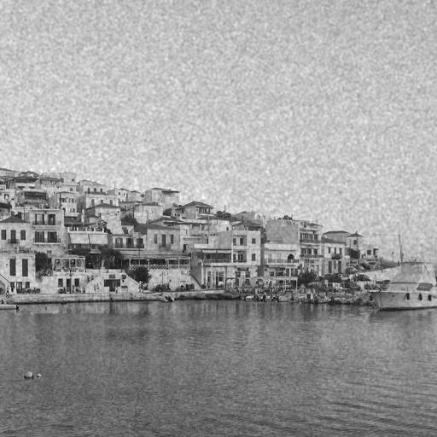
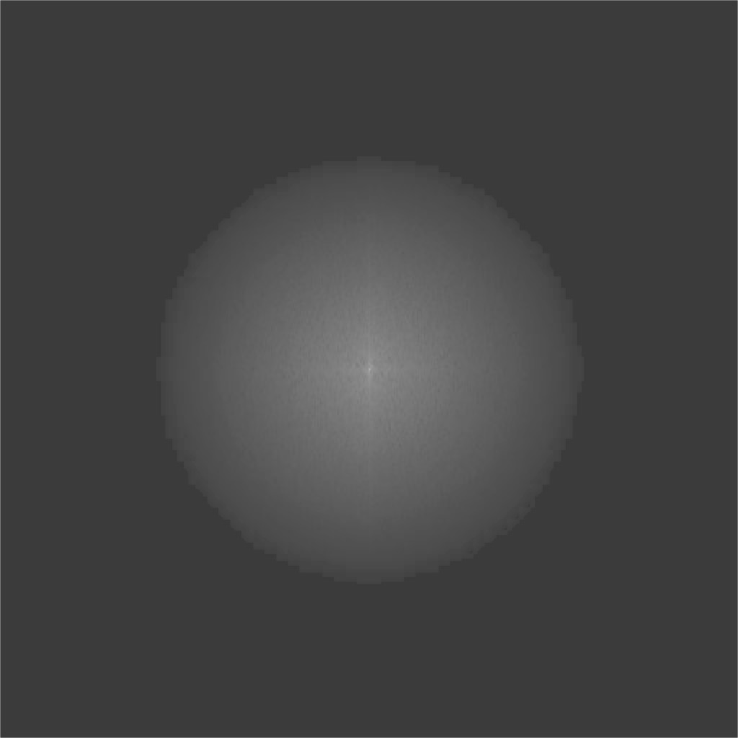
Original image and
its angular spectrum
Angular spectrum
at the output
Image
Coherent imaging
Incoherent imaging

Slide 26
Original image and
its angular spectrum
Angular spectrum
at the output
Image
Coherent imaging
Incoherent imaging

Slide 27
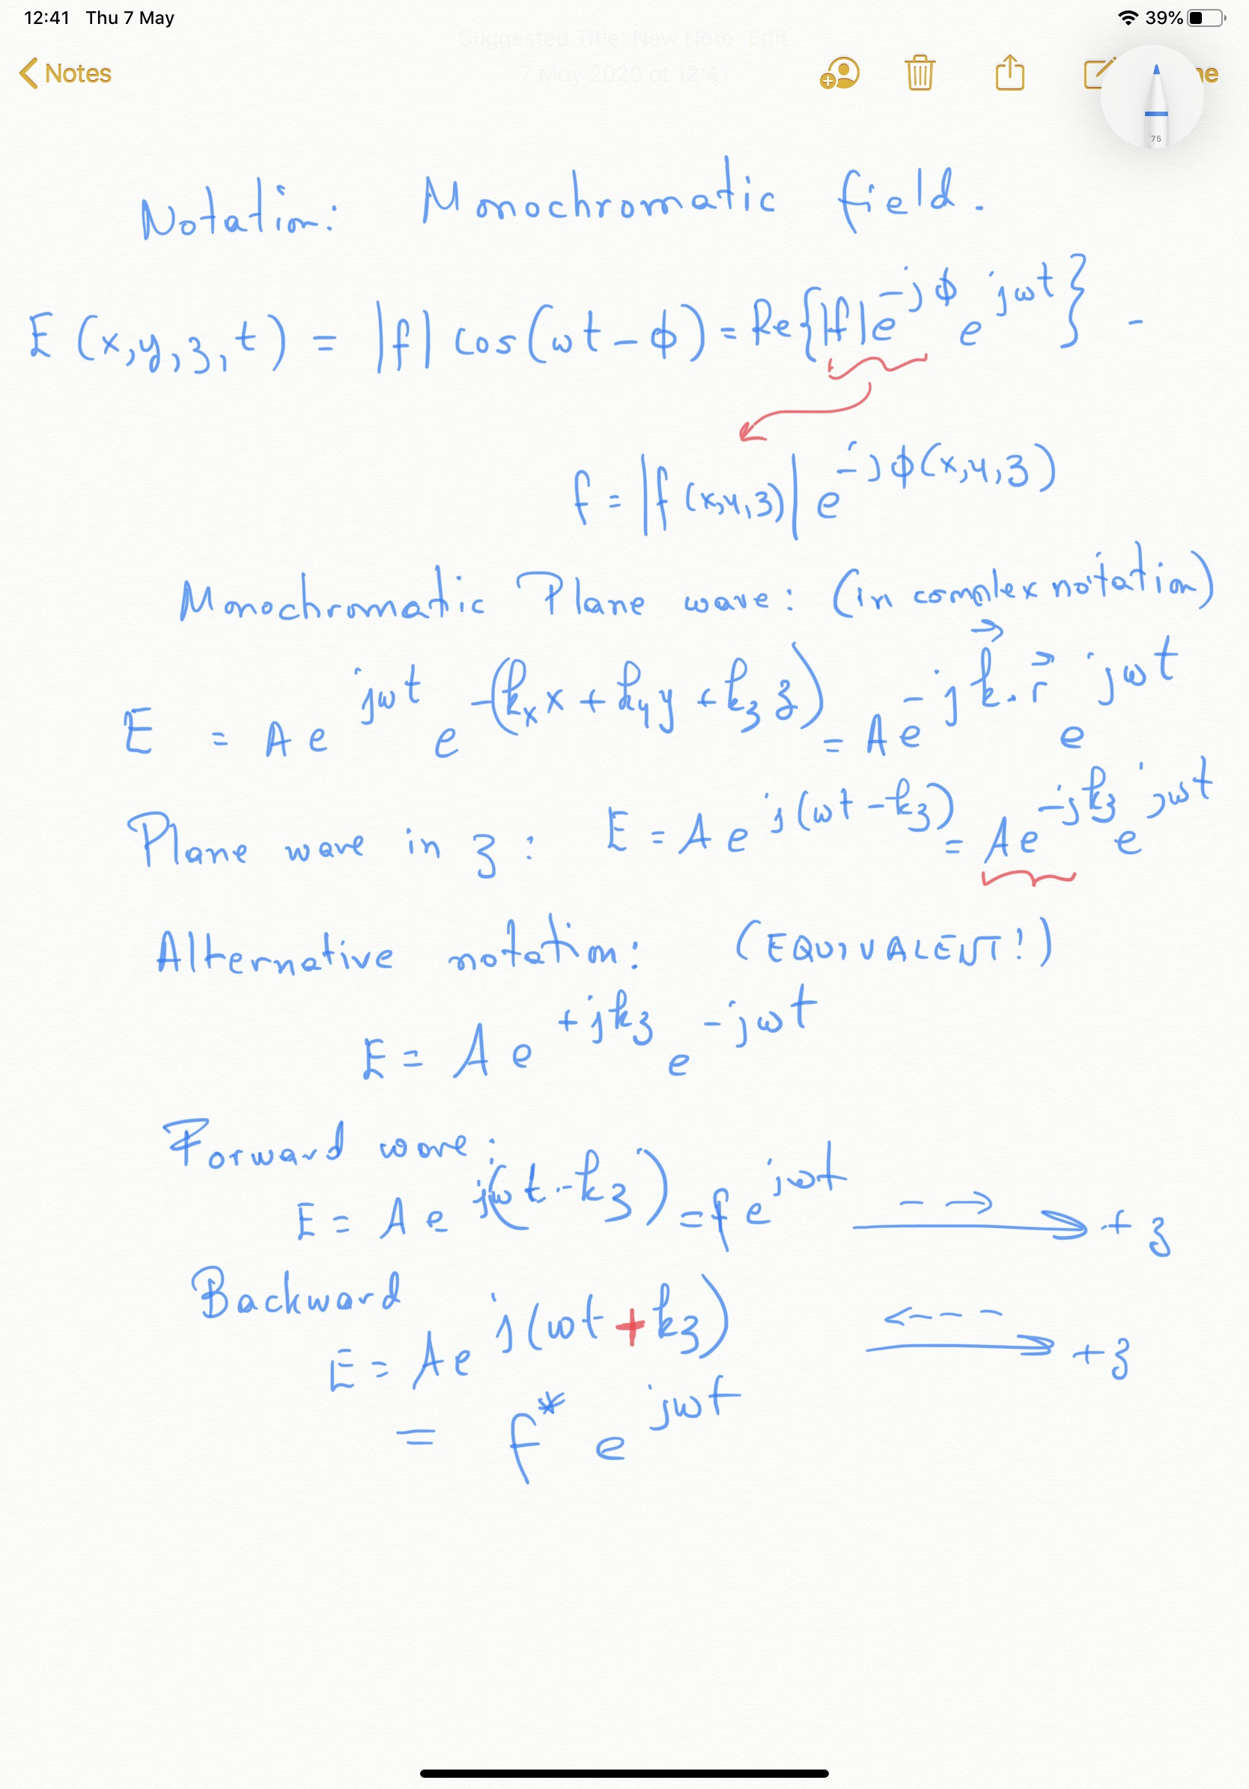

Slide 28
The pluses and the minuses
Goodman’s notation
Forward and backward
Upward and downward

Slide 29
