Slide 1
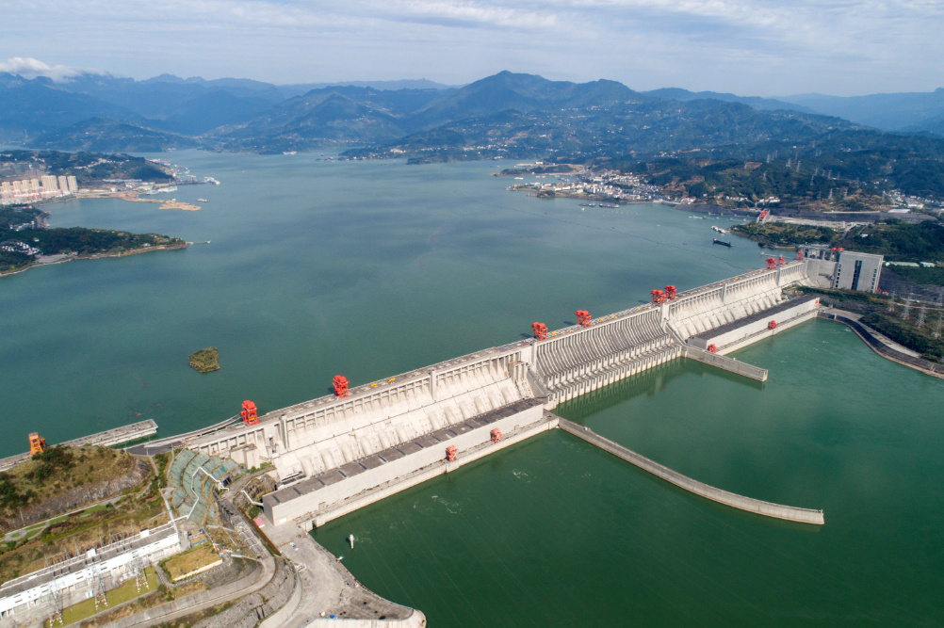
River dam impacts on biogeochemical cycling
Presented by
Jessica Tiago G.
Marit Nys
ENV-512
View of the Three Gorges project in Zigui County, central China's Hubei Province. (Photo by Wang Gang/Xinhua)
175-meter experimental impoundment of three gorges reservoir comes to final stage - Xinhua | English.news.cn (xinhuanet.com)

Slide 2
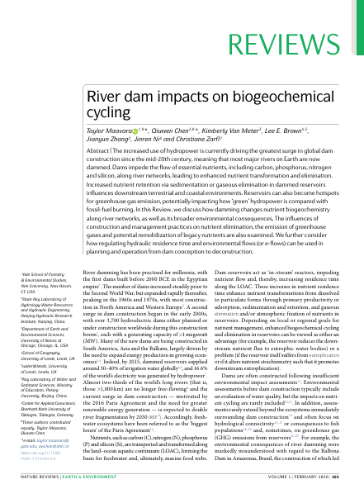
Agenda
Introduction
Methods
Results-Discussion (Nutrients and GHGs)
Conclusion

Slide 3
Introduction
Historical facts
Dams built in 2000 BCE (before common era) already
Steady increase until Second World War (1939-1945)
2000s: extend energy production in growing economies → 3700 hydroelectric dams built/planned
2015: Supply 30-40% irrigation water and generate 16.6% world’s electricity
Paris Agreement (2016): need for greater renewable energy
freshwater ecosystems considered as the “biggest losers”

Slide 4
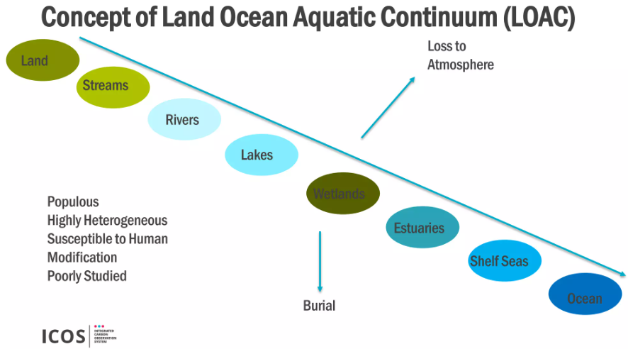
Introduction
Nutrients transported and transformed along the land–ocean aquatic continuum (LOAC):
Carbon (C)
Nitrogen (N)
Phosphorus (P)
Silicon (Si)
Form the basis for freshwater and, ultimately, marine food webs
https://fr.slideshare.net/ICOS_RI/sanders-richard-carbon-cycling-along-the-gb-land-ocean-aquatic-continuum-loac#6

Slide 5
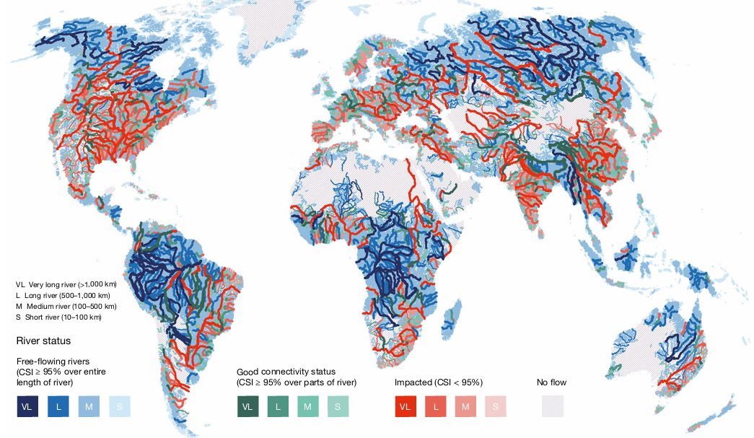
Introduction
What happens now
River fragmentation in ⅔ of the world’s
long rivers (expected to double by 2030)
Biogeochemical cycling alteration
“In-stream reactor”: eutrophication in the reservoirs
reduce downstream nutrient flux
Insufficient environmental impact assessments
40% of the global population rely on marine fisheries for >15% of their protein

Slide 6
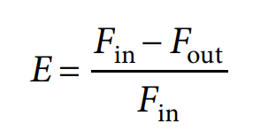
Methods
Parameters
Hydraulic residence time: HRT = Vw/Q , Vw=volume of water, Q=discharge
Elimination rates of nutrients: , Fin/out = nutrient in/out-flux [M*T^-1]
Sizes of nutrient loads from upstream
→ Dam removal and other strategies
→ Data from historical records, models, case studies

Slide 7
Results - Nutrients
7.4% total N / 12% total P / 5.3% reactive Si were eliminated in reservoirs (in 2000)
RSi = dissolved Si (DSi) + biogenic Si (BSi)
DSi : bioavailable form dissolved in water, direct uptake is possible
BSi : has been incorporated into structures of living organisms
diatoms : single-celled algae, primary producers, a type of phytoplanktons
→ dammed watersheds have longer HRT’s (>58 days) than undammed watersheds
→ enhancing biogeochemical and physical transformations

Slide 8
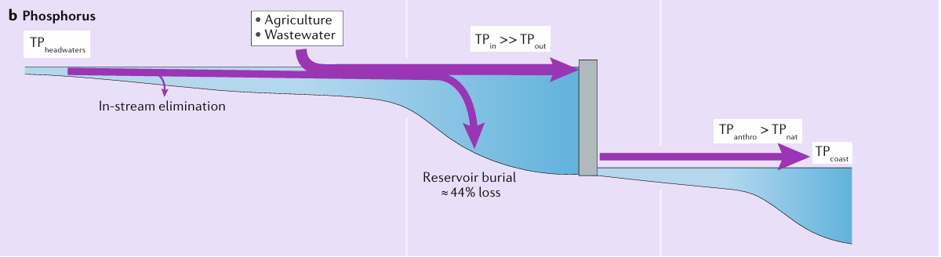
Results - Nutrients : P
P sources: weathering of rocks, soil erosion, anthropogenic sources
P elimination: burial (higher HRT)
P is typically the most efficiently eliminated nutrient in reservoirs (HRT dependant) / P-limitation in freshwater bodies

Slide 9
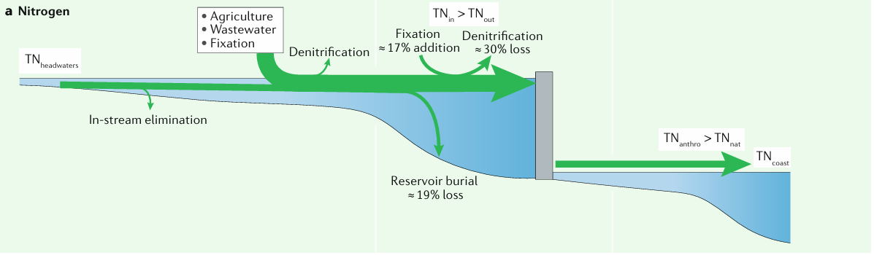
Results - Nutrients : N
N sources: atmospheric N2 fixation, soil erosion, plants, anthropogenic
N elimination: denitrification (lower HRT), burial, N-limitation in marine environments

Slide 10
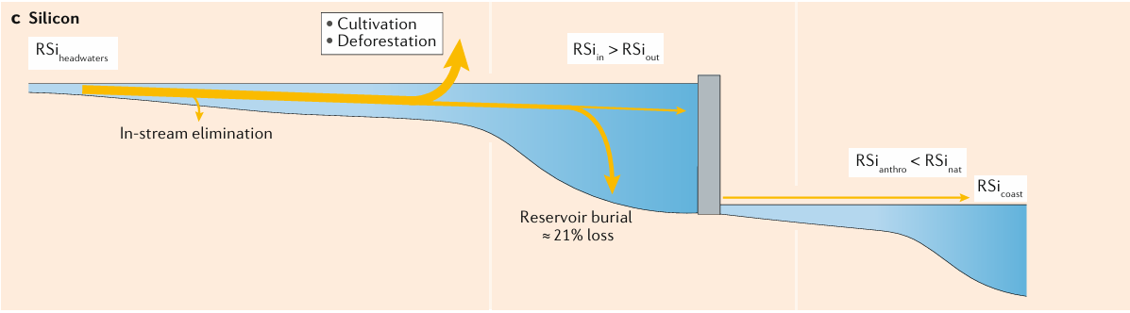
Results - Nutrients : Si
Si sources: weathering of silicate minerals, groundwater Inflows, anthropogenic
Si elimination: presence of diatoms (lower HRT) → hypothesis, uncertainties
HRTs below ~50 days : Si can be eliminated more efficiently than P and N
→ ability of diatoms to establish communities more rapidly than other phytoplankton communities

Slide 11
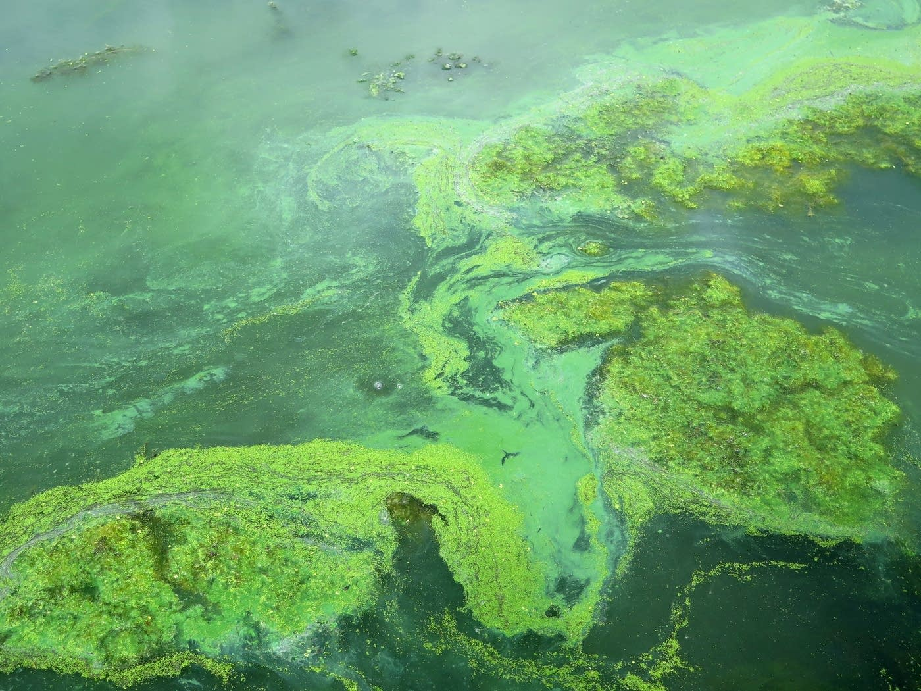
Results - Nutrients
Dam impacts to downstream ecosystems
Rising N and P loads have driven increased eutrophication and harmful algal blooms (HABs) in freshwater and coastal zones
changes to nutrient ratios that shift the limiting nutrient
Controlled releases can help mitigate the extent of eutrophication or HABs
A blue-green algae bloom on Peltier Lake, near Lino Lakes, Minn., on July 18.Dan Kraker | MPR News
Researchers search for clues to toxic algae blooms | MPR News

Slide 12
Nutrients - Examples
Nile damming:
90% decrease in flow → reduction of P, N, Si → less diatoms → less sardines
Simultaneously, less annual flooding → less fertile land → more fertilizers → more N, P than pre-damming conditions → more fish

Slide 13
Nutrients - Examples
Danube damming:
>60% decrease in Si at the mouth of the river → only 2x more diatoms but 6x more toxic coastal blooms at the Black Sea!
Health concerns
Shift from diatoms communities to harmful algal blooms
Alters coastal food chains (diatoms account for up to 40% of oceanic and 25% of global primary productivity)

Slide 14
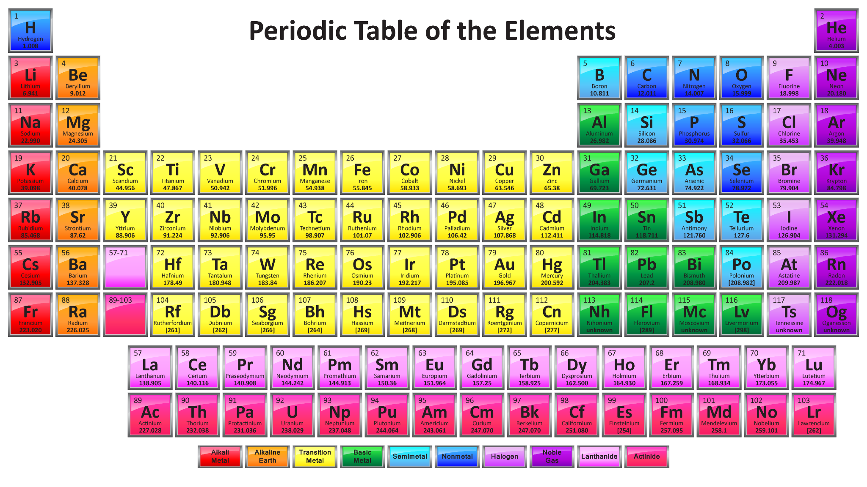
Dam management - Nutrients
Manipulation of HRT to select desired downstream nutrient loads and ratios
Implementing environmental flows (e-flows) to optimize nutrient cycling and minimize adverse impacts
Remove dam or build dam specifically for nutrient retention
Other drivers:
temperature, light availability, reservoir mixing , …
Management strategies that are focused not only on one nutrient !
Source: Free Printable Periodic Tables (PDF and PNG) - Science Notes and Projects

Slide 15
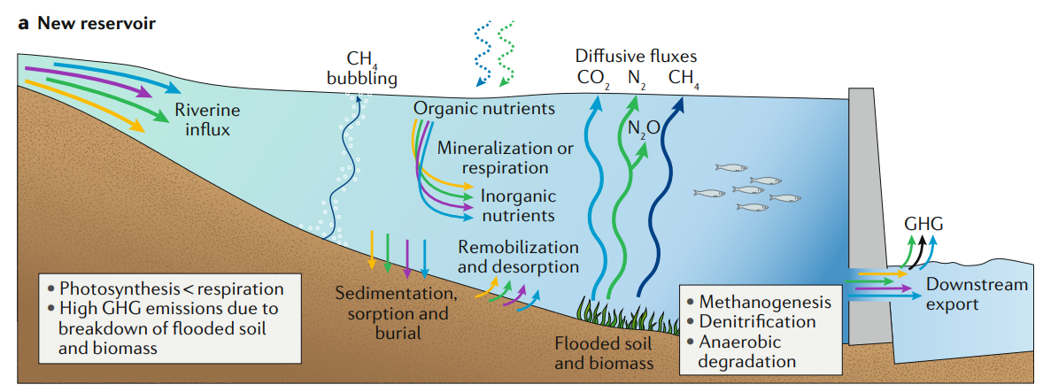
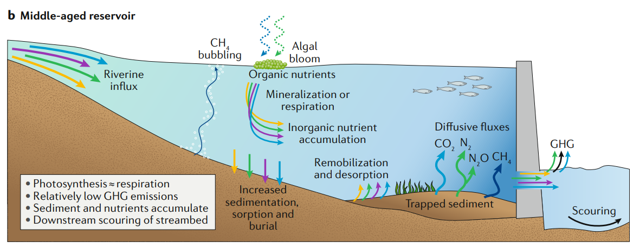
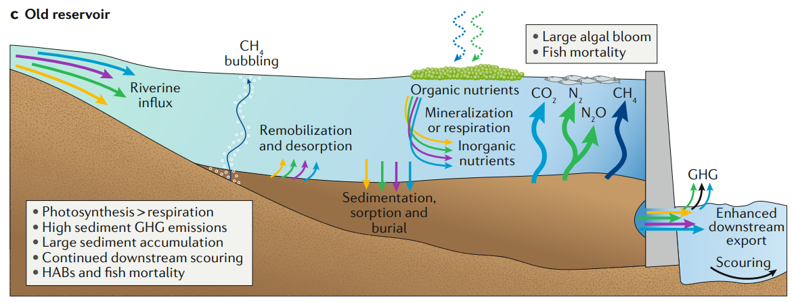
Results - GHG
Often emitted from reservoirs during nutrient elimination (diffusive fluxes from the reservoir surface and bubbling from the sediments)
Depends on reservoir’s age
Importance of dammed reservoirs as a GHG source heavily debated
uncertainties in the mechanisms responsible for GHG production

Slide 16
Results - GHG - C
Carbon based emissions: CO2, CH4
Reservoir (surface : 1.5*10^6 km2): 273 TgC CO2, 52 TgC CH4 per year
Hydropower reservoir (surface : 3.4*10^5 km2): 48 TgC CO2, 3 TgC CH4 per year
Organic C burial: 160-200 TgC (surface : 3.5*10^5 km2) per year
→ Higher C emissions in tropical regions (larger surface area, more flooded OC, warmer)
→ one solution : pre-flooding to clear vegetation and biomass
Chinese reservoirs example

Slide 17
Results - GHG - N
Long HRT : denitrification N2O → N2
Short HRT : larger N2O emissions
Nitrogen based emissions: N2, N2O
Reservoirs: 3.7 TgN (denitrification), 1.54 TgN in sediments, 0.98 TgN fix per year
Reservoirs: 34 GgN NO2 per year
Lakes, rivers, estuaries: 63 GgN NO2 per year
N2O has 298 times global warming potential of CO2!
N2O emissions from reservoirs: more than half of the emissions from lentic water bodies (only 9% of global lake+reservoir surface area)

Slide 18
Dam management - GHG
Young dams (new flooded zones) = notable sources of GHG
Dam removal : after 100 year, emissions can be 9 times higher!
→ dam removal strategies
→ dam locations to maximize hydroelectricity generation while minimizing GHG emissions
→ impact of dams of GHG is uncertain → is it really “green” ?
could compete with fossil fuel emissions …

Slide 19
Reservoir size
Generally a positive relationship between nutrient elimination and HRT
Small reservoirs: high biochemical reactivity, high nutrient elimination efficiency, low discharge, high surface/volume ratio at sediment-water interface
Multiple small reservoirs with HRTs that sum to the same HRT as a single large reservoir will eliminate nutrients and reduce downstream nutrient loads more efficiently
“treatment steps”
reduce risk of eutrophication + of HABs (harmful algal blooms)

Slide 20
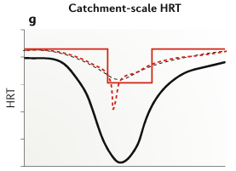

Nutrient management with dams
Growing interest in manipulating dam operations to regulate reservoir and riverine trophic conditions
E-flow approach is used to optimize the river-flow management to provide services to humans whilst protecting the aquatic environment
Modification of the flow regime achieved through the introduction of river flow dynamics → based on the objectives
Flow alterations in order to improve downstream conditions:
used to modify nutrient ratios, water temperatures, water quantity,...

Slide 21
Dam removal (1)
Popular in Europe and North America
Growing interest in river restoration and ageing infrastructure
Most dam-removal studies have focused on the physical effects of the removal (hydraulics, sediments) or effects on fish communities
Insufficient understanding of downstream effects associated with nutrient and contaminant release and water quality
Remobilization of legacy nutrients → need to consider how and on what timescale dam removal impacts legacy nutrients loading
Contaminants remobilization (PCBs for example)
Water table drops after draining the reservoir → bed degradation

Slide 22
Dam removal (2)
Ageing dams:
does not ensure that legacy nutrient will remain trapped upstream
decreased nutrient elimination efficiency owing to reservoir infilling
decreases volume and therefore HRT
Primary concern should not only be whether legacy nutrients will be released as a result of dam removals but also to what extent existing reservoirs are already beginning to act as nutrient sources
low-flow
high nutrient concentration
sink → source

Slide 23
Dam - management consideration
Size and type of dam
→ How big? Which function?
Location
→ Where?
Lifespan
→ How long?
GHG emissions
→ Pre-flooding? Minimization?
Eutrophication
→ Impact downstream?
Management
→ Nutrient elimination?
Nutrient-load management
→ E-flow? Which HRT?
Remobilization
→ Impacts of destruction?

Slide 24
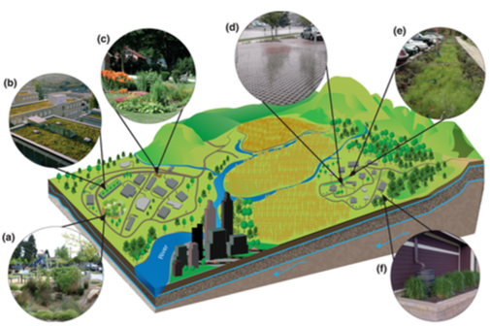
Future perspectives (1)
Damming rivers over time is unlikely to stop (energy production, floods control and unequal distribution of water balance)
Need for a responsible dam construction and management
from conception to deconstruction and for the entire watershed
by balancing the environmental impacts of damming with the services it provides
consider LOAC biogeochemistry at each stage of a dam’s life cycle, to avoid transferring nutrient-related challenges to another part of the LOAC
Source: File:Watershed scale GSI.png - Minnesota Stormwater Manual

Slide 25

Future perspectives (2)
Interdisciplinary collaboration in dam construction and management (including hydrological, ecological, social considerations) to achieve sustainable outcomes
Source: Communications materials - United Nations Sustainable Development

Slide 26
Other dam impacts
Inputs from other papers - Paper 6 and Paper 7
loss of connectivity due to
fragmentation
flow regulation
artificial increases in connectivity → spread of invasive species
due to inter-basin canal systems and water-transfer schemes
constant water release from dams in naturally intermittent streams
Decreasing sediment flux
dams : dominant agent of riverine suspended sediment alteration in the past several centuries
Sediment trapping in the global hydrologic north has contributed to global sediment flux declines to 49% of pre-dam conditions

Slide 27
Other dam impacts
Social and Economical
Hydropower (around 60% in CH)
Irrigation and Water Supply
Displacement of Communities
Recreational and Economic Benefits
Flood Control Benefits and Challenges
Flood Risk Mitigation
Downstream Flood Dependency
Environmental
Altered River Flow
Sediment Trapping
Temperature Changes
Fragmented Ecosystems
Reservoir Effects (flooding zones)
Hydrological
Flow Regulation
Groundwater Impact
Evaporation

Slide 28
Conclusion
Interdisciplinary collaboration between engineers, environmental scientists, and policymakers
energy-efficient and environmentally sustainable
Recognize that 'green' energy sources like hydropower are not without their own set of environmental challenges
More responsible dam management

Slide 29

Thank you for listening

Slide 30
Sources
Paper #9: Maavara, T., Chen, Q., Van Meter, K. et al. River dam impacts on biogeochemical cycling. Nat Rev Earth Environ 1, 103–116 (2020). https://doi.org/10.1038/s43017-019-0019-0
Paper #6: Grill, G., Lehner, B., Thieme, M. et al. Mapping the world’s free-flowing rivers. Nature 569, 215–221 (2019). https://doi.org/10.1038/s41586-019-1111-9
Paper #7: Dethier et al., Rapid changes to global river suspended sediment
flux by humans, Science 376, 1447–1452 (2022) https://www.researchgate.net/publication/361513534_Rapid_changes_to_global_river_suspended_sediment_flux_by_humans
Hydropower in Switzerland (Sustainable security of supply), AXPO
https://www.axpo.com/ch/en/energy/generation-and-distribution/wasserkraft.html#:~:text=In%20Switzerland%2C%20around%2060%20percent,%2Dfree%2C%20storable%20and%20renewable.
Dam Dog Meme : jonibaer (2024)
https://tenor.com/fr/view/dam-dog-meme-discord-gif-12347403741096544846

Slide 31
Backup slides
Remobilization of legacy nutrients: refers to the process by which nutrients that has accumulated and been stored in sediments over time is released back into the overlying water, making it available for biological uptake and potentially contributing to issues such as eutrophication.
Pre-Flooding is a proactive measure to reduce greenhouse gas emissions by allowing controlled, partial decomposition of organic material before a reservoir is fully filled. This practice is especially beneficial for hydropower reservoirs, which otherwise could emit significant amounts of methane and CO₂ due to submerged organic matter decomposing anaerobically.

Slide 32
Backup slides
Controlled releases:
Adjusting Timing and Flow Rates: By releasing water at certain times (often seasonally or during periods of high nutrient runoff), dam operators can dilute nutrient concentrations downstream.
Selective Withdrawal: Many modern dams are equipped with multi-level intakes, which allow water to be released from different depths within the reservoir. Because nutrient concentrations can vary with depth, withdrawing water from levels with lower nutrient loads helps reduce the downstream nutrient influx.
Pulse or High-Flow Releases: Short, high-flow releases can “flush” sections of the river, helping to move nutrients and organic material through the system and preventing stagnation.
Continuous Low-Flow Releases: Gradual, ongoing releases can help maintain downstream flow levels, which can improve water quality by preventing stagnation and diluting nutrient concentrations over time.

Slide 33
Backup slides
Regulate trophic conditions means controlling the nutrient levels and productivity within the water. "Trophic conditions" refer to the levels of nutrients (like nitrogen and phosphorus) that support plant and algae growth. These conditions impact the entire aquatic food web, from algae to fish.
Trapped sediments in reservoirs produce GHGs as organic material decomposes under anaerobic conditions, producing methane, and aerobic conditions, producing carbon dioxide. These emissions can be exacerbated by disturbances, warm temperatures, and ongoing organic input, leading to continuous GHG release into the atmosphere.
Older reservoirs act as significant stores of sediments and organic material, resulting in higher greenhouse gas emissions due to anaerobic decomposition. When disturbed, these sediments also become point sources of nutrients, impacting downstream water quality and ecosystem health.

