Slide 1
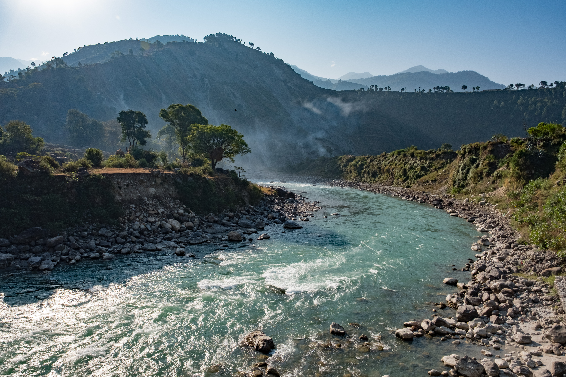
Influences of key factors on river water quality in urban and rural areas.
Evie Bonner Capucine Mondhard Marzhan Zhailau
ENV-512: Global Change Ecology and Fluvial Ecosystems
11/12/2024

Slide 2
Introduction
Current Issue: River water quality is declining globally due to human activities and climate change, with traditional and emerging pollutants threatening ecosystems and health.
Why It Matters: Rivers ( their water quality) are vital for ecosystems and human societies.
Objective: Understanding how changes and key factors affect river water quality is crucial for managing water quality and controlling pollutants in river basins.

Slide 3
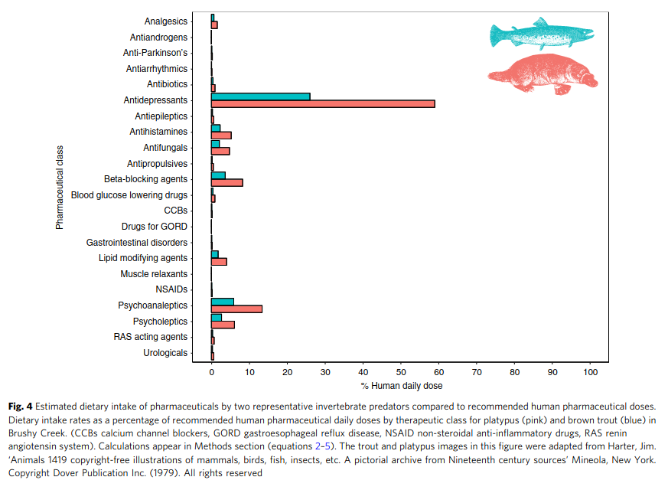
Problems of river water quality
POPs and EPs
Physical characteristics (DO, TSS, conductivity)
Nutrients and organic matter
Heavy metals
Pathogens
Richmond, E.K., Rosi, E.J., Walters, D.M. et al. A diverse suite of pharmaceuticals contaminates stream and riparian food webs. Nat Commun 9, 4491 (2018). https://doi.org/10.1038/s41467-018-06822-w

Slide 4
Methods & Tools assessing surface water quality
Standard Approach:
Direct comparison of water quality parameters with guideline values (e.g., WHO standards).
Derived Indices:
Water Quality Index (WQI): Simplifies multiple parameters into one value.
Advanced Analysis:
Statistical tools (e.g., Pearson or Spearman, Multivariable linear regression, factor analysis , principal component analysis, and cluster analysis )
Machine Learning for pattern recognition (e.g (ANN), support vector machine (SVM), decision tree (DT), naive Bayes, k-nearest neighbor (KNN), and random forest (RF)
The combination of multiple methods has proven to be effective in identifying factors and pollution sources.

Slide 5
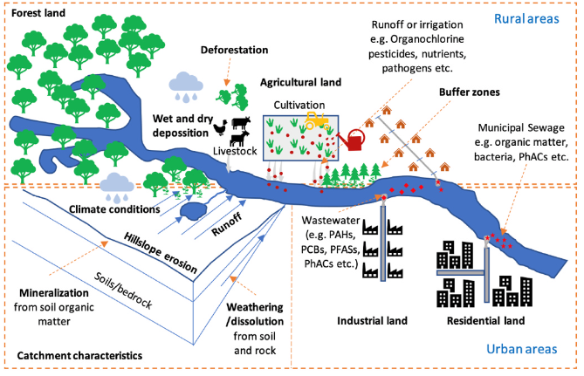
Factors affecting river water quality
Land use/land cover (LULC), climate conditions & catchment geology, topography and hydrology

Slide 6
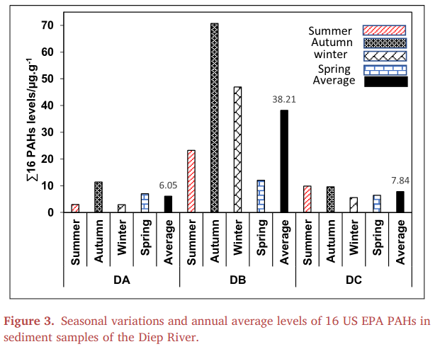
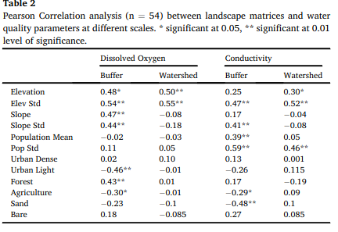
LULC
Correlations between surrounding LULC and river water quality
Awe, A. A. et al. (2020). Occurrence and probabilistic risk assessment of PAHs in water and sediment samples of the Diep River, South Africa. Heliyon, 6(6), e04306.
Industrial activities found to lead to increased PAH concentrations
Mainali, Janardan & Chang, Heejun. (2020). Environmental and Spatial Factors Affecting Surface Water Quality in a Himalayan Watershed, Central Nepal. Environmental and Sustainability Indicators. 9. 100096. 10.1016/j.indic.2020.100096.
Positive correlation between forest cover and DO levels !

Slide 7
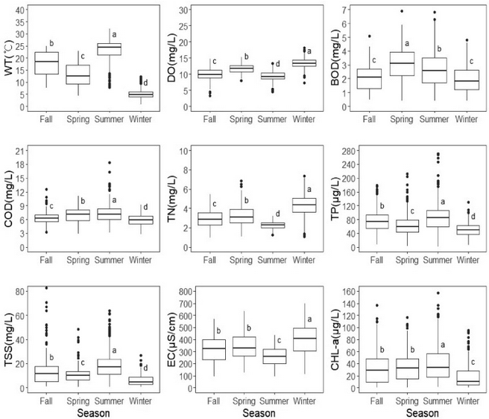
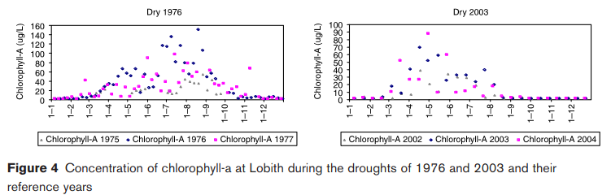
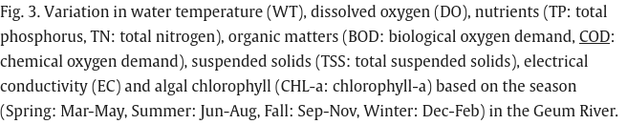
Climate conditions
Seasonal variation
Drought exacerbated eutrophication
Zwolsman, J., & AJ, v. B. (2007). Impact of summer droughts on water quality of the rhine river - a preview of climate change? Water Science and Technology, 56(4), 45-55. doi:https://doi.org/10.2166/wst.2007.535
+ Atmospheric deposition !
M. Mamun, N. Jargal, K.-G. An, Spatio-temporal characterization of nutrient and organic pollution along with nutrient-chlorophyll-a dynamics in the Geum River, (2022)

Slide 8
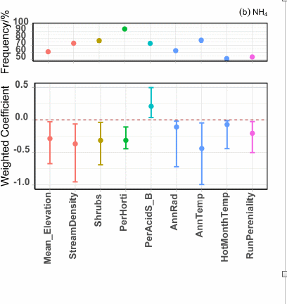

Catchment characteristics
Catchment elevation has negative effect on NH4 concentration
Shuci Liu, Dongryeol Ryu, J. Angus Webb, Anna Lintern, Danlu Guo, David Waters, Andrew W. Western, A multi-model approach to assessing the impacts of catchment characteristics on spatial water quality in the Great Barrier Reef catchments, Environmental Pollution, Volume 288, 2021, 117337

Slide 9
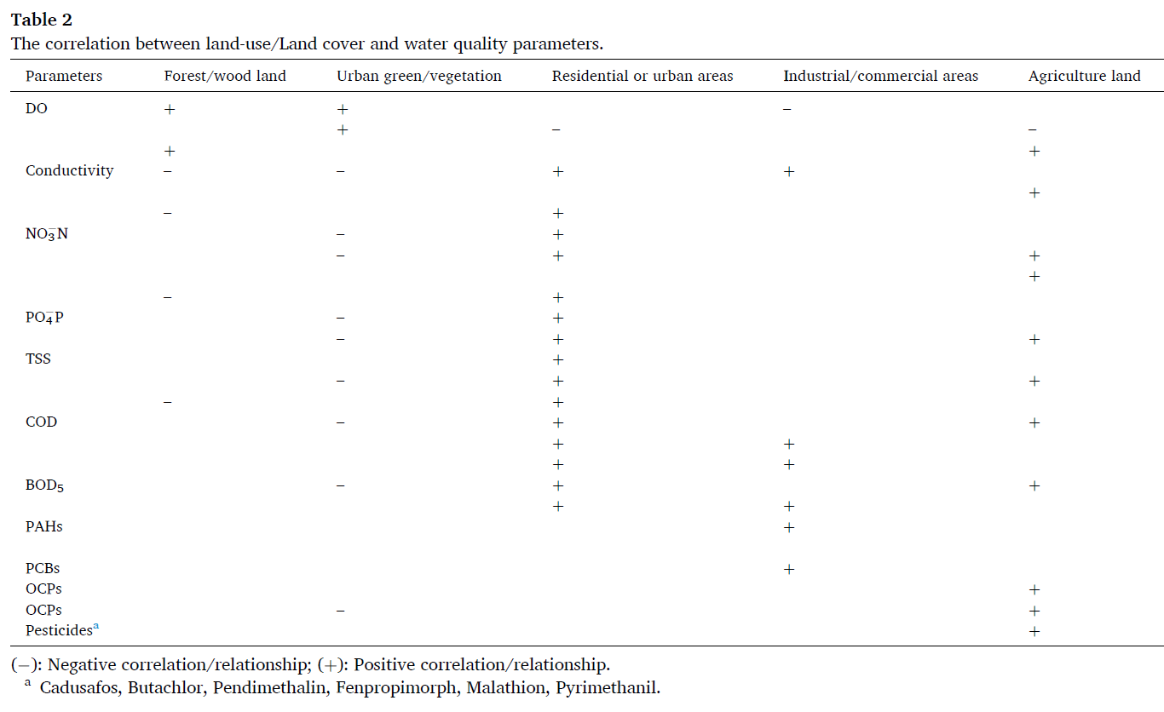
Key factors affecting river quality in urban and rural areas

Slide 10
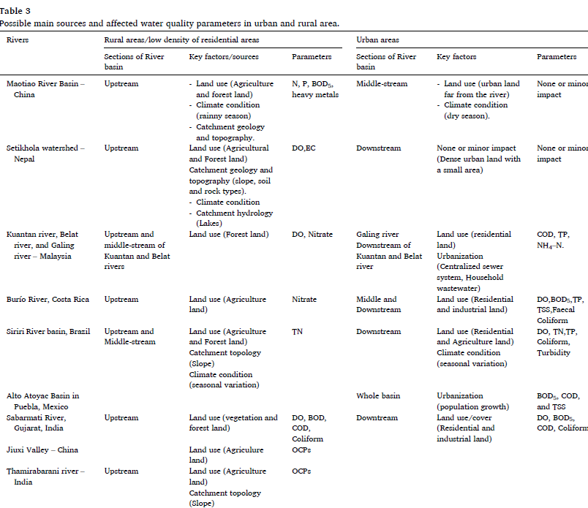
Possible key sources and affected water quality parameters in urban and rural areas

Slide 11
General insights on key factors affecting water quality in urban and rural areas
Urban areas are dominated by industrial and residential pollution sources,
while Rural areas face agricultural runoff challenges.
Land use, catchment characteristics, and hydrology are key to understanding and managing water quality.

Slide 12

Thank you!

