Slide 1

THE FUTURE OF GLOBAL RIVER HEALTH MONITORING
Jules Tresca, Jules Breton,
Quentin Poindextre

Slide 2
CONTENTS
Introduction
Methods
Results
Discussion
Summary and conclusion

Slide 3
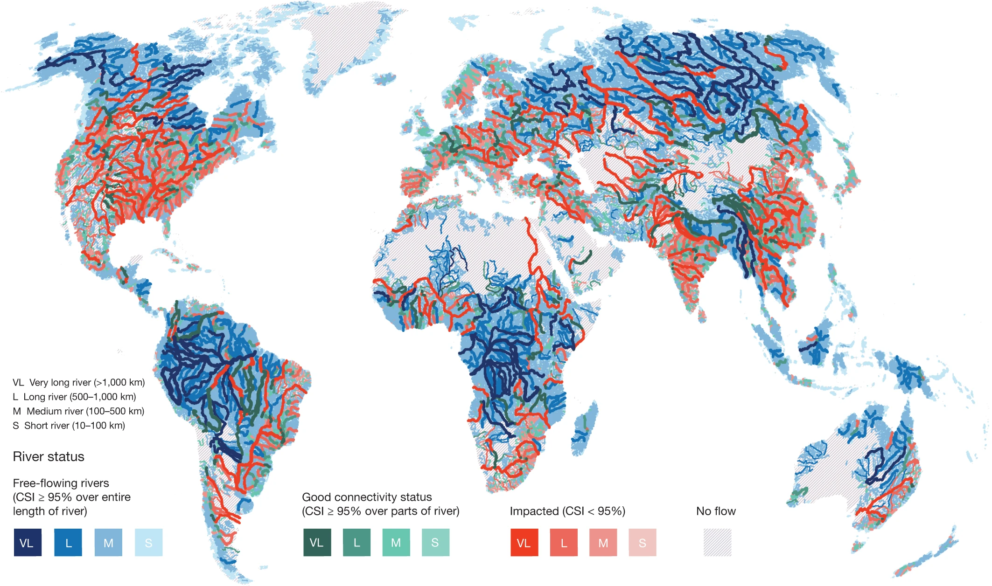
INTRO – WHY RIVER HEALTH MONITORING MATTERS
Declining river health in certain areas due to pollution, habitat loss, etc.
Importance for biodiversity and human societies (e.g., water resources, agriculture).
Global status of free-flowing rivers (Grill 2019).

Slide 4
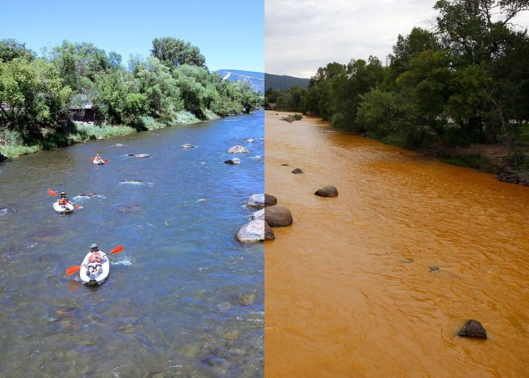
INTRO – THE URGENCY OF ACTION
Global River Health is Declining.
The trajectory is uncertain without better knowledge and intervention.
2015 Gold King Mine waste water spill

Slide 5
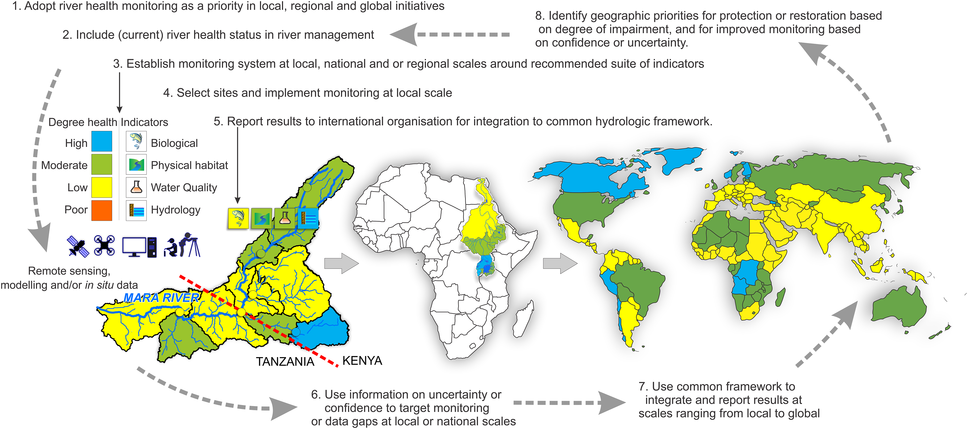
INTRO – THE PROPOSED GLOBAL FRAMEWORK
Prioritization of river health monitoring (importance for water management, biodiversity)
Coordination and development of indicators (technologies, remote sensing, eDNA)
International coordination (global agency, accountability)
Implementing a global river health monitoring framework.

Slide 6
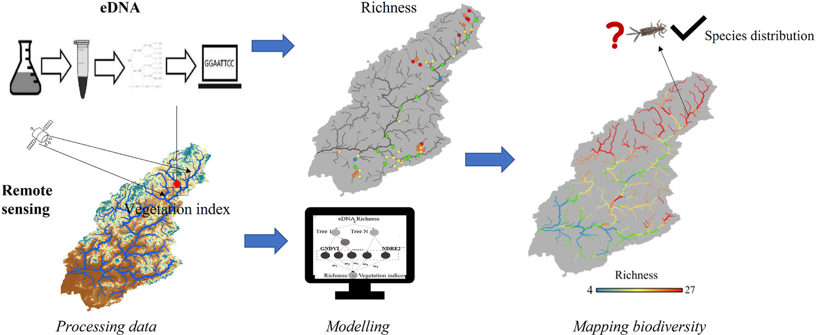
INTRO – THE ROLE OF TECHNOLOGY
Emerging technologies can significantly improve river health monitoring.
Applied technologies on field,
Environmental DNA and remote sensing datasets reveal the spatial distribution of aquatic insects in a disturbed subtropical river system, Journal of Environmental Management, 2024

Slide 7
METHODS
Available Data
Review of existing programs → Development of the Global Framework
Data challenges
Mix of Top-down and Bottom-up approaches = ideal
7 criteria for successful framework :
Consistency
Representativeness
Robustness
Flexibility
Scalability
Feasibility
Informativeness
In Situ
Remote Sensing
Modelling
Bottom-up approach
Top-down approaches

Slide 8
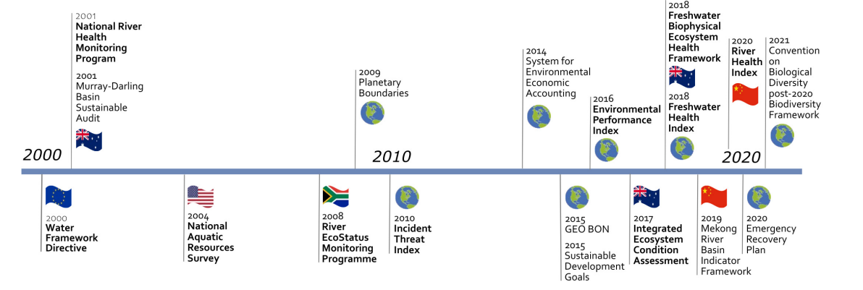
RESULTS – REVIEW
Selection of 10 River Health Monitoring programs
Different purposes and approaches
National, regional or global scale
Based on the 7 criteria

Slide 9
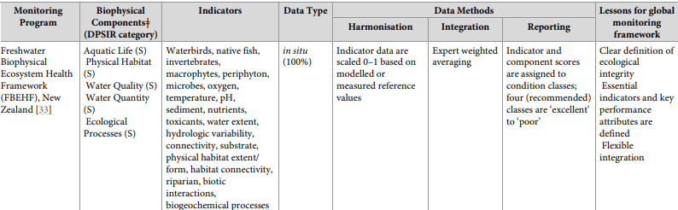
RESULTS – REVIEW
Key Findings :
Clear definition of ecosystem health
Standardised methods and protocols
The 4 most common components
Limitations with scalability

Slide 10
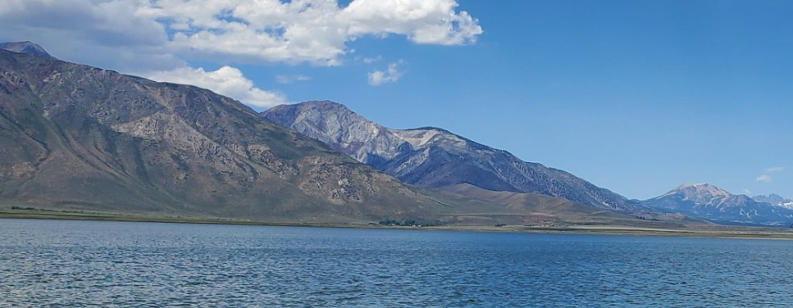
RESULTS – FRAMEWORK

Slide 11
RESULTS – INDICATORS CATEGORY
Biology
Water Quality
Physical Habitat
Hydrology
(1) Proposed framework of indicators to monitor global river health. Each indicator is described with both challenges and opportunities for application to global monitoring, the methods available for implementation by 2030, and recommendations for development toward more accurate and widespread implementation by 2050, The future of global river health monitoring

Slide 12
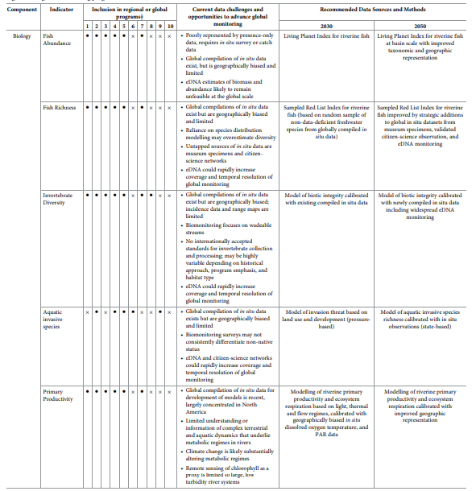
RESULTS – BIOLOGY INDICATORS
Fish abundance
Fish Richness
Invertebrate Diversity
Aquatic Invasive Species
Primary Production
(1)

Slide 13
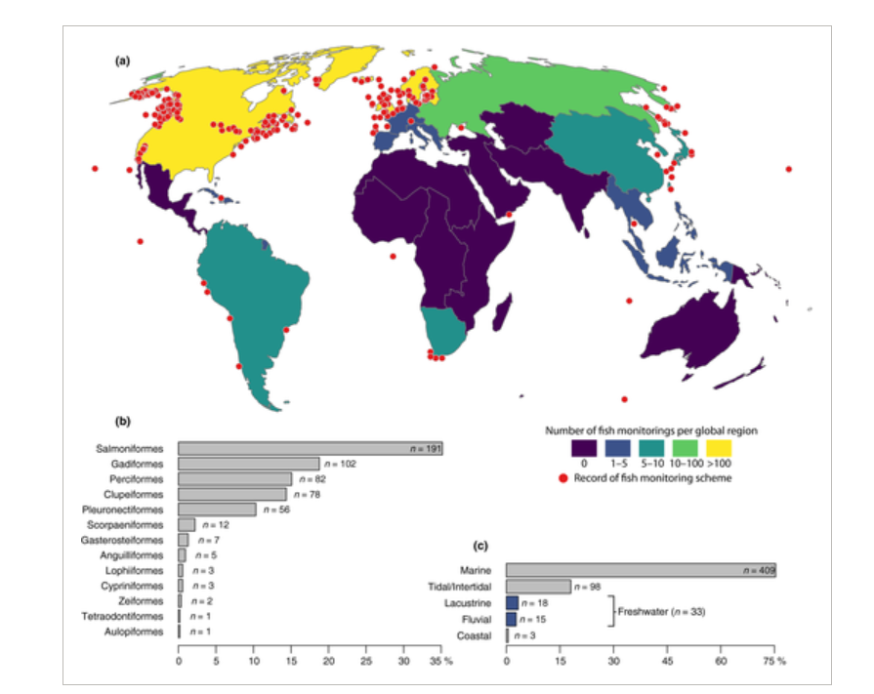
RESULTS – BIOLOGY INDICATORS
Fish abundance
Remote sensing data are not so usefull. Need more in situ data.
Geographically biased and limited of in situ data in global compilation.
Pushing for Living Planet Index for riverine fish and better geographic representation
Overview of fish monitoring programmes across global regions (a), taxonomic orders (b) and biotope types (c) based on records of the taxonomic group Osteichthyes (n = 543) in the Global Population Dynamics Database (GPDD, version 2.0, released 2010), Effective monitoring of freshwater fish, Johannes Radinger et al, 2019

Slide 14
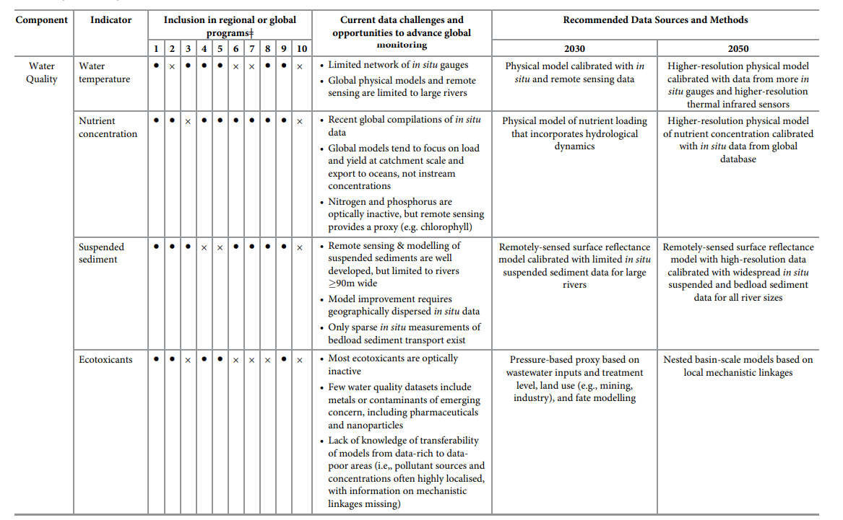
RESULTS – WATER QUALITY INDICATORS
Water temperature
Nutrient concentration
Suspended sediment
Ecotoxicants
(1)

Slide 15
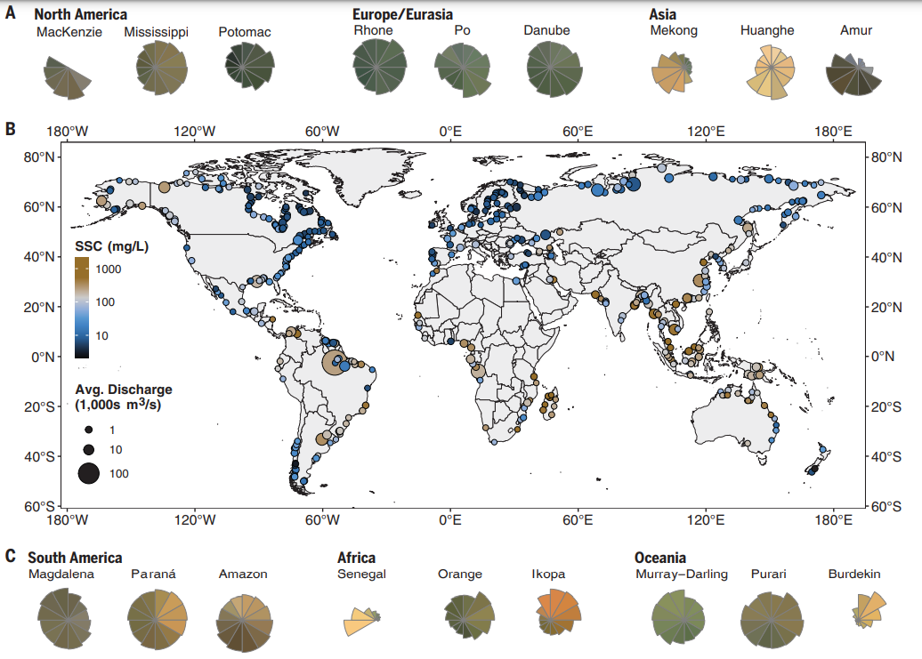
RESULTS – WATER QUALITY INDICATORS
Suspended Solids
Remote sensing data and modelling are well developed but limited by resolution
In situ data needed for model calibration
In the future higher resolution and more widespread data is needed for modelling
Global variations in SSC, as estimated from satellite imagery from 1984 to 2021. (A and C) Variation in suspended sediment is shown with color wheels for select rivers from each primary landmass.. (B) Global map of average discharge-weighted SSC. Rapid changes to global river suspended sediment flux by humans, Evan N. Dethier et al , 2022

Slide 16
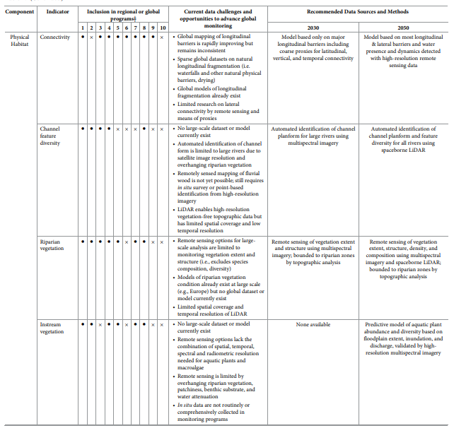
RESULTS – PHYSICAL HABITAT INDICATORS
Connectivity
Chanel feature diversity
Riparian vegetation
Instream vegetation
(1)

Slide 17
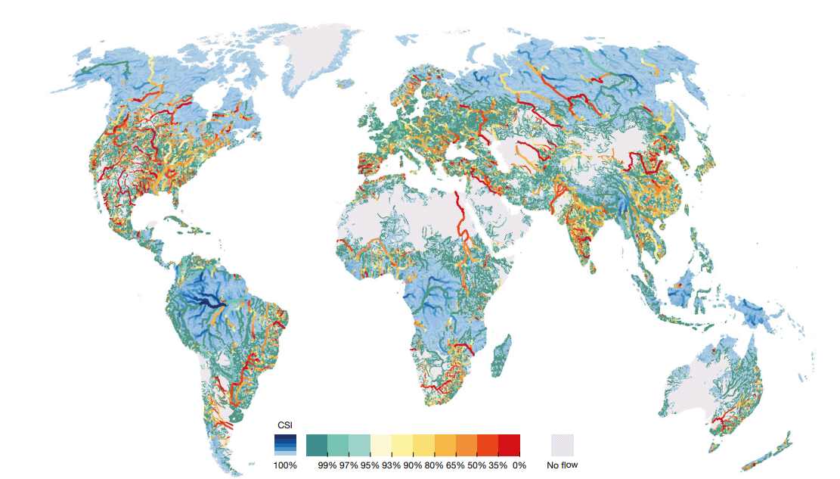
RESULTS – PHYSICAL HABITAT INDICATORS
Connectivity
Limited on the longitudinal connectivity, sparse invetory for natural longitudinal fragmentation
Research on lateral connectivity is limited
Improve modelling for longitudinal connectivity and include latitudinal, vertical and temporal connectivity
Connectivity status index of the world’s river reaches, with calculation of proxy indicators and application of a weighting models, Mapping the world’s free-flowing rivers, G.Grill et al. 2019

Slide 18
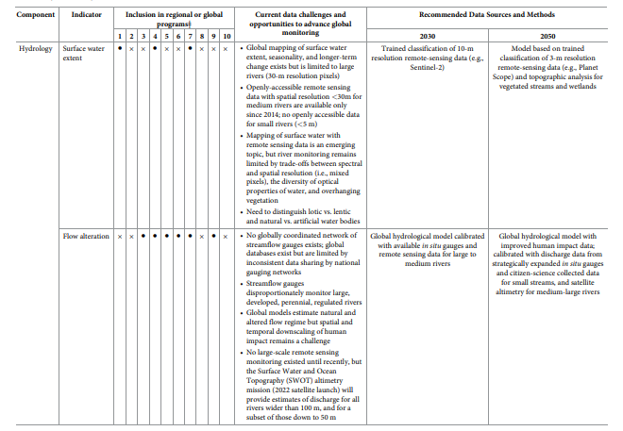
RESULTS – HYDROLOGY INDICATORS
Surface water extent
Flow Alteration
(1)

Slide 19
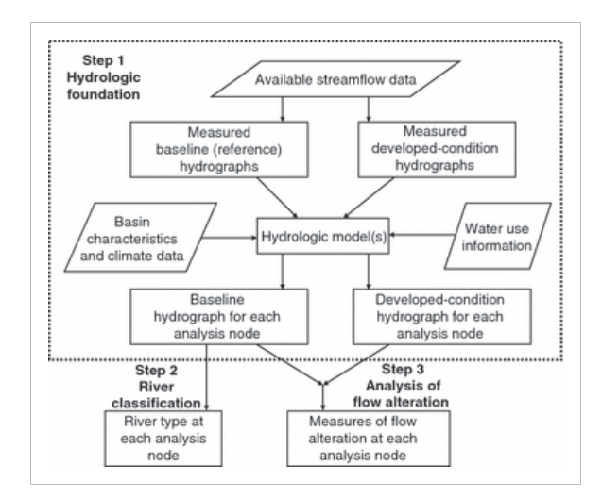
RESULTS – HYDROLOGY INDICATORS
Surface water extent
Mapping of surface water extent exist but limited to large rivers.
Trade-offs between spectral and spatial connectivity
For the future, the main improvment is resolution 10-m in 2030 and 3-m in 2050 with topographic analysis
Steps for developing the hydrologic foundation (ELOHA step 1 inside dashed box), showing how the resulting hydrographs are used to classify river types (ELOHA step 2) and calculate flow alteration (ELOHA step 3) at each analysis node. The ecological limits of hydrologic alteration (ELOHA): a new framework for developing regional environmental flow standards, N. LEROY POFF et al. 2009

Slide 20
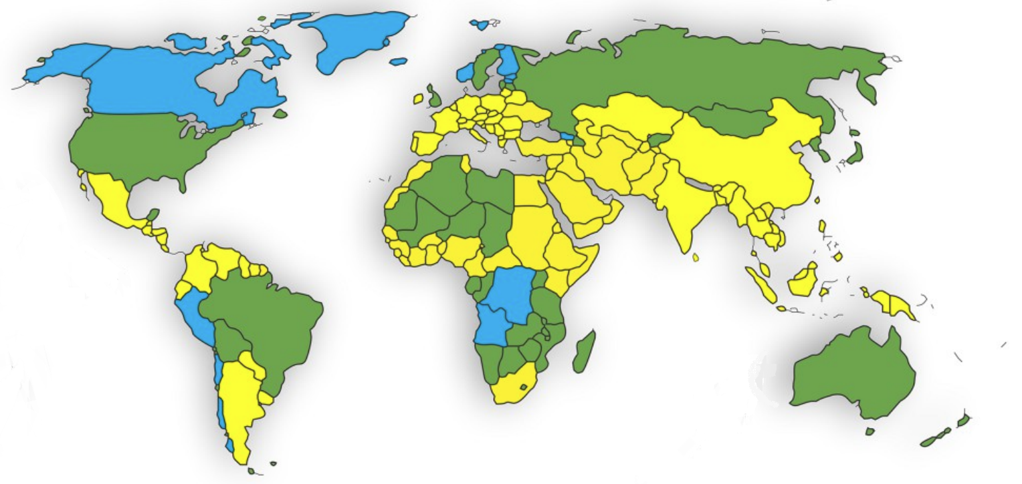
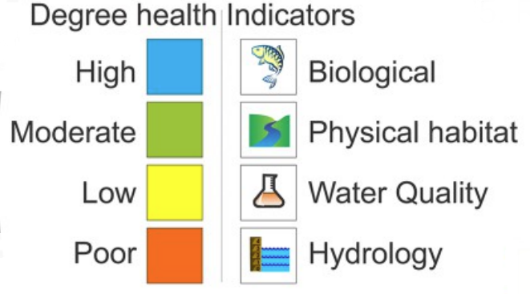
DISCUSSION – ADDRESSING GLOBAL DISPARITIES
Global disparities in implementing a global river health monitoring framework.

Slide 21
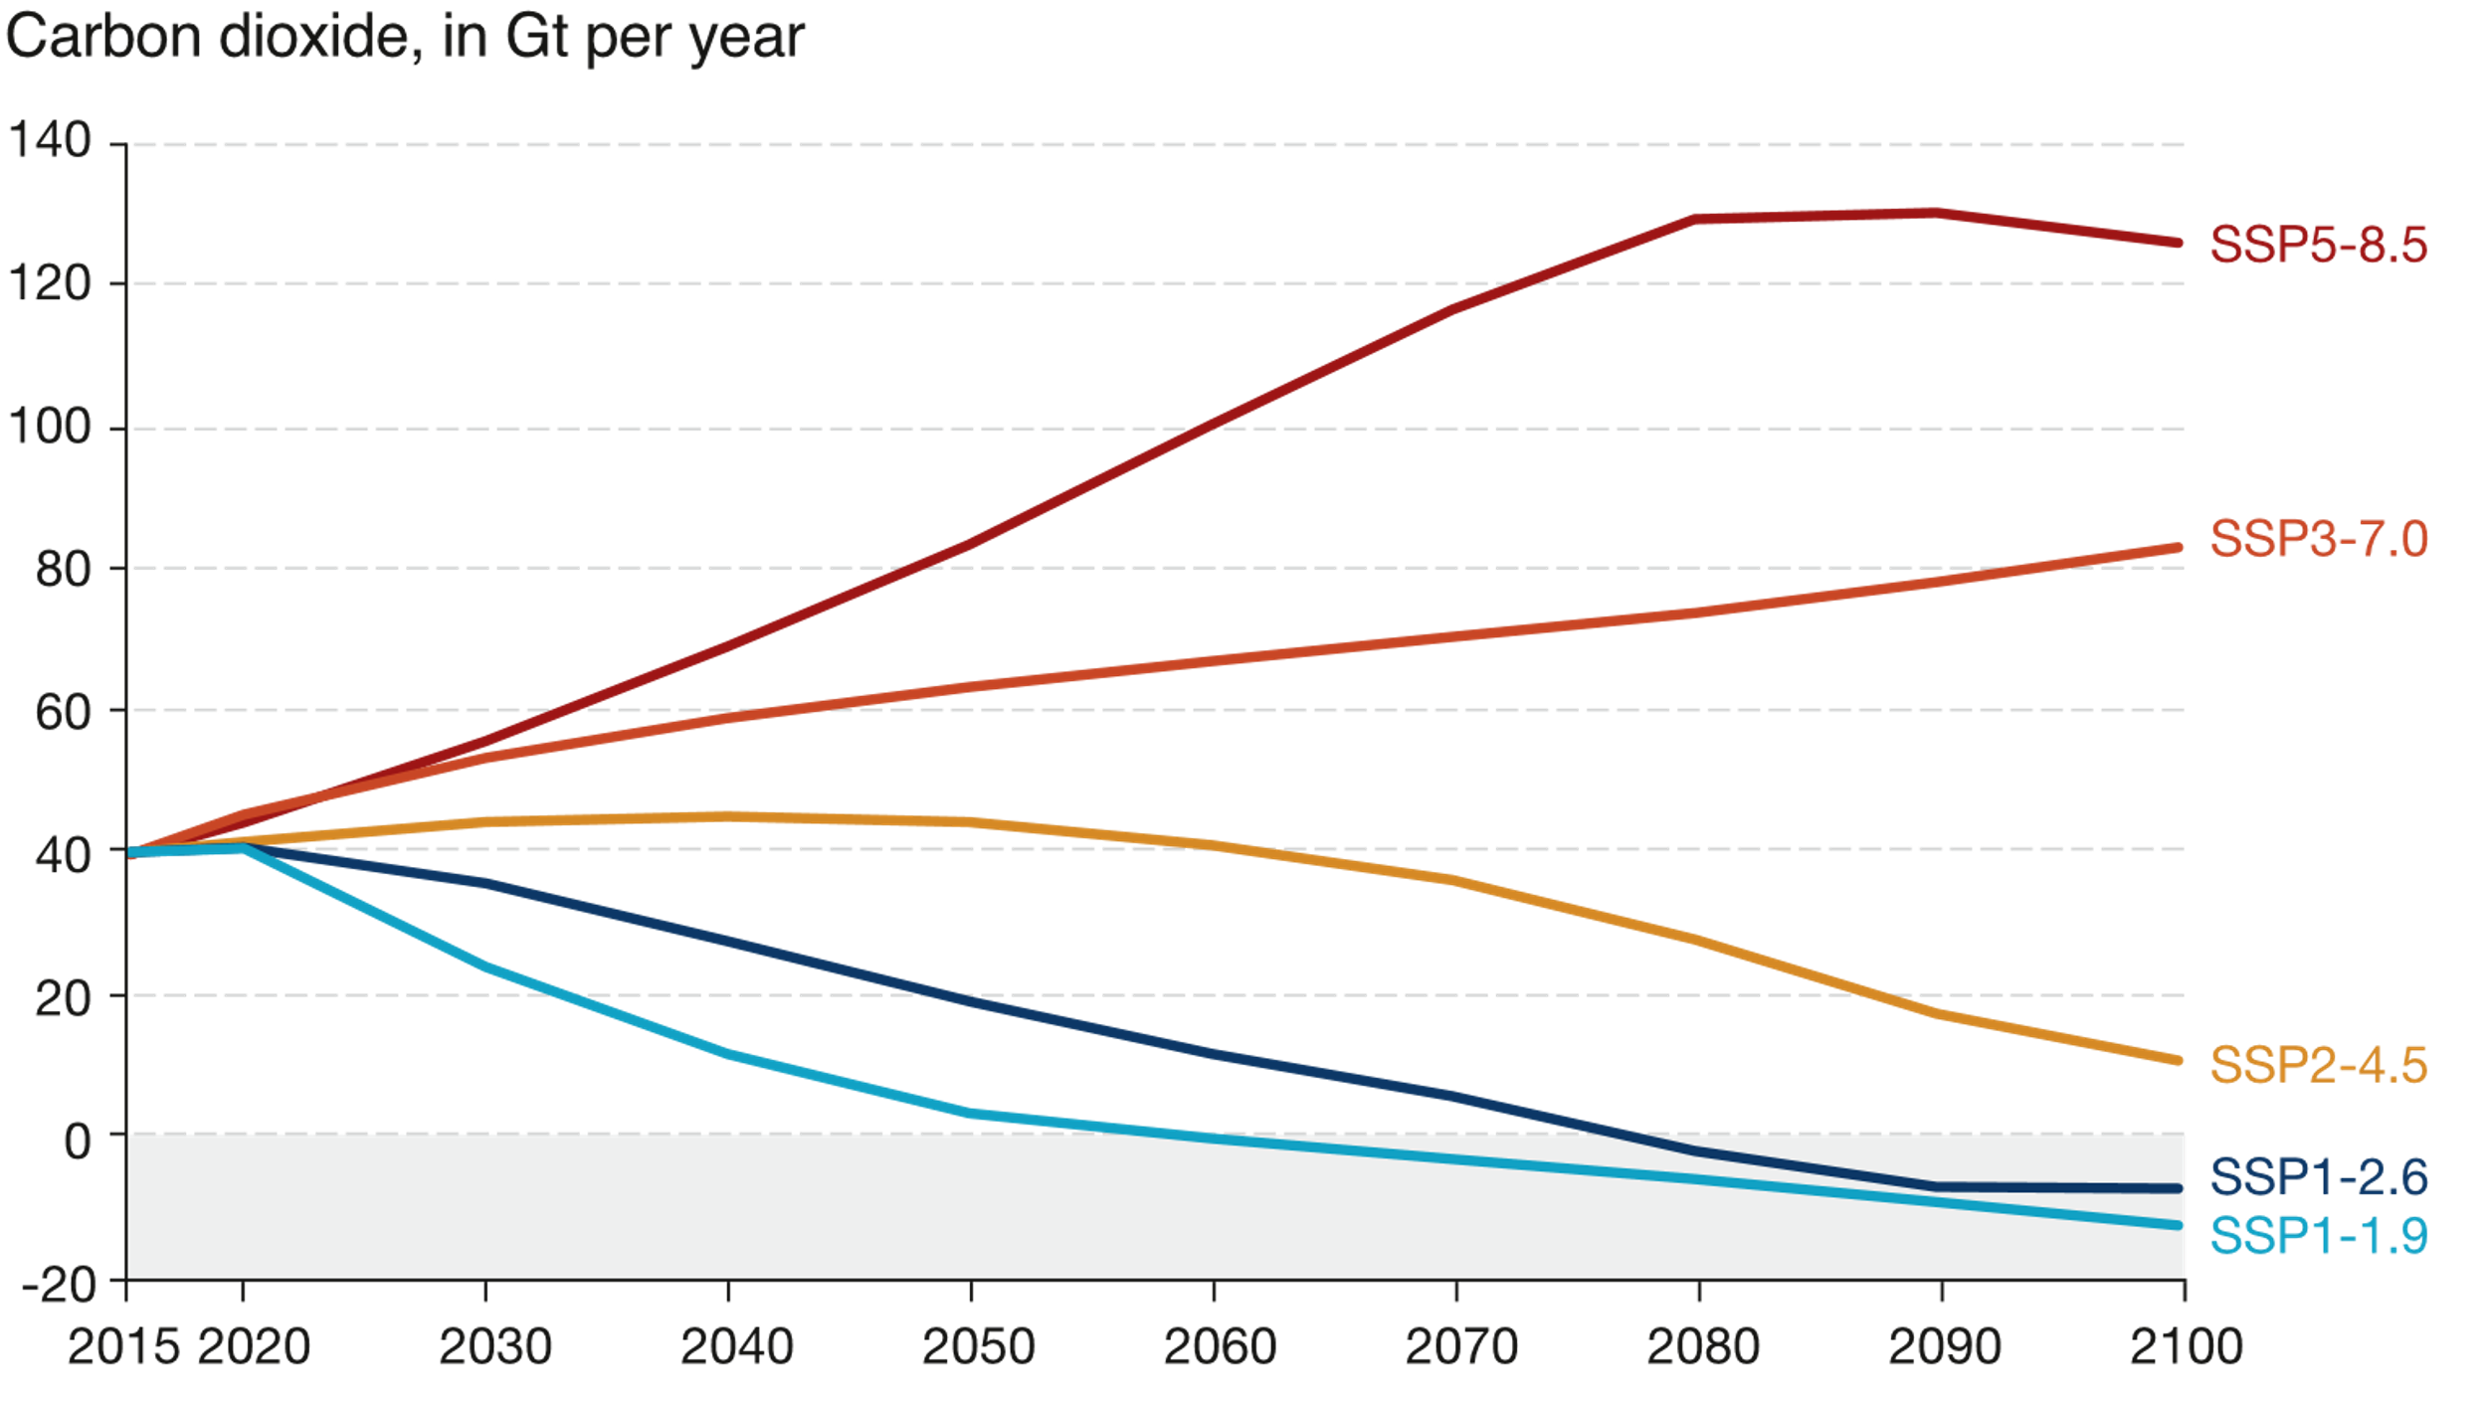
DISCUSSION – POTENTIAL FOR IMMEDIATE IMPACTS
River Health Index
Initial global assessment by 2030 and further.

Slide 22
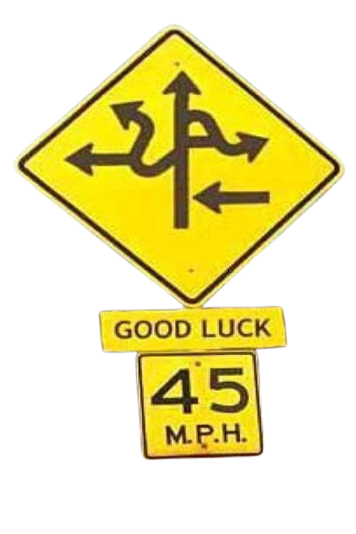


CONCLUSION
Historical lack of awareness
Technology and cooperation
Global framework

