Slide 1
Fall Semester 2024-2025
Global Change Ecology and Fluvial Ecosystems
ENV-512
Tom J Battin
David Touchette
River Ecosystems Laboratory
(www.epfl.ch/labs/river/)

Slide 2
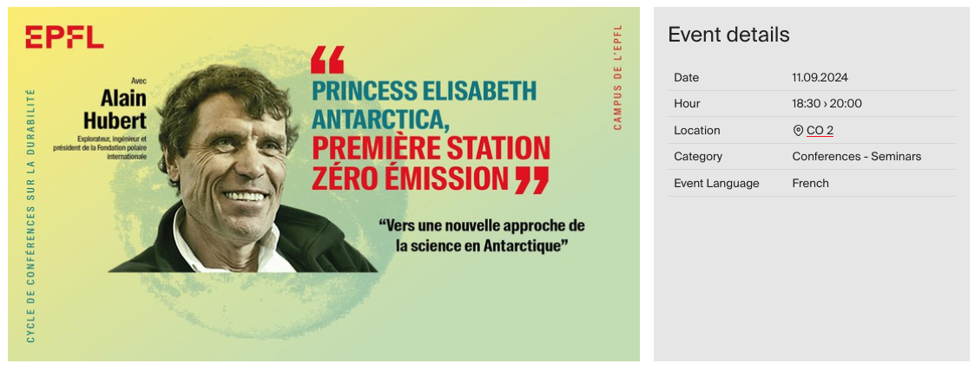

Slide 3
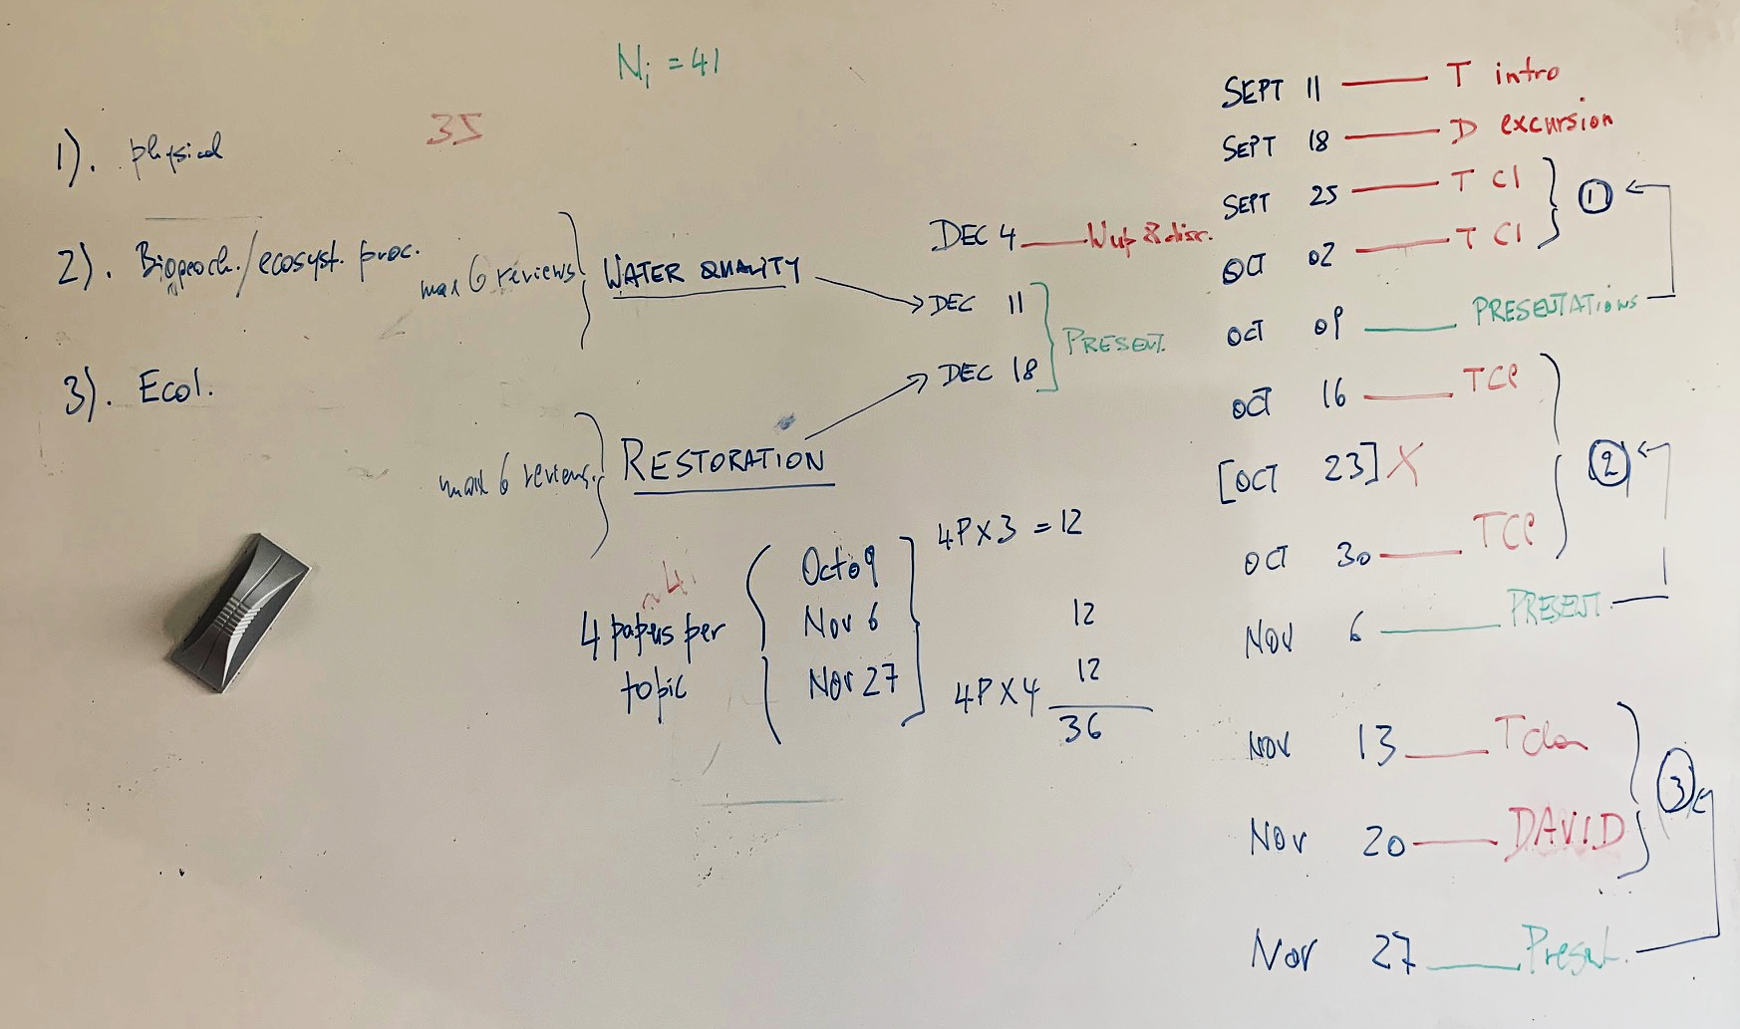
Introduction to the class

Slide 4
Global Change Ecology
‘At the interface between ecological systems and all aspects of environmental change that affects a substantial part of the globe’.
The Anthropcene

Slide 5
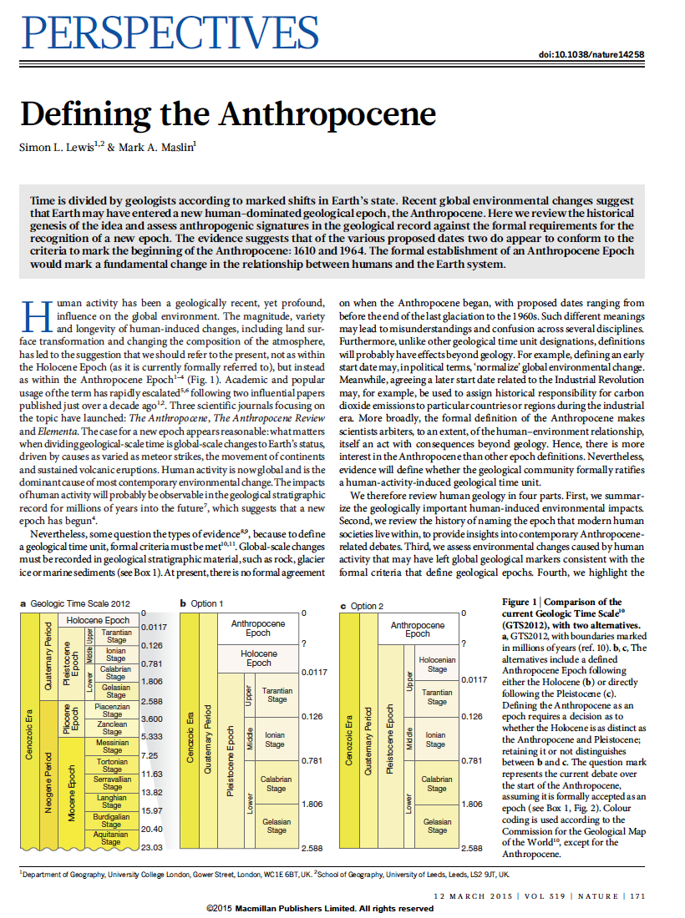
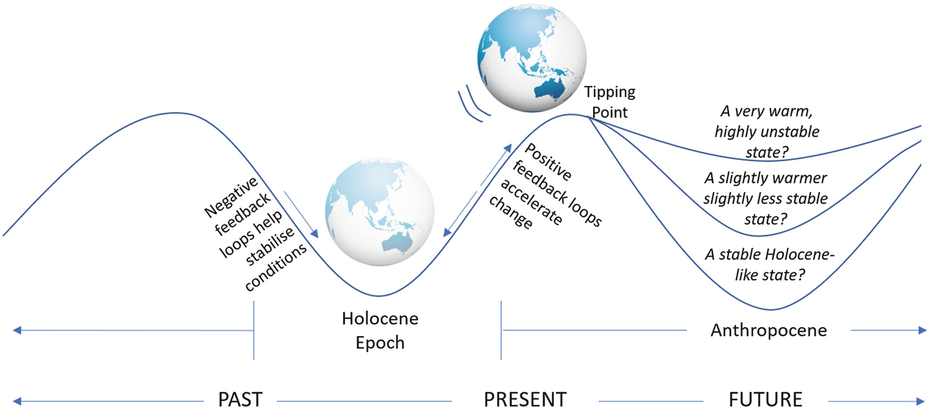
The Anthropocene
The magnitude, variety and longevity of human-induced changes, including land surface transformation and changing the composition of the atmosphere, has led to the suggestion that we should refer to the present, not as within the Holocene Epoch (as it is currently formally referred to), but instead as within the Anthropocene Epoch.
https://link.springer.com/chapter/10.1007/978-981-15-1443-2_3/figures/3

Slide 6
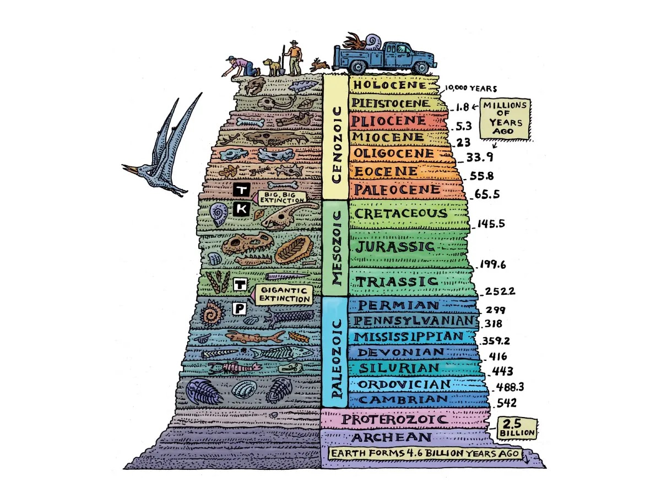

The Anthropocene
When has the Anthropocene begun?
Defining the beginning of the Anthropocene as a formal geologic unit of time requires the location of a global marker of an event in stratigraphic material, such as rock, sediment, or glacier ice, known as a Global Stratotype Section and Point (GSSP), plus other auxiliary stratigraphic markers indicating changes to the Earth system

Slide 7
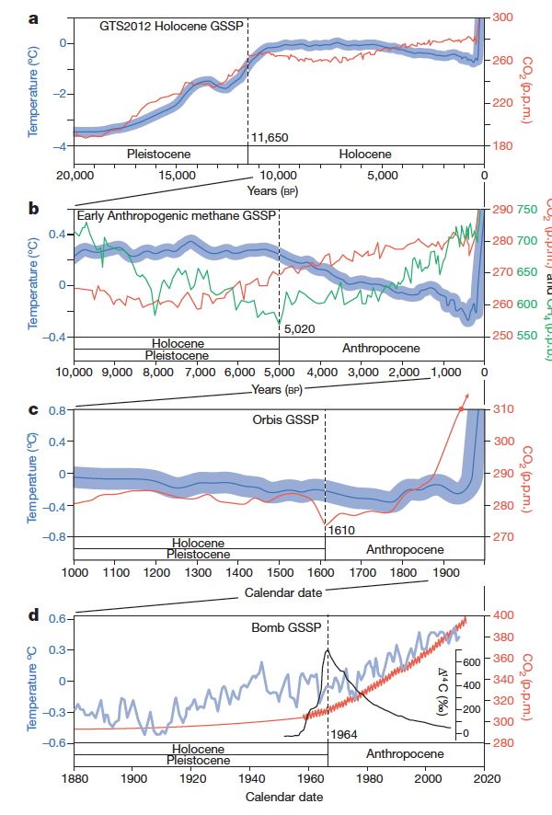
The Anthropocene
When has the Anthropocene begun?
Early Anthropogenic Hypothesis suggests boundary, which posits that early extensive farming impacts caused global environmental changes, defined here by the inflection and lowest level of atmospheric methane
Orbis GSSP suggested boundary (dashed line), representing the collision of the Old and New World peoples and homogenization of once distinct biotas, and defined by the pronounced dip in atmospheric carbon dioxide
Bomb GSSP suggested boundary, characterized by the peak in atmospheric radiocarbon from annual tree-rings (the Δ¹⁴C value is the relative difference between the absolute international standard (base year 1950) and sample activity corrected for the time of collection and δ¹³C)

Slide 8
The Anthropocene
When has the Anthropocene begun?
Why does this matter?
The choice of either 1610 or 1964 as the beginning of the Anthropocene would probably affect the perception of human actions on the environment.
The Orbis spike (1610) implies that colonialism, global trade and coal brought about the Anthropocene. Broadly, this highlights social concerns, particularly the unequal power relationships between different groups of people, economic growth, the impacts of globalized trade, and our current reliance on fossil fuels. The onward effects of the arrival of Europeans in the Americas also highlights a long-term and large-scale example of human actions unleashing processes that are difficult to predict or manage.
Choosing the bomb spike (1964) tells a story of an elite-driven technological development that threatens planet-wide destruction. The long-term advancement of technology deployed to kill people, from spears to nuclear weapons, highlights the more general problem of ‘progress traps’.

Slide 9
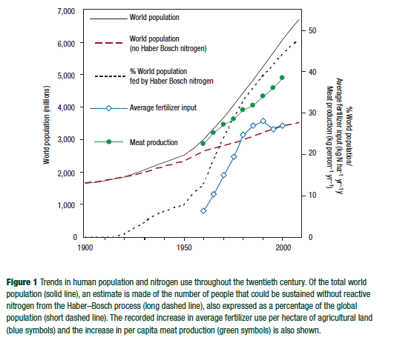
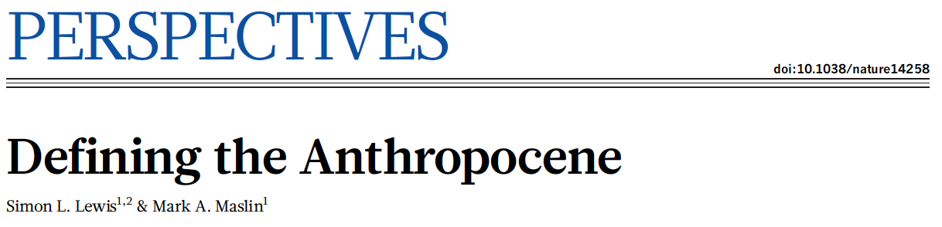
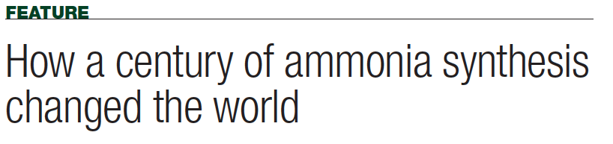
The Anthropocene
Human activity profoundly affects the environment, from Earth’s major biogeochemical cycles to the evolution of life.
The early twentieth-century invention of the Haber–Bosch process, which allows the conversion of atmospheric nitrogen to ammonia for use as fertilizer, has altered the global nitrogen cycle so fundamentally that the nearest suggested geological comparison refers to events about 2.5 billion years ago.

Slide 10
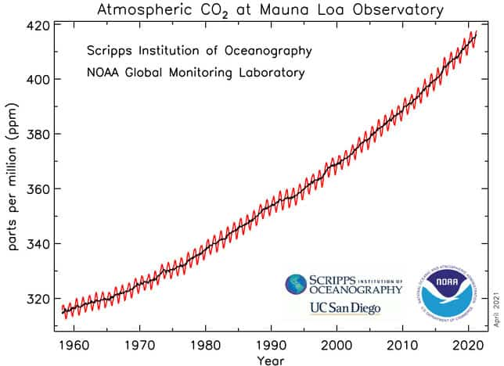
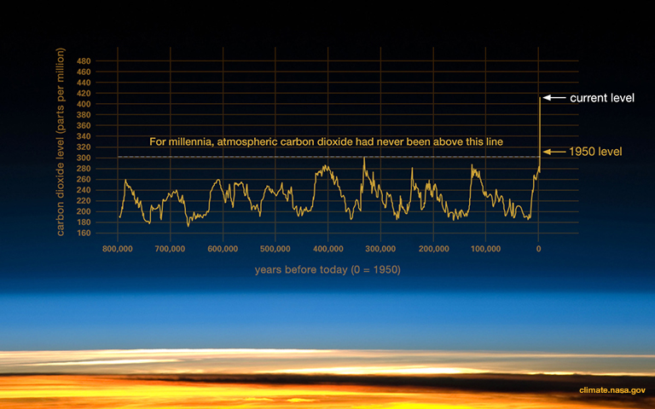
The Anthropocene
Human actions have released 555 petagrams of carbon (where 1 Pg=10¹⁵ g = billion metric tons) to the atmosphere since 1750, increasing atmospheric CO₂ to a level not seen for at least 800,000 years, and possibly several million years, thereby delaying Earth’s next glaciation event. The released carbon has increased ocean water acidity at a rate probably not exceeded in the last 300 million years.

Slide 11
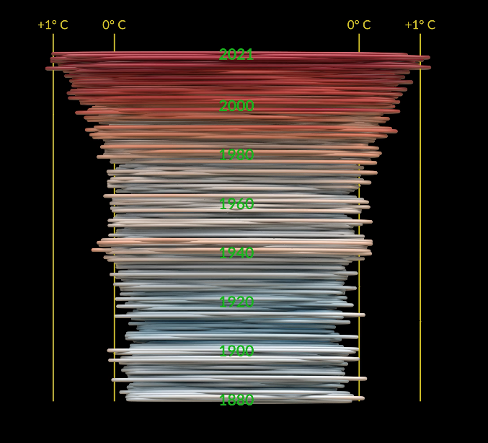

The Anthropocene
Human actions have released 555 petagrams of carbon (where 1 Pg=10¹⁵g = billion metric tons) to the atmosphere since 1750, increasing atmospheric CO₂ to a level not seen for at least 800,000 years, and possibly several million years, thereby delaying Earth’s next glaciation event. The released carbon has increased ocean water acidity at a rate probably not exceeded in the last 300 million years.

Slide 12

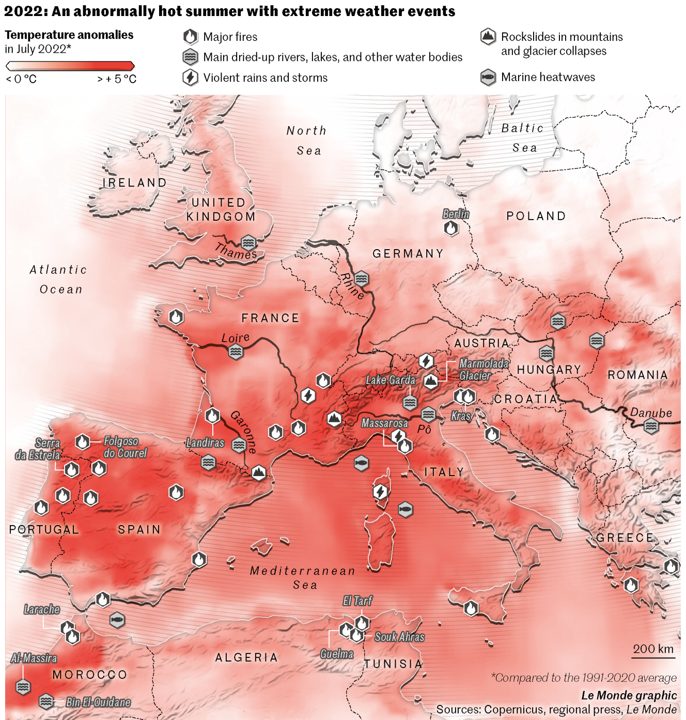
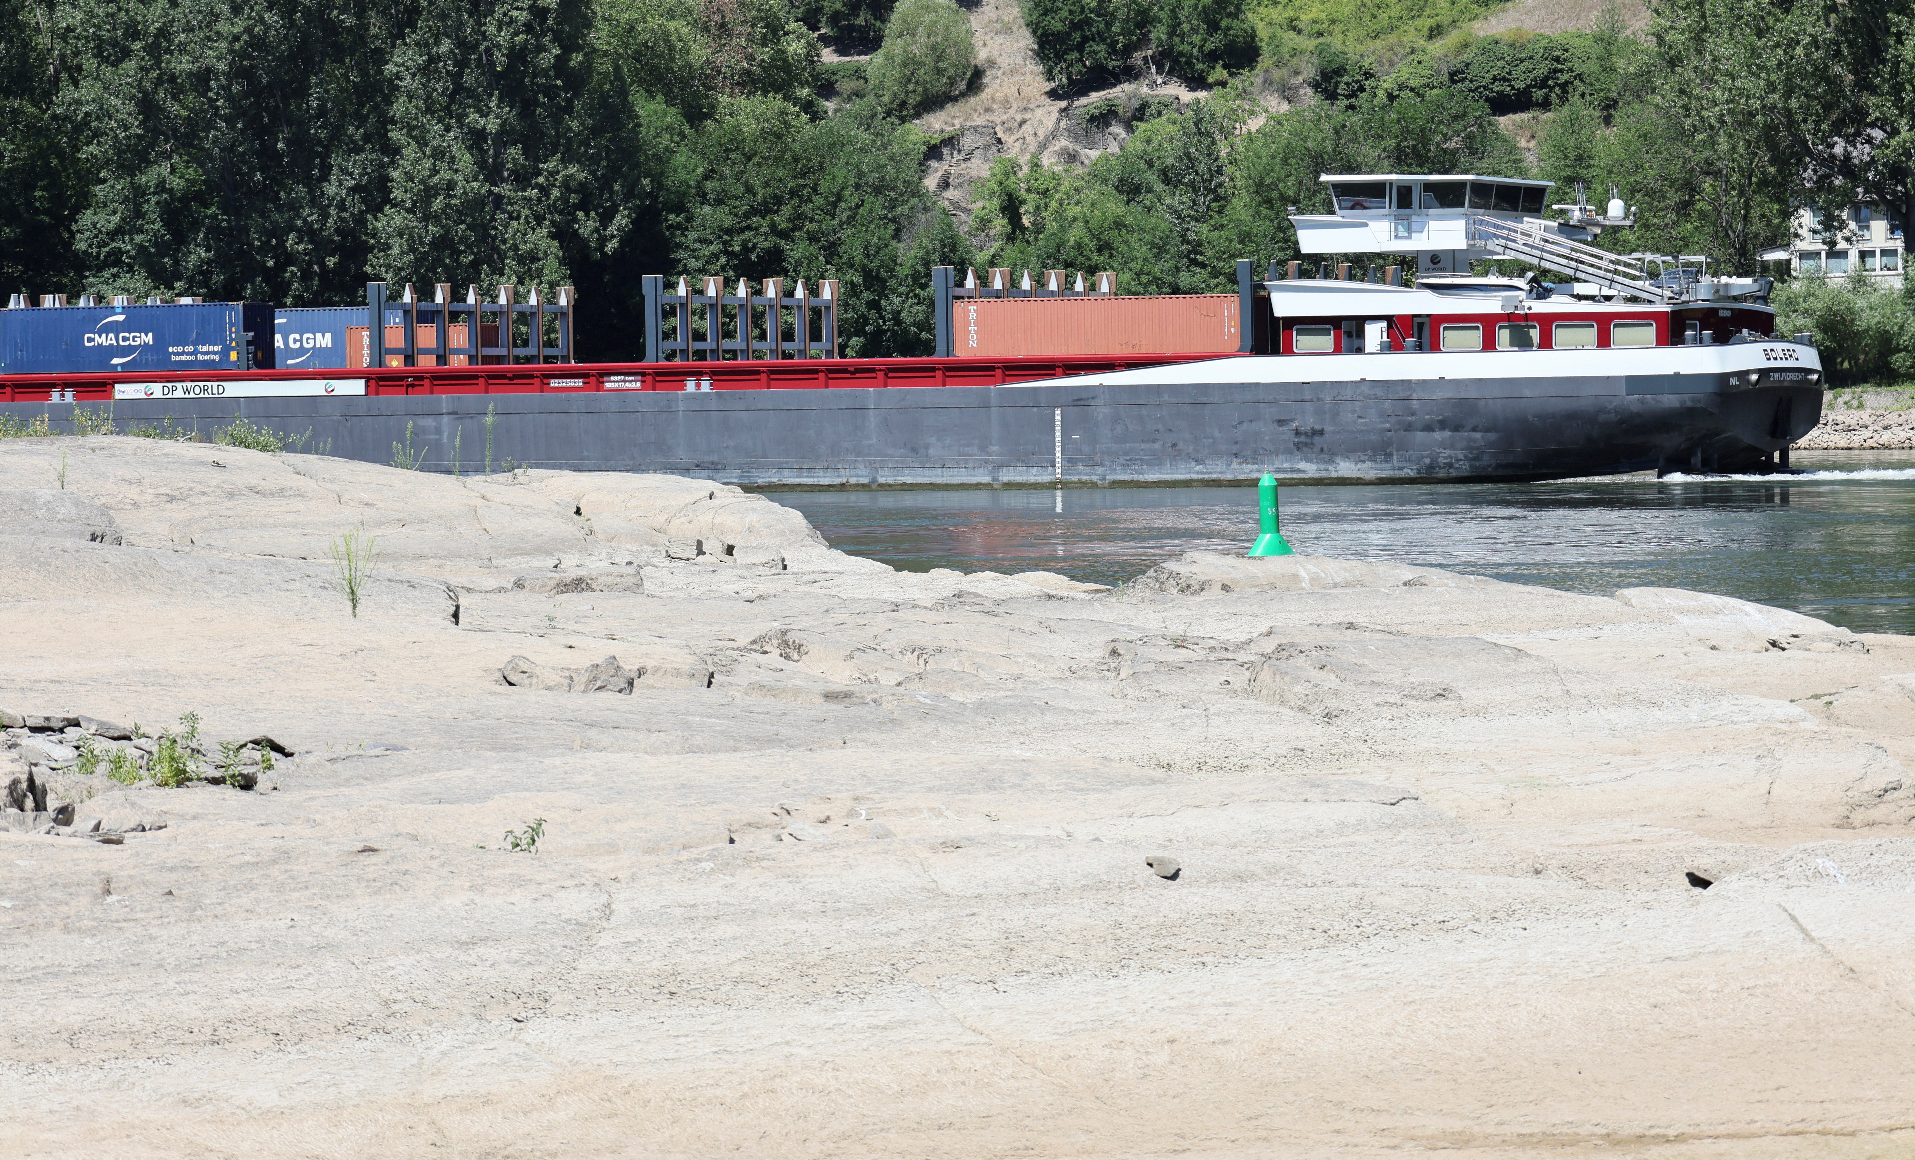
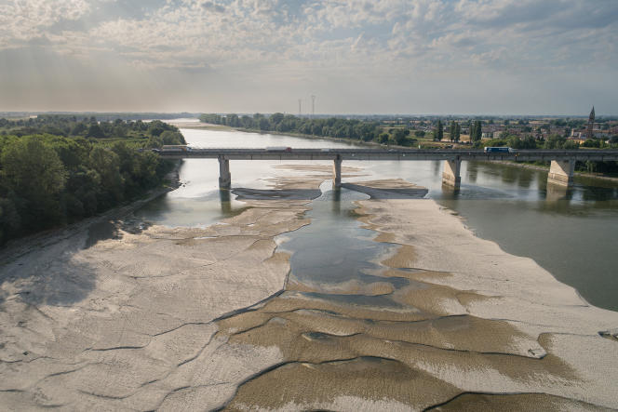
The Anthropocene
Rhine River
Po River

Slide 13
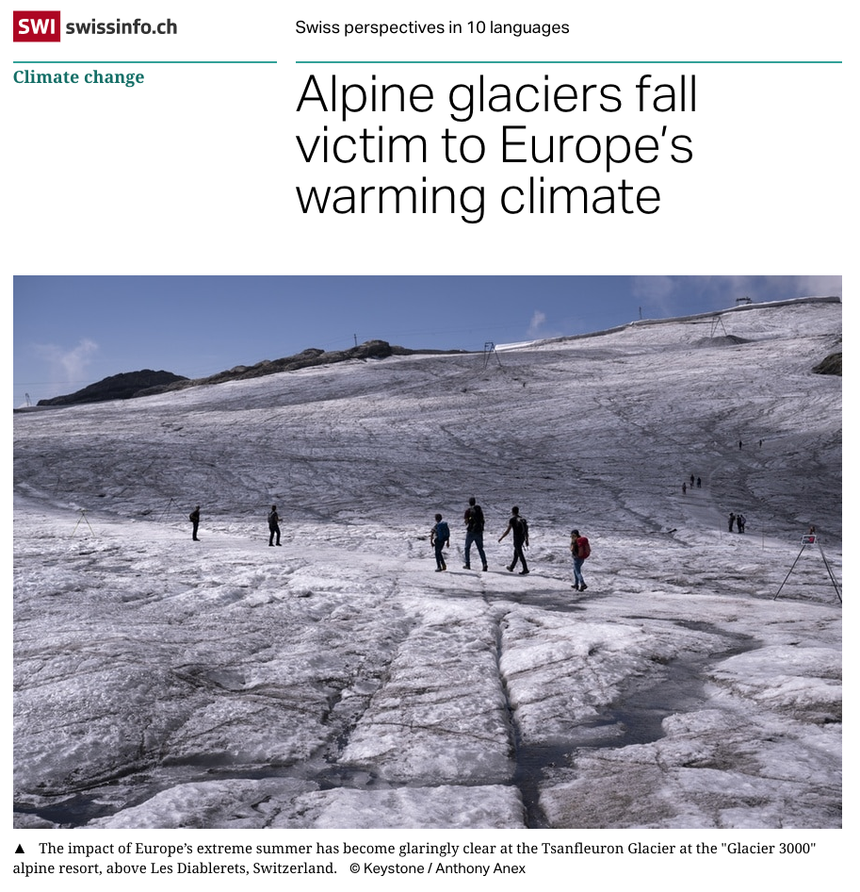
The Anthropocene

Slide 14
The Anthropocene
Examples related to Climate Change
The Great Acceleration

Slide 15
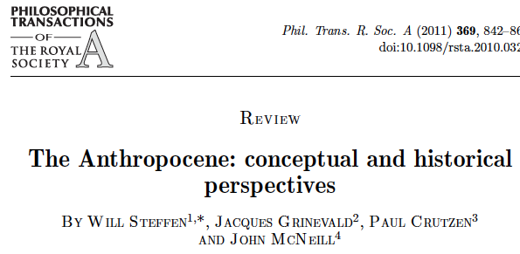
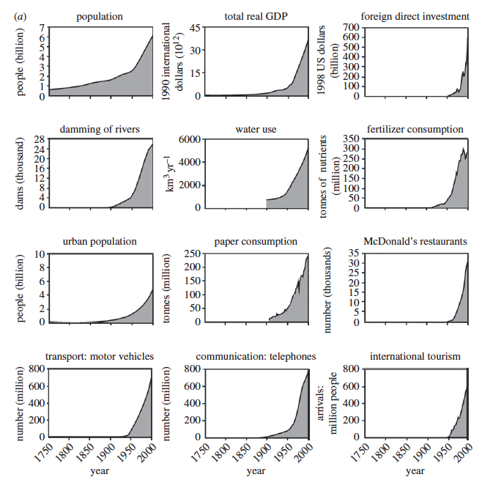
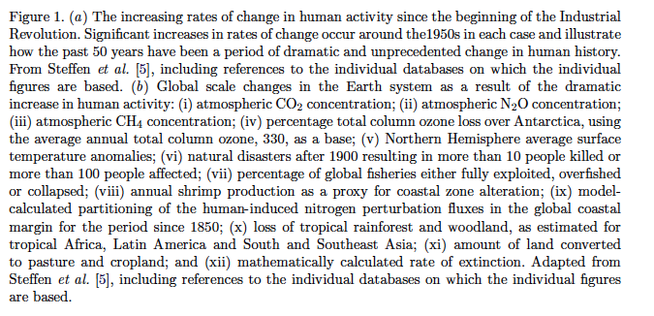
The Great Acceleration

Slide 16
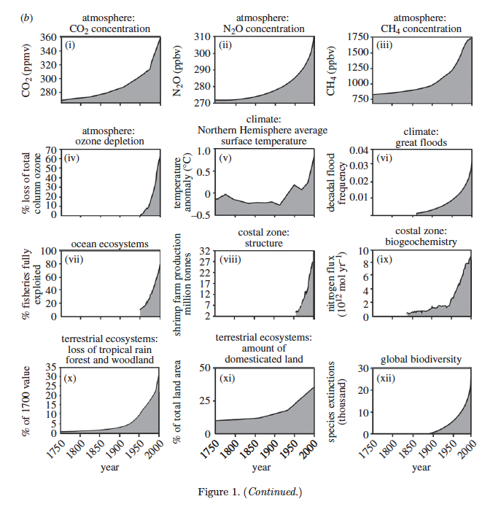
The Anthropocene
…there is more when we talk about global change
The Great Acceleration

Slide 17
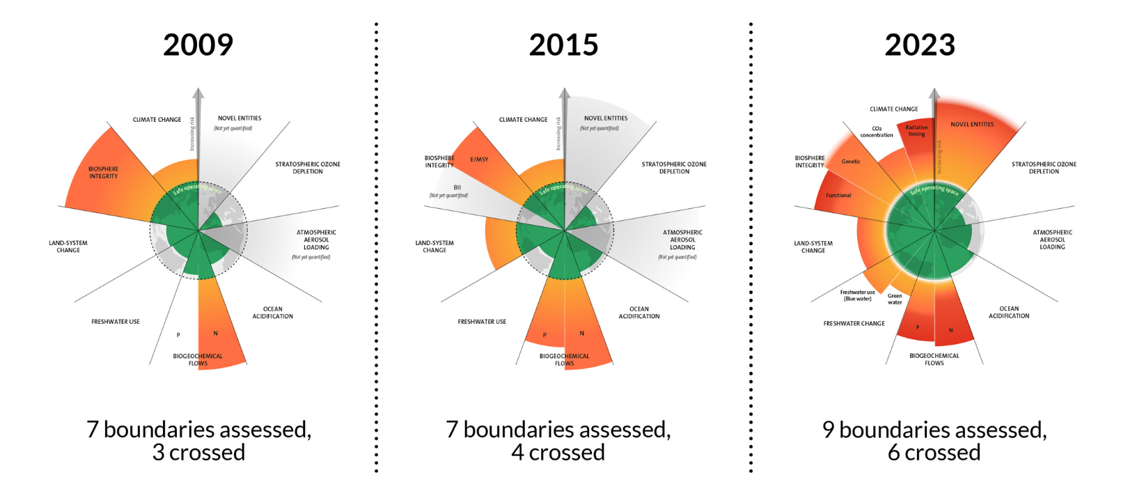
The Planetary Boundaries
Estimates of how the different control variables for planetary boundaries have changed from 1950 to present. The green shaded polygon represents the safe operating space.
https://www.stockholmresilience.org/research/planetary-boundaries/the-nine-planetary-boundaries.html

Slide 18
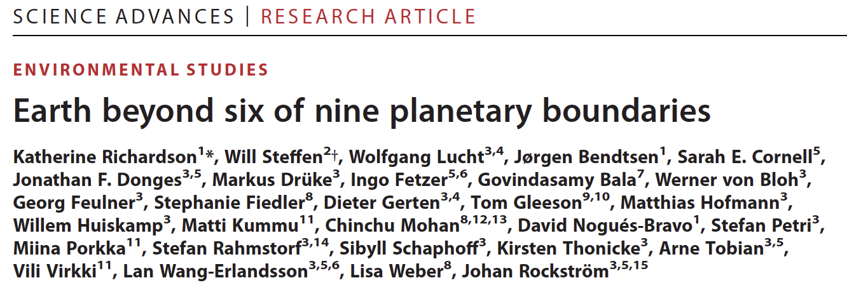
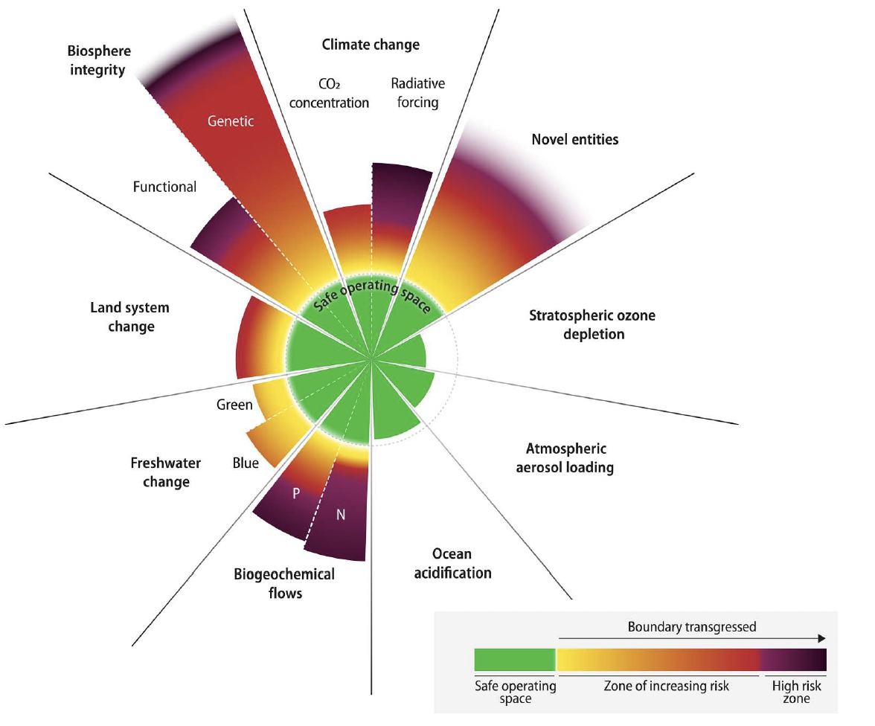
The nine planetary boundaries
Planetary boundaries framework update finds that six of the nine boundaries are transgressed, suggesting that Earth is now well outside of the safe operating space for humanity.
Ocean acidification is close to being breached, while aerosol loading regionally exceeds the boundary.
Stratospheric ozone levels have slightly re-covered.
The transgression level has increased for all boundaries earlier identified as overstepped.
2023
https://www.stockholmresilience.org/research/planetary-boundaries/the-nine-planetary-boundaries.html

Slide 19
The nine planetary boundaries
Novel entities: synthetic chemicals and substances (e.g., microplastics, endocrine disruptors, and organic pollutants); anthropogenically mobilized radioactive
materials, including nuclear waste and nuclear weapons; and human modification of evolution, genetically modified organisms and other direct human interventions in evolutionary processes.
Novel entities serve as geological markers of the Anthropocene.
However, their impacts on Earth system as a whole remain largely unstudied.
https://www.stockholmresilience.org/research/planetary-boundaries/the-nine-planetary-boundaries.html

Slide 20
The nine planetary boundaries
Global net primary productivity appears to be relatively constant; however, the appropriation of 25–38% of net primary productivity for human use reduces the amount available for millions of other species on Earth.
This land-use conversion to produce food, fuel, fibre and fodder, combined with targeted hunting and harvesting, has resulted in species extinctions some 100 to 1,000 times higher than background rates, and probably constitutes the beginning of the sixth mass extinction in Earth’s history.
https://www.stockholmresilience.org/research/planetary-boundaries/the-nine-planetary-boundaries.html

Slide 21

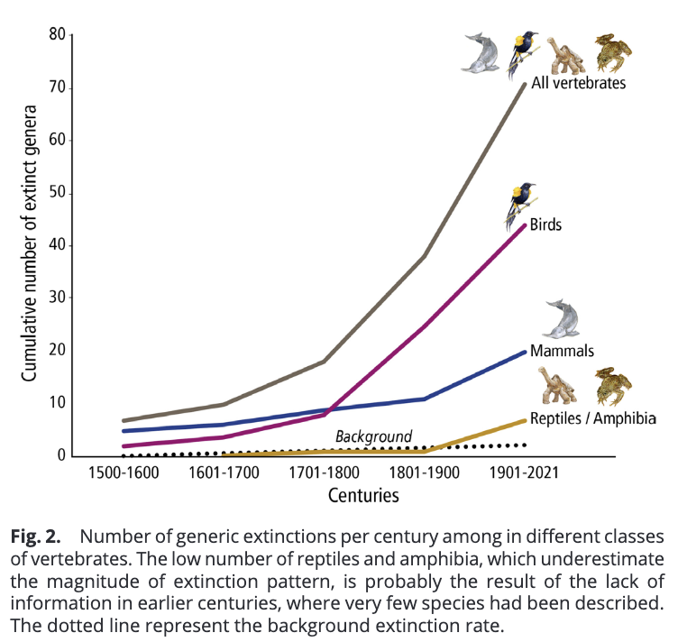
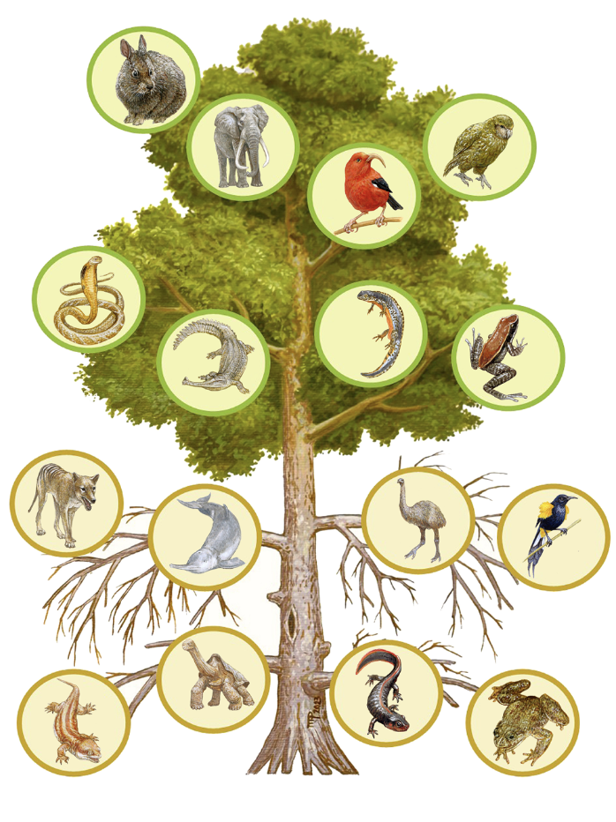
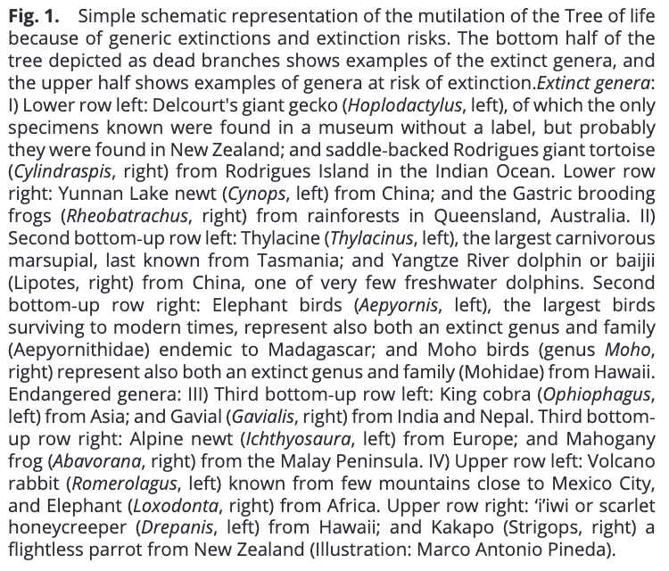

Slide 22
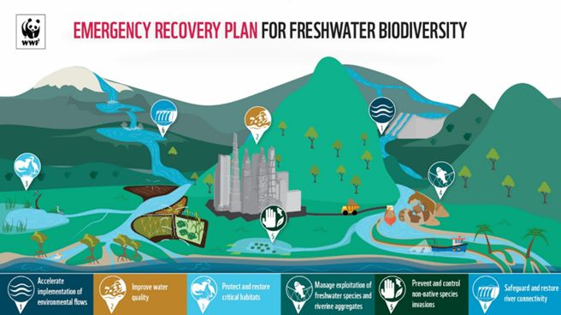
Streams and rivers figure among the most diverse ecosystems on Earth

Slide 23
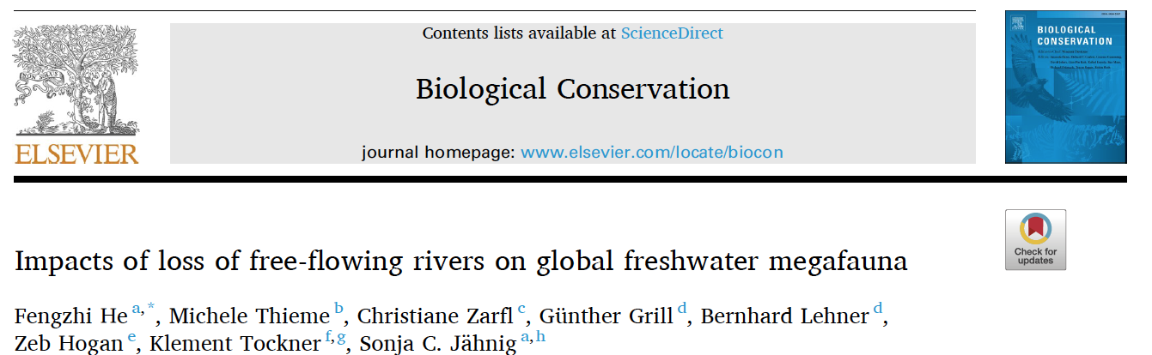
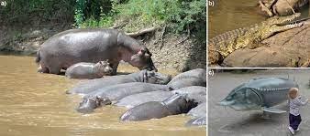
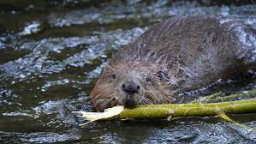
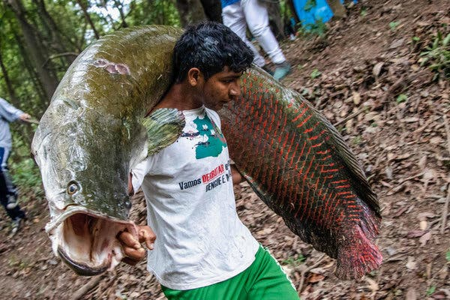
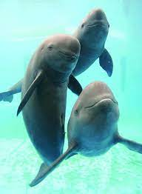
Megafauna
Top predators
Ecosystem engineers
Fisheries

Slide 24
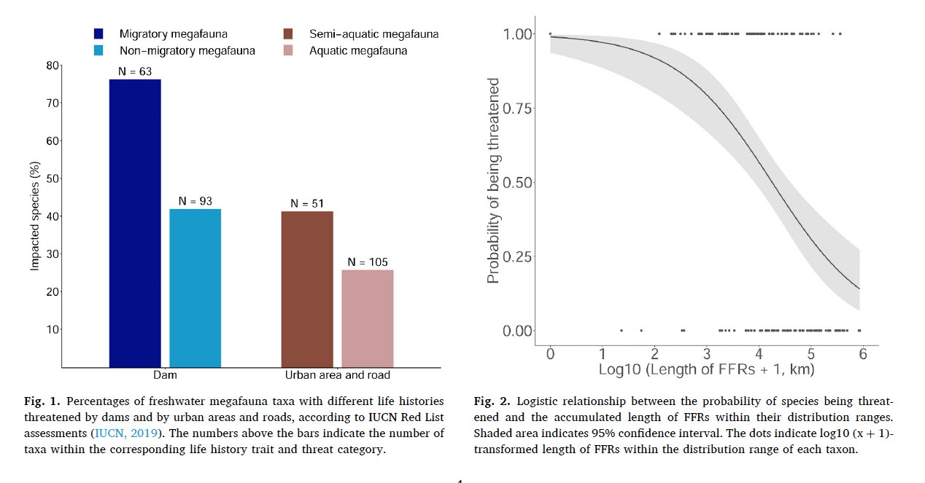
fragmented
free-flowing

Slide 25
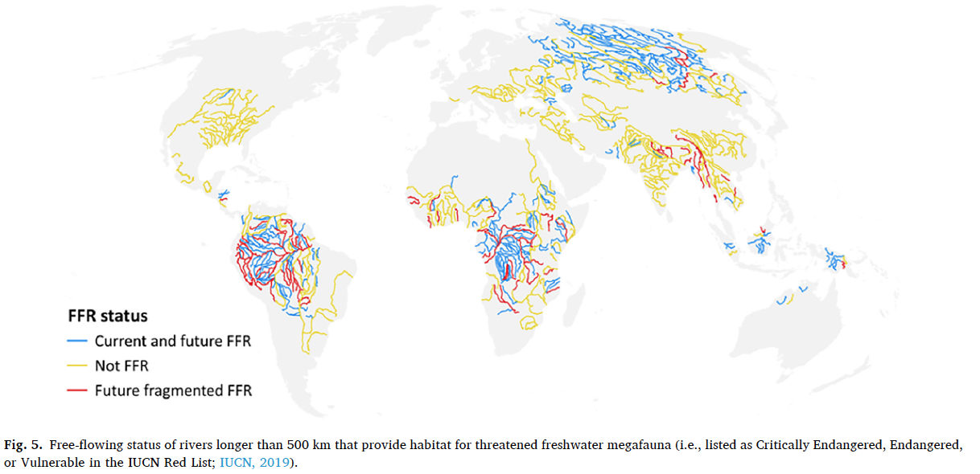
Free-flowing rivers

Slide 26
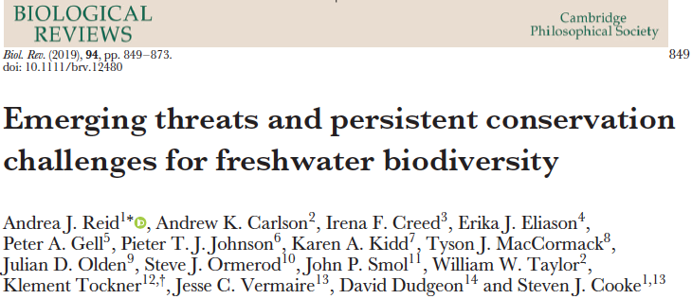
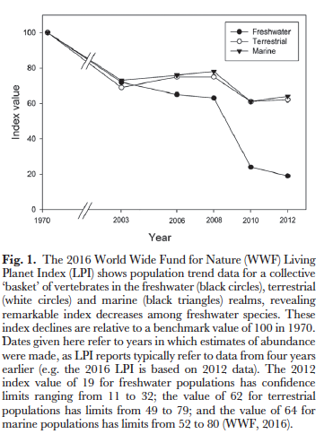
Freshwater biodiversity is at threat
Biodiversity loss relative to 1970

Slide 27
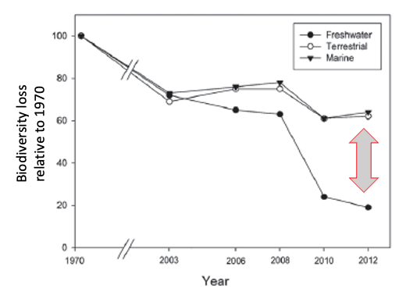
Emerging threats
Changing climates
E-commerce and invasions
Infectious diseases
(4) Harmful algal blooms
(5) Expanding hydropower
(6) Emerging contaminants
(7) Engineered nanomaterials
(8) Microplastic pollution
(9) Light and noise pollution
(10) Freshwater salinisation
(11) Declining calcium
(12) Cumulative stressors

Slide 28
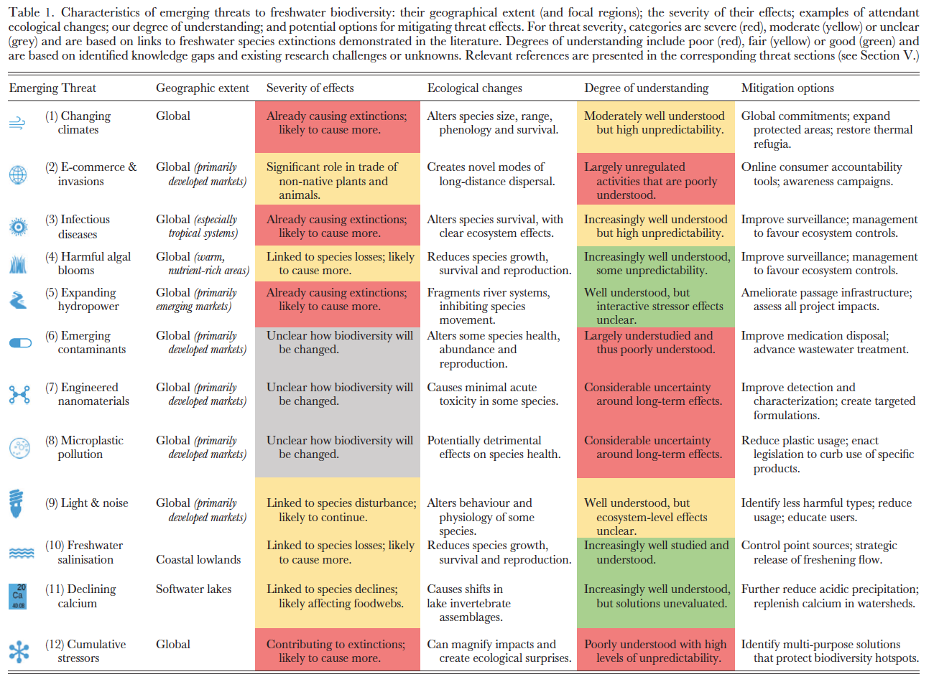

Slide 29
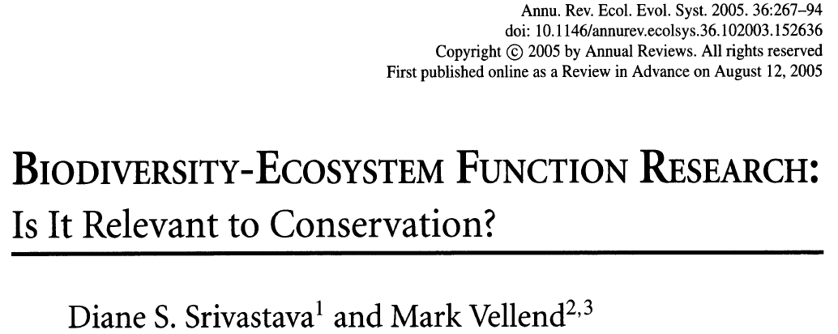
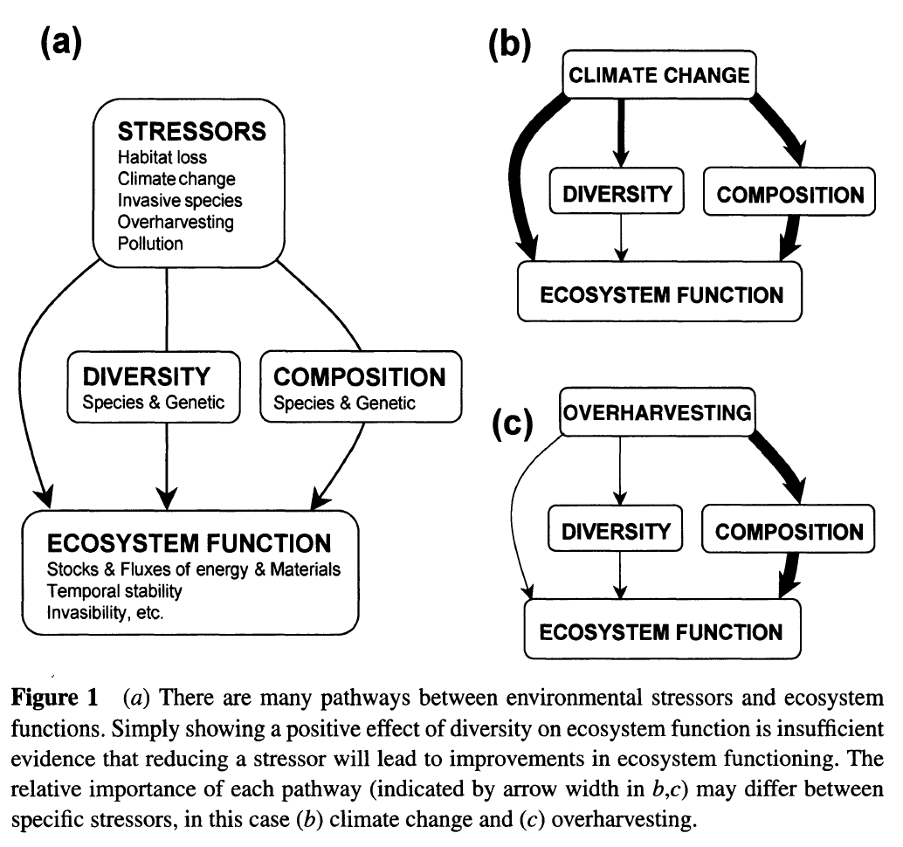
Biodiversity, ecosystem functioning and services are connected

Slide 30
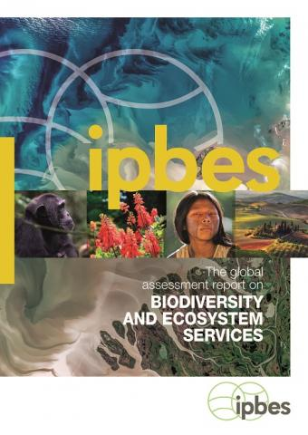
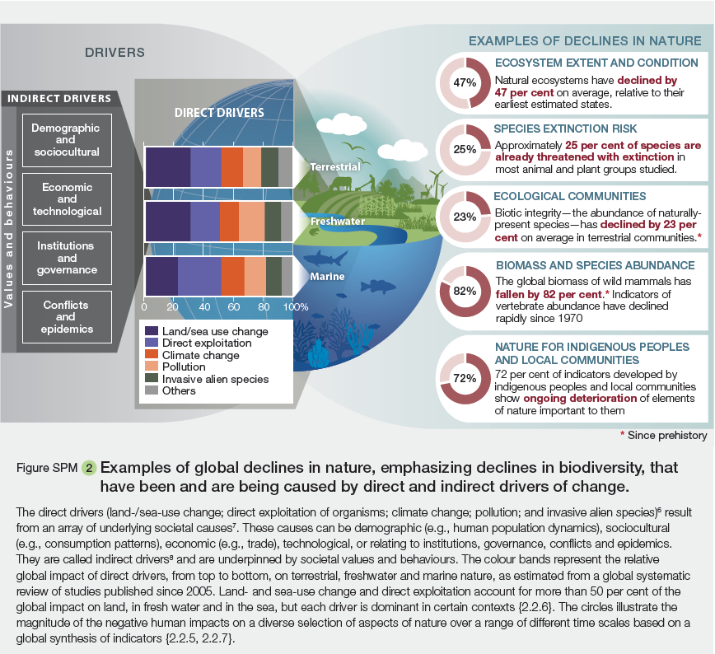

Slide 31
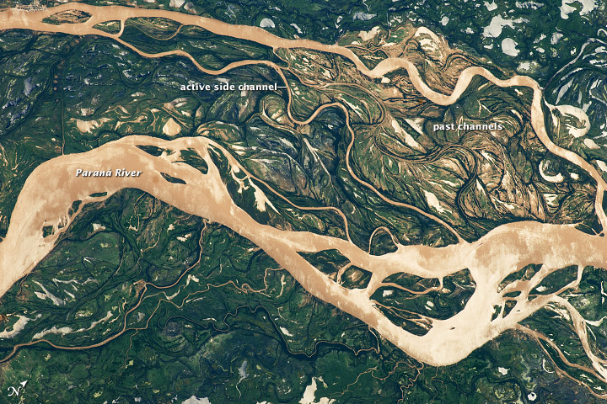
Global Change Ecology and Fluvial Ecosystems
This course lays the foundation towards mechanistic understanding of global-change impacts on stream and river ecosystem structure and function. The students will revisit the major agents of environmental change, including climate change, damming, eutrophication, and emergent pollutants, for instance, and discuss their potential relevance for coupled physical, chemical and biological processes in fluvial ecosystems. This approach will enable the students to better understand and predict the future of fluvial ecosystems and the services that they provide.

Slide 33
How to present a paper
Read the paper carefully
Extract the most critical information from the
Introduction (the ‘why’)
Methods (the ‘how’)
Results (the ‘what’)
Discussion (the ‘now’ and ‘next’)
Devote 20% to the introduction, 10 % to the methods, 30% to the results and 30% to the discussion
You are encouraged to add your personal reflections and conclusion en top of this
Use scientific language
Use scientific illustrations to make the argument clear
Guide the audience through your arguments
’Ornamental’ displays (e.g., photos, pictogram) are welcome

Slide 34
How to present a paper
Keep your presentation time to 20 – 25 minutes
Allow time for discussion
Build a storyline based on the introduction, results and discussion
For this, you may follow the paper or produce your own – consult the abstract as it should give a good summary of the paper

Slide 35
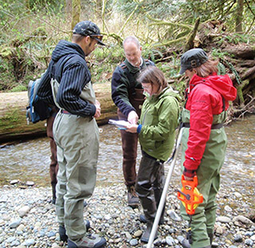
To do:
Review the syllabus
Read Chapter 1 of ‘Stream Ecology’ & ‘Rivers in the Anthropocene’ for broad introduction to course topic
Sign up for presentation groups on Moodle
Next week: Tour of campus stream, please wear appropriate attire, we will provide boots/waders

