Slide 1
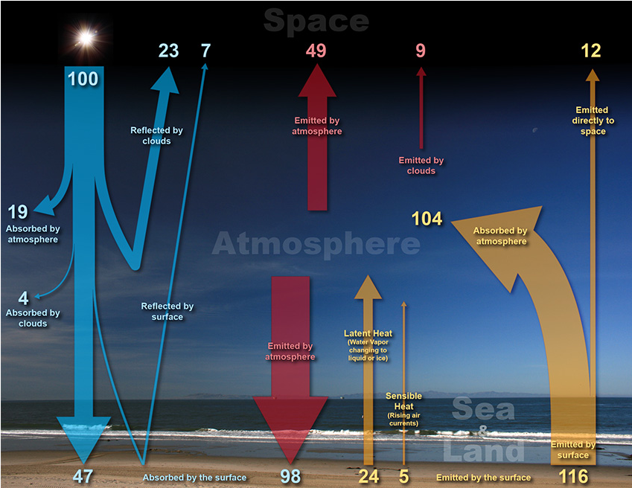
The earth-atmosphere energy balance is achieved as the energy received from the Sun balances the energy lost by the Earth back into space. In this way, the Earth maintains a stable average temperature and therefore a stable climate. Using 100 units of energy from the sun as a baseline the energy balance is as follows:
https://www.noaa.gov/jetstream/atmosphere/energy

Slide 2
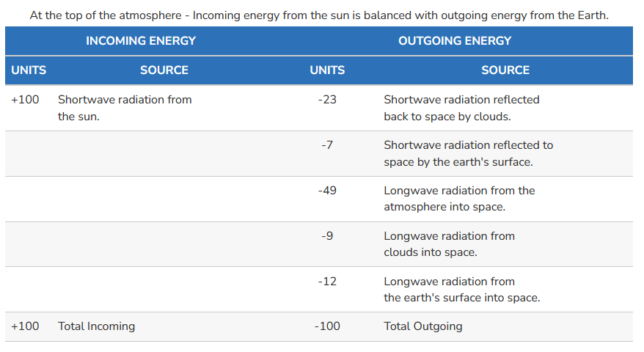
Top of the atmosphere

Slide 3
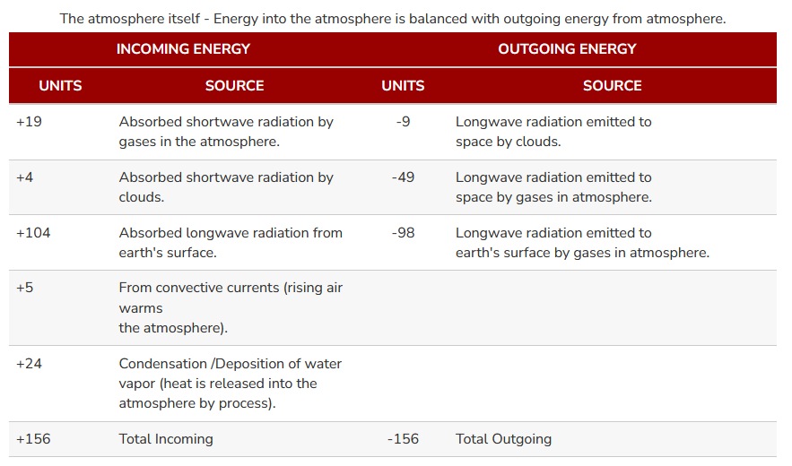
Atmosphere itself

Slide 4
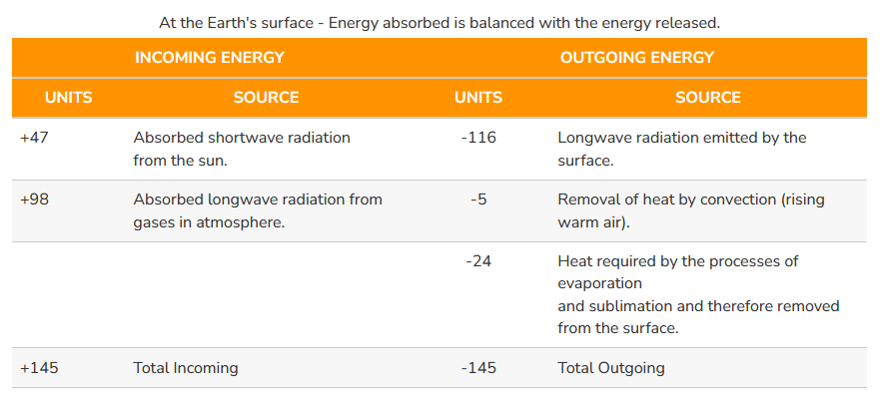
Earth’s surface

