Slide 1
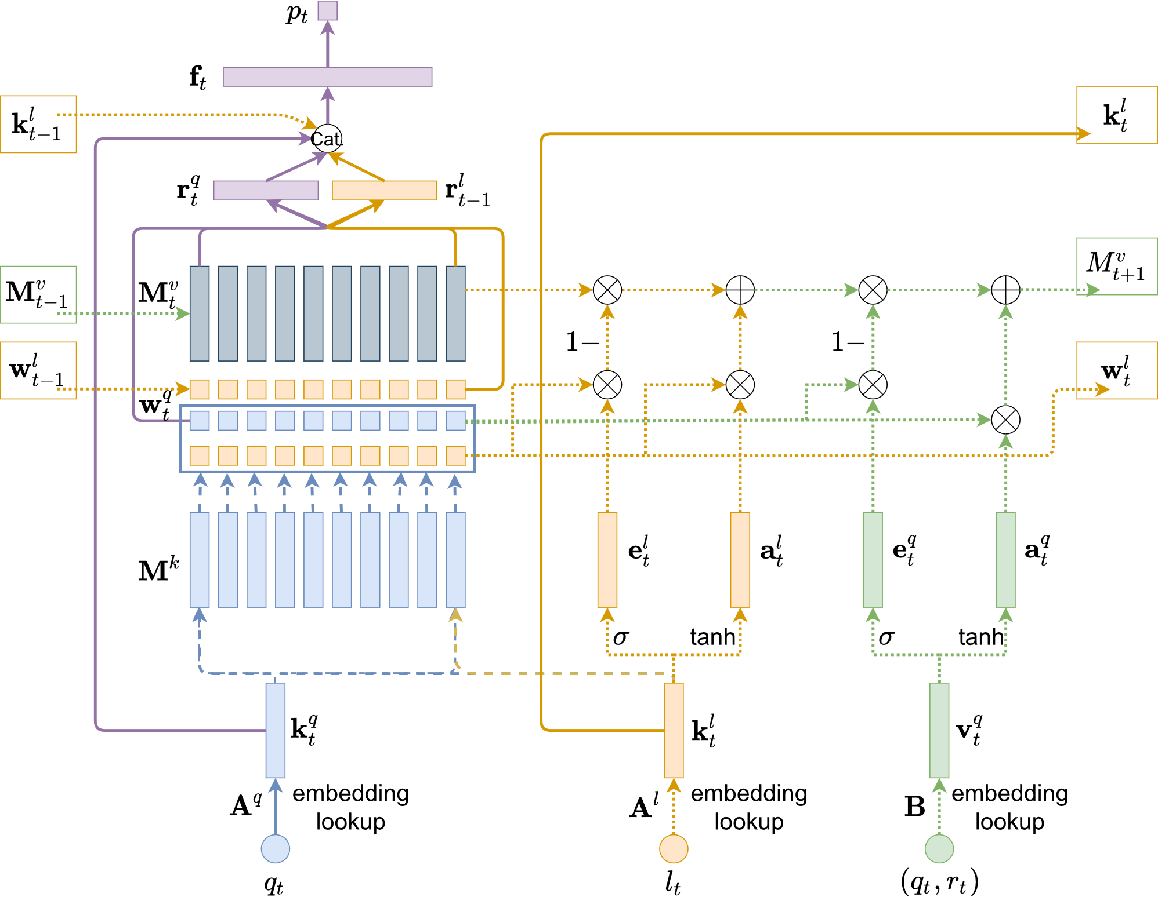
Learning from Non-Assessed Resources: Deep Multi-Type Knowledge Tracing
Chunpai Wang, Siquian Zhao, Shaghayegh Sahebi
University at Albany-SUNY
Published in EDM, 2021
Presentation by Lucas Ramirez

Slide 2
Timeline
Problem Motivation
Related Work
Methodology
Evaluation
Conclusion & Future Work

Slide 3
Timeline
Problem Motivation
Related Work
Methodology
Evaluation
Conclusion & Future Work

Slide 4
Motivation
MODELING NON-ASSESSED LEARNING RESOURCES
Some activities are assessed (e.g., quiz), some are non-assessed (e.g., lecture)
Assessed activities provide a direct window to student knowledge though activity performance, but such observations do not exist for non-assessed materials
Education landscape shifts toward distance learning
Modern online systems can handle heterogenous types of learning activities
Most KT approaches do not model non-assessed activities
However, student learn though these materials too. Modeling them should result in better knowledge state accuracy
DMKT estimates student knowledge gain between consecutive assessed activities
Knowledge gain is distributed among in-between non-assessed activities. DMKT can discover the underlying latent concept for (non-)assessed materials.

Slide 5
Timeline
Problem Motivation
Related Work
Methodology
Evaluation
Conclusion & Future Work

Slide 6
Related Work
KNOWLEDGE TRACING IN THE LITERATURE
Traditional methods model knowledge transitions on assessed learning resources using predefined knowledge model
Bayesian Knowledge Tracing (BKT)
Item Response Theory (IRT)
Recent techniques based on deep learning can discover latent concepts in activities while training
Deep Knowledge Tracing (DKT)
Transformer-based neural networks
Dynamic Key-Value Memory Networks (DKVMNs)
Extensions to DKVMN
None of the deep learning models have focused on non-assessed activities
According to authors, only Multi-View Knowledge Models (MVKMs) support such resources.
However, it can only learn linear relationships between latent concepts and faces scalability issues.

Slide 7
Timeline
Problem Motivation
Related Work
Methodology
Evaluation
Conclusion & Future Work
Recall DKVMN architecture
The DMKT architecture
Side-by-side comparison between the two architectures

Slide 8
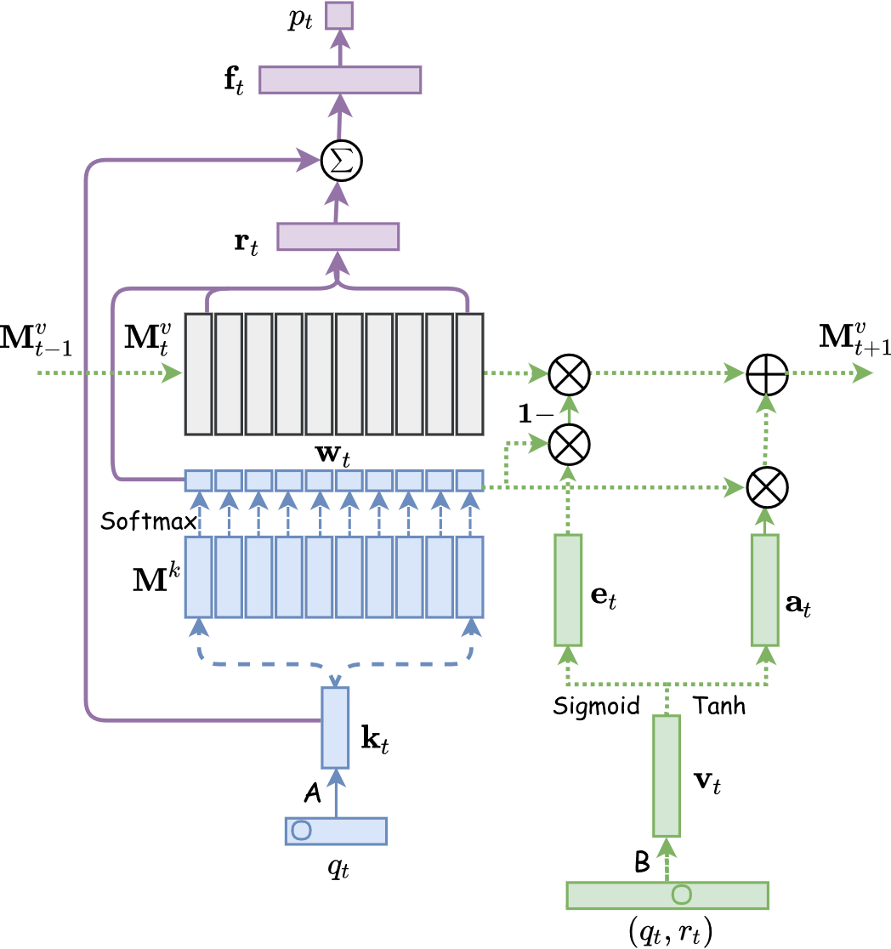
Methodology
DKVMN (RECALL)
Dynamic key-value memory networks discover latent concepts while training
Memory split in two matrices:
Key matrix (static) stores associations between questions and latent concepts
Value matrix (dynamic) stores evolving student knowledge state
Given a one-hot encoded question, model yields probability of correct answer at the current timestep

Slide 9
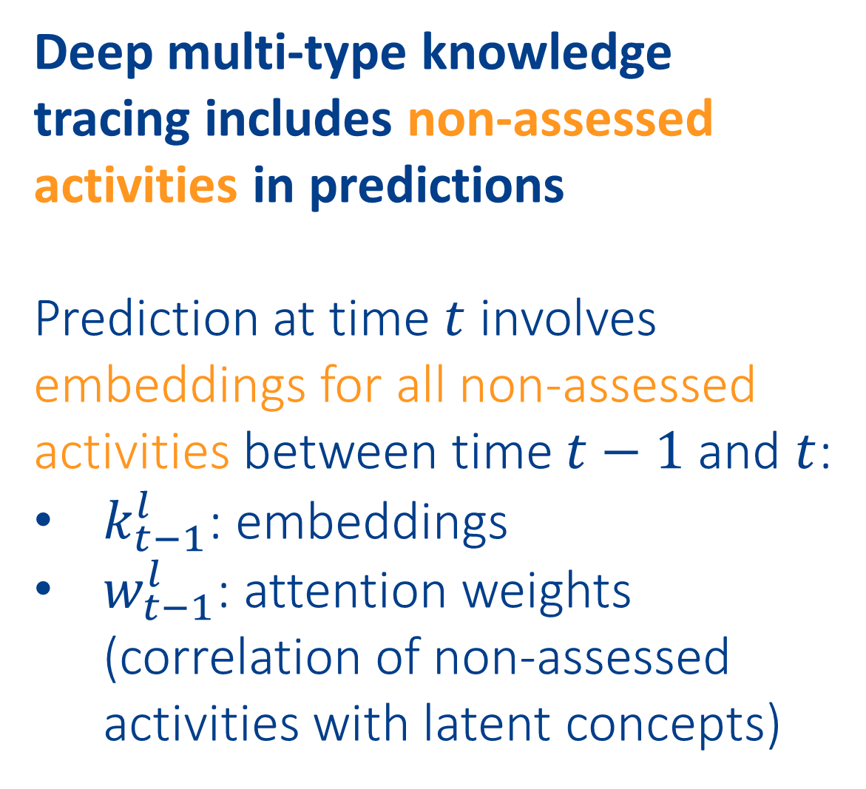
Methodology
DMKT
Deep multi-type knowledge tracing includes non-assessed activities in predictions
Prediction at time $t$ involves embeddings for all non-assessed activities between time $t−1$ and $t$:
$k_{t−1}^{l}$: embeddings
$w_{t−1}^{l}$: attention weights (correlation of non-assessed activities with latent concepts)

Slide 10
Methodology
COMPARING DKVMN and DMKT

Slide 11
Timeline
Problem Motivation
Related Work
Methodology
Evaluation
Conclusion & Future Work
Comparison against 13 baselines on student performance prediction
Analyze knowledge state evolution with respect to assessed and non-assessed learning activities
Validation of discovered latent concepts

Slide 12
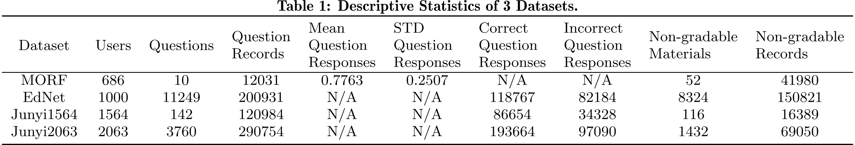
Evaluation
THREE REAL-WORLD DATASETS
MORF: an open online course from Coursera
Problems (assessed) & lectures (non-assessed)
Multiple attempts on each problem, watch any video anytime
EdNet: an AI tutoring service to prepare TOEIC English testing
Problems (assessed) & explanation documents (non-assessed)
Junyi: a Chinese e-learning website
Problems (assessed) & problem hints (non-assessed)
Students can request hints when solving problems

Slide 13
Evaluation
13 BASELINE METHODS
6 state-of-the-art deep learning based knowledge tracing models
4 baselines that can leverage non-assessed activities by design
DeepIRT
Extension of DKVMN with IRT
MLP-M
Multi-layer perceptron
DKT-M
DKT w/ feature embeddings
DKT
Uses RNNs and LSTM cells
SAINT-M
Variant of SAINT
SAINT
Transformer-based
MVKM
Multiview tensor factorization
3 baselines from modified models not supporting non-assessed activities
DKVMN
Variant of MANNs
SAKT
Attention-based
DKVMN-M
Multi-layer perceptron
SAKT-M
DKT w/ feature embeddings
AKT
Variant of transformer-based
AKT-M
Variant of SAINT

Slide 14
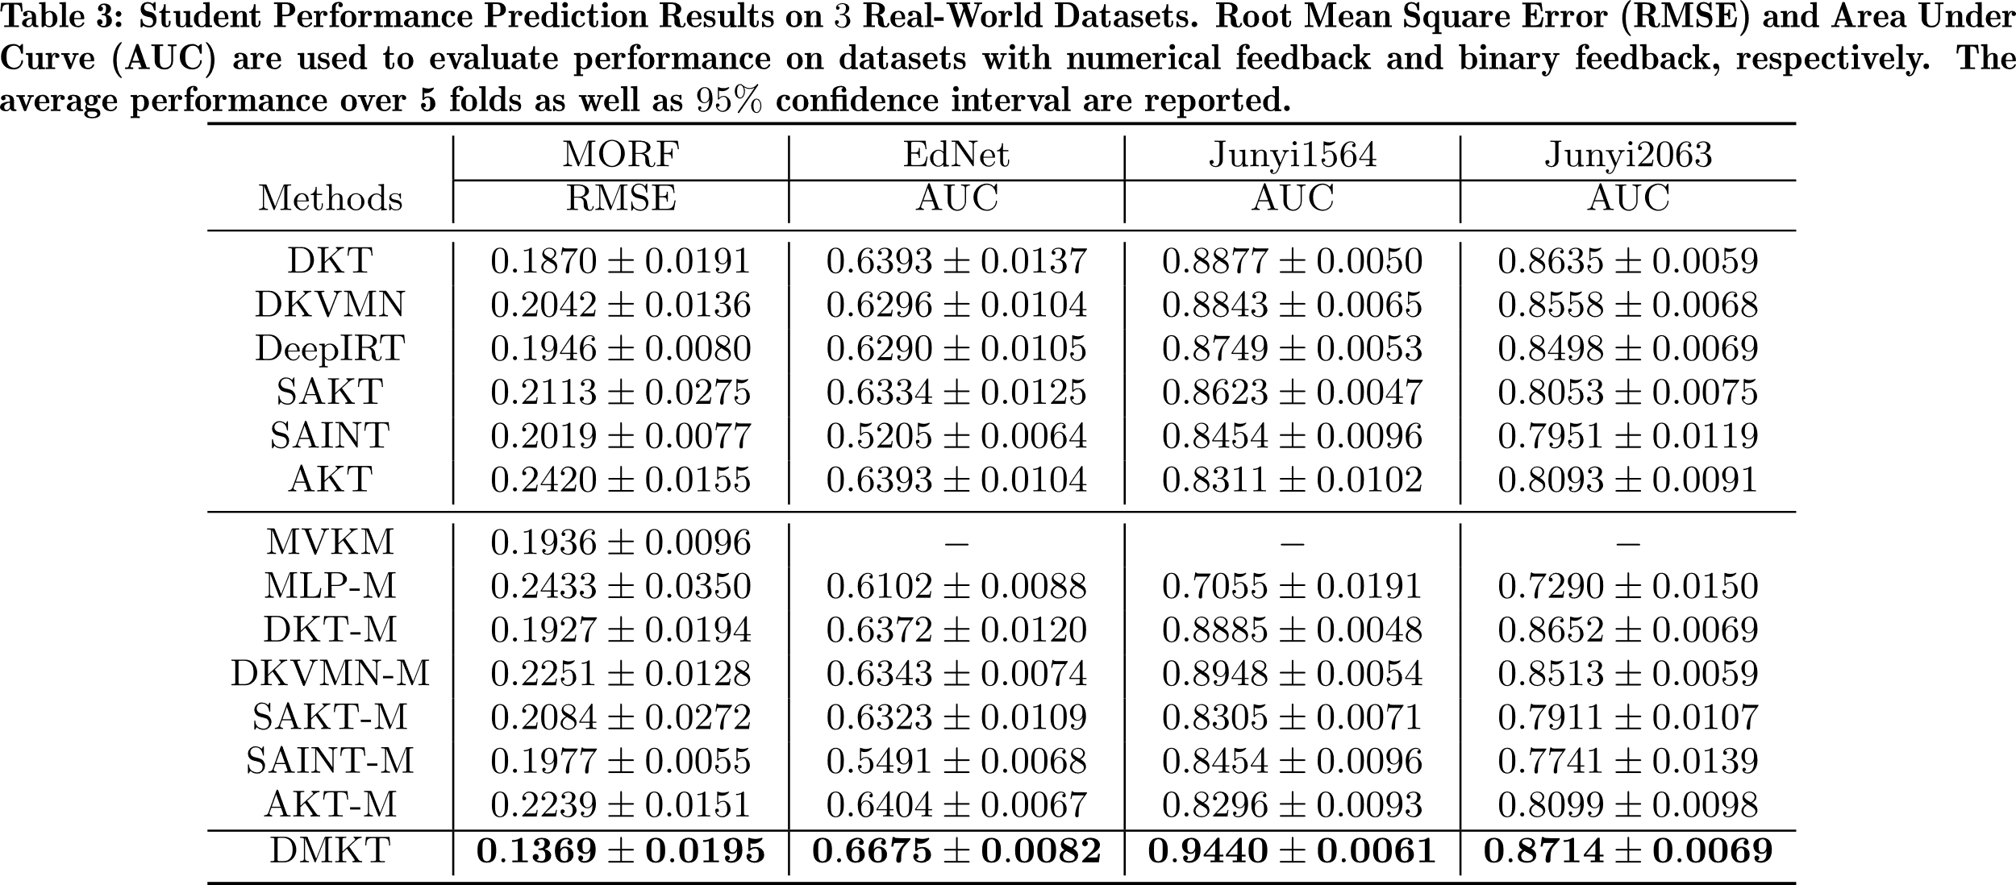
Evaluation
STUDENT PERFORMANCE PREDICTION
MVKM doesn’t run efficiently for larger datasets
Simply adding non-assessed activities as features may harm prediction performance
DMKT outperforms all baselines on all datasets

Slide 15
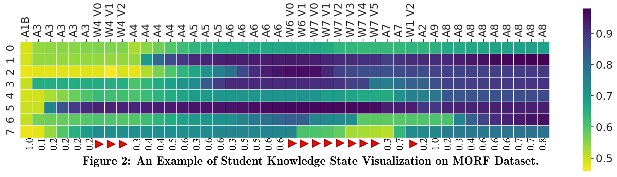
Evaluation
KNOWLEDGE STATE VISUALIZATION
Assessed activities start with A, non-assessed ones with W
8 latent concepts
Student performance on assessed activities indicated by a number

Slide 16
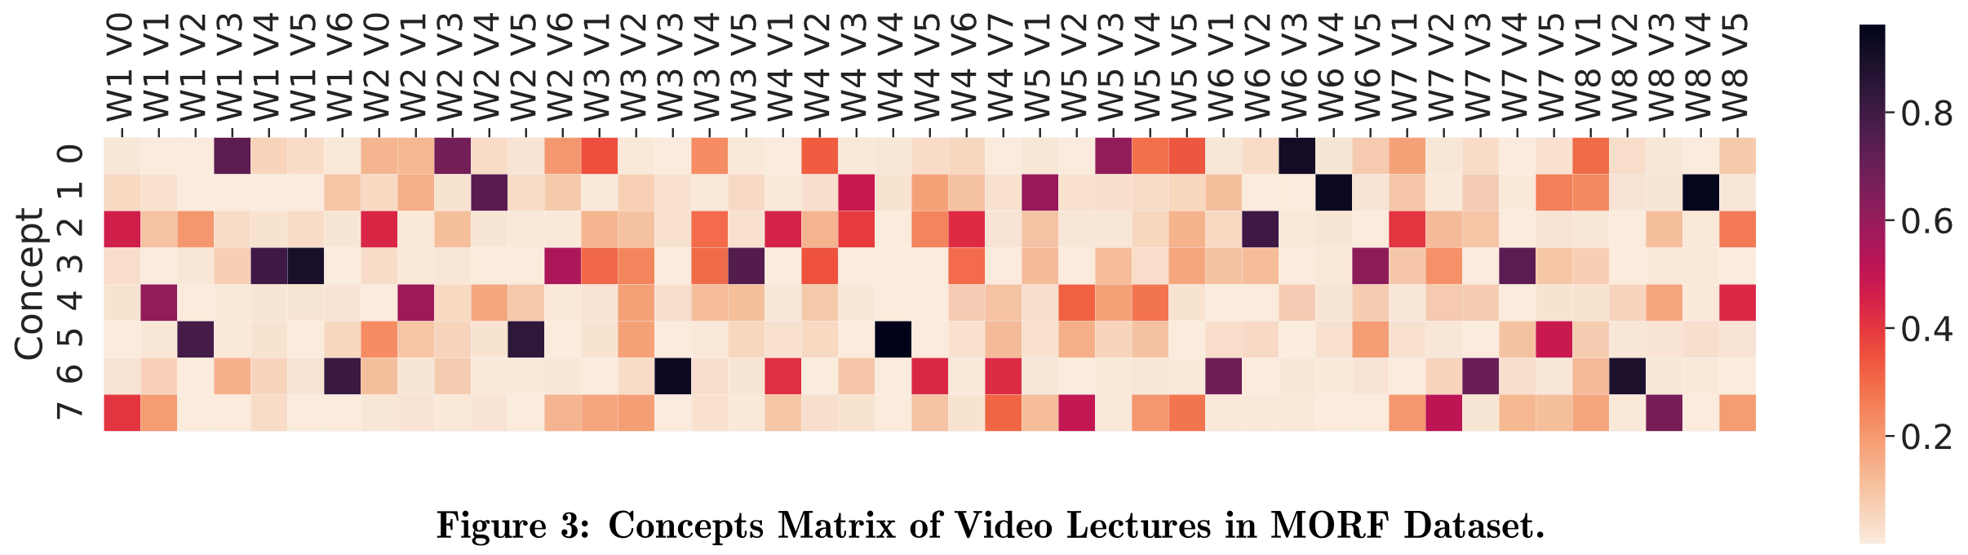
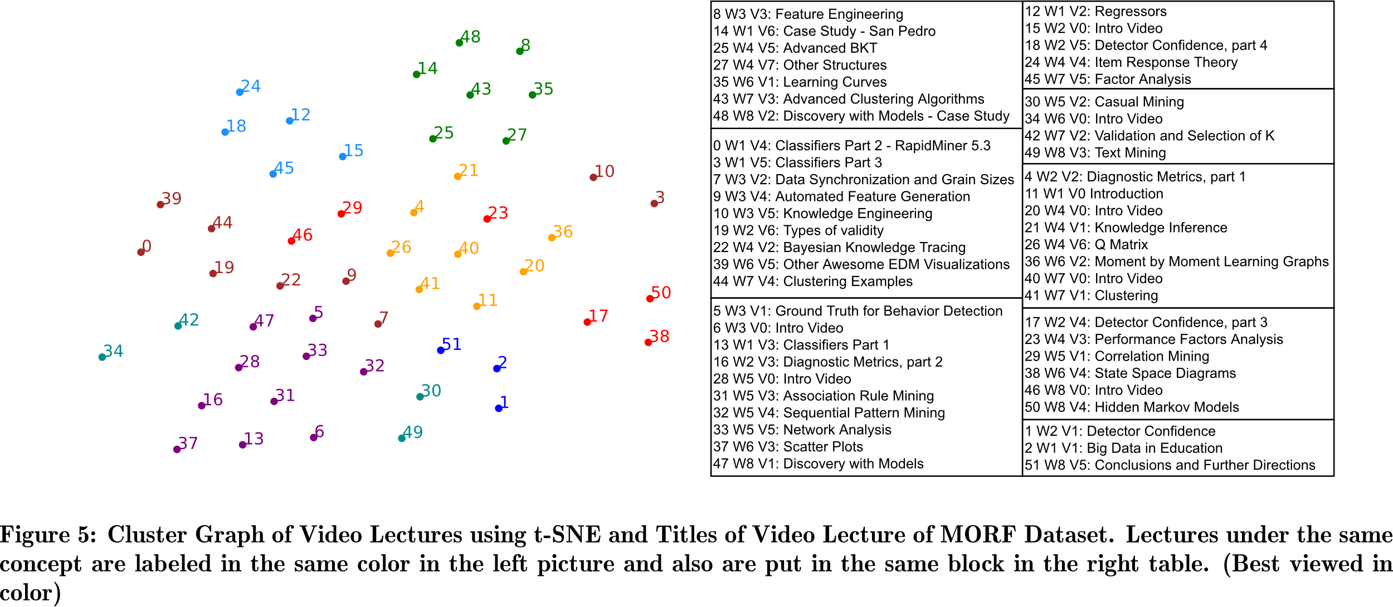
Evaluation
CONCEPT DISCOVERY
Correlation weights within network can be interpreted as importance of each latent concept in each activity
We can use these weights to find similar learning resources
Concept matrix for MORF dataset is relatively sparse, with most video lectures belonging to 2-3 concepts
Video lectures in the same week have similar concepts, which is expected

Slide 17
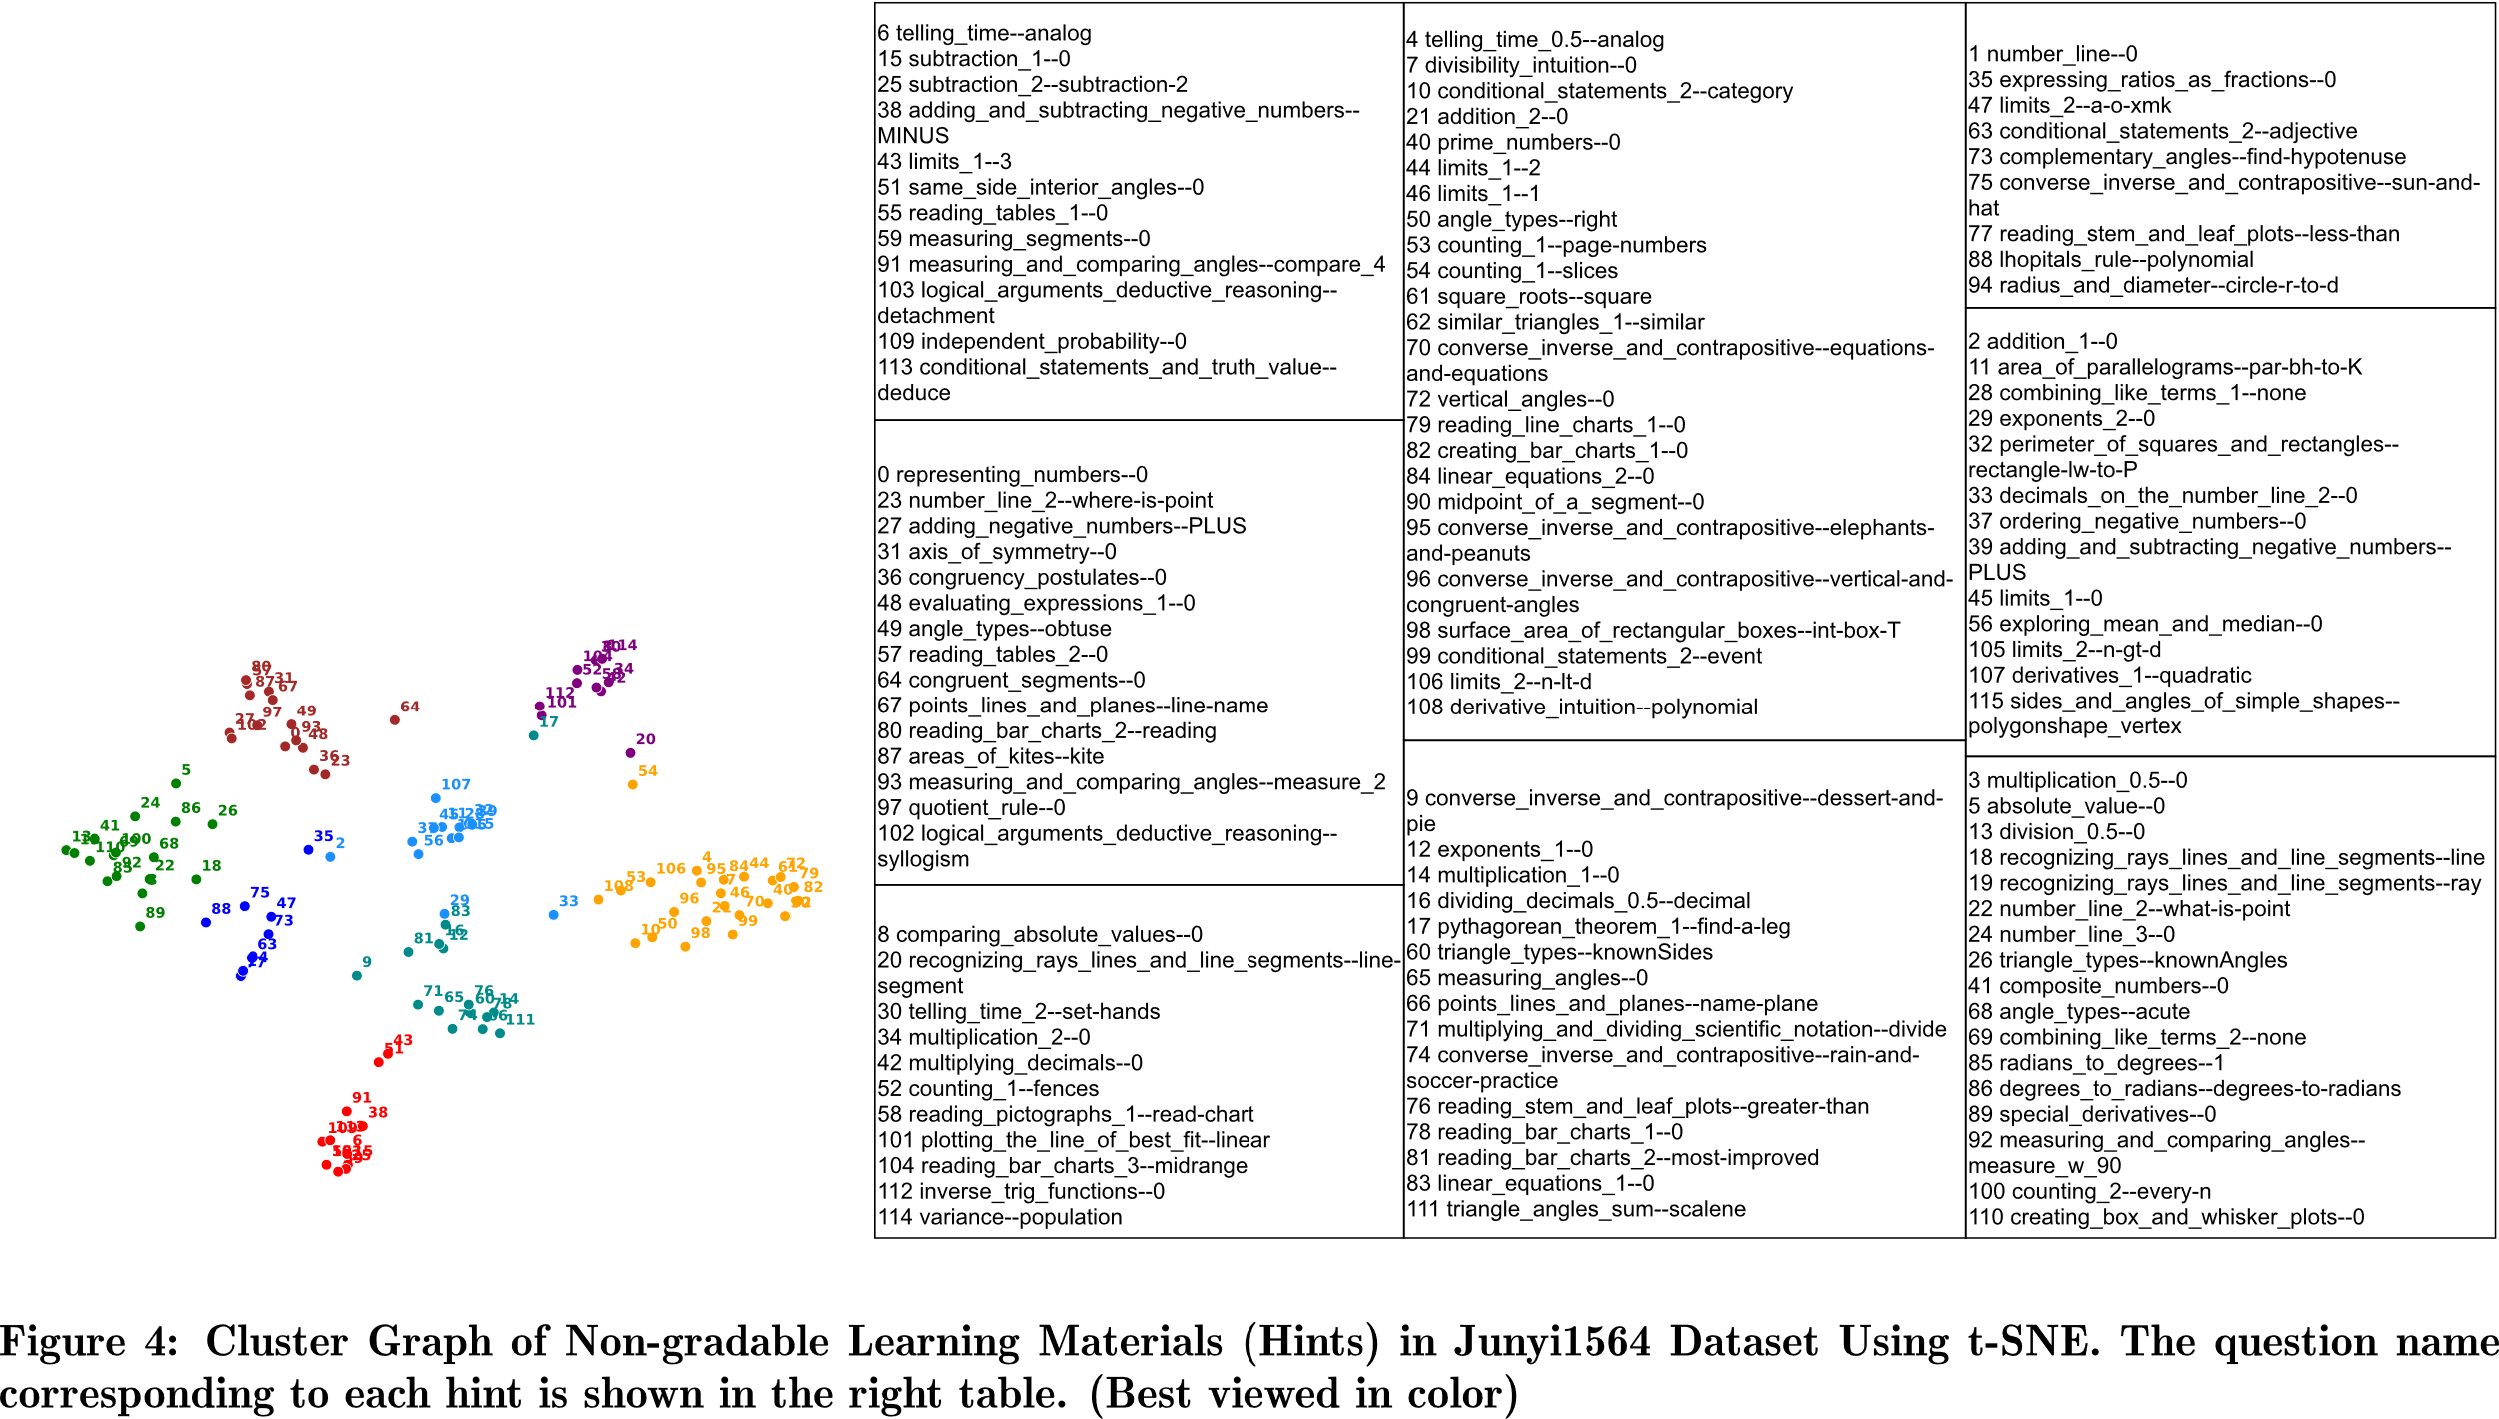
Evaluation
CONCEPT DISCOVERY

Slide 18
Timeline
Problem Motivation
Related Work
Methodology
Evaluation
Conclusion & Future Work

Slide 19
Conclusion & Future Work
The paper proposes DMKT, the first deep learning based KT framework to incorporate non-assessed learning resources
DMKT outperforms all baselines on the evaluated datasets
DMKT can discover latent concepts of non-assessed materials
Future work
Same qualitative advantages that DKVMN has:
Can represent non-linear relationships
Performance scales well with amount of data
Model finds similarities between learning resources
Evolution of knowledge state for each student is interpretable
Investigate model performance on different learning resources
Goal is to provide tailored learning recommendations

Slide 20
Thank you! Questions?

Slide 21
Architecture of DMKT

Slide 22
Architecture of DKVMN

