Slide 1
Representing & Predicting Knowledge
Tanja Käser
September 27, 2021

Slide 2



Student models enable individualization and insights
Select task
Give feedback
Provide hint
Individualization
Interaction
Model
Key stroke
Mouse Click
Speech
Video
Detection
Representation
Prediction
Strategies
Preferences
Learning skills
Insights
Notes:
Based on the predictions of these models we can then deliver the desired individualization and analyze and interpret the results.
An example could for example be that we have a probabilistic graphical model or a neural network to trace and predict the knowledge of the user and then select tasks with appropriate difficulty level.
Or we could use clustering techniques to learn about students learning strategies.
Of course, all the insights gained from the model are then fed back into our system.

Slide 3
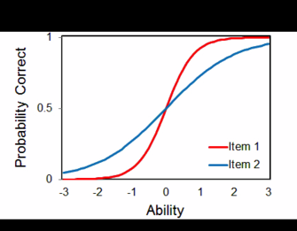
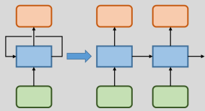
Modeling and Predicting Student Knowledge
Bayesian Knowledge Tracing (BKT)
Deep Knowledge Tracing (DKT)
Performance Factors Analysis (PFA)
Notes:
A lot of research has focused on accurately representing and predicting the knowledge and knowledge transitions of the user and today, I will present you three popular techniques for modeling and predicting student knowledge and learning.
BKT: BKT is a special case of a HMM, representing the knowledge of the student with different skills. It is simple, efficient, and widely used in educational software.

Slide 4

Inferring knowledge based on student answers
Subtraction 0-10
1
2
n
0
0
1
0
1
1
Notes:
Let us assume that we have a student solving subtraction task between 0 and 10.
The rectangles here denote a subtraction task
Solved n tasks
We can observe, whether the student answered the task correctly or not

Slide 5
Inferring knowledge based on student answers
Subtraction 0-10
1
2
n
n+1
0
0
1
0
1
1
?
Notes:
The goal of the model is: Given this sequence of n tasks, what is the probability that the student solves the next task correctly?

Slide 6
Modeling and Predicting Student Knowledge
Bayesian Knowledge Tracing (BKT)
Deep Knowledge Tracing (DKT)
Performance Factors Analysis (PFA)
Notes:
A lot of research has focused on accurately representing and predicting the knowledge and knowledge transitions of the user and today, I will present you three popular techniques for modeling and predicting student knowledge and learning.
BKT: BKT is a special case of a HMM, representing the knowledge of the student with different skills. It is simple, efficient, and widely used in educational software.

Slide 7
Bayesian Knowledge Tracing (BKT)
0
0
1
0
1
1
?
[Corbett & Anderson, UMUAI 1994]
Notes:
This leads me over to the Bayesian Knowledge Tracing model.
We add to the task outcomes a model of learning and track the knowledge of the student over time.

Slide 8
Bayesian Knowledge Tracing (BKT)
Latent variable
0
0
1
0
1
1
?
[Corbett & Anderson, UMUAI 1994]
Notes:
Blue node: Denotes the skill that is being trained, in our case subtraction 0-10. This is a binary variable, it is assumed that the skill can be either learned or not. We further assume that we cannot directly observe the knowledge of the students, because we cannot look into their heads. The variable is therefore hidden or latent.

Slide 9
Bayesian Knowledge Tracing (BKT)
Latent variable
Observed variable
0
0
1
0
1
1
?
[Corbett & Anderson, UMUAI 1994]
Notes:
However, we can observe students’ answers to tasks associated with the given skill. These answers are also binary (correct/wrong).
Assumptions of the model:
Knowledge can be divided into different skills
Definition of skills is accurate/detailed enough
Tasks are associated with one or several of these skills
Mastery can be achieved through practice

Slide 10
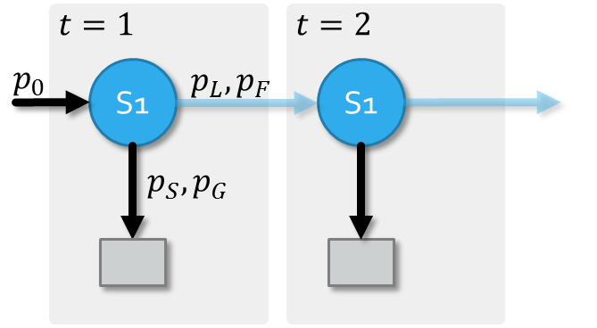

BKT parameters are interpretable
$$θ=\left\{p_{0},p_{L},p_{F},p_{S},p_{G}\right\}$$
[Corbett & Anderson, UMUAI 1994]
Notes:
The relations between skills and task outcomes as well as over time steps can be defined by 5 parameters.
These parameters can be interpreted in terms of learning. That means that they represent how students learn.

Slide 11
BKT parameters are interpretable
Probability of learning or forgetting
$$θ=\left\{p_{0},p_{L},p_{F},p_{S},p_{G}\right\}$$
[Corbett & Anderson, UMUAI 1994]
Notes:
Learning and forgetting

Slide 12
BKT parameters are interpretable
Probability of learning or forgetting
Probability of slipping or guessing
$$θ=\left\{p_{0},p_{L},p_{F},p_{S},p_{G}\right\}$$
[Corbett & Anderson, UMUAI 1994]
Notes:
Slipping and guessing

Slide 13
BKT parameters are interpretable
Probability of learning or forgetting
Initial probability
Probability of slipping or guessing
$$θ=\left\{p_{0},p_{L},p_{F},p_{S},p_{G}\right\}$$
[Corbett & Anderson, UMUAI 1994]
Notes:
Initial probability of knowing a skill a-priori.
In order to use our model and make predictions, we need to determine the values of the different probabilities.

Slide 14
BKT is simple and efficient
s
o
?
[Corbett & Anderson, UMUAI 1994]
Notes:
The equations to make these predictions are simple and efficient.
Here you see the first time step of a model and we want to predict the task outcome.

Slide 15

BKT is simple and efficient
s
o
$$p_{G},p_{S}$$
?
[Corbett & Anderson, UMUAI 1994]
Notes:
The relation between skill (blue) and task outcome (grey) is defined by the guess and slip probabilities.

Slide 16
BKT is simple and efficient
s
o
$$p_{G},p_{S}$$
?
$$p\left(o_{n}\right)=p\left(s_{n}\right)∙\left(1−p_{s}\right)+(1−p\left(s_{n}\right))∙p_{G}$$
[Corbett & Anderson, UMUAI 1994]
Notes:
Probability that the student solves task o_n correctly can be computed as
Knowledge and no slip, no knowledge and guess
Could do a similar thing for the probability of solving the task incorrect

Slide 17
BKT is simple and efficient
?
s
o
$$p_{G},p_{S}$$
1
$$p\left(o_{n}\right)=p\left(s_{n}\right)∙\left(1−p_{s}\right)+(1−p\left(s_{n}\right))∙p_{G}$$
[Corbett & Anderson, UMUAI 1994]
Notes:
As a next step: Probability that the student knew the skill, given that the task was solved correctly.

Slide 18
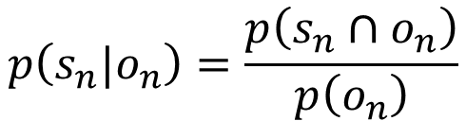
BKT is simple and efficient
?
s
o
$$p_{G},p_{S}$$
1
$$p\left(o_{n}\right)=p\left(s_{n}\right)∙\left(1−p_{s}\right)+(1−p\left(s_{n}\right))∙p_{G}$$
$$p\left(s_{n}{|o}_{n}\right)=\frac{p\left(s_{n}∩o_{n}\right)}{p\left(o_{n}\right)}$$
[Corbett & Anderson, UMUAI 1994]
Notes:
Prob that s_n (the skill) is 1 (learned), given that o_n was 1. This posterior probability can be computed using Bayes theorem.

Slide 19
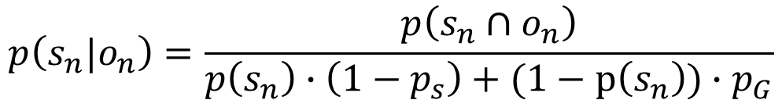
BKT is simple and efficient
?
s
o
$$p_{G},p_{S}$$
1
$$p\left(o_{n}\right)=p\left(s_{n}\right)∙\left(1−p_{s}\right)+(1−p\left(s_{n}\right))∙p_{G}$$
$$p\left(s_{n}{|o}_{n}\right)=\frac{p\left(s_{n}∩o_{n}\right)}{p\left(s_{n}\right)∙\left(1−p_{s}\right)+(1−p\left(s_{n}\right))∙p_{G}}$$
[Corbett & Anderson, UMUAI 1994]
Notes:
Denominator: p(o_n)
Nominator: probability that the student has learned the skill (s_n) and that the student solved the associated task correctly, so this is the probability that both s_n and o_n are 1.

Slide 20
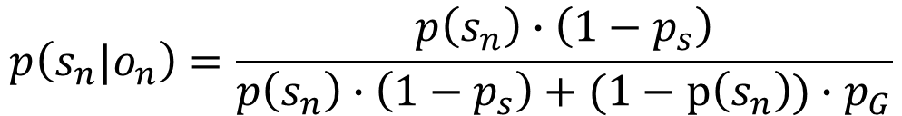
BKT is simple and efficient
?
s
o
$$p_{G},p_{S}$$
1
$$p\left(o_{n}\right)=p\left(s_{n}\right)∙\left(1−p_{s}\right)+(1−p\left(s_{n}\right))∙p_{G}$$
$$p\left(s_{n}{|o}_{n}\right)=\frac{p\left(s_{n}\right)∙\left(1−p_{s}\right)}{p\left(s_{n}\right)∙\left(1−p_{s}\right)+(1−p\left(s_{n}\right))∙p_{G}}$$
[Corbett & Anderson, UMUAI 1994]

Slide 21

BKT is simple and efficient
$$p_{F},p_{L}$$
?
s
o
1
$$p\left(o_{n}\right)=p\left(s_{n}\right)∙\left(1−p_{s}\right)+(1−p\left(s_{n}\right))∙p_{G}$$
$$p\left(s_{n}{|o}_{n}\right)=\frac{p\left(s_{n}\right)∙\left(1−p_{s}\right)}{p\left(s_{n}\right)∙\left(1−p_{s}\right)+(1−p\left(s_{n}\right))∙p_{G}}$$
[Corbett & Anderson, UMUAI 1994]
Notes:
This is: s_n is 1 and the student did not slip (1- p_s)
Formula can be deduced in the same way for the case that o_n is 0
We are then interested in predicting, whether the student will have learned the skill s_n

Slide 22
BKT is simple and efficient
$$p_{F},p_{T}$$
?
s
o
1
$$p\left(o_{n}\right)=p\left(s_{n}\right)∙\left(1−p_{s}\right)+(1−p\left(s_{n}\right))∙p_{G}$$
$$p\left(s_{n}{|o}_{n}\right)=\frac{p\left(s_{n}\right)∙\left(1−p_{s}\right)}{p\left(s_{n}\right)∙\left(1−p_{s}\right)+(1−p\left(s_{n}\right))∙p_{G}}$$
$$p\left(s_{n+1}\right)=p\left(s_{n}\right)∙\left(1−p_{F}\right)+(1−p\left(s_{n}\right))∙p_{L}$$
[Corbett & Anderson, UMUAI 1994]
Notes:
In other words, we want to predict whether p(s_n+1) = 1.
Can be computed as follows: know and not forget, not know and learn

Slide 23
BKT is simple and efficient
$$p_{F},p_{T}$$
s
o
1
?
$$p\left(o_{n}\right)=p\left(s_{n}\right)∙\left(1−p_{s}\right)+(1−p\left(s_{n}\right))∙p_{G}$$
$$p\left(s_{n}{|o}_{n}\right)=\frac{p\left(s_{n}\right)∙\left(1−p_{s}\right)}{p\left(s_{n}\right)∙\left(1−p_{s}\right)+(1−p\left(s_{n}\right))∙p_{G}}$$
$$p\left(s_{n+1}\right)=p\left(s_{n}\right)∙\left(1−p_{F}\right)+(1−p\left(s_{n}\right))∙p_{L}$$
[Corbett & Anderson, UMUAI 1994]
Notes:
In a next step, we would then use the first equation to predict the next outcome.
Let us compute the predictions for an example student.

Slide 24





Making predictions using a BKT model
0.5
$$p_{0}=0.5$$
$$p_{S}=0.2$$
$$p_{G}=0.3$$
$$p_{L}=0.4$$
$$p_{F}=0.0$$
Notes:
Explain the different values: Po. Ps, pg, pl,pf
Before the student has solved a task: 0.5

Slide 25
Making predictions using a BKT model
0.22
$$p_{0}=0.5$$
$$p_{S}=0.2$$
$$p_{G}=0.3$$
$$p_{L}=0.4$$
0
$$p_{F}=0.0$$
Notes:
After observing wrong: 0.22

Slide 26
Making predictions using a BKT model
0.22
0.53
$$p_{0}=0.5$$
$$p_{S}=0.2$$
$$p_{G}=0.3$$
$$p_{L}=0.4$$
0
$$p_{F}=0.0$$
Notes:
Next step: 0.53

Slide 27
Making predictions using a BKT model
0.22
0.75
0.85
$$p_{0}=0.5$$
$$p_{S}=0.2$$
$$p_{G}=0.3$$
$$p_{L}=0.4$$
0
1
$$p_{F}=0.0$$
Notes:
After observing correct: 0.75
Prediction for next step is: 0.85

Slide 28
Making predictions using a BKT model
0.22
0.75
0.94
0.96
$$p_{0}=0.5$$
$$p_{S}=0.2$$
$$p_{G}=0.3$$
$$p_{L}=0.4$$
0
1
1
$$p_{F}=0.0$$
Notes:
After observing correct: 0.94
Prediction for next step: 0.96

Slide 29
Making predictions using a BKT model
0.22
0.75
0.94
0.96
$$p_{0}=0.5$$
$$p_{S}=0.2$$
$$p_{G}=0.3$$
$$p_{L}=0.4$$
0
1
1
?
$$p_{F}=0.0$$
0.78
Notes:
Having learned the parameters and being able to do prediction, the next step would be to make the teaching decision. A common rule is to stop practicing a task when the probability of having learned a skill is higher than 0.95. There are data-driven ways of doing this, I will not go into details with that.
As you have seen, BKT, the first presented approach is simple, efficient, and interpretable.

Slide 30

Training a BKT model
$$θ=\left\{p_{0},p_{L},p_{F},p_{S},p_{G}\right\}$$
Student A:
0
1
1
0
1
0
Student B:
1
1
0
1
0
1
Student C:
0
1
0
1
1
1
Notes:
We could of course choose the parameters ourselves or let them determine by experts.
However, to obtain more accurate predictions, we need to fit them to the data.
That means: Given the sequences of task outcomes of all students, we want to find a set of parameter values that minimizes the prediction error of our model.
Or, more mathematically:
Given sequences of observations for N students, we want to find the parameters/probabilities theta that maximize the likelihood of the data.
This can be done using methods such as expectation maximization, brute-force grid search, or gradient descent.
Having solved the parameter task, the next task that we need to solve in order to be able to use our model in an online learning tool, is called inference. That means, we want to use the model to make predictions.

Slide 31






Training a BKT model
$$θ=\left\{p_{0},p_{L},p_{F},p_{S},p_{G}\right\}$$
$$h_{1}$$
$$h_{2}$$
$$p\left(A ∪B\right)=p\left(A\right)+p\left(B\right)$$
Student A:
$$o_{1}=0$$
$$o_{2}=1$$
$$p\left(o=\left[0,1\right]\right)=p\left(o_{1}=0 | h_{1}=0\right)∙p\left(h_{1}=0\right)∙p\left(h_{2}=0 | h_{1}=0\right)∙p\left(o_{2}=1 | h_{2}=0\right)$$
$$+ p\left(o_{1}=0 | h_{1}=0\right)∙p\left(h_{1}=0\right)∙p\left(h_{2}=1 | h_{1}=0\right)∙p\left(o_{2}=1 | h_{2}=1\right)$$
$$+ p\left(o_{1}=0 | h_{1}=1\right)∙p\left(h_{1}=1\right)∙p\left(h_{2}=0 | h_{1}=1\right)∙p\left(o_{2}=1 | h_{2}=0\right)$$
$$+ p\left(o_{1}=0 | h_{1}=1\right)∙p\left(h_{1}=1\right)∙p\left(h_{2}=1 | h_{1}=1\right)∙p\left(o_{2}=1 | h_{2}=1\right)$$
Notes:
We could of course choose the parameters ourselves or let them determine by experts.
However, to obtain more accurate predictions, we need to fit them to the data.
That means: Given the sequences of task outcomes of all students, we want to find a set of parameter values that minimizes the prediction error of our model.
Or, more mathematically:
Given sequences of observations for N students, we want to find the parameters/probabilities theta that maximize the likelihood of the data.
This can be done using methods such as expectation maximization, brute-force grid search, or gradient descent.
Having solved the parameter task, the next task that we need to solve in order to be able to use our model in an online learning tool, is called inference. That means, we want to use the model to make predictions.

Slide 32
Training a BKT model
$$θ=\left\{p_{0},p_{L},p_{F},p_{S},p_{G}\right\}$$
$$h_{1}$$
$$h_{2}$$
$$p\left(A ∪B\right)=p\left(A\right)+p\left(B\right)$$
Student A:
$$o_{1}=0$$
$$o_{2}=1$$
$$p\left(o=\left[0,1\right]\right)=p\left(o=\left[0,1\right],h_{1}=0,h_{2}=0 | θ\right)$$
$$+ p\left(o_{1}=0 | h_{1}=0\right)∙p\left(h_{1}=0\right)∙p\left(h_{2}=1 | h_{1}=0\right)∙p\left(o_{2}=1 | h_{2}=1\right)$$
$$+ p\left(o_{1}=0 | h_{1}=1\right)∙p\left(h_{1}=1\right)∙p\left(h_{2}=0 | h_{1}=1\right)∙p\left(o_{2}=1 | h_{2}=0\right)$$
$$+ p\left(o_{1}=0 | h_{1}=1\right)∙p\left(h_{1}=1\right)∙p\left(h_{2}=1 | h_{1}=1\right)∙p\left(o_{2}=1 | h_{2}=1\right)$$
Notes:
We could of course choose the parameters ourselves or let them determine by experts.
However, to obtain more accurate predictions, we need to fit them to the data.
That means: Given the sequences of task outcomes of all students, we want to find a set of parameter values that minimizes the prediction error of our model.
Or, more mathematically:
Given sequences of observations for N students, we want to find the parameters/probabilities theta that maximize the likelihood of the data.
This can be done using methods such as expectation maximization, brute-force grid search, or gradient descent.
Having solved the parameter task, the next task that we need to solve in order to be able to use our model in an online learning tool, is called inference. That means, we want to use the model to make predictions.

Slide 33



Training a BKT model
$$θ=\left\{p_{0},p_{L},p_{F},p_{S},p_{G}\right\}$$
$$h_{1}$$
$$h_{2}$$
$$p\left(A ∪B\right)=p\left(A\right)+p\left(B\right)$$
Student A:
$$o_{1}=0$$
$$o_{2}=1$$
$$p\left(o=\left[0,1\right]\right)=p\left(o=\left[0,1\right],h_{1}=0,h_{2}=0 | θ\right)$$
$$+ p\left(o=\left[0,1\right],h_{1}=0,h_{2}=1 | θ\right)$$
$$+ p\left(o=\left[0,1\right],h_{1}=1,h_{2}=0 | θ\right)$$
$$+ p\left(o=\left[0,1\right],h_{1}=1,h_{2}=1 | θ\right)$$
Notes:
We could of course choose the parameters ourselves or let them determine by experts.
However, to obtain more accurate predictions, we need to fit them to the data.
That means: Given the sequences of task outcomes of all students, we want to find a set of parameter values that minimizes the prediction error of our model.
Or, more mathematically:
Given sequences of observations for N students, we want to find the parameters/probabilities theta that maximize the likelihood of the data.
This can be done using methods such as expectation maximization, brute-force grid search, or gradient descent.
Having solved the parameter task, the next task that we need to solve in order to be able to use our model in an online learning tool, is called inference. That means, we want to use the model to make predictions.

Slide 34
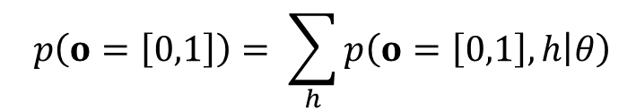
Training a BKT model
$$θ=\left\{p_{0},p_{L},p_{F},p_{S},p_{G}\right\}$$
$$h_{1}$$
$$h_{2}$$
$$p\left(A ∪B\right)=p\left(A\right)+p\left(B\right)$$
Student A:
$$o_{1}=0$$
$$o_{2}=1$$
$$p\left(o=\left[0,1\right]\right)= \sum_{h}{p\left(o=\left[0,1\right], h | θ\right)}$$
Notes:
We could of course choose the parameters ourselves or let them determine by experts.
However, to obtain more accurate predictions, we need to fit them to the data.
That means: Given the sequences of task outcomes of all students, we want to find a set of parameter values that minimizes the prediction error of our model.
Or, more mathematically:
Given sequences of observations for N students, we want to find the parameters/probabilities theta that maximize the likelihood of the data.
This can be done using methods such as expectation maximization, brute-force grid search, or gradient descent.
Having solved the parameter task, the next task that we need to solve in order to be able to use our model in an online learning tool, is called inference. That means, we want to use the model to make predictions.

Slide 35





Training a BKT model
$$θ=\left\{p_{0},p_{L},p_{F},p_{S},p_{G}\right\}$$
$$h_{1}$$
$$h_{2}$$
$$p\left(A ∪B\right)=p\left(A\right)+p\left(B\right)$$
$$o_{1}$$
$$o_{2}$$
Student A:
0
1
$$p\left(o=\left[0,1\right]\right)= \sum_{h}{p\left(o=\left[0,1\right], h | θ\right)}$$
Student B:
1
1
$$p\left(o=\left[1,1\right]\right)= \sum_{h}{p\left(o=\left[1,1\right], h | θ\right)}$$
Student C:
0
1
$$p\left(o=\left[0,1\right]\right)= \sum_{h}{p\left(o=\left[0,1\right], h | θ\right)}$$
Notes:
We could of course choose the parameters ourselves or let them determine by experts.
However, to obtain more accurate predictions, we need to fit them to the data.
That means: Given the sequences of task outcomes of all students, we want to find a set of parameter values that minimizes the prediction error of our model.
Or, more mathematically:
Given sequences of observations for N students, we want to find the parameters/probabilities theta that maximize the likelihood of the data.
This can be done using methods such as expectation maximization, brute-force grid search, or gradient descent.
Having solved the parameter task, the next task that we need to solve in order to be able to use our model in an online learning tool, is called inference. That means, we want to use the model to make predictions.

Slide 36

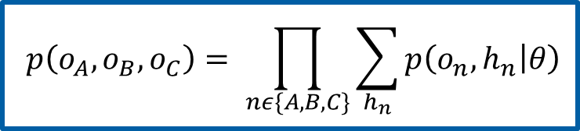
Training a BKT model
$$θ=\left\{p_{0},p_{L},p_{F},p_{S},p_{G}\right\}$$
$$h_{1}$$
$$h_{2}$$
$$p\left(A ∩B\right)=p\left(A\right)∙p\left(B\right)$$
$$o_{1}$$
$$o_{2}$$
Student A:
0
1
$$p\left(o_{A},o_{B},o_{C}\right)= \prod_{nε\{A,B,C\}}{\sum_{h_{n}}{p\left(o_{n}, h_{n} | θ\right)}}$$
Student B:
1
1
Student C:
0
1
Notes:
We could of course choose the parameters ourselves or let them determine by experts.
However, to obtain more accurate predictions, we need to fit them to the data.
That means: Given the sequences of task outcomes of all students, we want to find a set of parameter values that minimizes the prediction error of our model.
Or, more mathematically:
Given sequences of observations for N students, we want to find the parameters/probabilities theta that maximize the likelihood of the data.
This can be done using methods such as expectation maximization, brute-force grid search, or gradient descent.
Having solved the parameter task, the next task that we need to solve in order to be able to use our model in an online learning tool, is called inference. That means, we want to use the model to make predictions.

Slide 37
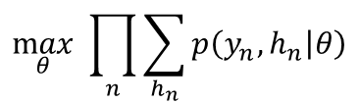
Training a BKT model
$$θ=\left\{p_{0},p_{L},p_{F},p_{S},p_{G}\right\}$$
$$\max_{θ}{ \prod_{n}{\sum_{h_{n}}{p\left(y_{n},h_{n} | θ\right)}}}$$
Notes:
We could of course choose the parameters ourselves or let them determine by experts.
However, to obtain more accurate predictions, we need to fit them to the data.
That means: Given the sequences of task outcomes of all students, we want to find a set of parameter values that minimizes the prediction error of our model.
This can be done using methods such as expectation maximization, brute-force grid search, or gradient descent.
Having solved the parameter task, the next task that we need to solve in order to be able to use our model in an online learning tool, is called inference. That means, we want to use the model to make predictions.

Slide 38
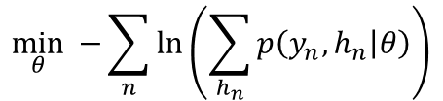
Training a BKT model
$$θ=\left\{p_{0},p_{L},p_{F},p_{S},p_{G}\right\}$$
$$\max_{θ}{ \prod_{n}{\sum_{h_{n}}{p\left(y_{n},h_{n} | θ\right)}}}$$
$$\min_{θ}{ −\sum_{n}{\ln\left(\sum_{h_{n}}{p\left(y_{n},h_{n} | θ\right)}\right)}}$$
Notes:
We could of course choose the parameters ourselves or let them determine by experts.
However, to obtain more accurate predictions, we need to fit them to the data.
That means: Given the sequences of task outcomes of all students, we want to find a set of parameter values that minimizes the prediction error of our model.
This can be done using methods such as expectation maximization, brute-force grid search, or gradient descent.
Having solved the parameter task, the next task that we need to solve in order to be able to use our model in an online learning tool, is called inference. That means, we want to use the model to make predictions.

Slide 39
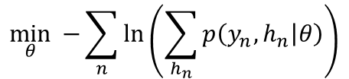
Training a BKT model
$$θ=\left\{p_{0},p_{L},p_{F},p_{S},p_{G}\right\}$$
Brute-Force Grid Search
Expectation Maximization
Gradient Descent
Nelder-Mead Optimization
$$\min_{θ}{ −\sum_{n}{\ln\left(\sum_{h_{n}}{p\left(y_{n},h_{n} | θ\right)}\right)}}$$
Notes:
We could of course choose the parameters ourselves or let them determine by experts.
However, to obtain more accurate predictions, we need to fit them to the data.
That means: Given the sequences of task outcomes of all students, we want to find a set of parameter values that minimizes the prediction error of our model.
This can be done using methods such as expectation maximization, brute-force grid search, or gradient descent.
Having solved the parameter task, the next task that we need to solve in order to be able to use our model in an online learning tool, is called inference. That means, we want to use the model to make predictions.

Slide 40
Modeling and Predicting Student Knowledge
Bayesian Knowledge Tracing (BKT)
Deep Knowledge Tracing (DKT)
Performance Factors Analysis (PFA)
Notes:
A lot of research has focused on accurately representing and predicting the knowledge and knowledge transitions of the user and today, I will present you three popular techniques for modeling and predicting student knowledge and learning.
BKT: BKT is a special case of a HMM, representing the knowledge of the student with different skills. It is simple, efficient, and widely used in educational software.

Slide 41
Deep Knowledge Tracing
y₁
y₂
y_{T}
h₀
h₁
h₂
h_{T}
x₁
x₂
x_{T}
[Piech et al., NIPS 2015]
Notes:
Over the last years, neural networks have been used successfully in domains such as computer vision or natural language processing. So called recurrent neural networks are able to handle sequences of arbitrary length. Recently, they have also been introduced to knowledge modeling.

Slide 42
Hidden layer captures relevant information
y₁
y₂
y_{T}
h₀
h₁
h₂
h_{T}
Hidden Layer
x₁
x₂
x_{T}
[Piech et al., NIPS 2015]
Notes:
Looks similar to BKT:
Hidden layer, supposed to capture the knowledge and learning of the student.

Slide 43
Input layer represents observations
y₁
y₂
y_{T}
h₀
h₁
h₂
h_{T}
Hidden Layer
0
1
2
0
1
2
0
1
0
0
0
0
0
0
0
1
0
0
0
0
0
0
1
0
Input Layer
[Piech et al., NIPS 2015]
Notes:
X: Input layer. The observation. Task outcomes of students. One-hot encoding, explain

Slide 44
Output layer consists of predicted probabilities
0
1
2
0.3
0.5
0.7
0.3
0.8
0.7
0.1
0.9
0.6
Output Layer
h₀
h₁
h₂
h_{T}
Hidden Layer
0
1
2
0
1
2
0
1
0
0
0
0
0
0
0
1
0
0
0
0
0
0
1
0
Input Layer
[Piech et al., NIPS 2015]
Notes:
Output layer: Prob. of solving a task correctly. One entry for each skill.

Slide 45


Network can learn non-linear relations
0
1
2
0.3
0.5
0.7
0.3
0.8
0.7
0.1
0.9
0.6
$$y_{t}=σ{(W_{yh}h_{t}+b_{y})}$$
h₀
h₁
h₂
h_{T}
$$h_{t}=\tanh{(W_{hx}x_{t}+W_{hh}h_{t−1}+b_{h})}$$
0
1
2
0
1
2
0
1
0
0
0
0
0
0
0
1
0
0
0
0
0
0
1
0
[Piech et al., NIPS 2015]
Notes:
Let us have a look at how the equations for this RNN look like.
Output layer: Hidden + bias, sigmoid function to have values between 0 and 1
Hidden layer: Combination of previous time step and actual observation + bias
Sigmoid = 1/(1+e^-x)
-> Advantage: Can learn non-linear relationships
-> Disadvantage: Many parameters needed (example: 6x6 + 6x6 + 6 + 3x6 + 3)
-> Training and prediction using frameworks such as Tensorflow

Slide 46
Modeling and Predicting Student Knowledge
Bayesian Knowledge Tracing (BKT)
Deep Knowledge Tracing (DKT)
Performance Factors Analysis (PFA)
Notes:
A lot of research has focused on accurately representing and predicting the knowledge and knowledge transitions of the user and today, I will present you three popular techniques for modeling and predicting student knowledge and learning.
BKT: BKT is a special case of a HMM, representing the knowledge of the student with different skills. It is simple, efficient, and widely used in educational software.

Slide 47
Item Response Theory (IRT)
Goal: explain the relationship between latent traits (unobservable characteristic or attribute) and their manifestations (i.e. observed outcomes, responses or performance)

Slide 48
Item Response Theory (IRT)
Goal: explain the relationship between latent traits (unobservable characteristic or attribute) and their manifestations (i.e. observed outcomes, responses or performance)
Knowledge/Skill
Binary answer

Slide 49
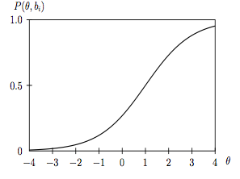
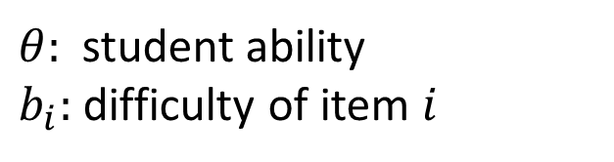
Item Response Theory (IRT)
Assumption: every response to an item provides some inclination about the individual’s level of the latent trait or ability
$θ:$ student ability
$b_{i}:$ difficulty of item $i$

Slide 50
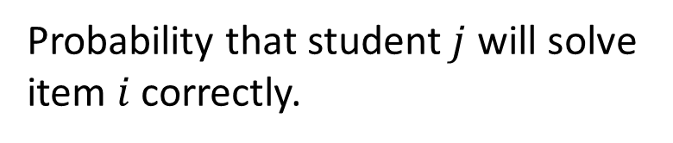

Rasch Model
$$P_{i,j}=\frac{e^{θ_{j} −{ b}_{i}}}{1+ e^{θ_{j }−b_{i}}}$$
Probability that student $j$ will solve item $i$ correctly.
$θ:$ student ability
$b_{i}:$ difficulty of item $i$
Notes:
-> S-Shaped curve = sigmoid!

Slide 51
Rasch Model
$$P_{i,j}=\frac{e^{θ_{j} −{ b}_{i}}}{1+ e^{θ_{j }−b_{i}}}$$
Probability that student $j$ will solve item $i$ correctly.
$θ:$ student ability
$b_{i}:$ difficulty of item $i$
Notes:
-> S-Shaped curve = sigmoid!

Slide 52

Additive Factors Model (AFM)
$$p_{n,i}=\frac{e^{π_{n,i }}}{1+ e^{π_{n,i }}}$$

Slide 53
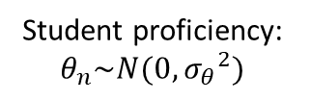
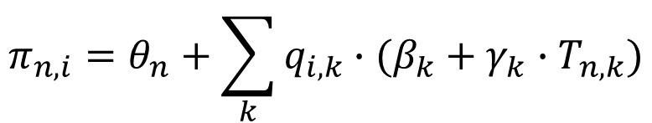
Additive Factors Model (AFM)
$$p_{n,i}=\frac{e^{π_{n,i }}}{1+ e^{π_{n,i }}}$$
$$π_{n,i}=θ_{n}+\sum_{k}{q_{i,k}∙(β_{k}+γ_{k}∙T_{n,k})}$$
Student proficiency: $θ_{n}\sim N(0,{σ_{θ}}^{2})$
[Cen et al., ITS 2006; Cen et al., IST 2008]
Notes:
here we outline five definitions that we have seen:
Fixed effects are constant across individuals, and random effects vary. For example, in a growth study, a model with random intercepts aiai and fixed slope bb corresponds to parallel lines for different individuals ii, or the model yit=ai+btyit=ai+bt. Kreft and De Leeuw (1998) thus distinguish between fixed and random coefficients.
Effects are fixed if they are interesting in themselves or random if there is interest in the underlying population. Searle, Casella, and McCulloch (1992, Section 1.4) explore this distinction in depth.
“When a sample exhausts the population, the corresponding variable is fixed; when the sample is a small (i.e., negligible) part of the population the corresponding variable is random.” (Green and Tukey, 1960)
“If an effect is assumed to be a realized value of a random variable, it is called a random effect.” (LaMotte, 1983)
Fixed effects are estimated using least squares (or, more generally, maximum likelihood) and random effects are estimated with shrinkage (“linear unbiased prediction” in the terminology of Robinson, 1991). This definition is standard in the multilevel modeling literature (see, for example, Snijders and Bosker, 1999, Section 4.2) and in econometrics.

Slide 54

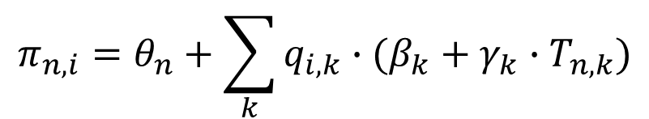
Additive Factors Model (AFM)
$$p_{n,i}=\frac{e^{π_{n,i }}}{1+ e^{π_{n,i }}}$$
$$π_{n,i}=θ_{n}+\sum_{k}{q_{i,k}∙(β_{k}+γ_{k}∙T_{n,k})}$$
Student proficiency: $θ_{n}\sim N(0,{σ_{θ}}^{2})$
$q_{ik}=1$, if item i uses skill k
[Cen et al., ITS 2006; Cen et al., IST 2008]
Notes:
ere we outline five definitions that we have seen:
Fixed effects are constant across individuals, and random effects vary. For example, in a growth study, a model with random intercepts aiai and fixed slope bb corresponds to parallel lines for different individuals ii, or the model yit=ai+btyit=ai+bt. Kreft and De Leeuw (1998) thus distinguish between fixed and random coefficients.
Effects are fixed if they are interesting in themselves or random if there is interest in the underlying population. Searle, Casella, and McCulloch (1992, Section 1.4) explore this distinction in depth.
“When a sample exhausts the population, the corresponding variable is fixed; when the sample is a small (i.e., negligible) part of the population the corresponding variable is random.” (Green and Tukey, 1960)
“If an effect is assumed to be a realized value of a random variable, it is called a random effect.” (LaMotte, 1983)
Fixed effects are estimated using least squares (or, more generally, maximum likelihood) and random effects are estimated with shrinkage (“linear unbiased prediction” in the terminology of Robinson, 1991). This definition is standard in the multilevel modeling literature (see, for example, Snijders and Bosker, 1999, Section 4.2) and in econometrics.

Slide 55
Additive Factors Model (AFM)
$$p_{n,i}=\frac{e^{π_{n,i }}}{1+ e^{π_{n,i }}}$$
$$π_{n,i}=θ_{n}+\sum_{k}{q_{i,k}∙(β_{k}+γ_{k}∙T_{n,k})}$$
Student proficiency: $θ_{n}\sim N(0,{σ_{θ}}^{2})$
Difficulty of skill k
$q_{ik}=1$, if item i uses skill k
[Cen et al., ITS 2006; Cen et al., IST 2008]
Notes:
ere we outline five definitions that we have seen:
Fixed effects are constant across individuals, and random effects vary. For example, in a growth study, a model with random intercepts aiai and fixed slope bb corresponds to parallel lines for different individuals ii, or the model yit=ai+btyit=ai+bt. Kreft and De Leeuw (1998) thus distinguish between fixed and random coefficients.
Effects are fixed if they are interesting in themselves or random if there is interest in the underlying population. Searle, Casella, and McCulloch (1992, Section 1.4) explore this distinction in depth.
“When a sample exhausts the population, the corresponding variable is fixed; when the sample is a small (i.e., negligible) part of the population the corresponding variable is random.” (Green and Tukey, 1960)
“If an effect is assumed to be a realized value of a random variable, it is called a random effect.” (LaMotte, 1983)
Fixed effects are estimated using least squares (or, more generally, maximum likelihood) and random effects are estimated with shrinkage (“linear unbiased prediction” in the terminology of Robinson, 1991). This definition is standard in the multilevel modeling literature (see, for example, Snijders and Bosker, 1999, Section 4.2) and in econometrics.

Slide 56
Additive Factors Model (AFM)
$$p_{n,i}=\frac{e^{π_{n,i }}}{1+ e^{π_{n,i }}}$$
$$π_{n,i}=θ_{n}+\sum_{k}{q_{i,k}∙(β_{k}+γ_{k}∙T_{n,k})}$$
Student proficiency: $θ_{n}\sim N(0,{σ_{θ}}^{2})$
Difficulty of skill k
Number of practice opportunities student n had at skill k
Learning rate at skill k
$q_{ik}=1$, if item i uses skill k
[Cen et al., ITS 2006; Cen et al., IST 2008]
Notes:
ere we outline five definitions that we have seen:
Fixed effects are constant across individuals, and random effects vary. For example, in a growth study, a model with random intercepts aiai and fixed slope bb corresponds to parallel lines for different individuals ii, or the model yit=ai+btyit=ai+bt. Kreft and De Leeuw (1998) thus distinguish between fixed and random coefficients.
Effects are fixed if they are interesting in themselves or random if there is interest in the underlying population. Searle, Casella, and McCulloch (1992, Section 1.4) explore this distinction in depth.
“When a sample exhausts the population, the corresponding variable is fixed; when the sample is a small (i.e., negligible) part of the population the corresponding variable is random.” (Green and Tukey, 1960)
“If an effect is assumed to be a realized value of a random variable, it is called a random effect.” (LaMotte, 1983)
Fixed effects are estimated using least squares (or, more generally, maximum likelihood) and random effects are estimated with shrinkage (“linear unbiased prediction” in the terminology of Robinson, 1991). This definition is standard in the multilevel modeling literature (see, for example, Snijders and Bosker, 1999, Section 4.2) and in econometrics.

Slide 57
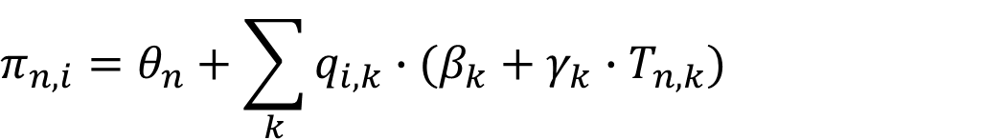
Performance Factors Analysis (PFA)
$$π_{n,i}=θ_{n}+\sum_{k}{q_{i,k}∙(β_{k}+γ_{k}∙T_{n,k})}$$
[Pavlik et al., AIED 2009]

Slide 58
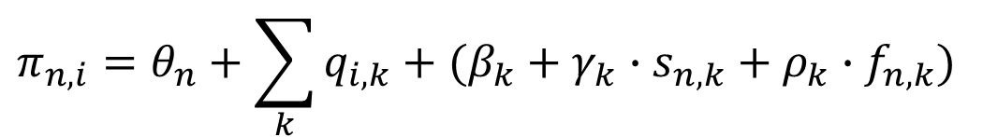
Performance Factors Analysis (PFA)
$$π_{n,i}=θ_{n}+\sum_{k}{q_{i,k}+(β_{k}+γ_{k}∙s_{n,k}+ρ_{k}∙f_{n,k})}$$
Number of prior successes student n had at skill k
Number of prior failures student n had at skill k
[Pavlik et al., AIED 2009]
Notes:
lme4 in R

Slide 59
Modeling and Predicting Student Knowledge
Bayesian Knowledge Tracing (BKT)
Deep Knowledge Tracing (DKT)
Performance Factors Analysis (PFA)
Notes:
A lot of research has focused on accurately representing and predicting the knowledge and knowledge transitions of the user and today, I will present you three popular techniques for modeling and predicting student knowledge and learning.
BKT: BKT is a special case of a HMM, representing the knowledge of the student with different skills. It is simple, efficient, and widely used in educational software.

Slide 60
Benchmarking of different student modeling techniques
Data Set
Students
Observations
AUC
Assistments
4417
328’000
Statics
333
189’297
Spanish
182
587’726
BKT
BKT+F
BKT+A
DKT
[How Deep is Knowledge Tracing?, Khajah et al., EDM 2016]
Notes:
Spanish: Middle School
Statics: College-level engineering
Assistments: Mathematics, K-12 education

Slide 61
Modeling and Predicting Student Knowledge
Learning Domain
Students
Observations
RMSE
BKT
Subtraction
1581
158’100
AFM
PFA
Physics
77
38’500
Algebra
6043
3’021’500
Spelling
7265
1’453’000
[Käser et al., IEEE TLT 2017]
Notes:
In the literature, there have been many attempts to improve the accuracy of Bayesian Knowledge Tracing with limited success. As you can see here, the new DBN modeling approach outperforms BKT over four data sets covering different learning domains and a wide age range. For all data sets and models, the parameters were trained using cross validation and the prediction accuracy is measured using the RMSE.
4 other learning domains (first two domains from Calcularis, Spelling domain from our own spelling data sets, physics and algebra data from DataShop)
Note that while these differences might look small, compared to previous work improving the accuracy of BKT models, our improvements in RMSE are considerably larger. Furthermore, it has been shown that even small improvements in prediction accuracy have a large effect on the learning time of the students, because prediction errors lead to underpractice or overpractice of skills.

Slide 62
References
[1] Corbett, A.T. & Anderson, J.R. (1995): Knowledge tracing: Modeling the acquisition of procedural knowledge, UMUAI
[2] Cen, H., Koedinger, K.R., Junker, B. (2006): Learning Factors Analysis - A general method for cognitive model evaluation and improvement, Proc. ITS
[3] Cen, H., Koedinger, K.R., Junker, B. (2008): Comparing two IRT models for conjunctive skills, Proc. ITS
[4] Pavlik, P.I., Cen, H., Koedinger, K.R. (2009): Performance Factors Analysis – A New Alternative to Knowledge Tracing, Proc. AIED
[5] Käser, T., Klingler, S., Schwing, A.G., Gross, M. (2017): Dynamic Bayesian Networks for Student Modeling, IEEE Transactions on Learning Technologies
[6] Piech, C., Bassen, J., Huang, J., Ganguli, S., Sahami, M., Guibas, L., Sohl-Dickstein, J. (2015): Deep Knowledge Tracing, Proc. NIPS
[7] Khajah, M., Lindsey, R.V., Mozer, M.C. (2016): How Deep is Knowledge Tracing?, Proc. EDM

