Slide 1
Writing Reviews
Tanja Käser
November 22, 2021

Slide 2
Agenda
Example review guidelines
Short input on reviews
Examine example reviews
Peer-review: review each other’s review

Slide 3
Example Review Guidelines
Each person on their own (5-10 minutes):
What are the criteria indicated for the respective venue?
Are their instructions regarding the structure and length of the venue?
In groups (10-15 minutes):
Inform your peers
What is similar among the guidelines? What is different?

Slide 4
Questions to ask: Big Picture
Relevance: Is the subject of paper suitable/relevant for this venue? Is the content of the paper likely to be of interest and appropriate for the target community?
Novelty: Is this a new and original contribution? Do the authors make clear what this contribution is?
Presentation: Is the paper clear, explicit, and well organized? Is the length appropriate for the content? Are there any gaps or redundancies?

Slide 5
Questions to ask: Introduction
Pitch: do the authors explain why the solved problem is relevant? Do they identify the gaps in previous work? Do they make their contribution clear?
Grounding: does the paper adequately refer to related work? Are the references complete and necessary?

Slide 6
Questions to ask: Methods
Is the paper technically sound and accurate?
Are the methods used suitable and well described?
Does the submission show accepted evidence of rigour in the tradition followed (statistical, computational, qualitative, design)?

Slide 7
Questions to ask: Results & Discussion
Have the ideas or systems been tested or evaluated sensibly?
Are the major claims and conclusions substantiated?

Slide 8
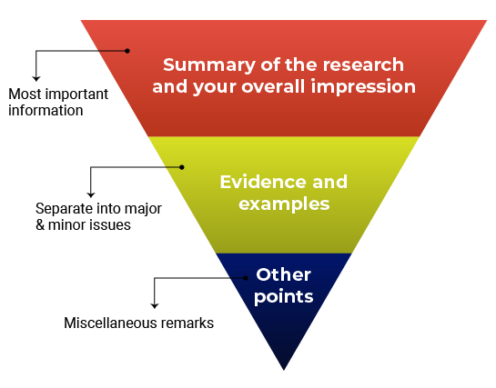
Structure
[Source: PLOS]

Slide 9
Major vs. Minor Issues
Major issues should consist of the essential points the authors need to address before the manuscript can proceed.
Minor issues:
Missing references (but depending on what is missing, this could also be a major issue)
Technical clarifications
Data presentation (e.g., the authors should present p-values differently or the authors should explain a figure better)
Typos, spelling, grammar, and phrasing issues

Slide 10


General Guidelines
Justify your recommendation with concrete evidence and specific examples.
Be specific so the authors know what they need to do to improve.
Be professional and respectful. The authors will be reading these comments too.
Remember to say what you liked about the manuscript!
Recommend additional experiments or unnecessary elements that are out of scope for the study or for the journal criteria.
Use the review to promote your own research or hypotheses.
Focus on typos and grammar. If the manuscript needs significant editing for language and writing quality, just mention this in your comments.

Slide 11
Formulation of constructive feedback
✗ Before
“It’s obvious that this type of experiment should have been included. I have no idea why the authors didn’t use it. This is a big mistake.”
✓ After
“The authors are off to a good start, however, this study requires additional experiments, particularly [type of experiment]. Alternatively, the authors should include more information that clarifies and justifies their choice of methods.”
[Source: PLOS]

Slide 12
Formulation of constructive feedback
✗ Before
“The authors appear to have no idea what they are talking about. I don’t think they have read any of the literature on this topic.”
✓ After
“The study fails to address how the findings relate to previous research in this area. The authors should rewrite their Introduction and Discussion to reference the related literature, especially recently published work such as Darwin et al.”
[Source: PLOS]

Slide 13
Examine example reviews
Examine the two example reviews:
Can you find answers to the presented questions?
Can you find the structural elements just presented?

Slide 14
Peer-review of reviews…
Two rounds:
Assess each other’s review: what do you like? What could be improved? What is missing?
Discuss

