Slide 1
Understanding Student Procrastination via Mixture Models
Presentation of the work from
Park, J., Yu, R., Rodriguez, F., Baker, R., Smyth, P., & Warschauer, M.
on International Educational Data Mining Society (2018)
Presenter: Angelika Romanou

Slide 2

2

Slide 3
Problem statement
Literature Review
Methodology
Experiments & Results
Conclusions
Agenda
Problem statement
Previous work
Proposed methodology
Experiments & Results
Overview and potential applications
3

Slide 4

Problem statement
Literature Review
Methodology
Experiments & Results
Conclusions
Procrastination in MOOCs
Lack of structure
Anonymity
MOOC:
Lectures
Assignments
Quizzes
Procrastination
DEADLINE
Self-regulation
4

Slide 5
Problem statement
Literature Review
Methodology
Experiments & Results
Conclusions
Procrastination in education
PREVIOUS WORK
Contribution
Self-regulated
behaviors
MOOC procrastination
& background characteristics
Demographic
characteristics
Procrastination
barrier
5

Slide 6
Problem statement
Literature Review
Methodology
Experiments & Results
Conclusions
Measuring procrastination
PREVIOUS WORK
Contribution
Clickstream
data
how regularity and procrastination are interrelated
Deadline - Interaction
Regularity
6

Slide 7
Problem statement
Literature Review
Methodology
Experiments & Results
Conclusions
Behavioral clustering
PREVIOUS WORK
Contribution
Hierarchical
clustering
Probabilistic student behavioral clustering with Poisson distributions
Deterministic clustering
Probabilistic clustering
Poisson mixtures
7

Slide 8
Problem statement
Literature Review
Methodology
Experiments & Results
Conclusions
Measuring student activity
14/07/2016
17:03
13/07/2016
13:24
8

Slide 9
Problem statement
Literature Review
Methodology
Experiments & Results
Conclusions
Measuring student activity
14/07/2016
17:03
3
2
13/07/2016
13:24
9

Slide 10
Problem statement
Literature Review
Methodology
Experiments & Results
Conclusions
Modeling student activity
Sat-Sun
Monday
Tuesday
Wednesday
Thursday
Friday
0
1
3
2
0
1
10

Slide 11
Problem statement
Literature Review
Methodology
Experiments & Results
Conclusions
Modeling student activity
Sat-Sun
Monday
Tuesday
Wednesday
Thursday
Friday
0
1
3
2
0
1
11

Slide 12
Problem statement
Literature Review
Methodology
Experiments & Results
Conclusions
Modeling student activity
Sat-Sun
Monday
Tuesday
Wednesday
Thursday
Friday
0
1
3
2
0
1
3
3
0
2
1
1
0
1
3
2
2
1
Aggregated daily task counts across weeks
Sat-Sun
Monday
Tuesday
Wednesday
Thursday
Friday
1
2
2
2
1
1
12

Slide 13
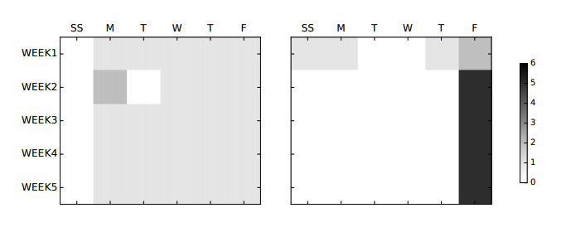
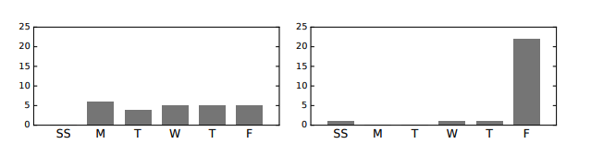
Problem statement
Literature Review
Methodology
Experiments & Results
Conclusions
Modeling student activity
Aggregated daily task counts
Aggregated daily task counts across weeks
Figures: Park, J., Yu, R., Rodriguez, F., Baker, R., Smyth, P., & Warschauer, M. (2018). Understanding Student Procrastination via Mixture Models. International Educational Data Mining Society.
13

Slide 14
Problem statement
Literature Review
Methodology
Experiments & Results
Conclusions
Modeling student behavior
GAUSSIAN MIXTURES
Soft clustering
14

Slide 15
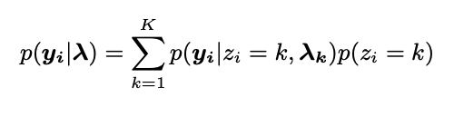
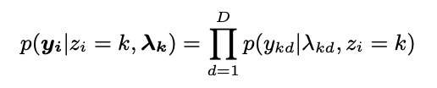
Problem statement
Literature Review
Methodology
Experiments & Results
Conclusions
Modeling student behavior
POISSON COMPONENTS – GAMMA PRIORS
Total Likelihood
Cluster Likelihood
Marginal mixing weight
Independent Gammas
15

Slide 16
Problem statement
Literature Review
Methodology
Experiments & Results
Conclusions
Modeling student behavior
EXPECTATION-MAXIMIZATION
16

Slide 17
Problem statement
Literature Review
Methodology
Experiments & Results
Conclusions
Modeling student behavior
EXPECTATION-MAXIMIZATION
17

Slide 18
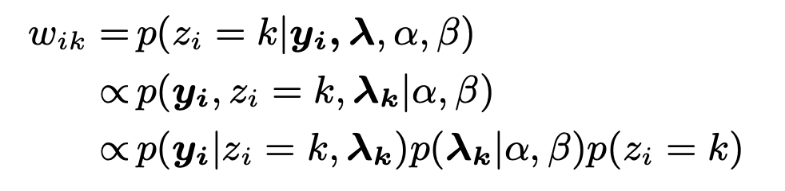
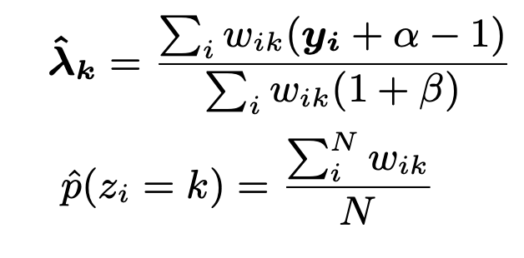
Problem statement
Literature Review
Methodology
Experiments & Results
Conclusions
Modeling student behavior
EXPECTATION-MAXIMIZATION
E Step
M Step
MAP estimation:
18

Slide 19
Problem statement
Literature Review
Methodology
Experiments & Results
Conclusions
Modeling student behavior
EXPECTATION-MAXIMIZATION
E Step
M Step
MAP estimation:
19

Slide 20


Problem statement
Literature Review
Methodology
Experiments & Results
Conclusions
Datasets
Clickstream data:
User ID
URL
Timestamp
Demographic data:
Gender
Ethnicity
First generation status
Income status
Academic achievements:
SAT score
Two summer course rounds: 2016 & 2017
5 weeks duration
5 lectures with a corresponding quiz each week
Deadline every Friday
20

Slide 21
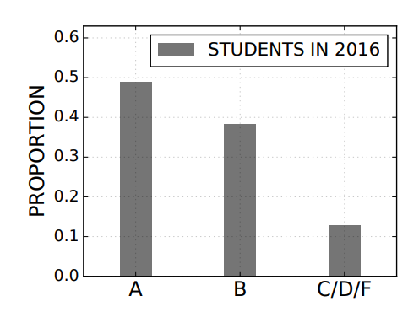
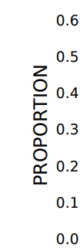
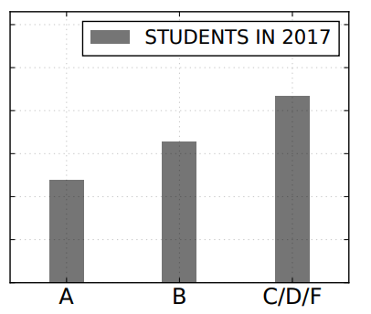
Problem statement
Literature Review
Methodology
Experiments & Results
Conclusions
Datasets
2016 vs 2017
172 students
First “video clicks”
Only video inside LMS
140 students
First click on “daily quizzes”
Video contribute to 8 % to final grade
Figures: Park, J., Yu, R., Rodriguez, F., Baker, R., Smyth, P., & Warschauer, M. (2018). Understanding Student Procrastination via Mixture Models. International Educational Data Mining Society.
21

Slide 22
Problem statement
Literature Review
Methodology
Experiments & Results
Conclusions
Experiments Overview
Identifying distinct behavioral patterns
Measure procrastination regularity
Investigation based on both procrastination and regularity score
Investigate correlations with demographic data
22

Slide 23
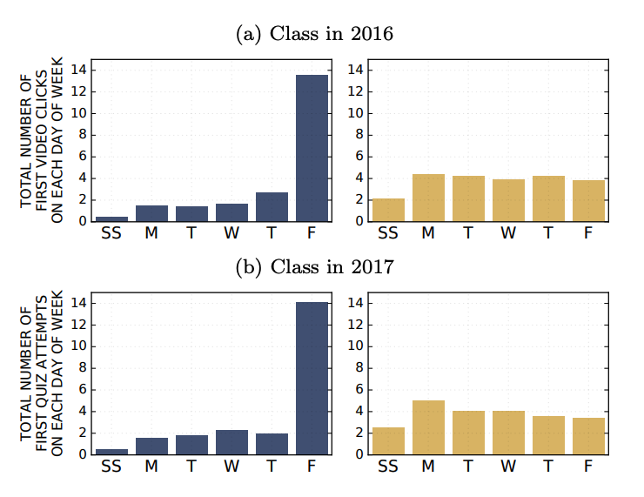
Problem statement
Literature Review
Methodology
Experiments & Results
Conclusions
A. Identifying procrastination
Two behavioral groups
Experiments on aggregated daily task count across week
2 Poisson components (2 clusters)
Figures: Park, J., Yu, R., Rodriguez, F., Baker, R., Smyth, P., & Warschauer, M. (2018). Understanding Student Procrastination via Mixture Models. International Educational Data Mining Society.
23

Slide 24
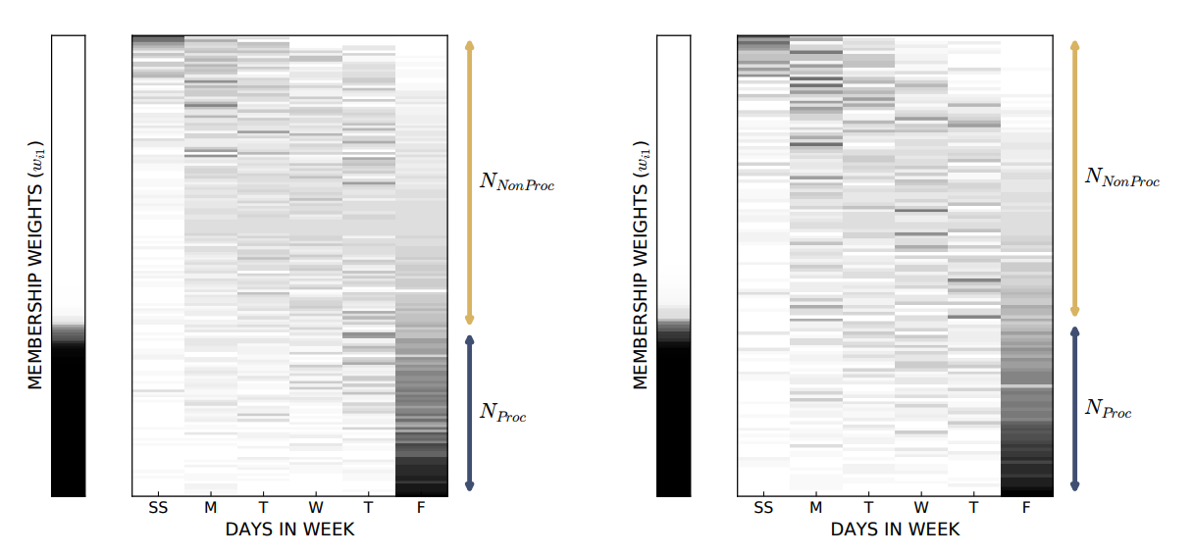
Problem statement
Literature Review
Methodology
Experiments & Results
Conclusions
A. Identifying procrastination
Two behavioral groups
CLASS 2016
CLASS 2017
Figures: Park, J., Yu, R., Rodriguez, F., Baker, R., Smyth, P., & Warschauer, M. (2018). Understanding Student Procrastination via Mixture Models. International Educational Data Mining Society.
24

Slide 25
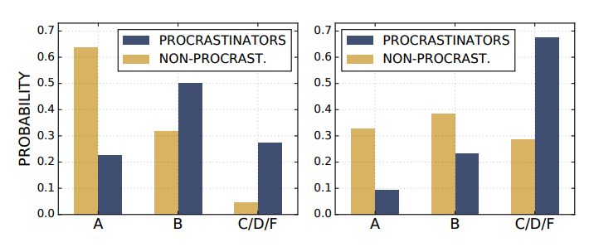
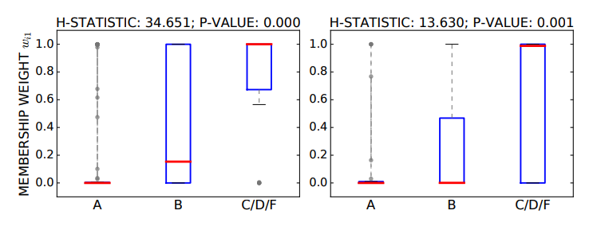
Problem statement
Problem statement
Literature Review
Literature Review
Methodology
Methodology
Experiments & Results
Experiments & Results
Conclusions
Conclusions
A. Identifying procrastination
Behavioral & grading groups analysis
BEHAVIORAL
GRADING
CLASS 2016
CLASS 2017
CLASS 2016
CLASS 2017
Non-procrastinators tend to get more A grades than procrastinators
Students who received lower grades have higher probability of being procrastinators
Figures: Park, J., Yu, R., Rodriguez, F., Baker, R., Smyth, P., & Warschauer, M. (2018). Understanding Student Procrastination via Mixture Models. International Educational Data Mining Society.
25

Slide 26
Problem statement
Literature Review
Methodology
Experiments & Results
Conclusions
A.
B. Measure procrastination regularity
Defining regularity
Sat-Sun
Monday
Tuesday
Wednesday
Thursday
Friday
0
1
3
2
0
1
3
3
0
2
1
1
0
1
3
2
2
1
Aggregated daily task counts across weeks
Sat-Sun
Monday
Tuesday
Wednesday
Thursday
Friday
1
2
2
2
1
1
26

Slide 27
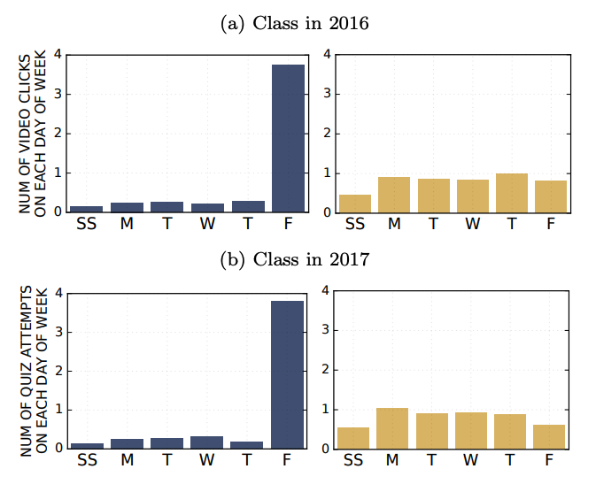
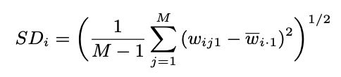
Problem statement
Literature Review
Methodology
Experiments & Results
Conclusions
A.
B. Measure procrastination regularity
Defining regularity
Deviation of procrastination:
Figures: Park, J., Yu, R., Rodriguez, F., Baker, R., Smyth, P., & Warschauer, M. (2018). Understanding Student Procrastination via Mixture Models. International Educational Data Mining Society.
27

Slide 28
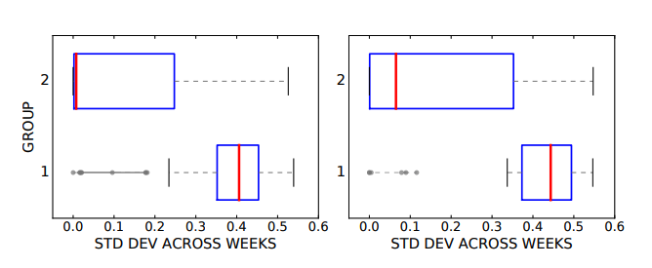
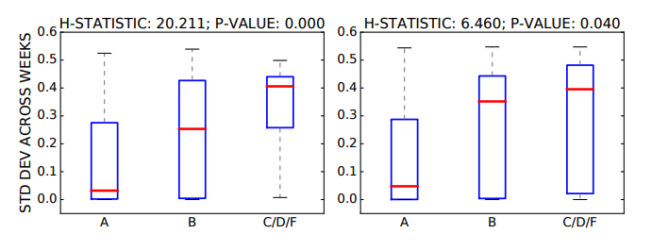
Problem statement
Literature Review
Methodology
Experiments & Results
Conclusions
A.
B. Measure procrastination regularity
Experiments on regularity
BEHAVIORAL
GRADING
CLASS 2016
CLASS 2017
CLASS 2016
CLASS 2017
Non-procrastinators are more likely to stay consistent throughout the course.
Students with better grades have lower level of SD
Figures: Park, J., Yu, R., Rodriguez, F., Baker, R., Smyth, P., & Warschauer, M. (2018). Understanding Student Procrastination via Mixture Models. International Educational Data Mining Society.
28

Slide 29

Problem statement
Literature Review
Methodology
Experiments & Results
Conclusions
A.
B.
C. Time management score
Combining Procrastination with regularity
TIME MANAGEMENT SCORE
Measures the degree of procrastination incorporating regularity information
Figures: Park, J., Yu, R., Rodriguez, F., Baker, R., Smyth, P., & Warschauer, M. (2018). Understanding Student Procrastination via Mixture Models. International Educational Data Mining Society.
29

Slide 30
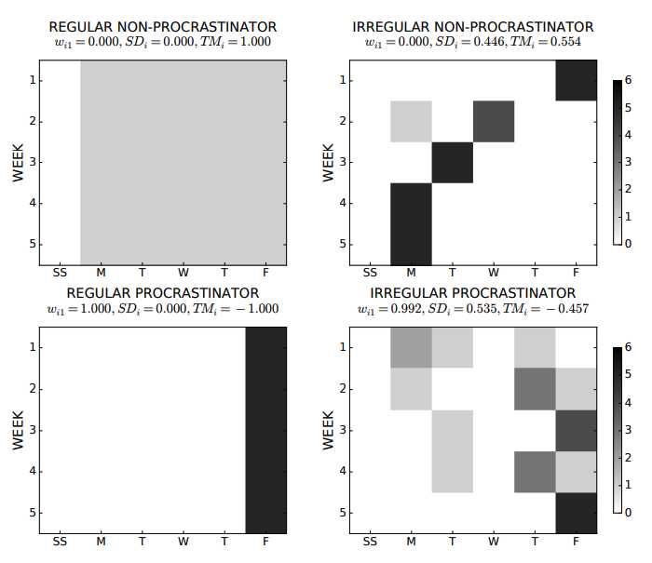
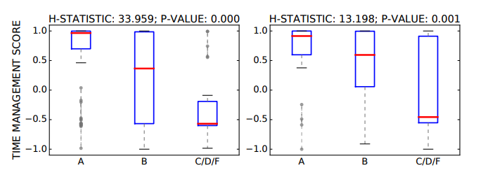
Problem statement
Literature Review
Methodology
Experiments & Results
Conclusions
A.
B.
C. Time management score
Experiments on TM score
BEHAVIORAL
GRADING
CLASS 2016
CLASS 2017
There exist positive relationship between TM and performance
Figures: Park, J., Yu, R., Rodriguez, F., Baker, R., Smyth, P., & Warschauer, M. (2018). Understanding Student Procrastination via Mixture Models. International Educational Data Mining Society.
30

Slide 31
Problem statement
Literature Review
Methodology
Experiments & Results
Conclusions
A.
B.
C.
D. Demographics correlation
Experiments demographics correlation
H₀: The observed behavioral differences are more individual-level in nature
H₁: The observed behavioral differences are related to demographic characteristics
31

Slide 32
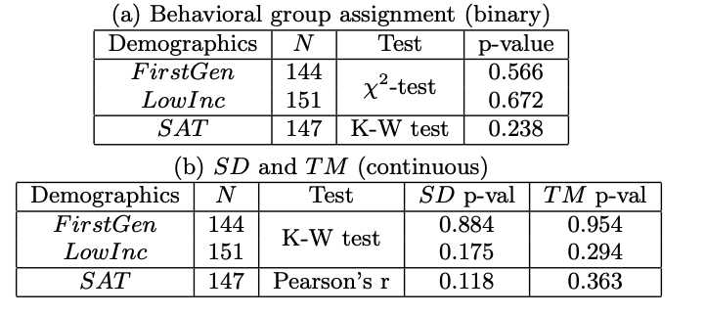
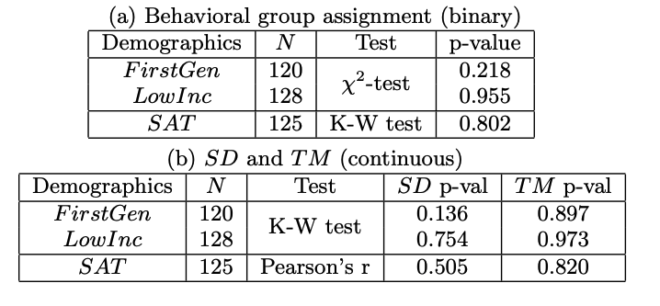
Problem statement
Literature Review
Methodology
Experiments & Results
Conclusions
A.
B.
C.
D. Demographics correlation
Experiments demographics correlation
2016
H₀: The observed behavioral differences are more individual-level in nature
H₁: The observed behavioral differences are related to demographic characteristics
2017
Demographics have no significant relationship with procrastination & regularity
32

Slide 33
Problem statement
Literature Review
Methodology
Experiments & Results
Conclusions
Overview of the analysis
Procrastination
and grading
Procrastination
identification
Procrastination
Grading
Time management score
TM = Procrastination + Regularity
Procrastination
regularity
Procrastination
Grading
Demographics
Regularity
33

Slide 34


Problem statement
Literature Review
Methodology
Experiments & Results
Conclusions
Applications
Better support on students
Automated interventions
Personalized methodological approach
Images: freepik.com
34

Slide 35

Harness your procrastination
Thank you ☺

