Slide 1
EDM 2020
Student Subtyping via EM-Inverse Reinforcement Learning
Xi Yang, Guojing Zhou, Michelle Taub, Roger Azevedo , Min Chi
Presented By Vinitra Swamy | DVET

Slide 2
PART 0
Problem Motivation
Agenda
PART 1
Main Contributions
PART 2
Methodology
PART 3
Evaluation of Results
PART 4
Future Work
02

Slide 3
Motivation
Student Subtype Identification: heterogeniety among students leads to different types of learning strategies, which require different types of interventions (self-regulated and personalized learning)
Why is classifying student clusters difficult?
Differences between student groups
Temporal dynamics
Can we use EM-IRL to help identify student subtypes?
Problem formulation: Given the student’s interactions with a digital learning platform, extract their heterogenous learning strategy

Slide 4
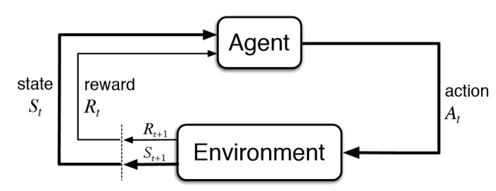
Reinforcement Learning

Slide 5
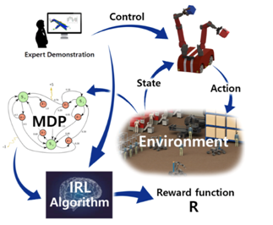
Inverse Reinforcement Learning
Takes expert player trajectories as input, determines a reward function based on that
Feeds that inferred reward function into the normal RL pipeline
Two types of IRL:
Directly learning a policy by state-action mapping by parroting behaviors (supervised learning)
Inferring rewards from demonstrations and using RL to determine policy

Slide 6
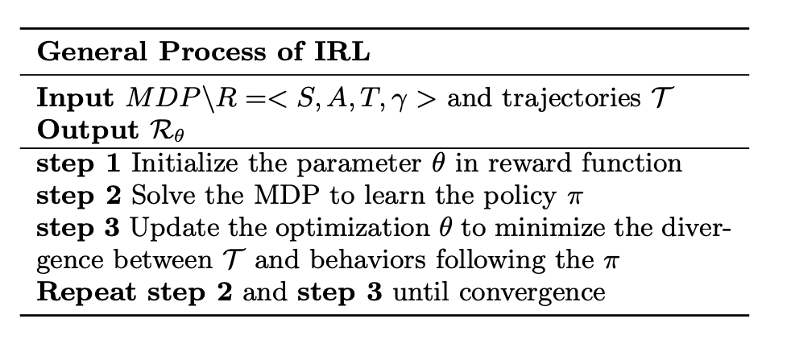
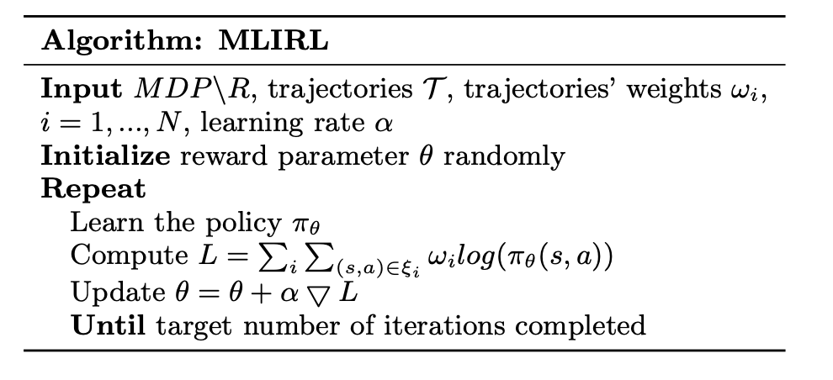
Inverse Reinforcement Learning
Learn inferred
reward function

Slide 7
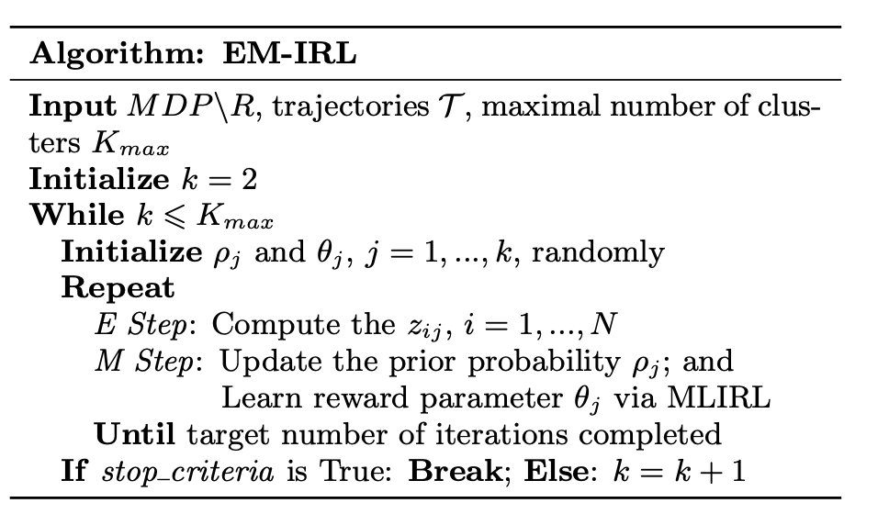
E-M Reinforcement Learning
assumption: different student subtypes have different pedagogical learning strategies
assumption: all students within the same cluster share the same strategy
Original EM-IRL paper has a fixed number of clusters. This work extends that algorithm by optimizing the number of clusters
Max_iterations=80
Cycle through # of clusters
stop criteria:
there were some empty clusters generated
the log-likelihood (LL) of the clustering results varied smaller in comparison to the last iteration (10)

Slide 8
1. SIMULATE EM-IRL for EDU
Contributions
Apply EM-IRL in the context of education to a new problem it hasn’t been used for before (student subtyping).
2. MODIFY EM-IRL
Modifying EM-IRL to recursively cluster students until both the number of clusters and the policy converges.

Slide 9
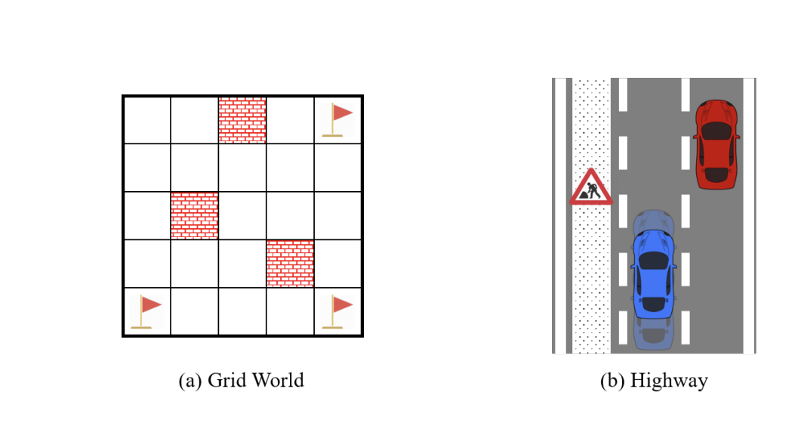
Methodology
Highway
States (729) the blue car’s speed had 3 levels and could move horizontally in 9 locations; the red car could move vertically in 9 locations and horizontally in 3 locations.
Actions (5) Staying at the current state, speeding up, slowing down, moving left, or moving right.
Strategies (2) 1) Keeping off the left lane (suppose it is under construction); 2) Driving at the fastest speed.
Grid World
States (25) 5×5 grid-size.
Actions (4) Moving to up, down, left, or right.
Strategies (3) Moving to the 1) upper-right corner; 2) lower-left corner; or 3) lower-right corner.

Slide 10
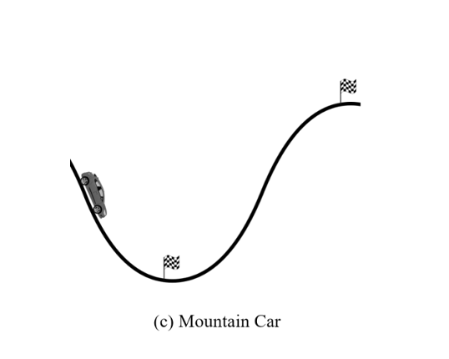
Methodology
Mountain Car
States (80) 10 horizontal positions with 8 levels of speed.
Actions (3) Pushing left, no pushing, or pushing right. • Strategies (2) 1) Reaching to the right mountain top (the car needs to drive back and forth to build up enough momentum to push up); 2) Parking at the valley bottom.

Slide 11

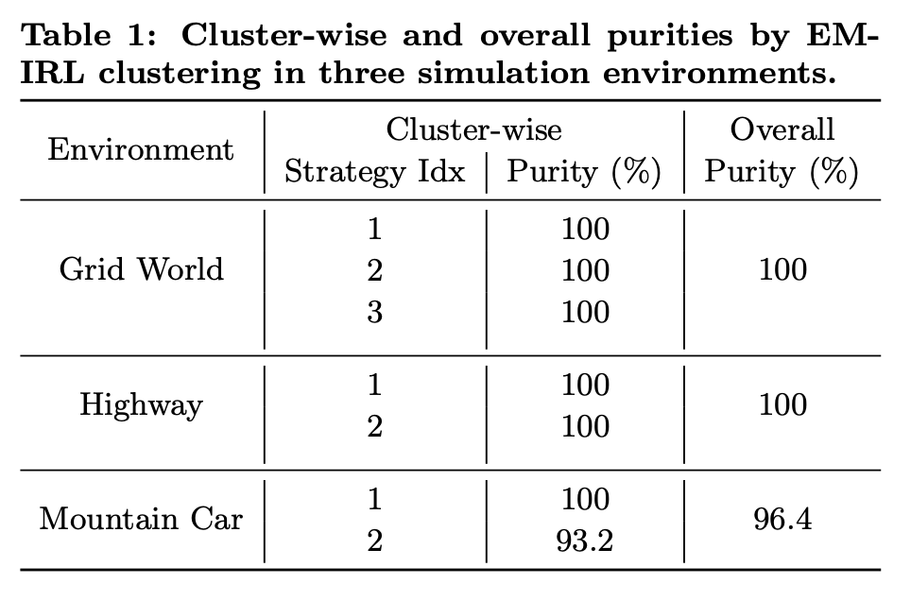

Results (Simulation)
Cluster-wise purity:
Majority labels / cluster size
Overall purity:
Mean of cluster purity
→ driving to right mountaintop (Strategy 0) mis-clustered to the parking at valley (Strategy 1).
→ misclustered trajectories tried to move to left to collect enough momentum

Slide 12
Dataset
Web-based ITS, teaching college students probability
(addition theorem, bayes’ theorem)
Tutor provides
step-by-step instruction
immediate feedback
on-demand help (increasingly specific hints)
(observe tutor)
(solve by themselves) → { (elicit), (tell) }
4 phases: textbook, pre-test (14), training (12), and post-test (20, with 14 isomorphic to pre-test, 6 harder multi-principle problems)

Slide 13
Dataset
4 phases:
Textbook (general description, reviewed examples, single + multi-principle problems)
pre-test (14 problems)
training (12 problems in the same order, each principle applied at least twice)
post-test (20, with 14 isomorphic to pre-test, 6 harder multi-principle problems)
The minimal number of steps to solve each training problem: 20 to 50
- Rubric: binary, partial credit, one-point per principle
- Measure students’ performance through normalized learning gain (NLG): gain irrespective of their incoming competence

Slide 14
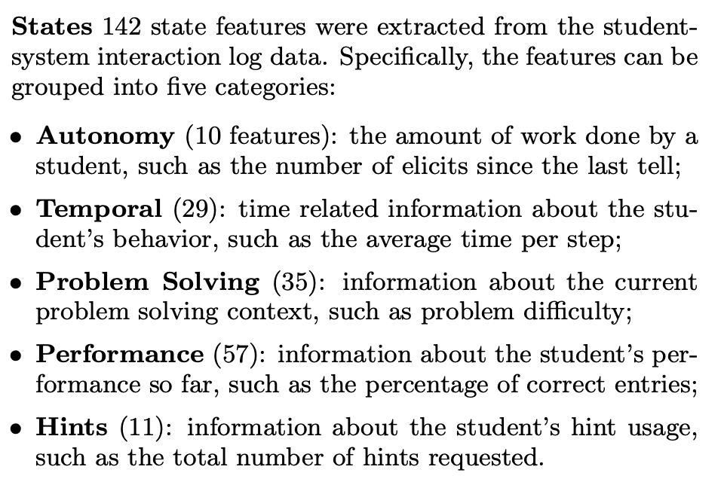

Slide 15
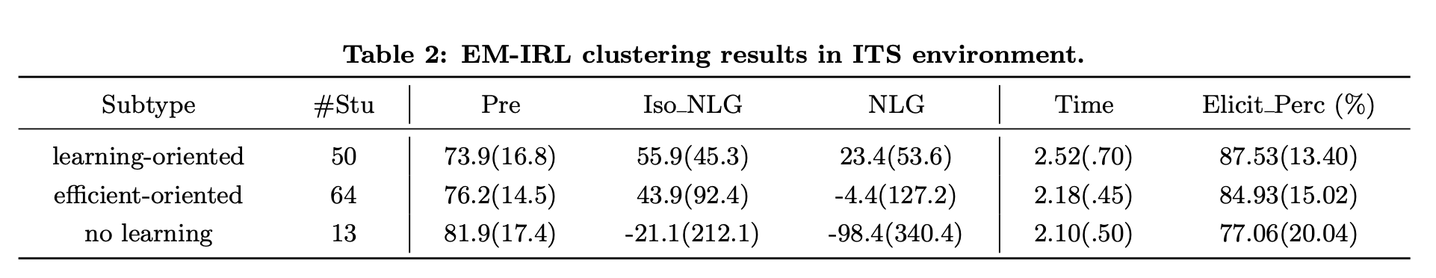
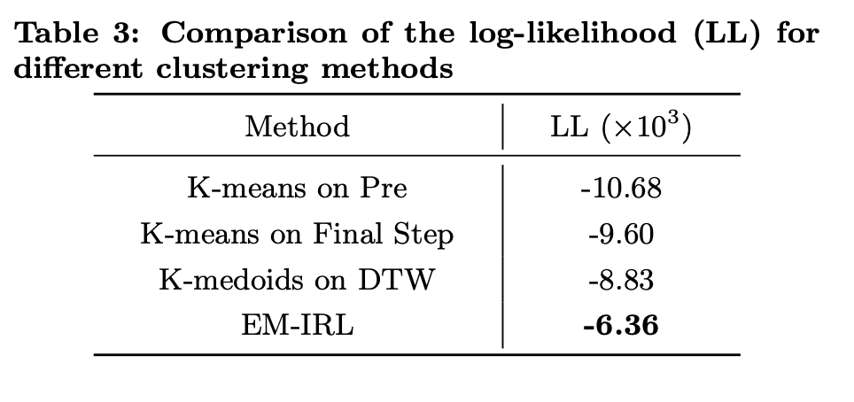

Slide 16
Matching with RL:
the High and Medium groups spent significantly more time than the Low group: t(124) = 3.85, p = 0.0002, d = 1.11 and t(124) = 3.99, p = 0.0001, d = 0.92.
An analysis on the percentage of elicit in students’ decisions showed a significant difference among the three groups: F(2, 124) = 66.97, p < 0.0001, η = 0.519. Subsequent contrast analysis revealed that High > Medium: t(124) = 4.38, p < 0.0001, d = 0.99 and Medium > Low: t(124) = 8.01, p < 0.0001, d = 1.70.
Matching with IRL :
A one-way ANOVA analysis on pre-test showed there was no significant difference among the three groups: F(2, 124) = 1.17, p = 0.314, η = 0.019. Analyses on the Iso NLG and NLG also showed no significant difference among the three groups

Slide 17
EM-IRL:
A one-way ANOVA analysis on pre-test scores showed no significant difference among the three clusters: F(2, 124) = 1.36, p = 0.260, η = 0.022. This suggested that students in the three clusters were balanced in incoming competence.
A one-way ANOVA analysis on Iso NLG showed a significant difference among the three clusters: F(2, 124) = 3.24, p = 0.042, η = 0.050. Subsequent contrast analysis revealed that learning-oriented > no learning: t(124) = 2.54, p = 0.012, d = 0.75 and efficient-oriented > no learning: t(124) = 2.19, p = 0.030, d = 0.54. Similar results were found for NLG in that a oneway ANOVA analysis showed a significant difference among the three clusters: F(2, 124) = 3.73, p = 0.027, η = 0.057. Subsequent contrast analysis revealed that learning-oriented and efficient-oriented significantly outperformed no learning: t(124) = 2.73, p = 0.007, d = 0.77 and t(124) = 2.15, p = 0.033, d = 0.52 respectively.
Significant difference with time on task

Slide 18
Conclusion
IRL based policy matching was able to cluster the students’ strategies different in time, but was unable to learn specific subtype of students whose strategy will lead to better learning outcomes.
EM-IRL effectively conducts student-subtyping better than RL / IRL

