Slide 1
WWW 2017
Dynamic Key-Value Memory Networks for Knowledge Tracing
Jiani Zhang, Xingjian Shi, Irwin King, Dit-Yan Yeung
Presented By Vinitra Swamy | DVET

Slide 2
PART 0
Problem Motivation
Agenda
PART 1
Main Contributions
PART 2
Methodology
PART 3
Evaluation of Results
PART 4
Future Work
02

Slide 3
Motivation
Knowledge Tracing: trace the knowledge state of students based on their past exercise performance.
give proper hints
tailor the sequence of exercises based on personalized strengths and weakness
Students can be made aware of their learning process
Students can dedicate energy to less-familiar concepts to learn efficiently
Problem formulation: Given the student’s past exercise interactions, predict the probability that a student will answer a new exercise correctly

Slide 4
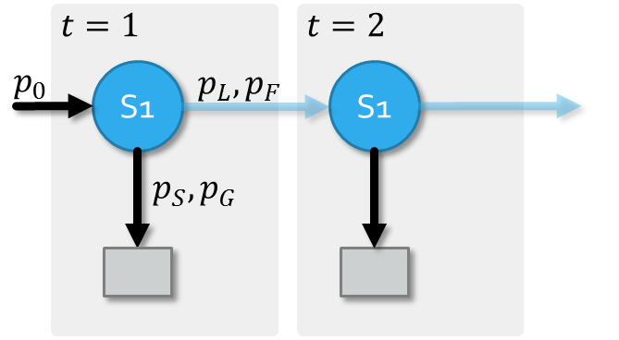

Bayesian Knowledge Tracing
Student knowledge state is analyzed into different concept states
Models knowledge state for each predefined concept separately
Probability of learning or forgetting
Initial probability
Probability of slipping or guessing
$$θ=\left\{p_{0},p_{L},p_{F},p_{S},p_{G}\right\}$$

Slide 5
Deep Knowledge Tracing
Exploits neural nets (LSTM) for a continuous representation of knowledge state
No human annotation required
Fails to pinpoint exactly which concepts a student is good at or unfamiliar with
0
1
2
0.3
0.5
0.7
0.3
0.8
0.7
0.1
0.9
0.6
Output Layer
h₀
h₁
h₂
h_{T}
Hidden Layer
0
1
2
0
1
2
0
1
0
0
0
0
0
0
0
1
0
0
0
0
0
0
1
0
Input Layer

Slide 6
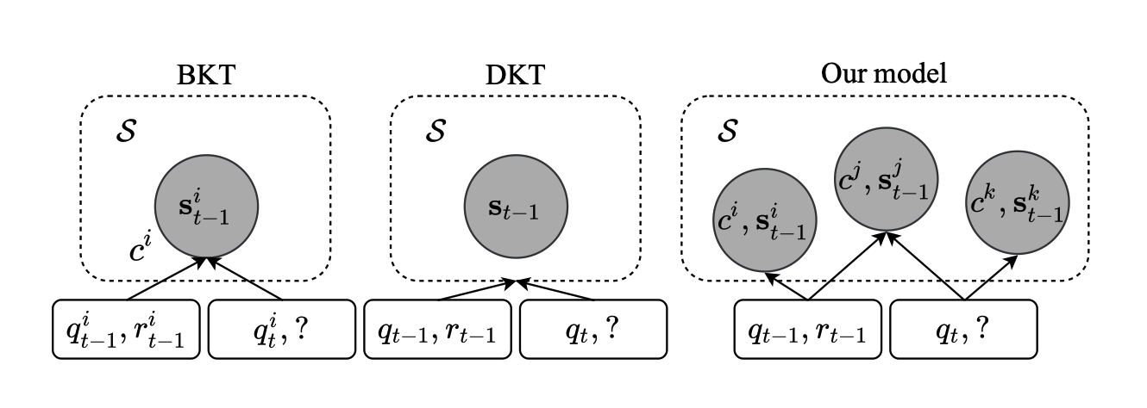
Dynamic Key-Value Memory Networks
student concept
states (values)
Concepts (keys)
DKVMN combines best of both worlds: exploit relationship between concepts + ability to trace each concept shape
Static matrix (key, immutable) – concept representations
dynamic matrix (value, mutable) – students’ understanding of concepts
exercise

Slide 7
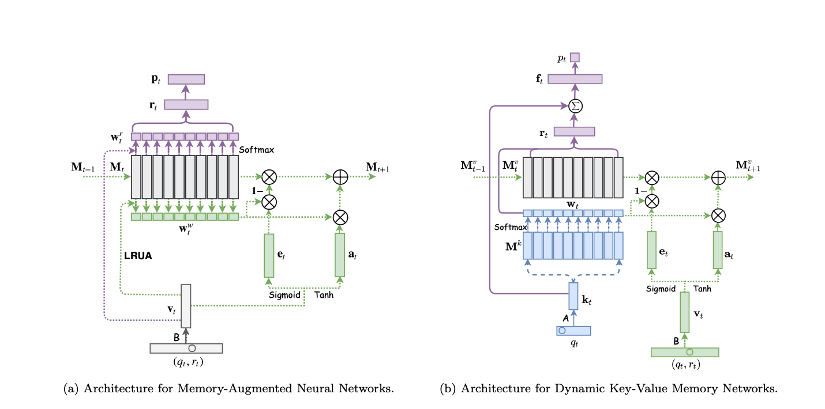
Inspired by memory-augmented neural nets (MANN)
-> Single memory matrix, or two static memory matrices
MANN vs DKVMN

Slide 8
1. MEMORY AUGMENTATION
2. PROPOSE DKVMN
Contributions
The utility of MANNs is exploited to better simulate the learning process of students.
A novel DKVMN model with one static key matrix and one dynamic value matrix is proposed.
3. AUTONOMOUS CONCEPTS
4. OUTPERFORM SotA
Our model can automatically discover concepts, a task that is typically performed by human experts, and depict the evolving knowledge state of students.
Our end-to-end trainable model consistently outperforms BKT and DKT on one synthetic and three real-world datasets respectively.

Slide 9
Datasets
Synthetic-5: Simulates 2000 virtual students answering 50 exercises
  Sampled from 1 of 5 concepts (unknown to model)
  Different levels of difficulty
ASSISTments 2009: ASSISTments tutoring platform
  4,151 students, 325,637 exercises of 110 different exercise tags
ASSISTments 2015: ASSISTments tutoring platform
  19,840 students, 683,801 records on 100 skills
Statics 2011: college-level engineering course
  333 students, 189,297 trials on 1,223 exercise tags

Slide 10
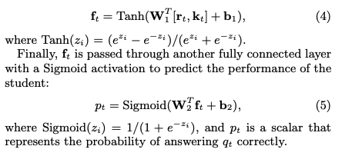
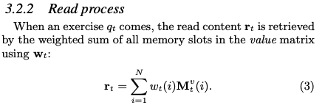
Methodology
Concatenated with input exercise embedding
Passed through FC layer to get a “summary vector” f
student’s mastery level of the exercise
Needs to be combined with (prior) difficulty of exercise

Slide 11

Methodology
After student answers question qt, model updates the value matrix
The tuple (qt,rt) is embedded with an embedding matrix B of size 2Q × dv
to obtain the knowledge growth vt of the student after working on this exercise.
Training is done by minimizing cross-entropy loss across both matrices!

Slide 12
Results
DKVMN outperforms the standard MANN and the state-of-the-art method on four datasets.
DKVMN can produce better results with fewer parameters than DKT.
DKVMN does not suffer from overfitting, which is a big issue for DKT.
DKVMN can discover underlying concepts for input exercises precisely.
DKVMN can depict students’ concept states of distinct concepts over time.

Slide 13
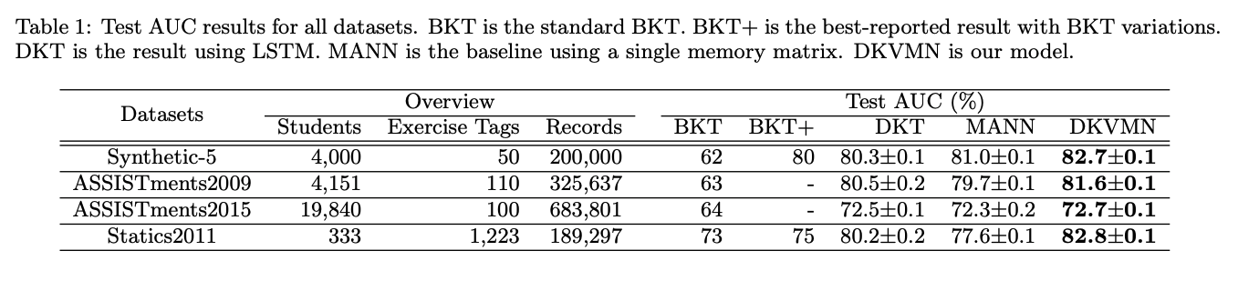

Slide 14
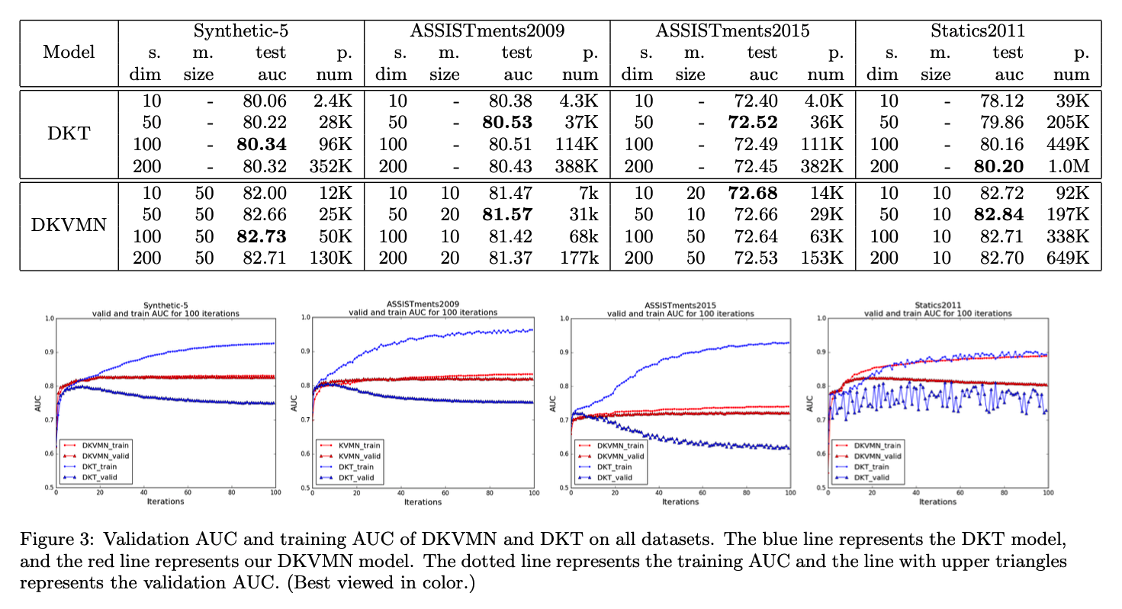

Slide 15
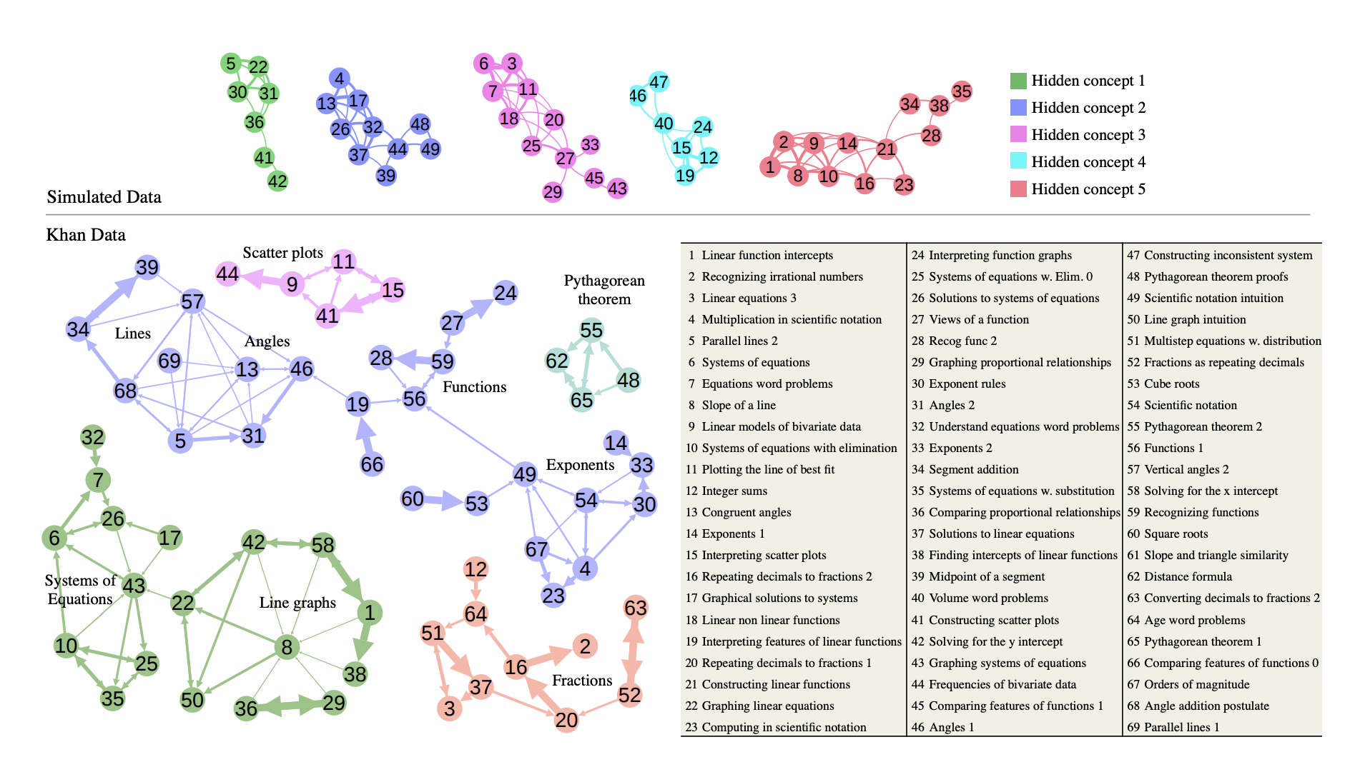
DKT

Slide 16
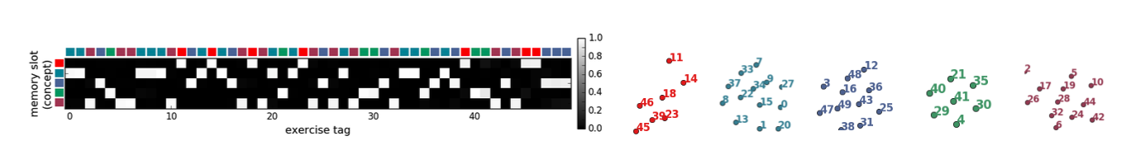
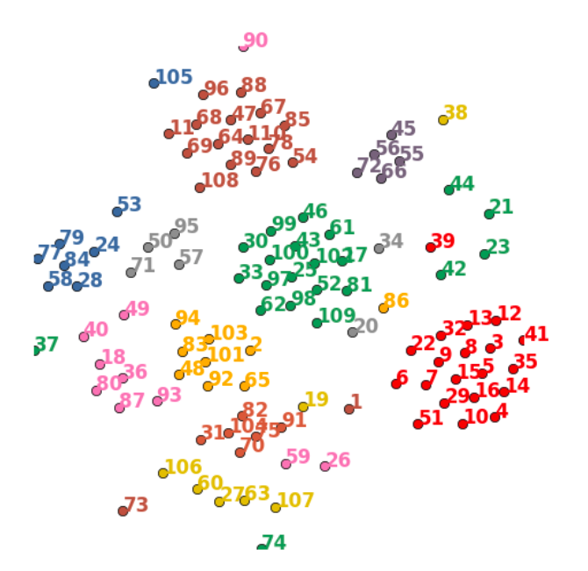
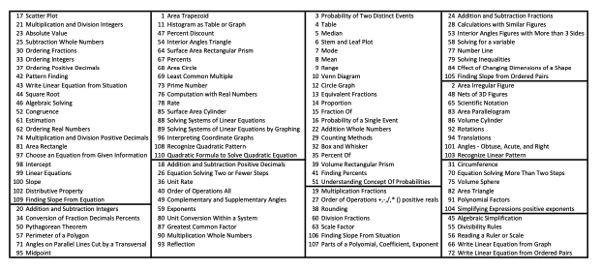
DKVMN

Slide 17
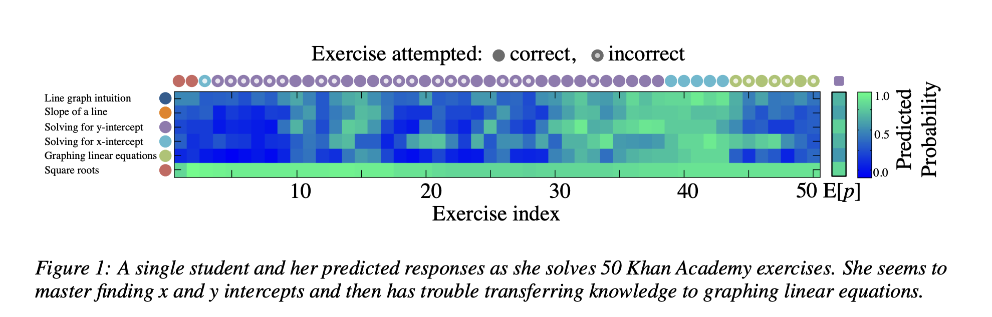
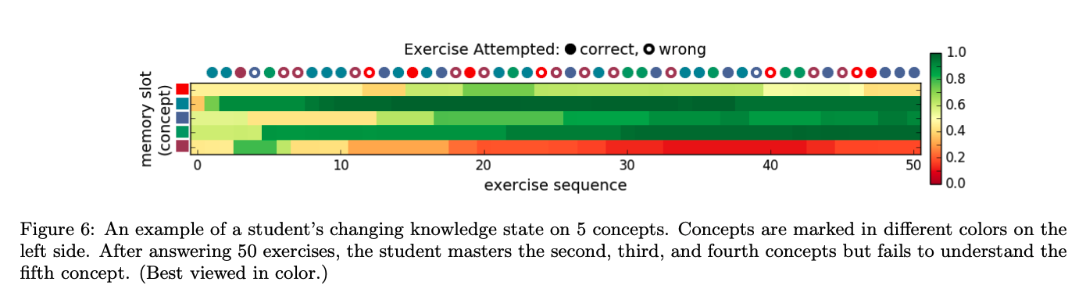

Slide 18
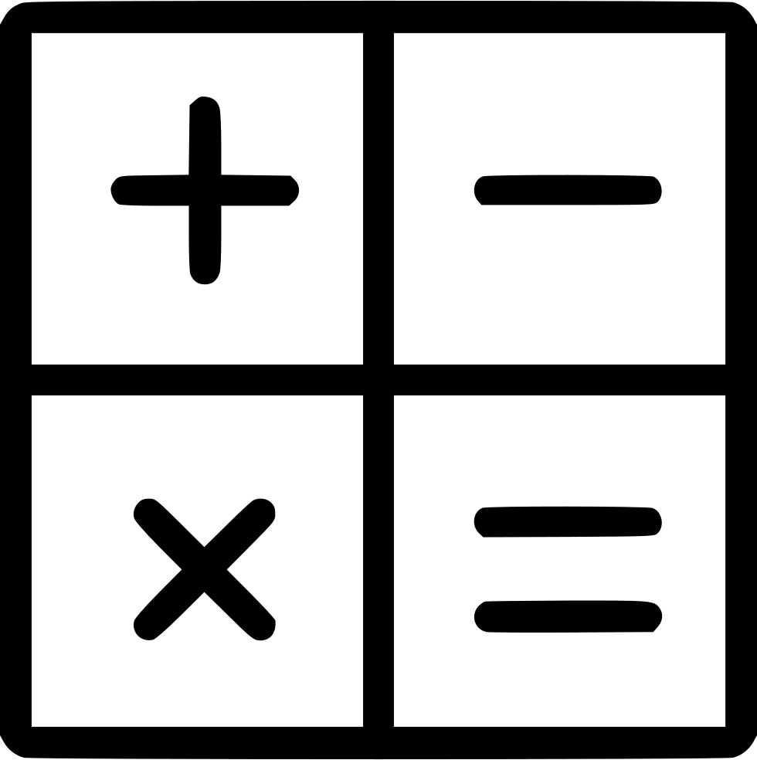
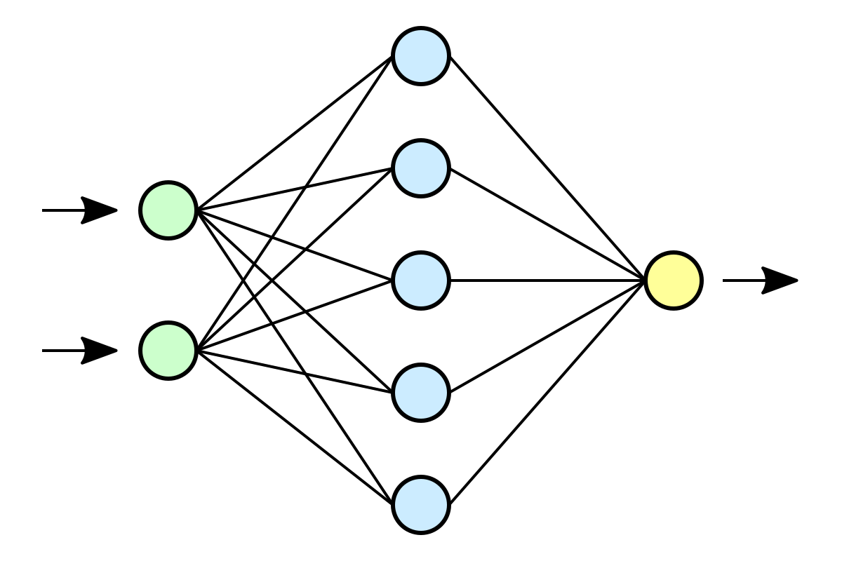
Limitations +
Future Work
IMPROVE REPRESENTATIONS
Incorporate content info into the concept representations and embeddings
NETWORK ARCHITECTURE
Explore hierarchical key-value memory networks to encode hierarchical relationship between concepts

Slide 19
Conclusion
DKVMN adds external memory storage (both static and dynamic) to augment DKT
It performs better than traditional KT and DKT techniques
It’s computationally efficient, with less parameters to train
Can trace a student’s understanding over time (main drawback of DKT)

