Slide 1
Predicting Affect from Gaze Data during Interaction with an Intelligent Tutoring System
Natasha Jaques, Cristina Conati, Jason M. Harley, and Roger Azevedo

Slide 2
Roadmap
Introduction & Contributions
Related Work
MetaTutor
User Study & Eye Tracking Data
Machine Learning Experiments
Results
Conclusion & Future Work

Slide 3
Roadmap
Introduction & Contributions
Related Work
MetaTutor
User Study & Eye Tracking Data
Machine Learning Experiments
Results
Conclusion & Future Work

Slide 4
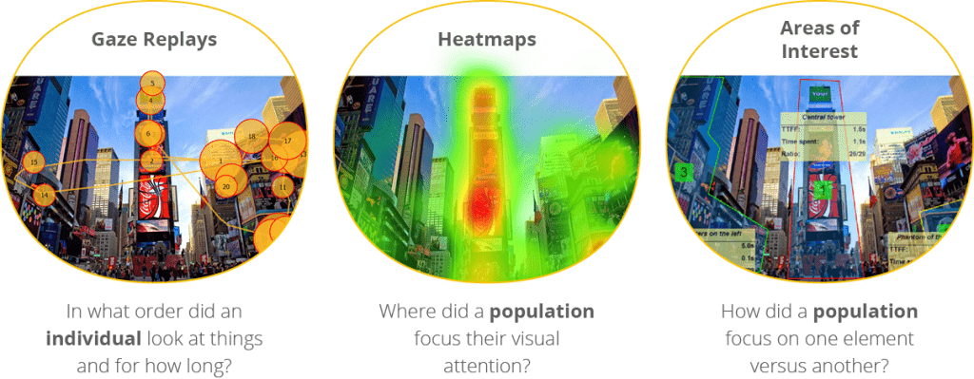
Introduction & Contributions
Notes:
Gaze data is gathered by tracking the eyes and what they focus on, for how long, identifying patterns, etc. Various types of gaze data applicable in many different contexts

Slide 5
Introduction & Contributions
Using eye tracking data as a stand alone tool
In contrast with hand-engineered heuristics for gaze-based interventions and other non-gaze features (e.g. pupil dilation)
Investigate boredom and curiosity
Identify features most predictive of each emotion
Notes:
This paper focuses on the field of Education, more specifically the usefulness of eye tracking data alone in predicting learner affect in MetaTutor via ML
Main contributions:
This approach is in contrast hand-engineered heuristics for gaze-based interventions and other non-gaze features (e.g. pupil dilation) used in prior work
Investigate boredom and curiosity - emotion related to interest not frequently studied in affective computing
Identify features most predictive of each emotion -- gives insight into effective methods for affect-adaptive ITS

Slide 6
Roadmap
Introduction & Contributions
Related Work
MetaTutor
User Study & Eye Tracking Data
Machine Learning Experiments
Results
Conclusion & Future Work

Slide 7
Related Work
Emotions in Academic Setting
Student motivation
Academic achievement
Boredom
Engagement
Emphatic & supportive tutor
Detect Learner’s Emotions
Interaction logs
Acoustic and dialog features
Physiological sensors
Posture
Questionnaires
Eye gaze
Notes:
Previous work has shown that emotions in an academic setting are indicative of students’ motivation & academic achievement
Boredom is associated with decreased task success; while engagement with user satisfaction
Emphatic & supportive tutor has shown to lead to enhanced learning & reduced stress
Previous work has detected learners’ emotional states using various sources:
Personalities & interaction logs
Acoustics and dialog features
Physiological sensors (skin conductance bracelets, pressure sensitive seat cushions)
Heart rate, posture, questionnaires
Eye Gaze: blinking often/lack of fixation on text → boredom, pupil size, wandering gaze

Slide 8
“Unfortunately, positive emotions (including curiosity)
declined over the course of the interaction, demonstrating a need for affective
interventions”
Notes:
Previous closely related work correlates emotions experienced during interactions with MetaTutor with output from FaceReader 5.0 software
It reported good performance and also uncovered the need for affective interventions (positive emotions decrease over with time)

Slide 9
Roadmap
Introduction & Contributions
Related Work
MetaTutor
User Study & Eye Tracking Data
Machine Learning Experiments
Results
Conclusion & Future Work

Slide 10
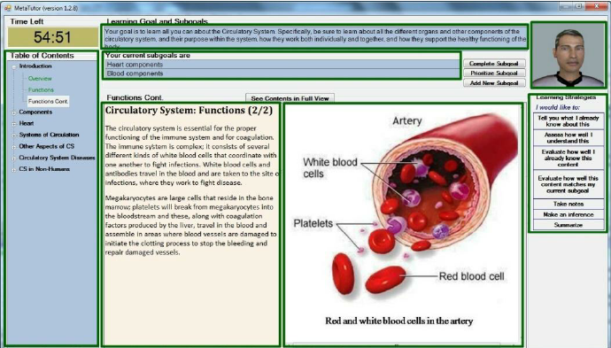
MetaTutor
Notes:
MetaTutor is an adaptive Intelligent Tutoring System used to encourage students to employ metacognitive Self-Regulated Learning strategies
There are 7 main Areas of Interest identified in the UI - Text Content, Image Content, Overall Learning Goal, Subgoals, Learning Strategies Palette, Agent, Table of Contents
4 pedagogical agents - allow users to initiate interactions (e.g. request an evaluation)

Slide 11
Roadmap
Introduction & Contributions
Related Work
MetaTutor
User Study & Eye Tracking Data
Machine Learning Experiments
Results
Conclusion & Future Work

Slide 12
User Study & Eye Tracking Data
67 undergraduate students
  51 considered after data validation
Used MetaTutor for about 90 minutes
Data from number of sensors, including an eye tracker
Self-reports
  5 per student
  Likert scale between 1 (strongly disagree) and 5 (strongly agree)
  Boredom : mean = 2.60, SD = 0.69
  Curiosity: mean = 2.93, SD = 0.71
Notes:
The user study included 67 undergraduate students with a variety of academic concentrations
51 considered after data validation (e.g. enough gaze samples)
Each of them used MetaTturo for about 90 minutes
Gaze data was recorded using a number of sensors, including Tobii T60 eye tracker
Each student filled out a number of self-reports using Emotions-Value Questionnaire (EVQ)
Each student filled out one report at the very beginning and one report every 14 minutes for a total of 5 self-reports per student
The report contained statements about an emotion and used a Likert scale between 1 (disagree) and 5 (agree)
The paper focuses on the two most strongly reported emotions (most frequently with values 4 and 5) - boredom (mean = 2.60, SD = 0.69) and curiosity (mean = 2.93, sd = 0.71)

Slide 13
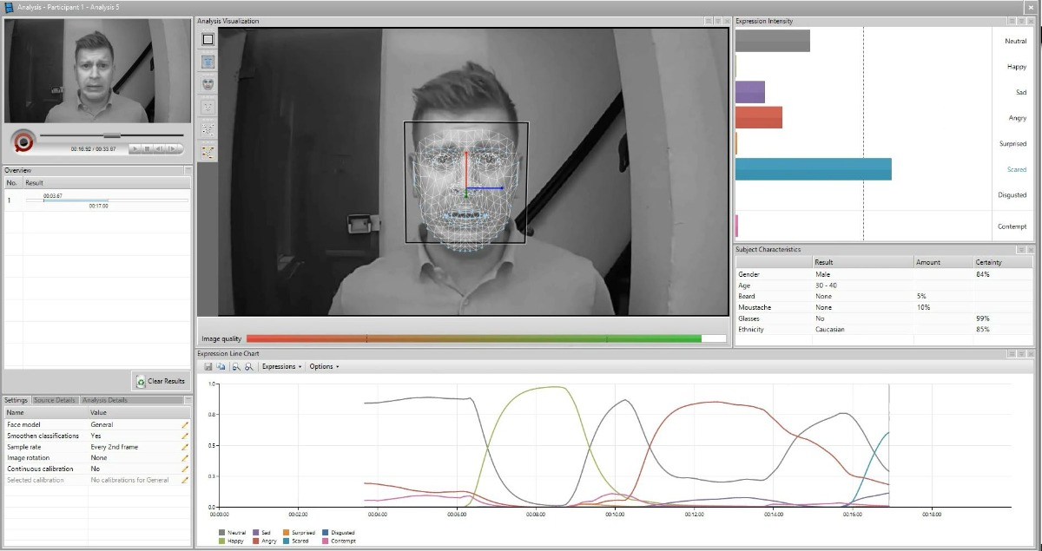
User Study & Eye Tracking Data
Notes:
MetaTutor is an adaptive Intelligent Tutoring System used to encourage students to employ metacognitive Self-Regulated Learning strategies
There are 7 main Areas of Interest identified in the UI - Text Content, Image Content, Overall Learning Goal, Subgoals, Learning Strategies Palette, Agent, Table of Contents
4 pedagogical agents - allow users to initiate interactions (e.g. request an evaluation)

Slide 14
User Study & Eye Tracking Data
Fixations: persistent focus on a single point
Saccades: paths between two consecutive fixations
166 features in total
Notes:
The gaze data consists of fixations & saccades.
A total of 166 features were used in the experiments.

Slide 15
User Study & Eye Tracking Data
Application-Independent
Number of fixations
Fixation duration
Saccade length
Angle between consecutive saccades
Angle between a saccade and the horizontal plane
Application-Dependent:
Duration of longest fixation
Proportion of fixations and time spent
Gaze transitions
Time of first/last fixation
Total fixation time
Notes:
The features used can be split in two categories:
Application-independent features such as:
Number of fixations, fixation duration, saccade length, angle between consecutive saccades, angle between a saccade and the horizontal plane
Pupil dilation NOT included - affected by luminocity, room with a window
Application-dependent features related to the areas of interest of the UI mentioned earlier:
Duration of longest fixation on a given AOI, proportion of fixations and time spent on an AOI, gaze transitions between pairs of AOI, time of first/last fixation on a given AOI, total fixation time of an AOI

Slide 16
Roadmap
Introduction & Contributions
Related Work
MetaTutor
User Study & Eye Tracking Data
Machine Learning Experiments
Results
Conclusion & Future Work

Slide 17
Machine Learning Experiments
Two separate binary classification problems: boredom and curiosity
Emotion Present (EP) vs. Emotion Absent (EA)
10-fold cross validation
Four algorithms used
  Random Forests
  Naive Bayes
  Logistic Regression
  Support Vector Machines
Notes:
The task of predicting boredom and curiosity was treated as two separate binary classification problems
Data does NOT support treating boredom and curiosity as mutually exclusive states
Significant negative correlation between corresponding ratings
BUT 18% of self-reports both are present, 13% of self-reports both are absent
Based on the self-reported emotion rating, the emotions and grouped in two types: Ratings >= 3 → Emotion Present (EP) & Ratings < 3 → Emotion Absent (EA)
10-fold cross validation - tune parameters of the algorithms
Four algorithms (showed the most promising performance in initial tests) from the Weka data mining toolkit
Random Forests (RF)
Naive Bayes
Logistic Regression
Support Vector Machines (SVM)

Slide 18
Machine Learning Experiments
Accuracy: percentage of correctly classified data points
Cohen’s kappa: measure of classification performance which accounts for correct predictions occuring by chance
  0 if the predictions were no more accurate than chance
  1 when labels exactly match the ground truth values
Feature reduction against overfitting
  Principal Component Analysis (PCA)
  Wrapper Feature Selection (WFS)
Notes:
The authors report two measurements from the ML experiments:
Accuracy reported - percentage of correctly classified data points)
Cohen’s kappa reported - measure of classification performance which accounts for correct predictions occuring by chance
1 when labels exactly match the ground truth values
0 if the predictions were no more accurate than chance
Good kappa score for trained human judges rating emotion → .5-.6
Typical score for machine predicting emotion → .3
Due to the combination of a small dataset size and a large number of features, the models are prone to overfitting. The authors use feature reduction to reduce that:
Principal Component Analysis (PCA)
Reduces dimension of a feature set by creating components based on highly correlated subsets of features
Wrapper Feature Selection (WFS) with nested 10-fold cross-validation
Finds useful subsets of features by testing them with a specific classifier
Use features selected in more than 10% of the sub-folds
Achieved better results, provided more interpretable features

Slide 19
Roadmap
Introduction & Contributions
Related Work
MetaTutor
User Study & Eye Tracking Data
Machine Learning Experiments
Results
Conclusion & Future Work
Notes:
training classifiers using all available self-reports and gaze features computed using
various time intervals preceding each report. We discuss the features chosen as
most predictive by WFS, and the effectiveness of predicting reports independently

Slide 20
Predicting Self-Reports across the Interaction
Goal: determine the amount of gaze data preceding the self-report that should be used for optimal prediction performance
Baseline: a majority-class baseline, using t-tests with a Bonferroni adjustment
Four 4x6 General Linear Models: boredom accuracy/kappa, curiosity accuracy/kappa as the dependent variables
  4 classifiers
  6 window lengths
  Treat one train/test split as a single point
Notes:
Goal: ...
The authors used 6 different window lengths - from 100% (14 minutes) to 1% (8 seconds)
T-test - A t-test is a type of inferential statistic used to determine if there is a significant difference between the means of two groups,
Bonferroni adjustment - Bonferroni correction is one of several methods used to counteract the problem of multiple comparisons which happens when one considers a set of statistical inferences simultaneously^{[1]} or infers a subset of parameters selected based on the observed values
As previously mentioned, each classifier provided 2 measurements for each of the two emotions. These 4 measurements were then used in 4 GLMs - one per each measurement, treating it as the dependent variable. In this way, the authors perform some statistical testing to uncover the significance of the classifier and various window lengths

Slide 21
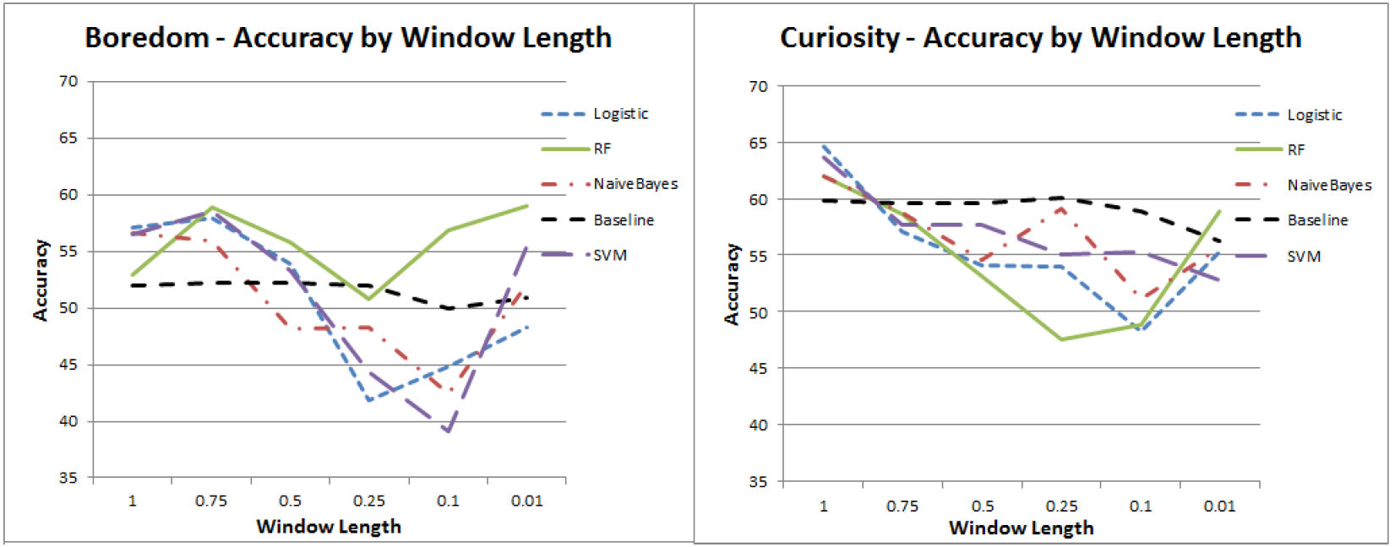
Predicting Self-Reports across the Interaction
Notes:
While for boredom RF performs well across different window lengths
For both emotions, the tendency is that model performance increases with the window length

Slide 22
Predicting Self-Reports across the Interaction
No significant effects of the classifier
Main effect of window length both for boredom and curiosity
  Low p-value
  High eta squared value
Significantly better than baseline
  Boredom at 75% and 100% (10.5 minutes and 14 minutes)
  Curiosity at 100% (14 minutes)
Notes:
The GLMs yielded no significant effects of the classifier choice but showed main effect of window length for both emotions:
A p-value is a measure of the probability that an observed difference could have occurred just by random chance. The lower the p-value, the greater the statistical significance of the observed difference
Eta squared (η²) is a common measure of effect size used in analyses of variance (ANOVAs) and analyses of covariance (ANCOVAs)
Eta squared is the proportion of variance associated with one or more main effects, errors or interactions in ANOVA

Slide 23
“This study provides empirical evidence that [using a 20 second interval for affect labeling] may not always be appropriate, depending on the data used for prediction.”
Notes:
A large body of previous affect prediction research has focused on using a 20-second interval for affect labeling

Slide 24
Identifying Important Features
Goal: examine features selected by the WFS process
Arrows: gaze transitions
Circles: features related to the AOI (circle size increases with the number of related features found)
Notes:
Examine features selected by the Wrapper Feature Selection process - given previous set of results, the authors only focus on features selected most frequently for the windows that achieved best performance
To visualize this, they use:
Arrows which indicate gaze transitions
Circles which indicate features related to the AOI (circle size increases with the number of such features found)

Slide 25
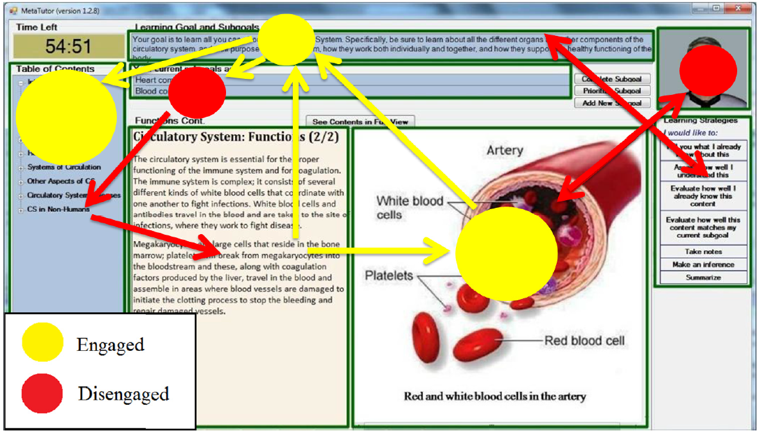
Identifying Important Features
Notes:
Trends:
frequent use of TOC (curiosity) is indicative of user being Engaged
Engaged → patterns suggesting strategic learning, looking between text, image, OLG, TOC
Bored → less time & number of fixations on the image, shorter maximum fixation on the OLG, fewer image-to-image/text-to-text/ OLG-to… transfer
Disengaged → frequent scattered gaze transitions, not remaining focused on a single AOI
Attention to the agent → disengagement
Another study on the same dataset showed the Agent was the only AOI which was NOT predictive of learning gains

Slide 26
Time-Dependent Effects on Prediction
Goal: improve performance by treating each self-report time as its own classification problem
Four 4x4 General Linear Models
  4 classifiers
  4 report times
Notes:
Different self-report time corresponds to different duration of interacting with the ITS
4 report times considered, since the first one was done before any interaction happened

Slide 27
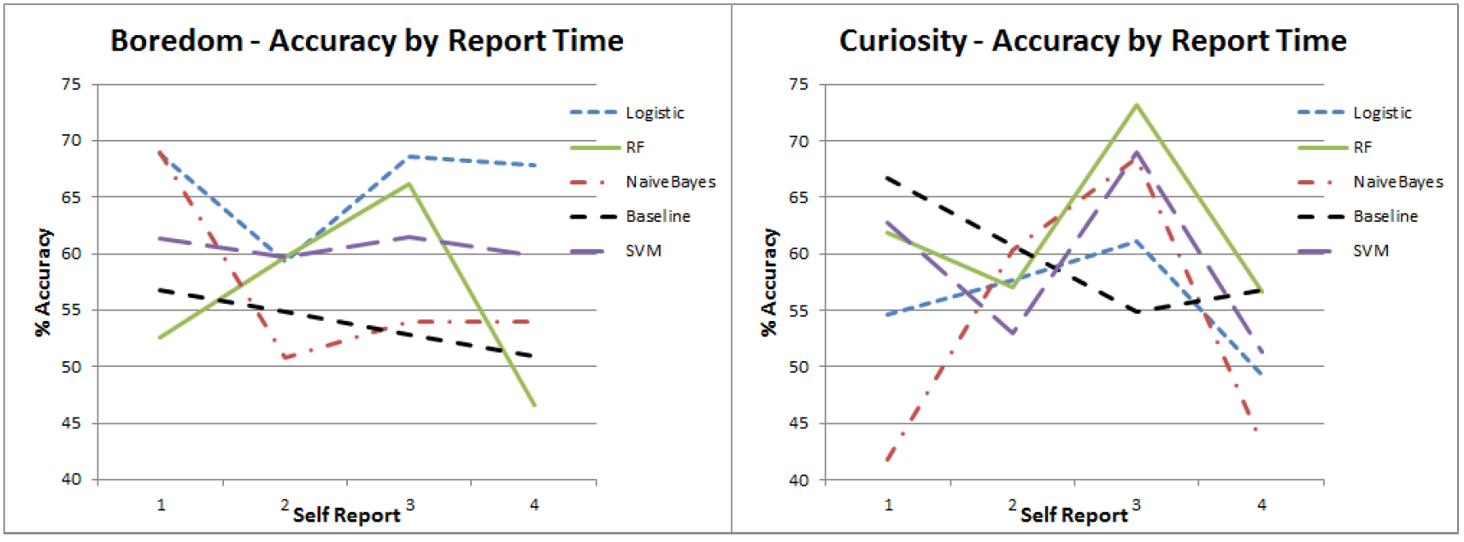
Time-Dependent Effects on Prediction
Notes:
Boredom - logistic regression performs best, peaking at report-time 1
Curiosity - main effect of report-time for both accuracy and kappa, best performance at report time 3

Slide 28
Time-Dependent Effects on Prediction
No significant effects for boredom
  Logistic Regression performing the best
  Single self-report time results are better
Effect of report time for both kappa and accuracy for curiosity
  Amount of time spent interacting with MetaTutor affects the relationship between gaze and affect
Notes:
Average results obtained by restricting to a single self-report time are higher than those when all report times are classified together

Slide 29
“The results of this section seem to indicate that the relationship between gaze and affect varies over time. Different gaze features would be more informative at different report times.”
Notes:
So the authors went ahead and investigated this

Slide 30
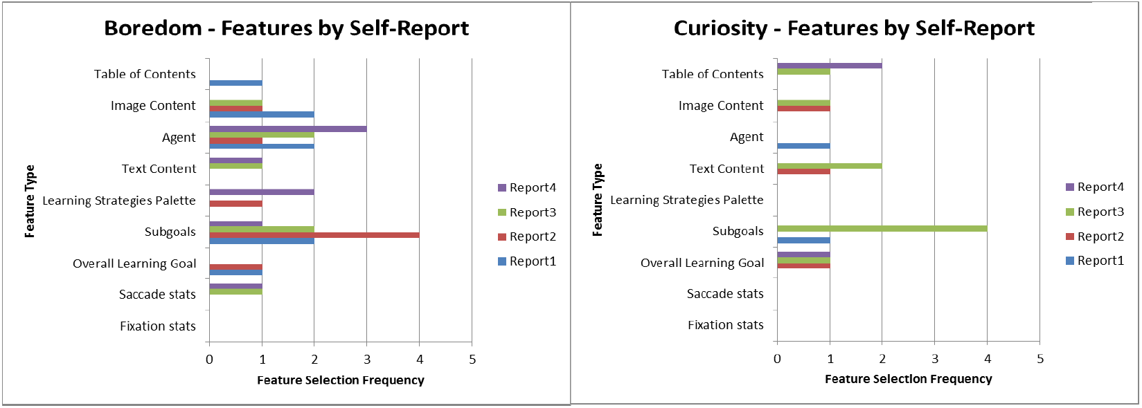
Time-Dependent Effects on Prediction
Notes:
The authors examined the features selected for each report time and found some significant variability
But they were not able to interpret this result and the cause for it
subgoals become highly relevant for predicting curiosity at report three, but otherwise are hardly chosen at all

Slide 31
Roadmap
Introduction & Contributions
Related Work
MetaTutor
User Study & Eye Tracking Data
Machine Learning Experiments
Results
Conclusion & Future Work

Slide 32
Conclusion & Future Work
Conclusion
Eye gaze data alone - a useful tool
Longer intervals for predicting affect
Temporal information can increase accuracy
Future Work
Use additional data sources
Develop intervention strategies
Notes:
Temporal information can increase accuracy
Eye gaze data alone is a useful tool for predicting boredom and curiosity in MetaTutor
Notable results in affect prediction domain:
Boredom → 69% accuracy with kappa = .33
Curiosity → 73% accuracy with kappa = .42
Provided empirical evidence contradicts the assumption that short intervals of a few seconds are always most appropriate when predicting affect
Showed that gaze & affect may depend on timing,. meaning temporal information about progress can increase accuracy
Future work
use additional data sources (e.g. Electrodermal Activity)
Develop interventions to help increase task success, engagement, and user satisfaction

