Slide 1
Constructive Computer Architecture
Networks-on-Chip
Part II: Topology and Routing
Thomas Bourgeat (EPFL)
From slides from Tushar Krishna (Georgia Tech)

Slide 2
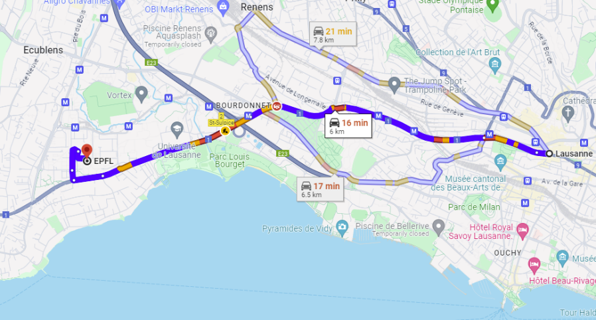
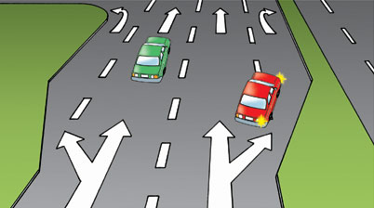


Network Architecture
Topology
How to connect the nodes
~Road Network
Routing
Which path should a message take
~Series of road segments from source to destination
Flow Control
When does the message have to stop/proceed
~Traffic signals at end of each road segment
Router Microarchitecture
How to build the routers
~Design of traffic intersection (number of lanes, algorithm for turning red/green)

Slide 3
Network Architecture
Today’s class
Topology
How to connect the nodes
~Road Network
Routing
Which path should a message take
~Series of road segments from source to destination
Flow Control
When does the message have to stop/proceed
~Traffic signals at end of each road segment
Router Microarchitecture
How to build the routers
~Design of traffic intersection (number of lanes, algorithm for turning red/green)

Slide 4
Network Architecture
Topology
How to connect the nodes
~Road Network
Routing
Which path should a message take
~Series of road segments from source to destination
Flow Control
When does the message have to stop/proceed
~Traffic signals at end of each road segment
Router Microarchitecture
How to build the routers
~Design of traffic intersection (number of lanes, algorithm for turning red/green)

Slide 5
Topology Overview
Often the first step in network design
Significant impact on network cost-performance
Determines implementation complexity, i.e., cost
number of routers and links
router degree (i.e., ports)
ease of layout
Determines application performance
number of hops → latency and energy consumption
maximum throughput
Notes:
What does topology impact?

Slide 6
How to select a topology?
A
B
Best topology?
A
B
F
D
C
D
E
C
F
E
Vertices - cores
Edges - links
Application’s
Task Communication Graph
Vertices - tasks
Edges - communication
Network Topology Graph
Problems?
Cannot change algorithm
Cannot change mapping
Topology is fixed at design-time.
Benefits to being regular and flexible
Cannot adapt to data-dependent load imbalance in application
Layout/packaging issue with long wires and high-node degree

Slide 7
Design-time metrics
Degree – number of ports at a node
Proxy for area/energy cost
Bisection Bandwidth - bandwidth crossing a minimal cut that divides the network in half
(Min # channels crossing two halves) * (BW of each channel)
Proxy for peak bandwidth
Can be misleading as it does not account for routing and flow control efficiency
At this stage, we assume ideal routing (perfect load balancing) and ideal flow control (no idle cycles on any channel)
Diameter – maximum routing distance (number of links in shortest route)
Proxy for latency

Slide 8
Regular topologies
B
Can you suggest a regular topology (each router with same degree) with smallest possible diameter?
A
D
C
Trick question :p
One node. Degree = 0, Diameter = 0.
F
E
Application’s
Task Communication Graph
Vertices - tasks
Edges - communication

Slide 9
Regular topologies
B
Can you suggest a regular topology (each router with same degree) with diameter = 1?
A
D
C
Challenge?
F
E
Not scalable!! Cannot layout more than 4-6 cores in this manner for area and power reasons
Application’s
Task Communication Graph
Vertices - tasks
Edges - communication
Bisection Cut
Fully Connected
Degree = ?
5
Bisection BW = ?
9

Slide 10
Bus
Pros
Cost-effective for small number of nodes
Easy to implement snoopy coherence
Most multicores with 4-6 cores use Buses
Cons
Bandwidth! → Not scalable
…
Diameter = ?
1
Degree = ?
1
Bisection BW = ?
1

Slide 11
Popular Bus Protocols
ARM AMBA Bus
AHB
AXI
ACE
CHI
IBM Core Connect
ST Microelectronics STBus
How to increase bus bandwidth?
Hierarchical Buses
Split-buses

Slide 12
Crossbar
Pros
Every node connected to all others (non-blocking)
Low latency and high bandwidth
Used by GPUs
Cons
Area and Power goes up quadratically (O(N²) cost)
Expensive to layout
Difficult to arbitrate
S
S
…
S
S
D
D
…
D
D
Switch
Diameter = ?
1
Degree = ?
1
Bisection BW = ?
N

Slide 13
Ring
Pros
Cheap: O(N) cost
Used in most multicores today
Cons
High latency
Difficult to scale – bisection bandwidth remains constant
No path diversity
1 shortest path from A to B
B
…
A
Diameter?
N/2
Avg Distance?
N/4
Bisection BW?
2
Degree?
2

Slide 14
Torus
Pros
O(N) cost
Exploit locality for near-neighbor traffic
High path diversity
6 shortest paths from A to B
Edge symmetric
good for load balancing
Same router degree
Cons
Unequal link lengths
Harder to layout
B
A
Diameter?
√N
Bisection BW?
2√N
Degree?
4

Slide 15
Mesh
Pros
O(N) cost
Easy to layout on-chip: regular and equal-length links
Path diversity
3 shortest paths from A to B
Cons
Not symmetric on edges
Performance sensitive to placement on edge vs. middle
Different degrees for edge vs. middle routers
Blocking, i.e., certain paths can block others (unlike crossbar)
Diameter?
2(√N-1)
Bisection BW?
√N
Degree?
4

Slide 16
Hierarchical Topologies
Hierarchical Rings
Concentrated Mesh
Pros
Lower degree
Fewer Wires
Cons
Data Layout
Bandwidth at access points
64 cores connected by a 4x4 Mesh

Slide 17
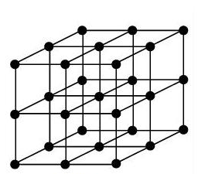
Other Topologies
Tree
Fat Tree
Mostly used in off-chip multi-processors
3D Mesh
Butterfly

Slide 18
Run-time metrics
Hop count (or routing distance)
Number of hops between a communicating pair
Depends on application and mapping
Average hop count or Average distance: average hops across all valid routes
Channel load
Number of flows passing through a particular link
Depends on application and mapping
Maximum channel load determines throughput
Path diversity
Number of shortest paths between a communicating pair
Can be exploited by routing algorithm
Provides fault tolerance

Slide 19
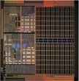
Network Latency
T_{N} = (t_{r}+t_{l})×H + T_{c}
+ T_{s}
t_{r}
Router
T_{N} | Network Latency
t_{r} | Router Latency
t_{l} | Link Latency
H | Hops
T_{c} | Contention Latency
T_{s} | Serialization Latency (for multi-flit packets)
t_{l}
Link
H
Hops
Contention
T_{c}
T_{s} = Serialization latency: time for packet with Length L to cross channel with bandwidth b (L/b)
Which of these is static?
t_{r}
t_{l}
T_{s}
Which of these is dynamic (traffic-dependent)?
H
T_{c}

Slide 20
Latency Example
A
E
C
B
H
F
D
G
What is the average hop count for any message from A?
(Sum hops from A→i, for all i) / Num (i)
(1 + 1 + 2 + 2 + 3 + 3 + 4) / 7 = 16/7 = 2.28
Latency?
2.28 x (router_delay + link_delay)

Slide 21
Throughput
Estimate the maximum bandwidth the network can support
Ideally this should be same as Bisection Bandwidth
In reality, depends on traffic pattern, congestion, and efficiency of routing and flow-control
Maximum Channel Load
Determine most congested link for a traffic pattern
Will limit overall network bandwidth
Network Saturation
network is operating at its peak and cannot accept any more packets

Slide 22
Maximum Throughput Example
A
E
C
B
H
F
D
G
Suppose uniform random traffic
Every node has equal probability of sending to every node
Identify bottleneck channel
Suppose each node generates p messages per cycle
4p messages per cycle in left ring
2p message per cycle will cross to other ring → Maximum Channel Load
Link can handle one message per cycle
So maximum injection rate (i.e., throughput) of p = ½
Similar calculation can be done for any {Topology,Traffic}

Slide 23
Path Diversity
Multiple shortest paths between source/destination pair (R)
Routing algorithm can exploit path diversity
Better load balancing
Fault tolerance
B
B
B
…
A
A
A
R_{AB} = 1
R_{AB} = 3
R_{AB} = 6

Slide 24
Network Architecture
Topology
How to connect the nodes
~Road Network
Routing
Which path should a message take
~Series of road segments from source to destination
Flow Control
When does the message have to stop/proceed
~Traffic signals at end of each road segment
Router Microarchitecture
How to build the routers
~Design of traffic intersection (number of lanes, algorithm for turning red/green)

Slide 25
Routing
Once topology is fixed, routing determines exact path from source to destination
Analogous to the series of road segments from source to destination

Slide 26
Routing Algorithms
Minimal or Non-Minimal
Minimal: only select shortest paths
Non Minimal: need not select shortest paths
Oblivious or Adaptive
Oblivious: routing decisions do not depend on network state/traffic
Deterministic is a subset where same route is always chosen
Adaptive: uses different routes depending on traffic
Implementation
Table based or combination circuit

Slide 27
Dimension Ordered Routing
XY: Always go X first, then Y
Cons of this approach?
DC
Eliminates any path diversity provided by topology
Poor load balancing
No deadlock under inf source, inf sink hypothesis
DA
DB
SA
SB
SC
And yet … This is the most common approach!
Minimal and Deterministic

Slide 28
XY vs YX
XY
YX
DC
DC
DA
DB
DA
DB
SA
SB
SC
SA
SB
SC
What happens if you use both simultaneously?
Suppose we toss a coin and send either XY or YX
Minimal and Oblivious

Slide 29
Challenge with Oblivious XY + YX
Deadlock!

Slide 30
Routing Deadlock
Deadlock: A condition in which a set of agents wait indefinitely trying to acquire a set of resources
A
0
1
D
u
Agents: Packets
Resources: Buffers
x
B
v
w
3
2
C
Packet A holds buffer u (in 1) and wants buffer v (in 2)
Packet B holds buffer v (in 2) and wants buffer w (in 3)
Packet C holds buffer w (in 3) and wants buffer x (in 0)
Packet D holds buffer x (in 0) and wants buffer u (in 1)

Slide 31
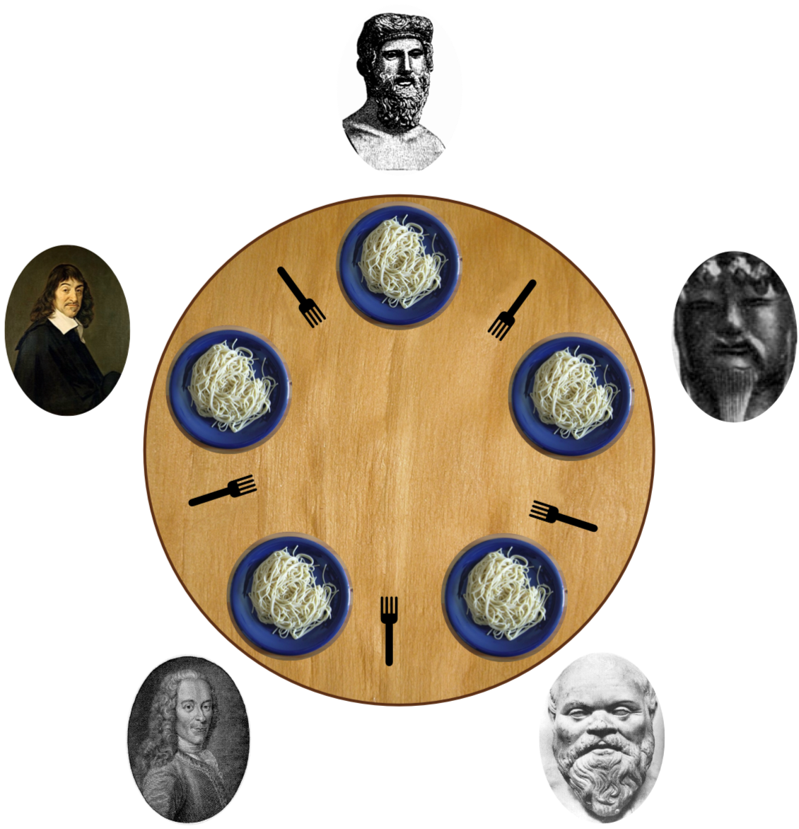
Classic Example: Dining Philosopher’s Problem
Deadlock: A condition in which a set of agents wait indefinitely trying to acquire a set of resources
Agents: Philosophers
Resources: Forks

Slide 32
Deadlock Condition
Agents hold and do not release a resource while waiting for access to another
A cycle exists between waiting agents such that there exists a set of agents A₀, .. A_{n-1}, where agent A_{i} holds resource R_{i}, while waiting on resource R_{(i+i mod n)}, for i = 0, …, n-1
To avoid deadlock – resource dependence graph should not have any cycles

Slide 33
Turn Model (Glass & Ni 1994)
One way of looking at whether a routing algorithm is deadlock free is to look at the turns allowed.
Deadlocks may occur if turns can form a cycle
Removing some turns can make algorithm deadlock free
XY Model
YX Model

Slide 34
Deadlock-free Routing Algorithms
West-First Turn Model
North-Last Turn Model
Negative-First Turn Model

Slide 35
Can we eliminate any two turns?
Six turn model
Deadlock!

Slide 36
Path Diversity vs Deadlock
Path diversity required for higher throughput
Path restrictions because of deadlock-free routing requirement
Can we allow all turns and still get deadlock freedom ?

Slide 37
Why do deadlocks occur?
Resource conflicts!
A
0
1
D
u
x
Add more buffers and partition!
B
v
w
3
2
C
Packet A holds buffer u (in 1) and wants buffer v (in 2)
Packet B holds buffer v (in 2) and wants buffer w (in 3)
Packet C holds buffer w (in 3) and wants buffer x (in 0)
Packet D holds buffer x (in 0) and wants buffer u (in 1)

Slide 38
Virtual Channels
Same physical link/channel between routers
additional buffers in each router to avoid deadlocks – called “virtual” channels
F
E
D
VC0
A
B
C
VC1

Slide 39
Escape Virtual Channels
Allow any turns across all VCs except one
“Escape” VC → deadlock-free route
If there is a deadlock, can jump into escape VC which is guaranteed to drain
VC0
VC1
Escape VC
F
E
D
VC0
A
B
C
VC1

Slide 40
Another kind of deadlock: Protocol Deadlock
Cache 0
Directory
out
in
req
req
req
req
req
req
req
req
resp
req
req
resp
in
out
Cache / Directory can process a request only if there is space in its output queue to send a response
Deadlock, even though network is deadlock-free!
Need separate Virtual Channels for requests and responses
(called Virtual Networks (VN))
for full coherence protocol, need three VNs
(see Cache Coherence Lecture)

Slide 41
Summary of Network Architecture
Topology
How to connect the nodes
~Road Network
Routing
Which path should a message take
~Series of road segments from source to destination
Flow Control
When does the message have to stop/proceed
~Traffic signals at end of each road segment
Router Microarchitecture
How to build the routers
~Design of traffic intersection (number of lanes, algorithm for turning red/green)

Slide 42
Evaluating NoCs
Throughput given by flow control
Latency
Throughput given by routing
Zero load latency
(topology+routing+flow control)
Throughput given by topology
Min latency given by routing algorithm
Min latency given by topology
Offered Traffic (bits/sec)

