Slide 1
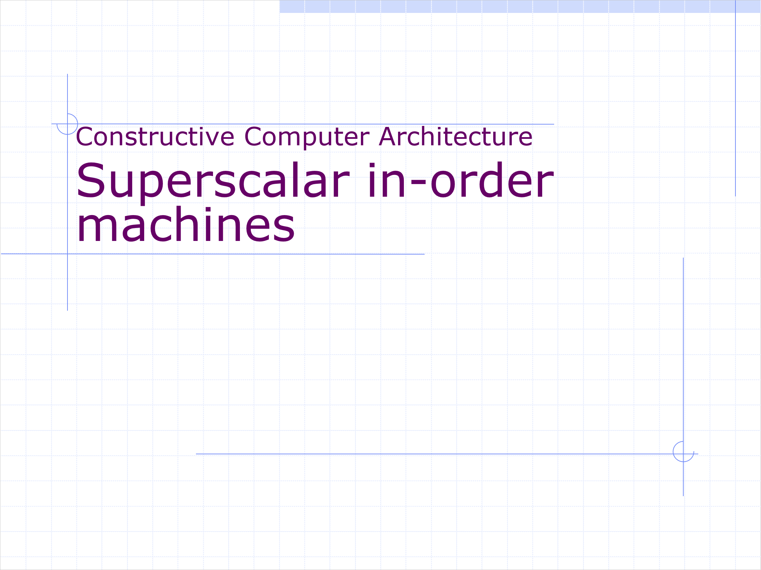
Constructive Computer Architecture
Superscalar in-order machines

Slide 2
Constructive Computer Architecture
Superscalar in-order machines
Or, going wider
Thomas Bourgeat and Martin Chan

Slide 3
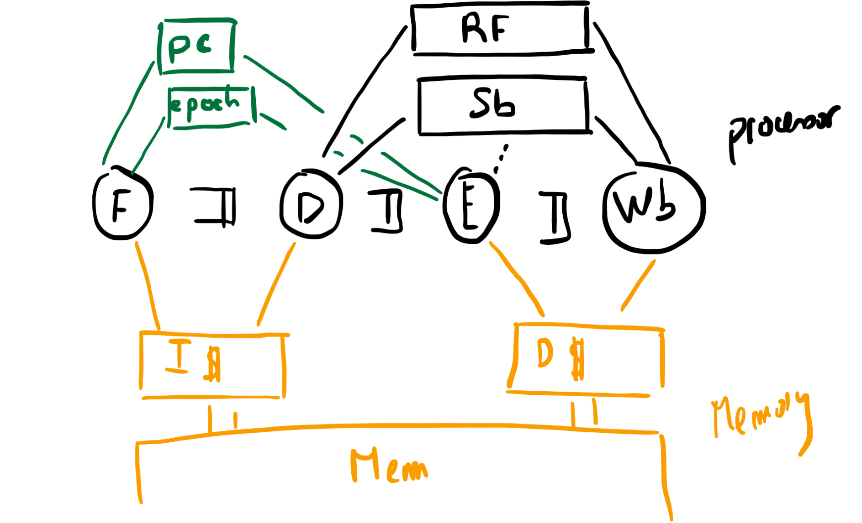
Starting point
No stores/
No store buffer

Slide 4
How to go faster?
Increase number of useful cycles per program
  On branch misprediction (seen last lecture)
  On load miss
  When stalling for dependencies
Improve program
Speed up clock
Time =
Instructions/Program * Cycles/Instruction *
Time/Cycle

Slide 5
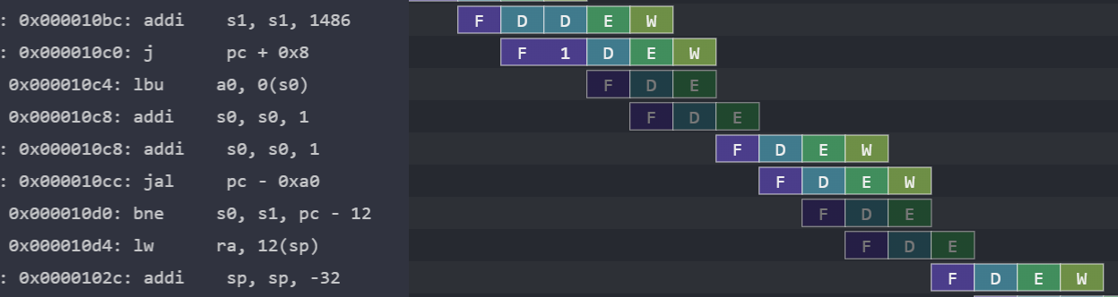
Branch Mispredictions
Mitigations:
  Improve branch predictor (last lecture)
    BHT, BTB, RAS, etc.
  Faster recovery
All at a price

Slide 6
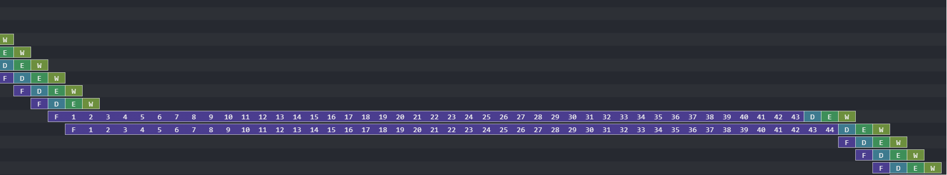
Instruction Miss
Mitigations:
  Prefetch
  Increase cache size/replacement policy

Slide 7
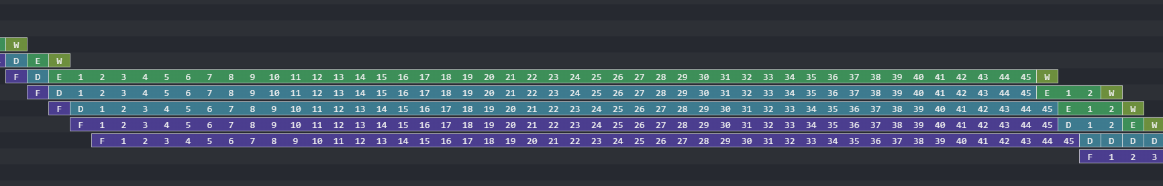
Data Cache Miss
Mitigations:
  Store buffer for stores (prioritize loads)
  Nonblocking cache* (e.g., hit under miss)
  Pipeline cache
  Increase cache size/replacement policy
  Data prefetch?
Notes:
If we’re maintaining in order, then nonblocking is only relevant for stores. For loads it can get weird if you want to proceed. Same for pipeline cache.

Slide 8
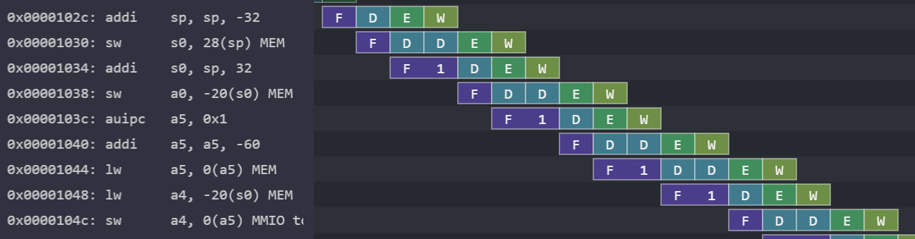
Data Dependency Stall
Mitigations:
  Add bypassing
  Register renaming for false dependencies (not covered)

Slide 9
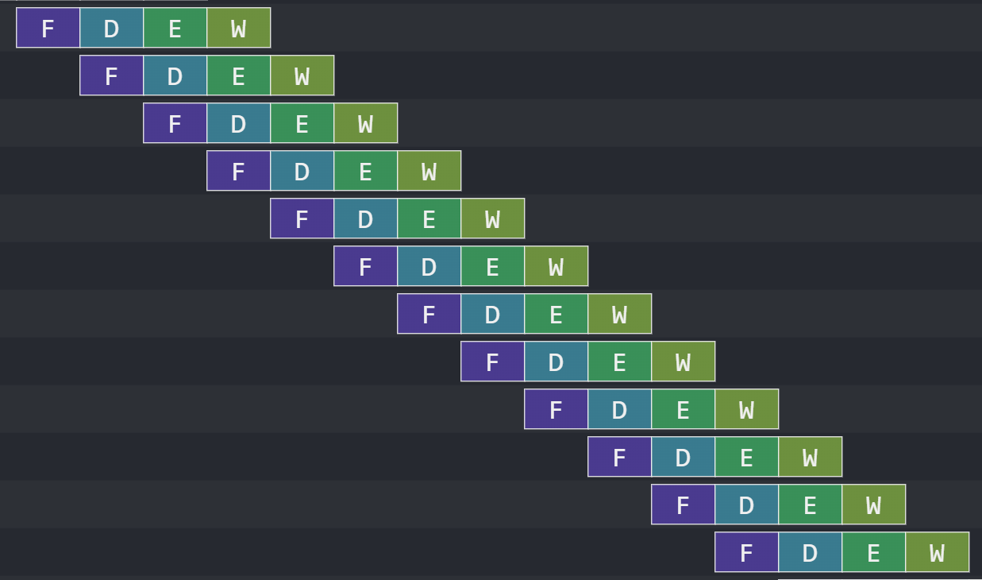
If we fix them all: best case scenario

Slide 10
Alternative idea
We have a single new instruction/cycle (IPC < 1)
  Can we find more work to do?
Idea:
  Do two instructions simultaneously!
Very rich idea: superscalar machines

Slide 11

High-level picture
We will need to decode multiple times
We will need to write multiple registers
(and some more)

Slide 12
Outline
Let’s consider all the stages
  Fetch
  Decode
  Execute
  Writeback
What changes to the processor will be required for each stage?

Slide 13
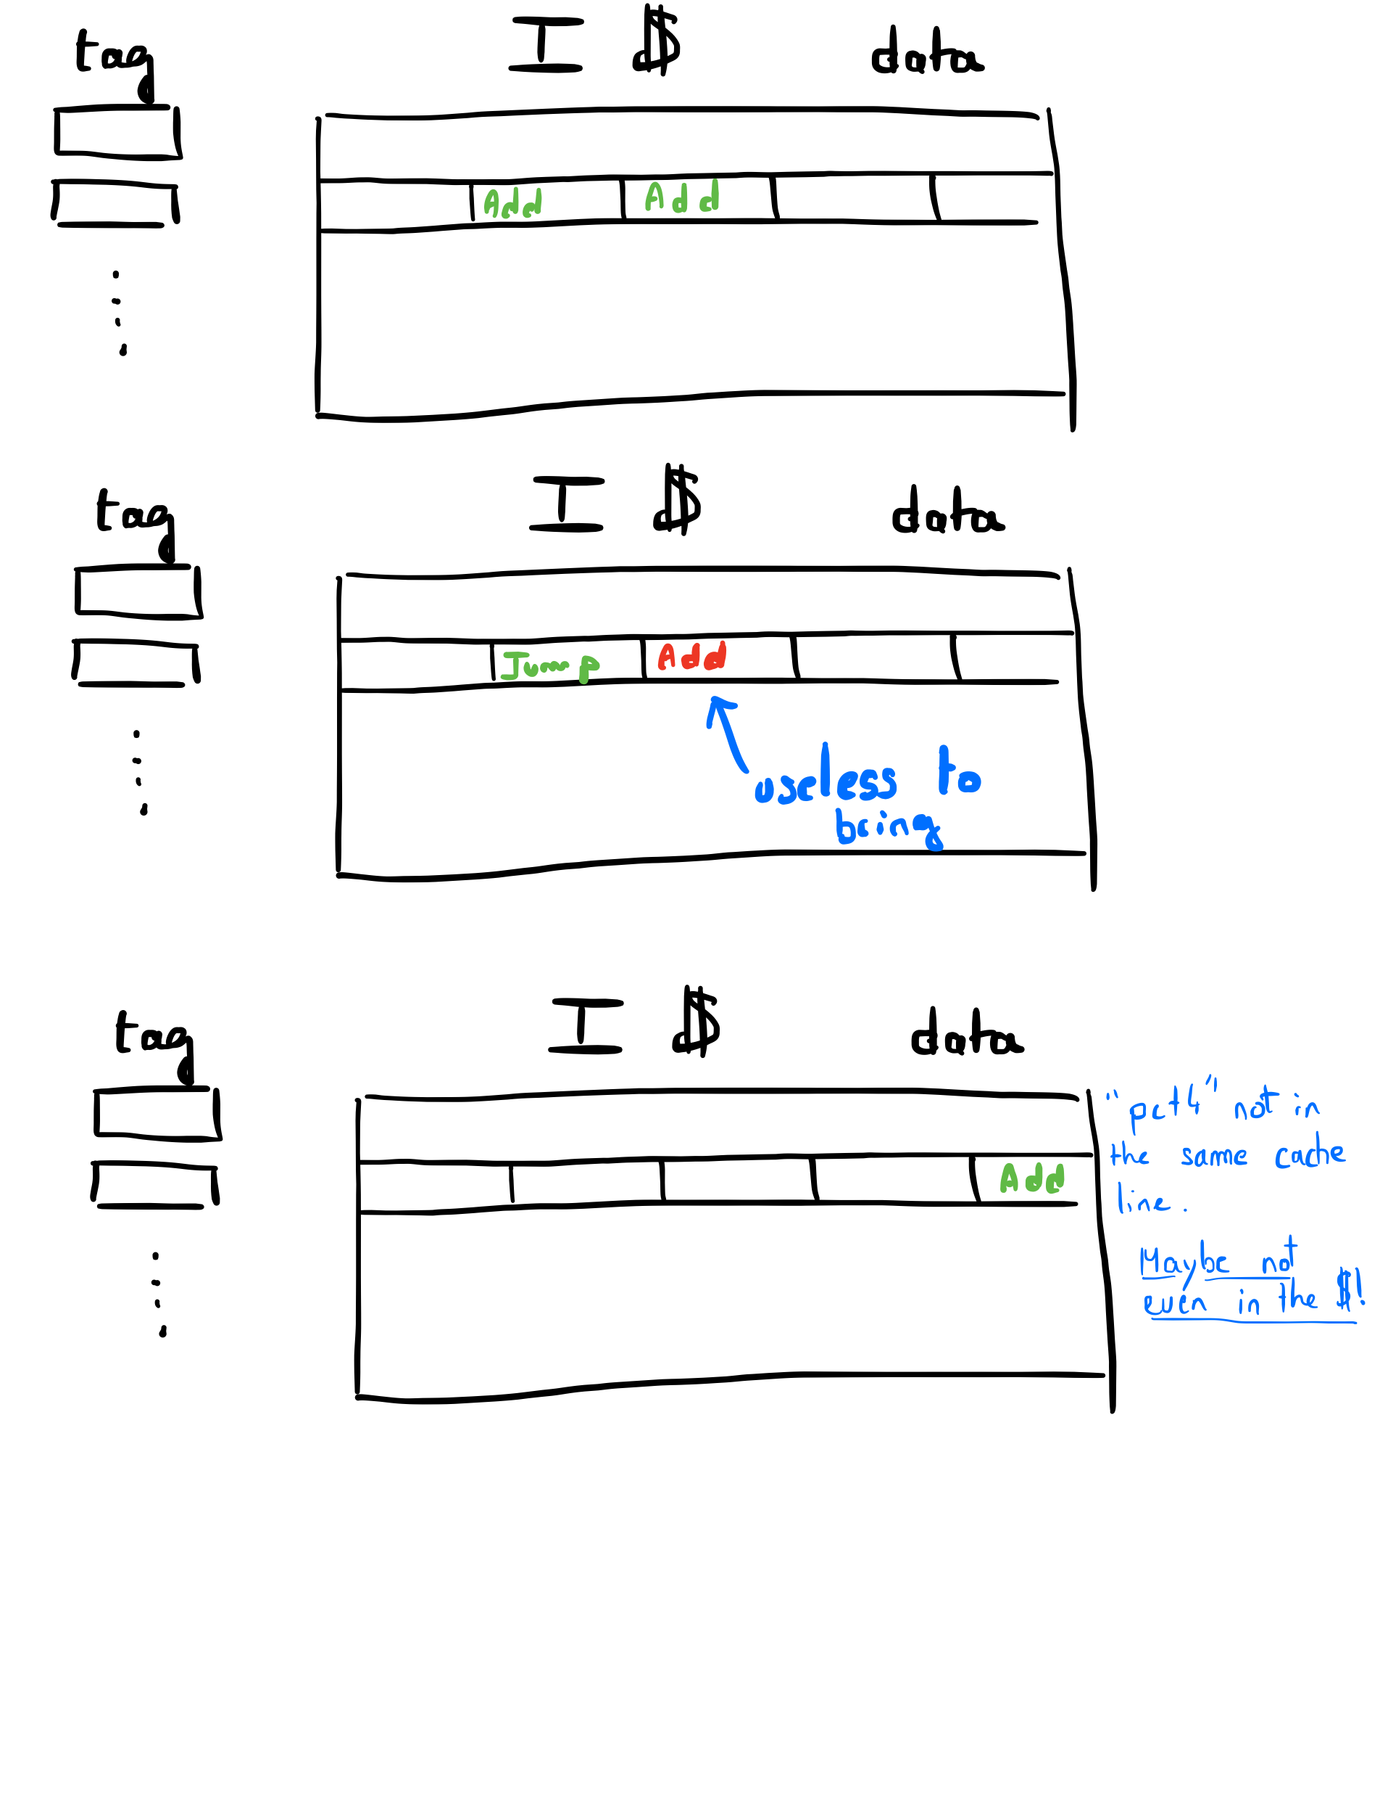
Brainstorming superscalar
Fetch
Fetch 2 instructions:
  Easy if instructions consecutive within one cache line of ICache

Slide 14
Fetch – Problem at the boundary
pc+4 not in the same cache line,
  (maybe not even in cache)

Slide 15
Revised solution
Idea:
  Always do two instructions simultaneously!
  Try to do two instructions simultaneously, sometimes do only one if it is too hard (e.g. cache boundary)

Slide 16
Not always useful – that’s ok

Slide 17
Summary ICache
typedef struct
{Word ins1; Maybe#(Word) ins2;} OneOrTwoWords deriving (…);
interface Cache;
method Action req(MemReq req);
method ActionValue#( Word ) resp();
method ActionValue#(LReq) lineReq;
method Action lineResp(Line r);
endinterface
OneOrTwoWords
Implementation:
When enqueuing into hitQ, enqueue pair of 2 words if you can

Slide 18
Fetch
// OLD
let req = Mem {byte_en : 0, addr : pcf[1], data : 0};
toImem.enq(req);
f2d.enq(F2D{pc: pcf[1], ppc : pcf[1] + 4, epoch: epoch[1]});
We need a queue where we can enqueue multiple times per rule
// NEW
let req = Mem {byte_en : 0, addr : pcf, data : 0};
toImem.enq(req); // Triggers a response with 1 or 2 inst
f2d.enq1(F2D{pc: pcf, ppc : pcf+4, epoch: epoch});
if (notLineBoundary(pcf)) begin
  f2d.enq2(F2D{pc: pcf+4, ppc : pcf+8, epoch: epoch});
  pcf <= pcf+8;
end else pcf <= pcf+4;
(An aside: you may want two predictor
ports, or keep using just one)

Slide 19
Everyone’s favorite kind of interface
Regular single FIFO
Superscalar FIFO
?

Slide 20
Superscalar FIFO- example
f == []
Cycle 0 “f.enq1(13), f.enq2(42)”
f==[13;42]
Cycle 1 “f.enq1(24), f.deq1()”
f==[42;24]
Cycle 2 “f.enq1(76), f.enq2(84), f.deq1(), f.deq2”
f==[76;84]

Slide 21
Interface for Superscalar FIFO
interface SuperFIFO#(type t);
method Action enq1(t x);
method Action enq2(t x); // implies enq1 called too
method Action deq1;
method Action deq2; // implies deq1 called too
method t first1;
method t first2; //…
endinterface
How to implement this interface?

Slide 22
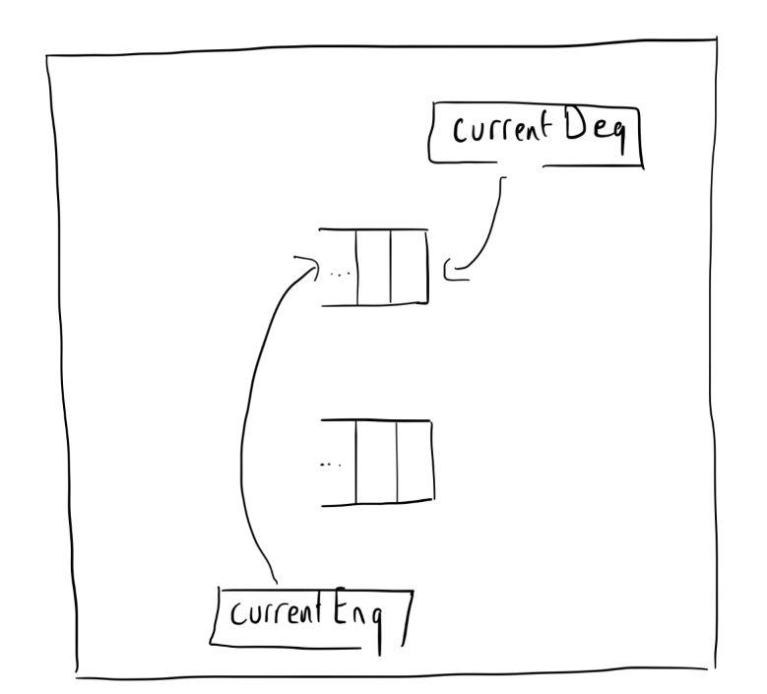
Sketch – Rotating FIFOs
2 internal queues
Track which queue holds the oldest value: 1 bit reg currentDeq
Track which queue should be enqueued into next: currentEnq
The two enqueue push into FIFO (currentEnq, currentEnq+1)
The two dequeue pull from FIFO (currentDeq, currentDeq + 1)

Slide 23

Rotating Superscalar FIFO
f == []

Slide 24
Rotating Superscalar FIFO
f == []
Cycle 0 “f.enq1(13), f.enq2(42)”
f==[13;42]

Slide 25
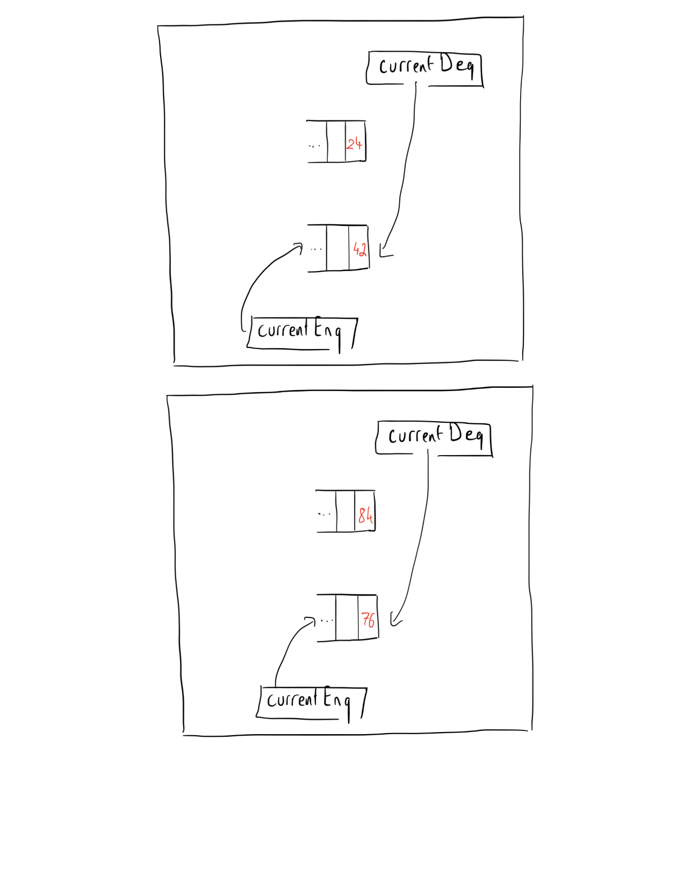
Rotating Superscalar FIFO
f == []
Cycle 0 “f.enq1(13), f.enq2(42)”
f==[13;42]
Cycle 1 “f.enq1(24), f.deq1()”
f==[42;24]

Slide 26
Rotating Superscalar FIFO
f == []
Cycle 0 “f.enq1(13), f.enq2(42)”
f==[13;42]
Cycle 1 “f.enq1(24), f.deq1()”
f==[42;24]
Cycle 2 “f.enq1(76), f.enq2(84), f.deq1(), f.deq2”
f==[76;84]
Code in appendix “SuperFIFO.bsv”

Slide 27
Subtle FIFO difference
FIFO with single enq, deq for two tokens vs.
FIFO with two enq, deq for one token each
Wrap OneOrTwoToken iMem FIFO with SuperFIFO

Slide 28
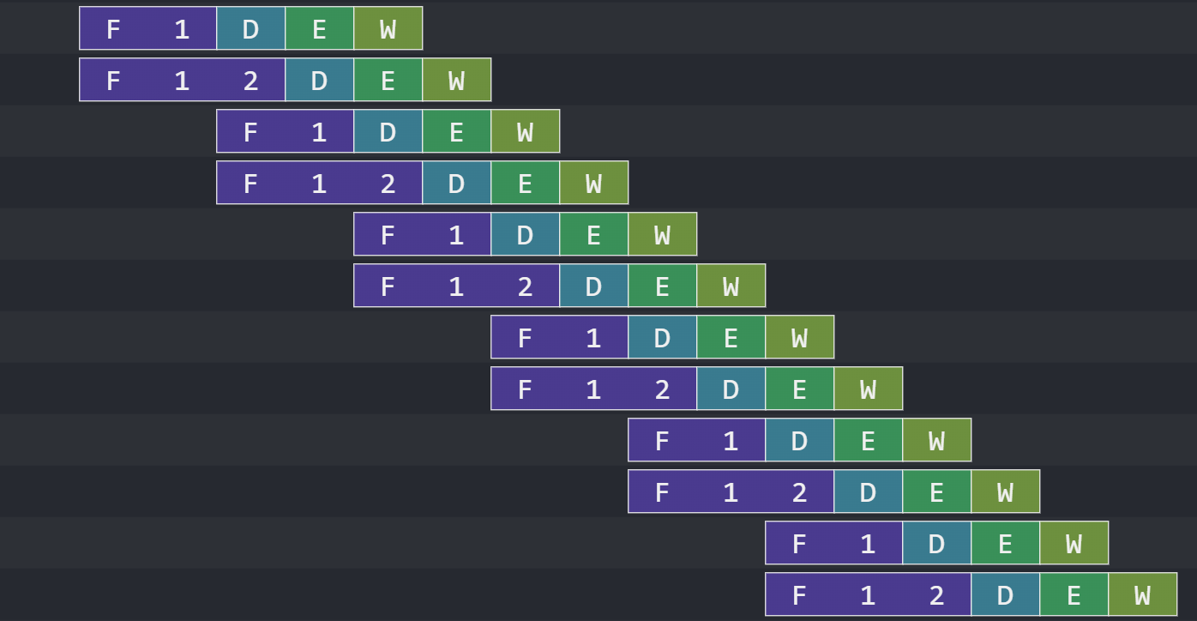
Fetch only
Useful?

Slide 29
Decode
Requirements:
  Dequeue two elements from f2d (ins1,ins2)
  Push multiple times into d2e
  Duplicate decoding logic
  Needs more register file and scoreboard reads/write
  Handle ins1 write a register read by ins2
  Decode (ins1, ins2), outstanding dependency on ins2, ins1 ok. Stall?

Slide 30
Partial stalling in Decode
if (noDependency(ins1,sb) && noDependency(ins2,sb) &&
noDependencyBetween(ins1, ins2)) begin
d2e.enq1(“ins1”);
d2e.enq2(“ins2”);
f2d.deq1;
f2d.deq2;
end
Is the second case for
correctness or performance?
else if (noDependency(ins1,sb)) begin d2e.enq1(“ins1”);
f2d.deq1;
end // otherwise stall

Slide 31
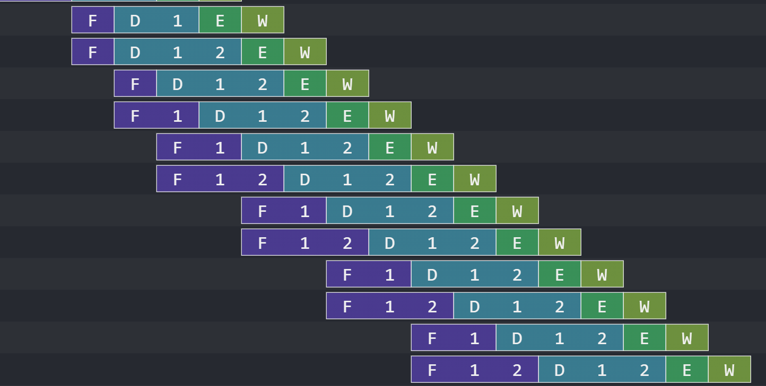
+ Decode
(Not the full picture)

Slide 32
Check your Decode
Some bugs might not show up in every program!
Think about how things may break
Write or find RISC-V unit tests
  Check for each of the cases we discussed
    I1 not in SB, I2 not in SB, I2 independent from I1
    I1 not in SB, I2 not in SB, but I2 depends on I1
    etc.
Key is thinking about dependencies

Slide 33
Execute
Execute 2 instructions:
  Duplicate ALU? Possible – some area tradeoff
  Duplicate memory? Much harder/impossible
  New kind of structural hazards:
    ins1 and ins2 are memory instructions
    More generally, any ins1 and ins2 using the same resource
      (multiplier, floating point unit, etc.)

Slide 34
Execute – ALU, Memory, Control
Many combinations in the sequence (ins1,ins2):
  Misprediction and both incorrect?
  Misprediction then correct instruction?
Easiest approximation:
  Do control (br/jmp) one-by-one
  Do memory one-by-one
  Do arithmetic two-by-two
  Check squashing two-by-two, then try again

Slide 35
Simple Execute
let ins1 = d2e.first1(); let ins2 = d2e.first2();
d2e.deq1(); // at least process ins1
if (ins1.epoch != epoch[0] && ins2.epoch != epoch[0]) begin
d2e.deq2(); // invalid ins1 and ins2
squash ins1 AND ins2D
end else if (ins1.epoch != epoch[0]) begin
squash ins1, don’t touch ins2, try again next cycle
end
else if (isALU(ins1) && isALU(ins2) && ins2.epoch == epoch[0]) begin
d2e.deq2();
execute both ins1 and ins2 (duplicate ALU circuit)
end else begin
be modest and only process ins1 (as in original design)
end

Slide 36
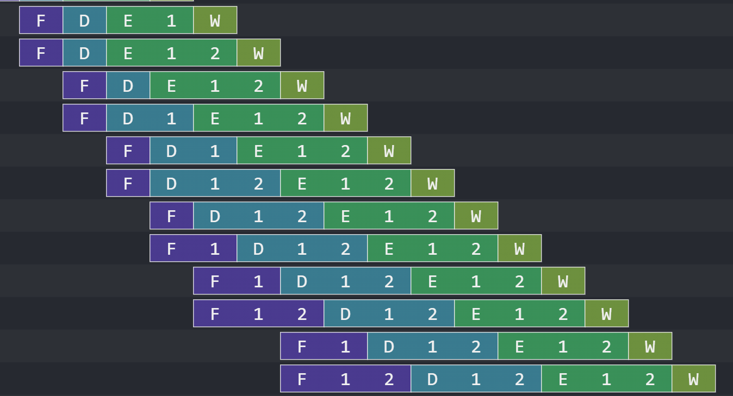
+ Execute
(Also not the full picture)

Slide 37
Check your Execute
Some bugs might not show up in every program!
Think about how things may break
  dMem and e2w mismatch
Write or find RISC-V unit tests
  Check for each of the cases we discussed
    Some things are tricky with control and memory
    Draw a 3x3 matrix

Slide 38
Brainstorming superscalar
Writeback
In reality, register file ports can become expensive, and so can cache ports
Writeback 2 instructions:
  More ports for the register file
  More ports for the scoreboard
Structural hazard for memory/MMIO instructions
What if the two instructions write the same register?
  Is it a problem?
  Easy safe solution: EHR with extra ports (RF and SB)
Notes:
Single bit scoreboard: doesn’t handle the two consecutive. But also the problem isn’t often present with optimized code. Could also stall in the scoreboard (third search per instruction)

Slide 39
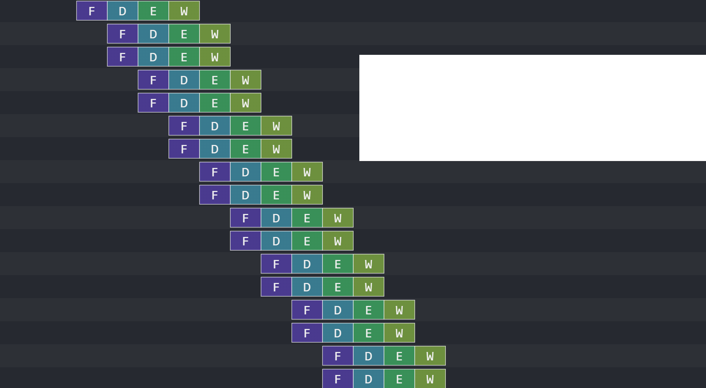
All together
Use the logs! Use them!

Slide 40
Teaser - next week and next lab
So far, processor runs one program
Why not making it run two programs?
  pc_x, rf_x[_]
  pc_y, rf_y[_]
  (but shared memory, shared other stuff)
The two programs are independent, unlikely to miss/branch/stall simultaneously.
We call this Simultaneous Multithreading (SMT)

