Slide 1
Indistinguishability Technique

Slide 2
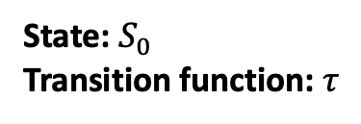
What is an algorithm?
State machine
Initial state
Transition function: changes state and produces outputs

Slide 3

What is an algorithm?
State machine
Initial state
Transition function: changes state and produces outputs

Slide 4
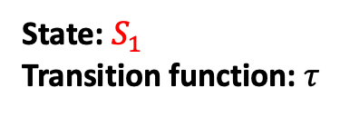

What is an algorithm?
State machine
Initial state
Transition function: changes state and produces outputs

Slide 5

What is an algorithm?
State machine
Initial state
Transition function: changes state and produces outputs

Slide 6
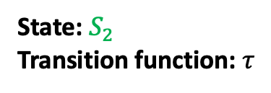

What is an algorithm?
State machine
Initial state
Transition function: changes state and produces outputs
If the algorithm is deterministic, the transition function is deterministic.

Slide 7
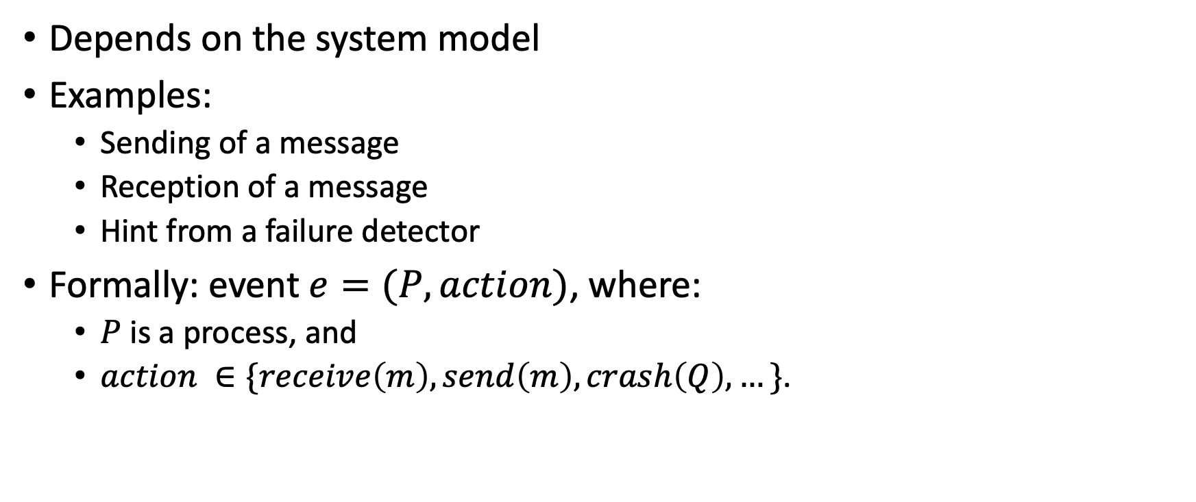
What is an event?

Slide 8
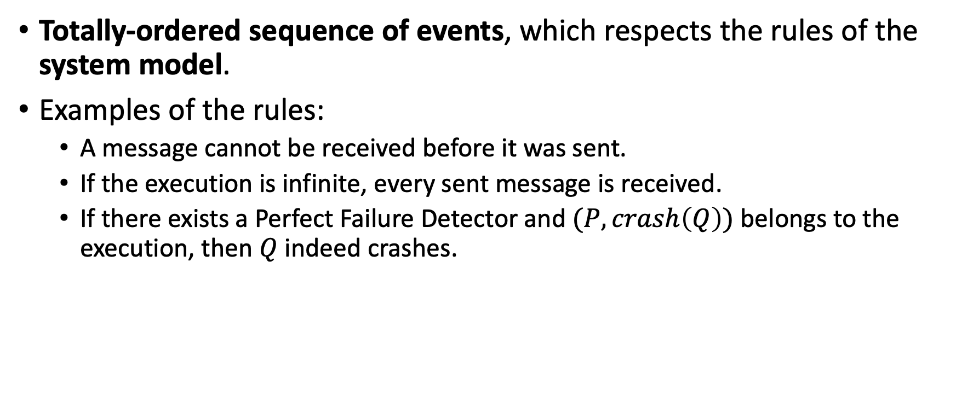
What is an execution?

Slide 9
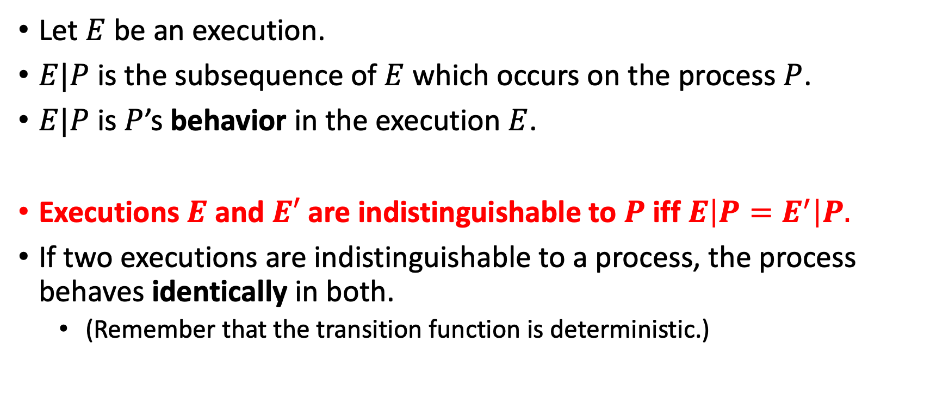
Indistinguishable executions

Slide 10
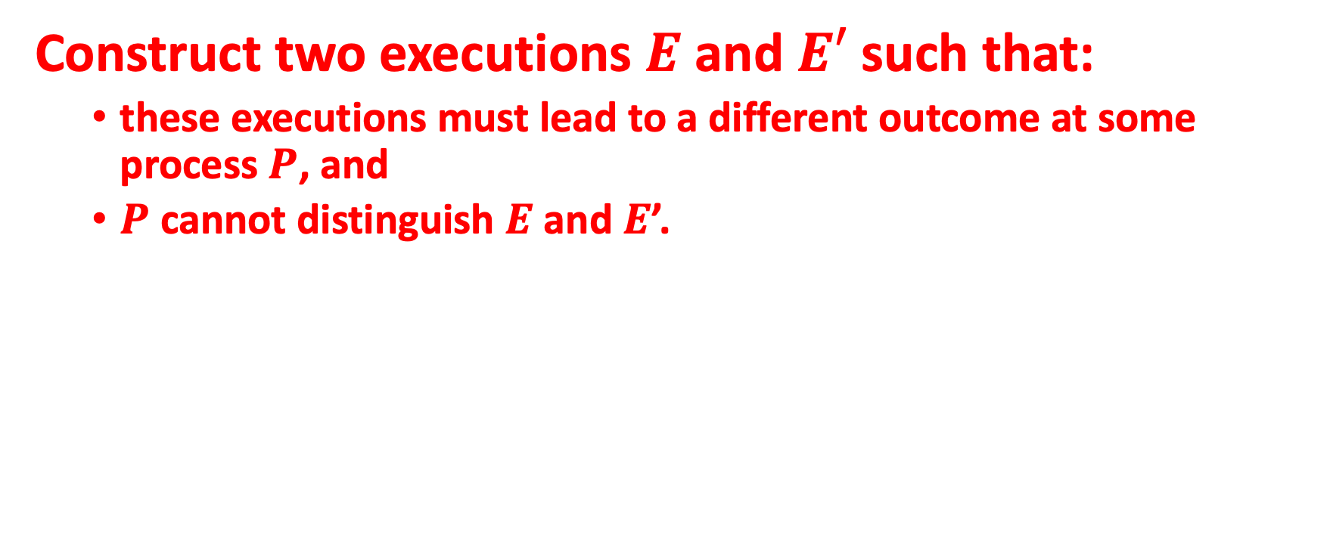
The idea

Slide 11
Example
Prove that it is impossible to solve the Consensus problem with an Eventually Perfect Failure Detector unless we assume a correct majority.

Slide 12
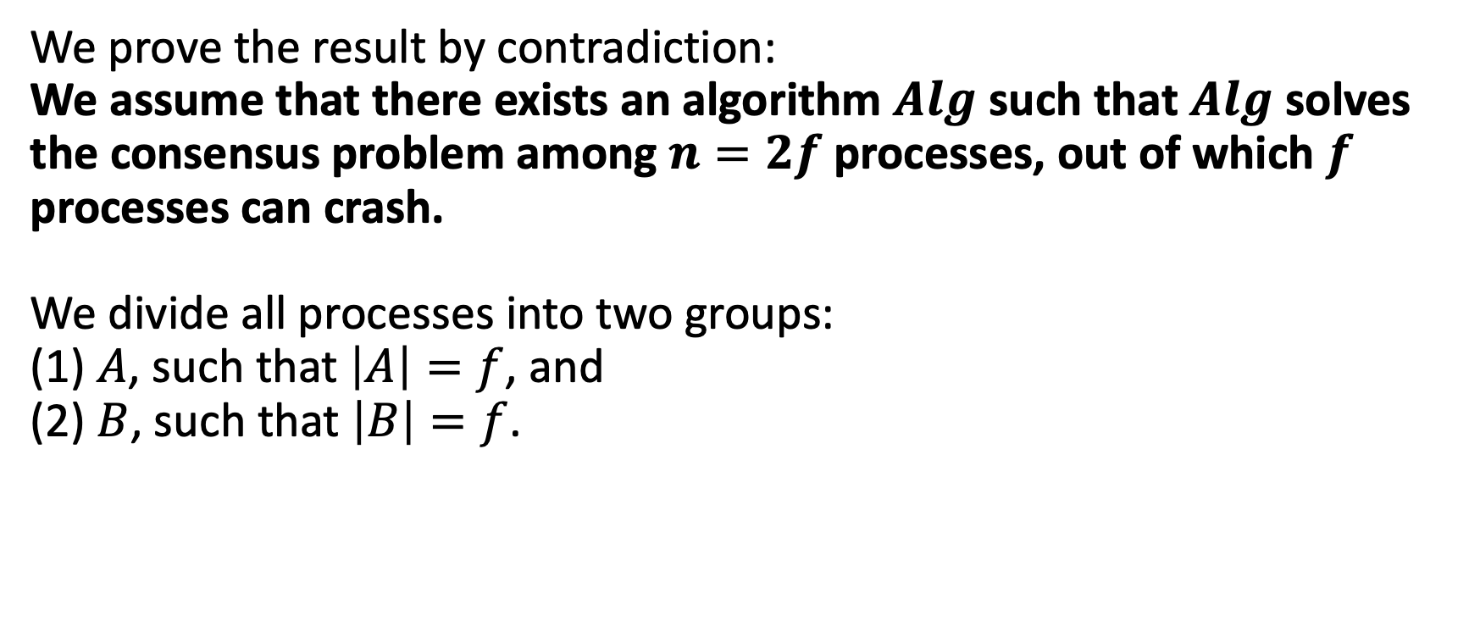
Proof (by indistinguishability)

Slide 13
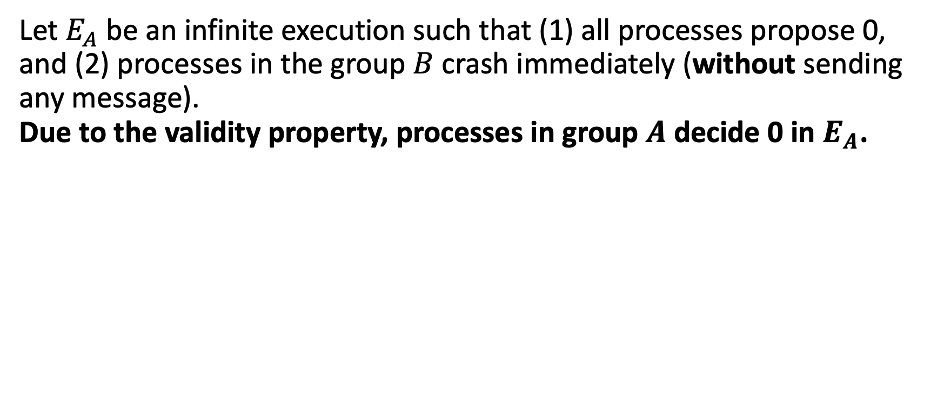
Proof (by indistinguishability)

Slide 14
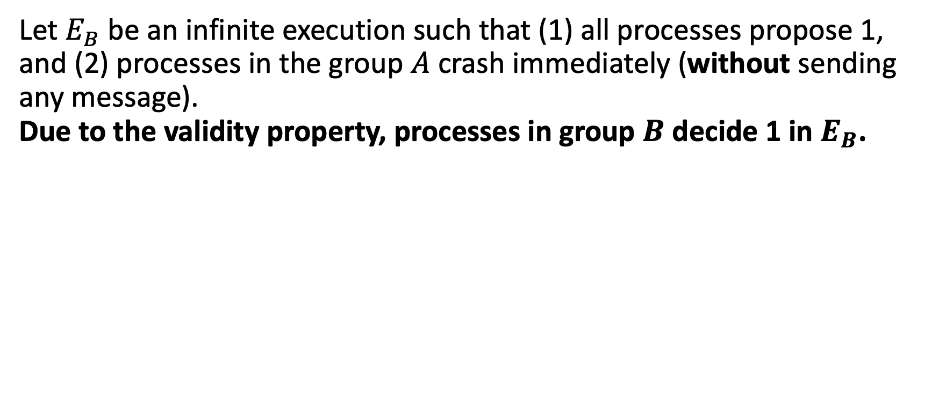
Proof (by indistinguishability)

Slide 15
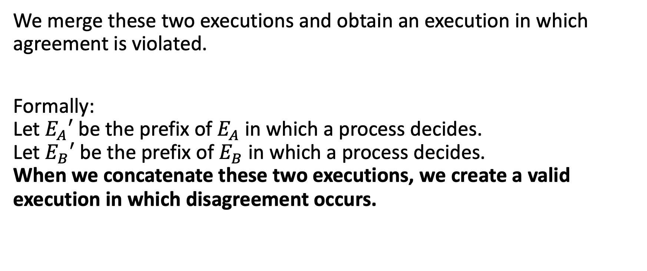
Proof (by indistinguishability)

Slide 16
Exercise 1
Prove that a Perfect Failure Detector cannot be implemented in an asynchronous system.

Slide 17
Proof (by indistinguishability)
We prove the result by contraction.
We assume that exists an algorithm alg that implements a Perfect Failure Detector in an asynchronous system.
Let us define an execution A of alg.
In A, a faulty process Q crashes immediately (without sending any message). Due to the completeness property of alg, some correct process P eventually detects that A has crashed.
Let this detection happen at some time t.

Slide 18
Proof (by indistinguishability)
Let us now define an execution B
In B, Q is correct, but all its messages are delayed until some time t’ > t.
Moreover, B is otherwise indistinguishable to P. Hence, P detects that Q has crashed. However, this detection violates the accuracy property.

Slide 19
Exercise 2
Prove, using the indistinguishability technique, that Non-Blocking Atomic Commit cannot be implemented without a Perfect Failure Detector.

Slide 20
Proof (by indistinguishability)
Let P be a process. Let all the other processes propose 1. We devise two executions: A and B.
In A, P crashes immediately and all processes decide x at time t.
In B, P is just “slow”: messages sent by P are received after time t. All processes, as in A, decide x at time t.

Slide 21
Proof (by indistinguishability)
Let x = 1.
If P proposes 0 in B, we have violated the commit-validity property in B.
Let x = 0.
If P proposes 1 in B, we have violated the abort-validity property in B.

Slide 22
Exercise 3
Prove, using the indistinguishability technique, that Terminating Reliable Broadcast cannot be implemented without a Perfect Failure Detector.

Slide 23
Proof (by indistinguishability)
Let S be a sender process.
In an execution A, S crashes immediately (without sending any messages), and processes decide x at some time t.
In an execution B, S is just “slow”: messages sent by S are received after time t. All processes, as in A, decide x at time t.

Slide 24
Proof (by indistinguishability)
Let x = φ.
In the execution B, we have violated the validity property.
Let x = m.
In the execution B, we have violated the integrity property.

