Slide 1
Indistinguishability Technique

Slide 2
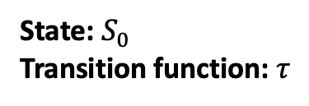
What is an algorithm?
State machine
Initial state
Transition function: changes state and produces outputs
State: $S_{0}$ Transition function: $τ$

Slide 3

What is an algorithm?
State machine
Initial state
Transition function: changes state and produces outputs
State: $S_{0}$ Transition function: $τ$
event $e_{1}$

Slide 4
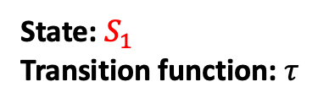

What is an algorithm?
State machine
Initial state
Transition function: changes state and produces outputs
State: $S_{1}$ Transition function: $τ$
event $e_{1}$
output $o_{1}$

Slide 5

What is an algorithm?
State machine
Initial state
Transition function: changes state and produces outputs
State: $S_{1}$ Transition function: $τ$
event $e_{2}$

Slide 6
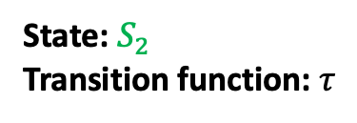

What is an algorithm?
State machine
Initial state
Transition function: changes state and produces outputs
If the algorithm is deterministic, the transition function is deterministic.
State: $S_{2}$ Transition function: $τ$
event $e_{2}$
output $o_{2}$

Slide 7
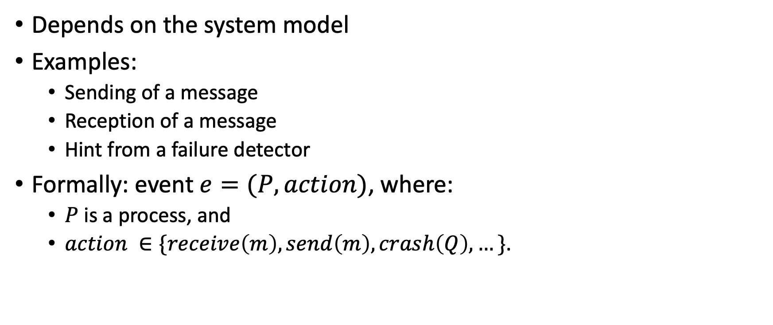
What is an event?
Depends on the system model
Examples:
Sending of a message
Reception of a message
Hint from a failure detector
Formally: event $e=(P, action)$, where:
$P$ is a process, and
$action ∈\{receive\left(m\right), send\left(m\right), crash\left(Q\right), …\}$.

Slide 8
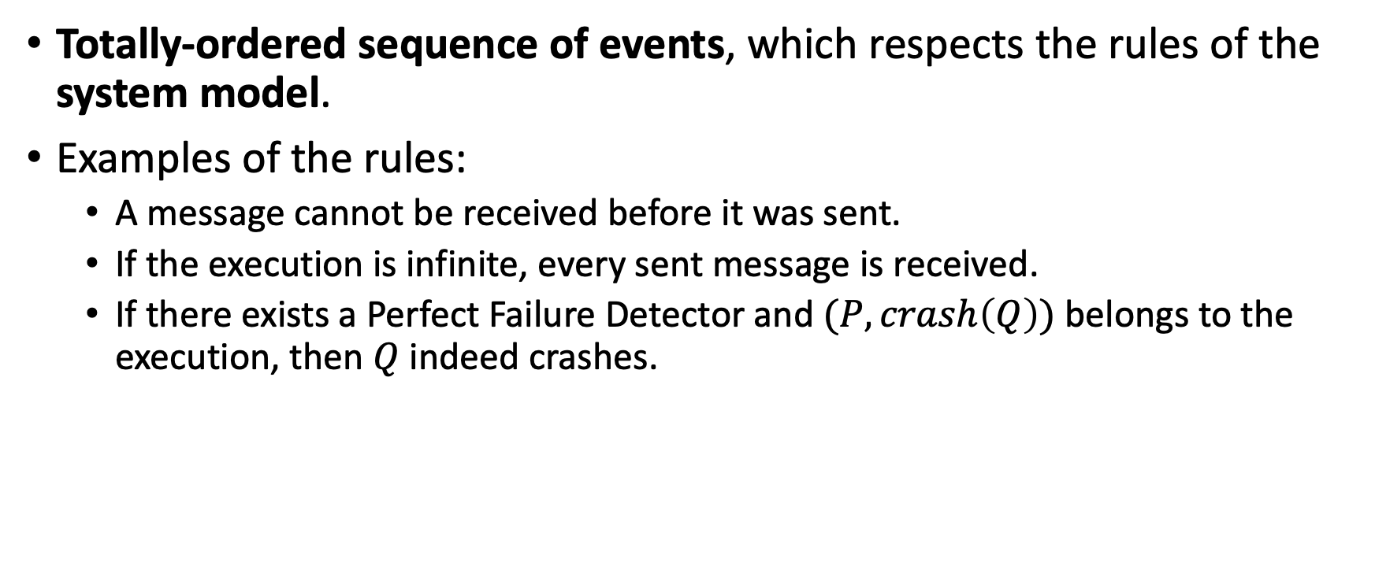
What is an execution?
Totally-ordered sequence of events, which respects the rules of the system model.
Examples of the rules:
A message cannot be received before it was sent.
If the execution is infinite, every sent message is received.
If there exists a Perfect Failure Detector and $(P, crash\left(Q\right))$ belongs to the execution, then $Q$ indeed crashes.

Slide 9
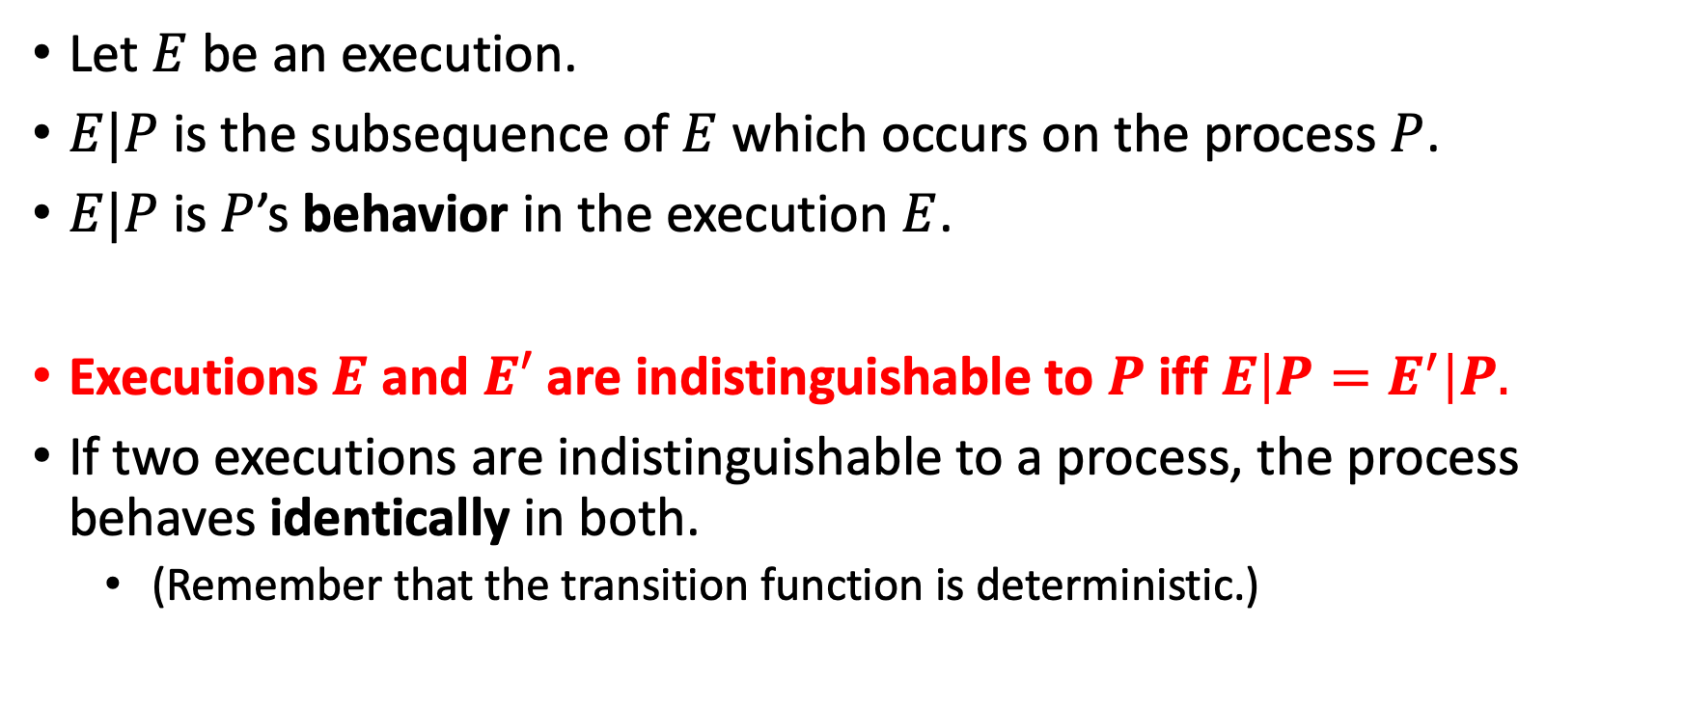
Indistinguishable executions
Let $E$ be an execution.
$E|P$ is the subsequence of $E$ which occurs on the process $P$.
$E|P$ is $P$’s behavior in the execution $E$.
Executions $E$ and $E′$ are indistinguishable to $P$ iff $E\left|P=E^{′}\right|P.$
If two executions are indistinguishable to a process, the process behaves identically in both.
(Remember that the transition function is deterministic.)

Slide 10

The idea
Construct two executions $E$ and $E′$ such that:
these executions must lead to a different outcome at some process $P$, and
$P$ cannot distinguish $E$ and $E$’.

Slide 11
Example
Prove that it is impossible to solve the Consensus problem with an Eventually Perfect Failure Detector unless we assume a correct majority.

Slide 12
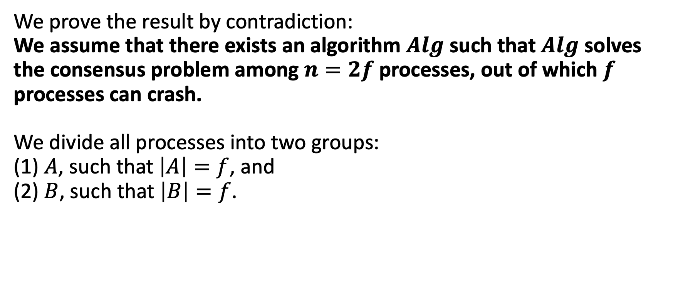
Proof (by indistinguishability)
We prove the result by contradiction: We assume that there exists an algorithm $Alg$ such that $Alg$ solves the consensus problem among $n=2f$ processes, out of which $f$ processes can crash. We divide all processes into two groups: (1) $A$, such that $\left|A\right|=f$, and (2) $B$, such that $\left|B\right|=f$.

Slide 13

Proof (by indistinguishability)
Let $E_{A}$ be an infinite execution such that (1) all processes propose 0, and (2) processes in the group $B$ crash immediately (without sending any message). Due to the validity property, processes in group $A$ decide 0 in $E_{A}$.

Slide 14

Proof (by indistinguishability)
Let $E_{B}$ be an infinite execution such that (1) all processes propose 1, and (2) processes in the group $A$ crash immediately (without sending any message). Due to the validity property, processes in group $B$ decide 1 in $E_{B}$.

Slide 15
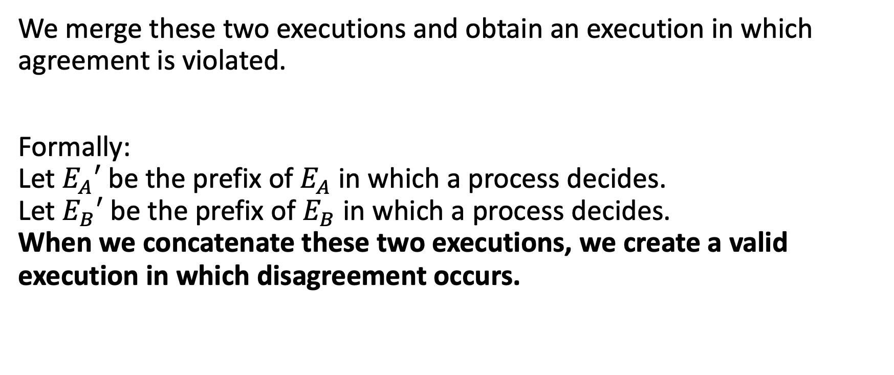
Proof (by indistinguishability)
We merge these two executions and obtain an execution in which agreement is violated.
Formally: Let $E_{A}′$ be the prefix of $E_{A}$ in which a process decides. Let $E_{B}′$ be the prefix of $E_{B}$ in which a process decides. When we concatenate these two executions, we create a valid execution in which disagreement occurs.

Slide 16
Exercise 1
Prove that a Perfect Failure Detector cannot be implemented in an asynchronous system.

Slide 17
Exercise 2
Prove, using the indistinguishability technique, that Non-Blocking Atomic Commit cannot be implemented without a Perfect Failure Detector.

Slide 18
Exercise 3
Prove, using the indistinguishability technique, that Terminating Reliable Broadcast cannot be implemented without a Perfect Failure Detector.

