Slide 1

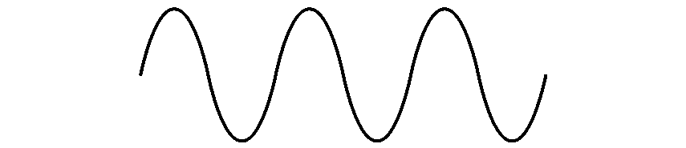

COM-405: Mobile Networks
Lecture 6.0: MAC
Haitham Hassanieh
Laboratory of SEnsing
& Networking Systems

Slide 2


Wireless Is Shared Medium
  interference from nodes in the network:
  interference from other sources: standardized wireless network frequencies (e.g., 2.4 GHz) shared by other devices (e.g., phone); devices (motors, microwaves, baby monitors, … ) interfere as well
X

Slide 3
Wireless Interference
SNR is no longer the main metric!
$$Interference to Noise Ratio: INR=\frac{Interference \left(I\right)}{Noise (N)}$$
$INR>1→$ Interference limited
$INR<1→$ Noise limited
$$Signal−to−Interference \& Noise Ratio:$$
$$SINR=\frac{Received Signal Power (P_{Rx})}{Interference \left(I\right)+Noise (N)}$$

Slide 4
Multiple Access Protocols
Single shared broadcast channel
Two or more simultaneous transmissions by nodes: interference
  collision if node receives two or more signals at the same time
Multiple Access Protocol
distributed algorithm that determines how nodes share channel, i.e., determine when node can transmit

Slide 5
MAC Protocol Should be:
Efficient:
No idle channels, Maximize utilization, No Collisions
→ No wasted resources
Fair:
No starvation, Equal distribution of resources
→ based on what? Need?

Slide 6
MAC Protocols
Reservation Based:
  divide channel into smaller “pieces” (time slots, frequency, code)
  allocate piece to node for exclusive use
Contention Based: (random access)
  channel not divided, allow collisions
  “recover” from collisions

Slide 7
TDMA: Time Division Multiple Access
access to channel in "rounds"
each station gets fixed length slot (length = packet transmission time) in each round
unused slots go idle
Need some synchronization
example: 6-station LAN, 1,3,4 have packets to send, slots 2,5,6 idle
6-slot
frame
6-slot
frame
1
3
4
1
3
4

Slide 8
FDMA: Frequency Division Multiple Access
channel spectrum divided into frequency bands
each station assigned fixed frequency band
unused transmission time in frequency bands go idle
Need guard bands
example: 6-station LAN, 1,3,4 have packet to send, frequency bands 2,5,6 idle
time
frequency bands
FDM cable

Slide 9
Code Division Multiple Access (CDMA)
unique “code” assigned to each user; i.e., code set partitioning
  all users share same frequency, but each user has own “chipping” sequence (i.e., code) to encode data
  allows multiple users to “coexist” and transmit simultaneously with minimal interference (if codes are “orthogonal”)
encoded signal = (original data) X (chipping sequence)
decoding: inner-product of encoded signal and chipping sequence
Example codes: Gold Codes, Walsh Codes

Slide 10
CDMA encode/decode
channel output Z_{i,m}
Z_{i,m}= d_{i}.c_{m}
data
bits
d₀ = 1
1
1
1
1
1
d₁ = -1
1
1
1
-
-
-
-
1
-
-
-
1
-
1
1
1
1
1
sender
1
1
slot 1
channel
output
slot 0
channel
output
1
1
1
1
1
code
1
1
-
-
-
1
-
1
1
1
-
-
-
1
-
1
1
1
slot 1
slot 0
M
D_{i} = Σ Z_{i,m}.c_{m}
m=1
M
received
input
1
1
1
1
1
1
1
1
d₀ = 1
-
-
-
-
1
-
-
-
1
-
1
1
1
1
1
1
d₁ = -1
1
slot 1
channel
output
slot 0
channel
output
1
1
1
1
1
code
1
1
-
-
-
1
-
1
1
1
-
-
-
1
-
1
1
1
receiver
slot 1
slot 0

Slide 11
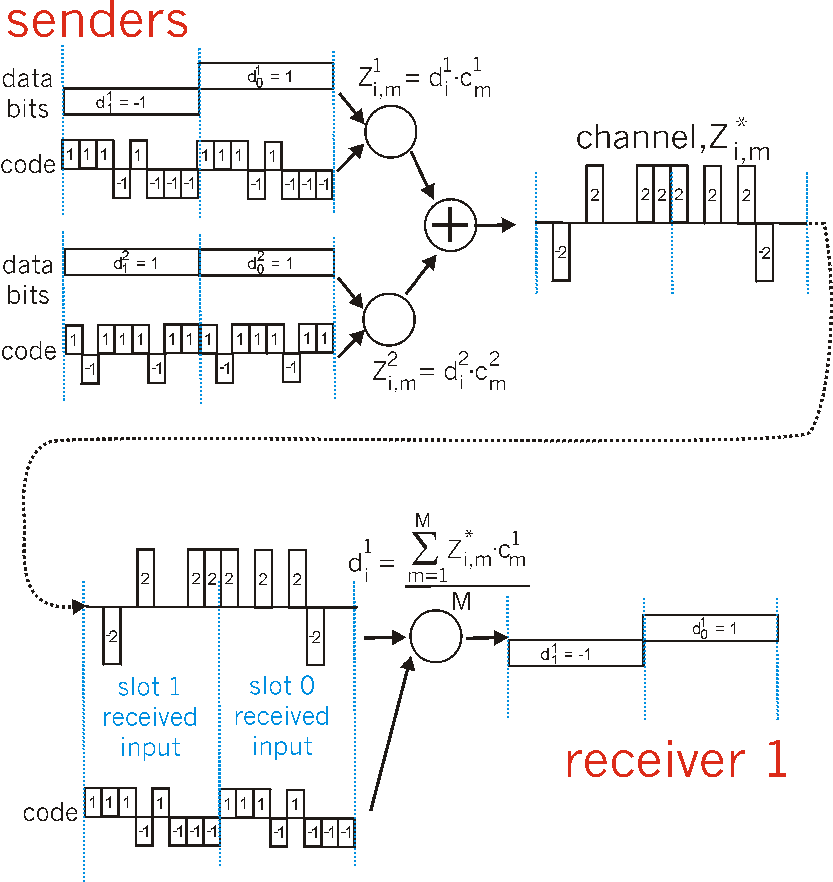
CDMA: two-sender interference
channel sums together transmissions by sender 1 and 2
Sender 1
Sender 2
using same code as sender 1, receiver recovers sender 1’s original data from summed channel data!

Slide 12
Code Division Multiple Access (CDMA)
Ideally, need codes to have good:
Auto-correlation properties: $c_{i}\left(t\right)⋅c_{i}\left(t\right)=1$
Cross-correlation properties: $c_{i}\left(t\right)⋅c_{j}\left(t\right)=0 for j≠i$
$$\left(\sum_{i}{h_{i}{d_{i}\left(t\right) c}_{i}\left(t\right)}\right)⋅c_{i}\left(t\right)=h_{i}d_{i}\left(t\right)$$
Need orthogonal codes:
For N users, length of code is exponential in N → $2^{N−1}$
Near Far Effect Problem→ need power management

Slide 13
Slotted ALOHA
assumptions:
all frames same size
time divided into equal size slots (time to transmit 1 frame)
nodes start to transmit only slot beginning
nodes are synchronized
if 2 or more nodes transmit in slot, these nodes detect collision
operation:
when node obtains fresh frame, transmits in next slot
  if no collision: node can send new frame in next slot
  if collision: node retransmits frame in each subsequent slot with prob. p until success

Slide 14
Slotted ALOHA
node 1
1
1
1
1
node 2
2
2
2
node 3
3
3
3
C
E
C
S
E
C
E
S
S
Pros:
single active node can continuously transmit at full rate of channel
highly decentralized: only slots in nodes need to be in sync
simple
Cons:
collisions, wasting slots
idle slots
nodes may be able to detect collision in less than time to transmit packet
clock synchronization

Slide 15
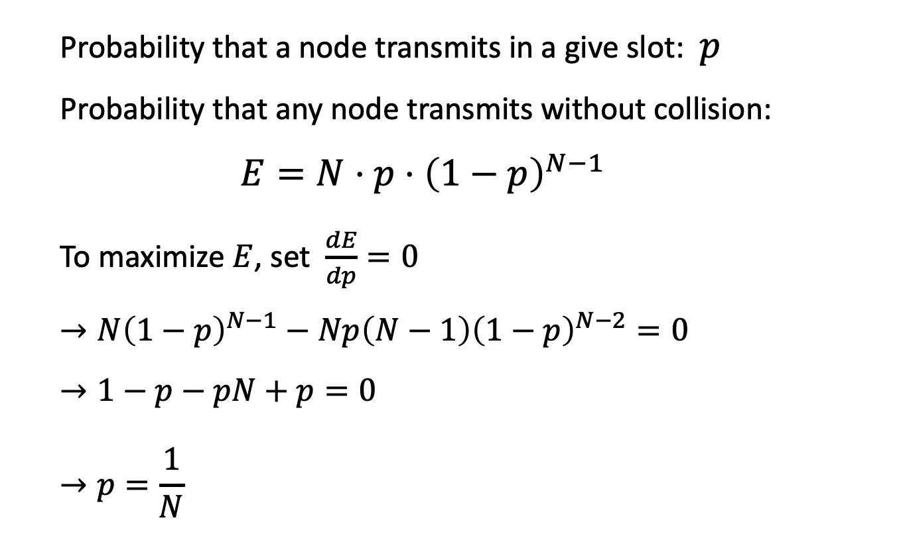
Slotted ALOHA: efficiency
  N nodes
  Each node picks a slot uniformly at random to transmit in.
  Probability that a node transmits in a give slot: $p$
  Probability that any node transmits without collision:
  $$E=N⋅p⋅{\left(1−p\right)}^{N−1}$$
  To maximize $E$, set $\frac{dE}{dp}=0$
  $$→N{\left(1−p\right)}^{N−1}−Np\left(N−1\right){\left(1−p\right)}^{N−2}=0$$
  $$→1−p−pN+p=0$$
  $$→p=\frac{1}{N}$$

Slide 16
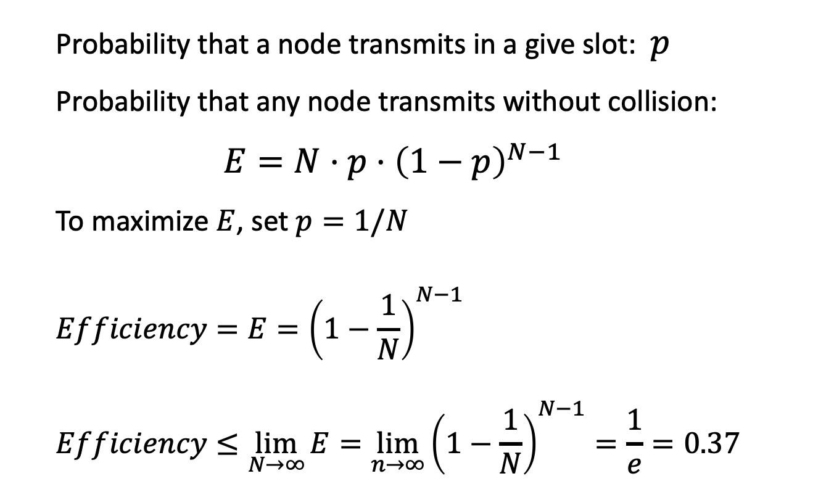
Slotted ALOHA: efficiency
  N nodes
  Each node picks a slot uniformly at random to transmit in.
  Probability that a node transmits in a give slot: $p$
  Probability that any node transmits without collision:
  $$E=N⋅p⋅{\left(1−p\right)}^{N−1}$$
  To maximize $E$, set $p=1/N$
  $$Efficiency=E={\left(1−\frac{1}{N}\right)}^{N−1}$$
  $$Efficiency≤\lim_{N→∞}{E}=\lim_{n→∞}{{\left(1−\frac{1}{N}\right)}^{N−1}}=\frac{1}{e}=0.37$$

Slide 17
Slotted ALOHA: efficiency
efficiency: long-run
fraction of successful slots
(many nodes, all with many frames to send)
max efficiency: find p* that maximizes
Np(1-p)^{N-1}
for many nodes, take limit of Np*(1-p*)^{N-1} as N goes to infinity, gives:
max efficiency = 1/e = .37
suppose: N nodes with many frames to send, each transmits in slot with probability p
prob that given node has success in a slot = p(1-p)^{N-1}
prob that any node has a success = Np(1-p)^{N-1}
at best: channel
used for useful
transmissions 37%
of time!
!

Slide 18
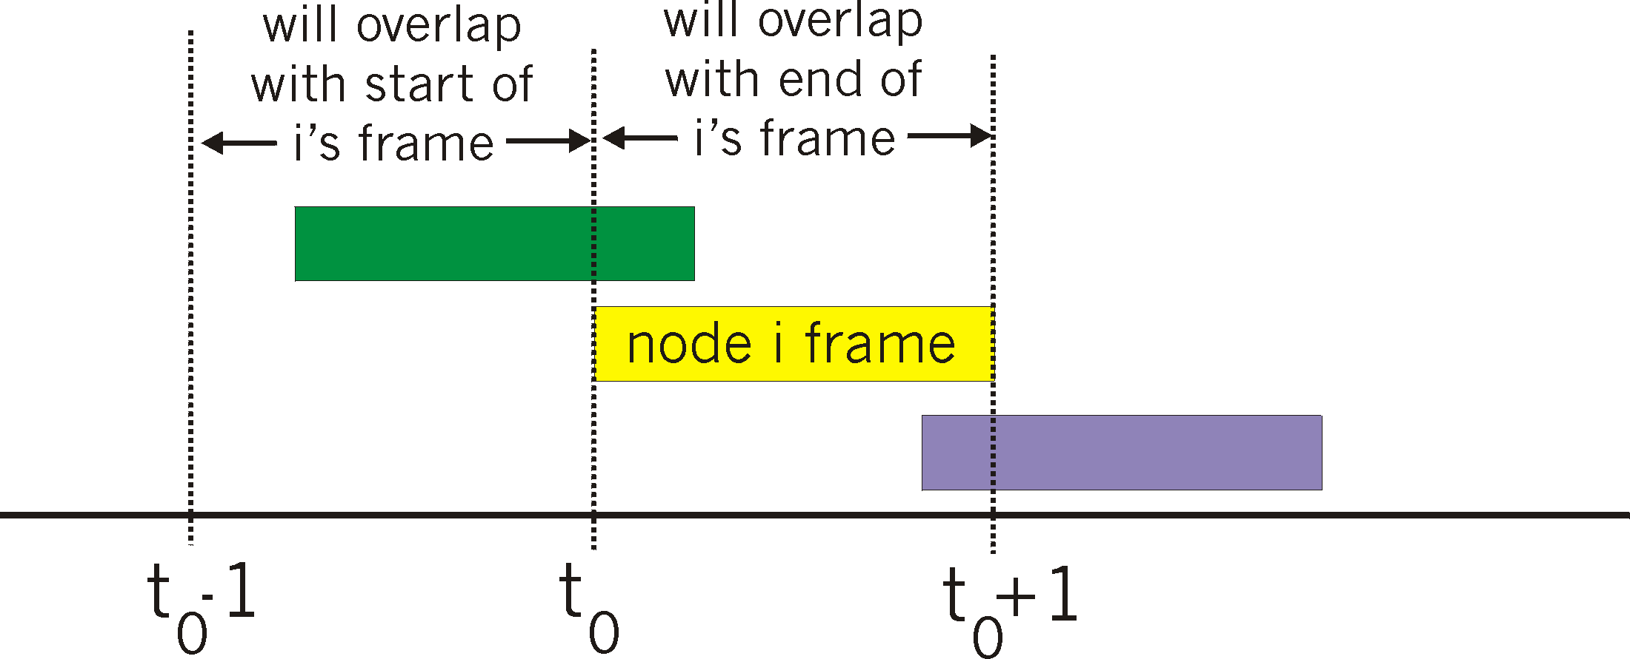
Pure (unslotted) ALOHA
unslotted Aloha: simpler, no synchronization
when frame first arrives
  transmit immediately
collision probability increases:
  frame sent at t₀ collides with other frames sent in [t₀-1,t₀+1]

Slide 19
Pure ALOHA efficiency
P(success by given node) = P(node transmits) .
P(no other node transmits in [t₀-1,t₀] .
P(no other node transmits in [t₀,t₀+1]
= p . (1-p)^{N-1 .} (1-p)^{N-1}
= p . (1-p)^{2(N-1)}
… choosing optimum p and then letting n
= 1/(2e) = .18
even worse than slotted Aloha!

Slide 20
CSMA/CA: Carrier Sense Multiple Access with Collision Avoidance
CSMA: listen before transmit:
if channel sensed idle: transmit entire frame
if channel sensed busy, defer transmission

Slide 21
CSMA/CA: Carrier Sense Multiple Access with Collision Avoidance
Contention Window (CW):
Sense, if channel idle, wait $DIFS≈50μs$
Pick random number $m$ between $0—CW_{max}$
Wait $m$ slots ($≈10μs)$, then sense & transmit
Wait S$IFS≈10μs$ for an ACK
If Collision: $CW_{max}=2×CW_{max}$
If Success: $CW_{max}=2$

Slide 22
CSMA/CA: Carrier Sense Multiple Access with Collision Avoidance
Throughput Efficiency
Data: 1500 bytes = 12000 bits
802.11n advertised rate: 300 Mbps
Data Packet Time $= 12000/300Mbps = 40μs$
Overhead:
$$DIFS + SIFS + ACK + m×slot=50+10+30+7×10=160μs$$
Actual Throughput: $12000/(40+160) =60Mbps$
80% Reduction in Throughput!!

Slide 23
Red signal >> Blue signal
Red < Blue = collision
C
D
X
A
B
Signal
power
SINR threshold
Distance

Slide 24
Important: C has not heard A, but can interfere at receiver B
C is the hidden terminal to A
C
D
X
A
B
Signal
power
SINR threshold
Distance

Slide 25
Important: X has heard A, but should not defer transmission to Y
Y
X is the exposed terminal to A
C
D
X
A
B
Signal
power
SINR threshold
Distance

Slide 26
Hidden and Exposed Terminal Problems
Critical to wireless networks even today

Slide 27
IEEE 802.11
RTS = Request
To Send
CTS = Clear
To Send
M
Y
S
RTS
D
CTS
K

Slide 28
IEEE 802.11
silenced
M
Y
S
silenced
Data
D
ACK
X
silenced
K
silenced

Slide 29
WiFi Standards Medium Access: CSMA/CA
Carrier Sense Multiple Access with Collision Avoidance
802.11b, 802.11g, 802.11n, 802.11ac
Contention based with exponential backoff
RTS and CTS to avoid collisions

Slide 30
WiFi Standards Medium Access: CSMA/CA
$$T_{backoff}$$
$$SIFS$$
$$DIFS$$
$$T_{DATA}$$
$$T_{ACK}$$
AP
DATA
STA
ACK
$$T_{timeout}$$
E1
E2
E3
collision
decoding error
good transmission

Slide 31
WiFi Standards Medium Access: CSMA/CA
$$T_{backoff}$$
$$SIFS$$
$$SIFS$$
$$SIFS$$
$$DIFS$$
$$T_{RTS}$$
$$T_{CTS}$$
$$T_{DATA}$$
$$T_{ACK}$$
AP
RTS
DATA
STA
CTS
ACK
$$T_{timeout}$$
E1
$$T_{timeout}$$
E2
E3
E4
collision
decoding error
good transmission

Slide 32
WiFi 6 802.11ax Medium Access: OFDMA
Orthogonal Frequency Division Multiple Access
Use OFDM: Assign different subcarriers to different users.
More efficient than FDMA since no guard bands are needed
Requires Time Synchronization

Slide 33
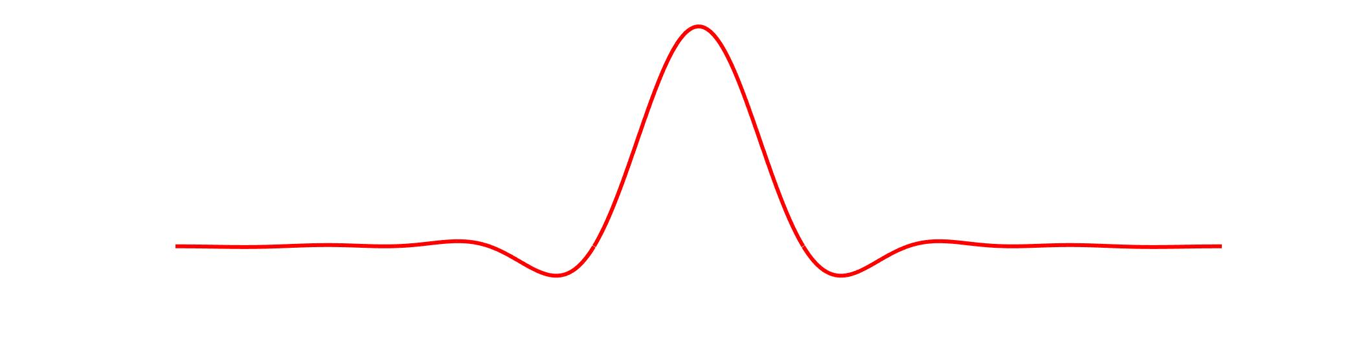
WiFi 6 802.11ax Medium Access: OFDMA
Orthogonal Frequency Division Multiple Access
Use OFDM: Assign different subcarriers to different users.
More efficient than FDMA since no guard bands are needed
Collision
User 1
User 2
Frequency
CSMA/CA (802.11a/bg/n/ac)
Time
Frequency
Frequency
OFDM Subcarriers
OFDMA (802.11ax)
Time

Slide 34
WiFi 6 802.11ax Medium Access: OFDMA

Slide 35
WiFi 6 802.11ax Medium Access: OFDMA
OFDM Symbol with 1024 Subcarriers in 802.11ax
1 User with 996 subcarriers
2 Users with 484 subcarriers each
4 Users with 242 subcarriers each
8 Users with 104 subcarriers each
16 Users with 52 subcarriers each
37 Users with 26 subcarriers each

Slide 36
WiFi 6 802.11ax Medium Access: OFDMA+ CSMA/CA
Downlink: AP → Clients
$$T_{backoff}$$
$$SIFS$$
$$SIFS$$
$$SIFS$$
$$SIFS$$
$$DIFS$$
$$T_{RTS}$$
$$T_{CTS}$$
$$T_{DATA}$$
$$T_{BAR}$$
$$T_{BA}$$
AP
MURTS
DATA
BAR
STA
MUCTS
BA
$$T_{timeout}$$
E1
$$T_{timeout}$$
E2
E3
E4
collision
decoding error
good transmission

Slide 37
WiFi 6 802.11ax Medium Access: OFDMA+ CSMA/CA
Uplink: AP → Clients
$$T_{backoff}$$
$$SIFS$$
$$SIFS$$
$$SIFS$$
$$SIFS$$
$$SIFS$$
$$SIFS$$
$$DIFS$$
$$T_{BSRP}$$
$$T_{BSR}$$
$$T_{MURTS}$$
$$T_{MUCTS}$$
$$T_{TF}$$
$$T_{DATA}$$
$$T_{BA}$$
AP
BSRP
MURTS
TF
BA
STA
BSR
MUCTS
DATA
$$T_{timeout}$$
E1
$$T_{timeout}$$
E2
E3
E4
collision
decoding error
good transmission

Slide 38
MAC Protocols: Pros and Cons
Reservation Based:
  No Interference
  Fair
  Centralized
  Wasted resources
Contention Based: (random access)
  Distributed
  Good for bursty traffic
  Collisions
  Overhead
TDMA
FDMA
CDMA
OFDMA
Token Passing
Polling
WiFi 6: OFDMA & CSMA
CSMA
Alloha
Slotter Aloha

