Slide 1
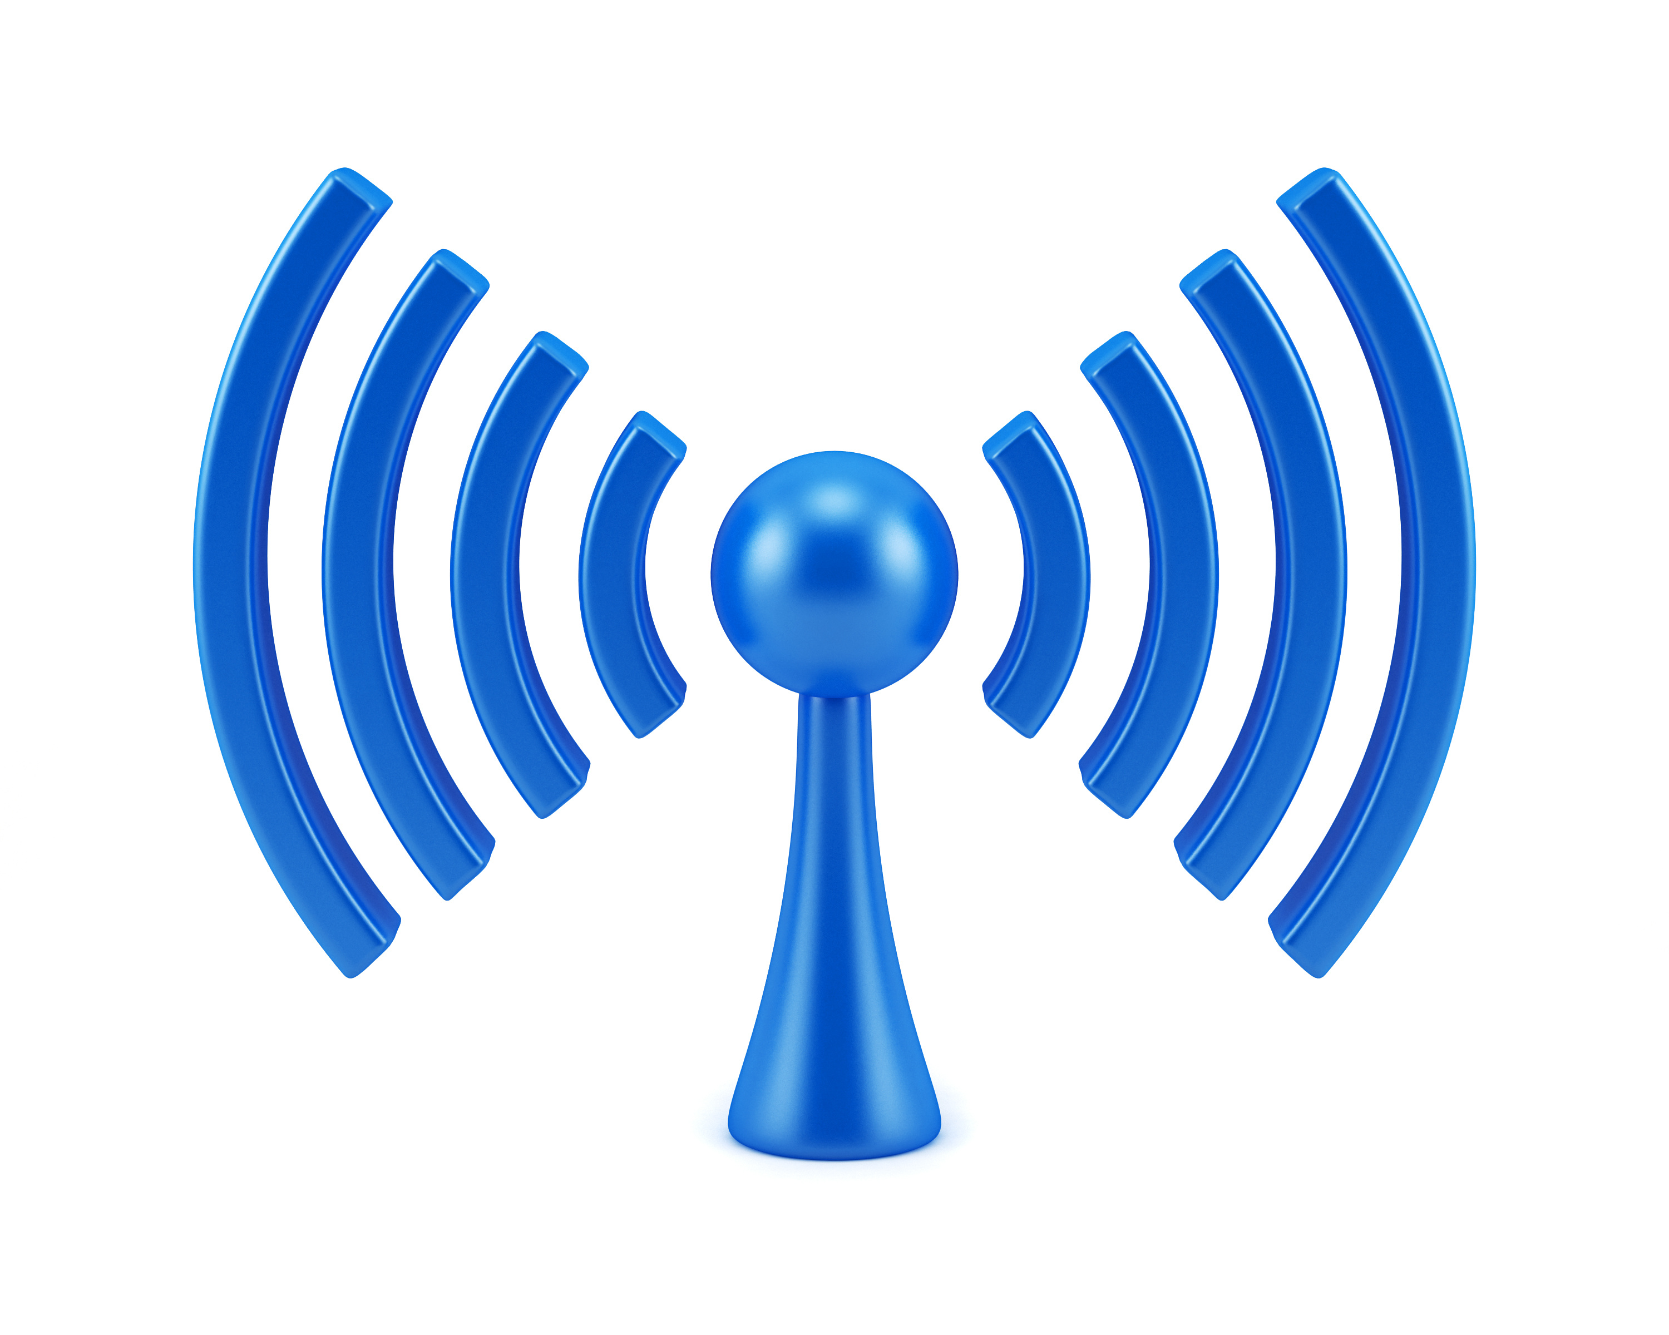

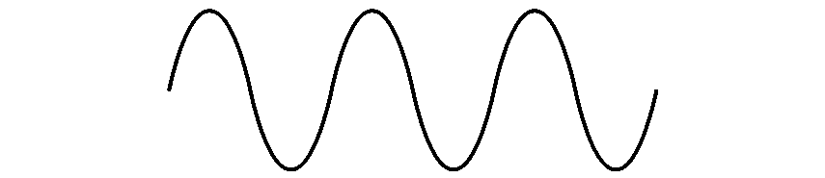
COM-405: Mobile Networks
Lecture 5.0: MIMO
Haitham Hassanieh
Laboratory of SEnsing
& Networking Systems

Slide 2
MIMO: Multiple Input Multiple Output
So far: single input single output
MIMO: multiple input multiple output
Increase capacity of channel using multiple TX and RX antennas.

Slide 3
MIMO: Multiple Input Multiple Output
So far: single input single output
MIMO: multiple input multiple output
Increase capacity of channel using multiple TX and RX antennas.

Slide 4
MIMO: Multiple Input Multiple Output
So far: single input single output
MIMO: multiple input multiple output
Increase capacity of channel using multiple TX and RX antennas.

Slide 5











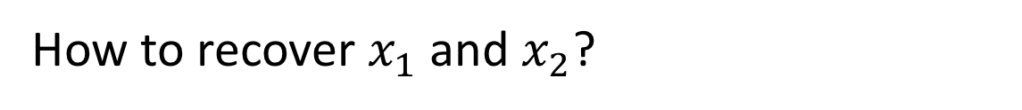














MIMO: Multiple TX-RX streams
$$x_{1}$$
$$h_{11}$$
$$y_{1}$$
$$=h_{11}x_{1}$$
$$+ h_{12}x_{2}$$
$$h_{21}$$
$$x_{2}$$
$$h_{12}$$
$$y_{2}$$
$$=h_{21}x_{1}$$
$$+ h_{22}x_{2}$$
$$h_{22}$$
$$y_{1}$$
$$h_{11}$$
$$h_{12}$$
$$x_{1}$$
$$n_{1}$$
$$=$$
$$+$$
$$y=Hx+n$$
$$y_{2}$$
$$h_{21}$$
$$h_{22}$$
$$x_{2}$$
$$n_{2}$$
How to recover $x_{1}$ and $x_{2}$?
Estimate $H$, compute $H^{−1}$ and invert the channel!
$$\tilde{x}=H^{−1}y=H^{−1}Hx+H^{−1}n=x+H^{−1}n$$
Transmit 2 packets at the same time!

Slide 6
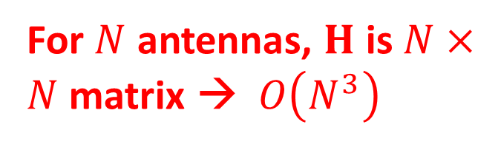
MIMO: Multiple TX-RX streams
$$x_{1}$$
$$h_{11}$$
$$y_{1}$$
$$=h_{11}x_{1}$$
$$+ h_{12}x_{2}$$
$$h_{21}$$
$$x_{2}$$
$$h_{12}$$
$$y_{2}$$
$$=h_{21}x_{1}$$
$$+ h_{22}x_{2}$$
$$h_{22}$$
$$y_{1}$$
$$h_{11}$$
$$h_{12}$$
$$x_{1}$$
$$n_{1}$$
$$=$$
$$+$$
$$y=Hx+n$$
$$y_{2}$$
$$h_{21}$$
$$h_{22}$$
$$x_{2}$$
$$n_{2}$$
For $N$ antennas, $H$ is $N×N$ matrix → $O\left(N^{3}\right)$
How to recover $x_{1}$ and $x_{2}$?
Estimate $H$, compute $H^{−1}$ and invert the channel!
$$\tilde{x}=H^{−1}y=H^{−1}Hx+H^{−1}n=x+H^{−1}n$$
Noise amplification

Slide 7








MIMO: Vector Representation
$$x_{1}$$
$$h_{11}$$
$$y_{1}$$
$$=h_{11}x_{1}$$
$$+ h_{12}x_{2}$$
$$h_{21}$$
$$x_{2}$$
$$h_{12}$$
$$y_{2}$$
$$=h_{21}x_{1}$$
$$+ h_{22}x_{2}$$
$$h_{22}$$
$$y_{1}$$
$$h_{11}$$
$$h_{12}$$
$$x_{1}$$
$$n_{1}$$
$$=$$
$$+$$
$$y=Hx+n$$
$$y_{2}$$
$$h_{21}$$
$$h_{22}$$
$$x_{2}$$
$$n_{2}$$
How to recover $x_{1}$ and $x_{2}$?
$$h_{11}$$
$$h_{12}$$
$$y$$
$$=$$
$$x_{1}$$
$$+$$
$$x_{2}$$
$$= \vec{h_{1}}x_{1}+\vec{h_{2}}x_{2}$$
$$h_{21}$$
$$h_{22}$$

Slide 8


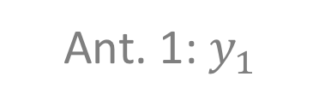



MIMO: Antenna Space
Ant. 2:$y_{2}$
$$\vec{y }= \vec{h_{1}}x_{1}+\vec{h_{2}}x_{2}$$
$$\vec{h_{2}}x_{2}$$
$$\vec{y }$$
$$\vec{h_{1}}x_{1}$$
Ant. 1:$y_{1}$

Slide 9








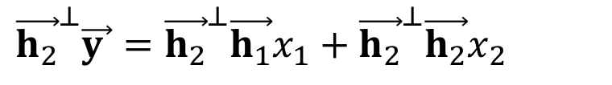


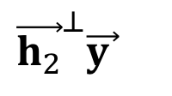

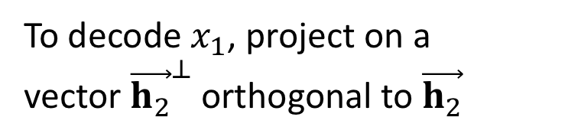


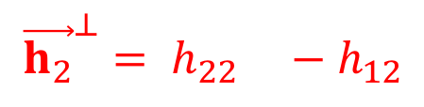

MIMO: Antenna Space
Ant. 2:$y_{2}$
$$\vec{y }= \vec{h_{1}}x_{1}+\vec{h_{2}}x_{2}$$
To decode $x_{1}$, project on a
vector ${\vec{h_{2}}}^{⊥}$orthogonal to $\vec{h_{2}}$
$$\vec{h_{2}}x_{2}$$
$$\vec{y }$$
0
$${\vec{h_{2}}}^{⊥}\vec{y }={\vec{h_{2}}}^{⊥}\vec{h_{1}}x_{1}+{\vec{h_{2}}}^{⊥}\vec{h_{2}}x_{2}$$
$$={\vec{h_{2}}}^{⊥}\vec{h_{1}}x_{1}$$
$$\vec{h_{1}}x_{1}$$
Ant. 1:$y_{1}$
$$h_{11}$$
$$h_{12}$$
$$y$$
$$=$$
$$x_{1}$$
$$+$$
$$x_{2}$$
$${\vec{h_{2}}}^{⊥}\vec{y }$$
$$=h_{22}h_{11}x_{1}$$
$$h_{21}$$
$$h_{22}$$
$$− h_{12}h_{21}x_{1}$$
0
$$+ h_{22}h_{12}x_{2}$$
$$− h_{12}h_{22}x_{2}$$
$${\vec{h_{2}}}^{⊥}= h_{22} −h_{12}$$
$$=\left(h_{22}h_{11}− h_{12}h_{21}\right) x_{1}$$

Slide 10



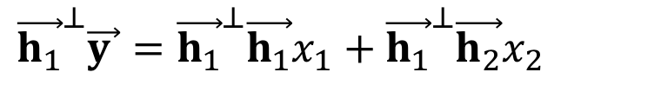

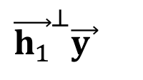

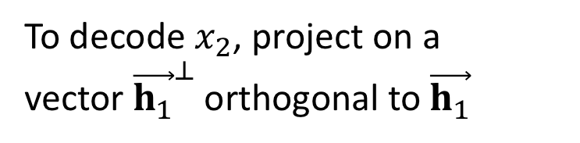
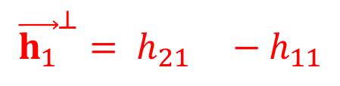

MIMO: Antenna Space
Ant. 2:$y_{2}$
$$\vec{y }= \vec{h_{1}}x_{1}+\vec{h_{2}}x_{2}$$
To decode $x_{2}$, project on a
vector ${\vec{h_{1}}}^{⊥}$orthogonal to $\vec{h_{1}}$
$$\vec{h_{2}}x_{2}$$
$$\vec{y }$$
0
$${\vec{h_{1}}}^{⊥}\vec{y }={\vec{h_{1}}}^{⊥}\vec{h_{1}}x_{1}+{\vec{h_{1}}}^{⊥}\vec{h_{2}}x_{2}$$
$$={\vec{h_{1}}}^{⊥}\vec{h_{2}}x_{2}$$
$$\vec{h_{1}}x_{1}$$
Ant. 1:$y_{1}$
$$h_{11}$$
$$h_{12}$$
$$y$$
$$=$$
$$x_{1}$$
$$+$$
$$x_{2}$$
0
$${\vec{h_{1}}}^{⊥}\vec{y }$$
$$=h_{21}h_{11}x_{1}$$
$$h_{21}$$
$$h_{22}$$
$$− h_{21}h_{11}x_{1}$$
$$+ h_{21}h_{12}x_{2}$$
$$− h_{11}h_{22}x_{2}$$
$${\vec{h_{1}}}^{⊥}= h_{21} −h_{11}$$
$$=\left(h_{21}h_{12}− h_{11}h_{22}\right) x_{2}$$

Slide 11



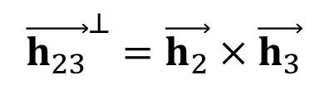



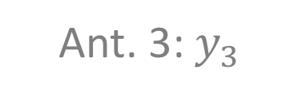

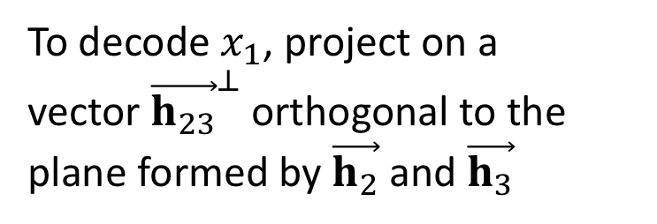
MIMO: Antenna Space
What about MIMO with more antennas?
Ant. 2:$y_{2}$
$$+\vec{h_{3}}x_{3}$$
$$\vec{y }= \vec{h_{1}}x_{1}+\vec{h_{2}}x_{2}$$
To decode $x_{1}$, project on a
vector ${\vec{h_{23}}}^{⊥}$orthogonal to the
plane formed by $\vec{h_{2}}$ and $\vec{h_{3}}$
$$\vec{h_{2}}x_{2}$$
$${\vec{h_{23}}}^{⊥}=\vec{h_{2}} × \vec{h_{3}}$$
$$\vec{h_{3}}x_{3}$$
$$\vec{h_{1}}x_{1}$$
Ant. 1:$y_{1}$
Ant. 3:$y_{3}$

Slide 12
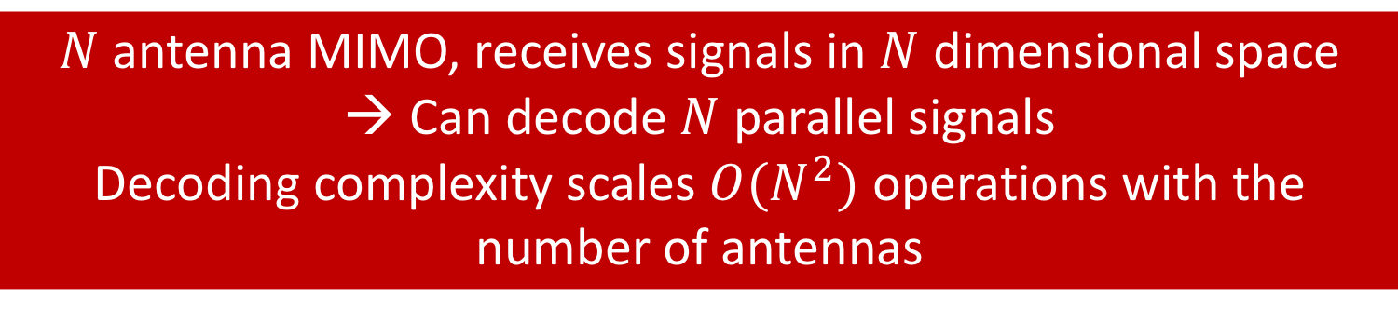

MIMO: Antenna Space
What about MIMO with more antennas?
Ant. 2:$y_{2}$
$$\vec{y }= \vec{h_{1}}x_{1}+\vec{h_{2}}x_{2}+\vec{h_{3}}x_{3}$$
To decode $x_{1}$, project on a
vector ${\vec{h_{23}}}^{⊥}$orthogonal to the
plane formed by $\vec{h_{2}}$ and $\vec{h_{3}}$
$$\vec{h_{2}}x_{2}$$
$${\vec{h_{23}}}^{⊥}=\vec{h_{2}} × \vec{h_{3}}$$
$$\vec{h_{3}}x_{3}$$
$$\vec{h_{1}}x_{1}$$
Ant. 1:$y_{1}$
$N$ antenna MIMO, receives signals in $N$ dimensional space
→ Can decode $N$ parallel signals
Decoding complexity scales $O(N^{2})$ operations with the number of antennas
Ant. 3:$y_{3}$

Slide 13


MIMO Channel
$$x_{1}$$
$$h_{11}$$
$$y_{1}$$
$$=h_{11}x_{1}$$
$$+ h_{12}x_{2}$$
$$h_{21}$$
$$x_{2}$$
$$h_{12}$$
$$y_{2}$$
$$=h_{21}x_{1}$$
$$+ h_{22}x_{2}$$
$$h_{22}$$
How to estimate the channels: $h_{11}$, $h_{12}$, $h_{21}$, $h_{22}$?
TX 1:
Preamble
$$x_{1}$$
TX 2:
Preamble
$$x_{2}$$

Slide 14


MIMO Channel
$$x_{1}$$
$$h_{11}$$
$$y_{1}$$
$$=h_{11}x_{1}$$
$$+ h_{12}x_{2}$$
$$h_{21}$$
$$x_{2}$$
$$h_{12}$$
$$y_{2}$$
$$=h_{21}x_{1}$$
$$+ h_{22}x_{2}$$
$$h_{22}$$
How to estimate the channels: $h_{11}$, $h_{12}$, $h_{21}$, $h_{22}$?
TX 1:
Preamble
$$x_{1}$$
TX 2:
Preamble
$$x_{2}$$

Slide 15
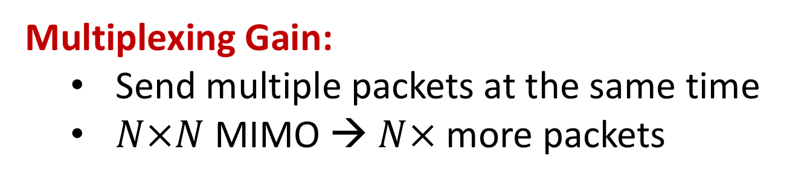
MIMO Gains
Multiplexing Gain:
Send multiple packets at the same time
$N×N$ MIMO → $N×$ more packets
Diversity Gain:
Send/Receive the same packet on multiple antennas
Increase SNR of the received packets → transmit at higher data rates

Slide 16







Receiver Diversity
$$x$$
$$h_{1}$$
$$y_{1}$$
$$=h_{1}x+n_{1}$$
$$h_{2}$$
$$y_{2}$$
$$=h_{2}x+n_{2}$$
How to best decode $x$?
Option 1: Add the received signals
$$y_{1}+y_{2}=h_{1}x+n_{1}+h_{2}x+n_{2}$$
$=\left(h_{1}+h_{2}\right)x+n_{1}+n_{2}$
Channels can sum up destructively! $h_{1}+h_{2}≈0$

Slide 17
Receiver Diversity
$$x$$
$$h_{1}$$
$$y_{1}$$
$$=h_{1}x+n_{1}$$
$$h_{2}$$
$$y_{2}$$
$$=h_{2}x+n_{2}$$
How to best decode $x$?
Option 1: Add the received signals
Option 2: Decode independently
Sub-optimal!

Slide 18
Receiver Diversity
$$x$$
$$h_{1}$$
$$y_{1}$$
$$=h_{1}x+n_{1}$$
$$h_{2}$$
$$y_{2}$$
$$=h_{2}x+n_{2}$$
How to best decode $x$?
Option 1: Add the received signals
Option 2: Decode independently
Optimal Solution: Maximum Ratio Combining (MRC)

Slide 19












Maximum Ratio Combining
$$x$$
$$h_{1}$$
$$y_{1}$$
$$=h_{1}x+n_{1}$$
$$h_{2}$$
$$y_{2}$$
$$=h_{2}x+n_{2}$$
$${α_{1}y}_{1}$$
$${+ α_{2}y}_{2}$$
$$={h_{1}^{∗}y}_{1}$$
$${+ h_{2}^{∗}y}_{2}$$
$$=h_{1}^{∗}h_{1}x+h_{1}^{∗}n_{1}+h_{2}^{∗}h_{2}x+h_{2}^{∗}n_{2}$$
$$=\left({\left|h_{1}\right|}^{2}+{\left|h_{2}\right|}^{2}\right)x+h_{1}^{∗}n_{1}+h_{2}^{∗}n_{2}$$
Let $P=𝔼\left[{\left|x\right|}^{2}\right]$ and $σ^{2}=𝔼\left[{\left|n_{1}\right|}^{2}\right]=𝔼\left[{\left|n_{2}\right|}^{2}\right]$
$$Signal Power=𝔼\left[{\left|\left({\left|h_{1}\right|}^{2}+{\left|h_{2}\right|}^{2}\right)x\right|}^{2}\right]$$
$$={\left({\left|h_{1}\right|}^{2}+{\left|h_{2}\right|}^{2}\right)}^{2} 𝔼\left[{\left|x\right|}^{2}\right]$$
$$={\left({\left|h_{1}\right|}^{2}+{\left|h_{2}\right|}^{2}\right)}^{2} P$$

Slide 20





Maximum Ratio Combining
$$x$$
$$h_{1}$$
$$y_{1}$$
$$=h_{1}x+n_{1}$$
$$h_{2}$$
$$y_{2}$$
$$=h_{2}x+n_{2}$$
$${α_{1}y}_{1}$$
$${+ α_{2}y}_{2}$$
$$={h_{1}^{∗}y}_{1}$$
$${+ h_{2}^{∗}y}_{2}$$
$$=h_{1}^{∗}h_{1}x+h_{1}^{∗}n_{1}+h_{2}^{∗}h_{2}x+h_{2}^{∗}n_{2}$$
$$=\left({\left|h_{1}\right|}^{2}+{\left|h_{2}\right|}^{2}\right)x+h_{1}^{∗}n_{1}+h_{2}^{∗}n_{2}$$
Let $P=𝔼\left[{\left|x\right|}^{2}\right]$ and $σ^{2}=𝔼\left[{\left|n_{1}\right|}^{2}\right]=𝔼\left[{\left|n_{2}\right|}^{2}\right]$
$$Signal Power={\left({\left|h_{1}\right|}^{2}+{\left|h_{2}\right|}^{2}\right)}^{2} P$$
$$Noise Power=𝔼\left[{\left|h_{1}^{∗}n_{1}+h_{2}^{∗}n_{2}\right|}^{2}\right]$$
$$=𝔼\left[{\left|h_{1}^{∗}n_{1}\right|}^{2}\right]+𝔼\left[{\left|h_{2}^{∗}n_{2}\right|}^{2}\right]$$
$$={\left|h_{1}\right|}^{2}𝔼\left[{\left|n_{1}\right|}^{2}\right]+{\left|h_{2}\right|}^{2}𝔼\left[{\left|n_{2}\right|}^{2}\right]$$
$$=\left({\left|h_{1}\right|}^{2}+{\left|h_{2}\right|}^{2}\right)σ^{2}$$

Slide 21
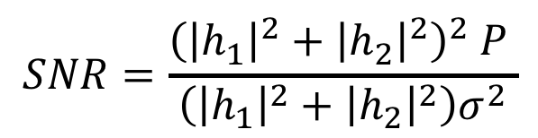


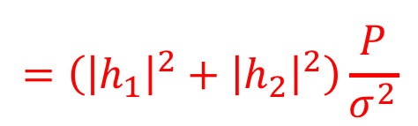
Maximum Ratio Combining
$$x$$
$$h_{1}$$
$$y_{1}$$
$$=h_{1}x+n_{1}$$
$$h_{2}$$
$$y_{2}$$
$$=h_{2}x+n_{2}$$
$${α_{1}y}_{1}$$
$${+ α_{2}y}_{2}$$
$$={h_{1}^{∗}y}_{1}$$
$${+ h_{2}^{∗}y}_{2}$$
$$=h_{1}^{∗}h_{1}x+h_{1}^{∗}n_{1}+h_{2}^{∗}h_{2}x+h_{2}^{∗}n_{2}$$
$$=\left({\left|h_{1}\right|}^{2}+{\left|h_{2}\right|}^{2}\right)x+h_{1}^{∗}n_{1}+h_{2}^{∗}n_{2}$$
Let $P=𝔼\left[{\left|x\right|}^{2}\right]$ and $σ^{2}=𝔼\left[{\left|n_{1}\right|}^{2}\right]=𝔼\left[{\left|n_{2}\right|}^{2}\right]$
$$Signal Power={\left({\left|h_{1}\right|}^{2}+{\left|h_{2}\right|}^{2}\right)}^{2} P$$
$$Noise Power=\left({\left|h_{1}\right|}^{2}+{\left|h_{2}\right|}^{2}\right)σ^{2}$$
$$SNR=\frac{{\left({\left|h_{1}\right|}^{2}+{\left|h_{2}\right|}^{2}\right)}^{2} P }{\left({\left|h_{1}\right|}^{2}+{\left|h_{2}\right|}^{2}\right)σ^{2}}$$
$$=\left({\left|h_{1}\right|}^{2}+{\left|h_{2}\right|}^{2}\right)\frac{ P }{σ^{2}}$$

Slide 22
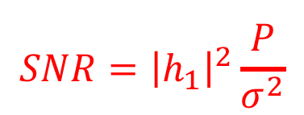
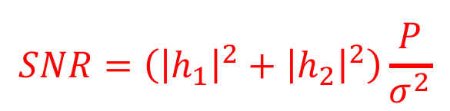
Maximum Ratio Combining
$$x$$
$$h_{1}$$
$$y_{1}$$
$$=h_{1}x+n_{1}$$
$$h_{2}$$
$$y_{2}$$
$$=h_{2}x+n_{2}$$
$${α_{1}y}_{1}$$
$${+ α_{2}y}_{2}$$
$$={h_{1}^{∗}y}_{1}$$
$${+ h_{2}^{∗}y}_{2}$$
$$=h_{1}^{∗}h_{1}x+h_{1}^{∗}n_{1}+h_{2}^{∗}h_{2}x+h_{2}^{∗}n_{2}$$
$$=\left({\left|h_{1}\right|}^{2}+{\left|h_{2}\right|}^{2}\right)x+h_{1}^{∗}n_{1}+h_{2}^{∗}n_{2}$$
$$SNR=\left({\left|h_{1}\right|}^{2}+{\left|h_{2}\right|}^{2}\right)\frac{ P }{σ^{2}}$$
With Receiver Diversity:
$$SNR={\left|h_{1}\right|}^{2}\frac{ P }{σ^{2}}$$
Single Receiver:

Slide 23
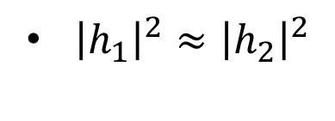
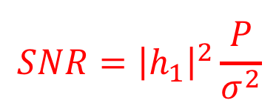
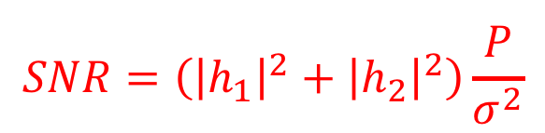
Receiver Diversity Gain
$$x$$
$$h_{1}$$
$$y_{1}$$
$$=h_{1}x+n_{1}$$
$$h_{2}$$
$$y_{2}$$
$$=h_{2}x+n_{2}$$
$$SNR=\left({\left|h_{1}\right|}^{2}+{\left|h_{2}\right|}^{2}\right)\frac{ P }{σ^{2}}$$
With Receiver Diversity:
$$SNR={\left|h_{1}\right|}^{2}\frac{ P }{σ^{2}}$$
Single Receiver:
${\left|h_{1}\right|}^{2}≈{\left|h_{2}\right|}^{2}$
→ Can double SNR!

Slide 24
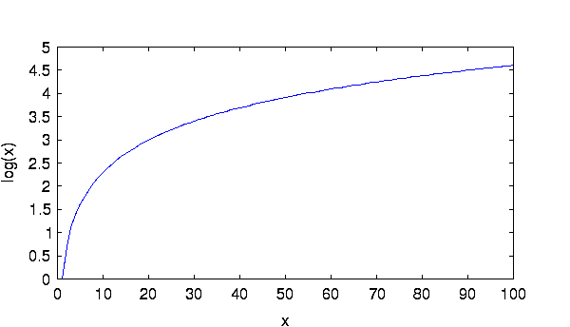
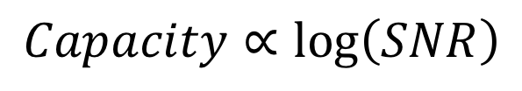
Receiver Diversity Gain
Do we care about doubling the SNR?
$$Capacity∝\log\left(SNR\right)$$
Rate
SNR

Slide 25
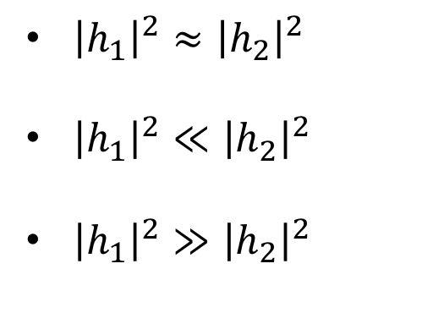
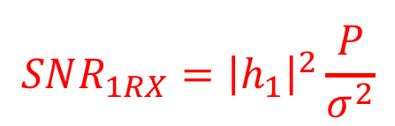
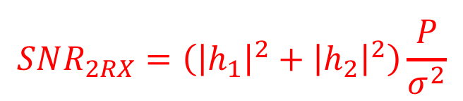
Receiver Diversity Gain
$$x$$
$$h_{1}$$
$$y_{1}$$
$$=h_{1}x+n_{1}$$
$$h_{2}$$
$$y_{2}$$
$$=h_{2}x+n_{2}$$
$$SNR_{2RX}=\left({\left|h_{1}\right|}^{2}+{\left|h_{2}\right|}^{2}\right)\frac{ P }{σ^{2}}$$
With Receiver Diversity:
$$SNR_{1RX}={\left|h_{1}\right|}^{2}\frac{ P }{σ^{2}}$$
Single Receiver:
${\left|h_{1}\right|}^{2}≈{\left|h_{2}\right|}^{2}$
${\left|h_{1}\right|}^{2}≪{\left|h_{2}\right|}^{2}$
${\left|h_{1}\right|}^{2}≫{\left|h_{2}\right|}^{2}$
→ Can double SNR!
It is unlikely that both antennas experience
channel fading.
→ Huge Gain in SNR
→ Little Gain in SNR

Slide 26

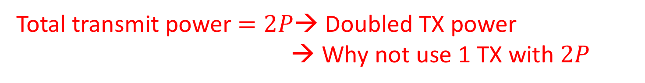




Transmitter Diversity
$x_{1}$
$$h_{1}$$
$$y=h_{1}x_{1}+h_{2}x_{2}+n$$
$x_{2}$
$$h_{2}$$
What should we transmit on each antenna?
Option 1: transmit the same thing $x$ on both antennas
$$y=\left(h_{1}+h_{2}\right)x+n$$
Channels can sum up destructively! $h_{1}+h_{2}≈0$
Total transmit power $=2P$→ Doubled TX power
→ Why not use 1 TX with $2P$

Slide 27
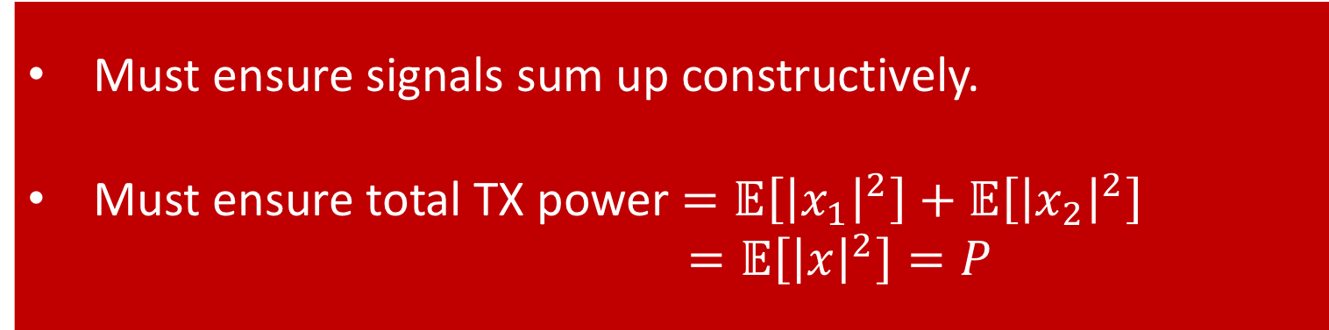
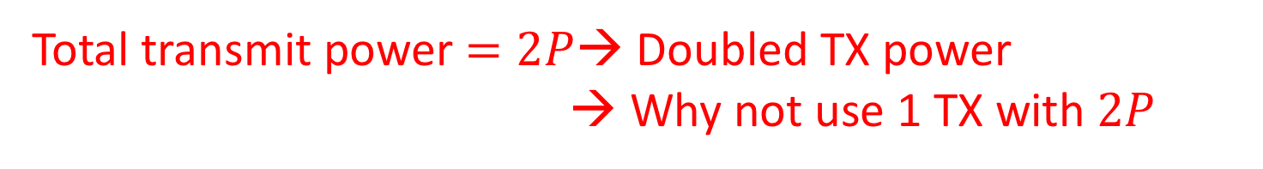
Transmitter Diversity
$x_{1}$
$$h_{1}$$
$$y=h_{1}x_{1}+h_{2}x_{2}+n$$
$x_{2}$
$$h_{2}$$
What should we transmit on each antenna?
Option 1: transmit the same thing $x$ on both antennas
$$y=\left(h_{1}+h_{2}\right)x+n$$
Must ensure signals sum up constructively.
Must ensure total TX power $=𝔼\left[{\left|x_{1}\right|}^{2}\right]+𝔼\left[{\left|x_{2}\right|}^{2}\right]$
$$=𝔼\left[{\left|x\right|}^{2}\right]=P$$
Channels can sum up destructively! $h_{1}+h_{2}≈0$
Total transmit power $=2P$→ Doubled TX power
→ Why not use 1 TX with $2P$

Slide 28
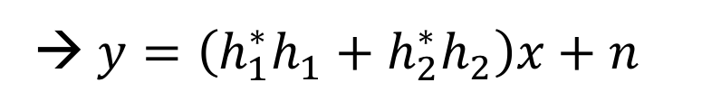
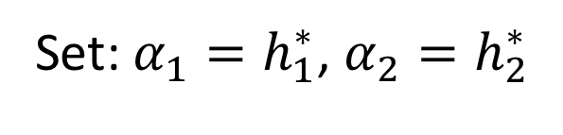


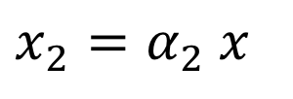

Transmitter Diversity
$x_{1}$
$$h_{1}$$
$$y=h_{1}x_{1}+h_{2}x_{2}+n$$
$x_{2}$
$$h_{2}$$
What should we transmit on each antenna?
Option 2: Maximum Ratio Combining (MRC)
$$x_{1}=α_{1}x$$
$$y=\left(α_{1}h_{1}+α_{2}h_{2}\right)x+n$$
$$x_{2}=α_{2} x$$
Set: $α_{1}=h_{1}^{∗}$, $α_{2}=h_{2}^{∗}$
→ $y=\left(h_{1}^{∗}h_{1}+h_{2}^{∗}h_{2}\right)x+n$
$$=\left({\left|h_{1}\right|}^{2}+{\left|h_{2}\right|}^{2}\right)x+n$$

Slide 29
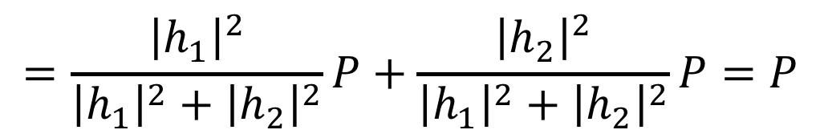
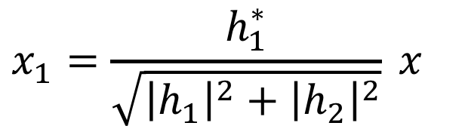
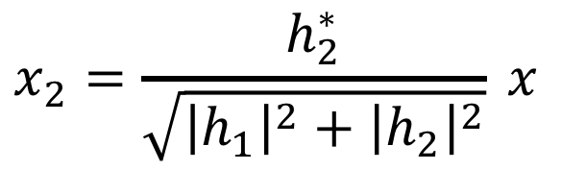
Transmitter Diversity
$x_{1}$
$$h_{1}$$
$$y=h_{1}x_{1}+h_{2}x_{2}+n$$
$x_{2}$
$$h_{2}$$
What should we transmit on each antenna?
Option 2: Maximum Ratio Combining (MRC)
$$x_{1}=\frac{h_{1}^{∗}}{\sqrt{{\left|h_{1}\right|}^{2}+{\left|h_{2}\right|}^{2}}} x$$
$$x_{2}=\frac{h_{2}^{∗}}{\sqrt{{\left|h_{1}\right|}^{2}+{\left|h_{2}\right|}^{2}}} x$$
$$Total TX Power=𝔼\left[{\left|x_{1}\right|}^{2}\right]+𝔼\left[{\left|x_{1}\right|}^{2}\right]$$
$$=\frac{{\left|h_{1}\right|}^{2}}{{\left|h_{1}\right|}^{2}+{\left|h_{2}\right|}^{2}}P+\frac{{\left|h_{2}\right|}^{2}}{{\left|h_{1}\right|}^{2}+{\left|h_{2}\right|}^{2}}P=P$$

Slide 30
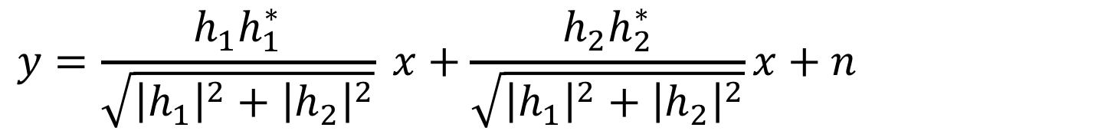
Transmitter Diversity
$x_{1}$
$$h_{1}$$
$$y=h_{1}x_{1}+h_{2}x_{2}+n$$
$x_{2}$
$$h_{2}$$
What should we transmit on each antenna?
Option 2: Maximum Ratio Combining (MRC)
$$x_{1}=\frac{h_{1}^{∗}}{\sqrt{{\left|h_{1}\right|}^{2}+{\left|h_{2}\right|}^{2}}} x$$
$$x_{2}=\frac{h_{2}^{∗}}{\sqrt{{\left|h_{1}\right|}^{2}+{\left|h_{2}\right|}^{2}}} x$$
$$y=\frac{h_{1}h_{1}^{∗}}{\sqrt{{\left|h_{1}\right|}^{2}+{\left|h_{2}\right|}^{2}}} x+\frac{h_{2}h_{2}^{∗}}{\sqrt{{\left|h_{1}\right|}^{2}+{\left|h_{2}\right|}^{2}}}x+n$$

Slide 31
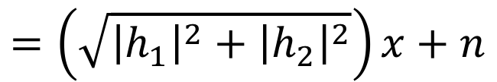
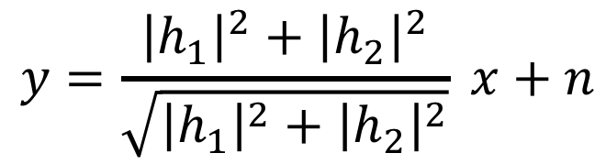
Transmitter Diversity
$x_{1}$
$$h_{1}$$
$$y=h_{1}x_{1}+h_{2}x_{2}+n$$
$x_{2}$
$$h_{2}$$
What should we transmit on each antenna?
Option 2: Maximum Ratio Combining (MRC)
$$x_{1}=\frac{h_{1}^{∗}}{\sqrt{{\left|h_{1}\right|}^{2}+{\left|h_{2}\right|}^{2}}} x$$
$$x_{2}=\frac{h_{2}^{∗}}{\sqrt{{\left|h_{1}\right|}^{2}+{\left|h_{2}\right|}^{2}}} x$$
$$y=\frac{{\left|h_{1}\right|}^{2}+{\left|h_{2}\right|}^{2}}{\sqrt{{\left|h_{1}\right|}^{2}+{\left|h_{2}\right|}^{2}}} x+n$$
$$=\left(\sqrt{{\left|h_{1}\right|}^{2}+{\left|h_{2}\right|}^{2}}\right)x+n$$

Slide 32

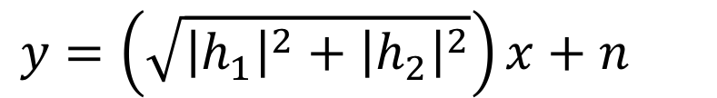
Transmitter Diversity
$x_{1}$
$$h_{1}$$
$$y=h_{1}x_{1}+h_{2}x_{2}+n$$
$x_{2}$
$$h_{2}$$
What should we transmit on each antenna?
Option 2: Maximum Ratio Combining (MRC)
$$y=\left(\sqrt{{\left|h_{1}\right|}^{2}+{\left|h_{2}\right|}^{2}}\right)x+n$$
$$SNR=\left({\left|h_{1}\right|}^{2}+{\left|h_{2}\right|}^{2}\right)\frac{P}{σ^{2}}$$
→ Similar SNR Gain to RX Diversity
Caveat: MRC at TX Requires Feedback from the Receiver!

Slide 33

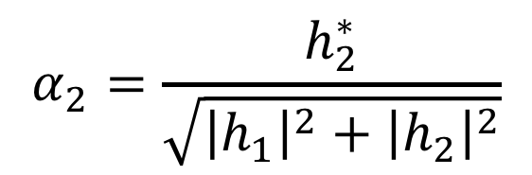


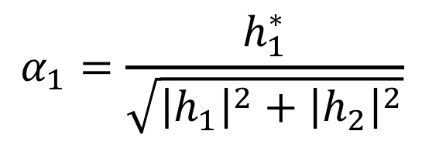




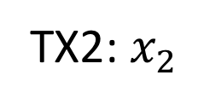

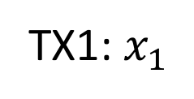


Transmitter Diversity
$x_{1}$
$$h_{1}$$
$$y=h_{1}x_{1}+h_{2}x_{2}+n$$
$x_{2}$
$$h_{2}$$
What should we transmit on each antenna?
Solution: Use Space-Time Codes
MRC codes across space only (Requires Channel Feedback):
$$α_{1}=\frac{h_{1}^{∗}}{\sqrt{{\left|h_{1}\right|}^{2}+{\left|h_{2}\right|}^{2}}}$$
TX1: $x_{1}$
$$α_{1}$$
$$x\left[1\right]$$
$$α_{1}$$
$$x\left[2\right]$$
TX2: $x_{2}$
$$α_{2}$$
$$x\left[1\right]$$
$$α_{2}$$
$$x\left[2\right]$$
$$α_{2}=\frac{h_{2}^{∗}}{\sqrt{{\left|h_{1}\right|}^{2}+{\left|h_{2}\right|}^{2}}}$$
$$t=1$$
$$t=2$$

Slide 34








Transmitter Diversity
$x_{1}$
$$h_{1}$$
$$y=h_{1}x_{1}+h_{2}x_{2}+n$$
$x_{2}$
$$h_{2}$$
What should we transmit on each antenna?
Solution: Use Space-Time Codes
Alamouti Codes:
TX1: $x_{1}$
$$x\left[1\right]$$
$$−x^{∗}\left[2\right]$$
$$y[1]=h_{1}x[1]+h_{2}x[2]$$
TX2: $x_{2}$
$$x\left[2\right]$$
$$x^{∗}\left[1\right]$$
$$y\left[2\right]=−h_{1}x^{∗}[2]+h_{2}x^{∗}[1]$$
$$t=1$$
$$t=2$$

Slide 35






Transmitter Diversity
$x_{1}$
$$h_{1}$$
$$y=h_{1}x_{1}+h_{2}x_{2}+n$$
$x_{2}$
$$h_{2}$$
What should we transmit on each antenna?
Solution: Use Space-Time Codes
Alamouti Codes:
$$y[1]=h_{1}x[1]+h_{2}x[2]$$
$$y\left[2\right]=−h_{1}x^{∗}[2]+h_{2}x^{∗}[1]$$
$$h_{1}^{∗}y\left[1\right]+h_{2}y^{∗}\left[2\right]$$
$$=h_{1}^{∗}h_{1}x\left[1\right]+h_{1}^{∗}h_{2}x\left[2\right]$$
$$−h_{2}h_{1}^{∗}x\left[2\right]+h_{2}h_{2}^{∗}x\left[1\right]$$
$$=\left({\left|h_{1}\right|}^{2}+{\left|h_{2}\right|}^{2}\right)x\left[1\right]$$

Slide 36




Transmitter Diversity
$x_{1}$
$$h_{1}$$
$$y=h_{1}x_{1}+h_{2}x_{2}+n$$
$x_{2}$
$$h_{2}$$
What should we transmit on each antenna?
Solution: Use Space-Time Codes
Alamouti Codes:
$$y[1]=h_{1}x[1]+h_{2}x[2]$$
$$y\left[2\right]=−h_{1}x^{∗}[2]+h_{2}x^{∗}[1]$$
$$h_{2}^{∗}y\left[1\right]−h_{1}y^{∗}\left[2\right]$$
$$=h_{2}^{∗}h_{1}x\left[1\right]+h_{2}^{∗}h_{2}x\left[2\right]$$
$$+h_{1}h_{1}^{∗}x\left[2\right]−h_{1}h_{2}^{∗}x\left[1\right]$$
$$=\left({\left|h_{1}\right|}^{2}+{\left|h_{2}\right|}^{2}\right)x\left[2\right]$$

Slide 37




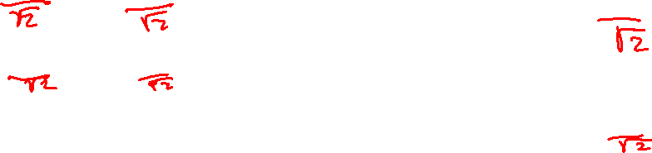
Transmitter Diversity
$x_{1}$
$$h_{1}$$
$$y=h_{1}x_{1}+h_{2}x_{2}+n$$
$x_{2}$
$$h_{2}$$
What should we transmit on each antenna?
Solution: Use Space-Time Codes
Alamouti Codes:
$$h_{1}^{∗}y\left[1\right]+h_{2}y^{∗}\left[2\right]$$
TX1: $x_{1}$
$$x\left[1\right]$$
$$−x^{∗}\left[2\right]$$
$$=\left({\left|h_{1}\right|}^{2}+{\left|h_{2}\right|}^{2}\right)x\left[1\right]$$
TX2: $x_{2}$
$$x\left[2\right]$$
$$x^{∗}\left[1\right]$$
$$h_{2}^{∗}y\left[1\right]−h_{1}y^{∗}\left[2\right]$$
$$=\left({\left|h_{1}\right|}^{2}+{\left|h_{2}\right|}^{2}\right)x\left[2\right]$$
$$t=1$$
$$t=2$$

Slide 38
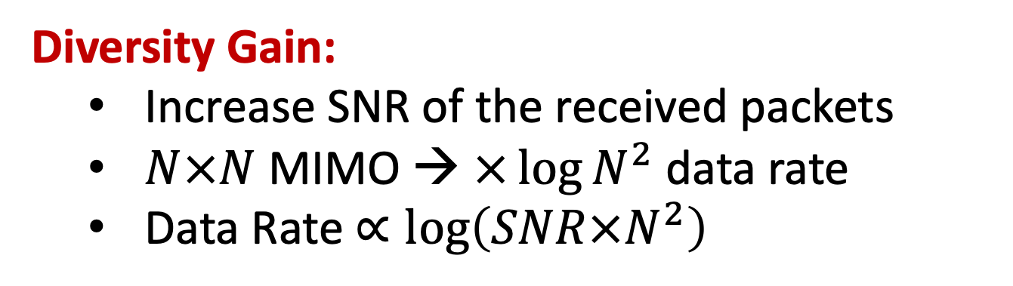
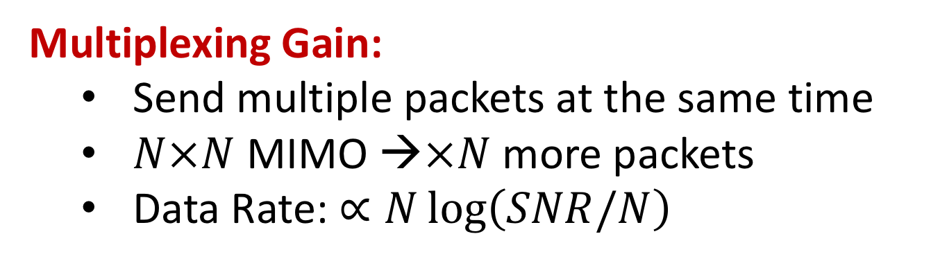
MIMO Gains
Multiplexing Gain:
Send multiple packets at the same time
$N×N$ MIMO →$×N$ more packets
Data Rate: $∝N\log\left(SNR/N\right)$
Diversity Gain:
Increase SNR of the received packets
$N×N$ MIMO → $×{\log{N}}^{2}$ data rate
Data Rate $∝\log\left(SNR×N^{2}\right)$

Slide 39

MIMO Gains
Multipath is essential for MIMO
More Multipath → More Diversity
More Multipath → More Degress of Freedom
Condition Number of Matrix $H$
A measure of how close a matrix is to being singular
A matrix with large condition number is nearly singular → Unstable MIMO system, high noise amplification, not enough degrees of freedom.
A matrix with condition number close to 1 is far from being singular.

Slide 40

Here is a link to the full MCS Table: ​http://bit.ly/2G0DIcD

Slide 41
MIMO: Multiple TX-RX streams
WiFi Access Points 2 to 8 MIMO
WiFi Devices 1 to 2 MIMO
Power
Form Factor & Antenna Separation
Most mobile phones support 2 MIMO

Slide 42

MIMO
$$x_{1}$$
$$h_{11}$$
$$y_{1}$$
$$=h_{11}x_{1}$$
$$+ h_{12}x_{2}$$
$$h_{21}$$
$$x_{2}$$
$$h_{12}$$
$$y_{2}$$
$$=h_{21}x_{1}$$
$$+ h_{22}x_{2}$$
$$h_{22}$$
$$y=Hx+n$$
$$\tilde{x}=H^{−1}y=H^{−1}Hx+H^{−1}n=x+H^{−1}n$$

Slide 43
Multi-User MIMO
$$x_{1}$$
$$h_{11}$$
$$y_{1}$$
$$=h_{11}x_{1}$$
$$+ h_{12}x_{2}$$
$$h_{21}$$
$$x_{2}$$
$$h_{12}$$
$$y_{2}$$
$$=h_{21}x_{1}$$
$$+ h_{22}x_{2}$$
$$h_{22}$$
$$y=Hx+n$$
$$\tilde{x}=H^{−1}y=H^{−1}Hx+H^{−1}n=x+H^{−1}n$$
Does not work. Receivers do not have access to each other’s signals

Slide 44


Precoding
$$x_{1}$$
$$h_{11}$$
$$y_{1}$$
$$=h_{11}x_{1}$$
$$+ h_{12}x_{2}$$
$$h_{21}$$
$$x_{2}$$
$$h_{12}$$
$$y_{2}$$
$$=h_{21}x_{1}$$
$$+ h_{22}x_{2}$$
$$h_{22}$$
Send: $\tilde{x}=H^{−1}x$
Receive: $y=H\tilde{x}+n=HH^{−1}x+n=x+n$
Also known as Beamforming or Zero-Forcing
Requires Channel Feedback!

Slide 45
What about distributed transmitters?
$$x_{1}$$
$$h_{11}$$
$$y_{1}$$
$$=h_{11}x_{1}$$
$$+ h_{12}x_{2}$$
$$h_{21}$$
$$x_{2}$$
$$h_{12}$$
$$y_{2}$$
$$=h_{21}x_{1}$$
$$+ h_{22}x_{2}$$
$$h_{22}$$
Send: $\tilde{x}=H^{−1}x$
Receive: $y=H\tilde{x}+n=HH^{−1}x+n=x+n$
Does not work. Transmitters do not have access to each other’s signals
False: what if transmitters are APs connected over Ethernet?

Slide 46






















Clock Synchronization in MIMO
$$x_{1}$$
$$h_{11}$$
$$y_{1}$$
$$h_{21}$$
$$x_{2}$$
$$h_{12}$$
$$y_{2}$$
$$h_{22}$$
$$y_{1}$$
$$=h_{11}x_{1}e^{−j2πΔf_{11}t}$$
$$+ h_{12}x_{2}e^{−j2πΔf_{12}t}$$
$$y_{2}$$
$$=h_{21}x_{1}e^{−j2πΔf_{21}t}$$
$$+ h_{22}x_{2}e^{−j2πΔf_{22}t}$$
$$y_{1}$$
$$h_{11}$$
$$h_{12}$$
$$x_{1}$$
$$n_{1}$$
$$=$$
$$+$$
$$y_{2}$$
$$h_{21}$$
$$h_{22}$$
$$x_{2}$$
$$n_{2}$$

Slide 47

























Clock Synchronization in MIMO
$$x_{1}$$
$$h_{11}$$
$$y_{1}$$
$$h_{21}$$
$$x_{2}$$
$$h_{12}$$
$$y_{2}$$
$$h_{22}$$
$$y_{1}$$
$h_{11}$ $e^{−j2πΔf_{11}t}$
$$h_{12}e^{−j2πΔf_{12}t}$$
$$x_{1}$$
$$n_{1}$$
$$=$$
$$+$$
$$y_{2}$$
$$h_{21}e^{−j2πΔf_{21}t}$$
$$h_{22}e^{−j2πΔf_{22}t}$$
$$x_{2}$$
$$n_{2}$$
On chip MIMO: $Δf_{11}$= $Δf_{21}$= $Δf_{12}$= $Δf_{22}$= $Δf$
$$y_{1}$$
$$h_{11}$$
$$h_{12}$$
$$x_{1}$$
$$n_{1}$$
$$=$$
$$e^{−j2πΔft}$$
$$+$$
$$y_{2}$$
$$h_{21}$$
$$h_{22}$$
$$x_{2}$$
$$n_{2}$$

Slide 48









Clock Synchronization in MIMO
$$x_{1}$$
$$h_{11}$$
$$y_{1}$$
$$h_{21}$$
$$x_{2}$$
$$h_{12}$$
$$y_{2}$$
$$h_{22}$$
$$y_{1}$$
$h_{11}$ $e^{−j2πΔf_{11}t}$
$$h_{12}e^{−j2πΔf_{12}t}$$
$$x_{1}$$
$$n_{1}$$
$$=$$
$$+$$
$$y_{2}$$
$$h_{21}e^{−j2πΔf_{21}t}$$
$$h_{22}e^{−j2πΔf_{22}t}$$
$$x_{2}$$
$$n_{2}$$
MU-MIMO: $Δf_{11}$= $Δf_{12}$ and $Δf_{21}$= $Δf_{22}$
$$y_{1}$$
$h_{11}$ $e^{−j2πΔf_{1}t}$
$$h_{12}e^{−j2πΔf_{1}t}$$
$$x_{1}$$
$$n_{1}$$
$$=$$
$$+$$
$$y_{2}$$
$$h_{21}e^{−j2πΔf_{2}t}$$
$$h_{22}e^{−j2πΔf_{2}t}$$
$$x_{2}$$
$$n_{2}$$

Slide 49








Clock Synchronization in MIMO
$$x_{1}$$
$$h_{11}$$
$$y_{1}$$
$$h_{21}$$
$$x_{2}$$
$$h_{12}$$
$$y_{2}$$
$$h_{22}$$
$$y_{1}$$
$h_{11}$ $e^{−j2πΔf_{11}t}$
$$h_{12}e^{−j2πΔf_{12}t}$$
$$x_{1}$$
$$n_{1}$$
$$=$$
$$+$$
$$y_{2}$$
$$h_{21}e^{−j2πΔf_{21}t}$$
$$h_{22}e^{−j2πΔf_{22}t}$$
$$x_{2}$$
$$n_{2}$$
MU-MIMO: $Δf_{11}$= $Δf_{12}$ and $Δf_{21}$= $Δf_{22}$
$$y_{1}$$
$$e^{−j2πΔf_{1}t}$$
$$0$$
$$h_{11}$$
$$h_{12}$$
$$x_{1}$$
$$n_{1}$$
$$=$$
$$+$$
$$y_{2}$$
$$0$$
$$e^{−j2πΔf_{2}t}$$
$$h_{21}$$
$$h_{22}$$
$$x_{2}$$
$$n_{2}$$

Slide 50

Clock Synchronization in MIMO
$$x_{1}$$
$$h_{11}$$
$$y_{1}$$
$$h_{21}$$
$$x_{2}$$
$$h_{12}$$
$$y_{2}$$
$$h_{22}$$
$$y_{1}$$
$h_{11}$ $e^{−j2πΔf_{11}t}$
$$h_{12}e^{−j2πΔf_{12}t}$$
$$x_{1}$$
$$n_{1}$$
$$=$$
$$+$$
$$y_{2}$$
$$h_{21}e^{−j2πΔf_{21}t}$$
$$h_{22}e^{−j2πΔf_{22}t}$$
$$x_{2}$$
$$n_{2}$$
Distributed MIMO: $Δf_{11}≠$ $Δf_{12}≠Δf_{21}≠$ $Δf_{22}$
Advanced Topics!

Slide 51







1-antenna devices
2-antenna devices
3-antenna devices
Wireless nodes increasingly have heterogeneous numbers of antennas

Slide 52
Consider a scenario with Tx-Rx pairs that have a different number of antennas
Alice
Bob
Chris
When a single-antenna node transmits,
multi-antenna nodes refrain from transmitting

Slide 53
But, MIMO Nodes Can Receive Multiple Concurrent Streams
Alice
Bob
Chris

Slide 54
It’s Not That Simple
Interference!!
Alice
Interference!!
Bob
Chris
But, how do we transmit without interfering at receivers with fewer antennas?

Slide 55
Interference Nulling
Alice
nulling
Bob
Signals cancel each other at Alice’s receiver
Signals don’t cancel each other at Bob’s receiver
Because channels are different

Slide 56
Interference Nulling
Alice
$$h_{1}α x$$
$$+h_{2}β x$$
$$=0$$
➔ Nulling : $h_{1}α=−h_{2}β$
$$α x$$
Bob
$$≠0$$
$$β x$$
Signals cancel each other at Alice’s receiver
Signals don’t cancel each other at Bob’s receiver
Because channels are different
Bob’s sender learns channels either by feedback from Alice’s receiver or via reciprocity

Slide 57
Interference Nulling
Alice
$$h_{1}α x$$
$$+h_{2}β x$$
$$=0$$
➔ Nulling : $h_{1}α=−h_{2}β$
$$α x$$
Bob
$$≠0$$
$$β x$$
Q: How to transmit without interfering with receivers with fewer antennas?
A: Nulling

Slide 58
Alice
Bob
Chris

Slide 59
Is Nulling Alone Enough? NO!!
Alice
Bob
Chris

Slide 60
Is Nulling Alone Enough? NO!!
Alice
Chris needs to null at three antennas
Bob
Chris

Slide 61
Is Nulling Alone Enough? NO!!
NO!
null
Alice
$$\left(h_{11}α+h_{21}β+h_{31}γ\right)z=0$$
$$\left(h_{12}α+h_{22}β+h_{32}γ\right)z=0$$
Bob
$$\left(h_{13}α+h_{23}β+h_{33}γ\right)z=0$$
$$αz$$
Only Solution: $α=β=γ=0$
Chris
$$βz$$
Transmit Nothing!!!
$$γz$$
Are we doomed?
No, we can use interference alignment

Slide 62
MIMO Recap
N-antenna node receives in N-dimensional space
antenna 1
antenna 2
antenna 1
antenna 2
antenna 1
antenna 3

Slide 63
MIMO Recap
N-antenna node receives in N-dimensional space
N-antenna receiver can decode N signals
2-antenna RX
y
y1
$$y_{1}$$
y2
$$y_{2}$$

Slide 64
MIMO Recap
N-antenna node receives in N-dimensional space
N-antenna receiver can decode N signals
Transmitter can rotate the received signal
2-antenna TX
2-antenna RX
y
y1
$$αx$$
$$y_{1}$$
y2
$$βx$$
$$y_{2}$$
x is the sender’s symbol, (y1,y2) is the received symbol, ($α$, $β$) is the pre-coding vector, and H is the channel matrix

Slide 65
MIMO Recap
N-antenna node receives in N-dimensional space
N-antenna receiver can decode N signals
Transmitter can rotate the received signal
2-antenna TX
2-antenna RX
y
$$αx$$
$$\left({y_{1} \atop y_{2}}\right)=H\left({α \atop β}\right)x$$
$$βx$$
x is the sender’s symbol, (y1,y2) is the received symbol, ($α$, $β$) is the pre-coding vector, and H is the channel matrix

Slide 66
MIMO Recap
N-antenna node receives in N-dimensional space
N-antenna receiver can decode N signals
Transmitter can rotate the received signal
2-antenna TX
2-antenna RX
y
$$γx$$
$$\left({y_{1} \atop y_{2}}\right)=H\left({γ \atop η}\right)x$$
$$ηx$$
Sender can rotate the received symbol by multiplying with a different pre-coding vector; However to align along a particular direction, sender needs to know H

Slide 67
Interference Alignment
2-antenna receiver
I₁
I₂
wanted signal
If I₁ and I₂ are aligned,
→ appear as one interferer
→ 2-antenna receiver can decode the wanted signal

Slide 68
Interference Alignment
2-antenna receiver
I₁ + I₂
wanted signal
If I₁ and I₂ are aligned,
→ appear as one interferer
→ 2-antenna receiver can decode the wanted signal

Slide 69
Use Nulling and Alignment
Alice
Null as before
Bob
Alice (unwanted)
Bob
nulling
Chris
aligning
Chris

Slide 70
Use Nulling and Alignment
Alice
Alice + Chris (unwanted)
Bob
Bob
nulling
aligning
2-signals in 2D-space
➔Can decode Bob’s signal
Chris

Slide 71
Use Nulling and Alignment
Alice
$$\left(h_{11}α+h_{21}β+h_{31}γ\right)z=0$$
$$\left({h_{12}α+h_{22}β+h_{32}γ \atop h_{13}α+h_{23}β+h_{33}γ}\right)∝ \left({h_{a1} \atop h_{a2}}\right)$$
Bob
nulling
$$αz$$
aligning
Chris
$$βz$$
$$γz$$

Slide 72
Use Nulling and Alignment
Alice
3 packets though receivers have fewer than 3 antennas
Bob
Chris

Slide 73
Interference Alignment and Cancellation (IAC)
p1
Alice
AP1
p3
p1
Ethernet
p3
$$α$$
Bob
AP2
$$β$$
p2
p3
Align P3 with P2 at AP1
→ AP1 decodes P1 to its bits
AP1 broadcasts P1 on Ethernet
AP2 subtracts/cancels P1→ decodes P2, P3

Slide 74
This Lecture
MIMO Multiplexing Gain
Heterogeneous # of antennas
(Interference Nulling/Alignment)
MIMO TX/RX Diversity Gain
MU-MIMO Beamforming
Distributed MIMO

