Slide 1


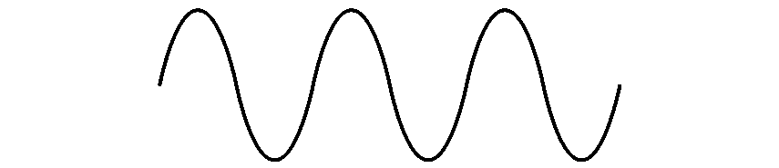
COM-405: Mobile Networks
Lecture 14.0: Multipath TCP
Haitham Hassanieh
slides shamelessly stolen from Prof. JP Hubaux & others
Laboratory of SEnsing
& Networking Systems

Slide 2
Reminder: Transmission Control Protocol (TCP)
Reliable, in-order data delivery service
Single path
tied to the source and destination addresses of the endpoints
Flow control
Congestion avoidance and control
End-to-end semantics

Slide 3
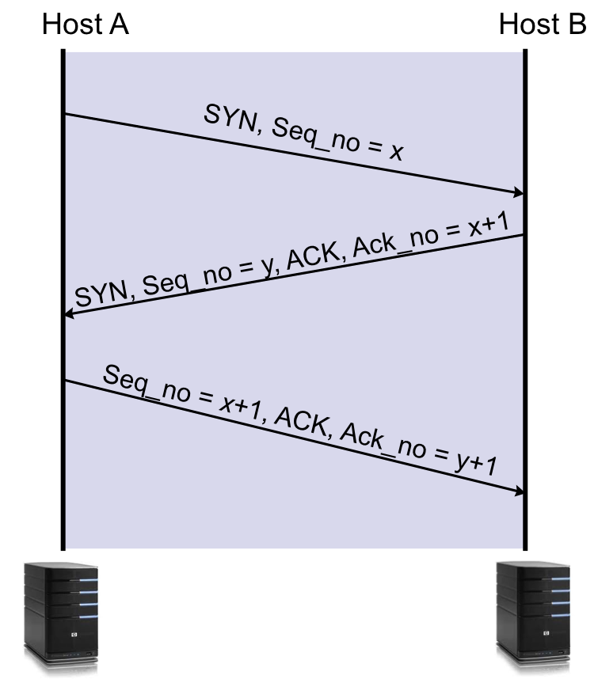
TCP Connection Setup
Three-way handshake

Slide 4
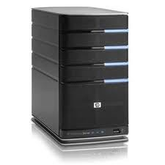
TCP Data Transmission
Assuming a browser wants to send 3KB of data in 3 TCP segments to an HTTP Server
Browser: Send 3KB of data
HTTP Server: Read Request

Slide 5
TCP Data Transmission
Assuming a browser wants to send 3KB of data in 3 TCP segments to an HTTP Server
Data: 0-1000
Browser: Send 3KB of data
HTTP Server: Read Request

Slide 6
TCP Data Transmission
Assuming a browser wants to send 3KB of data in 3 TCP segments to an HTTP Server
Data: 1000-2000
Data: 0-1000
Browser: Send 3KB of data
HTTP Server: Read Request

Slide 7
TCP Data Transmission
Assuming a browser wants to send 3KB of data in 3 TCP segments to an HTTP Server
Data: 2001-3000
Data: 1001-2000
Data: 1-1000
Browser: Send 3KB of data
HTTP Server: Read Request

Slide 8
TCP: Lost Packets
Assuming a browser wants to send 3KB of data in 3 TCP segments to an HTTP Server
How do the browser and the server know that a packet is lost?
Data:
2001-3000
Data: 1-1000
Browser: Send 3KB of data
HTTP Server: Read Request

Slide 9
TCP: Sequence #s and ACKs
Assuming a browser wants to send 3KB of data in 3 TCP segments to an HTTP Server
How do the browser and the server know that a packet is lost?
Based on the sequence numbers and ACKs
SEQ 2001
Data: 2001-3000
SEQ 1001
Data: 1001-2000
SEQ
1
Data: 1-1000
Browser: Send 3KB of data
HTTP Server: Read Request

Slide 10
TCP: Sequence #s and ACKs
Assuming a browser wants to send 3KB of data in 3 TCP segments to an HTTP Server
How do the browser and the server know that a packet is lost?
Based on the sequence numbers and ACKs
SEQ 2001
Data: 2001-3000
SEQ 1001
Data: 1001-2000
ACK 1001
Browser: Send 3KB of data
HTTP Server: Read Request

Slide 11
TCP: Sequence #s and ACKs
Assuming a browser wants to send 3KB of data in 3 TCP segments to an HTTP Server
How do the browser and the server know that a packet is lost?
Based on the sequence numbers and ACKs
SEQ 2001
Data: 2001-3000
ACK 1001
ACK 2001
Browser: Send 3KB of data
HTTP Server: Read Request

Slide 12
TCP: Sequence #s and ACKs
Assuming a browser wants to send 3KB of data in 3 TCP segments to an HTTP Server
How do the browser and the server know that a packet is lost?
Based on the sequence numbers and ACKs
ACK 1001
ACK 2001
ACK 3001
Browser: Send 3KB of data
HTTP Server: Read Request

Slide 13
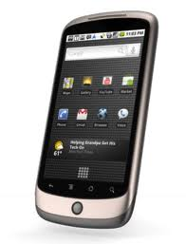

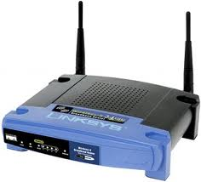
TCP for Wireless and Mobile Networks
Imagine a phone with cellular network and WiFi, moving around a campus
Would like to use the cellular network as semi-reliable baseline service, supplemented by WiFi when available, and switching between WiFi APs as they come and go
cell tower

Slide 14
TCP for Wireless and Mobile Networks
Imagine a phone with cellular network and WiFi, moving around a campus
Would like to use the cellular network as semi-reliable baseline service, supplemented by WiFi when available, and switching between WiFi APs as they come and go
cell tower

Slide 15
TCP for Wireless and Mobile Networks
Imagine a phone with cellular network and WiFi, moving around a campus
Would like to use cellular network as semi-reliable baseline service, supplemented by WiFi when available, and switching between WiFi APs as they come and go
cell tower

Slide 16
TCP for Wireless and Mobile Networks
Imagine a phone with cellular network and WiFi, moving around a campus
Would like to use cellular network as semi-reliable baseline service, supplemented by WiFi when available, and switching between WiFi APs as they come and go
cell tower
Offload to WiFi

Slide 17
TCP for Wireless and Mobile Networks
Imagine a phone with cellular network and WiFi, moving around a campus
Would like to use the cellular network as semi-reliable baseline service, supplemented by WiFi when available, and switching between WiFi APs as they come and go
Conventional TCP is not designed around such agile network connectivity
cell tower
All ongoing TCP connections die

Slide 18
Bringing Multipath TCP to the End Host
MPTCP is a modification of TCP that presents a regular TCP interface to applications, while spreading data across several subflows
Specified in RFC 6824, obsoleted by RFC 8684 (March 2020)
Not a new idea; originally proposed more than 15 years ago
MPTCP goes further to solve issues of fairness when competing with regular TCP and deployment issues
An MPTCP connection is composed of one or more regular TCP subflows that are combined
Each host maintains states that glue the TCP subflows of a MPTCP connection together
Each TCP subflow is sent over a single path and appears like a regular TCP connection along this path
Benefits
Higher throughput
Failover from one path to another
Seamless mobility

Slide 19
MPTCP Architecture
Application
socket
Application
Multipath TCP
Transport
TCP1
TCP2
TCPn
Network
...
Datalink
Physical

Slide 20
How to set up an MPTCP session?
Establish the initial subflow
Three-way TCP handshake with MP_CAPABLE option
Then additional subflows can be established
Three-way TCP handshake with MP_JOIN option
Each subflow looks similar to a regular TCP connection
Which subflows can be associated to a MPTCP connection?
At least one of the elements of the four-tuple needs to differ between two subflows
Local IP address
Remote IP address
Local port
Remote port

Slide 21
MPTCP Operation – Setting up the Initial Subflow
SYN
MP_CAP ABLE X

Slide 22
MPTCP Operation – Setting up the Initial Subflow
SYN/ACK
MP_CAPABLE Y

Slide 23
MPTCP Operation – Setting up the Initial Subflow
STATE 1 CWND Snd.SEQNO Rcv.SEQNO

Slide 24
MPTCP Operation – Adding an Additional Subflow
STATE 1 CWND Snd.SEQNO Rcv.SEQNO
SYN
JOIN Y

Slide 25
MPTCP Operation – Adding an Additional Subflow
STATE 1 CWND Snd.SEQNO Rcv.SEQNO
SYN/ACK
JOIN X

Slide 26
MPTCP Operation – Adding an Additional Subflow
STATE 1 CWND Snd.SEQNO Rcv.SEQNO
STATE 2 CWND Snd.SEQNO Rcv.SEQNO

Slide 27
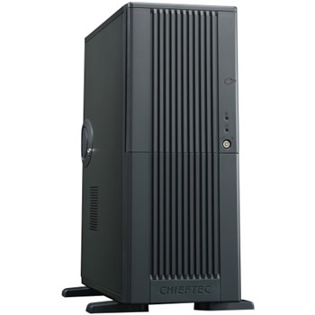

How to Transfer Data?
Assuming a MPTCP connection with 2 subflows and data for the connection can then be sent over any of the active subflows that has the capacity to take it
seq=123,"a"
ack=124
seq=125,"c"
ack=126
Gap in sequence numbering space. Some network middleboxes will not allow this!
seq=124,"b"
ack=125

Slide 28
MPTCP Data Transfer
To solve the problem of gaps in the sequence numbering space, MPTCP uses two levels of sequence numbers
ABCDEF
socket
socket
Multipath TCP
Multipath TCP
Data sequence #
TCP1
TCP1 sequence #
TCP1
TCP2
TCP2 sequence #
TCP2

Slide 29
MPTCP Data Transfer
Dseq is the data sequence number (SQN)
seq is the additional SQN carried inside the TCP option
ensures that the segments sent on any given subflow have consecutive SQNs (to not upset the middleboxes)
Dseq=0,seq=123,"a"
DAck=1,ack=124
DSeq=2, seq=124,"c"
DAck=3, ack=125
DSeq=1, seq=456,"b"
DAck=2,ack=457
*seq* is the sequence for a flow
*dseq* is for the MPTCP connection

Slide 30
What Happens When a TCP Subflow Fails ?
Dseq=0,seq=123,"a"
DSeq=1, seq=456,"b"
DSeq=0,ack=457
Dseq=0,seq=457,"a"
DAck=2,ack=458

Slide 31
Retransmission Heuristics
Heuristics used by current Linux implementation
Fast retransmit is performed on the same subflow as the original transmission
Upon timeout expiration, re-evaluate whether the packet could be retransmitted over another subflow
Upon loss of a subflow, all the unacknowledged data are retransmitted on other subflows

Slide 32
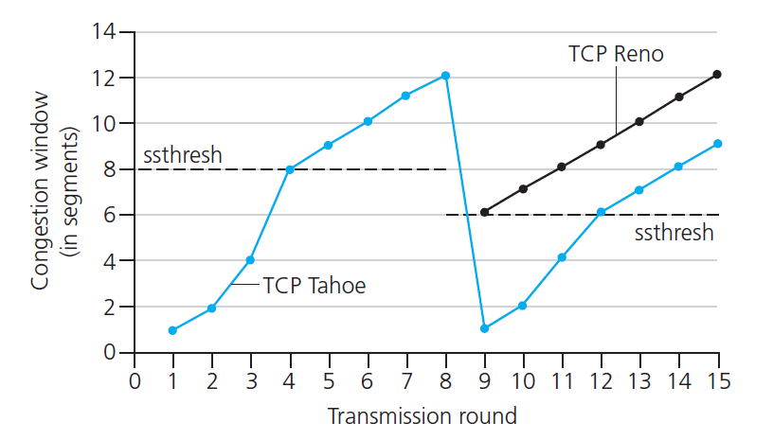
An Important Question
How does the congestion control algorithm work?

Slide 33
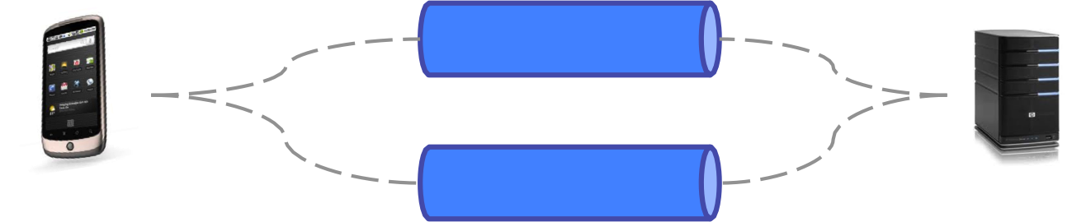
An Important Question
How does the congestion control algorithm work?

Slide 34
MPTCP Congestion Control
Each path runs its own congestion control, to detect and respond to the congestion it sees.
be less aggressive
But link the congestion control parameters, so as to move trafﬁc away from the more congested paths.
be more aggressive

Slide 35
Design Goals for MPTCP
Goal 1: Be fair to regular TCP
Goal 2: Use efficient (meaning uncongested) paths
Goal 3: Perform as well as TCP
We detail them one by one in the next slides

Slide 36
Design Goal 1: Be Fair to Regular TCP
To be fair, MPTCP should take as much capacity as TCP at a bottleneck link, no matter how many paths it is using
MPTCP
Regular TCP

Slide 37
Design Goal 2: MPTCP Should Use Efﬁcient Paths
Assume there are 3 MPTCP connections with the same data rates of X Mb/s, each consisting of 2 subflows
Each connection has a choice of a 1-hop and a 2-hop path
How should each connection split its traffic between its 1-hop and 2-hop subflows?
12Mb/s
X Mb/s
12Mb/s
X Mb/s
12Mb/s
X Mb/s

Slide 38
Design Goal 2: MPTCP Should Use Efﬁcient Paths
Assume there are 3 MPTCP connections with the same data rates of X Mb/s, each consisting of 2 subflows
If each connection splits its traffic between its 1-hop and 2-hop subflows with ratio 1:1
12Mb/s
X Mb/s
12Mb/s
X Mb/s
12Mb/s
X Mb/s
X/2 + X/2 + X/2 = 12 → X = 8Mb/s

Slide 39
Design Goal 2: MPTCP Should Use Efﬁcient Paths
Assume there are 3 MPTCP connections with the same data rates of X Mb/s, each consisting of 2 subflows
If each connection splits its traffic between its 1-hop and 2-hop subflows with ratio 2:1
12Mb/s
X Mb/s
12Mb/s
X Mb/s
12Mb/s
X Mb/s
2X/3 + X/3 + X/3 = 12 → X = 9Mb/s

Slide 40
Design Goal 2: MPTCP Should Use Efﬁcient Paths
Assume there are 3 MPTCP connections with the same data rates of X Mb/s, each consisting of 2 subflows
If each connection splits its traffic between its 1-hop and 2-hop subflows with ratio 4:1
12Mb/s
X Mb/s
12Mb/s
X Mb/s
12Mb/s
X Mb/s
4X/5 + X/5 + X/5 = 12 → X = 10 Mb/s

Slide 41
Design Goal 2: MPTCP Should Use Efﬁcient Paths
Assume there are 3 MPTCP connections with the same data rates of X Mb/s, each consisting of 2 subflows
If each connection splits its traffic between its 1-hop and 2-hop subflows with ratio ∞ :1
12Mb/s
X Mb/s
12Mb/s
X Mb/s
12Mb/s
X Mb/s
All data is sent through the 1-hop subflow → X = 12 Mb/s

Slide 42
Design Goal 2: MPTCP Should Use Efﬁcient Paths
Theoretical solution (Kelly + Voice 2005)
MPTCP should send all its trafﬁc on its least-congested paths.
Theorem: This will lead to the most efficient allocation possible, given a network topology and a set of available paths.
Assume there are 3 MPTCP connections, each consisting of 2 subflows
12Mb/s
12Mb/s
12Mb/s
12Mb/s
12Mb/s
12Mb/s
F. Kelly and T. Voice: Stability of end-to-end algorithms for joint routing and rate control, ACM SIGCOMM Communication Review, 2005

Slide 43
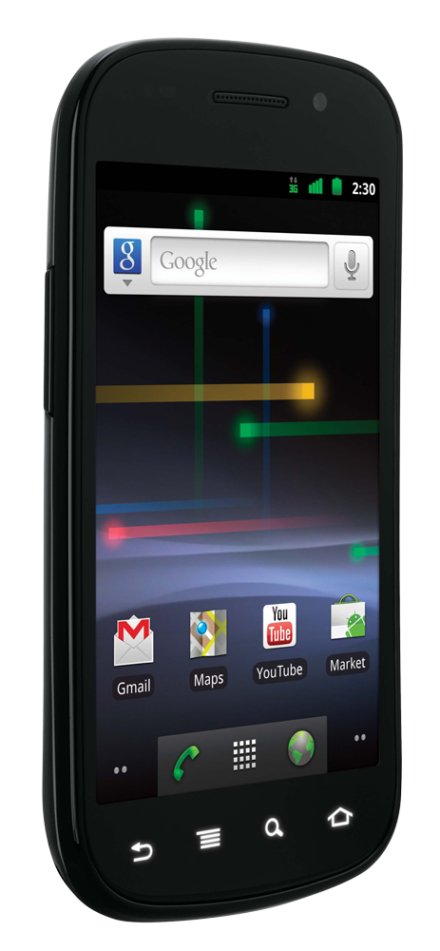
Design Goal 3: Perform as well as TCP
RTT = Round-Trip Time
wifi path: high loss, small RTT
WiFi path: small RTT
Goal 3a.
A Multipath TCP user should get at least as much throughput as a single-path TCP would on the best of the available paths
Goal 3b.
A Multipath TCP flow should take no more capacity on any link than a single-path TCP would
This is actually Design Goal 1
cellular path: high RTT
3G path: low loss, high RTT

Slide 44
MPTCP Congestion Control Algorithm
Needs to satisfy design goals 2 and 3
The authors do not claim that:
The algorithm is optimal
It is an exhaustive survey of the design space
The design space was signposted by examples, analyzed by calculations and experiments

Slide 45
MPTCP Congestion Control Algorithm
A connection consists of set of subflows R
Each subflow r ∈ R maintains a congestion window w_{r}
Denote RTT_{r} the round trip time measured by subflow r
Denote S the subset of R s.t. subflows in S share a bottleneck with r
Example:
S₀
S₁
S₂
Assume R consists of 4 subflows in red and this is r,
then the bottlenecks for r are S₁ and S₂ as shown in the figure.

Slide 46
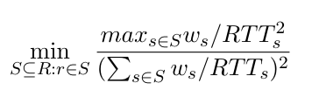
MPTCP Congestion Control Algorithm
For each ACK on path r, increase w_{r} by:
For each drop on path r, decrease w_{r} by w_{r} /2
Reminder: TCP sender maintains a congestion window, which governs the number of packets that the sender can send without
waiting for an acknowledgment. The congestion window is updated dynamically, growing linearly when there is no congestion
and halved when packet loss occurs. TCP congestion control ensures fairness: when multiple connections utilize the same congested link,
each of them will independently converge to the same average value of the congestion window.
Reminder – Algorithm for regular TCP
- For each ACK, increase the congestion window w by 1/w, resulting in an increase of one packet per RTT.1
- For each loss, decrease w by w/2.

Slide 47
MPTCP Congestion Control Algorithm
For each ACK on path r, increase w_{r} by:
For each drop on path r, decrease w_{r} by w_{r} /2
Design goal 3: At any potential bottleneck S that path r might be in, look at the best that a single-path TCP could get, and compare to what I’m getting.
Intuition:
Numerator -> the best that regular TCP could get
Denominator -> what MPTCP gets
Min -> least congested or used part

Slide 48
MPTCP Congestion Control Algorithm
For each ACK on path r, increase w_{r} by
For each drop on path r, decrease w_{r} by w_{r} /2
Design goal 2: We want to shift traffic away from congestion.
To achieve this, we
increase windows in
proportion to their size.

Slide 49
References
RFC 8684 (March 2020): https://www.rfc-editor.org/rfc/rfc8684.txt
Q. Peng, A. Walid, J. Hwang and S. H. Low, "Multipath TCP: Analysis, Design, and Implementation," in IEEE/ACM Transactions on Networking, vol. 24, no. 1, pp. 596-609, Feb. 2016.
O. Bonaventure, M. Handley, and C. Raiciu, An Overview of Multipath TCP, ;login:, Oct. 2012: http://inl.info.ucl.ac.be/system/files/bonaventure_0.pdf

