Slide 1
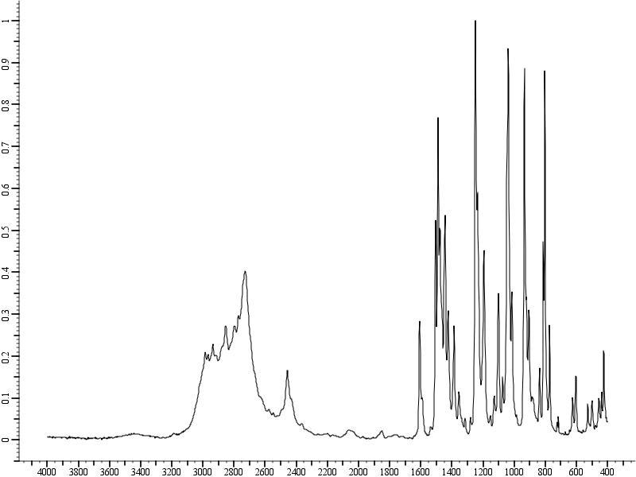
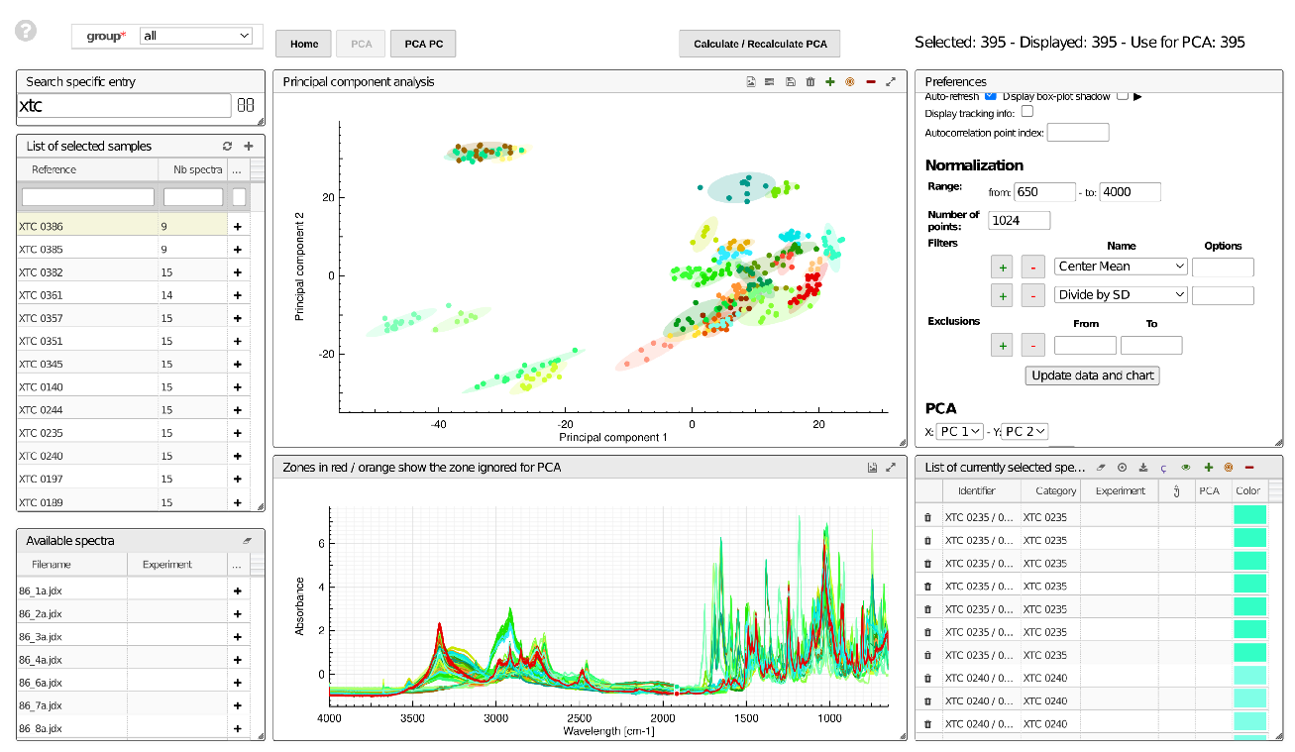
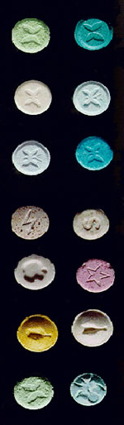
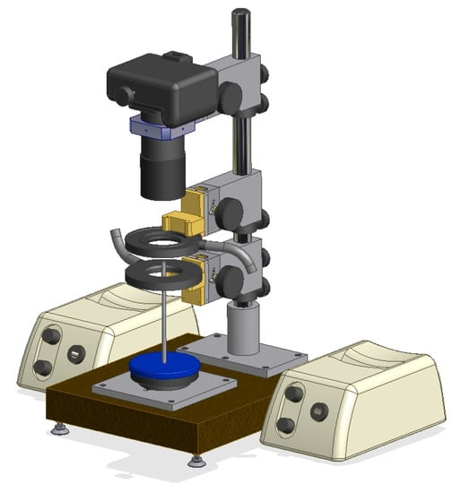
Online documentation: Exercise [~40 min + discuss.]
1
    Inaccurately inspired from Camargo et al. Forensic Science International 2012, 223(1-3), 298-305
    and Patiny et al. Data 2020, 5(4), 116
IR spectra
Algorithms: Principal Components Analysis (PCA)
and k-means clusterning (KMC)
Ecstasy pills
Alain Borel, Francesco Varrato
EDCH 2024 / Hands-on with Research Data Management in Chemistry
Photographs
Families of pills with probable same origin
Notes:
1

Slide 2






Online documentation: Exercise [~40 min + discuss.]
2
[10’] Familiar with your groups’s tool
Disposable emails:
mailsac.com
disposeamail.com
inboxkitten.com
Group 1: protocols.io
Group 2: hackmd.io
Group 3: noto.epfl.ch
Group 4: Chemotion
Group 5 drive.switch.ch
by groups
EDCH 2024 / Hands-on with Research Data Management in Chemistry
    [20’] Write a protocol for the analysis of ecstasy pills
    Focus on reproducibility of data workflow
    From recorded spectra and pictures …
    … to data publication.
    Try to include some data-oriented info, for ex. file formats
    [10’] Evaluate the software you used
      Who is this specific software for?
      Which difficulty in documenting?
      Which advantage in documenting?
go.epfl.ch/online-RDM-doc
Notes:
Trouver des outils plus chimie ?
Tester un outil de leur choix (6 x 5min = 30min)
Réaliser une tâche / exercice avec outils choisi dans la partie tips&tricks
Chaque ex. doit avoir : Un lien / Petite procedure step-by-step / Domande finale
Retour à faire (? Assez de temps ?)
2

