Slide 1
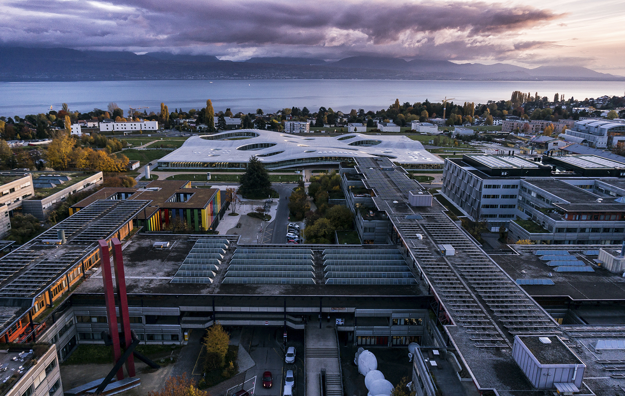

Hands-on with Research Data Management in Chemistry
- Day 2
Alain Borel
Francesco Varrato
Research Data Team, EPFL Library
EDCH-RDM, Feb. 2024

Slide 2
Program
2
 | 2024 – 02 – 21 | 2024 – 02 – 22 | 2024 – 02 – 29
Morning 9:00-12:30 | 1. [1h] Theory 1 | 5. [1h] Tools 2 | 9. [3h] Theory 3
 | 2. [3h] Patiny | 6. [3h] Dürr | 6. [3h] Dürr
 |  |  | 10. [1h] Theory 4
LUNCH BREAK
Afternoon 13:15-17:00 | 3. [1h] Tools 1 | 7. [3h] Hands-on: Data workflow | 11. [3h] Hands-on: Project / Report
 | 4. [3h] Theory 2
 | 4. [3h] Theory 2 | 8. [1h] Feedback 1 | 12. [1h] Feedback 2
Alain Borel, Francesco Varrato
EDCH 2024 / Hands-on with Research Data Management in Chemistry
+ short breaks every 1-2 hours
Notes:
2

Slide 3
Data actions in your project
3
ACTIVITIES | COLLEAGUE / PARTNER | TOOLS | TO-DO
FUNDING PLANNING
CREATION
ETHICAL CLEARANCE
ACQUISITION
STORING
ANALYSIS
LEGAL CLEARANCE
SHARING
PUBLISHING
ARCHIVING
Alain Borel, Francesco Varrato
Did you fill some?
EDCH 2024 / Hands-on with Research Data Management in Chemistry
Notes:
Présenter le doc
Leur dire de réfléchir à ce qu’ils savent déjà
Dire la documentation se fait à toutes les étapes (donc elle devrait être partout dans la to-do)

Slide 4





Online documentation: Exercise [~40 min + discuss.]
4
[5’] Familiar with your groups’s tool
Disposable emails:
mailsac.com
disposeamail.com
inboxkitten.com
Group 1: protocols.io
Group 2: hackmd.io
Group 3: noto.epfl.ch
Group 4: drive.switch.ch
by groups
Just a short reminder
EDCH 2024 / Hands-on with Research Data Management in Chemistry
[20’] Write a protocol for the analysis of ecstasy pills
Focus on reproducibility of data workflow
From recorded spectra and pictures …
… to data publication.
Try to include some data-oriented info, for ex. file formats
[5’] Evaluate the software you used:
Who is this specific software for?
Which difficulty in documenting?
Which advantage in documenting?
go.epfl.ch/online-RDM-doc
Notes:
Trouver des outils plus chimie ?
Tester un outil de leur choix (6 x 5min = 30min)
Réaliser une tâche / exercice avec outils choisi dans la partie tips&tricks
Chaque ex. doit avoir : Un lien / Petite procedure step-by-step / Domande finale
Retour à faire (? Assez de temps ?)
4

Slide 5
What tools do you use for protocols?
5
Alain Borel, Francesco Varrato
?
EDCH 2024 / Hands-on with Research Data Management in Chemistry
Notes:
Trouver des outils plus chimie ?
Tester un outil de leur choix (6 x 5min = 30min)
Réaliser une tâche / exercice avec outils choisi dans la partie tips&tricks
Chaque ex. doit avoir : Un lien / Petite procedure step-by-step / Domande finale
Retour à faire (? Assez de temps ?)
5

Slide 6

Exercise [~40 min]
6
[20’] Get to know the dataset you were assigned and answer the 4 questions
[10’] Compare your answers with your group and choose what to highlight
[10’] Each group presents their dataset and its main features / qualities / flaws:
+ discussion
individually
Datasets & Questions check Moodle
Alain Borel, Francesco Varrato
EDCH 2024 / Hands-on with Research Data Management in Chemistry
4 groups
one person per group [2 mins / p]
Notes:
5 minutes de consignes
+
35 minutes d’exercice
= 40 minutes + 8 minutes x n of datasets (32 minutes ?)
~ 1h15
6

