Slide 1
Transmission Electron Microscopy (TEM)
CH-633

Slide 2
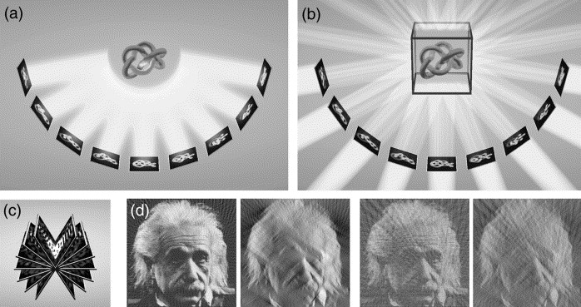
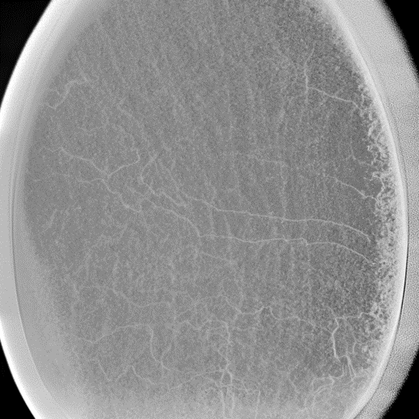
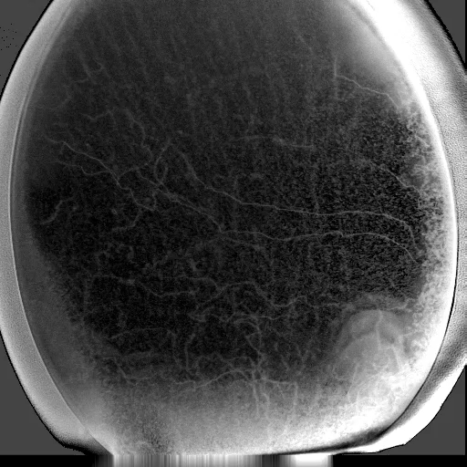
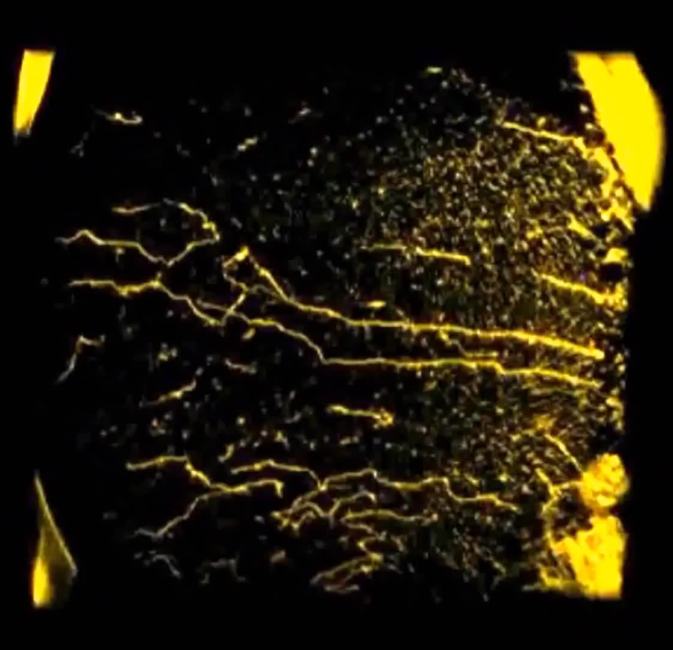
Projection problem | 3D imaging in TEM
Series of projections
Back-projection
200 nm
2D image
Series of tilted images
-35°/+35° tilt arc | 1° interval
3D reconstruction
SIRT 30 itterations

Slide 3
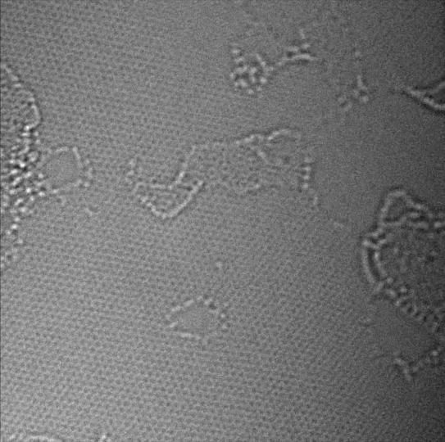
Cs-correction: Image-corrected low kV HR-TEM
Cs-correction and monochromatic illumination to reduce Cc allow sub-Å resolution even at lower kV where electron wavelength λ is greater
Beam sensitive, low contrast materials can be imaged
Here a monolayer graphene is imaged with 80 keV, monochromated e–
Collaboration with group of Prof. Agrawal, EPFL
S. Huang et al., Nat. Comm. 2018.

Slide 4
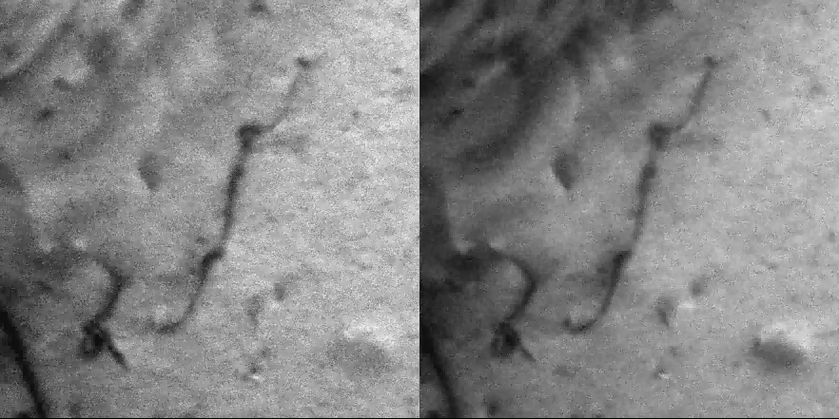
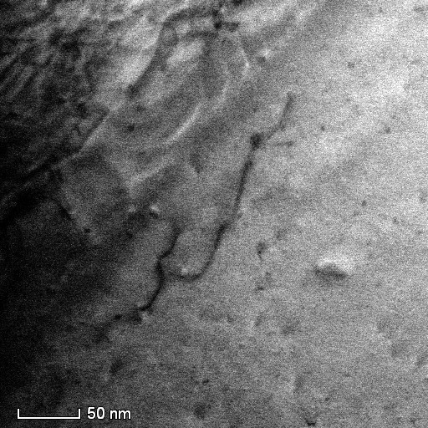
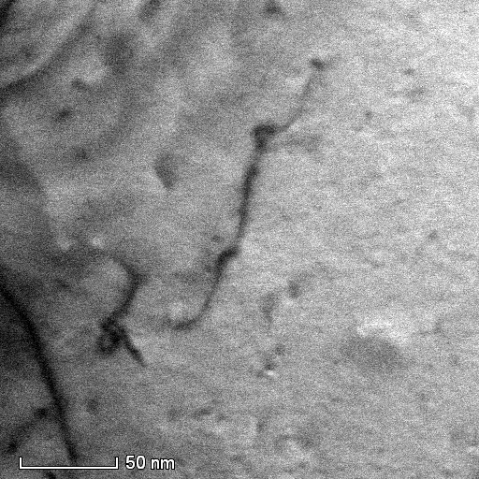
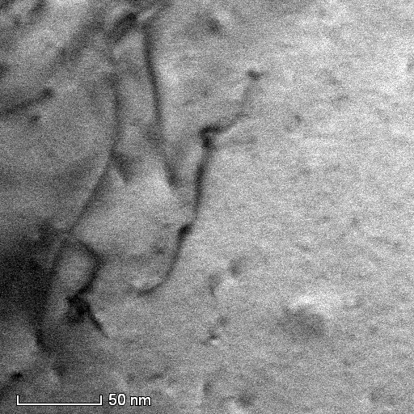
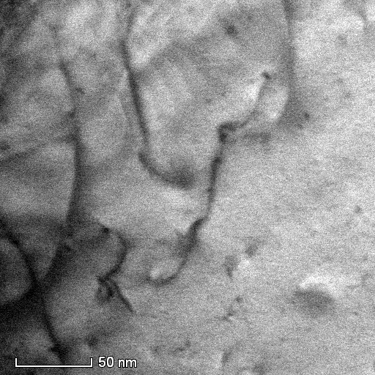
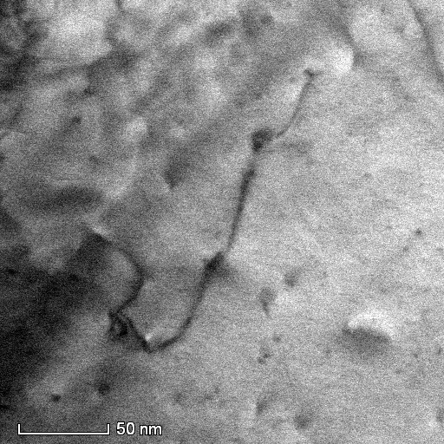
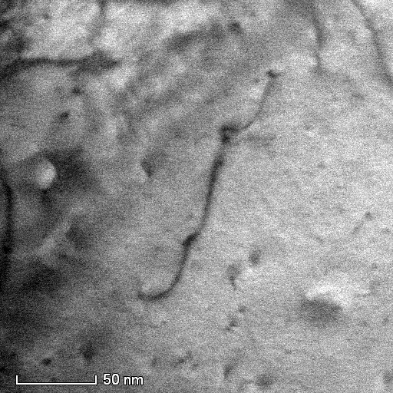
In situ TEM straining, deformation, mechanical manipulation
Dislocations interaction
Specimen: Cu foil | in situ deformation
50 nm
50 nm
t₀
t₁
t₂
t₃
t₄
t₅ = 16 Sec
In collaboration with Dr. Marc Legros of CNRS-CEMES Toulouse, France

Slide 5
Some useful literature
Transmission Electron Microscopy by D.B. Williams and C.B. Carter (Springer)
Large Angle Convergent Beam Electron Diffraction by J.-P. Morniroli
Aberration-corrected imaging in transmission electron microscopy: an introduction by R. Erni
Scanning Transmission Electron Microscopy by S.J. Pennycook and P.D. Nellist (eds) (Springer)
Diffraction Physics by J.M. Cowley (North Holland/Elsevier)
Science of Microscopy by C.W. Hawkes and J.C.H. Spence (eds) (Springer)

