Slide 1
Chemical biology CH-313
Part 1 Biological systems 1 week
Part 2 Bio-membranes 7 weeks
Part 3 Investigation of biological systems 4 weeks
Part 4 Paper presentations 2 weeks
Ruud Hovius
CH-B3-424
Ruud.Hovius@epfl.ch
Laboratory of Biophysical Chemistry of Macromolecules LCBM
Notes:
Part_1 : myself
Part_2 : Joachim Piguet

Slide 2
Introdudtion
Part 1 Biological systems
1 • Cellular conditions
2 • Individual
3 • Labeling proteins
4 • Molecular interactions
5 • Molecular sensors
and machines
Part 2 - Molecular characterization
Methods and results
• Fluorescence and
Single molecule detection
• Tracking of objects
• Super-resolution methods
• Single molecule experiments
• Single or few molecule devices
Notes:
Part_1 : myself
Part_2 : Joachim Piguet

Slide 3
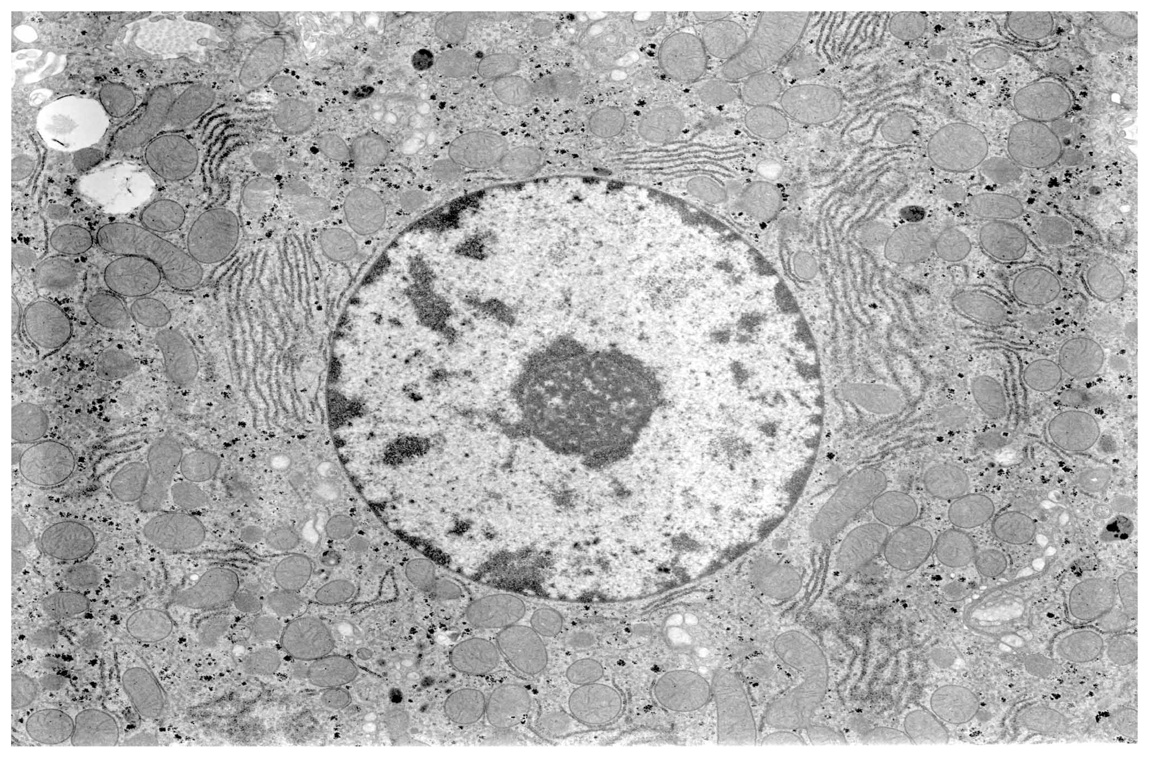
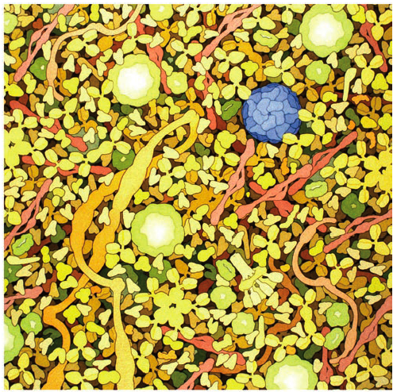
1 • Cells - Very complicated conditions
Goodsell, Nat Chem Biol 3 (2007) p.681
• Highly heterogeneous - compartments with very different contents
• Transport and separation
• Highly crowded
• Many different components – e.g. ~5’000 different gene products
=> Very far from an ideal system in physico-chemical terms
Notes:
idealized text book view
=> empty, no contact
EM image from a thin slice
=> contact sites between organelles
Molecular view how crowded it is
: => in between the membranes , the proteins bump with 10-100 kHz into the membranes, and much faster into other proteins/macro-molecules

Slide 4

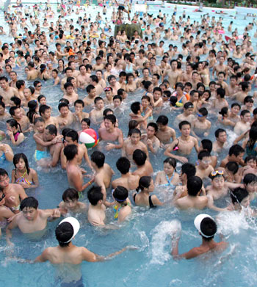
1 • Crowding & Size-dependent hinderance
versus
Notes:
5 nm GFP about 10-times lower D
50 nm is ribosome about 300 lower D
<x^2> = 6Dt
~x =

Slide 5
1 • Effects of Crowding: Size-dependent hinderance
Diffusion in the cytosol vs in water
http://book.bionumbers.org/ see also Lalwarczk,Bioinformatics,2012
Notes:
5 nm GFP about 10-times lower D
50 nm is ribosome about 300 lower D
<x^2> = 6Dt
~x =

Slide 6
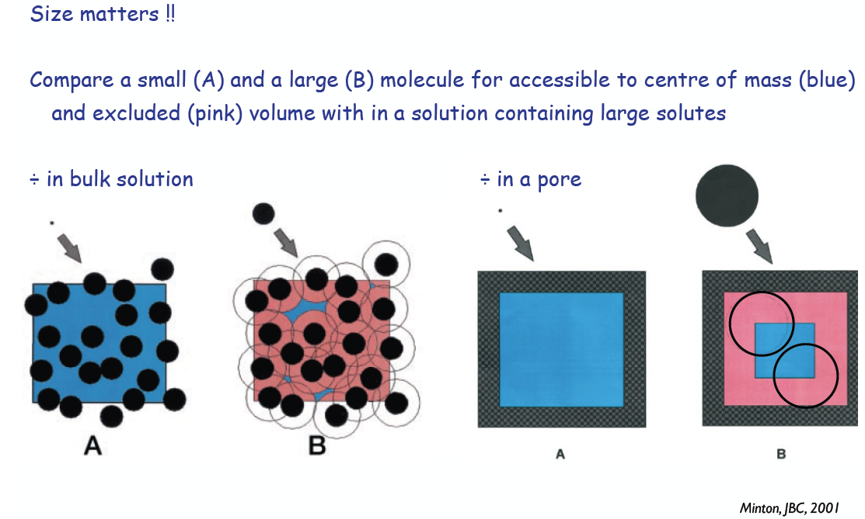
1 • Effects of Crowding: Excluded volume & confinement

Slide 7
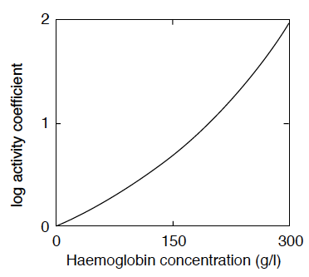
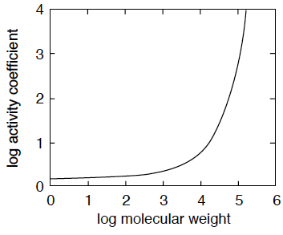
1 • Effects of Crowding: Effective concentrations
Molar concentrations [A] are multiplied by an activity coefficient a which depends on
i) total solute concentration and ii) molecular size of A
• Hemoglobin in water • Molecules in 300 g/l hemoglobin solution
at low conc. a = 1
in a blood cell a ≈ 100
at low MW a = 1
at high MW a “explodes”

Slide 8
1 • Effects of Crowding: Chemical equilibria
Imagine an oligomerization reaction:
characterized by a dissociation constant
Under non-ideal conditions the concentrations of each species has to be multiplied by a correction factor - the activity constant a
if n is small then a _{A} ~ a _{An}
=> Oligomerisation is very strongly favoured under crowded conditions

Slide 9
2 • Quantities in biology
Macroscopic world Cellular world
Length 1 decimeter 1 μm
Volume 1 liter 10⁻¹⁵ liter
• Consequence of scale on the number of molecules present
Macroscopic Cellular
Salts 100 mM 10²³ 10⁸
Synaptic
transmitter 1 mM 10²¹ 10⁶
Hormone 1 nM 10¹⁵ 1

Slide 10
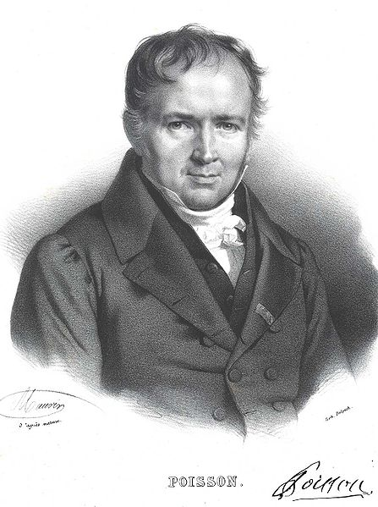
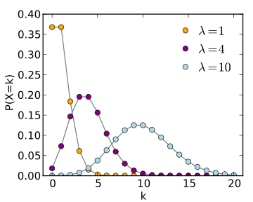

2 • Poisson distribution: To be or not to be
“when the average is small,
the change to observe nothing is not null !”
In fact, there is a distribution of the average λ with different probabilities p to observe value k :
Siméon Denis Poisson
1781 - 1840
=> the lower the average λ, the longer one has to observe to be sure !
Notes:
LAMBDA : Average
K : number of individual observations

Slide 11


2 • Small numbers reveal individual molecular characters
Two examples :
i • Detection of molecular properties of N molecules
signal ∝ N standard deviation ∝ √N
N = 10⁶ => SD = 10³ => ~N/1000
N = 1 SD = 1 ~N
ii • Imagine a molecule which can switch between two states
then the probability p to be in state A equals
N = 10⁶ => p_{A} x N molecules are on the average in state “A”
N = 1 => the molecule will be “A” for a p_{A}-fraction of time
with an average duration

Slide 12
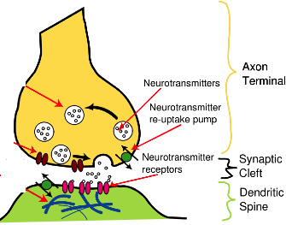
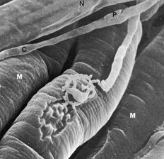
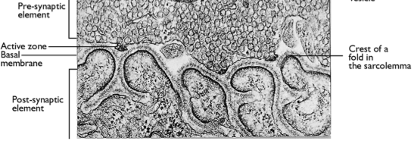
2 • Small vs big numbers
Synapses as example :
°Synaptic contact between neurons
only few active receptors present
versus
°Neuro-muscular junction
thousands of receptors
Notes:
Which is an evolutionary problem => selection pressure for a better system

Slide 13
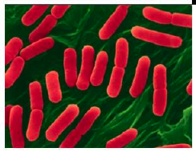
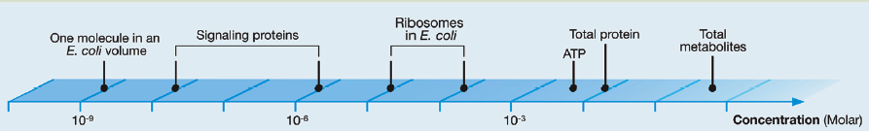
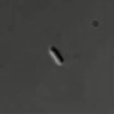
2 • The “n” in biology
Escherichia coli:
Volume ~10⁻¹⁵ L
Concentration (Molar)
Chromosome
DNA Polymeras
Several important molecules are rare, almost alone
=> these molecules are deciding !!
SNAP shot Key numbers in Biology (2010) Cell 141
S.Xie (2006) Science Vol 311

Slide 14
3 • Finding a needle in a haystack
protein of interest
Advantages of fluorescence methods
Non-invasive => in vivo
Sensitive => down to a single molecule
On line => direct info from ns to days
High spatial & temporal resolution
High information content
Focus:
Bio-orthogonal
labelling of proteins
Fluorescent labelling is needed to discriminate
between molecules of interest and the rest
Notes:
Very crowded and very full : how to find the special one..

Slide 15
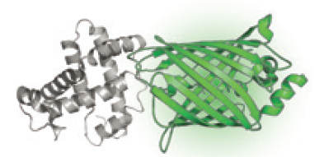
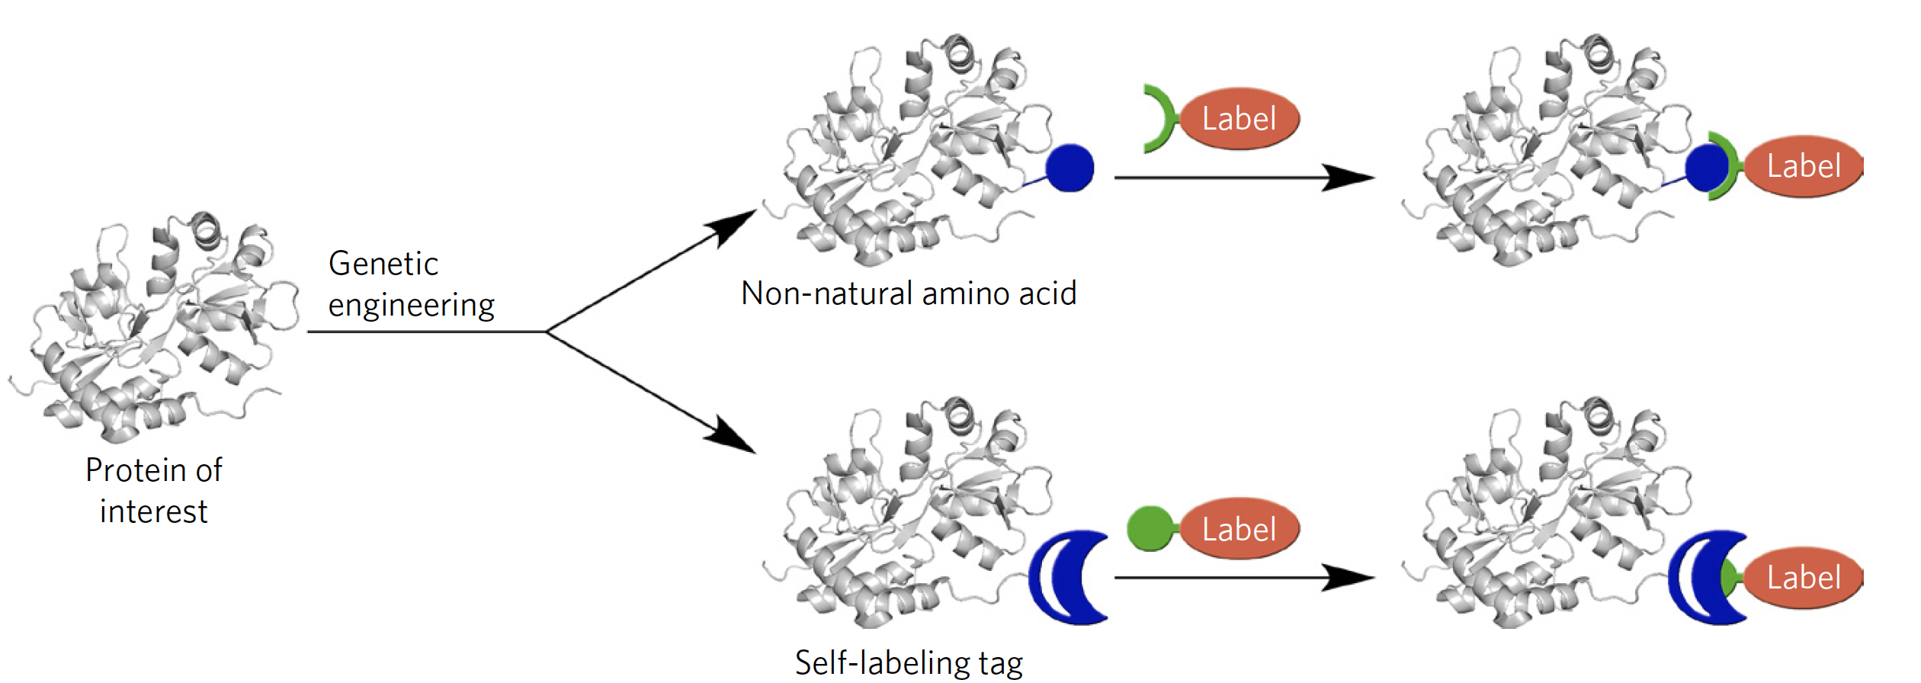
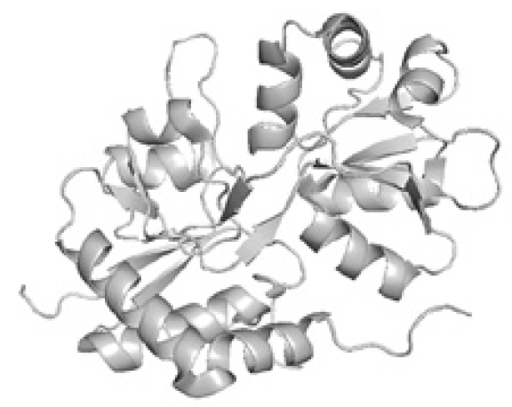
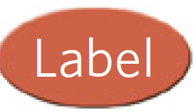
3 • How to label your Protein - of - Interest “poi” ?
Fluorescent protein
Small interacting molecules
- substrate
- ligand
- inhibitor
Binding partner
Enzymatic labeling
Notes:
nnAA can be already a fluorescent group

Slide 16
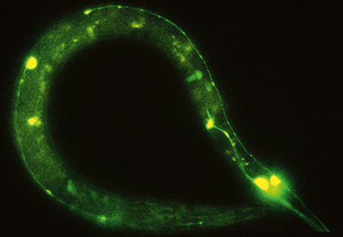
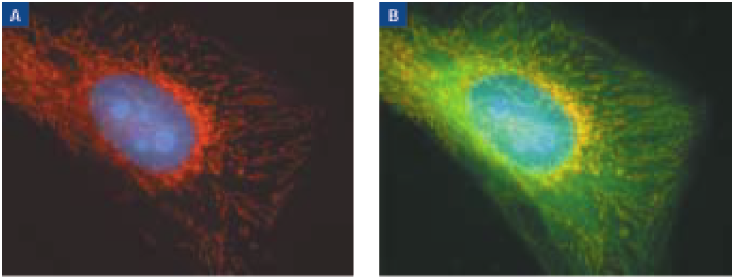
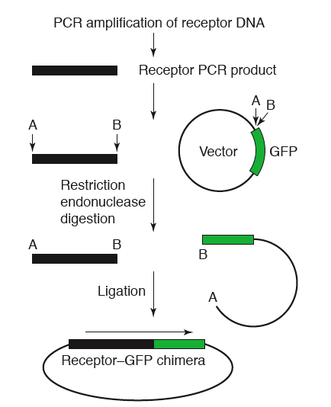
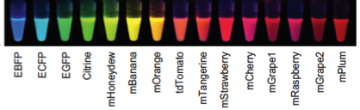

3 • Fluorescent proteins as label
• Fusion to protein of interest • Within single cells or living organisms
N- or C- terminal, internal
• Parallel labelling of several proteins with different fluorescent proteins
R. Y. Tsien
Which one to use ? => fpbase.org
Where to get ? =>
T. Kogure, Nat Biotech 24 (2006) 577
Notes:
N, C or internal sites –in loops
Standard molecular genetics, or more advanced Crisper-cas methods

Slide 17
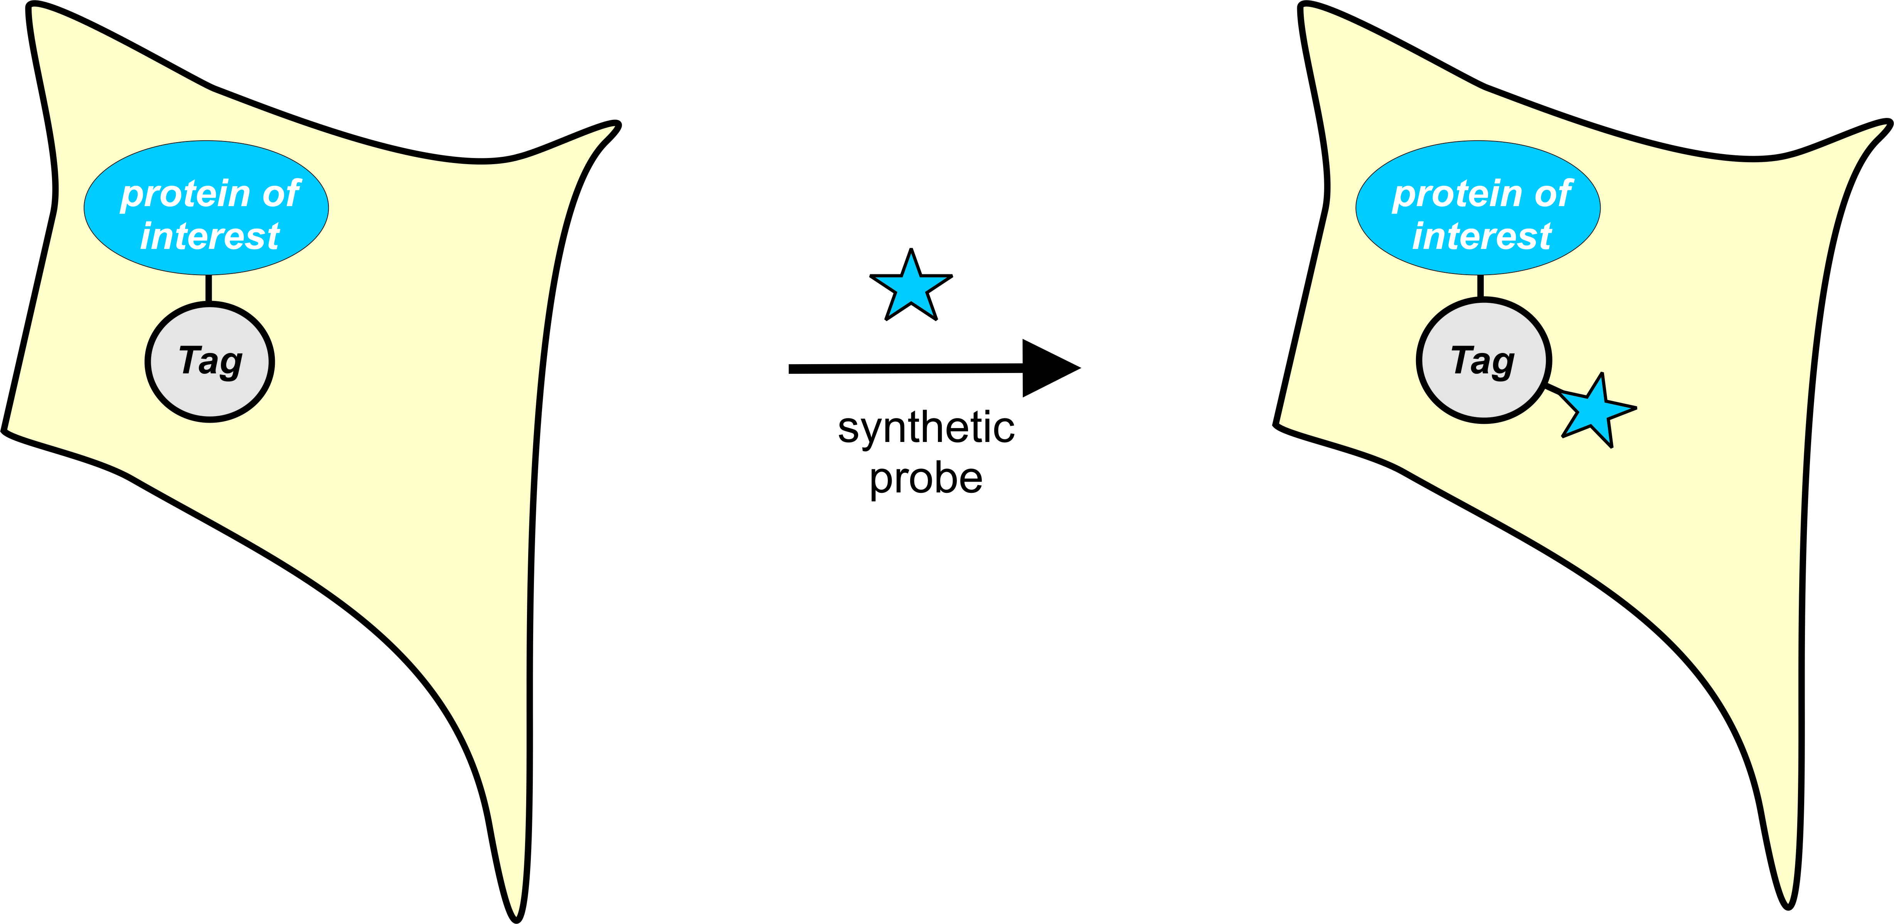
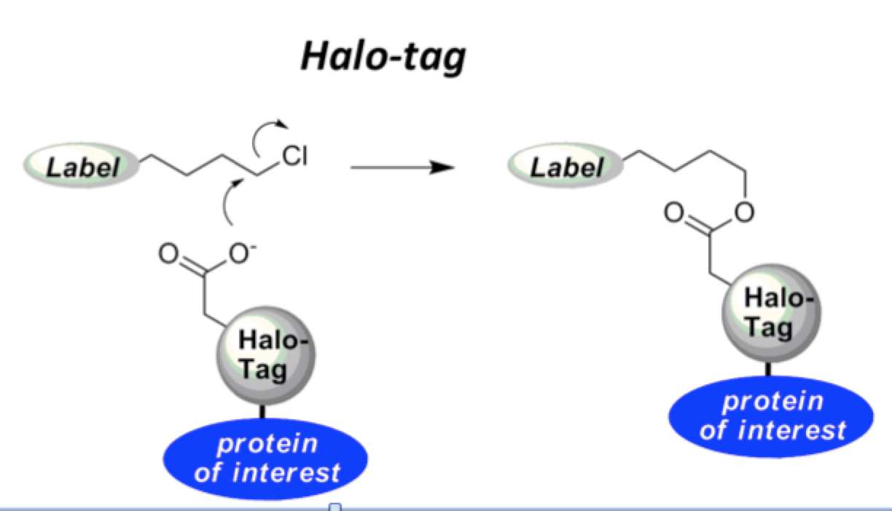
3 • Self-labelling fusion tags
Fuse tag to protein-of-interest
Tag = a “suicide” enzyme
Providing proteins with properties that cannot be genetically encoded
Using a single tag for different applications
Many different probes can react with the same tag
Popular examples are Halo-tag and Snap-tag
• Halo-tag
- based on a haloalkane dehalogenase
- provide very fast labeling
Notes:
Both enzymes are suicide –enzymes, ie, they make only 1 turn-over

Slide 18
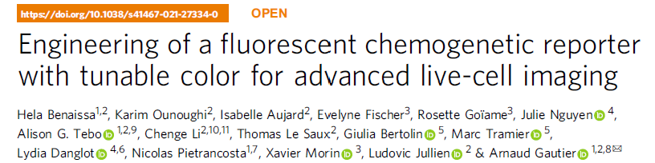
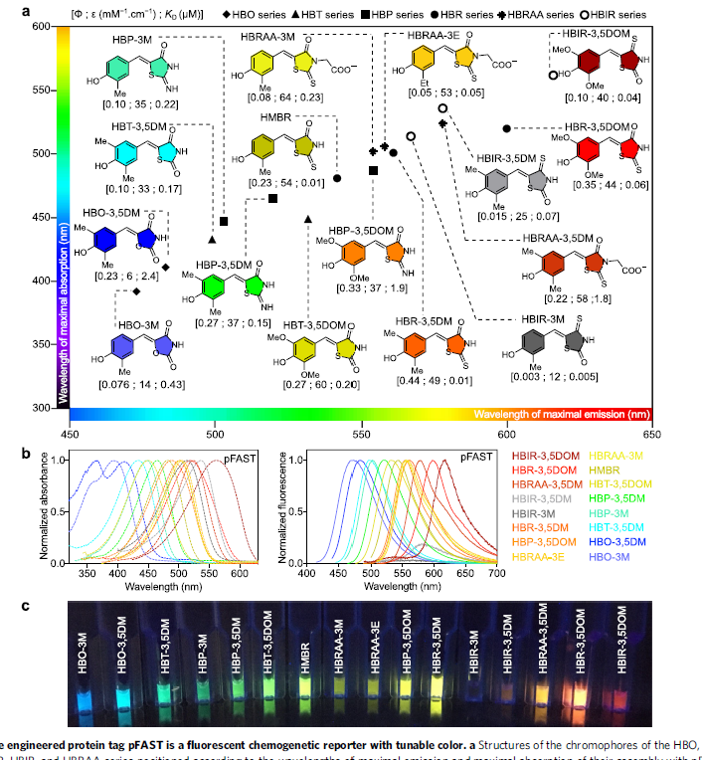
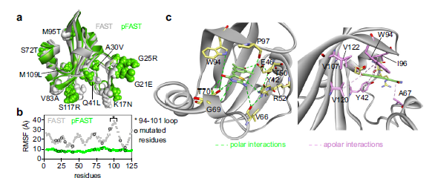
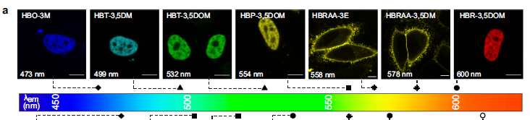
3 • A fluorescent protein-chromophore as label
Nature Communications 2021-12-6989
R. Y. Tsien
Photoactive protein from Hhalophila
Notes:
N, C or internal sites –in loops
Standard molecular genetics, or more advanced Crisper-cas methods

Slide 19
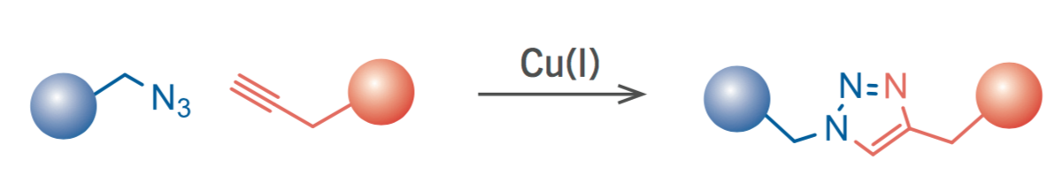
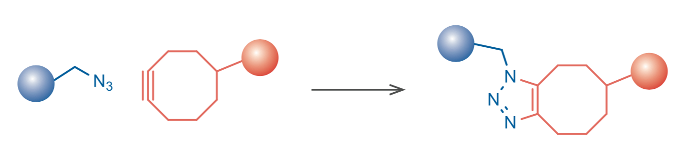
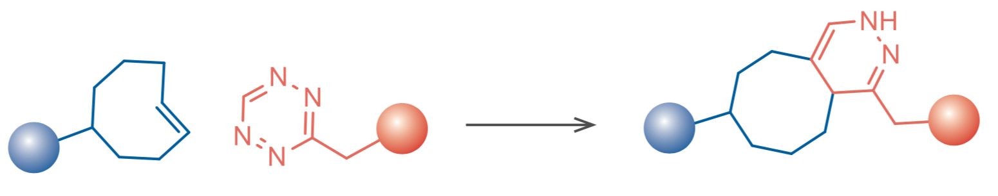

3 • Non-natural amino acids
Introduce amino acid analogues with handles for modification by “click” chemistry
Click-ing molecules together :
÷ The original Cu⁺-catalyzed
÷ Cu-free strain-promoted
÷ Inverse Diels-Alder reaction
Notes:
Click: AZIDE + ALKYN => TRIAZOLE
STRAINED CYCLO ALKYNE + AZIDE
INVERSE DIELS_ALDER : TETRAZOLE + STRAINED CYCLO ALKENE

Slide 20
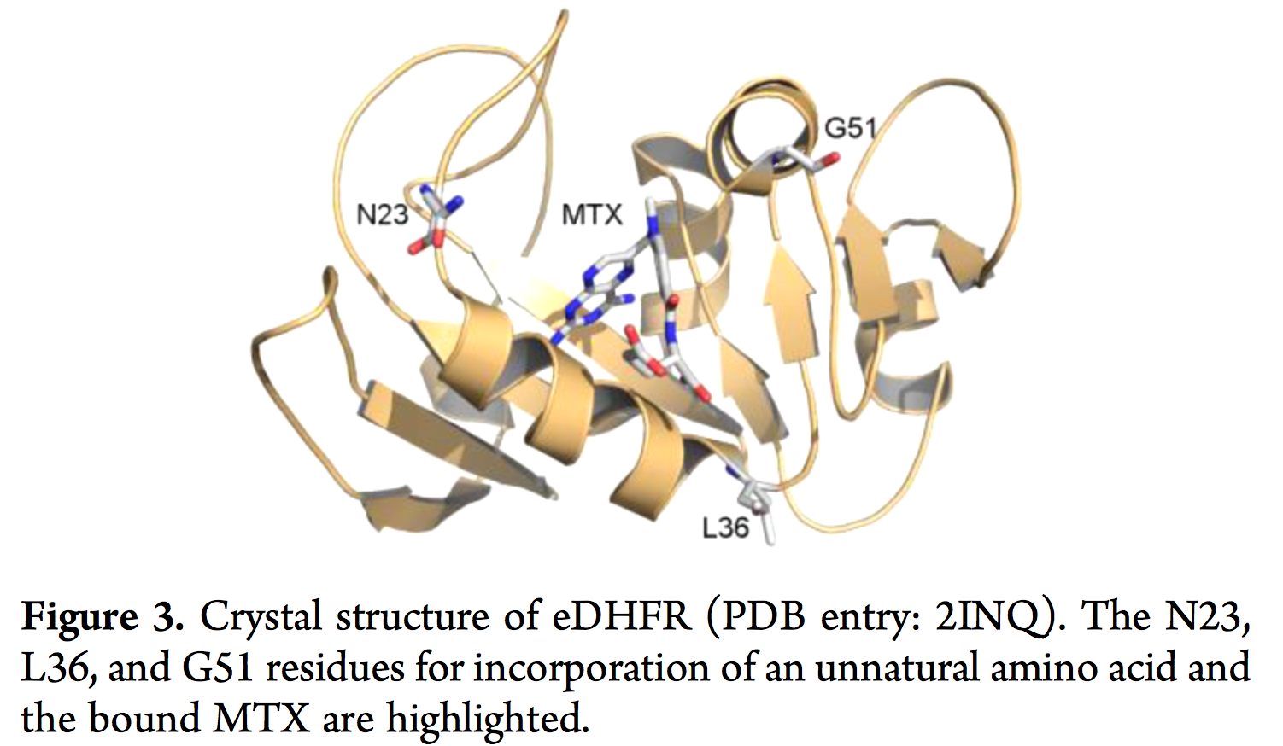
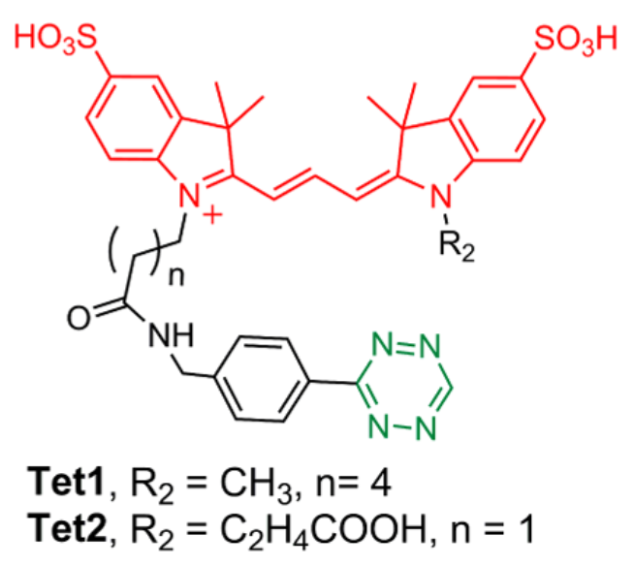
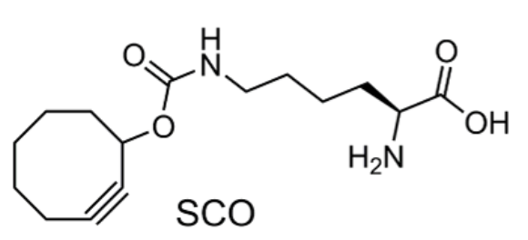
3 • Non-natural amino acids
An example of a “click-pair
Xue, JACS 2016
The combination of non-natural amino acids and click chemistry yields
a high spatial precision for the introduction of the fluorophore

Slide 21
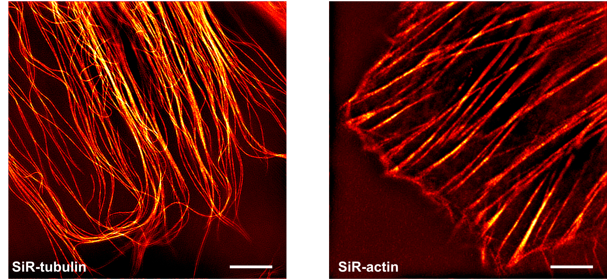
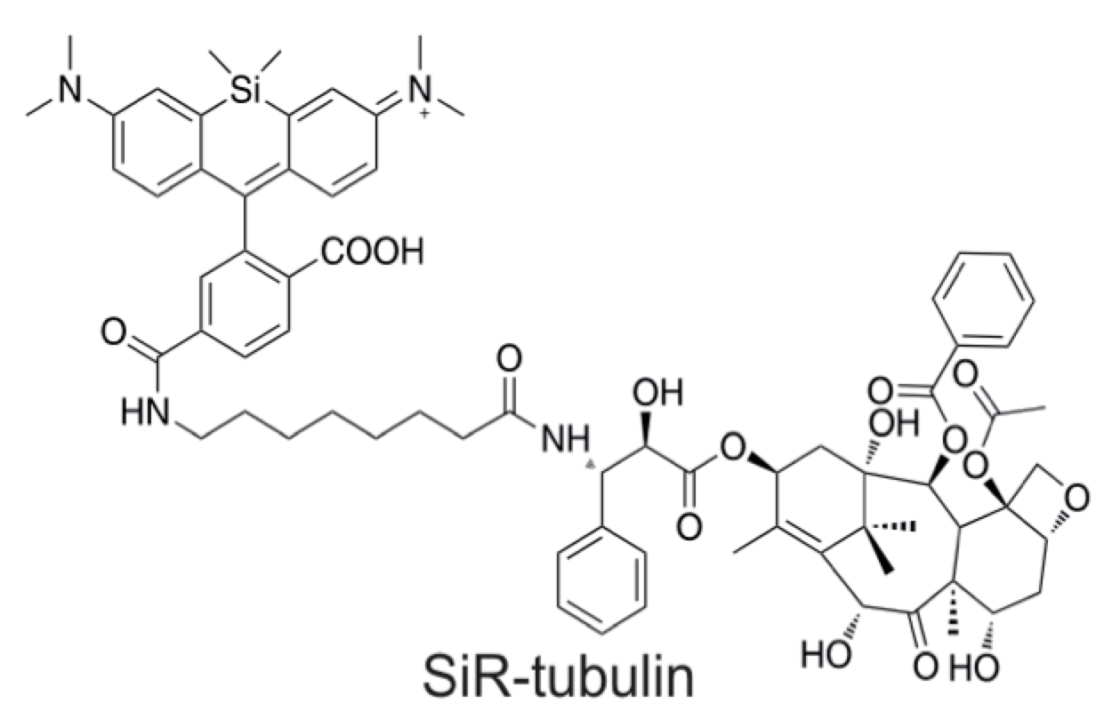

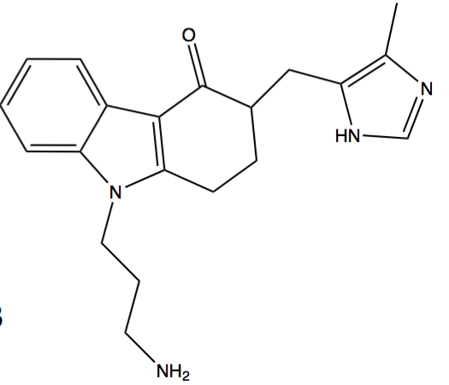

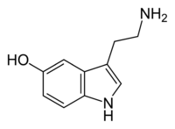
3 • Small interacting molecules
• A cell-permeable microtubule-binding conjugate of a taxol-analogue and Silicon Rhodamine
A labeled serotonin-analogue of interacting with the serotonin receptor in the cell membrane
serotonin
=>
Nature Methods 2014
Wohland, Biochemistry 1999

Slide 22
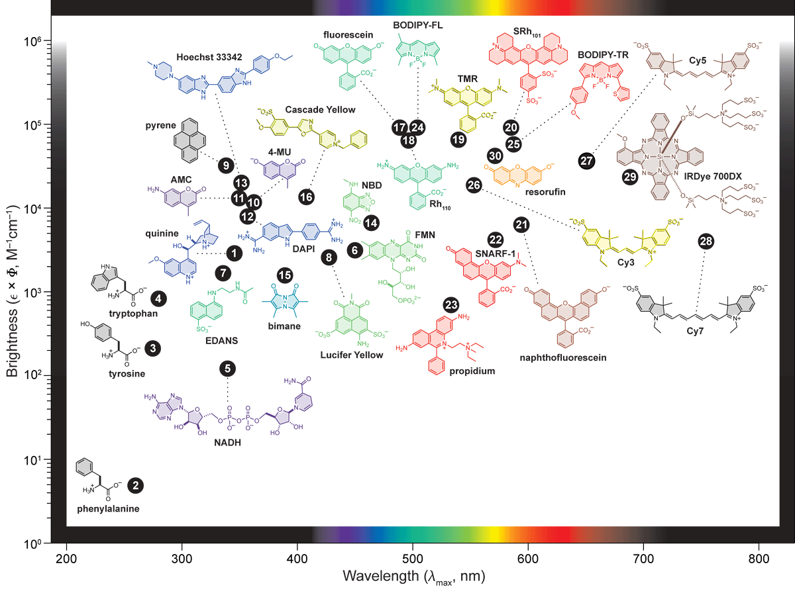
3 • Labelling with organic dyes - Which one ?
Very large choice of commercially available (reactive) dyes from e.g.
Many available dyes :
Alexa’s Invitrogen
Cy dyes GE
Atto’s Atto-tec
CF’s Biotium
SiR’s Spirochrome
Abbrerior
…..
Criteria : Brightness, stability, non-specific interactions & cell-permeability
http://www.hhmi.org/research/tailoring-fluorescent-molecules-biological-applications

Slide 23
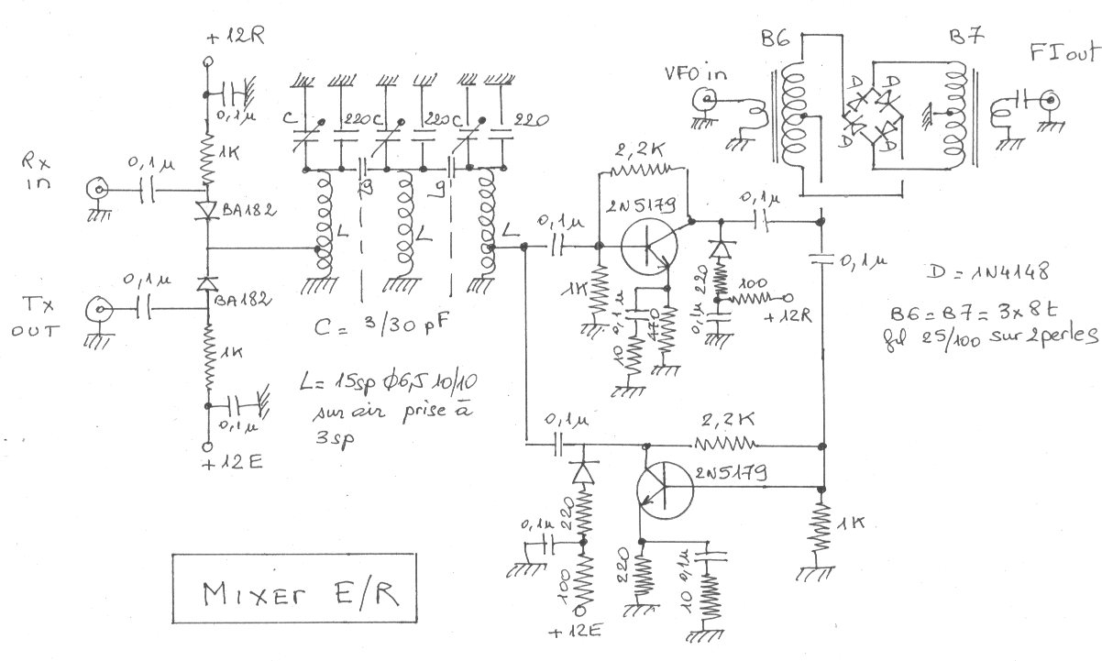
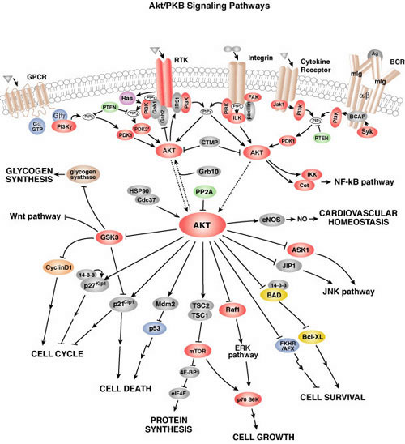
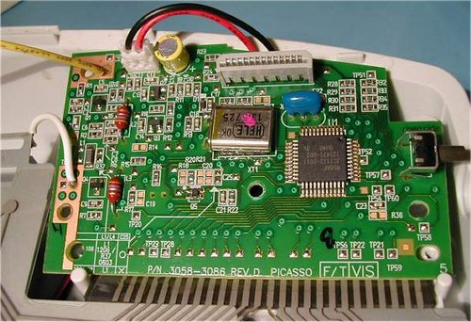
4 • Molecular interactions - Biological networks
• The cell is extremely complex : many intertwined processes of signaling and metabolism : - multi-dimensional networks
- a strong spatial-temporal organization
Notes:
Bio:free floating, reversible interactions

Slide 24
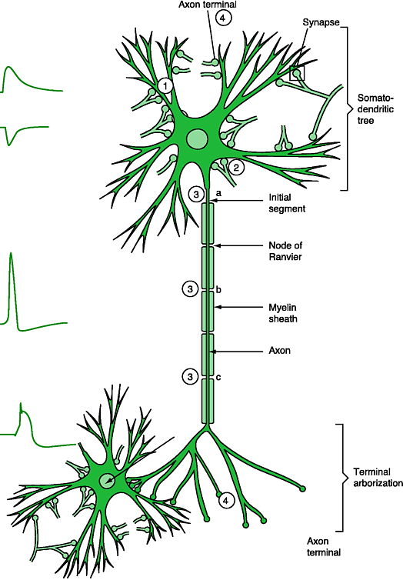
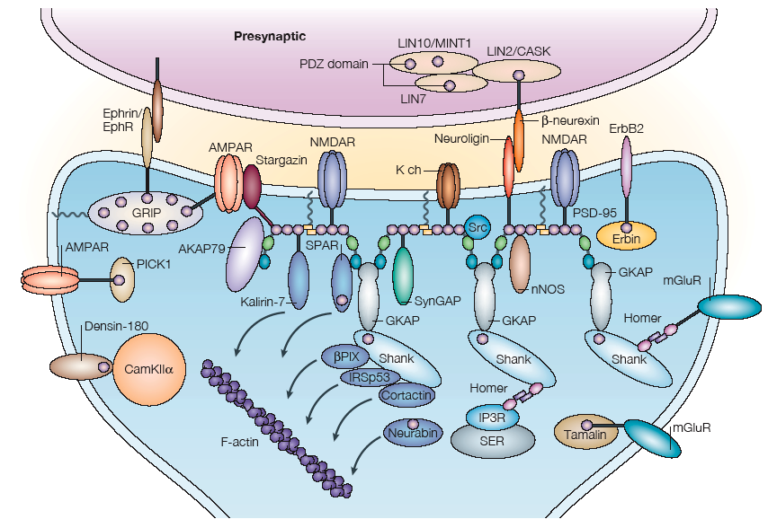
4 • Biological networks – Reversible molecular interactions
• Interacting neurons • Synaptic organization
Signaling events within a cell
Right place
Right time
Proper arrangement
Specificity & right partners
through reversible and adjustable molecular interactions.
Hammond “Cell & Mol Neurobiology”
Kim, Nat Rev Neurosci 5 (2004) 772

Slide 25

4 • Proteins - Modular assembly of functional domains
• Proteins must be multi-functional
- specific interaction
- regulation of interaction
- effector
• Proteins are in general not monolithic globules
but rather have a beads-on-a-string multi-domain structures,
where each domain has a specific function
• Domains: small (70-140 amino acids) autonomously folding sequences
specific function e.g. catalysis or binding
> 1’000 type of domains present in human genome
• Linear combination of a few domains yields an infinite variation of proteins
with each unique properties
“Modular Protein Domains” Cesareni e.a. (Eds) 2005 Wiley
Notes:
Domains: subunits specific function

Slide 26
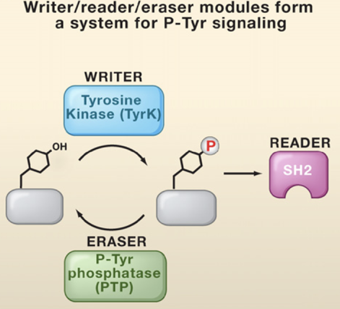
4 • Phospho-tyrosine signalling
Growth factor-activated receptors in plasma membrane
=> Active receptors phosphorylate themselves and other proteins
Writers:
- Receptor Tyr-Kinases :
activity is ligand-dependent
Erasers:
p-tyrosine phosphatases :
activity is generally constitutive
Readers :
- proteins with SH2-domains that bind P-Tyr
Lin (2010) Cell 142, 661

Slide 27
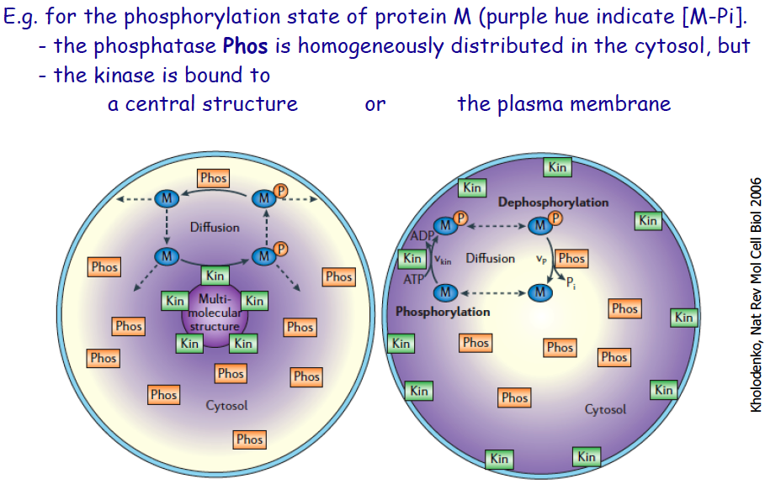
4 • Space & time in signalling: A thought experiment
=> Localized activity creates concentration gradients
Notes:
Draw cycle of writer reader eraser

Slide 28
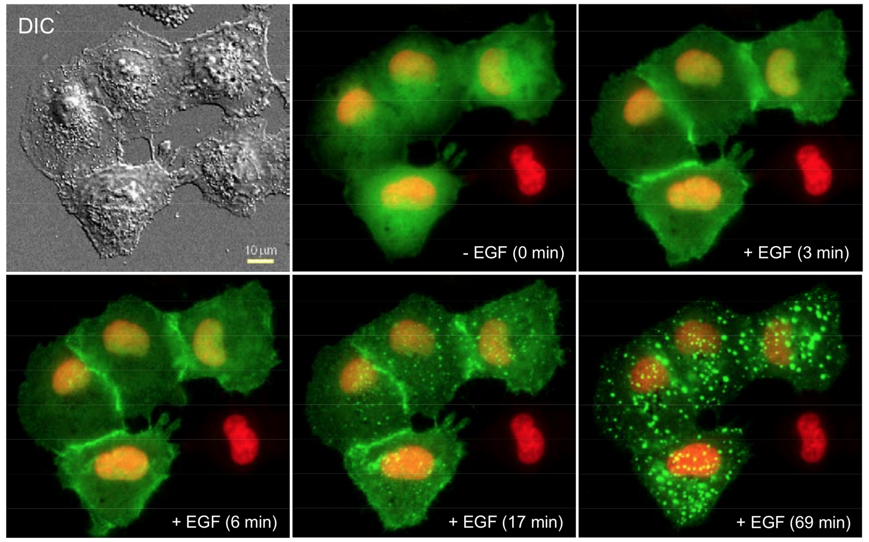
4 • Imaging tyrosine phosphorylation in vivo
• A fusion of and SH2 domain and GFP is expressed in mammalian cells
• At t = 0, the epidermal growth factor (EGF)is added
SH2-GFP translocates to
plasma membrane
binding to the phosphorylated
EGF-receptor
Finally, the EGF-receptor is
internalized.
NB : Nucleus is red
=> Hormone-induced phosphorylation and re-localisation of SH2 domain and receptor
Notes:
Location regulated by an external stimulus

Slide 29
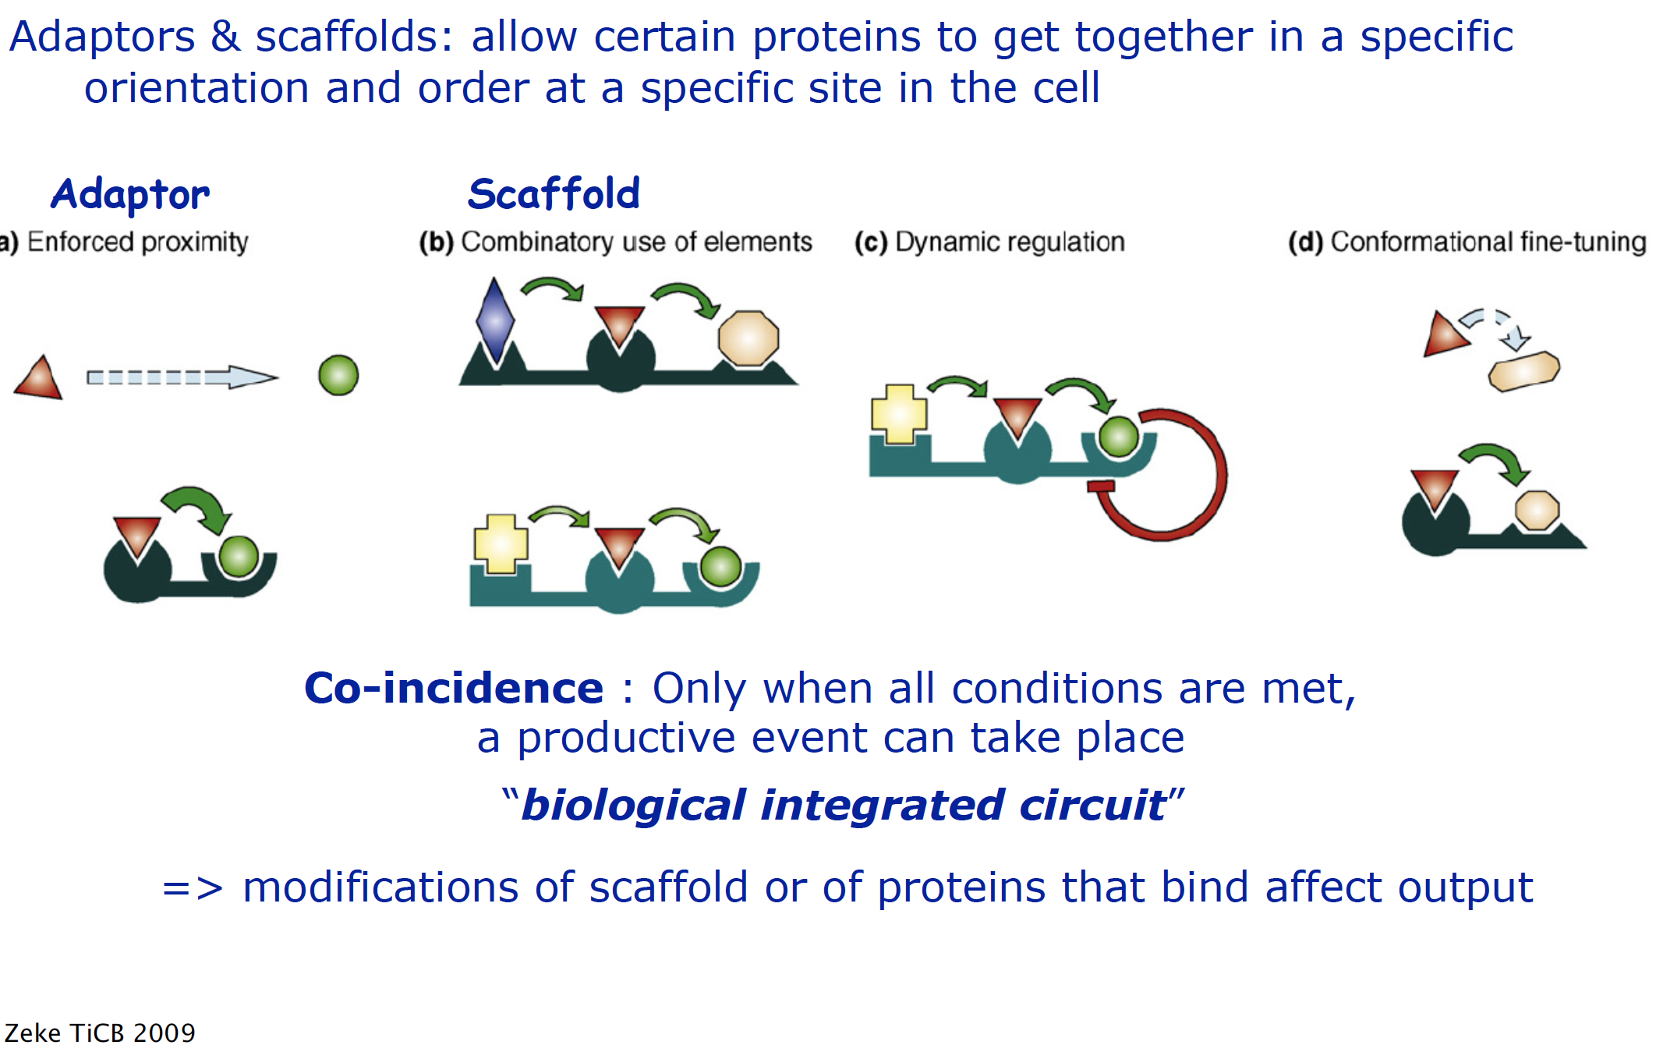
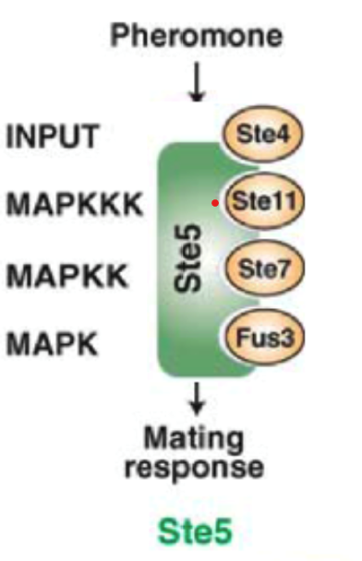
4 • Scaffolds facilitate molecular encounters

Slide 30
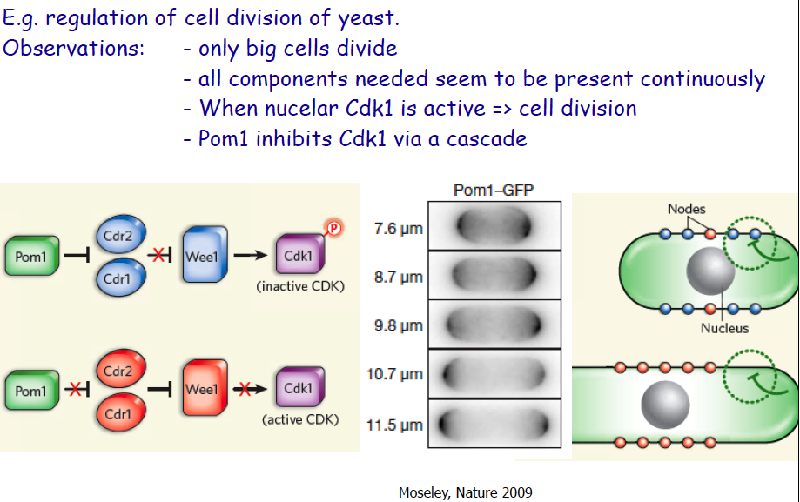
4 • Space & time in signalling: A cellular mechanism

Slide 31

4 • Effective molarity
G. Whitesides

Slide 32

4 • Effective molarity
• Effective molarity is concentration independent !!

Slide 33



5 • Sensors based on fluorescent proteins and molecular interaction
° Analyte detection
Föster resonance energy transfer (FRET):
Transer of excitation energy from
one fluorophore “Donor” to an “Acceptor”;
possible only when Donor and Acceptor
are within a few nm.
Semi-Up-to-date list:
codex.dpb.carnegiescience.edu/db/biosensor
Frommer (2009)
°Molecular interactions
J. Zhang, Nat Rev MolCelBiol 3 (2002) 906

Slide 34




5 • Snif-it’s for drug monitoring : LUCID’s
• LUCID’s : Luciferase-based Indicators of Drugs
e.g. for the anti-cancer drug methotrexate with intern analog
=> Paper based assay for patient poc diagnostics
+
Griss (2014) Nat Biotech Schena (2015) Nat Commun

Slide 35



5 • Sensors
+

Slide 36


5 • Nanopore sequencing : From dream to reality
~2000 : The dream Hagan Bayley (Oxford)

Slide 37


5 • Nanopore sequencing : From dream to reality
Today’s reality Minion from Oxforn Nanopore
Protein sequencing :https://www.biorxiv.org/content/10.1101/2021.07.13.452225v1

Slide 38
Reviews
• Chemical labelling
Schafer ea “Recent advances in Bioorthogonal reactions” Chimia 2019,73,308-312
Lang & Chin “Bioorthogonal Reactions for Label”
ACS Chem Biol (2014) 9, 16-20
Lang & Chin “Cellular Incorporation of Unnatural Amino Acids and Bioorthogonal Labeling of Proteins”
Chem Rev (2014) 114, 4764-4806
Resch et al “Quantum dots versus organic dyes as fluorescent labels”
Nature Methods (2008) 5, 763–775
• Fluorescent proteins
Wang et al “Fluorescence Proteins,Live-Cell Imaging, and Mechanobiology”
Annu. Rev. Biomed Eng. (2008) 10, 1-38.
Tsien, Campbelle.a.. “The Growing and Glowing Toolbox of Fluorescent and Photoactive Proteins” doi.org/10.1016/j.tibs.2016.09.010
• Fluorescent ligands
Baindur & Triggle “Concepts and Progress in the Development and Utilization of
Receptor-Specific Fluorescent ligands” Med Res Rev (1994) 14, 591-664
Current Opinion in Chemical Biology
Cell Biology by the Numbers http://book.bionumbers.org/

