Slide 1

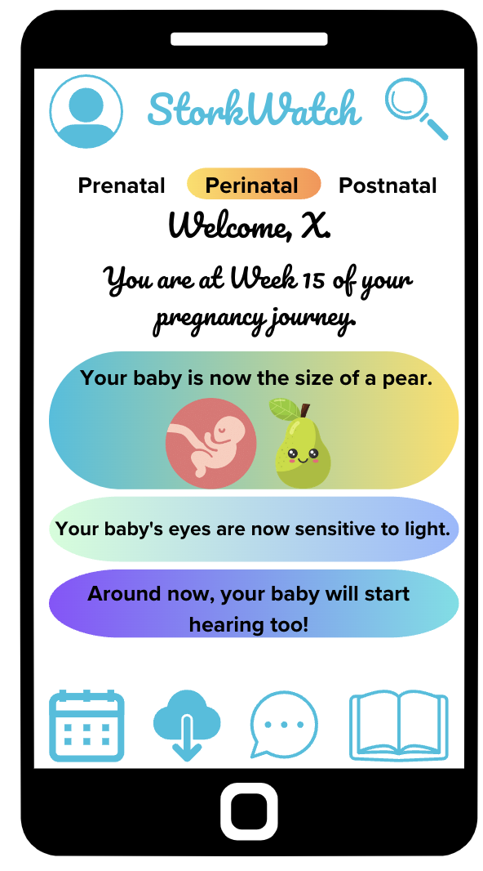

StorkWatch
Nurturing every moment, every step
Ekaterina Gorbacheva
Khosiyat Makhmudova
Danica Milovanovic
Camilla Di Giulio

Slide 2
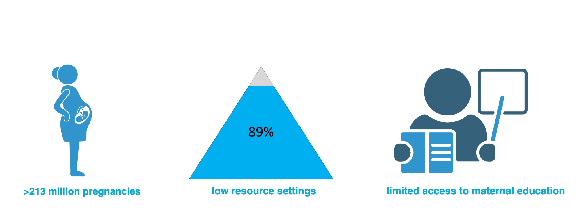
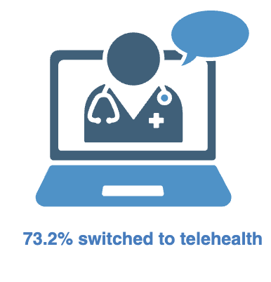
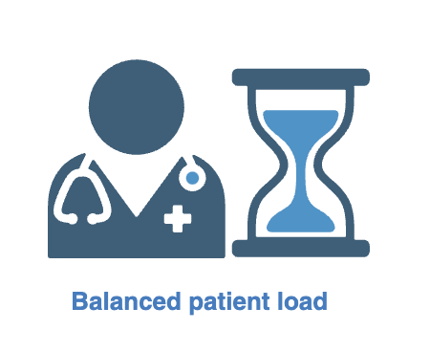
Why is remote pregnancy monitoring important?
McDonald, C. R., Weckman, A. M., Wright, J. K., Conroy, A. L., & Kain, K. C. (2020). Pregnant Women in Low- and Middle-Income Countries Require a Special Focus During the COVID-19 Pandemic [Opinion]. Frontiers in Global Women's Health
Townsend, R., Chmielewska, B., Barratt, I., Kalafat, E., van der Meulen, J., Gurol-Urganci, I., O'Brien, P., Morris, E., Draycott, T., Thangaratinam, S. (2021). Global changes in maternity care provision during the COVID-19 pandemic: A systematic review and meta-analysis. eClinicalMedicine
Taylor, Billie Lever et al. “Mums Alone: Exploring the Role of Isolation and Loneliness in the Narratives of Women Diagnosed with Perinatal Depression.” Journal of clinical medicine vol. 10,11 2271. 24 May. 2021
Notes:
Correlation between pregnancy outcome and educational level
Covid impact: Materinity services worldwide have faced an unprecedented challenge from the precipitous global spread of the SARS-CoV-2 virus and the attendant societal and healthcare disruption. In response to the pandemic national governments and healthcare providers implemented sweeping changes. In maternity care, face-to-face consultations were widely curtailed with rapid implementation of home blood pressure and blood glucose monitoring programs and telephone antenatal clinics where possible, mostly in high income countries. In many contexts, partners and visitors were restricted from attending outpatient appointments, ultrasound scans or even providing support during intrapartum care. Women's healthcare-seeking behaviour has changed; women have reported being less willing to attend hospital due to fear of contracting COVID-19. In addition to misinterpretations of local and national ‘stay at home guidance’, these factors may have impacted on the maternity care provided to mothers during pregnancy and the postpartum period.
Access to healthcare:
Ensuring that all women have access to adequate and respectful maternal care is fundamental to the health of mothers and their new-borns worldwide

Slide 3
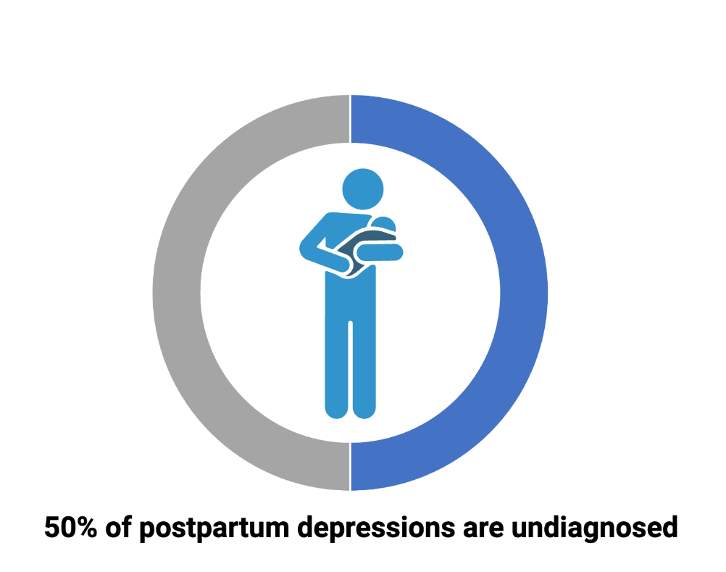
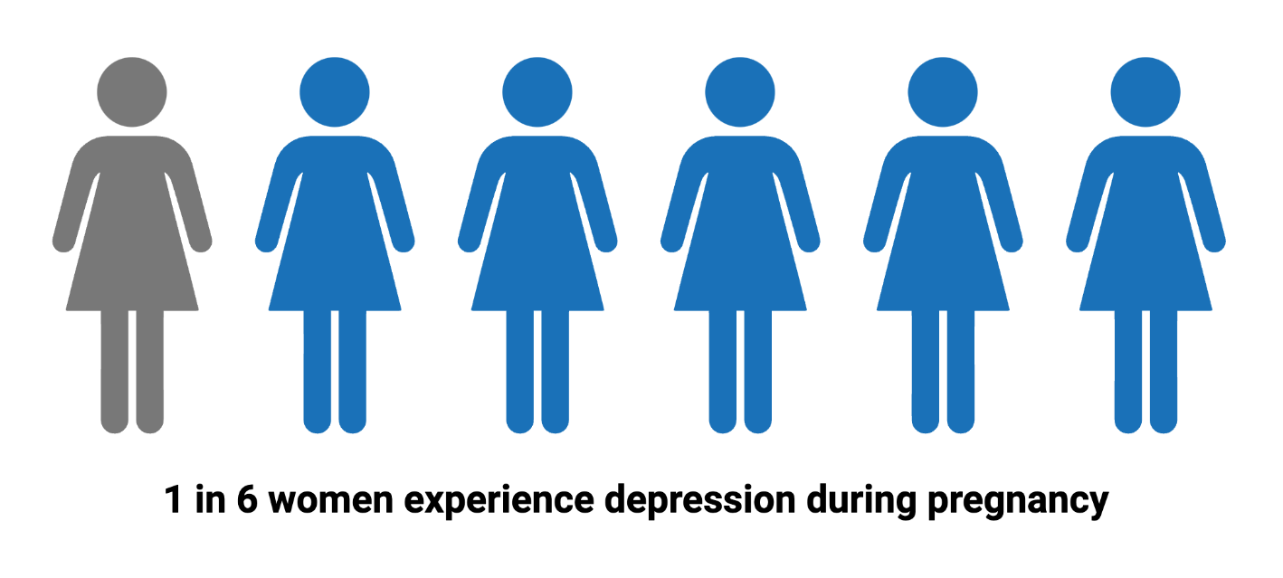
Why is remote pregnancy monitoring important?
McDonald, C. R., Weckman, A. M., Wright, J. K., Conroy, A. L., & Kain, K. C. (2020). Pregnant Women in Low- and Middle-Income Countries Require a Special Focus During the COVID-19 Pandemic [Opinion]. Frontiers in Global Women's Health
Townsend, R., Chmielewska, B., Barratt, I., Kalafat, E., van der Meulen, J., Gurol-Urganci, I., O'Brien, P., Morris, E., Draycott, T., Thangaratinam, S. (2021). Global changes in maternity care provision during the COVID-19 pandemic: A systematic review and meta-analysis. eClinicalMedicine
Taylor, Billie Lever et al. “Mums Alone: Exploring the Role of Isolation and Loneliness in the Narratives of Women Diagnosed with Perinatal Depression.” Journal of clinical medicine vol. 10,11 2271. 24 May. 2021
Notes:
Correlation between pregnancy outcome and educational level

Slide 4

Problem: no holistic pregnancy app on the market
Our Solution: StorkWatch
Existing options are simple trackers based on self-reporting
Limited availability to support groups
Lack of personalized tools
No direct contact with OB-GYN
Not user-friendly
Comprehensive app with a direct-to-healthcare-professional communication tool, to support and empower pregnant women and mothers in their journey to parenthood.

Slide 5
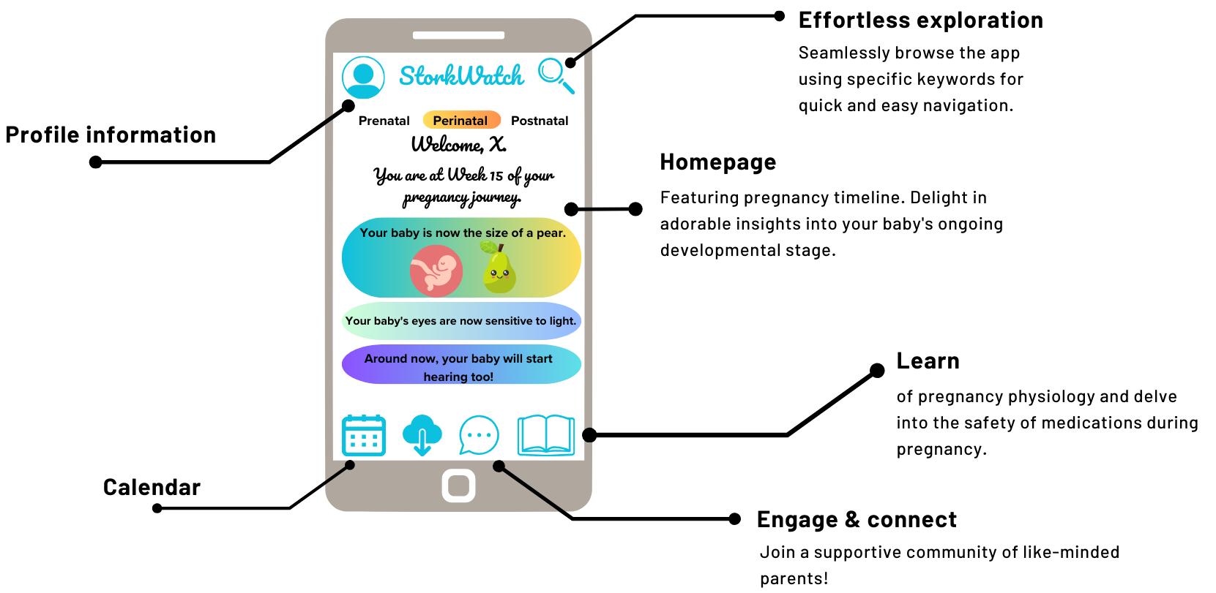
Education and support

Slide 6
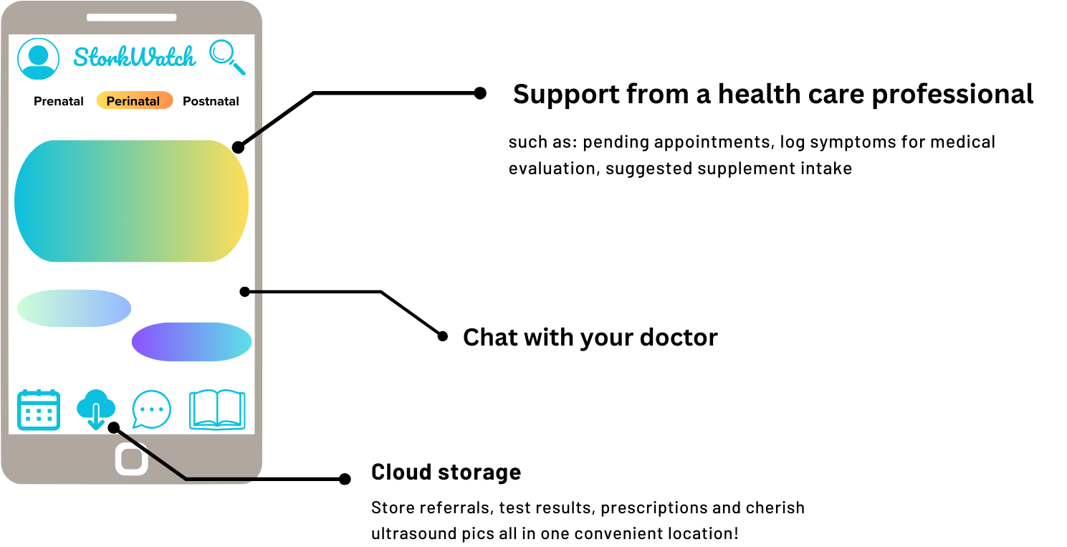
Direct OB-GYN contact

Slide 7
Business Plan - SWOT analysis
04
01
03
02

Slide 8
Business Plan - SWOT analysis
Strengths
Intuitive and engaging app
Continuous improvement to match customers’ need
Network of experts to ensure high-quality and reliable contents
Global reach
04
01
03
02

Slide 9
Business Plan - SWOT analysis
Strengths
Intuitive and engaging app
Continuous improvement to match customers’ need
Network of experts to ensure high-quality and reliable contents
Global reach
04
01
03
Weaknesses
Small team which limits the speed of product development
Being solely online could limit the reach to certain demographics
02

Slide 10
Business Plan - SWOT analysis
Strengths
Intuitive and engaging app
Continuous improvement to match customers’ need
Network of experts to ensure high-quality and reliable contents
Global reach
04
Opportunities
Increasing use of mobile applications to track health
Growing demand for personalized and tailored resources
Global increase in awareness and focus on maternal health as an opportunity to collaborate with healthcare organizations and professionals
01
03
Weaknesses
Small team which limits the speed of product development
Being solely online could limit the reach to certain demographics
02

Slide 11
Business Plan - SWOT analysis
Strengths
Intuitive and engaging app
Continuous improvement to match customers’ need
Network of experts to ensure high-quality and reliable contents
Global reach
04
Opportunities
Increasing use of mobile applications to track health
Growing demand for personalized and tailored resources
Global increase in awareness and focus on maternal health as an opportunity to collaborate with healthcare organizations and professionals
01
03
Weaknesses
Small team which limits the speed of product development
Being solely online could limit the reach to certain demographics
Threats
Competition in the mobile application market
Data privacy and security can impact user trust
02

Slide 12
StorkWatch
Our app to support and empower pregnant women and mothers in their journey to parenthood

Slide 13
Thank you
… any investors?
Ekaterina Gorbacheva
Khosiyat Makhmudova
Danica Milovanovic
Camilla Di Giulio

Slide 14
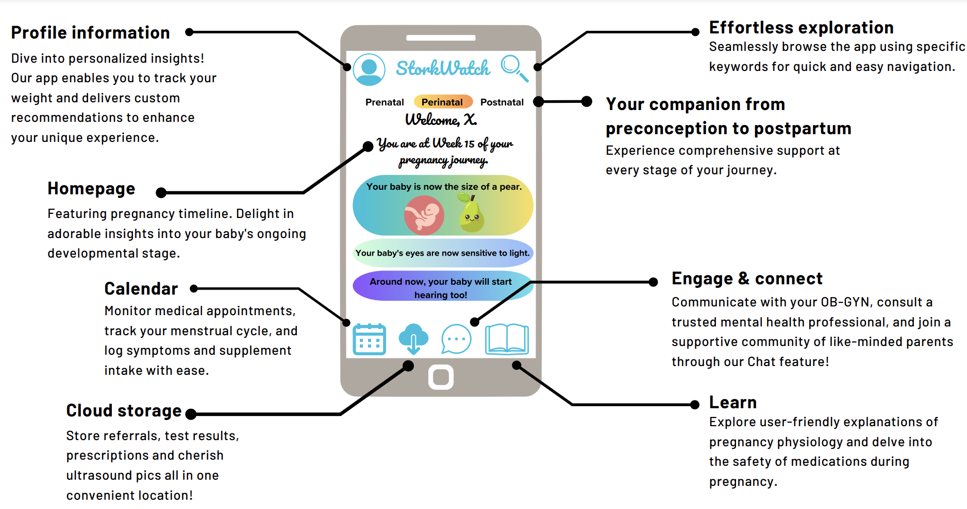
Step into parenthood: Welcome to StorkWatch
Notes:
it seems too crowded as a slide, and the tone is too marketing. i trieds separating it into 2 slide. it would also separate a bit the whole support etc for free VS direct doctor contact
Preconception
cycle tracking and ovulation prediction
supplements intake log
Prenatal
OB-GYN support
constant monitoring by a healthcare professional vs direct chat when assistance is needed
what insurance providers are included
weight monitoring with a photo feature (?), BMI and gestational weight gain
supplements intake log
cloud with test results and ultrasound pics (?) – risk of unauthorized access
referrals and prescriptions?
morning sickness, swollen ankles
group chat
Postnatal
educational material about newborn anatomy, physiology and behavior
mental health surveys
weight monitoring
vaccination schedule
group chat

Slide 15
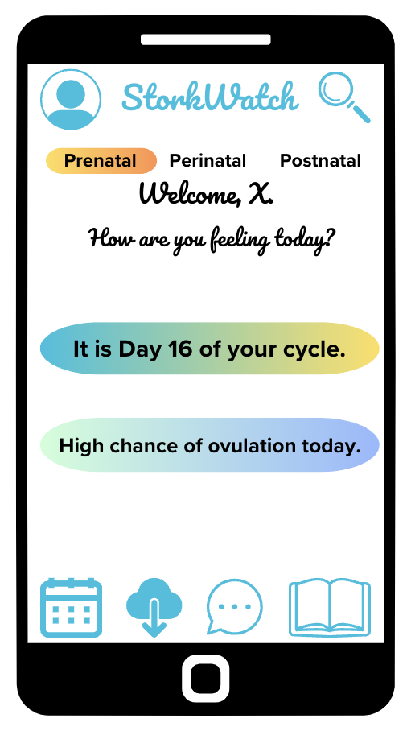
Layout for pre- and postnatal (?)

